Slide 1
Detecting Variable Length Anomaly Patterns in Time Series Data
Ngô Duy Khánh Vy and Dương Tuấn Anh

Slide 2
Content
Introduction
Proposed Algorithm
Experimental Evaluation
Conclusion
Q&A

Slide 3
Introduction
A time series is a sequence of data points made over a continuous time interval
Anomaly Patterns are subsequences that do not conform to a well deﬁned notion of normal behavior
Application areas that explore such time series anomalies include fault diagnostics, intrusion detection, fraud detection, auditing and data cleansing

Slide 4
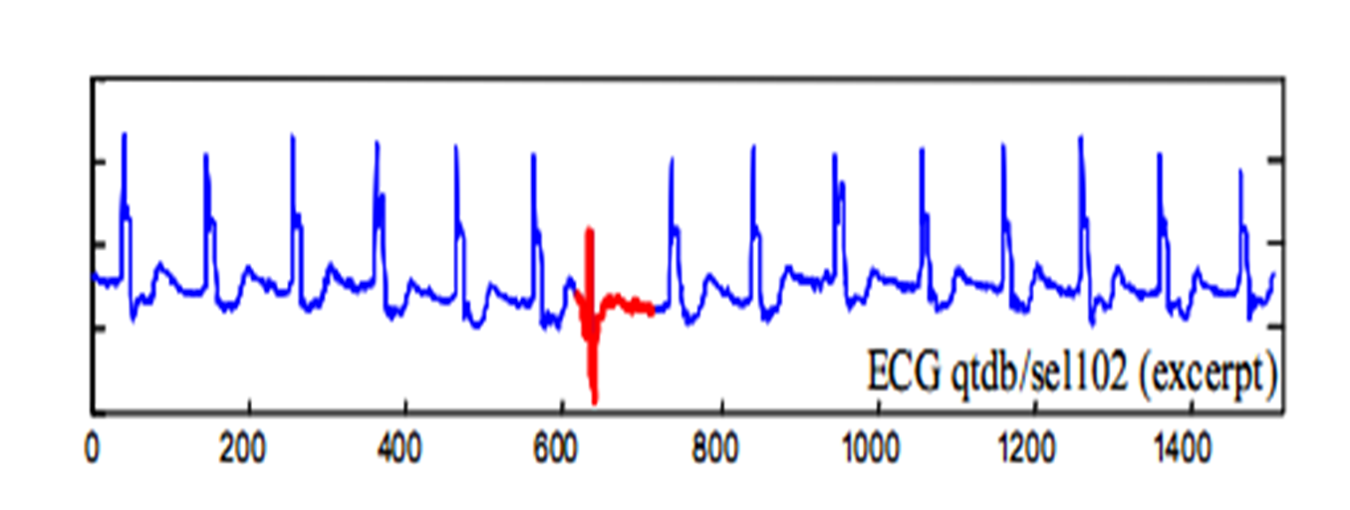
Introduction
unusual subsequence in time series data

Slide 5
Introduction
The problem to find anomaly subsequences in time series data is challenging.
There are many algorithms developed to find anomaly patterns such as HOT SAX, WAT,…But they require the user to specify the length of anomaly as an input parameter.
The exact lengths of the unusual subsequence are vary and are often unknown.

Slide 6
Introduction
In 2008, Leng et al proposed an algorithm to find variable length anomaly patterns without knowing in advance the lengths of them.
The method includes 2 phase:
Phase 1: use quadratic regression model to segment time series. Regression function is defined as quadratic polynomial f(t) = β₀ + β₁t + β₂t²,
Phase 2: Calculate anomaly factors for the subsequences base on DTW distance and show abnormal patterns.
Time consuming because of DTW distance.

Slide 7
Definitions
k-distance of a pattern: Given a positive integer k, a pattern set D and a pattern P ∈ D, the k-distance of P, denoted as k-dist(P), is defined as the distance between P and a pattern Q ∈ D such that.
i) For at least k patterns Q₁ ∈ D it holds that Dist(P, Q₁) ≤ Dist(P, Q).
ii) For at most k-1 patterns Q₁ ∈ D \{Q} it holds that Dist(P, Q₁) < Dist(P, Q).
Anomaly factor: For any pattern set D and a pattern P ∈ D, k-dist(D) denotes all k-dist of patterns, anomaly factor of pattern P defined as the ratio of k-dist(P) to median(k-dist(D)).
Anomaly Pattern: Given any pattern set D, a pattern P∈ D, P is anomaly only if its anomaly factor is larger than a, where a is the threshold of anomaly pattern

Slide 8
Proposed Algorithm
Based on method proposed by Leng et al
Use Homothetic Transformation + Modified Euclidean Distance instead of DTW
The Algorithm have 2 phase:
+ Phase 1: Segment the time series into variable length subsequences.
+ Phase 2: Calculate anomaly factor for each subsequence to extract anomaly patterns and then merge anomaly patterns which overlap each other

Slide 9
Segmentation
We use two segmentation method: quadratic regression (proposed by Leng et al), segmentation base on important extreme points.

Slide 10
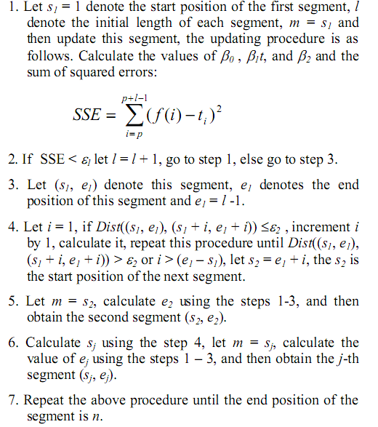
Quadratic regression

Slide 11
Extreme points
Based on the concepts of Important Extreme Points, proposed by Pratt and Fink (2002)
Parameter: R (R > 1), called compression rate and min_length, the minimum time lag between two adjacent important extreme points.
1. Extract all important extreme points of the time series T: EP = (ep₁, ep₂, …, ep_{l}). 2. For i in 1..(l-2) 2.1. Extract candidate pattern CPi(T) which is the subsequence of T that is bounded by extreme points ep_{i} and ep_{i+2}.

Slide 12
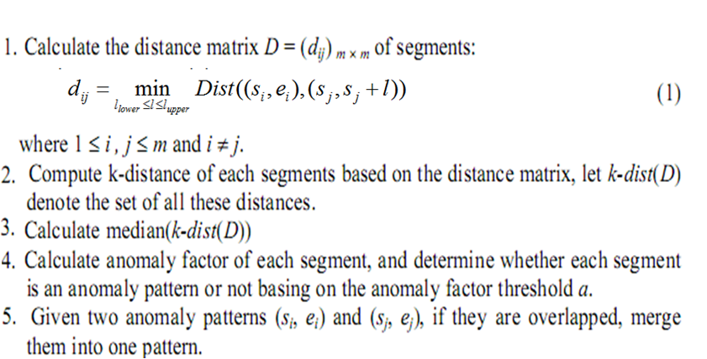
Find anomaly patterns

Slide 13
Find l_{upper} and l_{lower}
Propose parameter r
l_{upper} = ⎣l_{avg}(1+ r)⎦
l_{lower} = ⎡l_{avg}(1- r)⎤
l_{avg} is mean length of the subsequences.
Leng et al chose l_{upper} = l_{max} and l_{lower} = l_{min}

Slide 14
Calculate the similar between two subsequence
To reduce computation time for Dist function
Use Homothetic Transformation + Modified Euclidean Distance instead of DTW

Slide 15

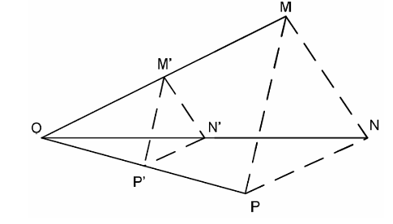
Homothetic Transformation
A Homothetic Transformation with center O and ratio k transforms the point M to the point M’ such that

Slide 16
Homothetic Transformation
Apply to time series, a homothetic transformation transforms a time series T of length n (T = {y1, y2, …, yn}) to time series T’ of length n’ by performing the following steps.
First, compute Y_MAX = MAX (y1, …, yn), Y_MIN = MIN(y1, …,yn ).
Second, set the center I of homothetic transformation with the coordinates X_C = n/2, Y_C = (Y_MAX + Y_MIN)/2. Next, perform the homothetic transformation with the center I and the ratio n’/n

Slide 17
Modified Euclidean Distance
Minimum Euclidean Distance between
T’ = {T’₁, T’₂,…, T’_{N}} and Q’ = {Q’₁, Q’₂,…, Q’_{N}}

Slide 18
Experimental Evaluation
VL_QR| HT: The proposed algorithm with quadratic regression
VL_EP| HT: The proposed algorithm with important extreme points.
Compare results and running time among VL_QR| HT, VL_EP| HT and HOT SAX
Compare running time between VL_QR| HT with the original algorithm proposed by Leng et al.

Slide 19
Experimental Evaluation
Experiments environment : Intel® Core™ 2 Duo 2.0GHz, Ram 3072MB PC
All algorithms are implemented in Microsoft Visual C# programing language

Slide 20
Compare VL_QR| HT, VL_EP| HT and HOT SAX
Use 8 time series in diverse domains from the UCR Time Series Data Mining Archive for discord discovery:
ECG 108, ECG 308, ERP, Memory, Power Demand In Italy, Dutch Power Demand, Stock20 and TEK16
To compute location difference of anomaly subsequences use:
d = |p – q|/l × 100
where p is the start position of the anomaly pattern found by proposed algorithm and q is the start position of the anomaly pattern found by HOT SAX and l is it’s length

Slide 21
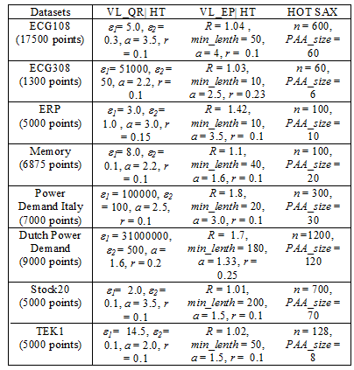
Parameter values in the three algorithms for each series

Slide 22
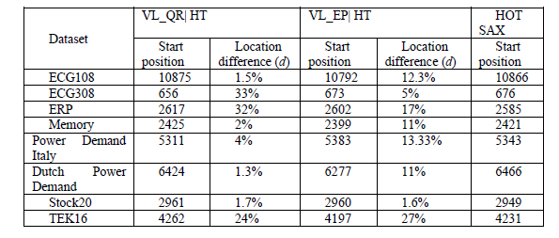
Positions of anomaly patterns detected by VL_QR|HT and VL_EP|HT and HOT SAX

Slide 23
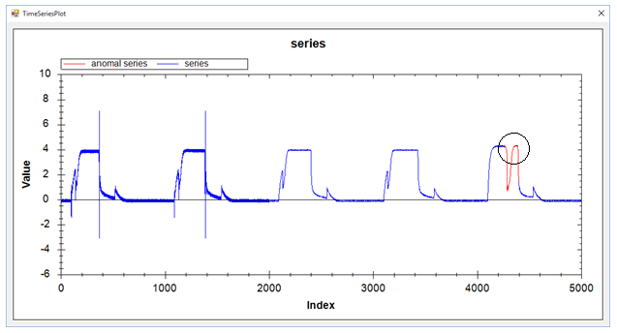
Positions of anomaly patterns detected by VL_QR|HT and VL_EP|HT and HOT SAX
Result of VL_QR | HT with series TEK16

Slide 24
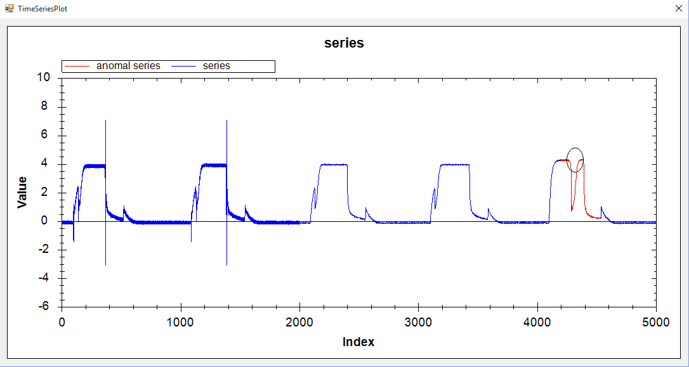
Positions of anomaly patterns detected by VL_QR|HT and VL_EP|HT and HOT SAX
Result of VL_EP | HT with series TEK16

Slide 25
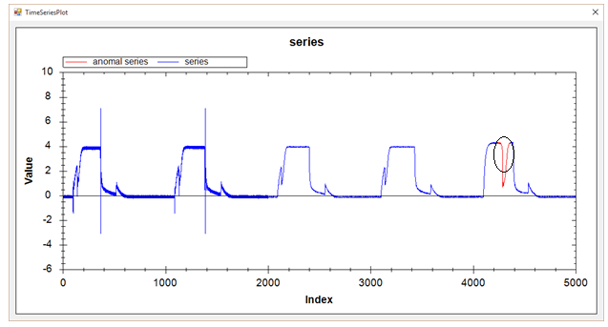
Positions of anomaly patterns detected by VL_QR|HT and VL_EP|HT and HOT SAX
Result of HOT SAX with series TEK16

Slide 26
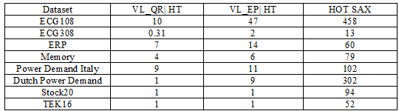
Running time among VL_QR|HT, VL_EP|HT and HOT SAX (s)

Slide 27
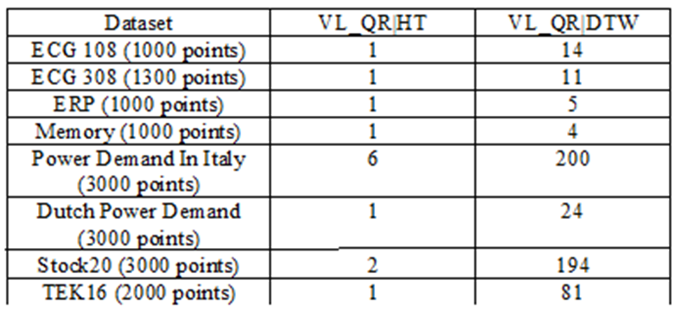
Running time between VL_QR| HT with the original algorithm (s)
The speedup: from 4 (dataset Memory) to 97 times (dataset Stock20), average 33.6.

Slide 28
Conclusion
VL_QR|HT and VL_EP|HT bring out a remarkable improvement for the original algorithm in time efficiency without compromising anomaly detection accuracy.
Experimental results on eight datasets demonstrate these algorithms outperform the VL_QR|DTW in time efficiency.
Not easy to estimate the regression error threshold ε₁ and the non-self match threshold ε₂ in the segmentation phase of VL_QR|HT.
Not easy to find the R in VL_EP|HT.
Future work: apply some more advanced method of time series segmentation Which is easy to find suitable parameters

Slide 29
References
E. Keogh, J. Lin, and A. Fu, “HOT SAX: efficiently finding the most unusual time series subsequence”, Proc. of 5th ICDM, Houston, Texas, pp. 226–233, 2005.
E. Keogh, www.cs.ucr.edu/~eamonn/discords/ (accessed on January 24 - 2015).
M. Leng, X. Chen and L. Li, “Variable length methods for detecting anomaly patterns in time series”, Proc. of Int. Symposium on. Computational Intelligence and Design (ISCID'08), Vol. 2, 2008.
K. B. Pratt and E. Fink, “Search for patterns in compressed time series”, International Journal of Image and Graphics , vol. 2, no. 1, pp. 89-106, 2002.
H. Sakoe and S. Chiba, “Dynamic programming algorithm optimization for spoken word recognition”, IEEE Trans. Acoustics, Speech, and Signal Proc., vol. ASSP-26, pp. 43-49, 1978.
C. D. Truong, H. N. Tin, D. T. Anh, “ Combining motif information and neural network for time series prediction”, Int. Journal of Business Intelligence and Data Mining, vol. 7, no. 4, pp. 318-339, 2012.

Slide 30
Q & A
Thank you!

Slide 32
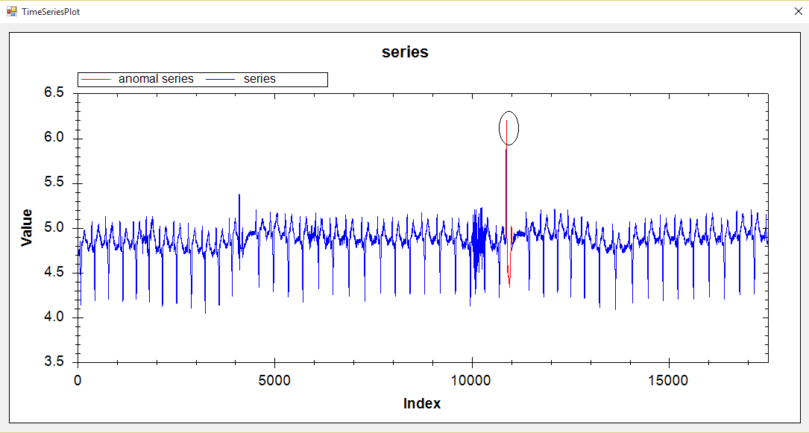
ECG 108 / VL_QR|HT

Slide 33
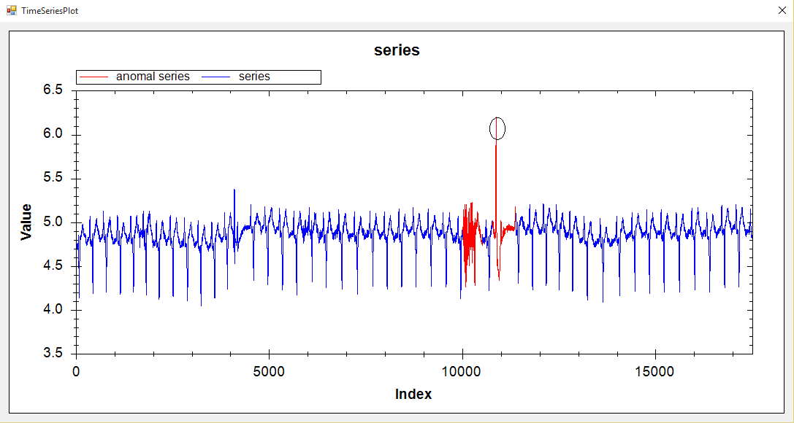
ECG 108 / VL_EP|HT

Slide 34
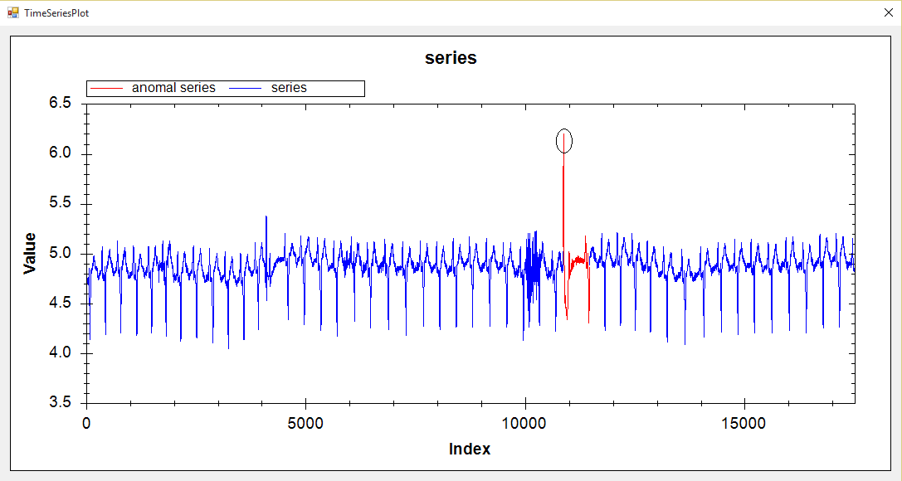
ECG 108 /HOT SAX

Slide 35
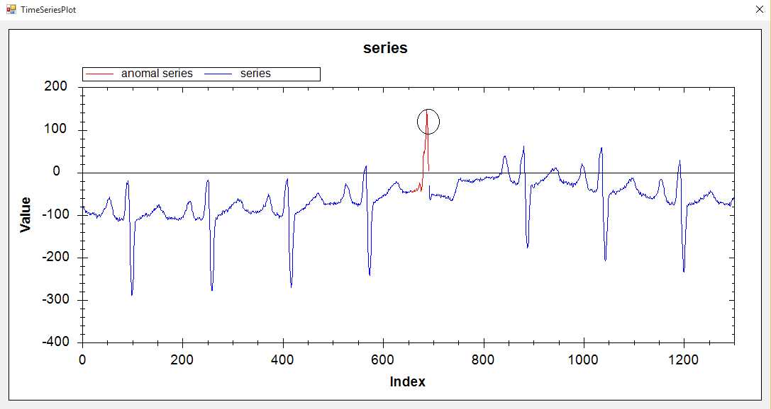
ECG 308 /VL_QR | HT

Slide 36
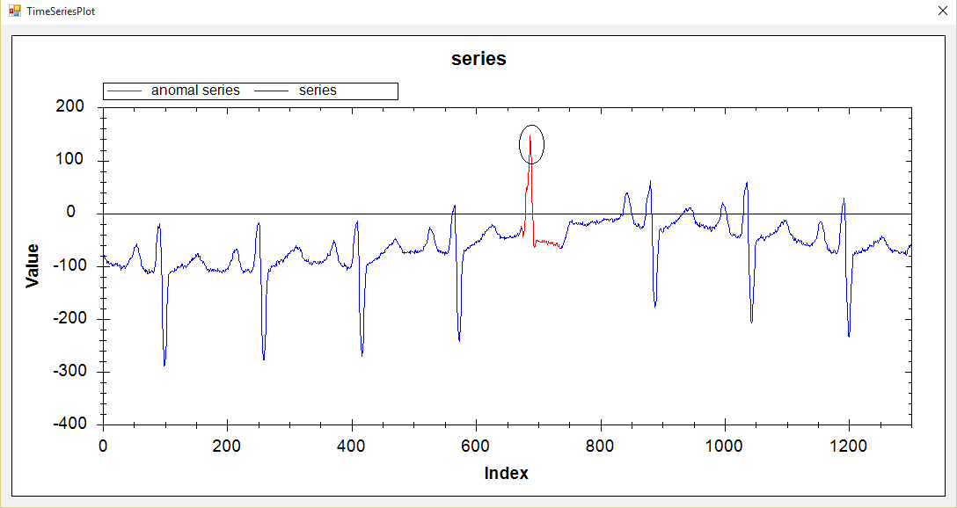
ECG 308 /VL_EP | HT

Slide 37
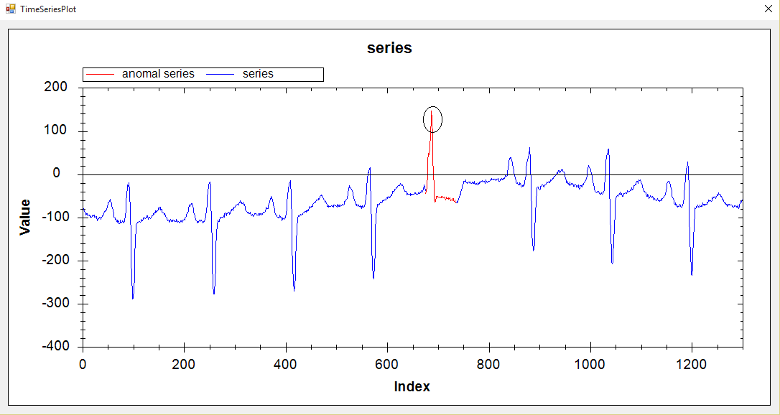
ECG 308 /HOT SAX

Slide 38
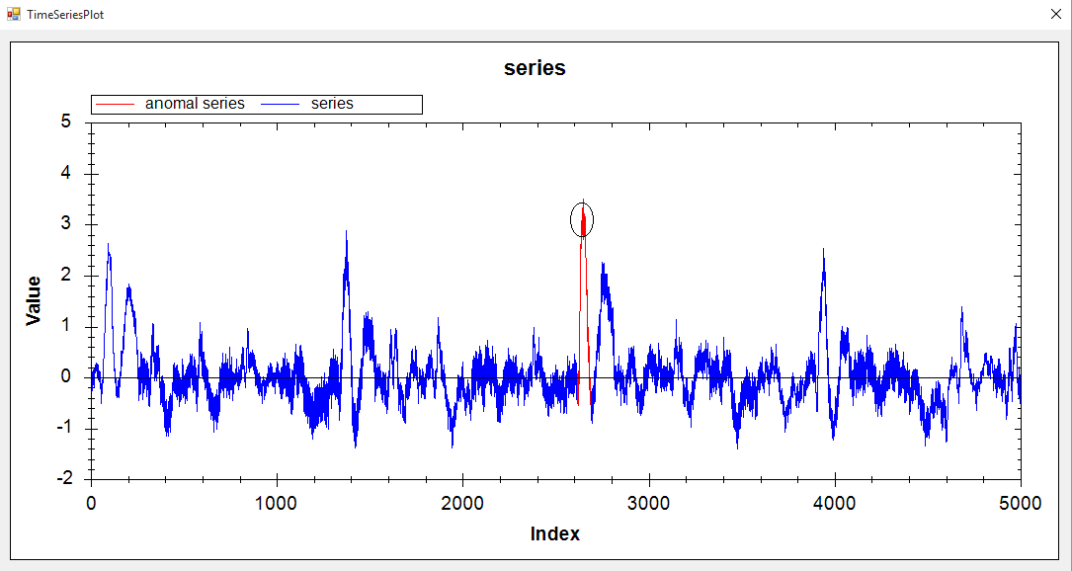
ERP / VL_QR |HT

Slide 39
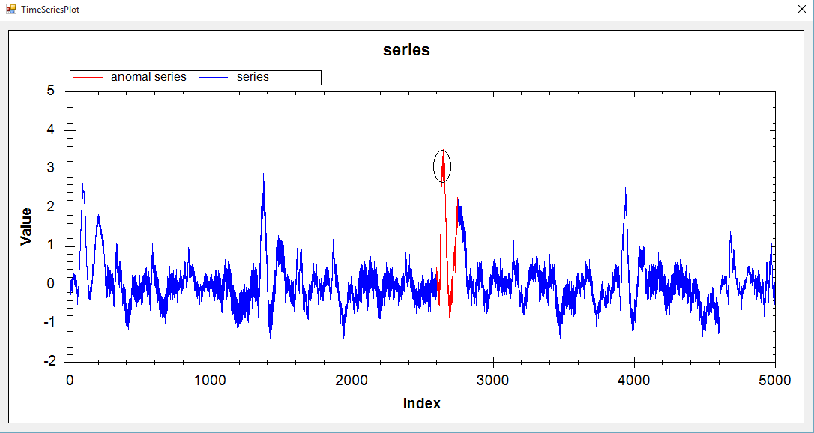
ERP / VL_EP | HT

Slide 40
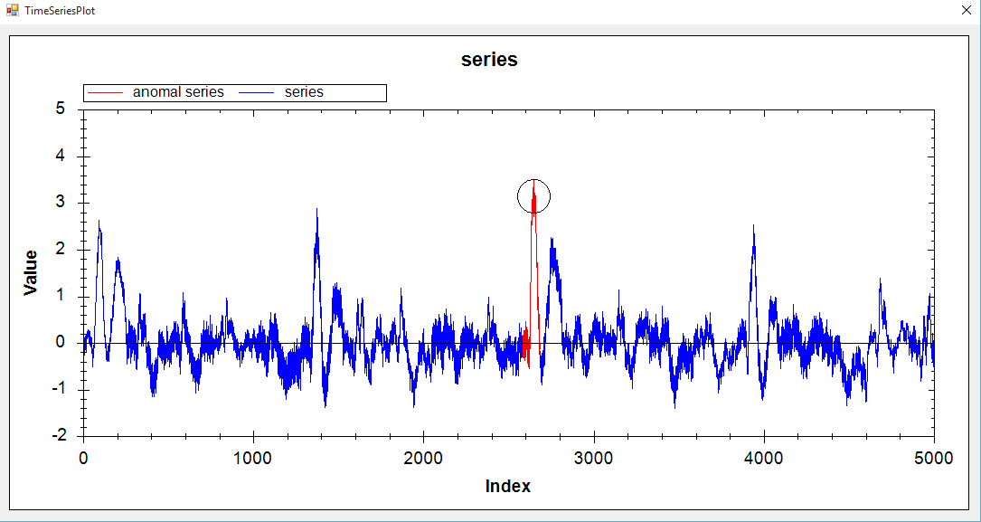
ERP / HOT SAX

Slide 41
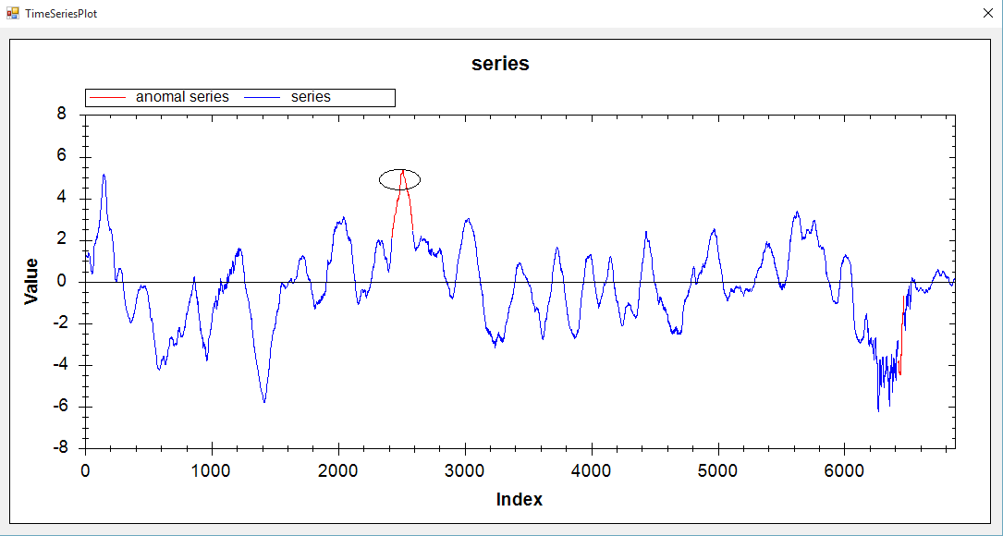
Memory/ VL_QR | HT

Slide 42
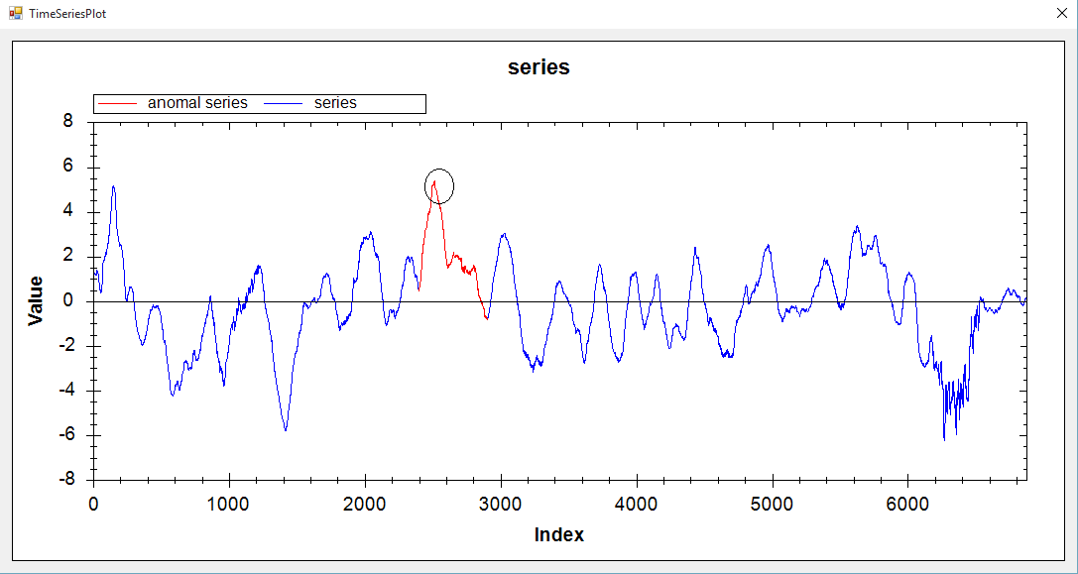
Memory/ VL_EP | HT

Slide 43
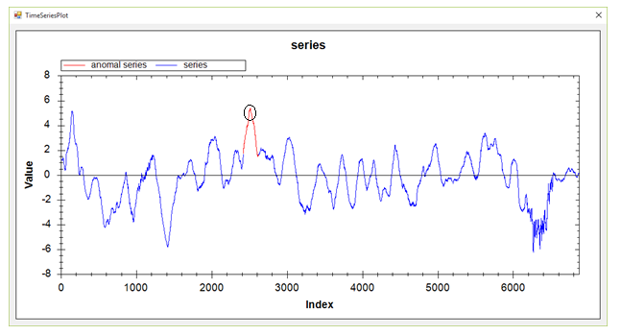
Memory/ HOT SAX

Slide 44
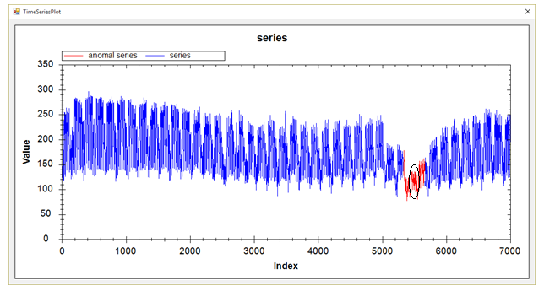
Power Demand In Italy/ VL_QR|HT

Slide 45
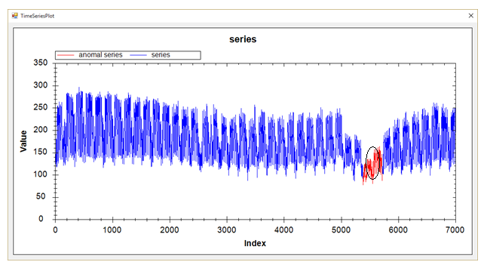
Power Demand In Italy/ VL_EP|HT

Slide 46

Power Demand In Italy/ HOT SAX

Slide 47
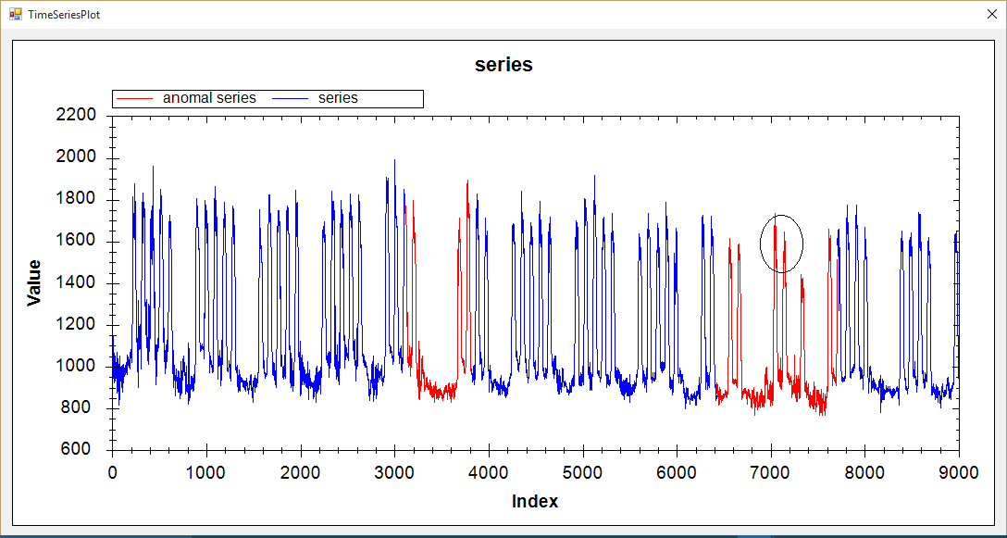
Dutch Power Demand/ VL_QR | HT

Slide 48
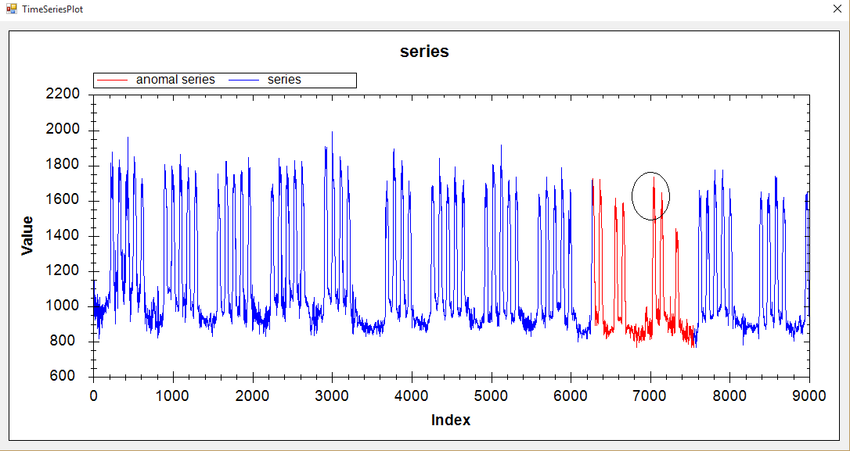
Dutch Power Demand/ VL_EP | HT

Slide 49
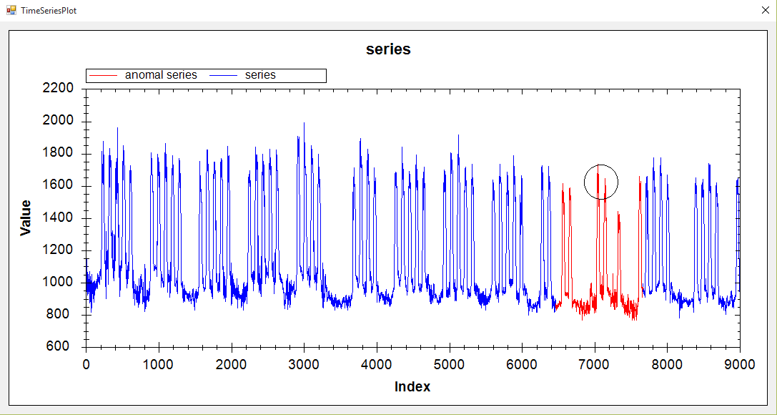
Dutch Power Demand/ HOT SAX

Slide 50
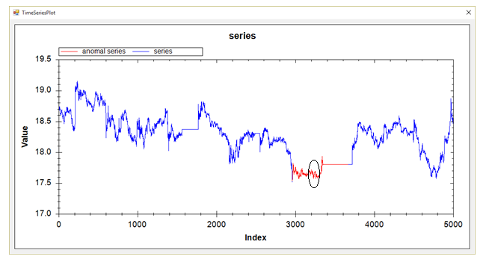
Stock20/ VL_QR | HT

Slide 51
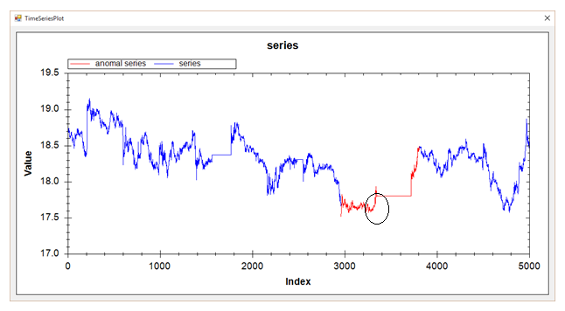
Stock20/ VL_EP | HT

Slide 52
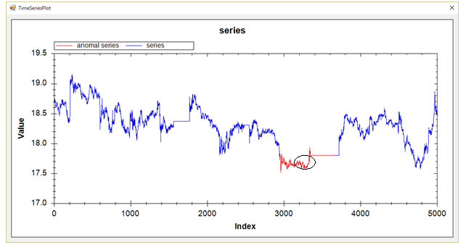
Stock20/ HOT SAX

Slide 53
TEK16/ VL_QR | HT

Slide 54
TEK16/ VL_EP | HT

Slide 55
TEK16/ HOT SAX

Slide 56
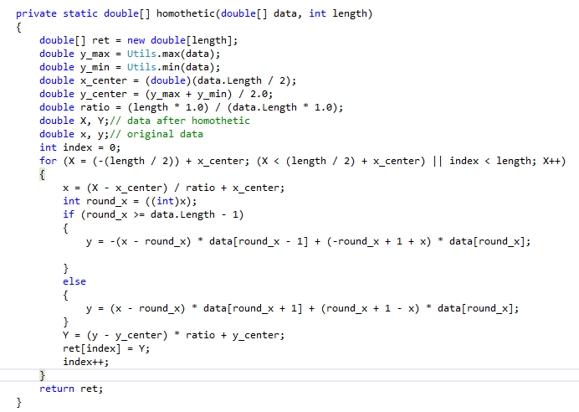

Slide 57
i = FIND-FIRST-TWO
if i < n and T[i] > T[1] then i = FIND-MIN(i)
while i < n do i = FIND-MAX(i); i = FIND-MIN(i)
---------------------------------------------------------------------------------
FIND-FIRST-TWO
iMin = 1; iMax = 1; i = 2
while i < n and T[i] / T[iMin] < R and T[iMax] / T[i] < R do
if T[i] < T[iMin] then iMin = i
if T[i] > T[iMax] then iMax = i
if iMin < iMax then output(T[iMin], iMin); output(T[iMax], iMax)
else output(T[iMax], iMax); output(T[iMin], iMin)
return i

Slide 58
FIND-MIN(i)
iMin = i
while i < n and T[i]/T[iMin] < R do
if T[i] < T[iMin] then iMin = i
i = i + 1; output(T[iMin], iMin)
return i
------------------------------------------------------------------------------------
FIND-MAX(i)
Finding the first significant maximum after the i-th point
iMax = i
while i < n and T[iMax] / T[i] < R do
if T[i] > T[iMax] then iMax = i
i = i + 1; output(T[iMax], iMax); return i

