Slide 1

Note: The data and information in this document is reflective of a hypothetical situation and client. This document is to be used for KPMG Virtual Internship purposes only.
Sprocket Central Pty Ltd
Data analytics approach
Vy Nguyen - Junior Consultant

Slide 2
Note: The data and information in this document is reflective of a hypothetical situation and client. This document is to be used for KPMG Virtual Internship purposes only.
Agenda
Introduction
Data Exploration
Model Development
Interpretation

Slide 3
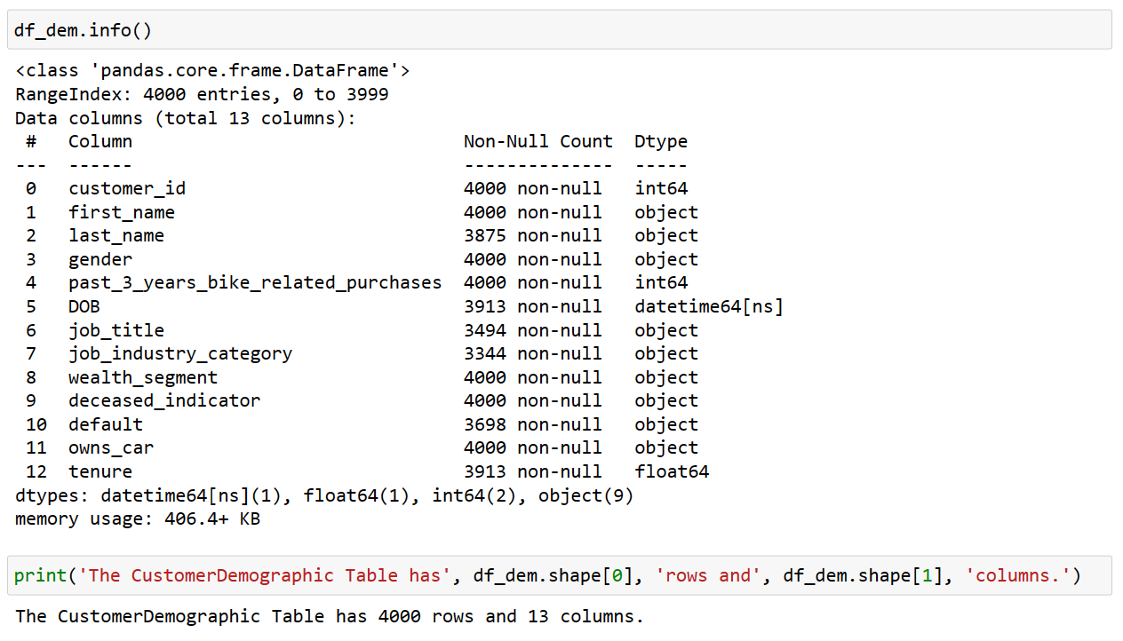
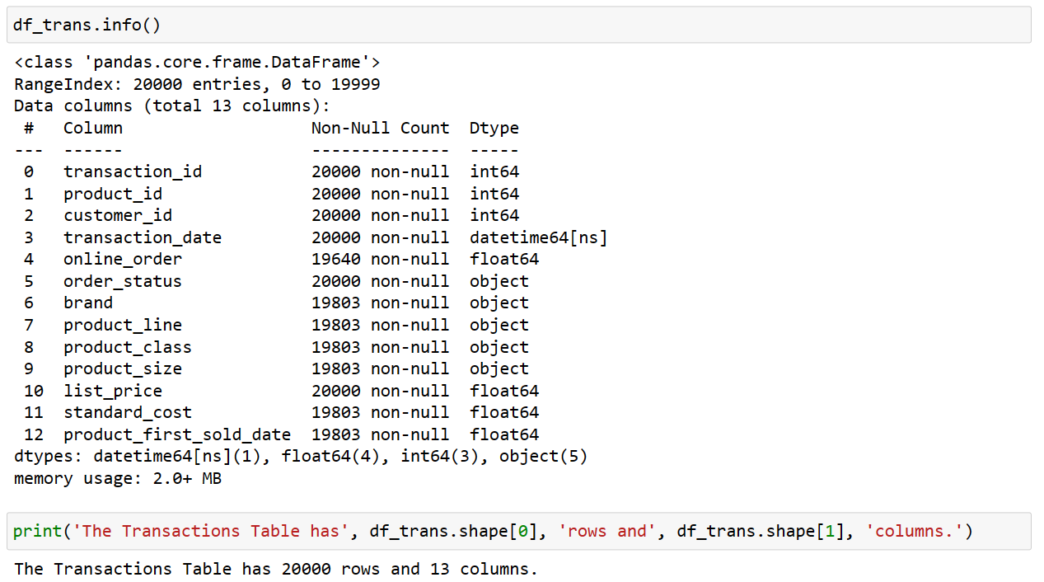
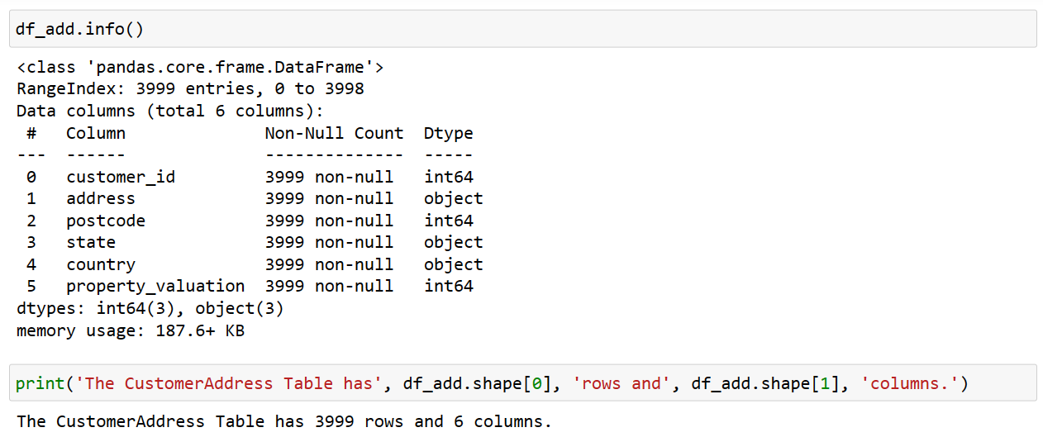
Note: The data and information in this document is reflective of a hypothetical situation and client. This document is to be used for KPMG Virtual Internship purposes only.
Introduction
Information of 3 datasets

Slide 4
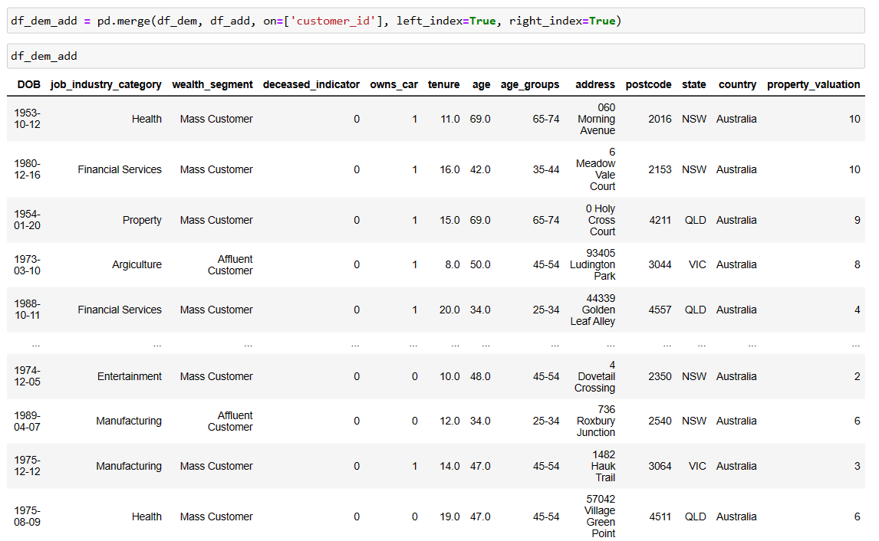
Note: The data and information in this document is reflective of a hypothetical situation and client. This document is to be used for KPMG Virtual Internship purposes only.
Data Exploration
Check missing values
Drop missing values
Create some columns for datasets
Merge CustomerDemographic with CustomerAddress

Slide 5
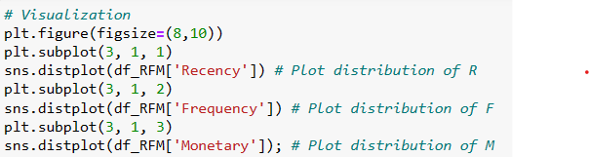
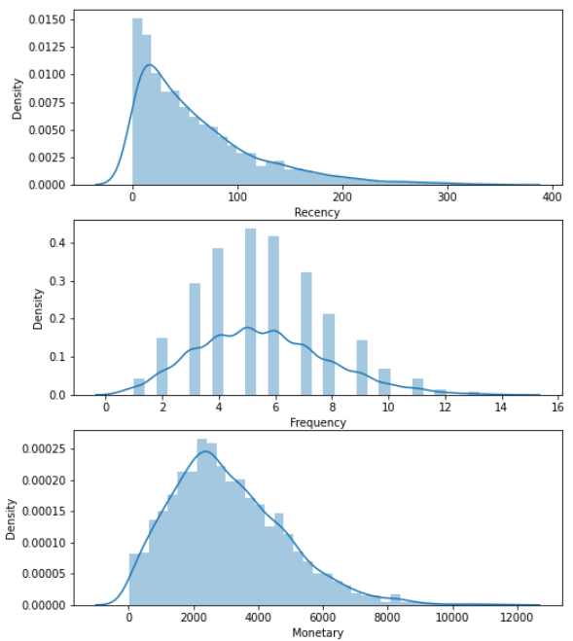
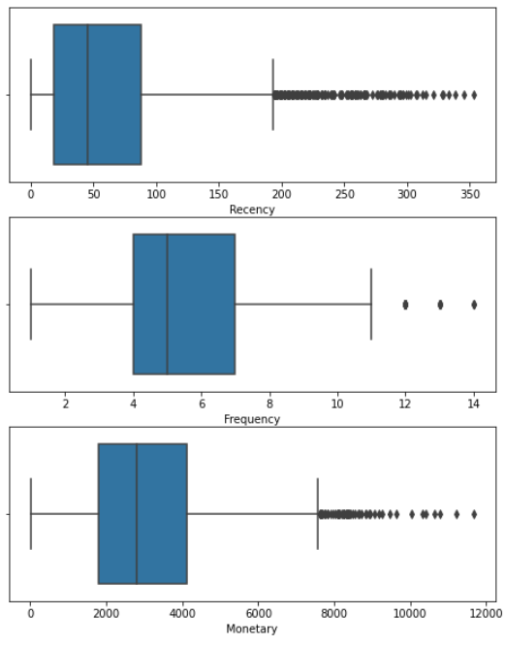
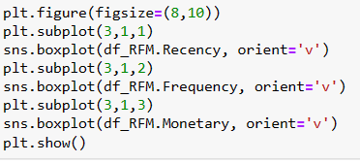
Note: The data and information in this document is reflective of a hypothetical situation and client. This document is to be used for KPMG Virtual Internship purposes only.
Model Development
- Analyze Transactions Tables with RFM Model
- Recency: from 35 to 40 days each customer purchased in average
- Frequency: a customer often purchased around 5 times per one in average
- Monetary Value: a customer spent about $2800 per one in average

Slide 6

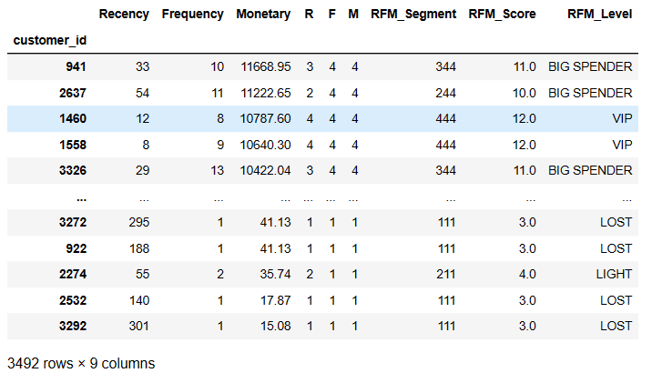
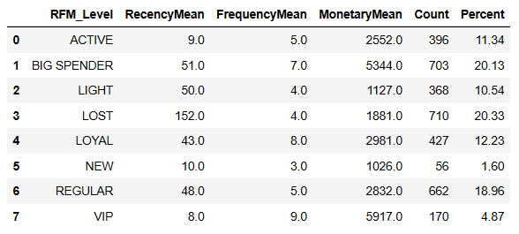
Note: The data and information in this document is reflective of a hypothetical situation and client. This document is to be used for KPMG Virtual Internship purposes only.
Model Development
Calculate mean values for each segement to visualize RFM charts

Slide 7
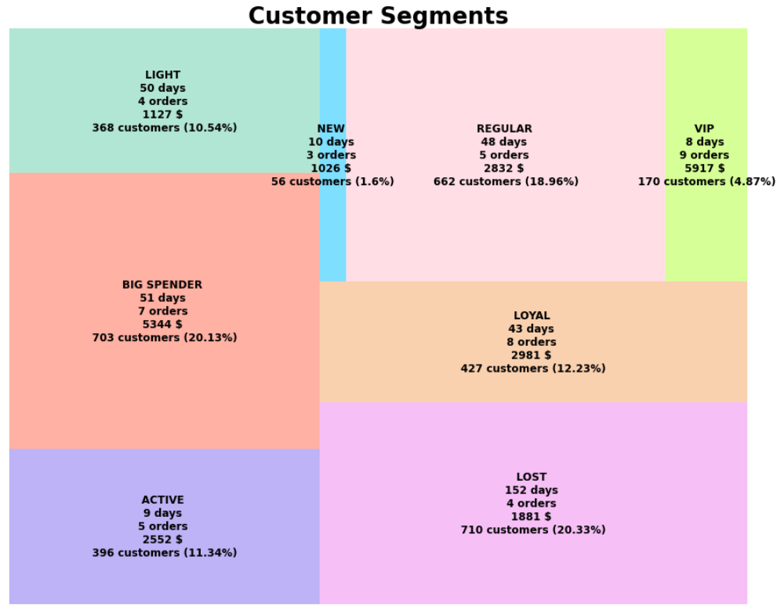
Note: The data and information in this document is reflective of a hypothetical situation and client. This document is to be used for KPMG Virtual Internship purposes only.
Interpretation
TreeMap
The clusters of customers are clear and easy to distinguish

Slide 8
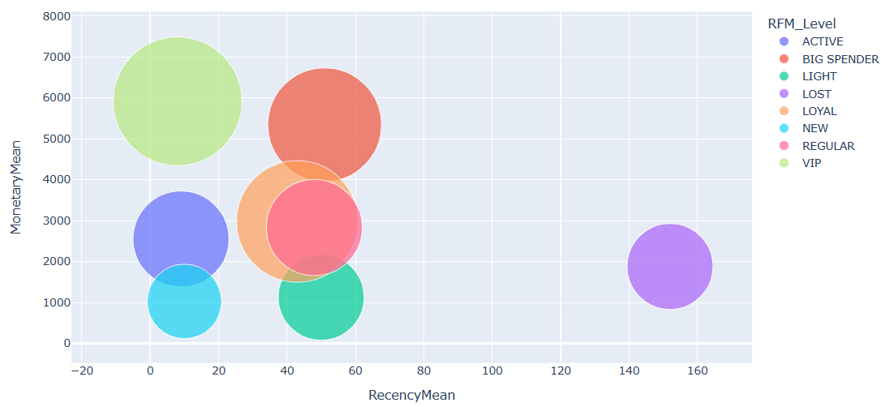
Note: The data and information in this document is reflective of a hypothetical situation and client. This document is to be used for KPMG Virtual Internship purposes only.
Interpretation
ScatterPlot
The clusters of customers are clear and easy to distinguish

Slide 9
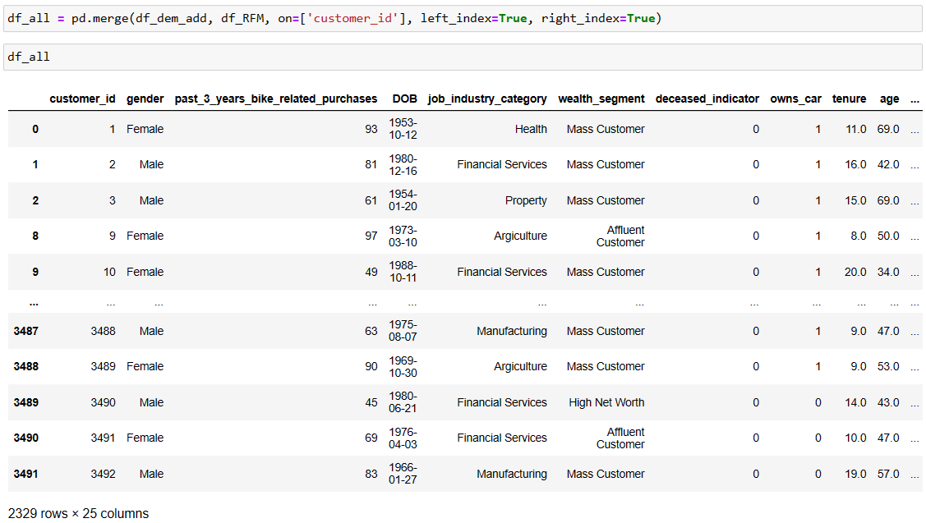
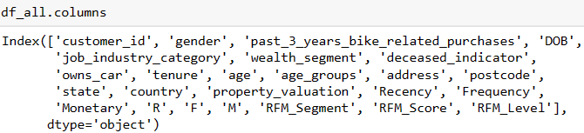
Note: The data and information in this document is reflective of a hypothetical situation and client. This document is to be used for KPMG Virtual Internship purposes only.
Interpretation
Merge all clean datasets into one

Slide 10
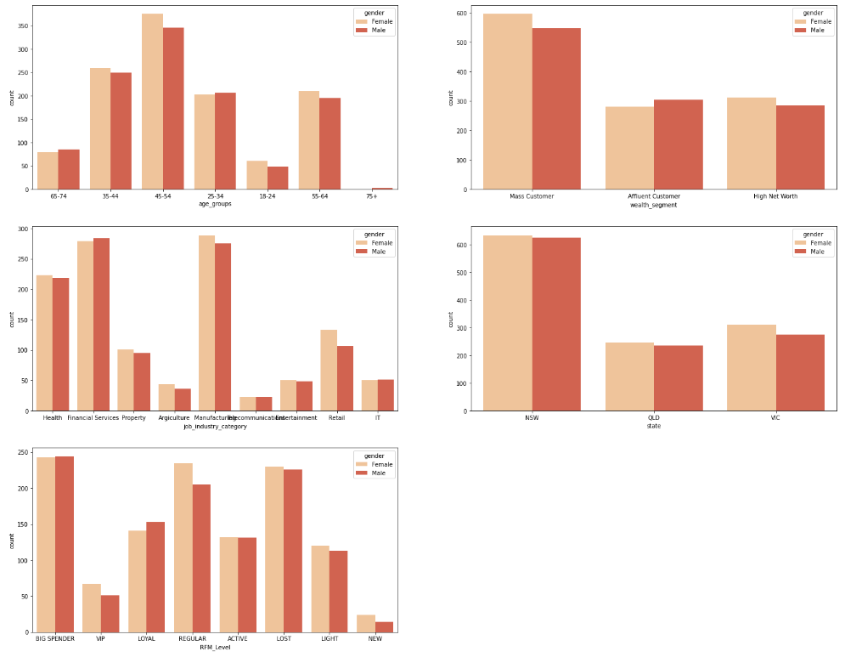
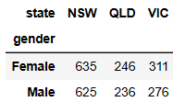
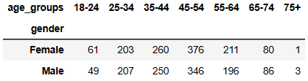
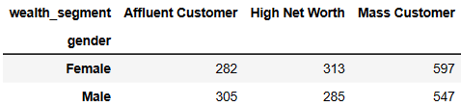
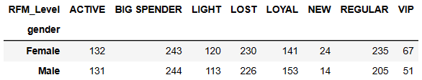
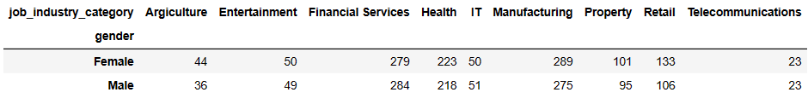
Note: The data and information in this document is reflective of a hypothetical situation and client. This document is to be used for KPMG Virtual Internship purposes only.
Interpretation
Top 3 Job Industry Categories are Manufacturing, Finacial Services, and Health in descending order
Top 3 RFM levels having high values are Big Spender, Lost, and Regular in descending order
Customers with LOST of RFM levels are very dangerous with high value (~ 20.33%), we need to have good marketing strategies and customer services for taking care of them
NSW (New South Wales) is the state which has the highest number of customers purchased
Both Female and Male have number of customers nearly similar with top 2 are at age group of '45-54' and '35-44’
Mass Customer has highest number of customers in Wealth Segment

Slide 11
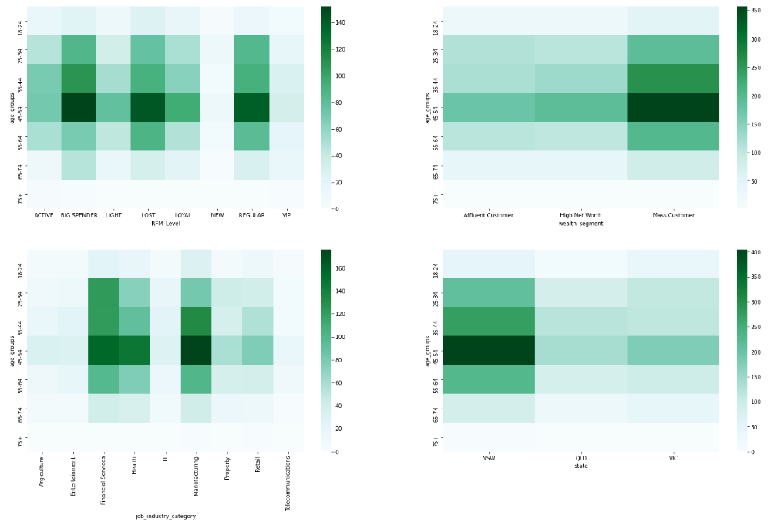
Note: The data and information in this document is reflective of a hypothetical situation and client. This document is to be used for KPMG Virtual Internship purposes only.
Interpretation
The age group of 45-54 has highest number of customers through almost fields (RFM Levels, Wealth Segment, Job Industry Category, and State)
Most of them belong to Mass Customer
Most of them live in New South Wales
Most of their job industries are Manufacturing, Finacial Services, and Health
Most of their RFM Levels are Big Spender, Lost, and Regular

Slide 12
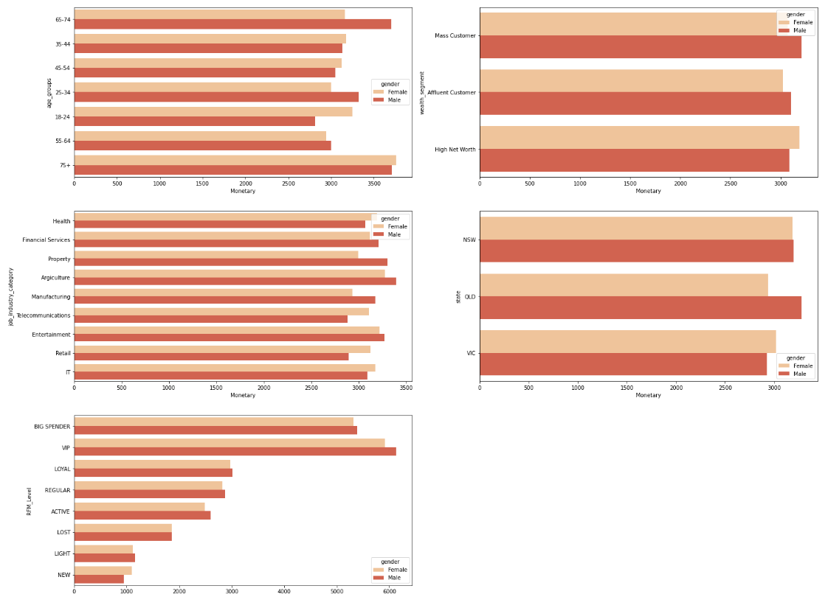
Note: The data and information in this document is reflective of a hypothetical situation and client. This document is to be used for KPMG Virtual Internship purposes only.
Interpretation
The age group of 65-74 and 75+ brought high profits at top 2
Property and Agriculture stand at top 2 whose profits are higher than other job industries (especially Male)
VIP and Big Spender are 2 customer groups brought profits with very high numbers
There are some differences a bit among states; as well as among wealth segments (not too much)

Slide 13
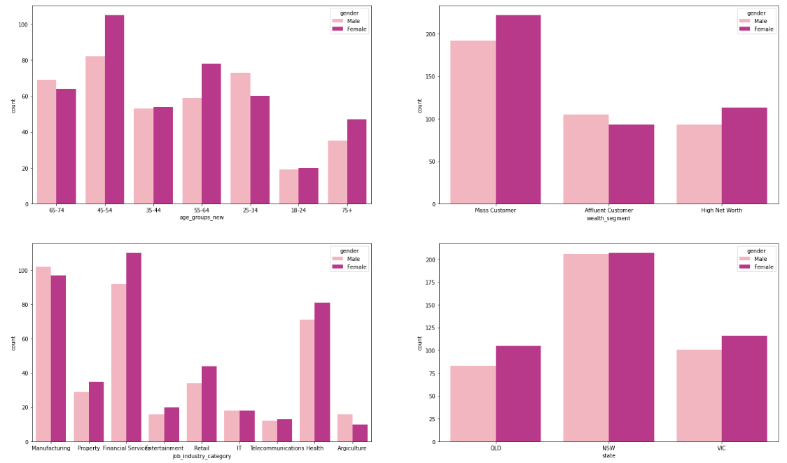
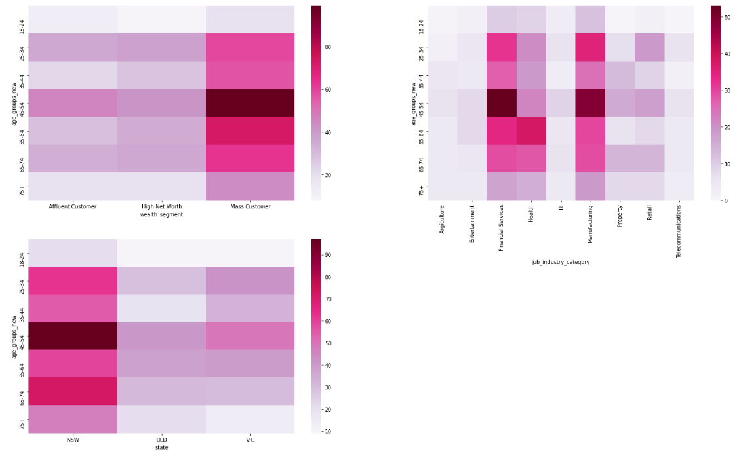
Note: The data and information in this document is reflective of a hypothetical situation and client. This document is to be used for KPMG Virtual Internship purposes only.
New Dataset
The age group of 45-54 is a potential group since it has highest number of customers (they are working at Manufacturing and Finacial Services; they are Mass Customer; they are living in New South Wales)
The age group of 65-74 and 75+ will bring high profit as RFM Model showed
Although Mass Customer has highest number of customers, the profit they brought was similar to others => Focus on 3 segments for marketing strategies ahead
Although New South Wales has highest number of customers, the profit they brought was similar to others => Focus on 3 states for marketing strategies ahead
Most of customers are working at job industry of Manufacturing, Finacial Services, and Health; however, Property and Agriculture are the two potential job industries which brought a lot of profit as RFM Model showed

Slide 14
Note: The data and information in this document is reflective of a hypothetical situation and client. This document is to be used for KPMG Virtual Internship purposes only.
Thank You

