Slide 1

Thiruvalla Highlights: Exploring Essence
Website Project
Vasudevan Nampoothiri
MCA S1-A
Roll No: 54

Slide 2
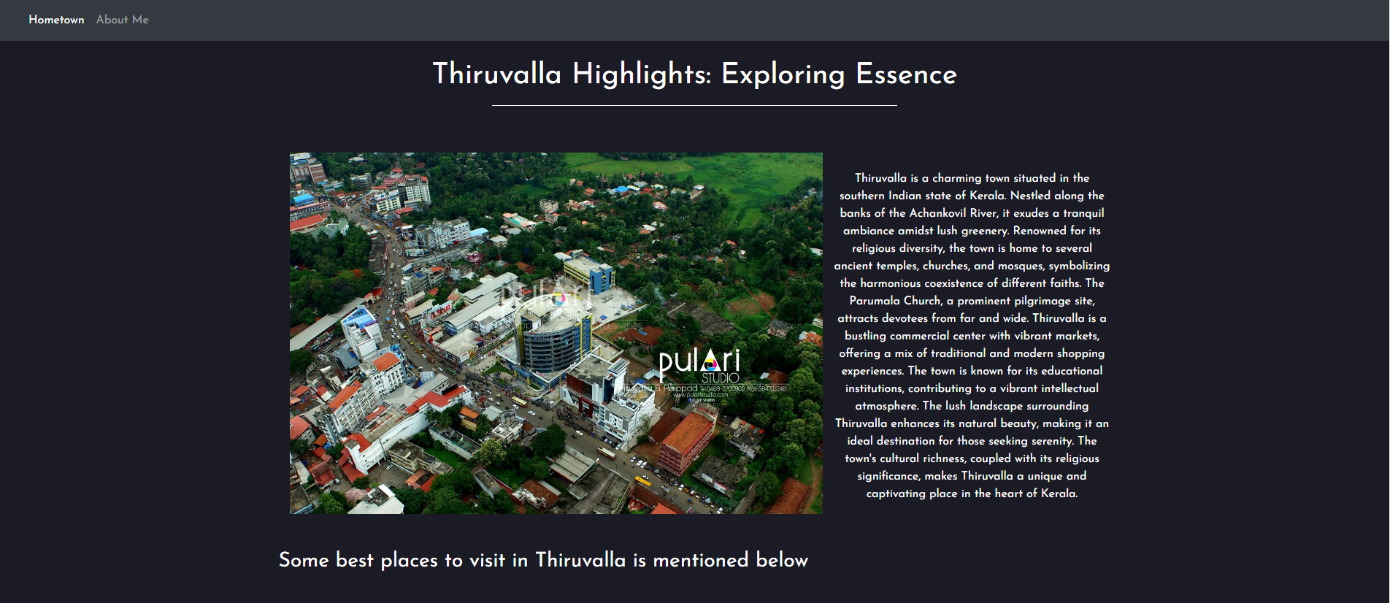
Screenshots

Slide 3
About Project
This website shows the essence of Thiruvalla, encorporating important places situated in Thiruvalla.
This website may act as a form of preliminary knowledge about prominent places before visiting Thiruvalla.

Slide 4
About Images
The project contains 3 images sourced locally as well as from internet.
The images shown are the places mentioned in the project.

Slide 5
നന്ദി നമസ്കാരം

