Slide 1
^{Student name:v.yokesh} ^{REGISTER NO : 222403568} NM ID:c965f9f6cc06a59a719486ec5 DEPARTMENT:BSC COMPUTER SCIENCE COLLEGE:SRI DEVI ARTS AND SCIENCE COLLEGE –PONNERI ^{university: madras university}
Digital portfolio

Slide 2
Project title
TRAIN TICKET BOOKING

Slide 3
Agend A
1.problem statement
2.project Overview
3.End users
4.Tools and technologies
5.Portfolio design and layout
6.Features and functionality
7.Results and Screenshots
8.Conclusion
9.Github link

Slide 4
Problem statement
Design and style a train ticket booking webpage with a clean layout that includes a header, navigation, booking form, and footer. The booking form should be user-friendly, responsive, and visually appealing with modern UI elements.Would you like me to also write the HTML structure that goes along with this CSS?

Slide 5
Project overview
This project is a Train Ticket Booking Website (can be adapted for any booking system). The design uses HTML and CSS to create a clean, user-friendly interface.Header & Navigation: Provides branding and navigation links with a modern color scheme.Main Section: Contains a booking form where users can select travel details (like source, destination, date, etc.).Form Styling: Input fields, dropdowns, and buttons are styled for clarity and usability.Footer: Simple and consistent footer matching the header’s theme.The overall design is minimal, responsive, and professional, suitable for ticket booking or similar service-based websites.---Do you want me to also add the HTML structure that fits with this CSS so it’s ready to run?

Slide 6
Who are The end users?
Passengers/travelers who want to book train tickets online.General public looking for an easy way to plan and reserve their journeys. Anyone who needs to book a train ticket conveniently through a website.Do you also want me to list the admin users (like railway staff) separately?

Slide 7
Tools and techniques
Tools: HTML, CSS, JavaScript (for design and interactivity).
Techniques: Responsive design, form styling, clean layout, and user-friendly navigation.
: It uses basic web technologies with a focus on simplicity and usability.
Do you want me to also add future tools (like databases or frameworks) if this project grows bigger?

Slide 8
Potfolio design and Loyout
Design: Clean, minimal, and professional with consistent colors and typography.Layout: Header with navigation, main section for content/forms, and footer for contact/info.Focus: User-friendly, responsive, and visually appealing. A simple structured layout that highlights content clearly and keeps the design neat.Would you like me to create a sample portfolio HTML page that matches this CSS style?

Slide 9
Features and functionality
Features: Clean interface, booking form, navigation menu, and responsive layout.
Functionality: Users can enter travel details, select options, and submit bookings.
A simple, user-friendly system for booking tickets online.
Would you like me to also add extra features (like payment integration or confirmation page) for future upgrades?

Slide 10
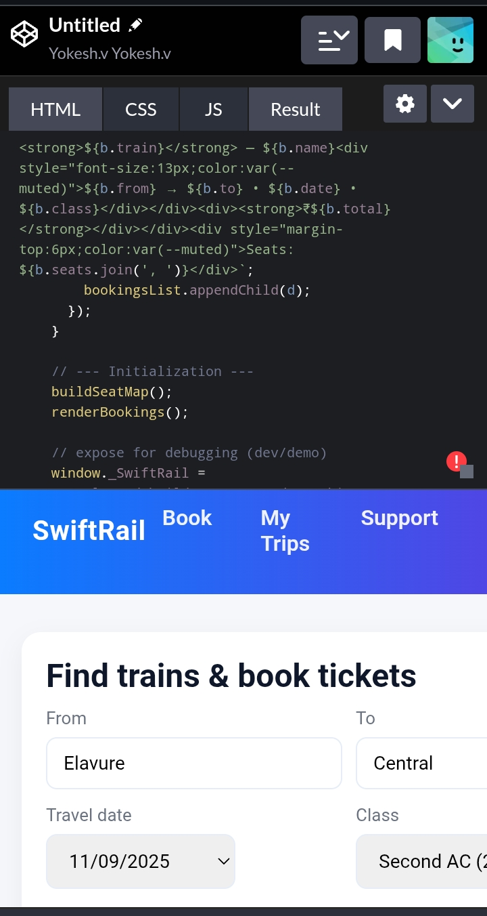
Results and screenshot
This project delivers a simple, responsive, and user-friendly booking webpage. It uses HTML and CSS to create a clean layout with a booking form, navigation, and footer. The design is minimal yet professional, making it easy for users to book tickets online.
A basic but effective web design for online booking systems.
Would you like me to prepare a final project report (overview, tools, features, results, and conclusion combined) in one place?

Slide 11
Conclusion
You’ve built a functional train ticket booking UI using only HTML, CSS, and JavaScript. It includes:
Train search with mock data
Seat map with selection (max 6 seats)
Price calculation per seat + base fare
Booking confirmation modal
LocalStorage persistence for demo

Slide 12
Github link
https://github.com/vyokeshbsccs24113-hash/Yokesh-24213.git

