Slide 1


SMART INDIA HACKATHON 2026
SMART INDIA HACKATHON
2026
TITLE PAGE
Problem Statement ID – 26085
Problem Statement Title –Urban Flood Nowcasting System (Drainage and Rainfall Coupling).
Theme –Disaster Management
PS Category – Software
Team Name – The OutThinkers
Mentor Name – Jay Pandya

Slide 2








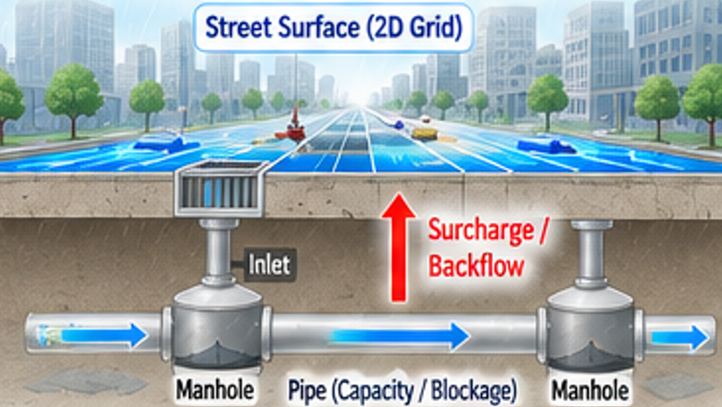







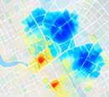
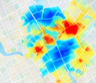
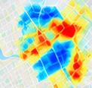









The
IDEA & PROPOSED SOLUTION
OutThinkers
SMART INDIA HACKATHON
2026
⚠ THE PROBLEM
💡 OUR SOLUTION - R.A.K.S.H.A.K
RAINFALL ≠ STREET – LEVEL FLOODING
Rainfall
Terrain / Elevation
Drainage Network
Urban Road Network
Weather forecasts predict how much rain may fall, but not exactly which streets will flood, when, or how deep. Urban flooding depends on micro-topography, impervious surfaces, and underground drainage constraints.
👥 USERS / APPLICATION
MUNICIPALITIES
WHERE?
WHEN?
COUPLED SIMULATION ENGINE
2D Surface Flow ↔ Underground Drainage Interaction
Monitor
Prioritize
Which streets are at risk?
Which junctions?
At what lead time?
When will it impact?
Rainfall Processing
(Spatio-temporal)
Hydraulic Capacity
(Flow estimation)
EMERGENCY SERVICES
Runoff Generation
(Considering imperviousness)
Drainage Interaction
(Surface ↔ Network)
HOW DEEP?
WHAT NEXT?
Surcharge / Backflow
Route
Street-level Flood Depth
(cm-level inundation)
Respond
Expected water depth?
Which areas will be worst hit?
Which routes remain safe?
Where to divert traffic?
2D Surface Flow
OUTPUT: 0–3 HOUR STREET NOWCAST (GIS-based)
CITIZENS / COMMUTERS
Water Depth
(cm-level inundation)
Get Alerts
Higher Flood Risk
Plan Travel
+30 min
+1 hour
Lower Flood Risk
+2 hours
+3 hours
NOW
⚙ KEY DIFFERENTIATORS
⚡ FROM PREDICTION TO ACTION
FORWARD-LOOKING
PREDICT
Where & when?
EXPLAIN
Why happening?
ALERT
Who to notify?
ROUTE
What to avoid?
RESPOND
Safer city action
EXPLAINABLE
COUPLED
ACTIONABLE
HYPER-LOCAL
→
→
→
→
Surface + underground drainage modelling
From forecast to alerts & safe routes
Respond
Street / junction level depth
NOW → 3 hour evolution
Linked to rain, terrain, capacity & blockage

Slide 3






















TECHNICAL APPROACH
SMART INDIA HACKATHON
2026
The
OutThinkers
Rainfall–Terrain–Drainage Coupling for Street-Level Flood Nowcasting
MULTI-SOURCE INPUT DATA
Technology Stack
Frontend
HTML / CSS / JavaScript
Rainfall & Forecast
DEM & Terrain
Drainage Network
Roads & Land- use
Citizen Reports
(DWR / NWP / Weather APIs)
(Elevation/Slope/Flow Paths)
(Inlets /Manholes /Pipes /Capacity)
(OSM /Urban GIS Layers)
(Waterlogging Reports)
Web GIS
Leaflet /GeoJSON /OSM
COUPLED FLOOD MODELLING ENGINE
Backend APIs
FastAPI /Python
Rainfall Processing
Runoff Generation
2D Surface Routing
Drainage Hydraulics
Surface–Drain Coupling
0–3 Hour Nowcasting
Modelling
NumPy /Rasterio / GeoPandas
Rainfall → Runoff → Drainage Capacity → Excess Water → Routing Depth → Flood Risk
ACTIONABLE OUTPUTS
Database
PostgreSQL /PostGIS
Deployment
Render
Critical Drainage nodes
Flood –aware Routing
Water depth (cm)
Flooded street
0-3h Forecast

Slide 4



















OutThinkers
FEASIBILITY & VIABILITY
The
SMART INDIA HACKATHON
2026
1.DATA FEASIBILITY
2. TECHNICAL FEASIBILITY
3. KEY CHALLENGES → MITIGATION
Rainfall Nowcast Doppler Weather Radar / available nowcast
Challenge | Mitigation
Incomplete drainage data | Coverage-aware NO DATA state
High computational demand | Spatial preprocessing & optimized computation
Variable data availability | LIVE / MODEL / SIMULATION states
Model uncertainty | Historical-event validation
Rainfall Nowcast
Runoff Estimation
2D Surface Flow
Drainage Network
Overflow
Alerts & Routing
Terrain (DEM) High-resolution elevation data
Pre-process static GIS / terrain data
Model drainage capacity and blockage effects
Run hydraulic computation for selected areas
Generate street-level flood-depth forecasts
Deliver results through Web GIS & APIs
Road Network Street-level GIS data
Citizen Inputs Waterlogging & blockage reports
4.VIABILITY & SCALABILITY
Reusable model & software architecture
City-specific GIS / drainage layers
API-based integration with existing systems
One platform for citizens, municipalities &
emergency services
Pilot Area
Data-supported pilot implementation
Ward Level
Expand within the ward
City Level
City-wide coverage
Multi-City
Scale to multiple cities / regions
Notes:
Runoff Estimation

Slide 5














OutThinkers
The
IMPACT & BENEFITS
SMART INDIA HACKATHON
2026
CITIZENS
MUNICIPALITIES
EMERGENCY SERVICES
Identify high-risk streets & drainage nodes
Prioritize field response and interventions
Monitor forecasted drainage stress
Know where & when flooding may occur
View 0–3 hour street-level flood forecasts
Choose safer route alternatives
Identify flood-affected / risky routes
Use flood-aware route alternatives
Improve response planning
KEY BENEFITS
SOCIAL
ECONOMIC
URBAN RESILIENCE
Safer mobility
Better public awareness
Reduced exposure to flood-prone locations
Help reduce traffic disruption
Support efficient field deployment
Minimize avoidable response delays
Proactive flood preparedness
Better drainage planning
Data-driven urban resilience
IMPACT CHAIN
Rainfall Nowcast
Faster Response
Flood Forecast
Better Decisions
Risk Awareness

Slide 6


RESEARCH & REFERENCES
The
OutThinkers
SMART INDIA HACKATHON
2026
RESEARCH
DATA SOURCES & REFERENCES
1. Real-Time Urban Flood Forecasting
1. ISRO / NRSC — CartoDEM (30 m)
Piadeh, Behzadian & Alani (2022) | Journal of Hydrology
Bhuvan / Bhoonidhi
https://doi.org/10.1016/j.jhydrol.2022.127476
https://bhuvan.nrsc.gov.in | https://bhoonidhi.nrsc.gov.in
• Real-time modelling and forecasting in urban drainage systems.
• Terrain, elevation and slope analysis
2. Rainfall–Runoff & Surface Flood Modelling
2. OpenStreetMap + Overpass API
Yang, Ma & Zhang (2022) | Water, MDPI
https://www.openstreetmap.org | https://overpass-api.de
https://doi.org/10.3390/w14111760
• Road and drainage/waterway network data
• Coupling drainage modelling with Surface Runoff & flow Estimation.
View Detailed Report https://docs.google.com/document/d/19qORQzDj_TlJYGB8Bng7_z4AOPrNlrw-/edit?usp=sharing&ouid=116236032653346115359&rtpof=true&sd=true QR Code of Report :
3. OpenWeatherMap
3. Surface Flooding & Sewer Interaction
https://openweathermap.org
Oberauer & Lehmann (2023) | Journal of Hydrology
• Live weather and precipitation data
https://doi.org/10.1016/j.jhydrol.2023.130053
4. Open-Meteo
• Urban surface flow and drainage performance.
https://open-meteo.com
4. Physics-Based & ML Approaches
• Precipitation forecast data
Anik, An & Li (2025) | Environmental Systems Research
5. OSRM — Open Source Routing Machine
https://doi.org/10.1186/s40068-025-00409-3
• Physical-process and ML approaches for urban flood prediction.
https://router.project-osrm.org
• Road routing and route evaluation
PROJECT REPOSITORY
GitHub Repository:
Turning data into early warnings
and safer decisions.
Scan the QR code or visit the link to explore the source code,
datasets and documentation.
https://github.com/vyom-kushvaha/sih-26085-urban-flood-nowcasting.git
Research and references • Smart India Hackathon 2026

