Slide 1

PropKart: Your Digital Property Nexus
Presented by the visionary team from Tech University's Computer Science Department, PropKart is designed to revolutionize the property dealing landscape. This project embodies our commitment to practical innovation, offering a robust and intuitive platform for all your real estate needs.

Slide 2
Navigating the Property Maze: The Problem
Fragmented Market
Trust & Transparency Deficit
Feature Limitations
The current property market is a complex web of scattered listings and unreliable sources, making the search for genuine opportunities akin to finding a needle in a haystack. This lack of a centralized hub leads to significant inefficiencies for both buyers and sellers.
Existing platforms frequently lack essential functionalities. Critical features such as advanced filtering, direct communication tools, and integrated digital processes are often missing, hindering a seamless transaction experience.
Prevalent issues like deceptive listings and unverified information erode trust. Without direct communication channels and robust verification, users often face a frustrating journey fraught with uncertainties and potential scams.

Slide 3


PropKart's Core Objectives
PropKart aims to transform property transactions by focusing on connectivity, precision, and simplicity. We are building a platform that not only solves current pain points but also anticipates future user needs.
Seamless Connections
Precision Search
Simplified Dealings
To establish a direct and efficient channel for buyers and sellers, fostering transparent interactions without intermediaries.
To empower users with advanced search capabilities and granular filters, ensuring they find exactly what they're looking for with minimal effort.
To integrate digital tools that streamline every step of the property transaction, from inquiry to agreement, enhancing efficiency and user experience.

Slide 4

PropKart: The Proposed Solution
PropKart will be a robust, web-based property dealing system engineered with Django, providing a secure and scalable foundation. Our design prioritizes user-centric workflows for both buyers and sellers, complemented by a powerful administrative backend.
For Buyers: An intuitive interface to search, filter, compare, and save listings, ensuring a highly personalized property discovery journey.
For Sellers: A streamlined process for posting detailed property information and high-quality images, maximizing visibility and appeal.
For Administrators: Comprehensive tools to manage properties, user accounts, and content, maintaining platform integrity and performance.

Slide 5
Key Features: User Experience
PropKart prioritizes a rich and interactive user experience, equipping buyers with powerful tools to navigate the property market efficiently and confidently.
Comprehensive Listings
1
Detailed property information including high-resolution images, floor plans, and virtual tours for an immersive viewing experience.
Personalized Profiles
2
Users can create and manage their profiles, save preferred searches, and track their interactions within the platform.
Advanced Search & Filters
3
Granular search options by location, price range, property type, amenities, and more, ensuring precise results.
Direct Communication
4
Integrated messaging system for direct, secure communication between potential buyers and sellers or agents.

Slide 6



Key Features: Administrative Control
The admin interface is the backbone of PropKart, ensuring smooth operations, data integrity, and content relevance. It provides powerful tools for comprehensive platform management.
Property Management Suite
Admins can effortlessly add, edit, or delete property listings, ensuring all information is accurate and up-to-date. This includes managing property status, verification, and visibility.
Analytics & Insights Dashboard
A comprehensive dashboard providing real-time data on user activity, listing performance, and transaction metrics. This enables data-driven decision-making for platform optimization.
Bulk Data Operations
Efficient bulk upload and download functionalities via CSV, allowing for quick management of large datasets, ideal for partnerships with real estate agencies.

Slide 7





Data Management & Operations (CRUD)
PropKart's architecture supports robust Create, Read, Update, and Delete (CRUD) operations across all critical data entities, ensuring data integrity and dynamic functionality.
Create
Read
Delete
Update
This structured approach to data handling underpins the reliability and responsiveness of the PropKart platform for all its users and administrative functions.

Slide 8
Technology Stack: Powering PropKart
Our choice of technology reflects a commitment to building a high-performance, scalable, and secure application. This stack provides the ideal foundation for PropKart's advanced features.
Frontend Technologies
Backend & Database
HTML: For structuring the web content.
Django (Python): Robust web framework for backend logic and API development.
CSS: For styling and responsive design.
JavaScript: For interactive user experiences.
SQLite : Flexible database solutions for data persistence.
Bootstrap: For rapid and responsive UI development.
Development & Authentication
GitHub: For version control and collaborative development.
VS Code: Our primary integrated development environment.
OTP/Email Login[SMTP]: Enhanced security and user convenience.

Slide 9
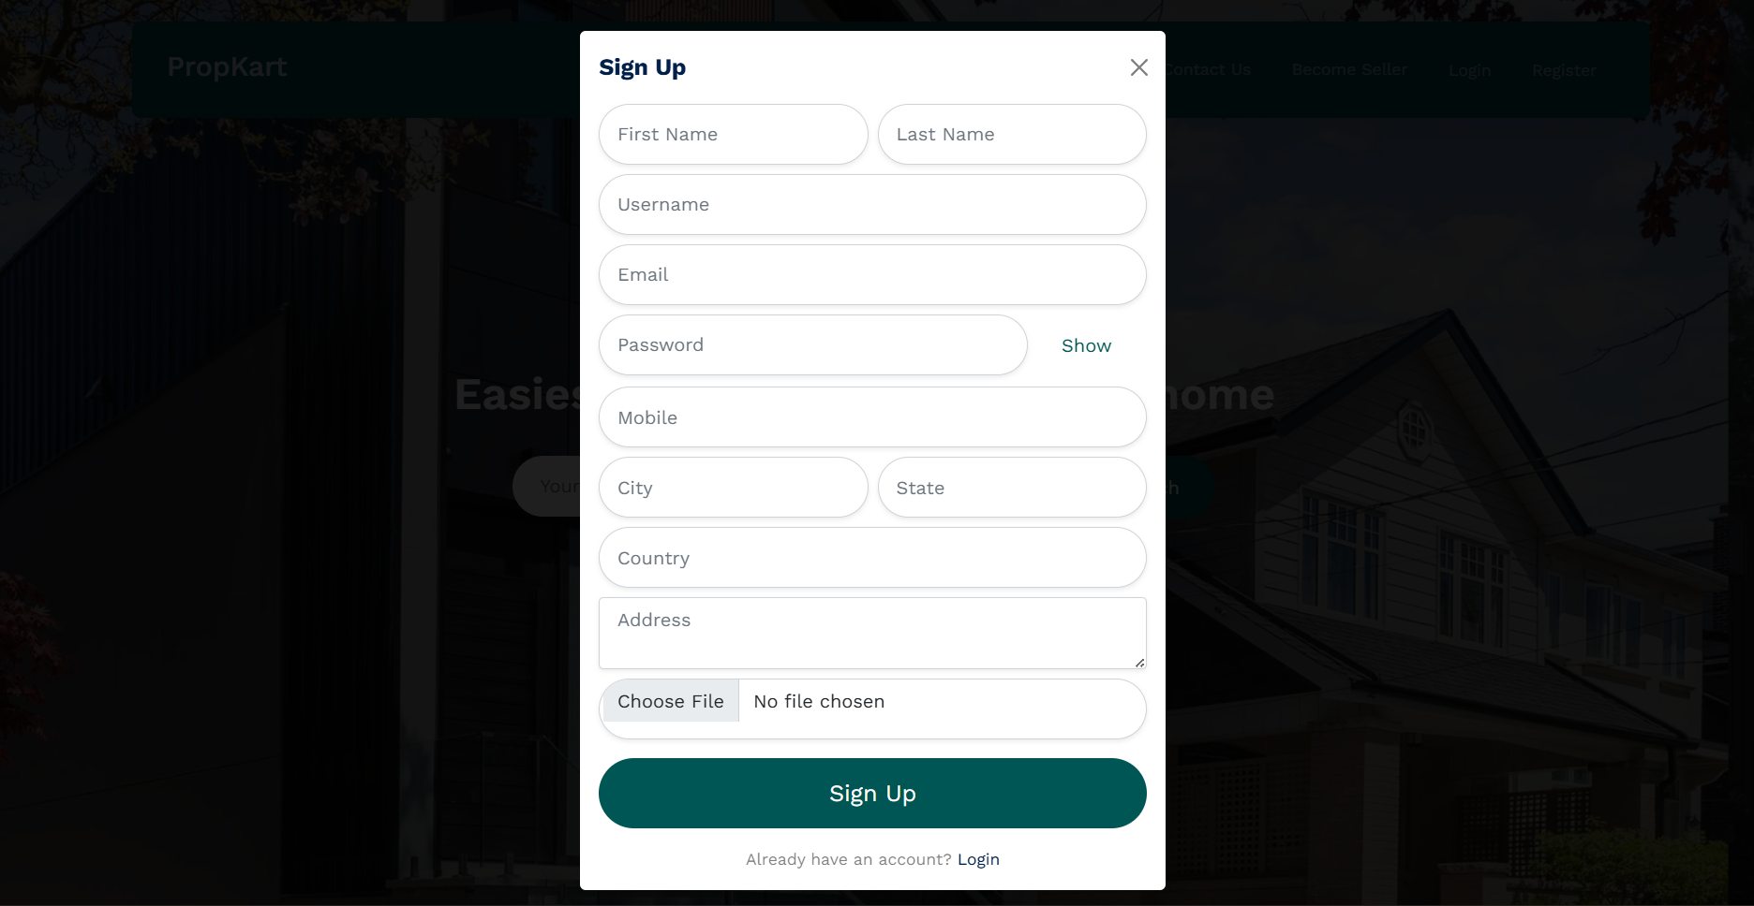
Screenshots :
Sign Up

Slide 10
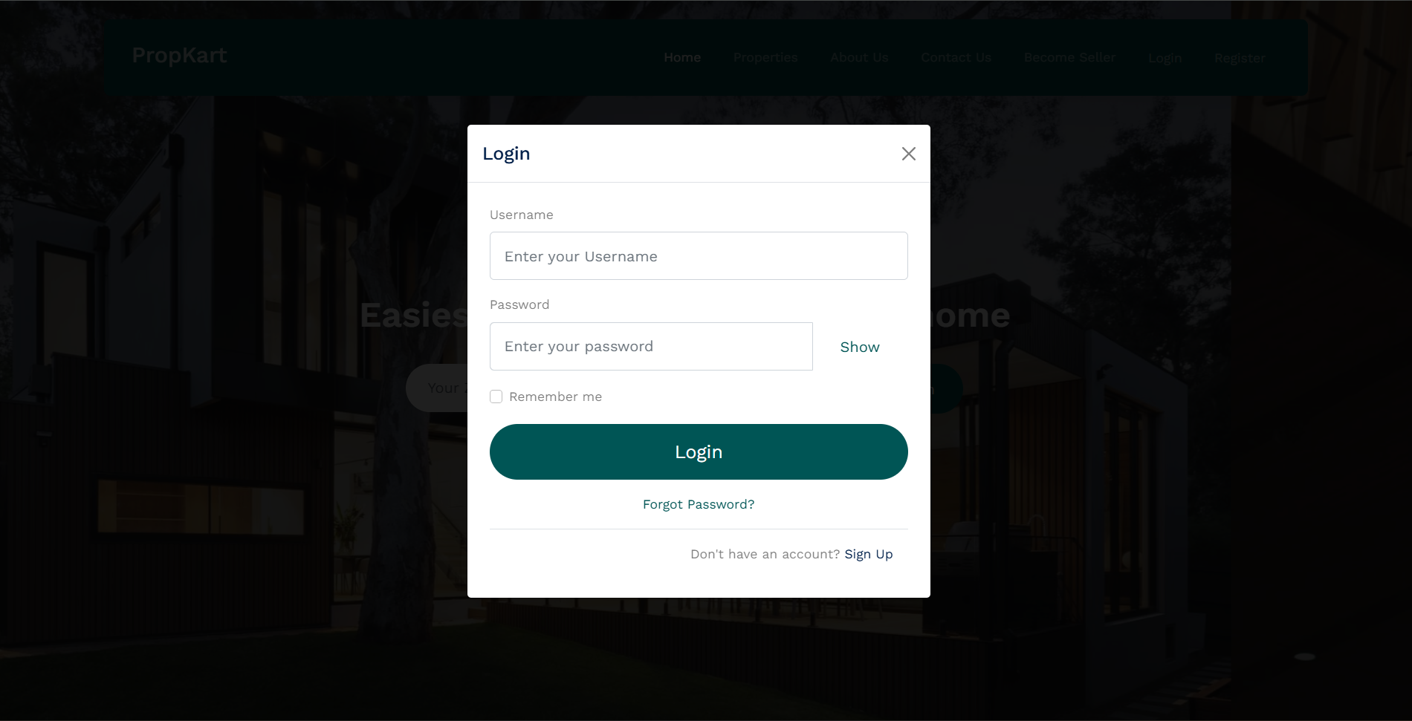
Log In

Slide 11
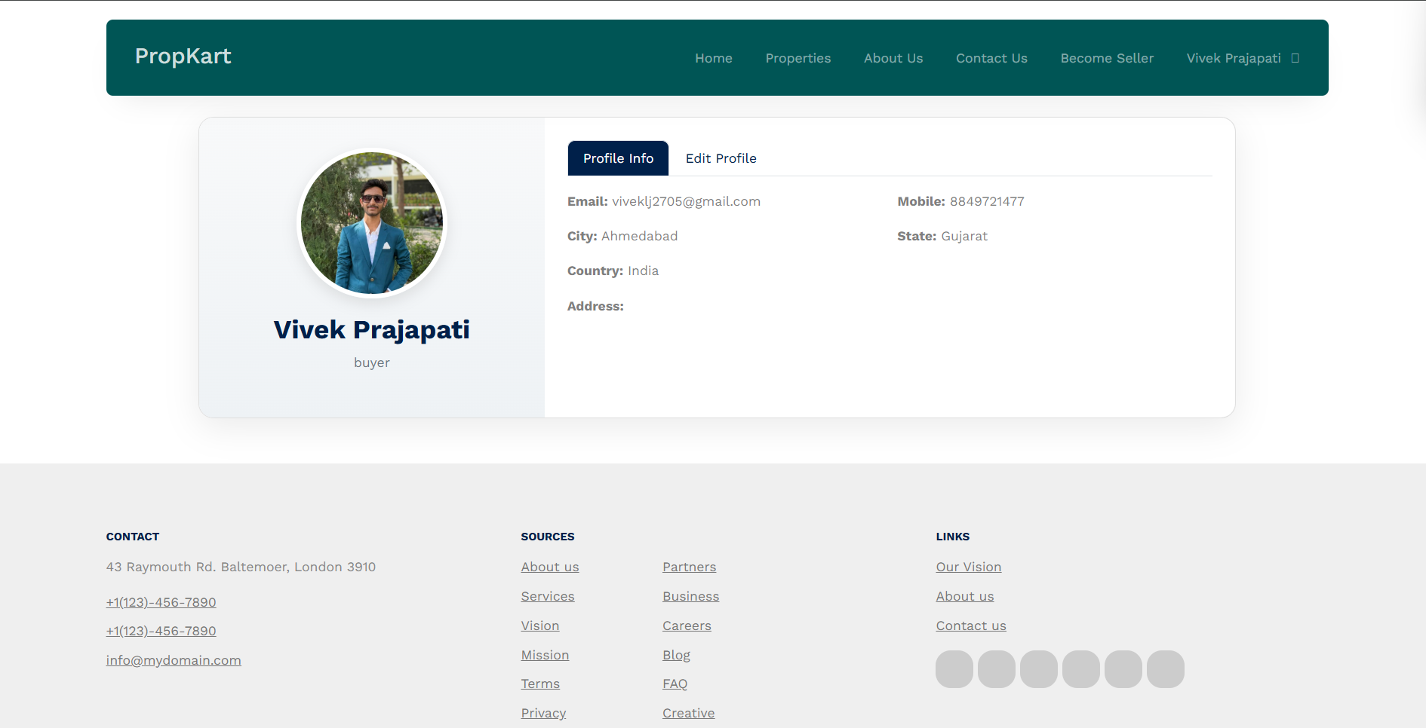
Profile

Slide 12
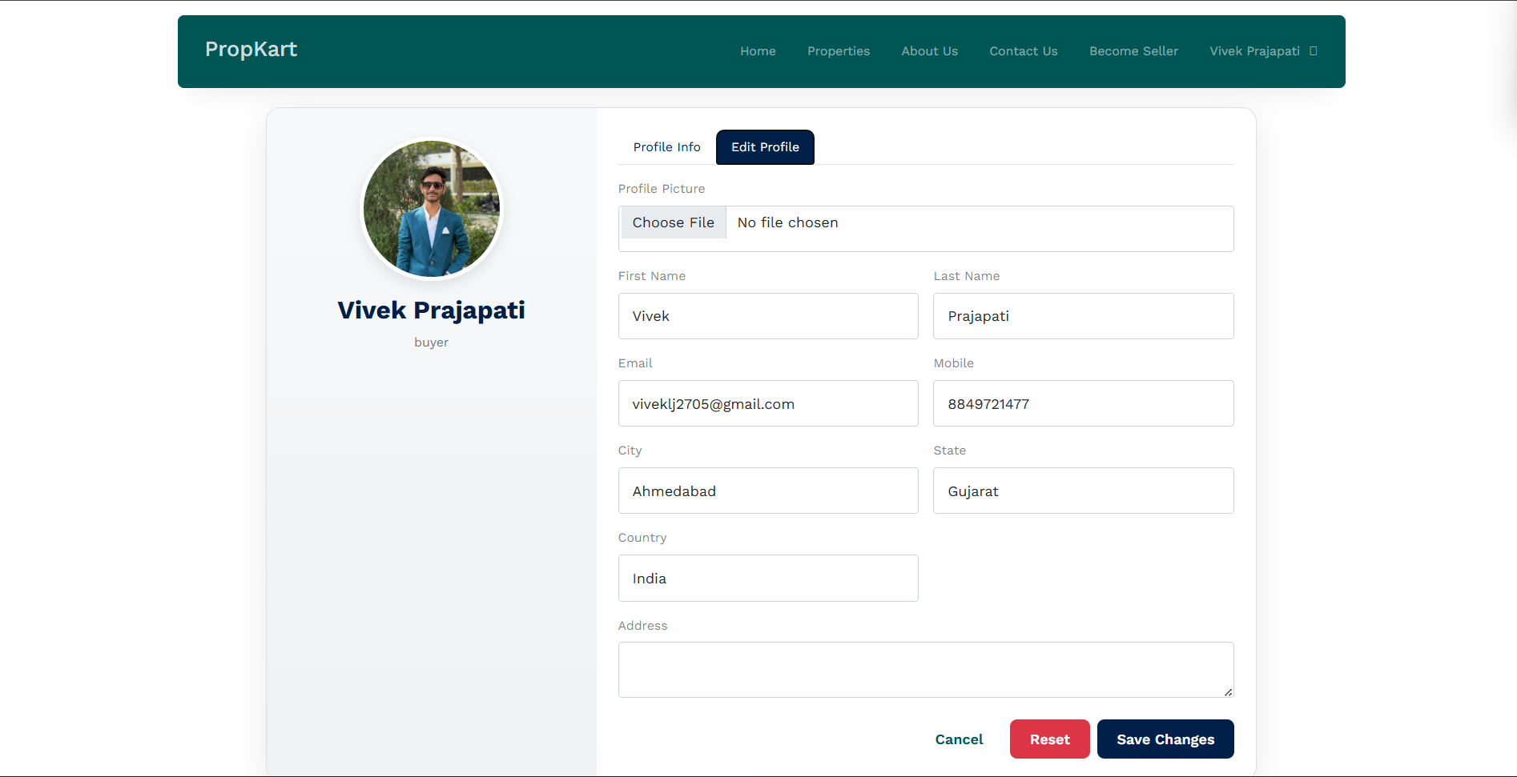

Edit Profile

