Slide 1
अमृत महाराष्ट्र · संकेतस्थळ पुनर्रचना
Why the new portal is better
A redesign of amrutmaharashtra.org for the people it is actually meant to reach — rural Maharashtra, in Marathi, on a slow connection.
Same content. Same colours. Same institution. Everything else rebuilt.

Slide 2
THE PROBLEM
Today the portal is a magazine that happens to be run by a government agency.
Every success story ends the same way: here is who qualifies, 24 castes, income under ₹8 lakh — now go contact your district office.
The site never says where that office is. It never links the scheme. It never offers a way to apply.
A reader who has just been convinced has nowhere to go.
2,664
articles published
0
of them lead anywhere
1

Slide 3
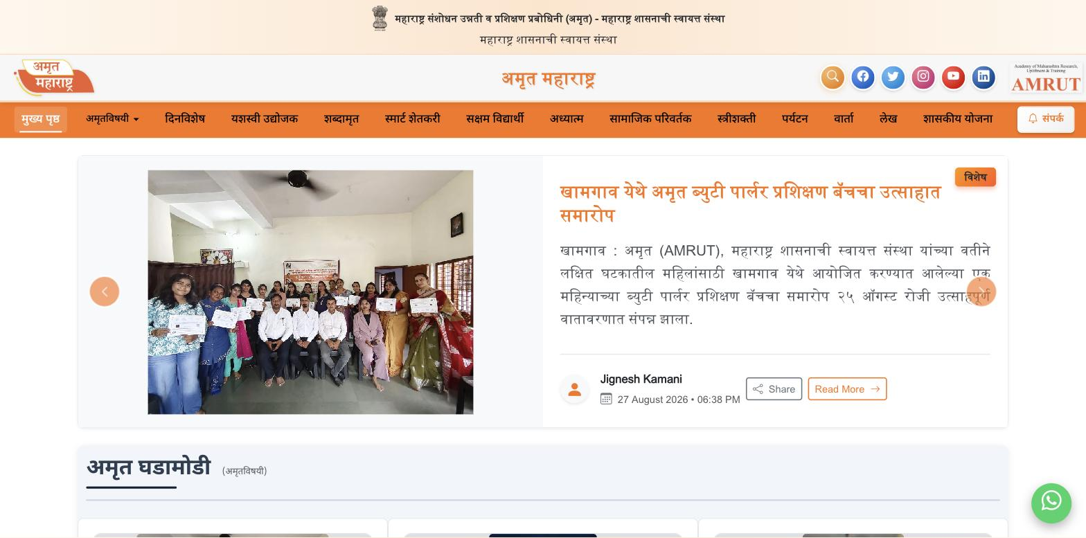
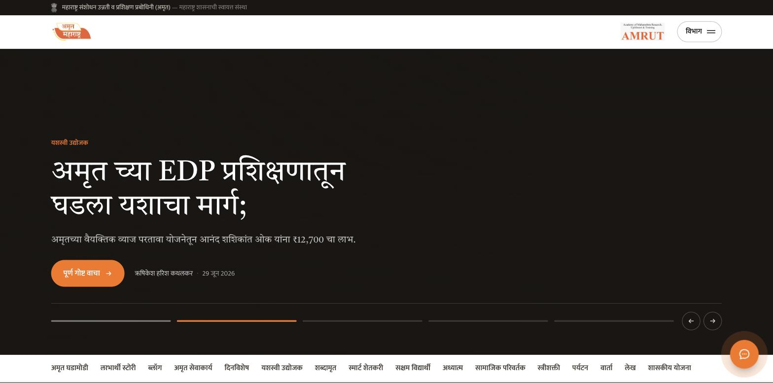
THE HOMEPAGE
Before and after
BEFORE · amrutmaharashtra.org
AFTER · amrut-mh.vercel.app
Three stacked bars of chrome take a quarter of the screen. Sixteen categories compete at equal weight. Saffron runs everything, so nothing leads.
One person, one photograph, rotating through five stories. The masthead is 64px. Saffron is spent once — on the thing you should do next.
2

Slide 4
COLOUR
We did not change a single colour. We changed how much of each you see.
The palette is AMRUT's own, read straight out of the live stylesheet — not matched by eye.
On the live site saffron runs the header, the nav bar, the buttons, the headings and the links, all at full strength. When everything shouts, nothing is heard.
Now it covers about 5% of the surface and marks one thing per screen.
#F97316
Saffron — the accent
#D35400
Deep orange — links
#FFF7ED
Cream — the ground
#FFEDD5
Cream 2 — panels
#1A1613
Ink — the type
This matters for approval: it still reads as AMRUT's site, done properly — not as somebody rebranding a government portal.
3

Slide 5
TYPOGRAPHY
Marathi set as Marathi — not as English wearing a Devanagari font.
Most Indian government sites set Devanagari in a default font at a line-height borrowed from Latin. It comes out cramped: the shirorekha crowds, the matras collide. Readers feel it even when they cannot name it.
We use two faces drawn for Devanagari, not adapted to it:
Tiro Devanagari Marathi — a text serif designed specifically for Marathi. Headlines and article body.
Mukta, by Ek Type of Mumbai — navigation, metadata, interface.
Body line-height
1.90
for Devanagari, against the 1.5 a Latin face would take — the matras need the room.
No uppercase anywhere. It does not exist in Devanagari, and Latin caps set beside it read as a foreign body.
This is the single biggest differentiator available, and almost nobody in this sector takes it.
4

Slide 6
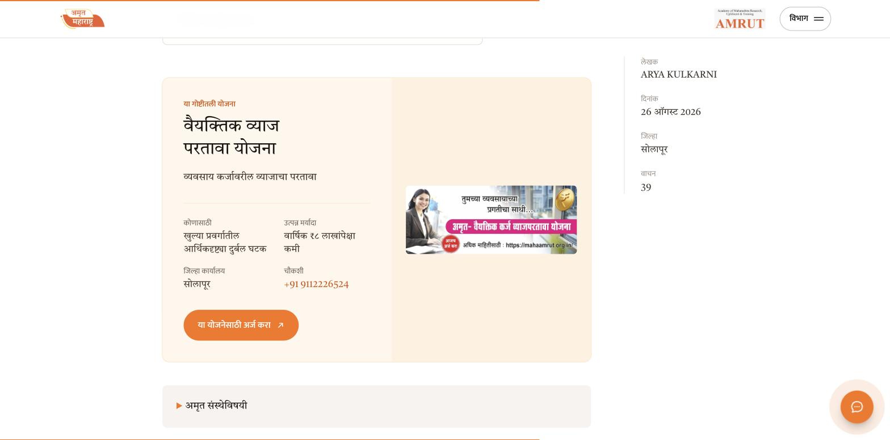
THE BIGGEST CHANGE
Every story now leads somewhere.
At the end of each article the site now works out which scheme the story is actually about — from the article's own words — and offers it.
Who qualifies. The income limit. The district office. The helpline. A button that goes straight into the application portal.
Not one word of the article was changed. This is a new component placed after it.
Do this, and 2,664 already-published stories become 2,664 entry points.
5

Slide 7
SPEED
The audience is on rural mobile data. The old site does not act like it.
~80
images on the homepage
none lazy-loaded, none responsive
18×
oversized at worst
a 1600×2133 photo filling a 150×200 slot
152 MB
of original artwork
downloaded in full, every visit
After: 152 MB → 37 MB
Every image rebuilt as WebP at three widths. The versions that fill the homepage average 24 KB each. Same pictures, roughly a tenth of the weight.
On a slow connection this is felt before anything else on this list.
6

Slide 8
CREDIBILITY
Three things that quietly undermine an official government site.
The visitor counter invents its own traffic
It climbed from 2,03,935 to 3,09,418 while we sat on the homepage — about a minute — then read 0 on every inner page. On a site whose footer says “This is an official government website”, that is the fastest way to lose a reader.
Now: report real analytics, or remove it.
The Contact button does nothing
संपर्क sits in the navigation styled as the one highlighted action, and is wired to nothing at all. There is no contact page anywhere on the site.
Now: a real contact route, and the details in the footer and the assistant.
The 404 page is somebody else's template
A wrong link lands on a stock illustration of a skateboarder. No masthead, no Marathi, no emblem, no way back. It is where every broken link ends.
Now: a proper page, in Marathi, listing all 16 sections.
7

Slide 9
REACH
2,664 Marathi articles that search engines can barely see.
BEFORE
AFTER
robots.txt
Missing
Generated at build
sitemap.xml
Missing
Generated at build
Article URLs
news.php?id=3283
/beneficiary-story/3284/सोलापुरच्या…
Page titles
One generic title reused
Per-page, in Marathi
Shared to WhatsApp
Previews as nothing
Proper title, image and description
WhatsApp is how this content actually travels in Maharashtra. Right now a shared link arrives looking like nothing.
8

Slide 10
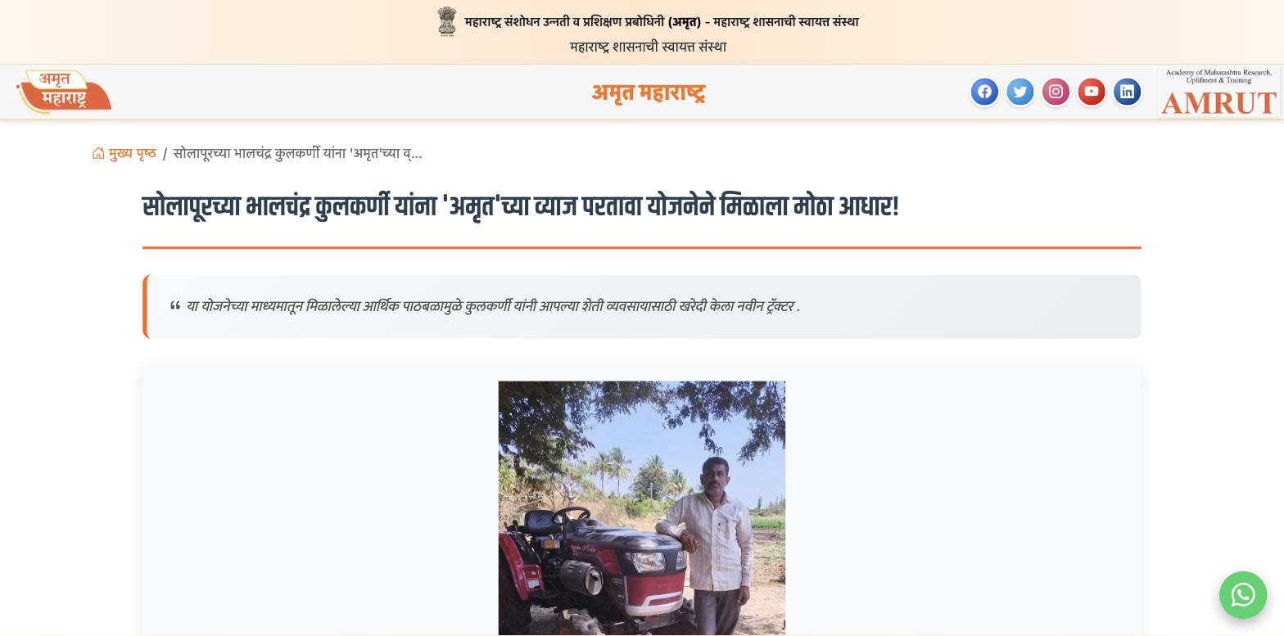
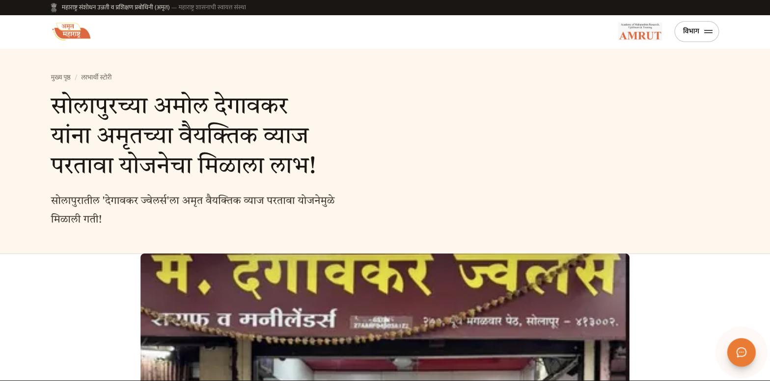
THE ARTICLE
The same words, made readable
BEFORE
AFTER
Text runs the full width of the screen. The office address and the standing “about AMRUT” paragraph sit mid-story as if they were part of it. No navigation — the only way out is back.
A measured reading column. Author, date, district and views in a quiet margin. The office and the boilerplate lifted out and given their own place — same words, no longer read as story.
9

Slide 11
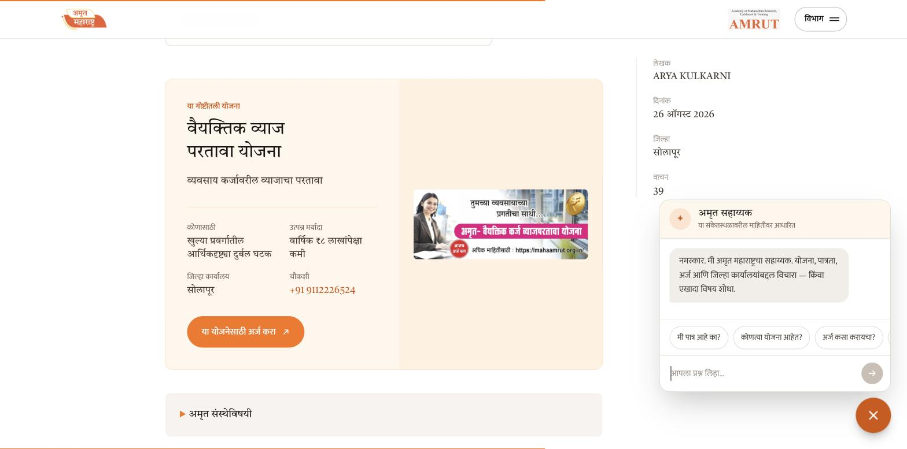
NEW
An assistant that answers in Marathi — and refuses to make things up.
It handles eligibility, the four live schemes, how to apply, what documents are needed, district offices and contact — and searches every story on the site.
Every answer is built from this site's own content. It cannot invent an eligibility rule or an office address.
Ask it for a district office and it gives Solapur — the only one AMRUT actually publishes — and points to the head office for the rest.
On a government portal, being right matters more than sounding fluent.
10

Slide 12
IN SHORT
What changed
Homepage weight
~152 MB of images
37 MB, 24 KB per card
Masthead height
~200 px, always
64 px, sticky rail below
Navigation on inner pages
Disappears
Follows you down every page
Where a story ends
Nowhere
The scheme it is about
Contact button
Does nothing
Works, plus an assistant
404 page
Stock skateboarder
In Marathi, all 16 sections
robots.txt / sitemap
Neither
Both, generated at build
Marathi typography
Latin line-height
Set for Devanagari
11

Slide 13
BEING STRAIGHT WITH YOU
What this is not, yet
It is a proof, not a migration
24 articles per category are loaded, out of 2,664. The templates are finished; the rest is data through them.
Mobile is unverified
Built mobile-first with no fixed widths, but not yet confirmed on a real handset. That is the first thing to check.
The content is a snapshot
Collected 28 August 2026 and static. Database access would keep it live and is worth asking for.
Photography is the real ceiling
Group shots under fluorescent light, GPS watermarks, posters with text baked in. The design is forgiving of it — but a one-page shot standard for the 36 district offices would lift this site further than another round of design.
12

Slide 14
The design was never the hard part.
AMRUT already has the stories, the schemes and offices in all 36 districts. What was missing was the path between them.
Build the scheme directory, the district office finder and the eligibility check, and every article already published becomes a way in.
amrut-mh.vercel.app

