Slide 1


Texting versus Videochat: Effects on Confidence and Performance
Vanessa Y. Oviedo and Jean E. Fox Tree
University of California, Santa Cruz
Abstract Number: 2213
Notes:
Hi I’m Vanessa Oviedo and today I’ll be talking about Texting versus Videochat: Effects on Confidence and Performance. This is work I’m doing in collaboration with my advisor, Dr. Jean E. Fox Tree at the University of California Santa Cruz.

Slide 2
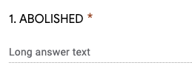


Introduction
Methods
Oviedo & Fox Tree, 2213
Please contact Vanessa Oviedo with questions: voviedo@ucsc.edu
Communicative Media: People use a mix of communication media to interact with each other: text, audio-only, audiovisual
Media Richness Theory: Each medium can be placed on a continuum and rated from lean to rich (Daft & Lengel, 1986)
The Hyperpersonal Model: Text-based media may unexpectedly cultivate more intimate relationships than audiovisual (Walther, 1996)
Modality Switching: How does the way people first interact affect future work performance and feelings about their addresses?
Independent Variables
Video Chat First
Messaging First
Anagram Task
Dependent Measures
Correct Anagrams
Anagram Complexity Score
Confidence, Naturalness, Personal Ratings

Slide 3
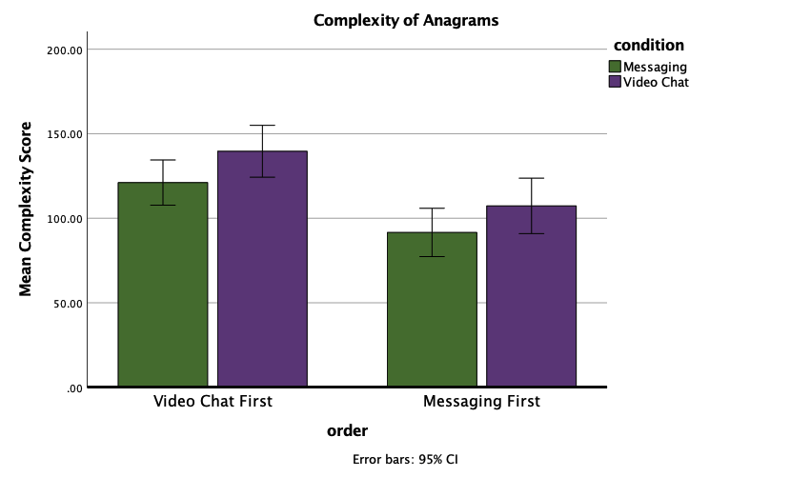
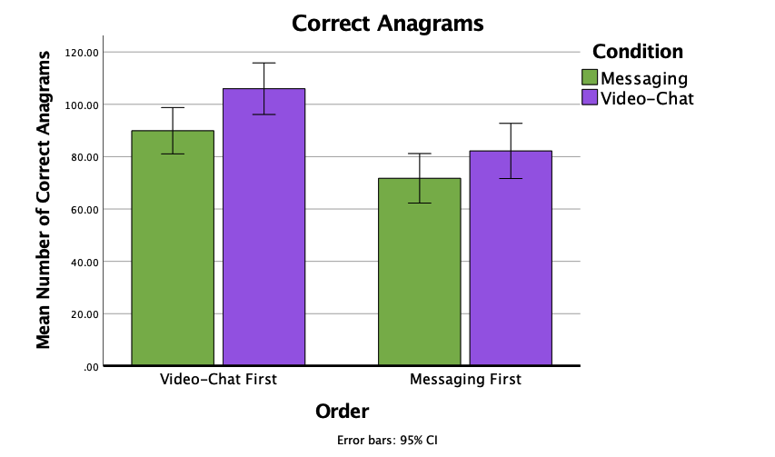
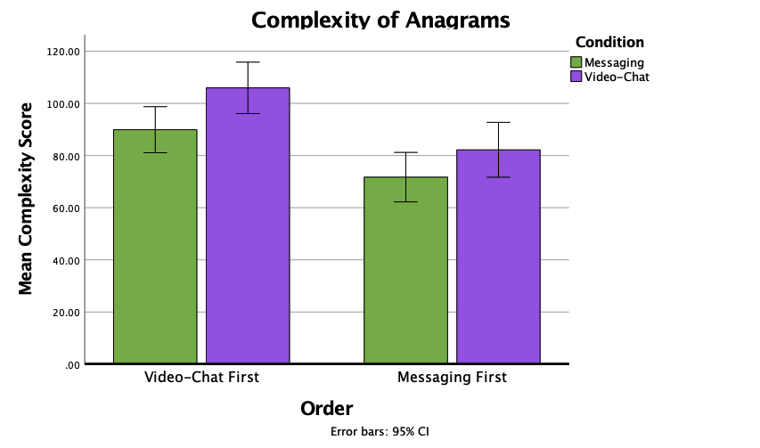

Results
Oviedo & Fox Tree, 2213
Please contact Vanessa Oviedo with questions: voviedo@ucsc.edu
Notes:
Overall, people who interacted over video chat created more correct anagrams and more complex anagrams than those who interacted over messaging.
People who interacted over video chat first also created more correct anagrams and more complex anagrams than those who interacted over messaging first.

Slide 4
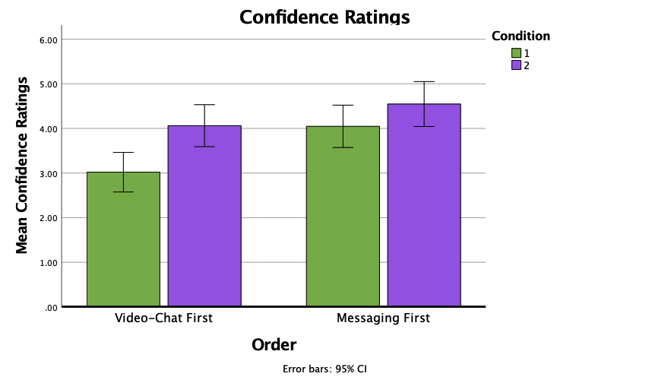
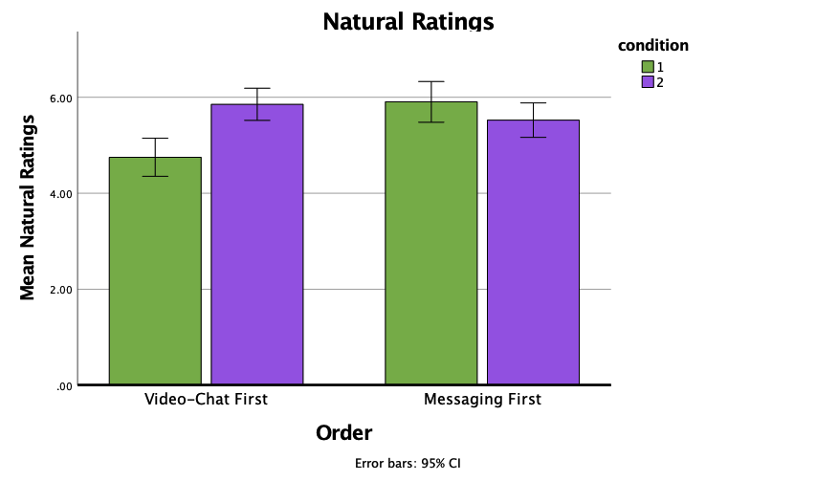
Results
Oviedo & Fox Tree, 2213
Please contact Vanessa Oviedo with questions: voviedo@ucsc.edu
Notes:
In terms of confidence, people who interacted over video chat were more confident in their performance in video chat than messaging. However, those who did messaging first were more confident than those who did video chat first.
There was also an interaction effect between condition and order for how natural people felt their interactions were. For messaging, those who interacted over messaging first rated their interactions as more natural than those who did messaging second. For video chat, there were no differences in order.

Slide 5
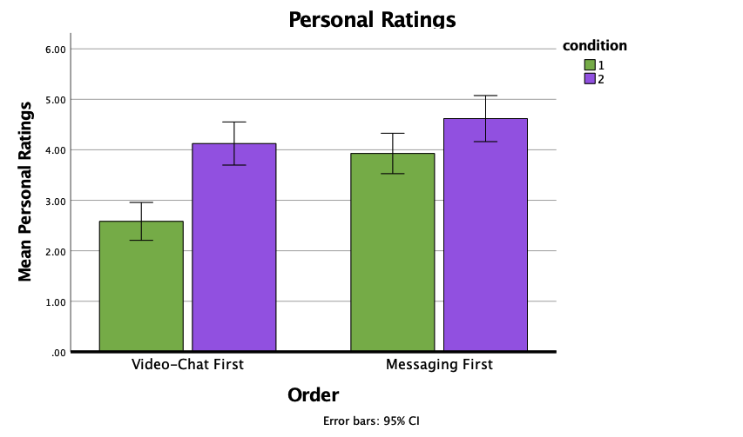
Results
Discussion
Oviedo & Fox Tree, 2213
Please contact Vanessa Oviedo with questions: voviedo@ucsc.edu
Video chat interactions resulted in better performance on the anagram task than text communication.
Confidence in having found all possible anagrams and natural and personal ratings were higher in initial messaging interactions.
Switching from messaging to video chat increased ratings, but switching from video chat to messaging decreased ratings.
While initial interactions may have shown a hyperpersonal effect, any such effect was short-lived.
Having cues was beneficial for performance, confidence and personal ratings.
Notes:
Likewise, there was an interaction effect between condition and order for how personal people felt their interactions were. For messaging, those who interacted over messaging first rated their interactions as more personal than those who did messaging second. For video chat, there were no differences in order. However, after switching from MSG to VC scores increased, likewise those who switched from VC to MSG saw their ratings decrease.

