Slide 1


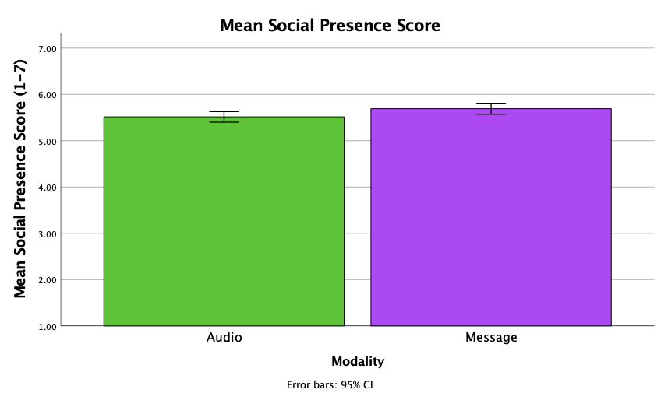
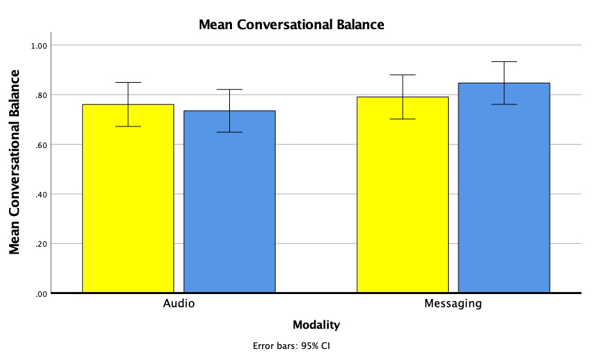

How Modality Switching Affects Social Presence and Emotional Connection
1082 | Vanessa Y. Oviedo and Jean E. Fox Tree | University of California Santa Cruz
Introduction: Does the way people first interact affect how present and connected they feel with others?
Media Richness Theory: Each medium can be placed on a continuum and rated from lean to rich¹
Social Presence: feeling of being present²
Emotional Connection: emotional experience of being in touch³
Modality Switching: switching between two communication media⁴
Results
Discussion:
Higher Social Presence scores and Conversational Balance in Messaging instead of Audio
No other differences between modalities
No effects of Modality Switching
Social Presence and Emotional Connection were correlated
Method:
IV: Audio or Messaging first
Task:
Story task
Social Presence/Emotional Connection Questionnaire
DV:
Social Presence Composite Score
Emotional Connection Composite Score
Story Complexity Score
Conversational Balance
References: 1. Daft & Lengel (1984). 2. Short, Williams, & Christie (1976). 3. Ijsselsteijn, van Baren, & van Lanen (2003). 4. Ramirez & Zhang (2007).
Contact Email: voviedo@ucsc.edu

