Slide 1











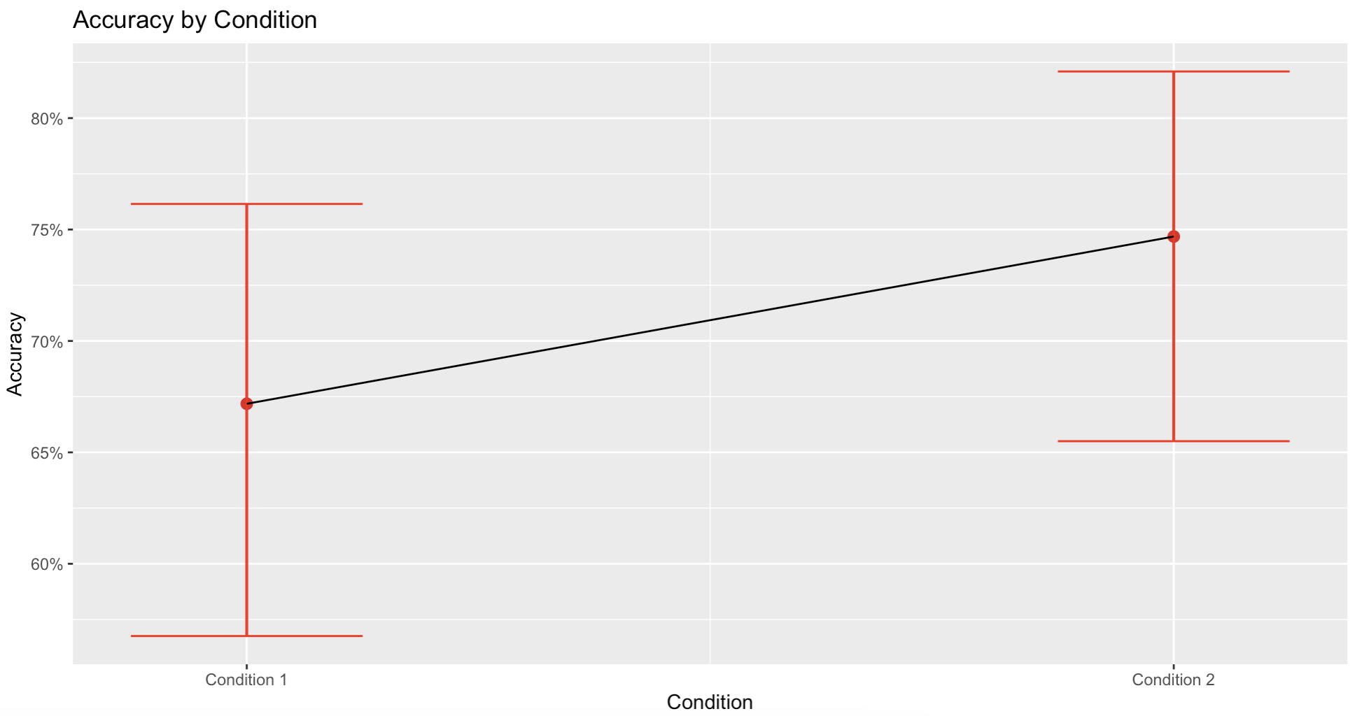

Interacting with Diverse Audiences Improves Communication Skills
1101 | Vanessa Y. Oviedo and Jean E. Fox Tree | University of California, Santa Cruz
Background
Successful communication is essential for cooperation and collaboration.
One way to become more effective communicators is by interacting with different types of people as this improves one’s ability to convey information clearly to someone new¹.
Exposure to different types of people yields greater perspective taking and exposure to more diverse perspectives leads to better creativity^{2,3}.
Perspective taking has also been linked with improved communication skills due to a shift toward global processing when encountering something unfamiliar^{1,4}.
Method
Condition 1
Condition 2
Discussion
Describing shapes to multiple different addressees yields good performance on subsequent memory for the tangram shapes¹, but describing shapes to diverse addressees resulted in better performance.
Replicated finding that interacting with multiple others improves communication skills by increasing our understanding of what we explain and how we explain it.
Added to this by showing that interacting with diverse addressees further improves communication skills.
Diverse audiences further challenge perspective taking and also further increase the global processing necessary for providing fitting descriptions
Future RQ: 1) How good were the descriptions from the diverse audience condition? 2) Do naive listeners perform better on the matching portion of the tangram task when listening to diverse descriptions?
Memory Test
Memory Test
Results
Figure 1. Accuracy in the memory test as dependent on type of audience.
Logistic mixed effects regression model with Accuracy as the DV, Condition as the fixed effect, and number of items as a random intercept, β = 0.365, SE = 0.144, z = 2.52, p = .011.
Hypotheses
RQ: Does interacting with diverse audiences improve communication skills?
H1: Describing the tangram shapes to more diverse audiences will improve communication skills by engaging in perspective taking and global processing.
H2: Participants who design their descriptions for different diverse audiences will be better at discriminating between sets that they had described and re-arranged sets.
References
Lev-Ari & Sebanz (2020) 2. Hawlin et al. (2017) 3. Savitsky et al. (2011) 4. Forster et al. (2009)
Contact
voviedo@ucsc.edu

