Slide 1
Doubly & Circular LINKED LIST
GROUP 03
presentation begins

Slide 2
—Bui Thanh Ngoc
—Nguyen Thanh Phong
—Lecturor Mr.Nguyen Thien Bao
—Le Cong Thuong
—Cao Dinh Sy Vy
—Tran Van Thien
—Le Thien An
19110136
19119105
18110034
19110103
—Nguyen Thanh Thien
19110058
19110150
19110143

Slide 3
Doubly Linked List
NULL
NULL
pNext
pNext
pNext
HEAD
TAIL
*Advantages over singly linked list
pPrev
pPrev
pPrev
We can quickly insert a new node before
a given node.
In singly linked list, to delete a node,
pointer to the previous node is needed.
To get this previous node, sometimes
the list is traversed. In DLL, we can get
the previous node using previous
pointer.
A DLL can be traversed in both forward and backward direction.
The delete operation in DLL is more
efficient if pointer to the node to be
deleted is given.

Slide 4
Doubly Linked List
NULL
NULL
pNext
pNext
pNext
HEAD
TAIL
*Disadvantages over singly linked list
pPrev
pPrev
pPrev
Every node of DLL require extra space for an previous pointer.
All operations require an extra pointer previous to be maintained. For
example, in insertion, we need to modify previous pointers together
with next pointers. For example in following functions for insertions at
different positions, we need 1 or 2 extra steps to set previous pointer.

Slide 5
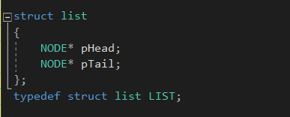
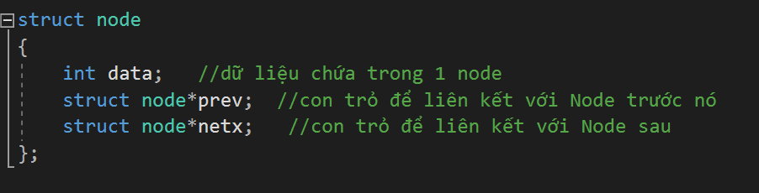
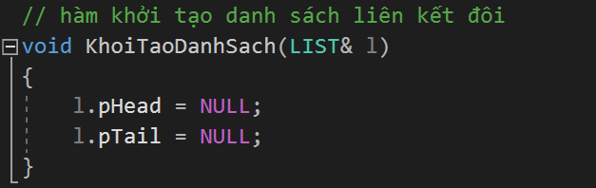
Installing doubly linked list:
Structure of list:
Structure of Node:
In doubly linked list, there is a slight difference compered to singly linked list.

Slide 6
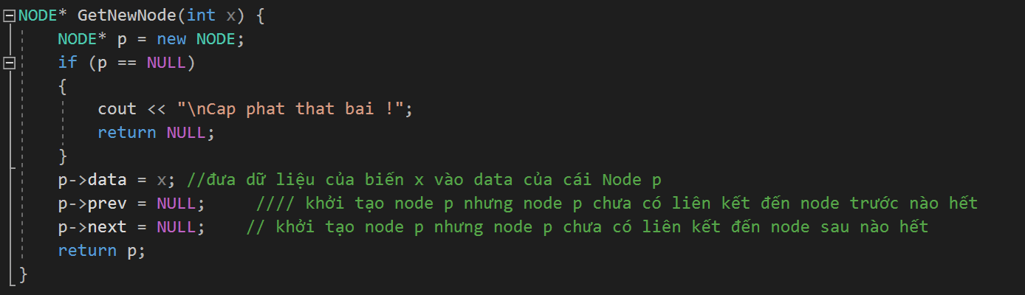
Installing doubly linked list:
Declare a node

Slide 7
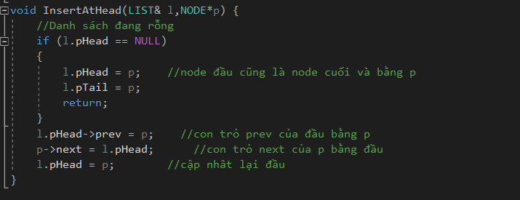
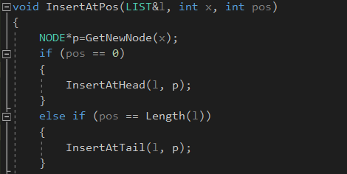
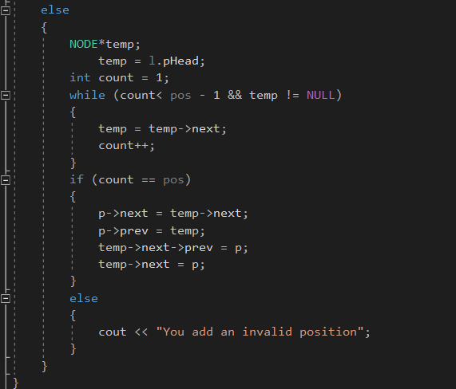
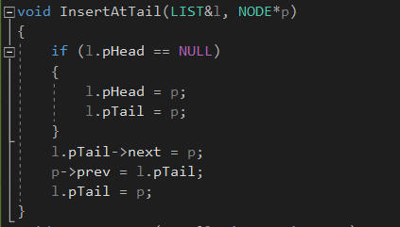
Manipulation with Dbly LnkLst
Adding node at front:
ADDING
Adding node at end:
Adding node at any position:
Head
Index
Tail

Slide 8
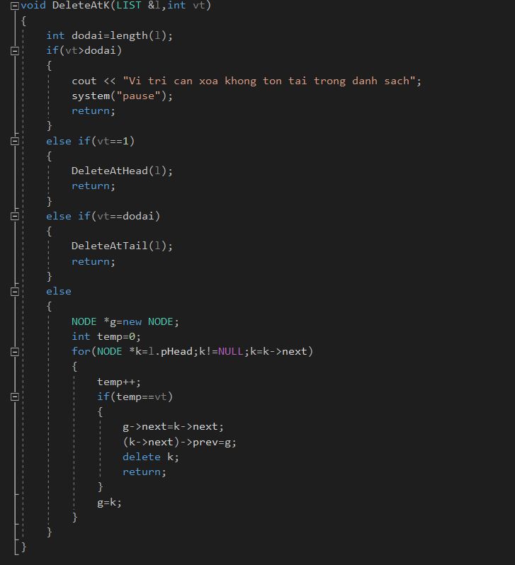


Deleting
Del Head
Del Tail
Del k position

Slide 9


What is Circular Linked List
“The Circular Linked List is a variation of the Linked List.”
CircularSingly:
Both the Singly Linked List and the Doubly Linked List can be made into Circular LL.
CircularDoubly:

Slide 10
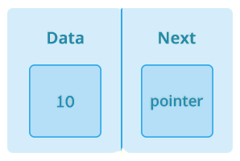
Create Circular linked list from Single linked list
In the Singly Linked List, the next point of the last node will point to the first node, instead of NULL.

Slide 11
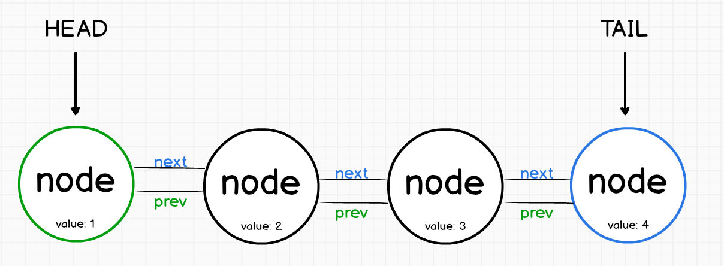
Create Circular linked list from Doubly linked list
In the Doubly Linked List, the next point of the last node points to the first node and the point to the front of the previous node will point to the last node. This process will form loops in both directions

Slide 12
There are three basic operations on the Circular Linked List
Node
Node
Node
Node
Add()
Delete()
Display()

Slide 13

ADDING function
l.head
l.tail
X
X
addHead()
addPosition()
addTail()

Slide 14
DELETING function
l.head
l.tail
delHead()
delPosition()
delTail()

Slide 15
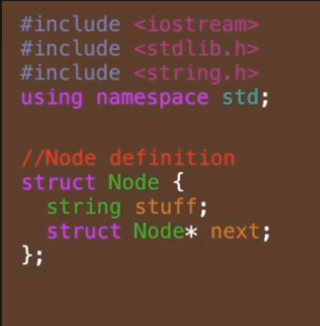
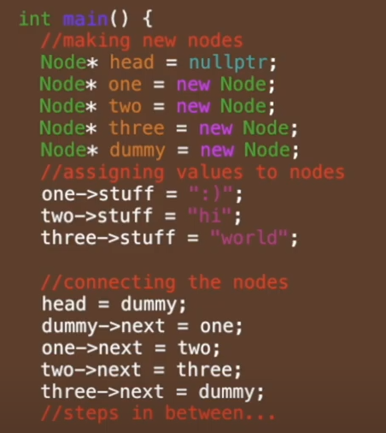
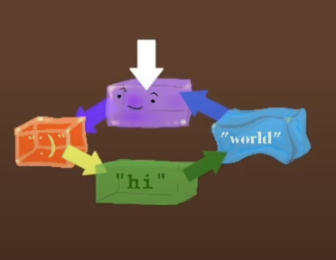
Display()
Node *ptr = l.head;
do{
cout<<ptr->data;
ptr=ptr->next; } while(ptr != );
NULL
l.head

Slide 16
Why we use circular LL
Problems/Mistakes
The entire list can be traversed starting from any node (traverse means visit every node just once)
Finding end of list and loop control is harder (no NULL's to mark beginning and end)
It saves time when we have to go to the first node from the last node. It can be done in single step because there is no need to traverse the in between nodes.
It is not easy to reverse the linked list.

