Slide 1
Pure Y1 Ch 1
Algebraic Expressions
Notes:
Last modified: 7th September 2020

Slide 2
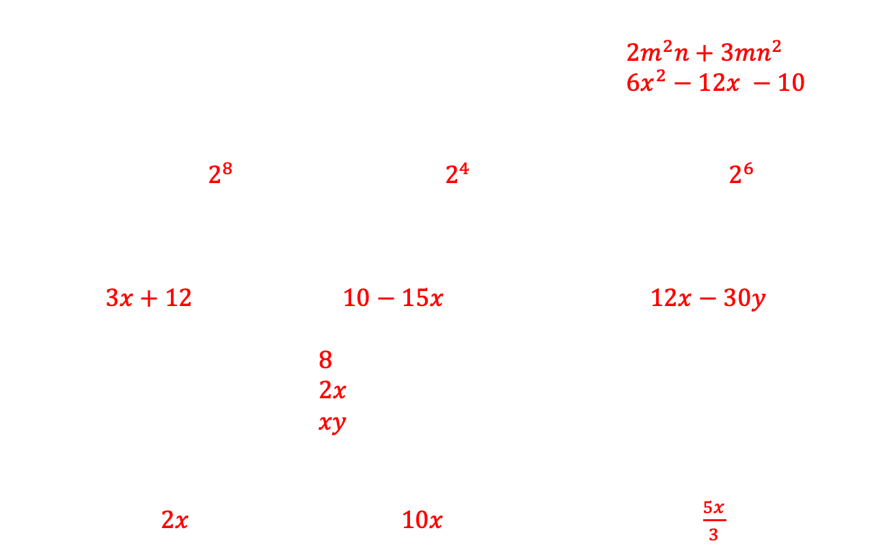
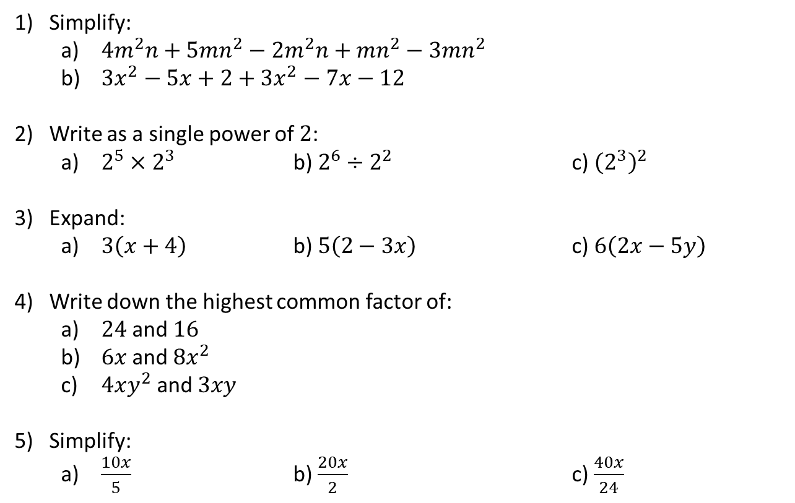
Algebraic Expression Starter
$2m^{2}n+3mn^{2}$ $6x^{2}−12x −10$
$2^{8}$ $2^{4}$ $2^{6}$
$3x+12$ $10−15x$ $12x−30y$
$8$
$2x$
$xy$
$2x$ $10x$ $\frac{5x}{3}$
Simplify:
  $4m^{2}n+5mn^{2}−2m^{2}n+mn^{2}−3mn^{2}$
  $3x^{2}−5x+2+3x^{2}−7x−12$
Write as a single power of $2$:
  $2^{5}×2^{3}$ b) $2^{6}÷2^{2}$ c) ${\left(2^{3}\right)}^{2}$
Expand:
  $3\left(x+4\right)$ b) $5\left(2−3x\right)$ c) $6\left(2x−5y\right)$
Write down the highest common factor of:
  $24$ and $16$
  $6x$ and $8x^{2}$
  $4xy^{2}$ and $3xy$
Simplify:
  $\frac{10x}{5}$ b) $\frac{20x}{2}$ c) $\frac{40x}{24}$

Slide 3
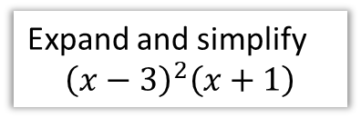
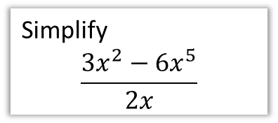
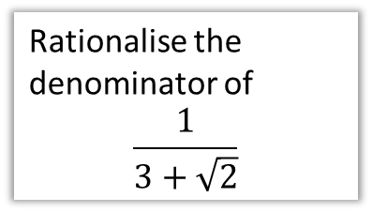
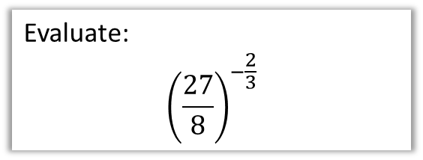
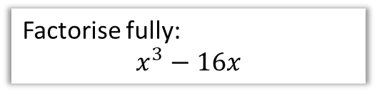
Chapter Overview
As a relatively gentle introduction to Pure, most of this chapter is a recap of core GCSE algebraic skills.
1: Basic Index Laws
2: Expand brackets
Simplify
$$\frac{3x^{2}−6x^{5}}{2x}$$
Expand and simplify
$${\left(x−3\right)}^{2}\left(x+1\right)$$
4: Fractional/Negative Powers
3: Factorise quadratics/cubics
Evaluate:
$${\left(\frac{27}{8}\right)}^{−\frac{2}{3}}$$
Factorise fully:
$$x^{3}−16x$$
5: Surds
Rationalise the denominator of
$$\frac{1}{3+\sqrt{2}}$$

Slide 4

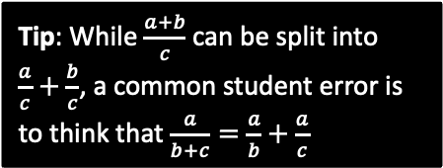
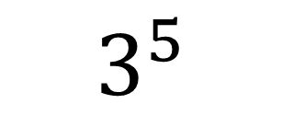

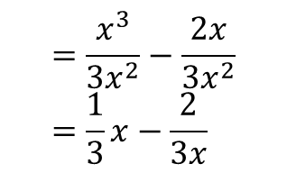
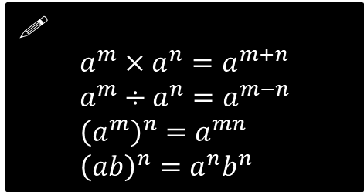

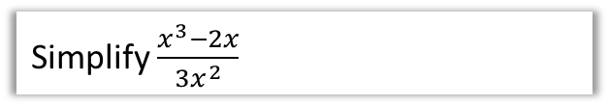

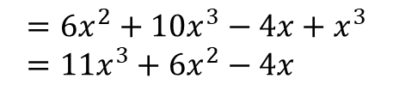

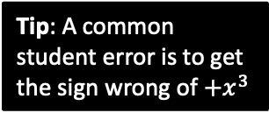
1: Index Laws
exponent or index (plural: indices)
base
!
$$a^{m}×a^{n}=a^{m+n} \\ a^{m}÷a^{n}=a^{m−n} \\ {\left(a^{m}\right)}^{n}=a^{mn} \\ {\left(ab\right)}^{n}=a^{n}b^{n}$$
$$3^{5}$$
power
Some also refer to the 5 as the ‘power’. But this would lead to unfortunate ambiguous phrases like “when we multiply two powers together, we add the powers” instead of “when we multiply two powers together, we add the indices”.
Simplify ${\left(a^{3}\right)}^{2}×2a^{2}$
Simplify ${\left(4x^{3}y\right)}^{3}$
?
?
$$=a^{6}×2a^{2}=2a^{8}$$
$$=64x^{9}y^{3}$$
Simplify $2x^{2}\left(3+5x\right)−x\left(4−x^{2}\right)$
Simplify $\frac{x^{3}−2x}{3x^{2}}$
?
$$=6x^{2}+10x^{3}−4x+x^{3} \\ =11x^{3}+6x^{2}−4x$$
$$=\frac{x^{3}}{{3x}^{2}}−\frac{2x}{3x^{2}} \\ =\frac{1}{3}x−\frac{2}{3x}$$
?
Tip: A common student error is to get the sign wrong of $+x^{3}$
Tip: While $\frac{a+b}{c}$ can be split into $\frac{a}{c}+\frac{b}{c}$, a common student error is to think that $\frac{a}{b+c}=\frac{a}{b}+\frac{a}{c}$

Slide 5
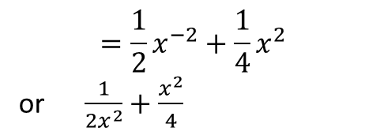
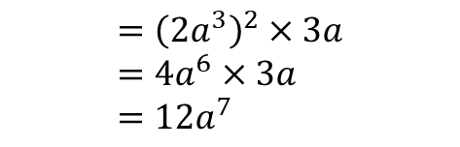


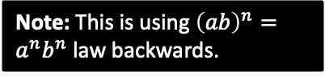

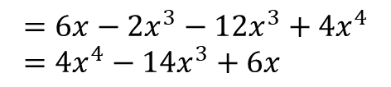

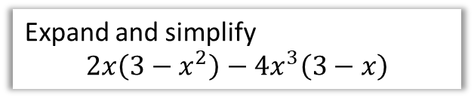
Test Your Understanding
1
Simplify ${\left(\frac{2a^{5}}{a^{2}}\right)}^{2}×3a$
2
Simplify $\frac{2x+x^{5}}{4x^{3}}$
?
?
$$={\left(2a^{3}\right)}^{2}×3a \\ =4a^{6}×3a \\ =12a^{7}$$
$$=\frac{1}{2}x^{−2}+\frac{1}{4}x^{2}$$
or $\frac{1}{2x^{2}}+\frac{x^{2}}{4}$
3
Expand and simplify
$$2x\left(3−x^{2}\right)−4x^{3}\left(3−x\right)$$
4
Simplify $2^{x}×3^{x}$
?
$$=6^{x}$$
Note: This is using ${\left(ab\right)}^{n}=a^{n}b^{n}$ law backwards.
?
$$=6x−2x^{3}−12x^{3}+4x^{4} \\ =4x^{4}−14x^{3}+6x$$

Slide 6

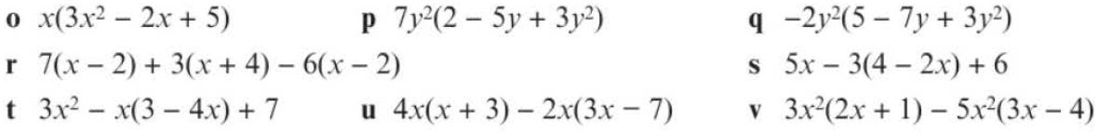








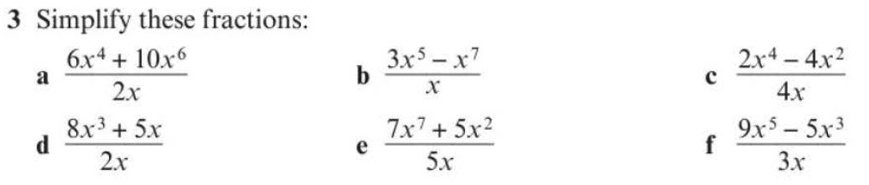
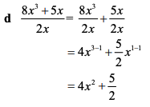
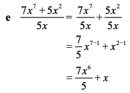
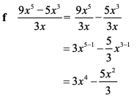
Exercise 1A – Pearson Pure Y1 page 4
?
?

Slide 7
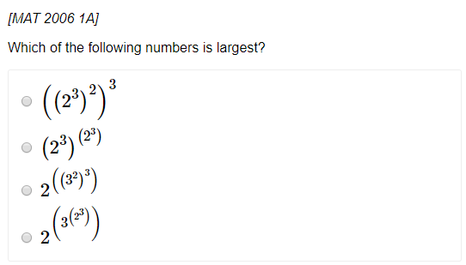
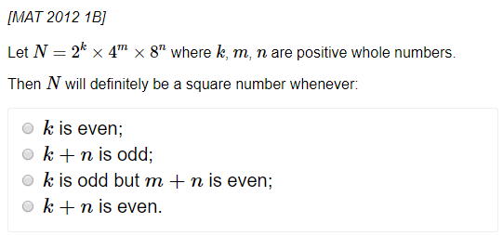
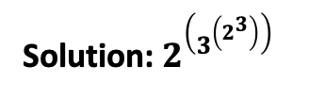
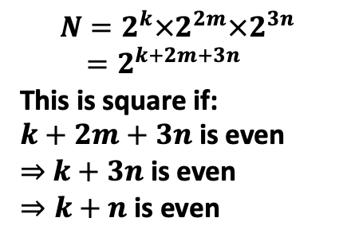
Exercise 1A – Pearson Pure Y1 page 4
Extension (Full Database: http://www.drfrostmaths.com/resources/resource.php?rid=268 )
1
2
?
$$N=2^{k}×2^{2m}×2^{3n} \\ =2^{k+2m+3n}$$
This is square if:
$k+2m+3n$ is even
$⇒$ $k+3n$ is even
$⇒k+n$ is even
?
Solution: $2^{\left(3^{\left(2^{3}\right)}\right)}$

Slide 8






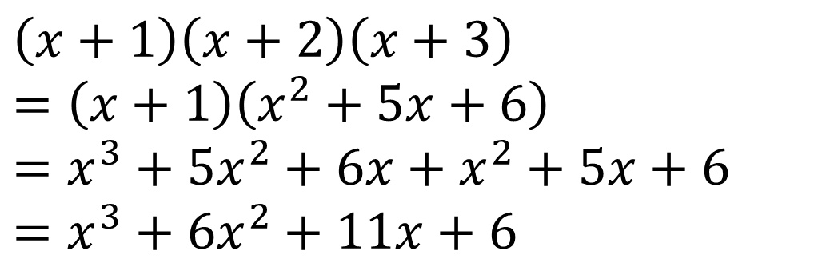


2: Expanding Brackets
If you have ever been taught ‘FOIL’ to multiply brackets please purge it from your mind now – instead:
Multiply each term in the first bracket by each term in the second.
$$\left(x−y\right)\left(x+y−1\right)$$
Tip: My order is “first term in first brackets times each in second, then second term in first bracket times each in second, etc.”
$$=x^{2}$$
$$+xy$$
$$−x$$
$$−xy$$
$$−y^{2}$$
$$+y$$
$$=x^{2}−y^{2}−x+y$$
Tip: For more than 2 brackets, multiply two out each time to reduce the number of brackets by one.
$$\left(x+1\right)\left(x+2\right)\left(x+3\right) \\ =\left(x+1\right)\left(x^{2}+5x+6\right) \\ =x^{3}+5x^{2}+6x+x^{2}+5x+6 \\ =x^{3}+6x^{2}+11x+6$$
?

Slide 9
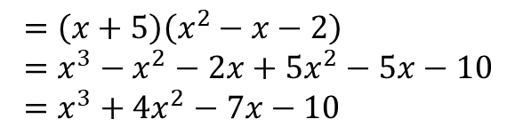
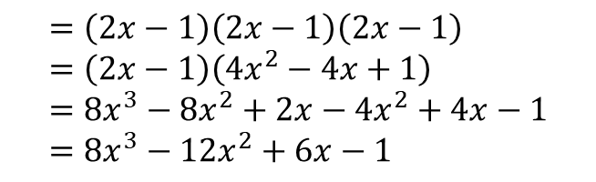
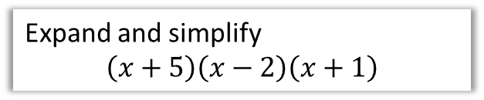
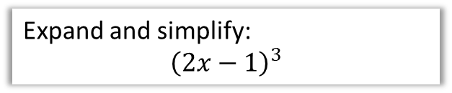
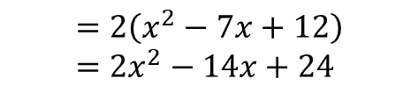
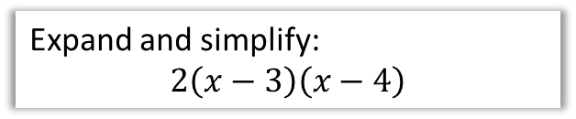
Test Your Understanding
1
Expand and simplify
$$\left(x+5\right)\left(x−2\right)\left(x+1\right)$$
2
Expand and simplify:
$$2\left(x−3\right)\left(x−4\right)$$
?
?
$$=\left(x+5\right)\left(x^{2}−x−2\right) \\ =x^{3}−x^{2}−2x+5x^{2}−5x−10 \\ =x^{3}+4x^{2}−7x−10$$
$$=2\left(x^{2}−7x+12\right) \\ =2x^{2}−14x+24$$
3
Expand and simplify:
$${\left(2x−1\right)}^{3}$$
?
$$=\left(2x−1\right)\left(2x−1\right)\left(2x−1\right) \\ =\left(2x−1\right)\left(4x^{2}−4x+1\right) \\ =8x^{3}−8x^{2}+2x−4x^{2}+4x−1 \\ =8x^{3}−12x^{2}+6x−1$$

Slide 10
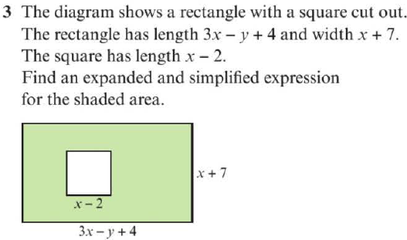


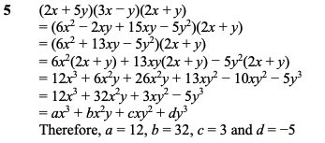
Exercise 1B - Pure Year 1/AS Page 6
?
?

Slide 11
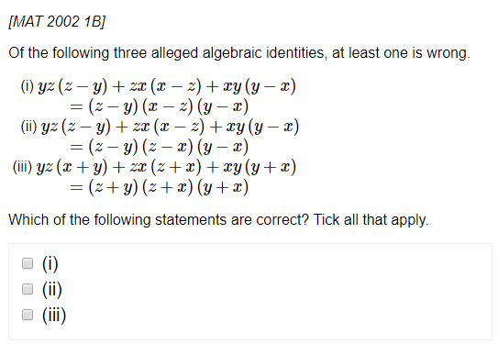
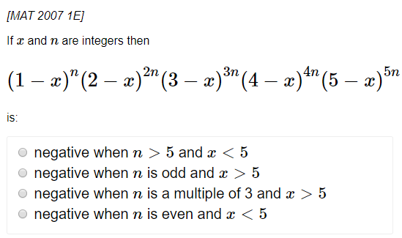

Exercise 1B - Pure Year 1/AS Page 5
Extension (Full Database: http://www.drfrostmaths.com/resources/resource.php?rid=268 )
1
2
?
?
Solution: (ii) only
Solution: $n$ is odd and $x>5$

Slide 12
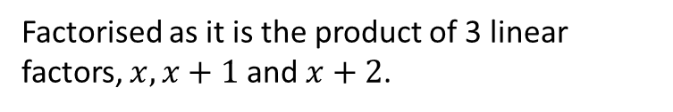

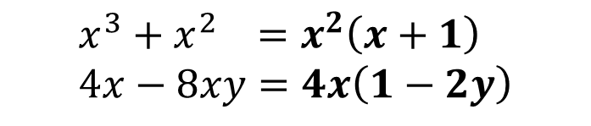

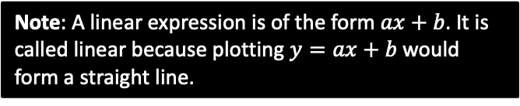
3: Factorising
Informally, factorising is the opposite of expanding brackets.
More formally, a factorised expression is one which is expressed as a product of expressions.
$$x(x+1)(x+2)$$
Factorised as it is the product of 3 linear factors, $x, x+1$ and $x+2$.
Note: A linear expression is of the form $ax+b$. It is called linear because plotting $y=ax+b$ would form a straight line.
$$x\left(x+1\right)+\left(x−1\right)\left(x+1\right)$$
Not factorised because the outer-most operation is a sum, not a product.
Basic Examples:
?
$$x^{3}+x^{2} =x^{2}\left(x+1\right) \\ 4x−8xy=4x\left(1−2y\right)$$
?

Slide 13
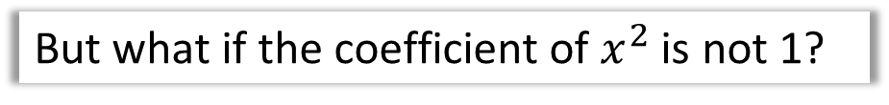

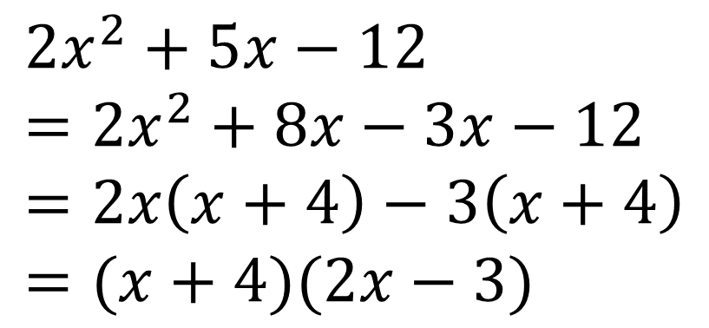
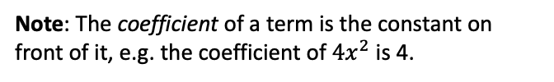
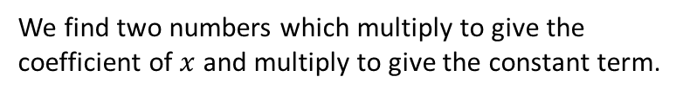

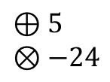
Factorising Quadratics
Recap:
We find two numbers which multiply to give the coefficient of $x$ and multiply to give the constant term.
$$⊕$$
$$⊗$$
?
$$x^{2}−5x−14=\left(x−7\right)\left(x+2\right)$$
Note: The coefficient of a term is the constant on front of it, e.g. the coefficient of $4x^{2}$ is 4.
But what if the coefficient of $x^{2}$ is not 1?
$${2x}^{2}+5x−12=\left(2x−3\right)\left(x+4\right)$$
?
The easiest way is to use your common sense to guess the brackets. What multiplies to give the $2x^{2}$? What multiplies to give the constant term of $−12$?
?
Or you can ‘split the middle term’ (don’t be embarrassed if you’ve forgotten how to!)
$$⊕5 \\ ⊗−24$$
$${2x}^{2}+5x−12 \\ =2x^{2}+8x−3x−12 \\ =2x\left(x+4\right)−3\left(x+4\right) \\ =(x+4)(2x−3)$$
?
STEP 1: Find two numbers which add to give the middle number and multiply to give the first times last.
?
STEP 2: Split the middle term.
?
STEP 3: Factorise first half and second half ensuring bracket is duplicated..
?
STEP 4: Factorise out bracket.

Slide 14
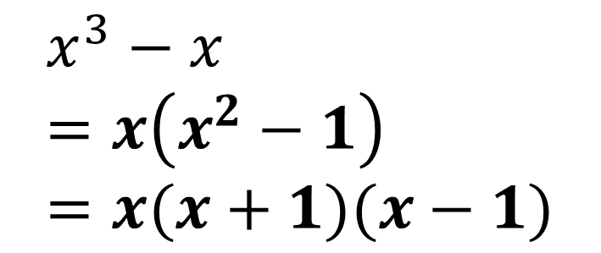
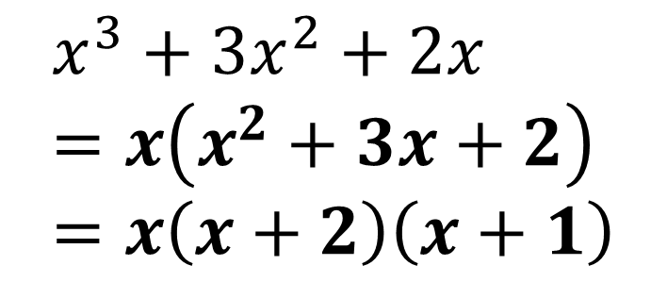
Other Factorisations
Difference of two squares:
?
$$4x^{2}−9=\left(2x+3\right)\left(2x−3\right)$$
Using multiple factorisations:
$$x^{3}−x \\ =x\left(x^{2}−1\right) \\ =x(x+1)(x−1)$$
Tip: Always look for a common factor first before using other factorisation techniques.
?
$$x^{3}+3x^{2}+2x \\ =x\left(x^{2}+3x+2\right) \\ =x\left(x+2\right)\left(x+1\right)$$
?

Slide 15
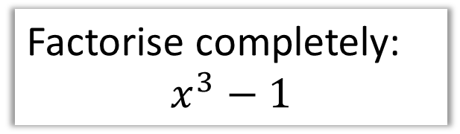








Test Your Understanding
1
Factorise completely:
$$6x^{2}+x−2$$
2
Factorise completely:
$$x^{3}−7x^{2}+12x$$
$$6x^{2}+x−2 ⊕1 ⊗−12 \\ =6x^{2}+4x−3x−2 \\ =2x\left(3x+2\right)−1\left(3x+2\right) \\ =\left(3x+2\right)\left(2x−1\right)$$
$$=x\left(x^{2}−7x+12\right) \\ =x\left(x−3\right)\left(x−4\right)$$
?
?
N
Factorise completely:
$$x^{4}−1$$
N
Factorise completely:
$$x^{3}−1$$
?
?
$$=\left(x^{2}+1\right)\left(x^{2}−1\right) \\ =\left(x^{2}+1\right)\left(x+1\right)\left(x−1\right)$$
$$=(x−1)(x^{2}+x+1)$$
Note: You would not be expected to factorise this at A Level (but you would in STEP!).
In general, the difference of two cubes:
$$x^{3}−y^{3}=\left(x−y\right)\left(x^{2}+xy+y^{2}\right)$$

Slide 16





Exercise 1C - Pure Y1 Page 8
?
?
Challenge: Write $4x^{4}−13x^{2}+9$as the product of four linear factors
?

Slide 17














4: Negative and Fractional Indices
$$a^{0}=1 \\ a^{\frac{1}{m}}=\sqrt[m]{a} \\ a^{\frac{n}{m}}={\left(\sqrt[m]{a}\right)}^{n} \\ a^{−m}=\frac{1}{a^{m}}$$
Note: $\sqrt{9}$ only means the positive square root of 9, i.e. 3 not -3.
Otherwise, what would be the point of the $±$ in the quadratic formula before the $\sqrt{b^{2}−4ac}$?
Prove that $x^{\frac{1}{2}}=\sqrt{x}$
Evaluate ${27}^{−\frac{1}{3}}$
Evaluate ${32}^{\frac{2}{5}}$
?
?
?
$$x^{\frac{1}{2}}×x^{\frac{1}{2}}=x^{1}$$
But $\sqrt{x}×\sqrt{x}=x$
$$∴x^{\frac{1}{2}}=\sqrt{x}$$
$$=\frac{1}{{27}^{\frac{1}{3}}}=\frac{1}{3}$$
$$=2^{2}=4$$
Simplify ${\left(\frac{1}{9}x^{6}y\right)}^{\frac{1}{2}}$
Evaluate ${\left(\frac{27}{8}\right)}^{−\frac{2}{3}}$
If $b=\frac{1}{9}a^{2}$, determine $3b^{−2}$ in the form $kb^{n}$ where $k,n$ are constants.
?
$$={\left(\frac{8}{27}\right)}^{\frac{2}{3}}={\left(\frac{2}{3}\right)}^{2}=\frac{4}{9}$$
$$=\frac{1}{3}x^{3}y^{\frac{1}{2}}$$
?
?
$$3b^{−2}=3{\left(\frac{1}{9}a^{2}\right)}^{−2} \\ =3\left(81a^{−4}\right)=243a^{−4}$$

Slide 18



Writing a surd using indices
If $9\sqrt{3}=3^{k}$, determine the value of $k$.
The key here is to write everything as powers with a consistent base, in this case, 3.
?
$$9\sqrt{3}=9×\sqrt{3} \\ =3^{2}×3^{\frac{1}{2}} \\ =3^{\frac{5}{2}}$$
$$∴k=\frac{5}{2}$$
Note: In algebra we like to avoid mixed numbers. So don’t write $3^{2\frac{1}{2} }$

Slide 19




Further Examples
[Edexcel IGCSE May14-4H] Given that
$${\left(2^{\frac{1}{2}}\right)}^{n}=\frac{2^{x}}{8^{y}}$$
Express $n$ in terms of $x$ and $y$.
[Edexcel IAL C12 Jan 2019 Q2c] Given that $y=2^{x}$, express the following in terms of $y$.
$$\frac{1}{4^{2x−3}}$$
Write your expression in its simplest form.
?
?
$$2^{\frac{1}{2}n}=\frac{2^{x}}{{\left(2^{3}\right)}^{y}} \\ =\frac{2^{x}}{2^{3y}}=2^{x−3y} \\ ∴\frac{1}{2}n=x−3y \\ n=2x−6y$$
$$\frac{1}{4^{2x−3}}=4^{−(2x−3)}=4^{−2x+3} \\ ={\left(2^{2}\right)}^{−2x+3} \\ =2^{−4x+6} \\ =2^{−4x}×2^{6} \\ ={\left(2^{x}\right)}^{−4}×64 \\ =64y^{−4} or \frac{64}{y^{4}}$$
Write 8 as a power of 2 (putting a bracket around it), for consistency of base with the other powers.

Slide 20


Test Your Understanding
Edexcel Paper 2 – May 2019
?

Slide 21










Exercise 1D
a?
b?
a?
Challenge
b?
?
$$=\frac{2^{r+s}×3^{r+s}×2^{2r−2s}×3^{r−s}}{2^{3r}×3^{2r+4s}} \\ =2^{−s}×3^{−4s}$$
This is an integer only if $s≤0$.

Slide 22



5: Surds
Recap:
Note: A rational number is any which can be expressed as $\frac{a}{b}$ where $a,b$ are integers. $\frac{2}{3}$ and $\frac{4}{1}=4$ are rational numbers, but $π$ and $\sqrt{2}$ are not.
A surd is a root of a number that does not simplify to a rational number.
Laws:
$$\sqrt{a}×\sqrt{b}=\sqrt{ab} \\ \frac{\sqrt{a}}{\sqrt{b}}=\sqrt{\frac{a}{b}}$$
?
$$\sqrt{3}×2 =2\sqrt{3} \\ 3\sqrt{5}×2\sqrt{5} =30 \\ \sqrt{8}=\sqrt{4}\sqrt{2} =2\sqrt{2} \\ \sqrt{12}+\sqrt{27} =2\sqrt{3}+3\sqrt{3}=5\sqrt{3} \\ \left(\sqrt{8}+1\right)\left(\sqrt{2}−3\right)=\sqrt{16}−3\sqrt{8}+\sqrt{2}−3 \\ =4−6\sqrt{2}+\sqrt{2}−3 \\ =1−5\sqrt{2}$$
?
?
?
?
?
?

Slide 23





Exercise 1E – Pure Y1 Page 13
?
Extension
1
2
Note that:
$$10−3\sqrt{11}=\sqrt{100}−\sqrt{99}$$
The other options can similarly be written as $\sqrt{n+1}−\sqrt{n}$. The greater the $n$, the smaller the number, so the answer is $10−3\sqrt{11}$.
If $\sqrt{a+12\sqrt{2}}=x+y\sqrt{2}$, then squaring:
$$a+12\sqrt{2}=x^{2}+2y^{2}+2xy\sqrt{2}$$
Thus $2xy=12 → xy=6$
The only possibilities are $\left(x,y\right)=\left(1,6\right),\left(2,3\right),\left(3,2\right),\left(6,1\right)$ corresponding to the 5th, 2nd, 1st and 3rd options. Thus $54+12\sqrt{2}$ is the odd one out.
?
?

Slide 24


6: Rationalising The Denominator
Here’s a surd. What could we multiply it by such that it’s no longer an irrational number?
?
?
$$\sqrt{5}×\sqrt{5}=5$$
$$\frac{1}{\sqrt{2}}×\frac{\sqrt{2}}{\sqrt{2}}=\frac{\sqrt{2}}{2}$$
?
?
In this fraction, the denominator is irrational. ‘Rationalising the denominator’ means making the denominator a rational number.
What could we multiply this fraction by to both rationalise the denominator, but leave the value of the fraction unchanged?
Side Note: There’s two reasons why we might want to do this:
For aesthetic reasons, it makes more sense to say “half of root 2” rather than “one root two-th of 1”. It’s nice to divide by something whole!
It makes it easier for us to add expressions involving surds.

Slide 25


Examples
$$\frac{3}{\sqrt{2}}=\frac{3\sqrt{2}}{2}$$
$$\frac{6}{\sqrt{3}}=\frac{6\sqrt{3}}{3}=2\sqrt{3}$$
$$\frac{7}{\sqrt{7}}=\frac{7\sqrt{7}}{7}=\sqrt{7}$$
$$\frac{15}{\sqrt{5}}+\sqrt{5}=3\sqrt{5}+\sqrt{5}=4\sqrt{5}$$
Test Your Understanding:
?
?
$$\frac{12}{\sqrt{3}}=4\sqrt{3}$$
$$\frac{2}{\sqrt{6}}=\frac{\sqrt{6}}{3}$$
$$\frac{4\sqrt{2}}{\sqrt{8}}=\frac{16}{8}=2$$
?
?
?
?
?

Slide 26


More Complex Denominators
You’ve seen ‘rationalising a denominator’, the idea being that we don’t like to divide things by an irrational number.
But what do we multiply the top and bottom by if we have a more complicated denominator?
$$\frac{1}{\sqrt{2}+1}×\frac{\sqrt{2}−1}{\sqrt{2}−1}=\frac{\sqrt{2}−1}{1}=\sqrt{2}−1$$
?
?
We basically use the same expression but with the sign reversed (this is known as the conjugate). That way, we obtain the difference of two squares. Since $\left(a+b\right)\left(a−b\right)=a^{2}−b^{2}$, any surds will be squared and thus we’ll end up with no surds in the denominator.

Slide 27




More Examples
$$\frac{3}{\sqrt{6}−2}×\frac{\sqrt{6}+2}{\sqrt{6}+2}=\frac{3\sqrt{6}+6}{2}$$
You can explicitly expand out $\left(\sqrt{6}−2\right)\left(\sqrt{6}+2\right)$ in the denominator, but remember that $\left(a−b\right)\left(a+b\right)=a^{2}−b^{2}$ so we can mentally obtain $6−4=2$
Just remember: ‘difference of two squares’!
?
?
$$\frac{4}{\sqrt{3}+1}×\frac{\sqrt{3}−1}{\sqrt{3}−1}=\frac{4\sqrt{3}−4}{2}=2\sqrt{3}−2$$
?
?
?
?
?
$$\frac{3\sqrt{2}+4}{5\sqrt{2}−7}×\frac{5\sqrt{2}+7}{5\sqrt{2}+7}=\frac{30+21\sqrt{2}+20\sqrt{2}+28}{1} \\ =58+41\sqrt{2}$$

Slide 28






Test Your Understanding
Rationalise the denominator and simplify
$$\frac{4}{\sqrt{5}−2}$$
?
$$8+4\sqrt{5}$$
Rationalise the denominator and simplify
$$\frac{2\sqrt{3}−1}{3\sqrt{3}+1}$$
AQA IGCSE FM June 2013 Paper 1
Solve $y\left(\sqrt{3}−1\right)=8$
Give your answer in the form $a+b\sqrt{3}$ where $a$ and $b$ are integers.
?
$$\frac{2\sqrt{3}−1}{3\sqrt{3}+1}×\frac{3\sqrt{3}−1}{3\sqrt{3}−1} \\ =\frac{18−2\sqrt{3}−3\sqrt{3}+1}{27−1} \\ =\frac{19−5\sqrt{3}}{26}$$
?
$$y=\frac{8}{\sqrt{3}−1}×\frac{\sqrt{3}+1}{\sqrt{3}+1} \\ =\frac{8\sqrt{3}+8}{2}=4+4\sqrt{3}$$

Slide 29





Writing surd expressions in power form
This is not in the textbook, but a common type of question in exams, often asked in conjunction with differentiation (a later chapter).
Express $\frac{{\left(2+\sqrt{x}\right)}^{2}}{x}$ as powers of $x$.
Test Your Understanding
Express $\frac{{\left(x+\sqrt{x}\right)}^{2}}{2\sqrt{x}}$ as powers of $x$.
?
$$\frac{4+4\sqrt{x}+x}{x}=\frac{4+4x^{\frac{1}{2}}+x}{x^{1}} \\ =\frac{4}{x^{1}}+\frac{4x^{\frac{1}{2}}}{x^{1}}+\frac{x}{x} \\ =4x^{−1}+4x^{−\frac{1}{2}}+1$$
Expand.
?
$$\frac{x^{2}+2x\sqrt{x}+x}{2\sqrt{x}} \\ =\frac{x^{2}+2x^{\frac{3}{2}}+x}{2x^{\frac{1}{2}}} \\ =\frac{1}{2}x^{\frac{3}{2}}+x+\frac{1}{2}x^{\frac{1}{2}}$$
Write any roots as powers of $x$.
Split fraction (some may wish to do this step mentally)

Slide 30


Exercise 1F (Page 15)
or alternatively: (not in textbook)
2
Expand and simplify:
$$\left(\sqrt{5}+3\right)\left(\sqrt{5}−2\right)\left(\sqrt{5}+1\right)=4$$
Rationalise the denominator, giving your answer in the form $a+b\sqrt{3}$.
$$\frac{3\sqrt{3}+7}{3\sqrt{3}−5}=31+18\sqrt{3}$$
Solve $x\left(4−\sqrt{6}\right)=10$ giving your answer in the form $a+b\sqrt{6}$.
$$x=\frac{10}{4−\sqrt{6}}=4+\sqrt{6}$$
Solve $y\left(1+\sqrt{2}\right)−\sqrt{2}=3$
$$y=\frac{3+\sqrt{2}}{1+\sqrt{2}}=2\sqrt{2}−1$$
Simplify:
$$\frac{\sqrt{a+1}−\sqrt{a}}{\sqrt{a+1}+\sqrt{a}}=2a+1−2\sqrt{a}\sqrt{a+1}$$
1
Rationalise the denominator and simplify the following:
$$\frac{1}{\sqrt{5}+2}=\sqrt{5}−2$$
$$\frac{\sqrt{3}}{\sqrt{3}−1}=\frac{3+\sqrt{3}}{2}$$
$$\frac{\sqrt{5}+1}{\sqrt{5}−2}=7+3\sqrt{5}$$
$$\frac{2\sqrt{3}−1}{3\sqrt{3}+4}=2−\sqrt{3}$$
$$\frac{5\sqrt{5}−2}{2\sqrt{5}−3}=4+\sqrt{5}$$
?
?
a
3
?
?
b
c
?
4
?
?
d
5
?
e
?
6
?

Slide 31


A final super hard puzzle
Solve $\frac{\sqrt[4]{9}}{\sqrt[5]{27}}=\sqrt[x]{3}$
N
$$\frac{\sqrt[4]{3^{2}}}{\sqrt[5]{3^{3}}}=\frac{{\left(3^{2}\right)}^{\frac{1}{4}}}{{\left(3^{3}\right)}^{\frac{1}{5}}}=\frac{3^{\frac{1}{2}}}{3^{\frac{3}{5}}}=3^{−\frac{1}{10}}$$
But $\sqrt[x]{3}=3^{\frac{1}{x}}$
$$∴\frac{1}{x}=−\frac{1}{10} → x=−10$$
?

