Slide 1
Pure Y1 Ch 2
Quadratics
Notes:
Last modified: 5th November 2019

Slide 2

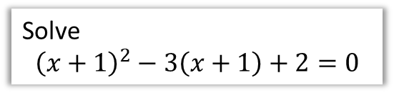
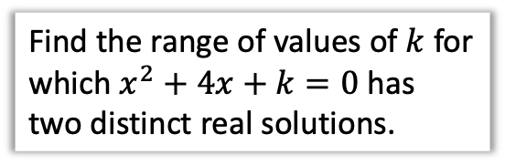
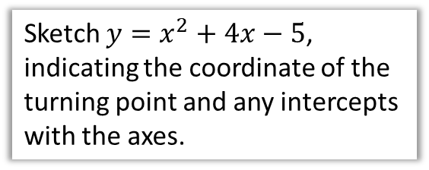
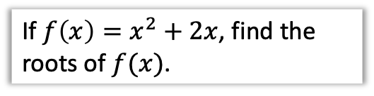
Chapter Overview
Again, most of the content in this chapter is not new, but brings together a variety of algebraic and graph sketching GCSE skills regarding quadratic equations.
1: Solving quadratic equations
2: Completing the square
Solve
$${\left(x+1\right)}^{2}−3\left(x+1\right)+2=0$$
Write $2x^{2}+8x−5$ in the form $a{\left(x+b\right)}^{2}+c$
4: Quadratic Graphs
3: Quadratics as functions
Sketch $y=x^{2}+4x−5$, indicating the coordinate of the turning point and any intercepts with the axes.
If $f\left(x\right)=x^{2}+2x$, find the roots of $f(x)$.
5: The Discriminant
6: Modelling with Quadratics
Find the range of values of $k$ for which $x^{2}+4x+k=0$ has two distinct real solutions.

Slide 3

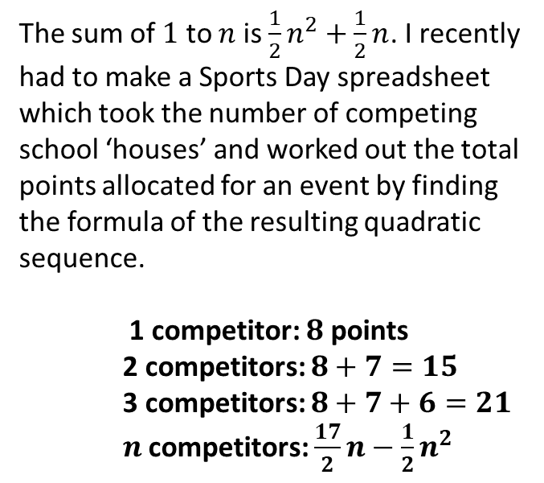
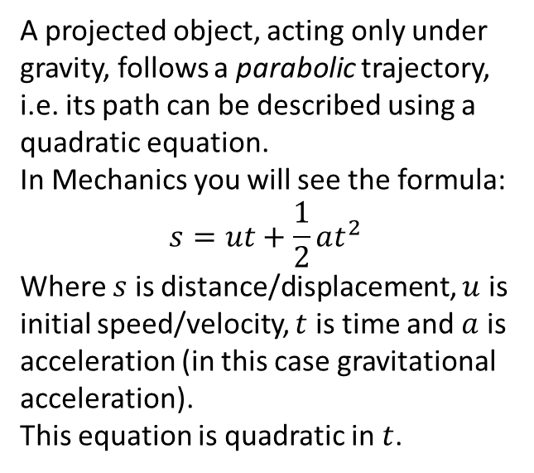
Why do we care about quadratics…
Good question!
There are a number of practical scenarios where a quadratic relationship arises between variables…
Projectile Motion
Summations
The sum of $1$ to $n$ is $\frac{1}{2}n^{2}+\frac{1}{2}n$. I recently had to make a Sports Day spreadsheet which took the number of competing school ‘houses’ and worked out the total points allocated for an event by finding the formula of the resulting quadratic sequence.
1 competitor: $8$ points
2 competitors: $8+7=15$
3 competitors: $8+7+6=21$
$n$ competitors: $\frac{17}{2}n−\frac{1}{2}n^{2}$
A projected object, acting only under gravity, follows a parabolic trajectory, i.e. its path can be described using a quadratic equation.
In Mechanics you will see the formula:
$$s=ut+\frac{1}{2}at^{2}$$
Where $s$ is distance/displacement, $u$ is initial speed/velocity, $t$ is time and $a$ is acceleration (in this case gravitational acceleration).
This equation is quadratic in $t$.

Slide 4
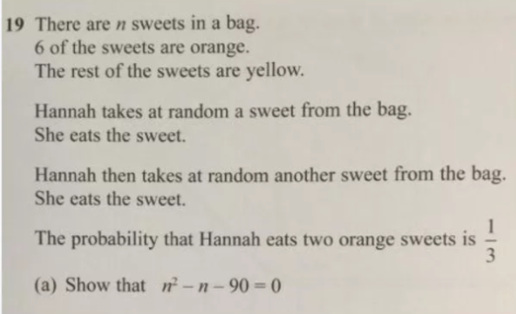
Why do we care about quadratics…
Hannah’s sweets
Quadratic expressions also regularly emerge when there’s a product of two expressions involving the same variable (in this case because Hannah ate two orange sweets).

Slide 5
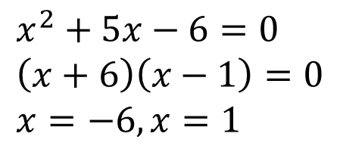

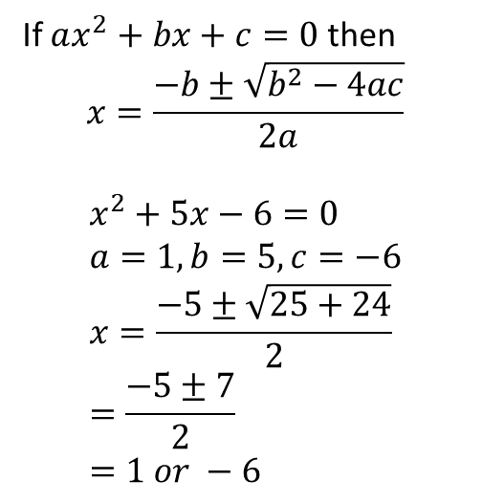
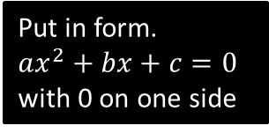
1: Solving Quadratic Equations
$$x^{2}+5x=6$$
There are three ways of solving a quadratic equation.
One is by completing the square, which we’ll do later.
What are the other two ways?
By factorisation
Using the quadratic formula.
?
?
If $ax^{2}+bx+c=0$ then
$$x=\frac{−b±\sqrt{b^{2}−4ac}}{2a}$$
$$x^{2}+5x−6=0 \\ a=1, b=5, c=−6 \\ x=\frac{−5±\sqrt{25+24}}{2} \\ =\frac{−5±7}{2} \\ =1 or −6$$
$$x^{2}+5x−6=0 \\ \left(x+6\right)\left(x−1\right)=0 \\ x=−6, x=1$$
Put in form.
$ax^{2}+bx+c=0$ with 0 on one side
Factorise. If the product of two things is 0, at least one must be 0.

Slide 6
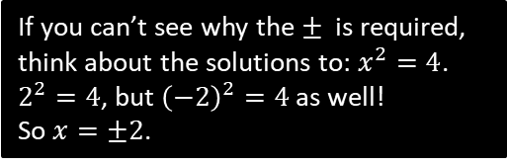
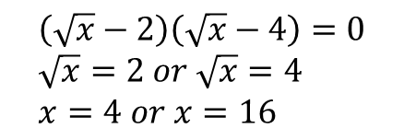
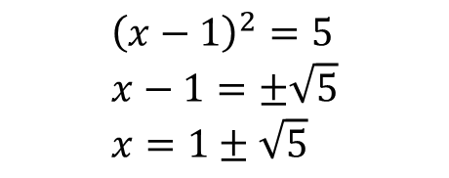
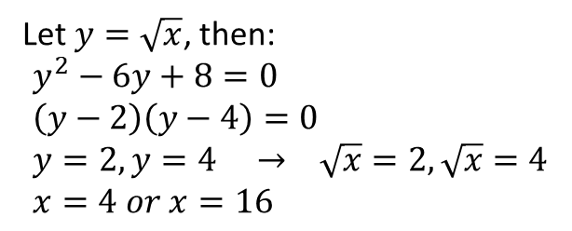
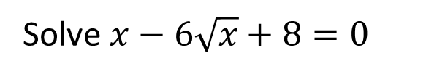
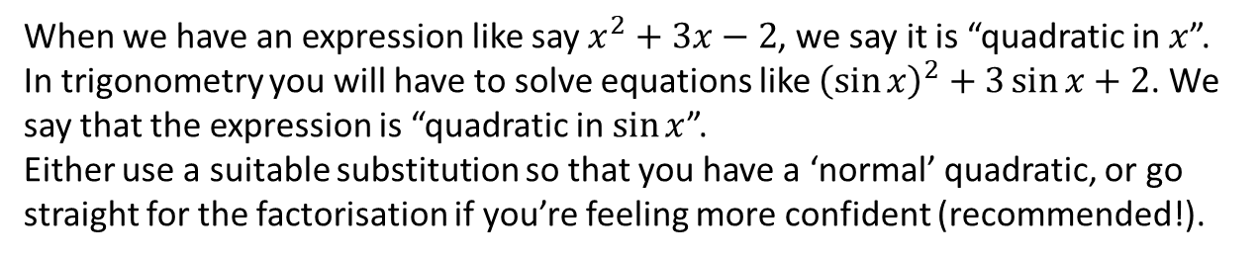
1: Solving Quadratic Equations
Solving without factorising
If the subject only appears once however, it might be easier not to expand out/factorise:
$${\left(x−1\right)}^{2}=5 \\ x−1=±\sqrt{5} \\ x=1±\sqrt{5}$$
If you can’t see why the $±$ is required, think about the solutions to: $x^{2}=4$.
$2^{2}=4$, but ${\left(−2\right)}^{2}=4$ as well!
So $x=±2$.
?
Quadratics ‘in disguise’
When we have an expression like say $x^{2}+3x−2$, we say it is “quadratic in $x$”. In trigonometry you will have to solve equations like ${\left(\sin{x}\right)}^{2}+3\sin{x}+2$. We say that the expression is “quadratic in $\sin{x}$”.
Either use a suitable substitution so that you have a ‘normal’ quadratic, or go straight for the factorisation if you’re feeling more confident (recommended!).
Solve $x−6\sqrt{x}+8=0$
Let $y=\sqrt{x}$, then:
$$y^{2}−6y+8=0 \\ \left(y−2\right)\left(y−4\right)=0 \\ y=2, y=4 → \sqrt{x}=2, \sqrt{x}=4 \\ x=4 or x=16$$
?
substitution
?
$$\left(\sqrt{x}−2\right)\left(\sqrt{x}−4\right)=0 \\ \sqrt{x}=2 or \sqrt{x}=4 \\ x=4 or x=16$$
hardcore

Slide 7

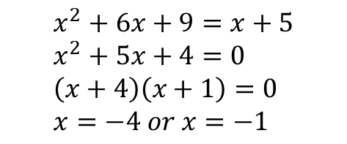
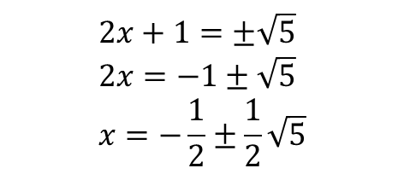
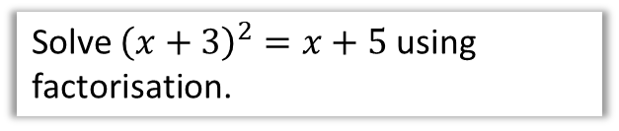

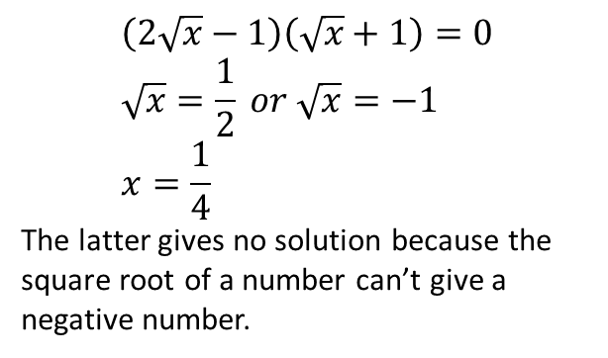
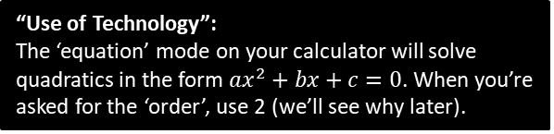

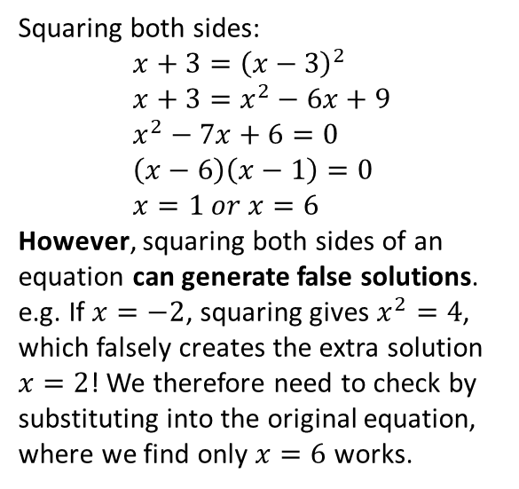
Test Your Understanding
1
Solve ${\left(x+3\right)}^{2}=x+5$ using factorisation.
2
Solve ${\left(2x+1\right)}^{2}=5$
?
$$2x+1=±\sqrt{5} \\ 2x=−1±\sqrt{5} \\ x=−\frac{1}{2}±\frac{1}{2}\sqrt{5}$$
?
$$x^{2}+6x+9=x+5 \\ x^{2}+5x+4=0 \\ \left(x+4\right)\left(x+1\right)=0 \\ x=−4 or x=−1$$
3
Solve $\sqrt{x+3}=x−3$
4
Solve $2x+\sqrt{x}−1=0$
?
?
Squaring both sides:
$$x+3={\left(x−3\right)}^{2} \\ x+3=x^{2}−6x+9 \\ x^{2}−7x+6=0 \\ \left(x−6\right)\left(x−1\right)=0 \\ x=1 or x=6$$
However, squaring both sides of an equation can generate false solutions. e.g. If $x=−2$, squaring gives $x^{2}=4$, which falsely creates the extra solution $x=2$! We therefore need to check by substituting into the original equation, where we find only $x=6$ works.
$$\left(2\sqrt{x}−1\right)\left(\sqrt{x}+1\right)=0 \\ \sqrt{x}=\frac{1}{2} or \sqrt{x}=−1 \\ x=\frac{1}{4}$$
The latter gives no solution because the square root of a number can’t give a negative number.
“Use of Technology”:
The ‘equation’ mode on your calculator will solve quadratics in the form $ax^{2}+bx+c=0$. When you’re asked for the ‘order’, use 2 (we’ll see why later).

Slide 8


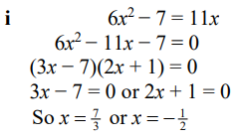
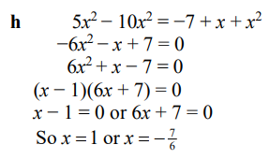
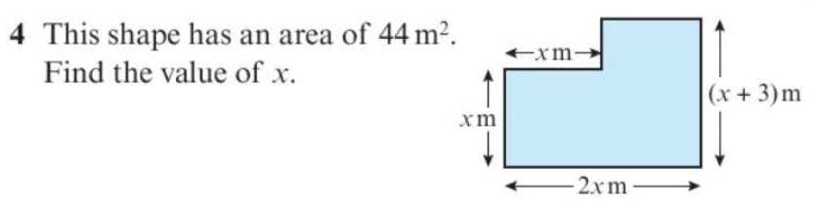
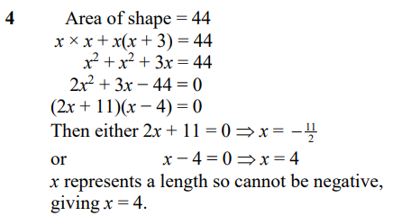
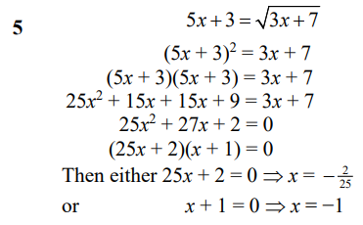
Exercise 2A/2B Pure Y1 Pages 20-22
i?
h?
?
?

Slide 9


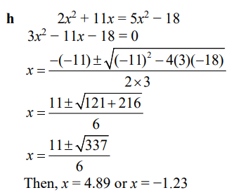
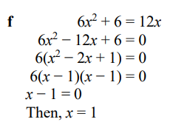
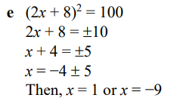
Exercise 2A/2B Pure Y1 Pages 20-22
?
e?
f?

Slide 10
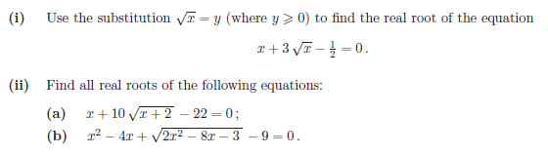
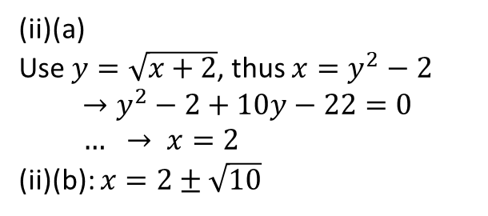
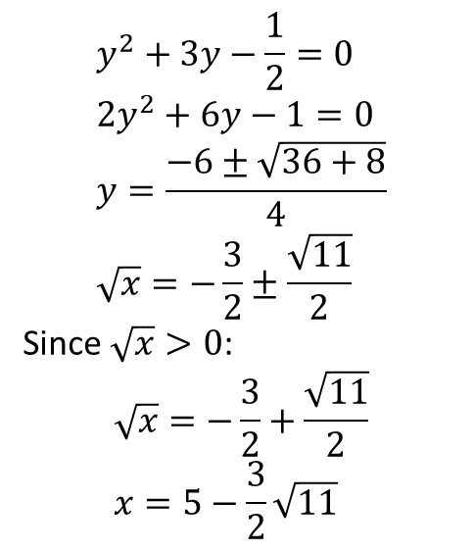
Exercise 2A/2B Pure Y1 Pages 20-22
Extension: (Full Database: http://www.drfrostmaths.com/resources/resource.php?rid=268 )
1
$$y^{2}+3y−\frac{1}{2}=0 \\ 2y^{2}+6y−1=0 \\ y=\frac{−6±\sqrt{36+8}}{4} \\ \sqrt{x}=−\frac{3}{2}±\frac{\sqrt{11}}{2}$$
Since $\sqrt{x}>0$:
$$\sqrt{x}=−\frac{3}{2}+\frac{\sqrt{11}}{2} \\ x=5−\frac{3}{2}\sqrt{11}$$
? i
? ii(a)
(ii)(a)
Use $y=\sqrt{x+2}$, thus $x=y^{2}−2$
$$→y^{2}−2+10y−22=0 \\ … → x=2$$
(ii)(b): $x=2±\sqrt{10}$
? ii(b)

Slide 11
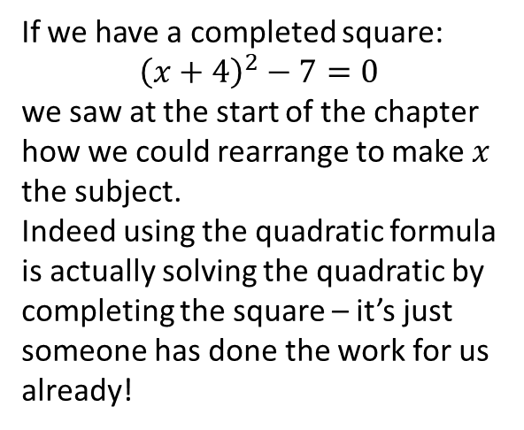
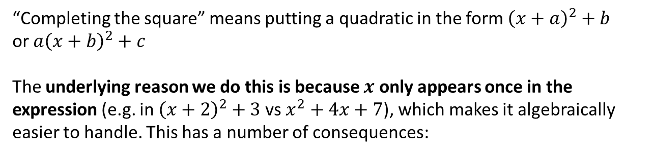
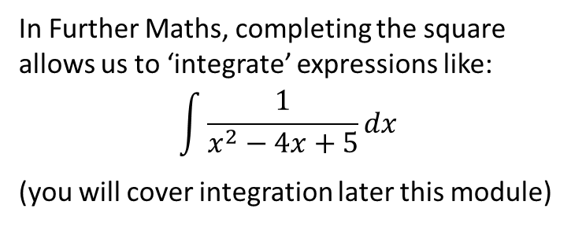
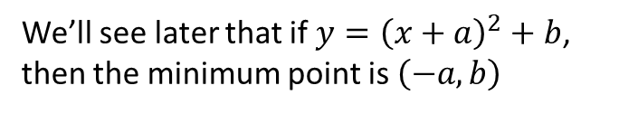
2: Completing the Square
“Completing the square” means putting a quadratic in the form ${\left(x+a\right)}^{2}+b$
or $a{\left(x+b\right)}^{2}+c$
The underlying reason we do this is because $x$ only appears once in the expression (e.g. in ${\left(x+2\right)}^{2}+3$ vs $x^{2}+4x+7$), which makes it algebraically easier to handle. This has a number of consequences:
a. Solving Quadratics
b. Sketching Quadratics
If we have a completed square:
$${\left(x+4\right)}^{2}−7=0$$
we saw at the start of the chapter how we could rearrange to make $x$ the subject.
Indeed using the quadratic formula is actually solving the quadratic by completing the square – it’s just someone has done the work for us already!
We’ll see later that if $y={\left(x+a\right)}^{2}+b$, then the minimum point is $\left(−a,b\right)$
c. In integration
In Further Maths, completing the square allows us to ‘integrate’ expressions like:
$$\int{\frac{1}{x^{2}−4x+5}dx}$$
(you will cover integration later this module)

Slide 12
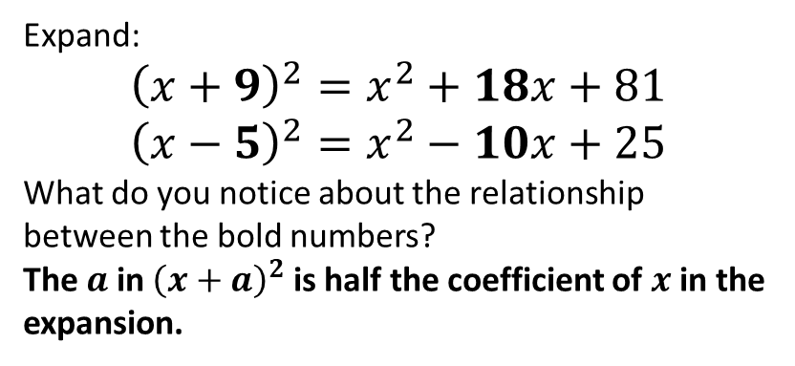
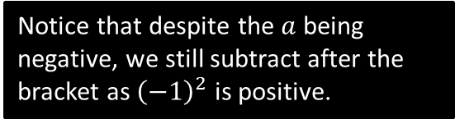
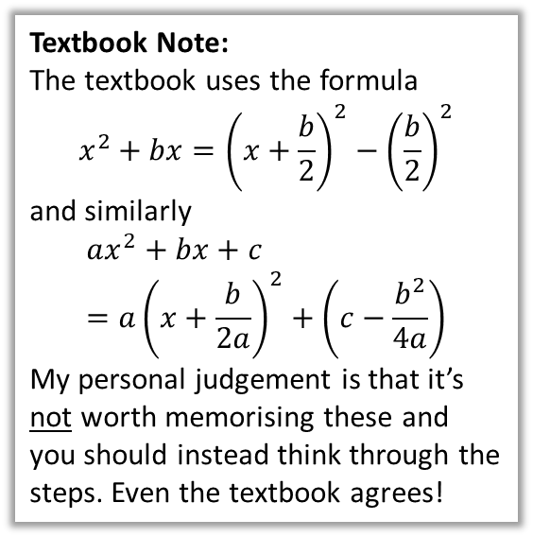
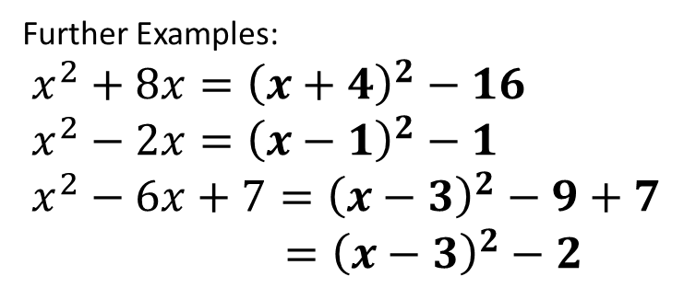
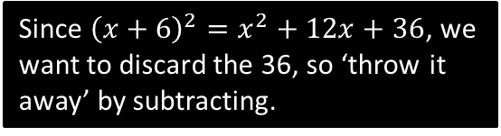
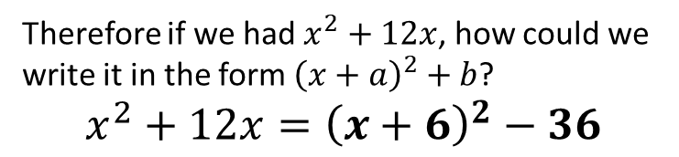
Completing the Square Recap
Textbook Note:
The textbook uses the formula
$$x^{2}+bx={\left(x+\frac{b}{2}\right)}^{2}−{\left(\frac{b}{2}\right)}^{2}$$
and similarly
$$ax^{2}+bx+c=a{\left(x+\frac{b}{2a}\right)}^{2}+\left(c−\frac{b^{2}}{4a}\right)$$
My personal judgement is that it’s not worth memorising these and you should instead think through the steps. Even the textbook agrees!
Expand:
$${\left(x+9\right)}^{2}=x^{2}+18x+81 \\ {\left(x−5\right)}^{2}=x^{2}−10x+25$$
What do you notice about the relationship between the bold numbers?
The $a$ in ${\left(x+a\right)}^{2}$ is half the coefficient of $x$ in the expansion.
?
?
?
Therefore if we had $x^{2}+12x$, how could we write it in the form ${\left(x+a\right)}^{2}+b$?
$$x^{2}+12x={\left(x+6\right)}^{2}−36$$
?
Since ${\left(x+6\right)}^{2}=x^{2}+12x+36$, we want to discard the 36, so ‘throw it away’ by subtracting.
Further Examples:
$$x^{2}+8x={\left(x+4\right)}^{2}−16 \\ x^{2}−2x={\left(x−1\right)}^{2}−1 \\ x^{2}−6x+7={\left(x−3\right)}^{2}−9+7 \\ ={\left(x−3\right)}^{2}−2$$
?
Notice that despite the $a$ being negative, we still subtract after the bracket as ${\left(−1\right)}^{2}$ is positive.
?
?

Slide 13
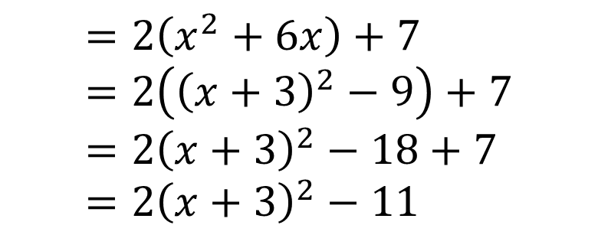

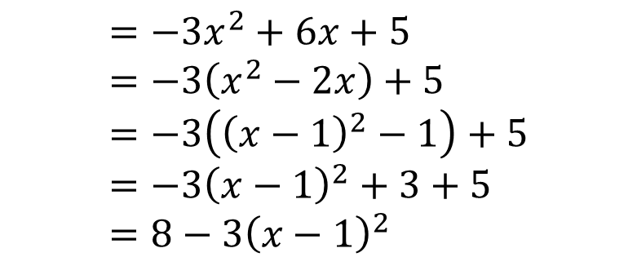
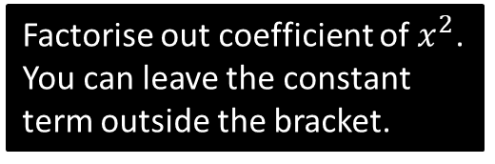
Completing the Square
Express $2x^{2}+12x+7$ in the form $a{\left(x+b\right)}^{2}+c$
?
Factorise out coefficient of $x^{2}$. You can leave the constant term outside the bracket.
$$=2\left(x^{2}+6x\right)+7 \\ =2\left({\left(x+3\right)}^{2}−9\right)+7 \\ =2{\left(x+3\right)}^{2}−18+7 \\ =2{\left(x+3\right)}^{2}−11$$
?
?
Complete the square inside the bracket (you should have two sets of brackets)
?
Expand out outer bracket.
Express $5−3x^{2}+6x$ in the form $a−b{\left(x+c\right)}^{2}$
$$=−3x^{2}+6x+5 \\ =−3\left(x^{2}−2x\right)+5 \\ =−3\left({\left(x−1\right)}^{2}−1\right)+5 \\ =−3{\left(x−1\right)}^{2}+3+5 \\ =8−3{\left(x−1\right)}^{2}$$
?
?
It may help to write in the form $ax^{2}+bx+c$ first.
?
?
?

Slide 14
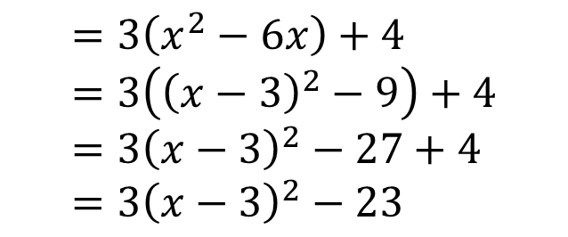
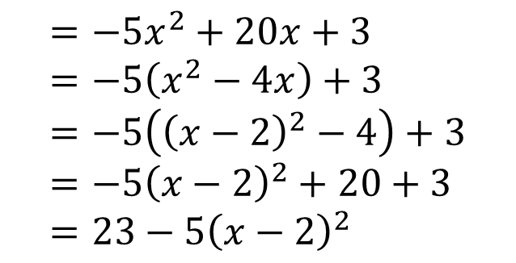
Test Your Understanding
Express $3x^{2}−18x+4$ in the form $a{\left(x+b\right)}^{2}+c$
$$=3\left(x^{2}−6x\right)+4 \\ =3\left({\left(x−3\right)}^{2}−9\right)+4 \\ =3{\left(x−3\right)}^{2}−27+4 \\ =3{\left(x−3\right)}^{2}−23$$
?
Express $20x−5x^{2}+3$ in the form $a−b{\left(x+c\right)}^{2}$
$$=−5x^{2}+20x+3 \\ =−5\left(x^{2}−4x\right)+3 \\ =−5\left({\left(x−2\right)}^{2}−4\right)+3 \\ =−5{\left(x−2\right)}^{2}+20+3 \\ =23−5{\left(x−2\right)}^{2}$$
?

Slide 15
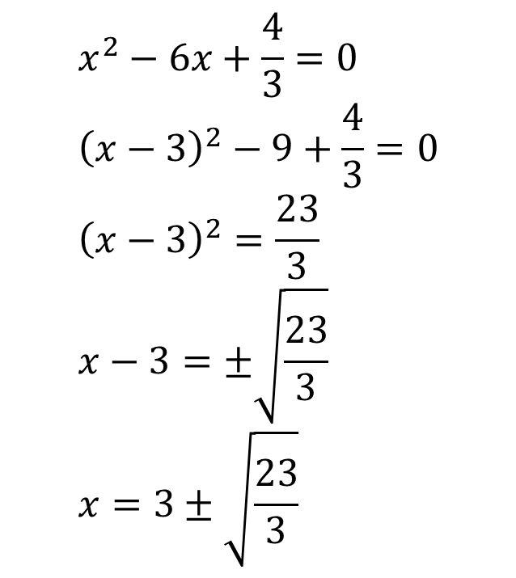

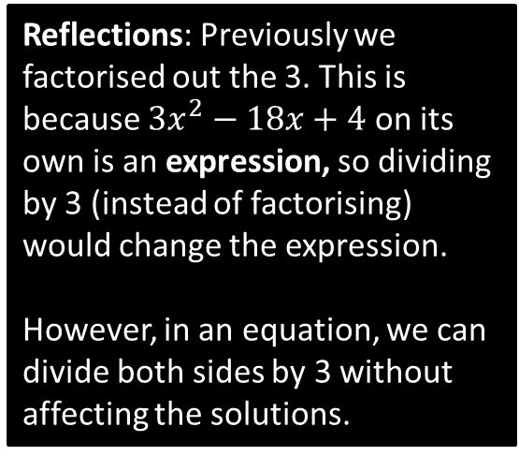
Solving by Completing the Square
Solve the equation:
$$3x^{2}−18x+4=0$$
? First step
$$x^{2}−6x+\frac{4}{3}=0 \\ {\left(x−3\right)}^{2}−9+\frac{4}{3}=0 \\ {\left(x−3\right)}^{2}=\frac{23}{3} \\ x−3=±\sqrt{\frac{23}{3}} \\ x=3±\sqrt{\frac{23}{3}}$$
Reflections: Previously we factorised out the 3. This is because $3x^{2}−18x+4$ on its own is an expression, so dividing by 3 (instead of factorising) would change the expression.
However, in an equation, we can divide both sides by 3 without affecting the solutions.
? And the rest…

Slide 16











Exercise 2C/2D Pure Y1 Page 23-24
a?
b?
c?
d?
e?
a?
b?
c?
d?

Slide 17




Exercise 2C/2D Pure Y1 Page 23-24
4 Given that $x^{2}+3x+6={(x+a)}^{2}+b$ find the values of the constants $a$ and $b$
?
5 Write $2+0.8x−0.04x^{2}$ in the form $A−B{(x+C)}^{2}$ where $A and B$are constants to be
determined
?
?

Slide 18


Proving the Quadratic Formula
If $ax^{2}+bx+c=0$, prove that $x=\frac{−b±\sqrt{b^{2}−4ac}}{2a}$
$$ax^{2}+bx+c=0 \\ x^{2}+\frac{b}{a}x+\frac{c}{a}=0 \\ {\left(x+\frac{b}{2a}\right)}^{2}−\frac{b^{2}}{4a^{2}}+\frac{c}{a}=0 \\ {\left(x+\frac{b}{2a}\right)}^{2}=\frac{b^{2}}{4a^{2}}−\frac{c}{a} \\ {\left(x+\frac{b}{2a}\right)}^{2}=\frac{b^{2}−4ac}{4a^{2}} \\ x+\frac{b}{2a}=\frac{±\sqrt{b^{2}−4ac}}{2a} \\ x=\frac{−b±\sqrt{b^{2}−4ac}}{2a}$$
Just use exactly the same method as you usually would!
?

Slide 19





3: Functions
A function is something which provides a rule on how to map inputs to outputs.
We saw at GCSE that functions were a formal way of describing a ‘number machine’:
Input
Output
$$x$$
$$f$$
$$2x$$
?
Name of the function (often $f$ or $g$)
Input
Output
$$f(x)=2x$$

Slide 20





3: Functions
You’ll cover functions extensively in future chapters, but for now, you need to understand the following concepts:
The domain of a function could potentially be any real number. If so, we’d write:
$$x∈ℝ$$
Inputs
Outputs
-1
1
?
0
0
The input $x$…
the set of real numbers
$$f\left(x\right)=x^{2}$$
2.89
is a member of…
1.7
2
4
We might be interested in what inputs $x$ give an output of 0. These are known as the roots of the function.
3.1
9.61
...
?
...
! The roots/zeroes of a function are the values of $x$ for which $f\left(x\right)=0$.
! The domain of a function is the set of possible inputs.
! The range of a function is the set of possible outputs.

Slide 21





Examples
If $f\left(x\right)=x^{2}−3x$ and $g\left(x\right)=x+5, x∈ℝ$
Find $f(−4)$
Find the values of $x$ for which $f\left(x\right)=g(x)$
Find the roots of $f(x)$.
Find the roots of $g(x)$.
Note: The domain is usually stated for you.
a
?
The roots are the inputs which give an output of 0. So set output expression to 0.
$$x^{2}−3x=0 \\ x\left(x−3\right)=0 \\ x=0 or x=3$$
$$f\left(−4\right)={\left(−4\right)}^{2}−3\left(−4\right) \\ =28$$
c
?
Conceptually, we’re looking for the inputs of the functions which give the same outputs. We can just equate the output expressions.
$$x^{2}−3x=x+5 \\ x^{2}−4x−5=0 \\ \left(x−5\right)\left(x+1\right)=0 \\ x=5 or x=−1$$
b
?
d
$$x+5=0 \\ x=−5$$
?

Slide 22







Examples
Determine the minimum value of the function $f\left(x\right)=x^{2}−6x+2$, and state the value of $x$ for which this minimum occurs.
This means we want to minimise the output of the function.
You might try a (clumsy) approach of trying a few values of $x$ and try to see what makes the output as small as possible…
?
$$f\left(1\right)=1−6+2=−3 \\ f\left(2\right)=4−12+2=−6 \\ f\left(3\right)=9−18+2=−7 \\ f\left(4\right)=16−24+2=−6$$
This looks like the minimum as the value starts going up after.
But the best way to find the minimum/maximum value of a quadratic is to complete the square:
$$f\left(x\right)={\left(x−3\right)}^{2}−7$$
Since anything squared is at least 0, the smallest we can make the bracket is 0, which occurs when $x=3$.
?
$$f\left(1\right)={\left(−2\right)}^{2}−7=−3 \\ f\left(2\right)={\left(−1\right)}^{2}−7=−6 \\ f\left(3\right)=0^{2}−7=−7 \\ f\left(4\right)=1^{2}−7=−6$$
! If $f\left(x\right)={\left(x+a\right)}^{2}+b$, the minimum value of $f(x)$ is $b$, which occurs when $x=−a$.

Slide 23

Quickfire Questions
$$f(x)$$ | Completed square | Min/max value of $f(x)$ | $x$ for which this min/max occurs
$$x^{2}+4x+9$$ | $${\left(x+2\right)}^{2}+5$$ | $$5$$ | $$−2$$
$$x^{2}−10x+21$$ | $${\left(x−5\right)}^{2}−4$$ | $$−4$$ | $$5$$
$$10−x^{2}$$ | Already completed | $$10$$ | $$0$$
$$8−x^{2}+6x$$ | $$17−{\left(x−3\right)}^{2}$$ | $$17$$ | $$3$$
?
?
?
?
?
?
?
?
?
?
?
?

Slide 24






Test Your Understanding
1
Find the minimum value of $f\left(x\right)=2x^{2}+12x−5$ and state the value of $x$ for which this occurs.
2
Find the roots of the function $f\left(x\right)=2x^{2}+3x+1$
?
$$2x^{2}+3x+1=0 \\ \left(2x+1\right)\left(x+1\right)=0 \\ x=−\frac{1}{2} or x=−1$$
?
$$f\left(x\right)=2\left(x^{2}+6x\right)−5 \\ =2\left({\left(x+3\right)}^{2}−9\right)−5 \\ =2{\left(x+3\right)}^{2}−18−5 \\ =2{\left(x+3\right)}^{2}−23$$
Minimum value is -23.
$x$ at which this occurs is -3.
3
Find the roots of the function $f\left(x\right)=x^{4}−x^{2}−6$
?
$$x^{4}−x^{2}−6=0 \\ \left(x^{2}+2\right)\left(x^{2}−3\right)=0 \\ x^{2}=−2 or x^{2}=3 \\ x=±\sqrt{3}$$

Slide 25








Exercise 2E Pure Y1 Pages 26-27
?
a?
b?
a?
b?

Slide 26





4: Quadratic Graphs
Recall that $x$ refers to the input of a function, and the expression $f(x)$ refers to the output. For graph sketches, we often write $y=f(x)$, i.e. we set the $y$ values to be the output of the function.
$$y$$
A ‘sketch’ in maths has a clearly defined meaning:
We care about the general shape of the graph, not exact points.
The axes should have no scale.
Generally the only coordinates indicated are intercepts with the axis or other points of interest (e.g. intersections of multiple graphs)
Features needed in sketch of quadratic?
Recall a root of a function is where the output, in this case the $y$ value, is 0.
Roots
?
$$x$$
?
General shape: Smiley face or hill?
?
$y$-intercept
?
Turning point

Slide 27









Example
Sketch the graph of $y=x^{2}+3x−4$ and find the coordinates of the turning point.
$$y$$
Roots:
?
$$x^{2}+3x−4=0 \\ \left(x+4\right)\left(x−1\right)=0 \\ x=−4 or x=1$$
$y$-intercept:
When $x=0,$
$$y=0^{2}+3\left(0\right)−4=−4$$
?
$$y={\left(x+\frac{3}{2}\right)}^{2}−\frac{9}{4}−4 \\ y={\left(x+\frac{3}{2}\right)}^{2}−\frac{25}{4}$$
Min point: $\left(−\frac{3}{2},−\frac{25}{4}\right)$
Turning point:
?
$$x$$
-4
1
$$\left(−\frac{3}{2},−\frac{25}{4}\right)$$
-4
Recall that if $f\left(x\right)={\left(x+a\right)}^{2}+b$, the minimum output is $b$ and $−a$ is the $x$ value which minimises it. i.e. Turning point is $(−a,b)$

Slide 28








Example
Sketch the graph of $y=4x−2x^{2}−3$ and find the coordinates of the turning point. Write down the equation of the line of symmetry.
Roots:
$$y$$
?
$$−2x^{2}+4x−3=0 \\ a=−2, b=4, c=−3 \\ x=\frac{−4±\sqrt{4^{2}−\left(4×−2×−3\right)}}{−4}$$
$$=\frac{−4±\sqrt{−8}}{−4}$$
This has no solutions, so the $y$ value can never be 0, i.e. the parabola does not touch the $x$-axis.
$$x=1$$
$$x$$
-3 (by inspection)
$y$-intercept:
?
$$\left(1,−1\right)$$
Turning point:
$$y=−2x^{2}+4x−3 \\ =−2\left(x^{2}−2x\right)−3 \\ =−2\left({\left(x−1\right)}^{2}−1\right)−3 \\ =−2{\left(x−1\right)}^{2}+2−3 \\ =−2{\left(x−1\right)}^{2}−1$$
Max point is $(1,−1)$
-3
?
?
Line of reflection:
$$x=1$$

Slide 29


















Test Your Understanding
Sketch the following, indicating any intercepts with the axis, the turning point and the equation of the line of symmetry.
a
$$y=x^{2}+4$$
c
$$y=5x+3−2x^{2}$$
$$y$$
?
?
$$\left(\frac{5}{4},\frac{49}{8}\right)$$
3
$$\left(0,4\right)$$
$$x$$
$$−\frac{1}{2}$$
3
$$x$$
$$x=0$$
$$x=\frac{5}{4}$$
b
$$y=x^{2}−7x+10$$
d
$$y=x^{2}+4x+11$$
?
?
$$x=\frac{7}{2}$$
11
10
$$\left(−2,7\right)$$
2
5
$$x$$
$$x$$
$$\left(\frac{7}{2}, −\frac{9}{4}\right)$$
$$x=−2$$

Slide 30




Determining the Equation using a Graph
$$y$$
Determine the equation of this quadratic graph, in the form $y=ax^{2}+bx+c$.
?
Since the roots are $−3$ and $2$, a good start would be:
$$y=(x+3)(x−2)$$
noting that this gives us the correct ‘positive quadratic’ shape.
However, expanding, we get the wrong $y$-intercept of -6:
$$y=x^{2}+x−6$$
We can simply scale the $y$-value appropriately without affecting the roots:
$$y=2\left(x+3\right)\left(x−2\right) \\ =2x^{2}+2x−12$$
$$x$$
-3
2
-12

Slide 31


Further Example
$$y$$
Determine the equation of this quadratic graph, in the form $y=ax^{2}+bx+c$, where $a,b,c$ are integers.
?
A good start would be:
$$y=−(x+1)(x−3.5)$$
The minus on the front ensures we get a negative $x^{2}$ term for the correct shape.
Expanding:
$$y=−x^{2}+2.5x+3.5$$
Note that no $y$-intercept has been specified, so we can scale the whole expression without affecting the roots (i.e. we only scale in the $y$ direction). Doubling:
$$y=−2x^{2}+5x+7$$
$$x$$
-1
3.5

Slide 32

Test Your Understanding
$$y$$
Determine an equation of this quadratic graph.
10
?
A good start to get the roots correct is:
$$y=−(x+3)(x−3)$$
The minus on the front ensures we get a negative $x^{2}$ term for the correct shape.
Expanding this gives us the incorrect $y$-intercept of 9:
$$y=−x^{2}+9$$
To scale 9 to 10, without affecting the root, we need to scale by $\frac{10}{9}$:
$$y=−\frac{10}{9}(x+3)(x−3)$$
Or more cleanly:
$$y=\frac{10}{9}\left(x+3\right)\left(3−x\right)$$
$$x$$
-3
3

Slide 33




Exercise 2F Pure Y1 Page 30
a?
b?
c?
d?

Slide 34




Exercise 2F Pure Y1 Page 30
Extension Question:
[MAT 2003 1H] Into how many regions is the plane divided when the following three parabolas are drawn?
$$y=x^{2} \\ y=x^{2}−2x \\ y=x^{2}+2x+2$$
$$y$$
?
Completing the square:
$$y=x^{2} \\ y={\left(x−1\right)}^{2}−1 \\ y={\left(x+1\right)}^{2}+1$$
2
5
3
6
7
1
4
$$x$$

Slide 35

Starter
How many distinct real solutions do each of the following have?
?
$x^{2}−12x+36=0$ $x=6$ (1 distinct solution)
$x^{2}+x+3=0$ $x=\frac{−1±\sqrt{−11}}{2}$
We can’t square root -11,
Therefore no real solutions.
$x^{2}−2x−1=0$ $x=1±\sqrt{2}$ (2 distinct solutions)
?
?

Slide 36




5: The Discriminant
Note: Roots of a function $f$ are the values of $x$ such that $f\left(x\right)=0$.
Similarly the roots of an equation are solutions to an equation in the form $f\left(x\right)=0$
$$ax^{2}+bx+c=0$$
$$x=\frac{−b±\sqrt{b^{2}−4ac}}{2a}$$
Looking at this formula, when in general do you think we have:
No real roots? $b^{2}−4ac<0$
Equal roots? $b^{2}−4ac=0$
Two distinct roots? $b^{2}−4ac>0$
?
?
!
?
Because adding 0 or subtracting 0 in the quadratic formula gives the same value.
$b2 – 4ac$is known as the discriminant.

Slide 37









5: The Discriminant
$$y$$
$$y$$
We say the graph “touches” the axis.
$$x$$
$$x$$
$$y$$
Distinct real roots
Equal roots
$$b^{2}−4ac>0$$
$$b^{2}−4ac=0$$
$$x$$
No real roots
$$b^{2}−4ac<0$$

Slide 38








Just for your interest…
Why do we say “Equal Roots” not “One root”?
$$x^{2}−12x+36=0$$
It is due to the Fundamental Theorem of Algebra:
Using the quadratic formula gives us the same value in both $+$ and $−$ cases: $x=6$.
You might wonder why we say “it has one repeated root” or “it has equal roots”, i.e. indicating we have 2 roots (but with the same value). Why not say it has 1 root?
“Every polynomial of order $n$ has exactly $n$ roots.”
A polynomial is an expression with
non-negative integer powers of $x$, i.e.
$$a+bx+cx^{2}+dx^{3}+…$$
All linear, quadratic and cubic expressions are examples of polynomials.
These roots might be repeated or might not be ‘real’ roots. $\sqrt{−1}$ is known as a complex number, which you will encounter if you do FM. But it is still a value!
The theorem means that a quadratic (order 2) will always have 2 roots. This is why you should say “no real roots” when $b^{2}−4ac<0$ rather than “no roots”, because there are still roots – it’s just they’re not ‘real’! Similarly we must say “equal roots” because there are still 2 roots.
Despite the theorem being a simple statement, it was only until 1806 that it was first proven by Argand. Clearly by using the quadratic formula we can show a quadratic equation has 2 roots. We can use similar formulas to show that a cubic has 3 roots and a quartic 4 roots. But there is provably no such formulae for order 5 (quintics) and beyond. So we have to prove for example that 5 roots exist for a quintic, despite us having no way to find these exact roots!
One side result of the Fundamental Theorem of Algebra is that every polynomial can be written as a product of linear and/or quadratic expressions.
Leibniz claimed in 1702 that a polynomial of the form
$x^{4}+a^{4}$ cannot be written in this way. He then got completely burned by Euler in 1742 who managed to do so:
$$x^{4}+a^{4}=\left(x^{2}+a\sqrt{2} x+a^{2}\right)\left(x^{2}−a\sqrt{2} x+a^{2}\right)$$
The order of a polynomial is its highest power of $x$. So the order of a quadratic is 2, and a cubic 3.
There are various other ‘Fundamental Laws’. The ‘FL of Arithmetic’ you encountered at KS3, which states that “every positive integer $>1$ can be written as a product of primes in one way only”. You will encounter the ‘FL of Calculus’ in Chapter 13.

Slide 39
Quickfire Questions
Number of Distinct Real Roots
Equation
Discriminant
?
?
$$x^{2}+3x+4=0$$
$$−7$$
$$0$$
?
?
$$x^{2}−4x+1=0$$
$$12$$
$$2$$
?
?
$$x^{2}−4x+4=0$$
$$0$$
$$1$$
?
?
$$2x^{2}−6x−3=0$$
$$60$$
$$2$$
?
?
$$x−4−3x^{2}=0$$
$$−47$$
$$0$$
?
?
$$1−x^{2}=0$$
$$4$$
$$2$$

Slide 40


Problems involving the discriminant
?
?
?
a) $a=1, b=2p, c=3p+4$
$${\left(2p\right)}^{2}−4\left(1\right)\left(3p+4\right)=0 \\ 4p^{2}−12p−16=0 \\ p^{2}−3p−4=0 \\ \left(p+1\right)\left(p−4\right)=0 \\ p=4$$
Tip: Always start by writing out $a, b$ and $c$ explicitly.
?
b) When $p=4$: $x^{2}+8x+16=0$
$${\left(x+4\right)}^{2}=0, x=−4$$
?

Slide 41


Exercise 2G Pure Y1 Page 32
?
?

Slide 42


Exercise 2G Pure Y1 Page 32
?
?

Slide 43






Exercise 2G Pure Y1 Page 32
a?
b?
a?
b?

Slide 44




Test Your Understanding
$$x^{2}+5kx+\left(10k+5\right)=0$$
where $k$ is a constant.
Given that this equation has equal roots, determine the value of $k$.
$$a=1, b=5k, c=10k+5 \\ {\left(5k\right)}^{2}−4\left(1\right)\left(10k+5\right)=0 \\ 25k^{2}−40k−20=0 \\ 5k^{2}−8k−4=0 \\ \left(5k+2\right)\left(k−2\right)=0 \\ k=2$$
?
Find the range of values of $k$ for which $x^{2}+6x+k=0$ has two distinct real solutions.
$$a=1, b=6, c=k \\ 36−4\left(1\right)\left(k\right)=36−4k>0 \\ 36>4k \\ k<9$$
?

Slide 45



Exercise 2G Pure Y1 Page 32
Extension Questions:
1
[MAT 2009 1C] Given a real constant $c$, the equation
$$x^{4}={\left(x−c\right)}^{2}$$
Has four real solutions (including possible repeated roots) for:
$c≤\frac{1}{4}$
$−\frac{1}{4}≤c≤\frac{1}{4}$
$c≤−\frac{1}{4}$
all values of $c$
Square rooting: $x^{2}=±(x−c)$
Case 1:
$$x^{2}−x+c=0$$
Discriminant: $1−4c≥0∴c≤\frac{1}{4}$
Case 2:
$$x^{2}+x−c=0$$
Discriminant: $1+4c≥0∴c≥−\frac{1}{4}$
Answer is B.
[MAT 2006 1B] The equation
${\left(2+x−x^{2}\right)}^{2}=16$ has how many real root(s)?
$$2+x−x^{2}=±4$$
First case:
$$2+x−x^{2}=4 \\ x^{2}−x+2=0$$
As $b^{2}−4ac<0$ no real roots.
Second case:
$$2+x−x^{2}=−4 \\ x^{2}−x−6=0 \\ \left(x+2\right)\left(x−3\right)=0 \\ x=−2 or x=3$$
So 2 distinct real roots.
[MAT 2011 1B] A rectangle has perimeter $P$ and area $A$. The values $P$ and $A$ must satisfy:
$P^{3}>A$
$A^{2}>2P+1$
$P^{2}≥16A$
$PA>A+P$
Let $x$ and $y$ be the width and height. Then $A=xy, P=2x+2y$. Substituting:
$$P=2x+2\left(\frac{A}{x}\right) \\ Px=2x^{2}+2A \\ 2x^{2}−Px+2A=0$$
Discriminant: $a=2, b=−P, c=2A$
$${\left(−P\right)}^{2}−4\left(2\right)\left(2A\right)≥0 \\ P^{2}−16A≥0 \\ P^{2}≥16A$$
2
3
?
?
?

Slide 46


Modelling
The new A Level has a particular emphasis of the application of theory to real-life situations. A mathematical model is the maths used to model such a situation, possibly with some simplifying assumptions.
Example (from textbook): A spear is thrown over level ground from the top of a tower.
The height, in metres, of the spear above the ground after $t$ seconds is modelled by the function: $h\left(t\right)=12.25+14.7t−4.9t^{2}, t≥0$
Interpret the meaning of the constant term 12.25 in the model.
After how many seconds does the spear hit the ground?
Write $h(t)$ in the form $A−B{\left(t−C\right)}^{2}$, where $A, B$ and $C$ are constants to be found.
Using your answer to part c or otherwise, find the maximum height of the spear above the ground, and the time at which this maximum height is reached?
When the time is 0, clearly $h\left(0\right)=12.25$. So the 12.25m is the height of the tower. (In general, the constant term of an expression is often the ‘initial value’.
When it hits the ground, $h\left(t\right)=0$, thus: $12.25+14.7t−4.9t^{2}$
Solving gives $t=−0.679 or t=3.68$ (to 3sf) but as $t≥0$, $t=3.68$ (to 3sf)
By completing the square: $23.275−4.9{\left(t−1.5\right)}^{2}$
The maximum height of the spear is 23.275m, 1.5 seconds after spear is thrown.
a
?
b
?
c
?
d
?

Slide 47





Exercise 2H Pure Y1 Page 34
a?
c?
b?
d?

Slide 48




Exercise 2H Pure Y1 Page 34
a?
b?

Slide 49



Exercise 2H Pure Y1 Page 34
a?
b?
c?

Slide 50


Would you like $1,000,000 for finding roots?
We saw earlier that the roots of a function $f$ are the values $x$ such that $f\left(x\right)=0$.
The Riemann Zeta Function is a function that allows you to do the infinite sum of powers of reciprocals, e.g.
$$ζ\left(2\right)=\frac{1}{1^{2}}+\frac{1}{2^{2}}+\frac{1}{3^{2}}+… \\ ζ\left(3\right)=\frac{1}{1^{3}}+\frac{1}{2^{3}}+\frac{1}{3^{3}}+…$$
One of the 8 ‘Clay Millennium Problems’ (for which solving any attracts a $1,000,000 prize) is to showing all roots of this function have some particular form, i.e. the form of $x$ such that $ζ\left(x\right)=0$.

