Slide 1
Pure Y1 Ch 5
Straight Line Graphs
Notes:
Last modified: 7th September 2020

Slide 2
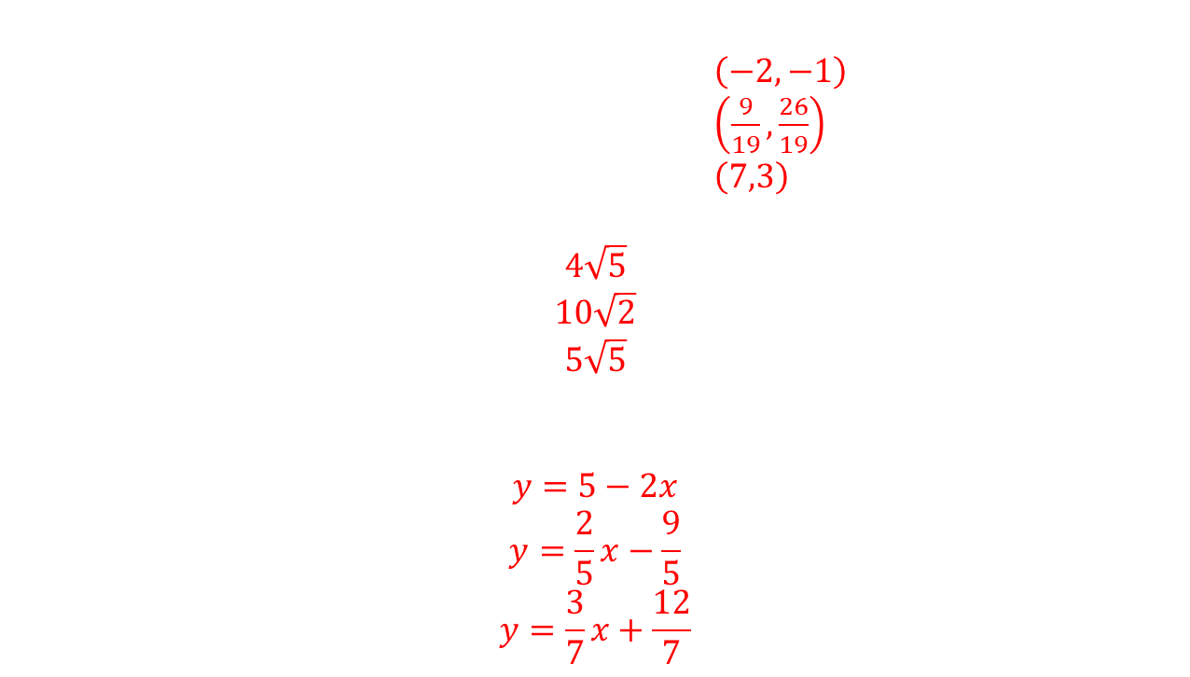
Straight Line Graphs
Starter (Pre-requisites)
$\left(−2,−1\right)$
$\left(\frac{9}{19},\frac{26}{19}\right)$
$\left(7,3\right)$
$$4\sqrt{5}$$
$$10\sqrt{2}$$
$$5\sqrt{5}$$
$$y=5−2x$$
$$y=\frac{2}{5}x−\frac{9}{5}$$
$$y=\frac{3}{7}x+\frac{12}{7}$$
Find the point of intersections of the following pairs of lines.
  $y=4x+7$ and $3y=2x−1$
  $y=5x−1$ and $3x+7y=11$
  $2x−5y=−1$ and $5x−7y=14$
Simplify each of the following:
  $\sqrt{80}$
  $\sqrt{200}$
  $\sqrt{125}$
Make $y$ the subject of each equation:
  $6x+3y−15=0$
  $2x−5y−9=0$
  $3x−7y+12=0$

Slide 3
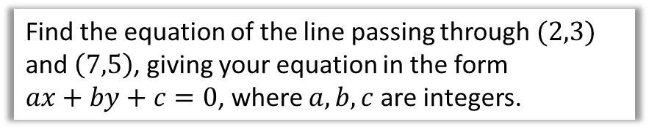
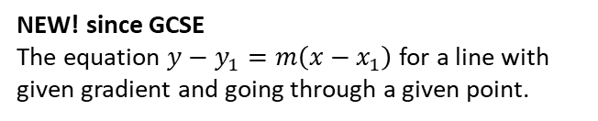
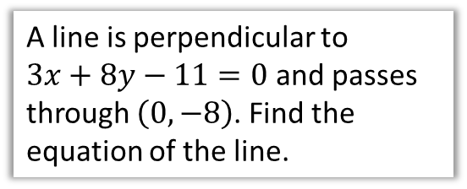
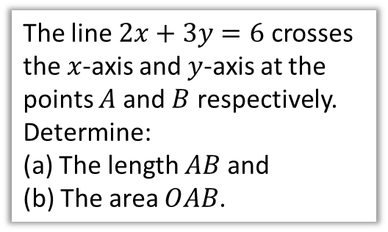
Chapter Overview
There is little new theory since GCSE, but the algebraic manipulation is harder.
1: $y=mx+c$ , Gradient & Determining Equations
2: Parallel/Perpendicular Lines
Find the equation of the line passing through $(2,3)$ and $\left(7,5\right)$, giving your equation in the form
$ax+by+c=0$, where $a,b,c$ are integers.
A line is perpendicular to
$3x+8y−11=0$ and passes through $\left(0,−8\right)$. Find the equation of the line.
NEW! since GCSE
The equation $y−y_{1}=m\left(x−x_{1}\right)$ for a line with given gradient and going through a given point.
3: Lengths and Areas
4: Modelling
The line $2x+3y=6$ crosses the $x$-axis and $y$-axis at the points $A$ and $B$ respectively.
Determine:
(a) The length $AB$ and
(b) The area $OAB$.
A plumber charges a fixed cost plus a unit cost per day. If he charges £840 for 2 days work and …

Slide 4


y
Let’s start simple…
What is the equation of this line?
And more importantly, why is it that?
4
3
2
1
-1
-2
-3
-4
x -5 -4 -3 -2 -1 0 1 2 3 4 5 6
$$x=2$$
?
For any point we pick on the line, the $x$ value is always 2.

Slide 5





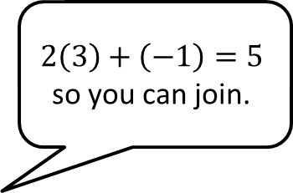
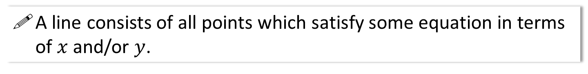
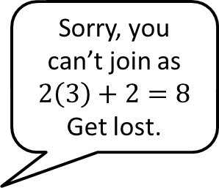

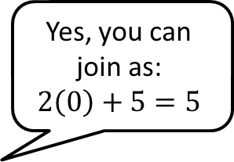

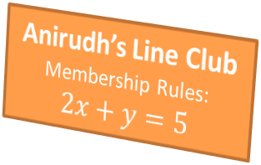
Lines and Equations of Lines
A line consists of all points which satisfy some equation in terms of $x$ and/or $y$.
Sorry, you can’t join as $2\left(3\right)+2=8$
Get lost.
Yes, you can join as:
$$2\left(0\right)+5=5$$
$$2\left(3\right)+\left(−1\right)=5$$
so you can join.
Anirudh’s Line Club
Membership Rules:
$$2x+y=5$$
$$\left(3,2\right)$$
$$\left(0,5\right)$$
$$\left(3,−1\right)$$

Slide 6
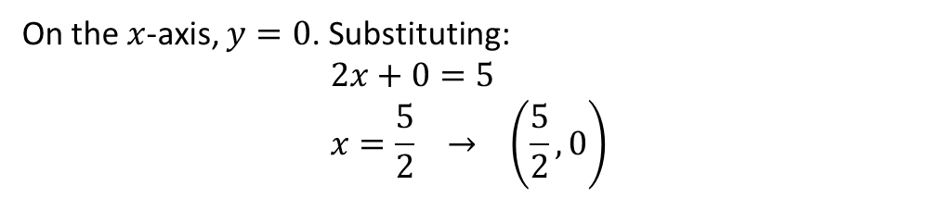

Examples
This means we can substitute the values of a coordinate into our equation whenever we know the point lies on the line.
The point $\left(5,a\right)$ lies on the line with equation $y=3x+2$. Determine the value of $a$.
?
Substituting in $x$ and $y$ value:
$$a=3\left(5\right)+2 \\ a=17$$
Find the coordinate of the point where the line $2x+y=5$ cuts the $x$-axis.
On the $x$-axis, $y=0$. Substituting:
$$2x+0=5 \\ x=\frac{5}{2} → \left(\frac{5}{2}, 0\right)$$
?

Slide 7
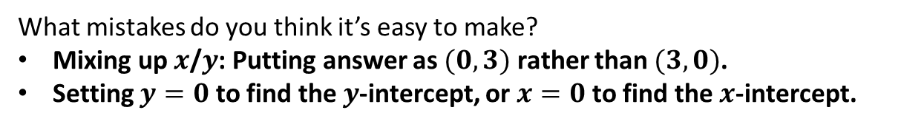
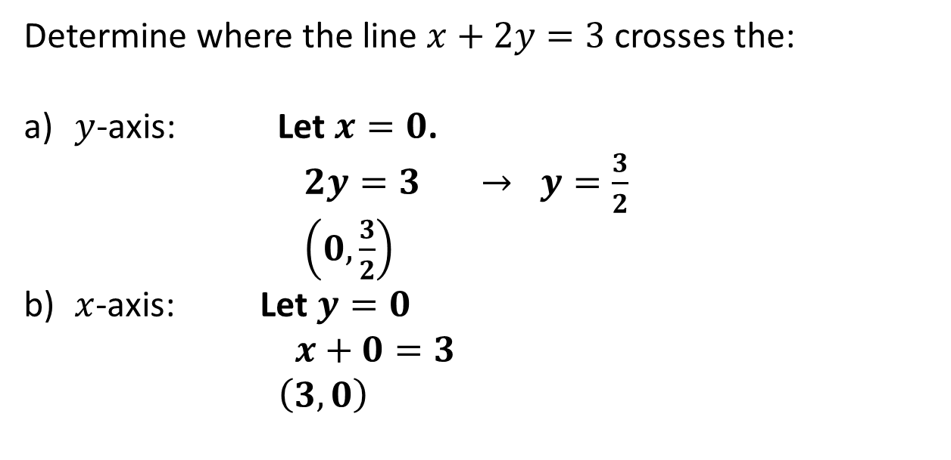
Test Your Understanding
Determine where the line $x+2y=3$ crosses the:
$y$-axis: Let $x=0$.
$2y=3 → y=\frac{3}{2}$
$\left(0,\frac{3}{2}\right)$
$x$-axis: Let $y=0$
$x+0=3$
$\left(3,0\right)$
?
?
What mistakes do you think it’s easy to make?
Mixing up $x$/$y$: Putting answer as $(0,3)$ rather than $(3,0)$.
Setting $y=0$ to find the $y$-intercept, or $x=0$ to find the $x$-intercept.
?

Slide 8
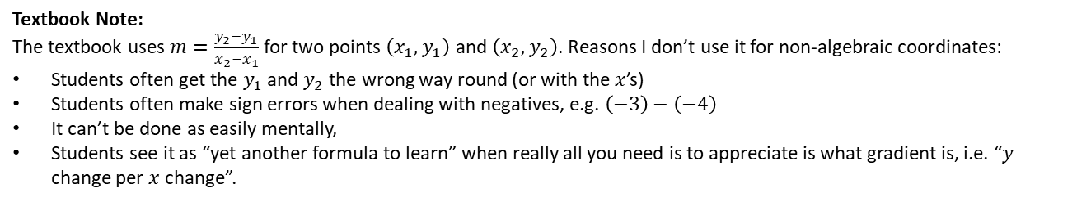

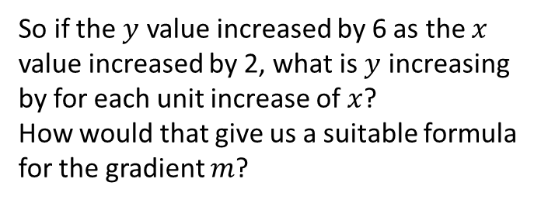


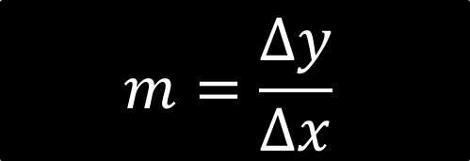

Recap of gradient
The steepness of a line is known as the gradient.
It tells us what $y$ changes by as $x$ increases by 1.
So if the $y$ value increased by 6 as the $x$ value increased by 2, what is $y$ increasing by for each unit increase of $x$?
How would that give us a suitable formula for the gradient $m$?
$$m$$
$$1$$
$$m=\frac{Δy}{Δx}$$
?
$Δ$ is the (capital) Greek letter “delta” and means “change in”.
Textbook Note:
The textbook uses $m=\frac{y_{2}−y_{1}}{x_{2}−x_{1}}$ for two points $\left(x_{1},y_{1}\right)$ and $\left(x_{2},y_{2}\right)$. Reasons I don’t use it for non-algebraic coordinates:
Students often get the $y_{1}$ and $y_{2}$ the wrong way round (or with the $x$’s)
Students often make sign errors when dealing with negatives, e.g. $\left(−3\right)−\left(−4\right)$
It can’t be done as easily mentally,
Students see it as “yet another formula to learn” when really all you need is to appreciate is what gradient is, i.e. “$y$ change per $x$ change”.

Slide 9
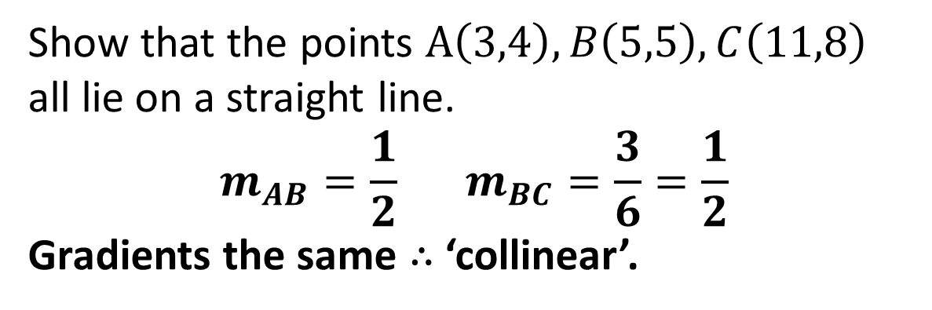



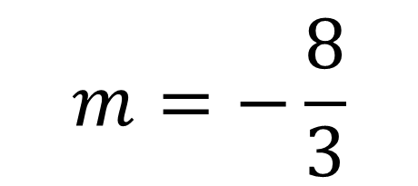
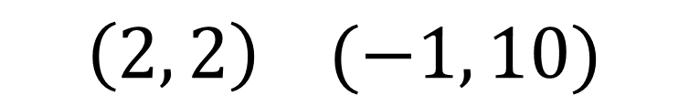
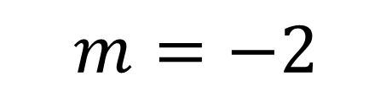
Examples
Find the gradient of the line that goes through the points:
$$\left(1, 4\right) (3, 10)$$
$$m=3$$
1
?
$$m=−2$$
$$\left(5, 7\right) (8, 1)$$
?
2
$$m=−\frac{8}{3}$$
?
$$\left(2, 2\right) (−1, 10)$$
3
4
Show that the points $A\left(3,4\right),B\left(5,5\right),C\left(11,8\right)$ all lie on a straight line.
$$m_{AB}=\frac{1}{2} m_{BC}=\frac{3}{6}=\frac{1}{2}$$
Gradients the same $∴$ ‘collinear’.
?
If points are ‘collinear’ they lie on the same line.

Slide 10
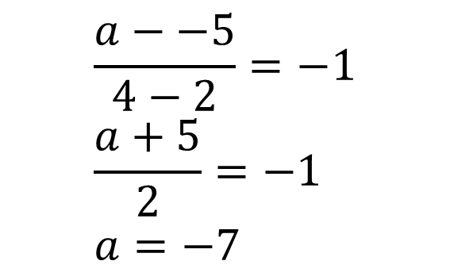
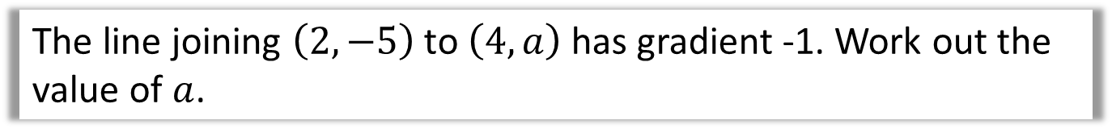
Further Example
The line joining $\left(2,−5\right)$ to $\left(4,a\right)$ has gradient -1. Work out the value of $a$.
?
$$\frac{a−−5}{4−2}=−1 \\ \frac{a+5}{2}=−1 \\ a=−7$$

Slide 11
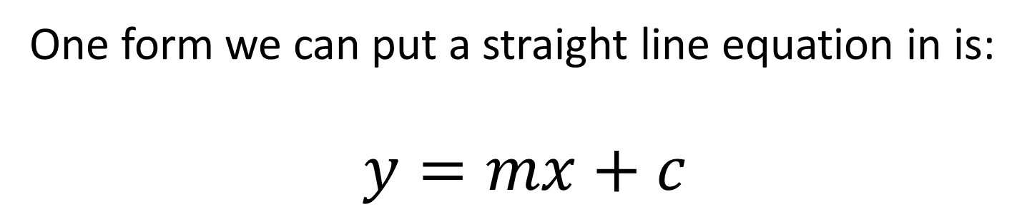
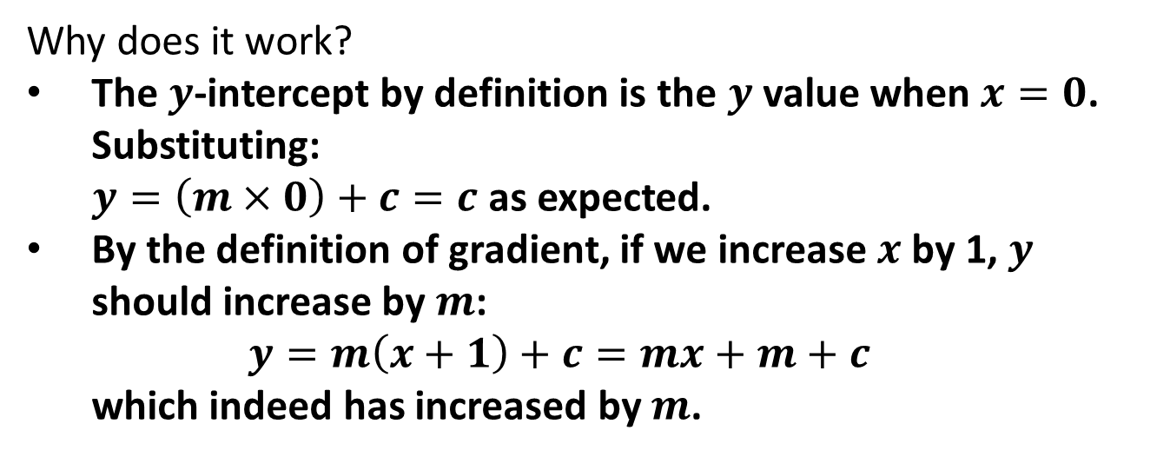
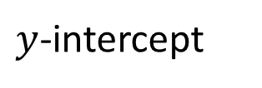
$$y=mx+c$$
One form we can put a straight line equation in is:
$$y=mx+c$$
Gradient
$y$-intercept
Why does it work?
The $y$-intercept by definition is the $y$ value when $x=0$. Substituting:
$y=\left(m×0\right)+c=c$ as expected.
By the definition of gradient, if we increase $x$ by 1, $y$ should increase by $m$:
$y=m\left(x+1\right)+c=mx+m+c$
which indeed has increased by $m$.
?

Slide 12
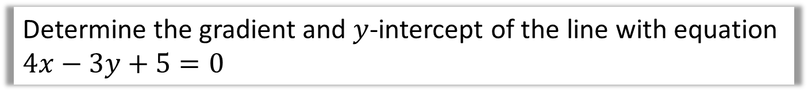
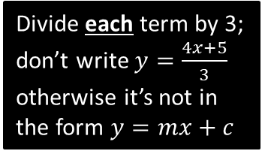
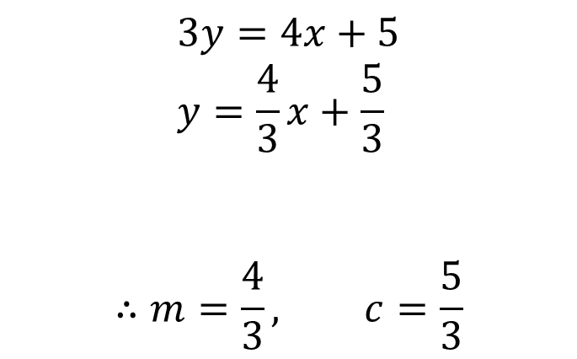
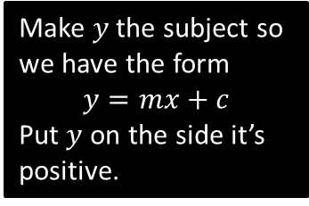
$$y=mx+c$$
Determine the gradient and $y$-intercept of the line with equation $4x−3y+5=0$
?
Make $y$ the subject so we have the form
$$y=mx+c$$
Put $y$ on the side it’s positive.
$$3y=4x+5 \\ y=\frac{4}{3}x+\frac{5}{3}$$
$$∴m=\frac{4}{3}, c=\frac{5}{3}$$
Divide each term by 3; don’t write $y=\frac{4x+5}{3}$ otherwise it’s not in the form $y=mx+c$
This is algebra, so use improper fractions, and not mixed numbers or recurring decimals.

Slide 13
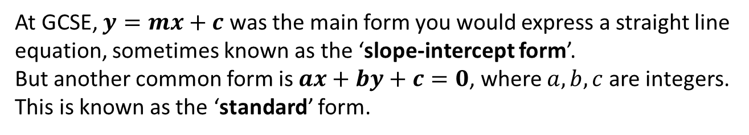

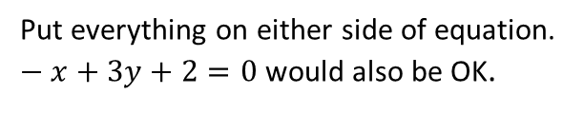

$$ax+by+c=0$$
At GCSE, $y=mx+c$ was the main form you would express a straight line equation, sometimes known as the ‘slope-intercept form’.
But another common form is $ax+by+c=0$, where $a,b,c$ are integers. This is known as the ‘standard’ form.
Express $y=\frac{1}{3}x−\frac{2}{3}$ in the form $ax+by+c=0$, where $a,b,c$ are integers.
?
$$3y=x−2 \\ x−3y−2=0$$
We don’t want fractions, so multiply by an appropriate number.
Put everything on either side of equation. $−x+3y+2=0$ would also be OK.
We’ll see on the next slide WHY we might want to put an equation in this form over $y=mx+c$…

Slide 14
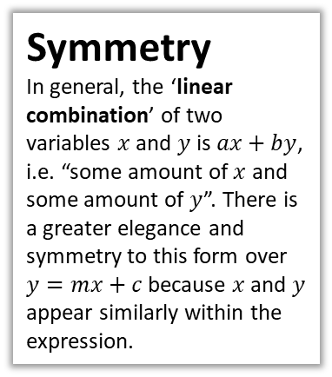



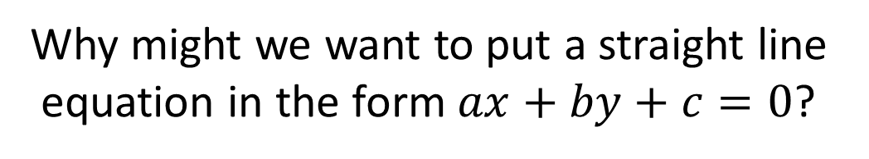
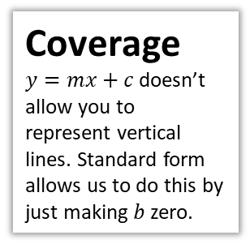

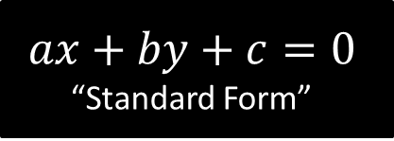
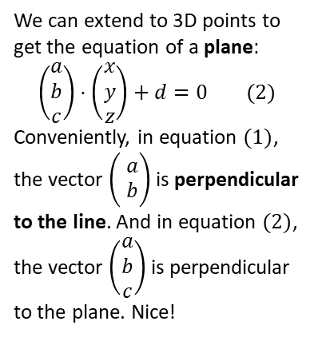
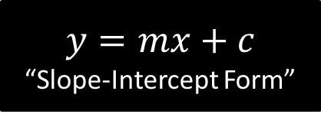
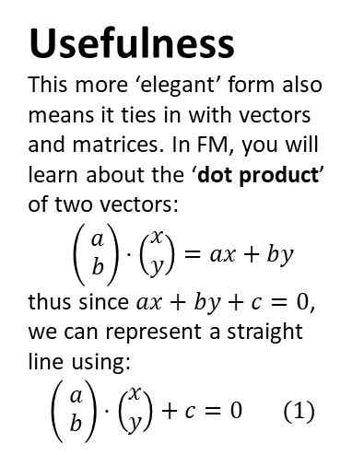
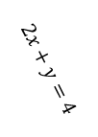
Just for your interest…
Why might we want to put a straight line equation in the form $ax+by+c=0$?
$$y=mx+c$$
“Slope-Intercept Form”
$$ax+by+c=0$$
“Standard Form”
Usefulness
This more ‘elegant’ form also means it ties in with vectors and matrices. In FM, you will learn about the ‘dot product’ of two vectors:
$$\left(\begin{matrix} \\ \\ \end{matrix}\begin{matrix}a \\ b\end{matrix}\right)⋅\left(\begin{matrix}x \\ y\end{matrix}\right)=ax+by$$
thus since $ax+by+c=0$, we can represent a straight line using:
$$\left(\begin{matrix} \\ \\ \end{matrix}\begin{matrix}a \\ b\end{matrix}\right)⋅\left(\begin{matrix}x \\ y\end{matrix}\right)+c=0 (1)$$
Coverage
$y=mx+c$ doesn’t allow you to represent vertical lines. Standard form allows us to do this by just making $b$ zero.
Symmetry
In general, the ‘linear combination’ of two variables $x$ and $y$ is $ax+by$, i.e. “some amount of $x$ and some amount of $y$”. There is a greater elegance and symmetry to this form over $y=mx+c$ because $x$ and $y$ appear similarly within the expression.
We can extend to 3D points to get the equation of a plane:
$$\left(\begin{matrix}a \\ b \\ c\end{matrix}\right)⋅\left(\begin{matrix}x \\ y \\ z\end{matrix}\right)+d=0 (2)$$
Conveniently, in equation $(1)$, the vector $\left(\begin{matrix} \\ \\ \end{matrix}\begin{matrix}a \\ b\end{matrix}\right)$ is perpendicular to the line. And in equation $(2)$, the vector $\left(\begin{matrix}a \\ b \\ c\end{matrix}\right)$ is perpendicular to the plane. Nice!
$$x+4=0$$
$$2x+y=4$$
$$\left(\begin{matrix}2 \\ 1\end{matrix}\right)⋅\left(\begin{matrix}x \\ y\end{matrix}\right)=4$$
$$2x+y=4$$
$$\left(\begin{matrix}2 \\ 1\end{matrix}\right)$$

Slide 15

Test Your Understanding
Express $y=\frac{2}{5}x+\frac{3}{5}$ in the form $ax+by+c=0$, where $a,b,c$ are integers.
?
$$5y=2x+3 \\ 2x−5y+3=0$$

Slide 16


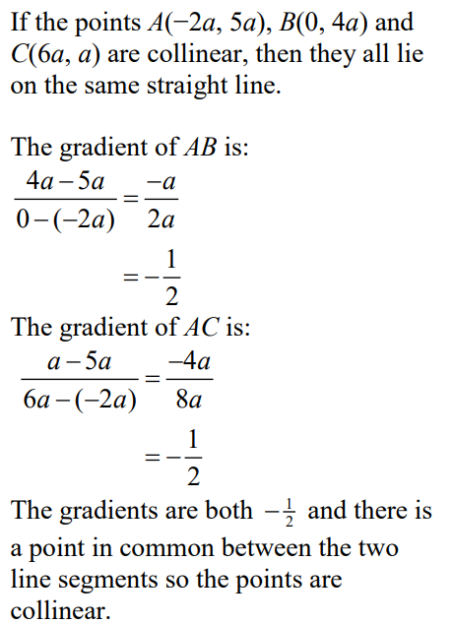
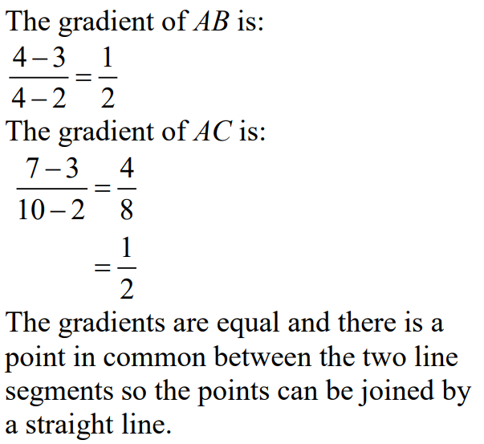
Exercise 5A – Pure Y1 Page 91
?
?

Slide 17
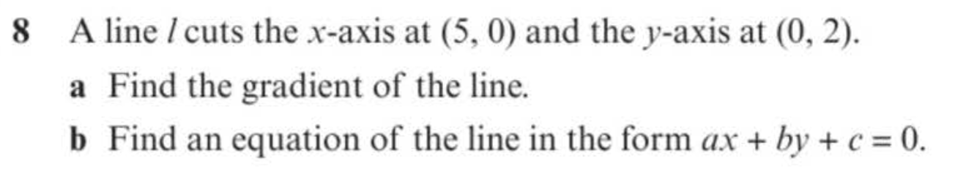
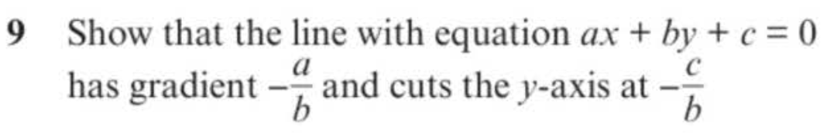
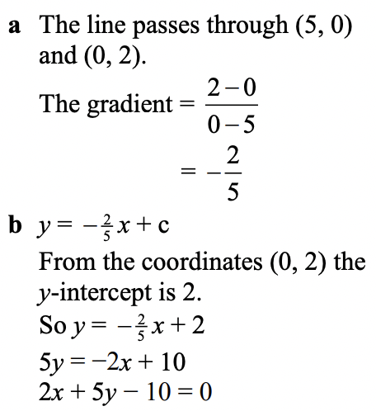
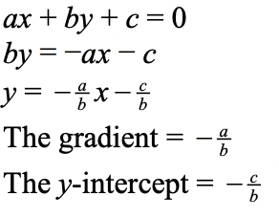
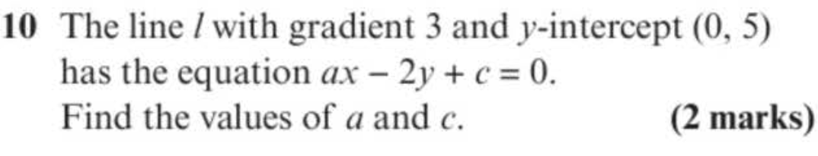
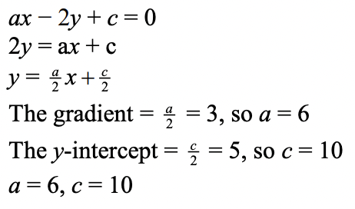
Exercise 5B – Pure Y1 Page 92-93
a?
?
b?
?

Slide 18
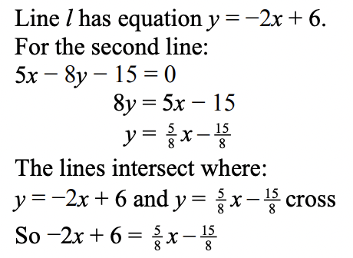
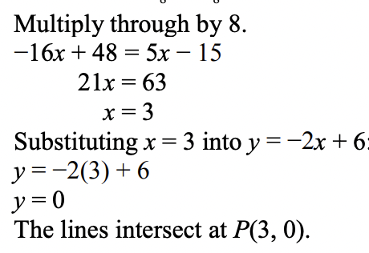
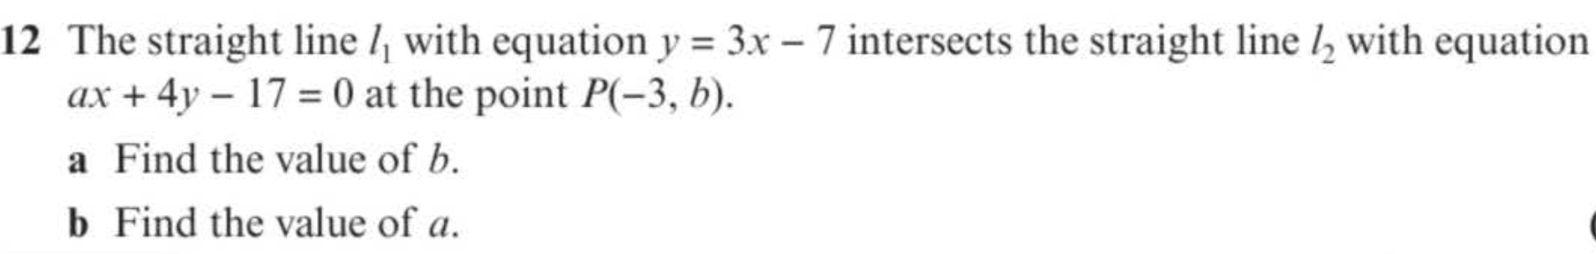


Exercise 5B – Pure Y1 Page 92-93
?
a?
b?

Slide 19

Equations using two points/point + gradient
Find the equation of the line that goes through $\left(3,5\right)$ and has gradient 2.
How would you have done this at GCSE?
?
If gradient is 2, then equation of the line is of the form:
$$y=2x+c$$
Since $\left(3,5\right)$ is on the line, it must satisfy this equation. Therefore:
$$5=2\left(3\right)+c \\ c=−1 \\ ∴y=2x−1$$

Slide 20









A new way…
$$y$$
Suppose that $\left(x_{1},y_{1}\right)$ is some fixed point on the line that we specify (e.g. $(3,5)$).
Suppose that $(x,y)$ represents a generic point on the line, which is allowed to change as we consider different points on this line.
Then:
$$m=\frac{y−y_{1}}{x−x_{1}}$$
Thus:
$$\left(x,y\right)$$
$$\left(x_{1},y_{1}\right)$$
$$x$$
?
Notes: Note that $x_{1}$ and $y_{1}$ are constants while $x$ and $y$ are variables. The latter are variables because as these ‘vary’, we get different points on the line.
! The equation of a line that has gradient $m$ and passes through a point $\left(x_{1},y_{1}\right)$ is:
$$y−y_{1}=m\left(x−x_{1}\right)$$
Let’s revisit:
Find the equation of the line that goes through $\left(3,5\right)$ and has gradient 2.
?
$$y−5=2\left(x−3\right)$$
No manipulation required! Just plug in numbers and we’re done.
Again, note that $x$ and $y$ are variables so need to remain as such.

Slide 21

Quickfire Questions
In a nutshell: You can use this formula whenever you have (a) a gradient and (b) any point on the line.
Gradient | Point | (Unsimplified) Equation
$$3$$ | $$\left(1,2\right)$$ | $$y−2=3(x−1)$$
$$5$$ | $$\left(3,0\right)$$ | $$y=5\left(x−3\right)$$
$$2$$ | $$\left(−3,4\right)$$ | $$y−4=2(x+3)$$
$$\frac{1}{2}$$ | $$\left(1,−5\right)$$ | $$y+5=\frac{1}{2}\left(x−1\right)$$
$$9$$ | $$\left(−4,−4\right)$$ | $$y+4=9\left(x+4\right)$$
?
?
?
?
?
Important Side Note: I’ve found that many students shun this formula and just use the GCSE method. Please persist with it – it’ll be much easier when fractions are involved.
Further Mathematicians, don’t even think about using the GCSE method, because you’ll encounter massive headaches when you consider algebraic points. Trust me on this one!

Slide 22




Using 2 points
Find the equation of the line that goes through $\left(4,5\right)$ and $\left(6,2\right)$, giving your equation in the form
$ax+by+c=0$.
Test Your Understanding:
Find the equation of the line that goes through $\left(−1,9\right)$ and $\left(4,5\right)$, giving your equation in the form
$ax+by+c=0$.
?
?
We need to work out the gradient first before we can use $y−y_{1}=m\left(x−x_{1}\right)$:
$$m=−\frac{3}{2}$$
Using $\left(4,5\right)$ (we could have also used $\left(6,2\right)$):
$$y−5=−\frac{3}{2}\left(x−4\right)$$
$$2y−10=−3\left(x−4\right) \\ 2y−10=−3x+12 \\ 3x+2y−22=0$$
$$m=−\frac{4}{5}$$
Using $\left(−1,9\right)$:
$$y−9=−\frac{4}{5}\left(x+1\right) \\ 5y−45=−4\left(x+1\right) \\ 5y−45=−4x−4 \\ 4x+5y−41=0$$

Slide 23











Exercise 5C – Pure Y1 Page 94-95
?
?
?

Slide 24








Intersection of lines
The diagram shows two lines with equations $y=3x$ and $x+2y=4$, which intersect at the point $P$.
Determine the coordinates of $P$.
We know from Chapter 4 we can just solve two equations simultaneously.
$x+2\left(3x\right)=4$
$7x=4$
$x=\frac{4}{7}$
$y=3\left(\frac{4}{7}\right)=\frac{12}{7}$
The line $x+2y=4$ intersects the $x$-axis at the point $Q$. Determine the coordinate of $Q$.
When $y=0, x=4$
Area $=\frac{1}{2}×4×\frac{12}{7}=\frac{24}{7}$
$$y$$
$$y=3x$$
$$P$$
?
$$x+2y=4$$
$$x$$
$$O$$
$$Q$$
?

Slide 25



Test Your Understanding
C1 Edexcel May 2013 Q6
?
?

Slide 26






Exercise 5D – Pure Y1 Page 96
?
?

Slide 27









Exercise 5D – Pure Y1 Page 96
?
?

Slide 28









y
4
3
2
1
-1
-2
-3
-4
?
?
$$m=−\frac{1}{3}$$
$$m=\frac{1}{2}$$
$$b$$
$$a$$
?
$$m=3$$
x -5 -4 -3 -2 -1 0 1 2 3 4 5 6
$$a$$
?
$$m=−2$$
$$b$$
Find the gradients of each pair of perpendicular lines. What do you notice?
Using the changes above, we can see the gradient of one line is $m=\frac{b}{a}$ and the other $m=−\frac{a}{b}$. One is the ‘negative reciprocal’ of the other.

Slide 29


Perpendicular Lines
!
The gradients of parallel lines are equal.
If two lines are perpendicular, then the gradient of one is the negative reciprocal of the other.
$$m_{1}=−\frac{1}{m_{2}}$$
To show that two lines are perpendicular:
$$m_{1}m_{2}=−1$$
Gradient | Gradient of Perpendicular Line
$$2$$ | $$−\frac{1}{2}$$
$$−3$$ | $$\frac{1}{3}$$
$$\frac{1}{4}$$ | -4
$$5$$ | $$−\frac{1}{5}$$
$$−\frac{2}{7}$$ | $$\frac{7}{2}$$
$$\frac{7}{5}$$ | $$−\frac{5}{7}$$
?
?
?
?
?
?

Slide 30
Example Problems
1
A line is goes through the point (9,10) and is perpendicular to another line with equation $y=3x+2$. What is the equation of the line?
$$y−10=−\frac{1}{3}\left(x−9\right)$$
A line $L_{1}$ goes through the points $A\left(1,3\right)$ and $B\left(3,−1\right)$. A second line $L_{2}$ is perpendicular to $L_{1}$ and passes through point B. Where does $L_{2}$ cross the x-axis?
$$\left(5,0\right)$$
Are the following lines parallel, perpendicular, or neither?
$$y=\frac{1}{2}x$$
$$2x−y+4=0$$
Neither. Gradients are $\frac{1}{2}$ and $2$. But $\frac{1}{2}×2=1$, not -1, so not perpendicular.
?
2
?
3
?

Slide 31







Test Your Understanding
1
A line goes through the point (4,7) and is perpendicular to another line with equation $y=2x+2$. What is the equation of the line? Put your answer in the form $ax+by+c=0$, where $a,b,c$ are integers.
$$y=−\frac{1}{2}x+9 \\ 2y=−x+18 \\ x+2y−18=0$$
2
Determine the point $A$.
$$y$$
$$A$$
$$y=−\frac{1}{2}x+4$$
?
$$x$$
?
Equation of other line: $y=2x$
$$2x=−\frac{1}{2}x+4 \\ 4x=−x+8 \\ 5x=8 →x=\frac{8}{5} \\ y=2×\frac{8}{5}=\frac{16}{5}$$

Slide 32







Exercise 5E/5F – Pure Y1 Page 96
?
?

Slide 33













Exercise 5F – Pure Y1 Page 100
?
?

Slide 34






Exercise 5E/5F – Pure Y1 Page 96
Extension Problems
2
[MAT 2014 1D] The reflection of the point $\left(1,0\right)$ in the line $y=mx$ has coordinates: (in terms of $m$)
Using a similar method:
$$\left(\frac{1−m^{2}}{1+m^{2}},\frac{2m}{1+m^{2}}\right)$$
1
[MAT 2004 1D]
What is the reflection of the point $\left(3,4\right)$ in the line
$3x+4y=50$?
Gradient of $3x+4y=50$ is $−\frac{3}{4}$.
$∴$ Equation of line passing through $(3,4)$ perpendicular to ths line:
$$y−4=\frac{4}{3}\left(x−3\right)$$
Find intersection of two lines to get closest point of $\left(3,4\right)$ to original line:
$$\left(6,8\right)$$
Thus reflected point is $\left(9,12\right)$
?
?
3
[STEP I 2004 Q6] The three points $A,B,C$ have coordinates $\left(p_{1},q_{1}\right),\left(p_{2},q_{2}\right)$ and $\left(p_{3},q_{3}\right)$, respectively. Find the point of intersection of the line joining $A$ to the midpoint of $BC$, and the line joining $B$ to the midpoint of $AC$. Verify that this point lies on the line joining $C$ to the midpoint of $AB$.
The point $H$ has coordinates $\left(p_{1}+p_{2}+p_{3},q_{1}+q_{2}+q_{3}\right)$. Show that if the line $AH$ intersects the line $BC$ at right angles, then $p_{2}^{2}+q_{2}^{2}=p_{3}^{2}+q_{3}^{2}$, and write down a similar result if the line $BH$ intersects the line $AC$ at right angles.
Deduce that if $AH$ is perpendicular to $BC$ and also $BH$ is perpendicular to $AC$, then $CH$ is perpendicular to $AB$.
$$\left(6,8\right)$$
$$\left(3,4\right)$$
$$3x+4y=50$$

Slide 35








Distances between points
Recall: $Δ$ (said ‘delta’) means “change in”.
How could we find the distance between these two points?
Hint: Pythagoras
Form a right-angled triangle using the change in $x$ and change in $y$, then use Pythagoras.
$$(5,9)$$
?
?
$$5$$
?
?
$$Δy=3$$
$$(1,6)$$
?
$$Δx=4$$
! Distance between two points:
$$\sqrt{{\left(Δx\right)}^{2}+{\left(Δy\right)}^{2}}$$

Slide 36


Examples
Distance between:
$(3,4)$ and $\left(5,7\right)$ $\sqrt{2^{2}+3^{2}}=\sqrt{13}$
$(5,1)$ and $\left(6,−3\right)$ $\sqrt{1^{2}+4^{2}}=\sqrt{17}$
$(0,−2)$ and $\left(−1,3\right)$ $\sqrt{1^{2}+5^{2}}=\sqrt{26}$
?
?
Note: Unlike with gradient, we don’t care if the difference is positive or negative (it’s being squared to make it positive anyway!)
?
Quickfire Questions:
Distance between:
$(1,10)$ and $\left(4,14\right)$ $\sqrt{3^{2}+4^{2}}=5$
$(3,−1)$ and $\left(0,1\right)$ $\sqrt{3^{2}+2^{2}}=\sqrt{13}$
$(−4,−2)$ and $\left(−12,4\right)$ $\sqrt{8^{2}+6^{2}}=10$
?
?
?

Slide 37

Area of Shapes
The diagram shows two lines with equations $y=3x$ and $x+2y=4$, which intersect at the point $P$.
Determine the coordinates of $P$.
(We did this in a previous lesson)
Just solve two equations
simultaneously.
$$x+2\left(3x\right)=4 \\ 7x=4 \\ x=\frac{4}{7} \\ y=3\left(\frac{4}{7}\right)=\frac{12}{7}$$
b) The line $x+2y=4$ intersects the $x$-axis at the point $Q$. Determine the area of the triangle $OPQ$.
When $y=0, x=4$
Area $=\frac{1}{2}×4×\frac{12}{7}=\frac{24}{7}$
$$y$$
$$y=3x$$
$$P$$
$$x+2y=4$$
$$x$$
$$O$$
$$Q$$
?

Slide 38







Further Example
a
Determine the length of $PQ$.
$$x=8−y \\ 2y=8−y+4 \\ 3y=12 \\ y=4 → x=4 \\ P(4,4)$$
When $x=0$
$$2y=4 \\ y=2 \\ Q(0,2)$$
Distance $PQ$:
$$\sqrt{4^{2}+2^{2}}=\sqrt{20}$$
$$y$$
?
$$2y=x+4$$
$$R$$
$$P$$
$$Q$$
$$x+y=8$$
$$x$$
$$O$$
Tip: When finding areas of triangles in exam questions, one line is often vertical or horizontal. You should generally choose this to be the ‘base’ of your triangle.
b
Determine the area $PQR$.
$$R\left(0,8\right)$$
Use $RQ$ as the base:
$$∴Area=\frac{1}{2}×6×4=12$$
?

Slide 39







Test Your Understanding
$$y$$
a) Determine the coordinate of $P$.
$$2\left(x−3\right)+x=12 \\ x=6 → y=3$$
b) Determine the area of $PQR$.
$$R\left(0,−3\right) \\ Q\left(0,6\right) \\ Area=\frac{1}{2}×9×6=27$$
c) Determine the length $PQ$.
$$P\left(6,3\right), Q\left(0,6\right) \\ Dist=\sqrt{6^{2}+3^{2}}=\sqrt{45}$$
$$Q$$
$$2y+x=12$$
$$y=x−3$$
?
$$P$$
?
$$O$$
$$x$$
?
$$R$$

Slide 40
















Exercise 5G – Pure Y1 Page 102
?
a?
b?

Slide 41






Exercise 5G – Pure Y1 Page 103
a?
c?
b?
d?

Slide 42



Exercise 5G – Pure Y1 Page 102-103
Extension Problems
1
[MAT 2001 1C]
The shortest distance from the origin to the line $3x+4y=25$ is what?
Gradient of $3x+4y=25$ is $−\frac{3}{4}$. Therefore gradient of line going through origin and closest point is $\frac{4}{3}$ (see diagram). This line therefore has equation $y=\frac{4}{3}x$
Solving two equations simultaneously, we get point of intersection $A(3,4)$.
Therefore distance $OA=\sqrt{3^{2}+4^{2}}=5$.
?
$$3x+4y=25$$
$$\left(0,0\right)$$

Slide 43




What’s the point of straight line equations?
We saw in Chapter 2 that lots of things in real life have a ‘quadratic’ relationship, e.g. vertical height with time. Lots of real life variables have a ‘linear’ relationship, i.e. there is a fixed increase/decrease in one variable each time the other variable goes up by 1 unit.
Examples
The relationship between Celsius and Fahrenheit.
Car sales made and take home pay.
Temperature and altitude (in a particular location)
(And a pure maths one:)
The $n$th term of an arithmetic series.
3, 5, 8, 11, 14, …

Slide 44





Modelling
$$y$$
100
80
60
40
20
A mathematical model is an attempt to model a real-life situation based on mathematical concepts.
A Level Maths Mark
For this example, our model might be a linear model with equation $y=mx+c$ where $x$ is a student’s GCSE mark and $y$ is the predicted A Level mark.
$$x$$
20 40 60 80 100
GCSE Maths mark
Such a linear model can be drawn as a line of best fit.
The data obviously doesn’t fit this line exactly. This chosen model may only partially fit the data (and the further the points are away from the line, the less suitable this model is).
We might decide another model, e.g.
$y=ax^{2}+bx+c$, is more appropriate.
But if we choose a well-known model such as a linear one, then we can use established mathematical theory in useful ways:
We need to choose the most appropriate ‘parameters’ $m$ and $c$ so the model best matches the data. You will learn in S1 there are existing techniques to do this.
We can then predict a student’s A Level mark based on their maths mark.

Slide 45




Example
$$y$$
100
80
60
40
20
Temperature $°F$
$$x$$
50 100 150 200 250
Altitude (m)
The temperature $y$ at different points on a mountain is recorded at different altitudes $x$.
Suppose we were to use a linear model $y=mx+c$.
Determine $m$ and $c$ (you can assume the line goes through $\left(0,70\right)$ and $\left(250,20\right)$.
$$m=\frac{−50}{250}=−0.2 c=70$$
Interpret the meaning of $m$ and $c$ in this context.
The temperature at sea level is $70°F$. The temperature goes down $0.2°F$ for each extra metre in altitude.
Predict at what altitude the temperature reaches $0°F$.
$$0=−0.2x+70 → x=350m$$
a
?
b
?
c
?

Slide 46



Evaluating if a linear model is most suitable
Choosing a model for our data usually involves making simplifying assumptions. For a linear model we are assuming:
The $y$ value goes up the same amount for each unit increase in $x$.
The current population of Bickerstonia is 26000. This year (2017) the population increased by 150. Matt decides to model the population $P$ based on the years $t$ after 2017 by the linear model:
$$P=mt+c$$
Why might this not be a suitable model?
?
The population is unlikely to increase by the same amount each year.
i.e. the assumption of a linear model is violated.
Note: Population tends to grow/decline by a percentage each year. Therefore a better model would be an exponential function $P=ab^{t}$ where $a,b$ are constants. The $a$ would be the initial population and the $b$ the factor increase each year, e.g. $b=1.1$ would be a 10% annual growth.

Slide 47









Exercise 5H – Pure Y1 Page 106-108
a?
c?
d?
b?
e?

Slide 48






Exercise 5H – Pure Y1 Page 106-108
a?
c?
b?
d?

Slide 49












Exercise 5H – Pure Y1 Page 106-108
a?
b?
c?
a?
b?

