Slide 1
Pure Y1 Ch 6
Circles
Notes:
Last modified: 7th September 2020

Slide 2
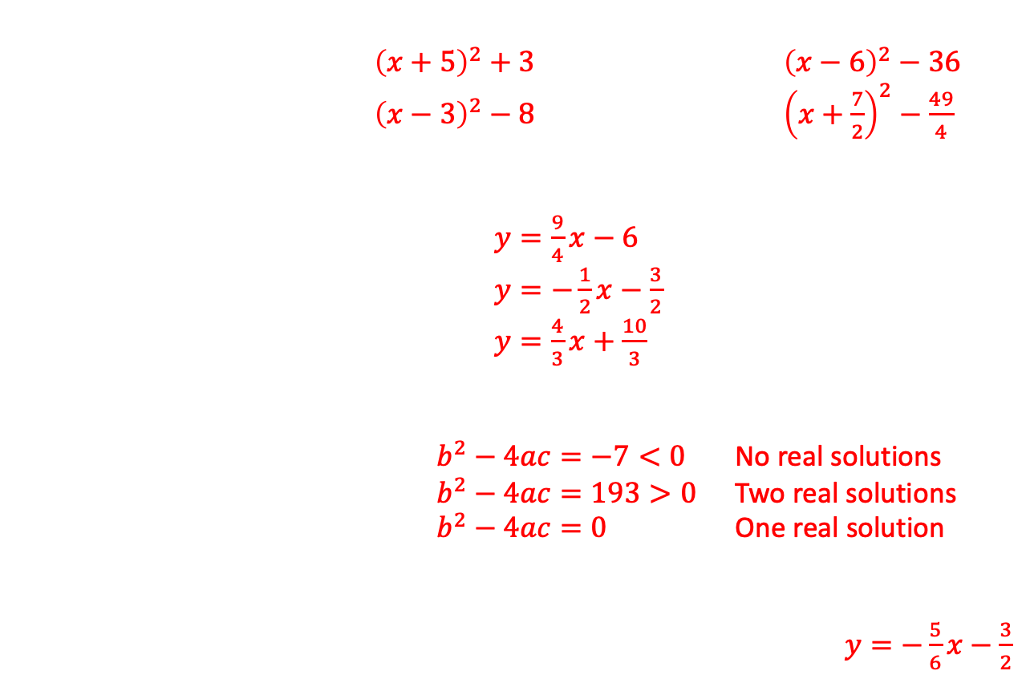
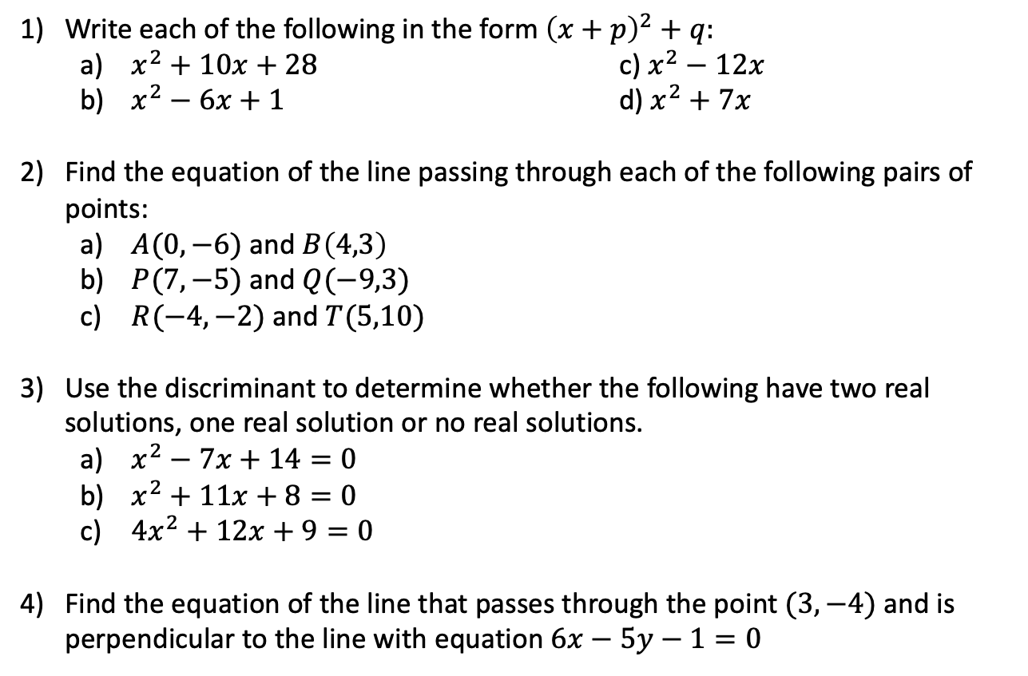
Circles
Starter (Pre-requisites)
${\left(x+5\right)}^{2}+3$ ${\left(x−6\right)}^{2}−36$
${\left(x−3\right)}^{2}−8$ ${\left(x+\frac{7}{2}\right)}^{2}−\frac{49}{4}$
$y=\frac{9}{4}x−6$
$y=−\frac{1}{2}x−\frac{3}{2}$
$y=\frac{4}{3}x+\frac{10}{3}$
$b^{2}−4ac=−7<0$ No real solutions
$b^{2}−4ac=193>0$ Two real solutions
$b^{2}−4ac=0$ One real solution
$y=−\frac{5}{6}x−\frac{3}{2}$
Write each of the following in the form ${\left(x+p\right)}^{2}+q:$
  $x^{2}+10x+28$ c) $x^{2}−12x$
  $x^{2}−6x+1$ d) $x^{2}+7x$
Find the equation of the line passing through each of the following pairs of points:
  $A(0,−6)$ and $B\left(4,3\right)$
  $P(7,−5)$ and $Q(−9,3)$
  $R(−4,−2)$ and $T(5,10)$
Use the discriminant to determine whether the following have two real solutions, one real solution or no real solutions.
  $x^{2}−7x+14=0$
  $x^{2}+11x+8=0$
  $4x^{2}+12x+9=0$
Find the equation of the line that passes through the point $(3,−4)$ and is perpendicular to the line with equation $6x−5y−1=0$

Slide 3
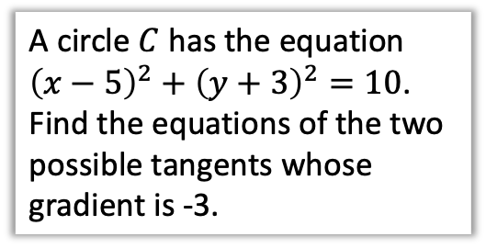
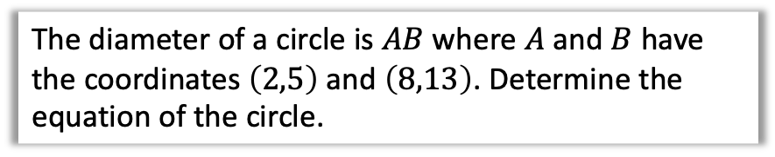
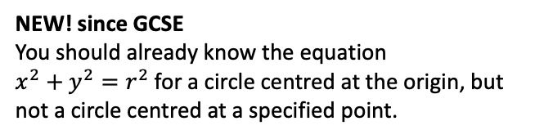
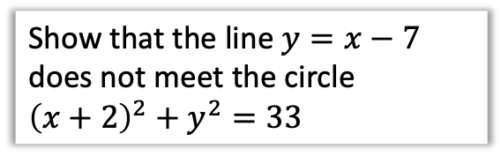
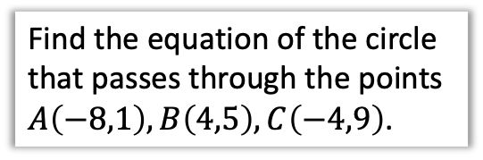
Chapter Overview
From this chapter onwards, the majority of the theory you will learn is new since GCSE.
1: Equation of a circle
2: Intersections of lines + circles
The diameter of a circle is $AB$ where $A$ and $B$ have the coordinates $\left(2,5\right)$ and $\left(8,13\right)$. Determine the equation of the circle.
Show that the line $y=x−7$ does not meet the circle ${\left(x+2\right)}^{2}+y^{2}=33$
NEW! since GCSE
You should already know the equation
$x^{2}+y^{2}=r^{2}$ for a circle centred at the origin, but not a circle centred at a specified point.
3: Chords, tangents and perpendicular bisectors.
4: Circumscribing Triangles
Find the equation of the circle that passes through the points $A\left(−8,1\right), B\left(4,5\right), C\left(−4,9\right)$.
A circle $C$ has the equation ${\left(x−5\right)}^{2}+{\left(y+3\right)}^{2}=10$. Find the equations of the two possible tangents whose gradient is -3.

Slide 4

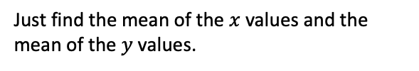



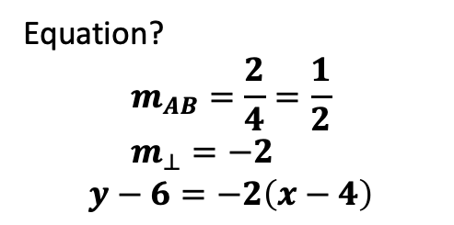
Midpoints and Perpendicular Bisectors
Later in the chapter you will need to find the perpendicular bisector of a chord of a circle.
What two properties does a perpendicular bisector of two points $A$ and $B$ have?
chord
perpendicular bisector
$$B\left(6,7\right)$$
$$A\left(2,5\right)$$
$$M\left(4,6\right)$$
Just find the mean of the $x$ values and the mean of the $y$ values.
?
1. It passes through the midpoint of $AB$.
2. It is perpendicular to $AB$.
Equation?
$$m_{AB}=\frac{2}{4}=\frac{1}{2} \\ m_{⊥}=−2$$
$$y−6=−2\left(x−4\right)$$
?

Slide 5
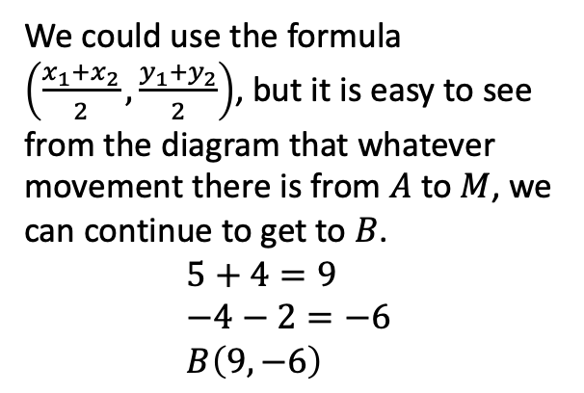
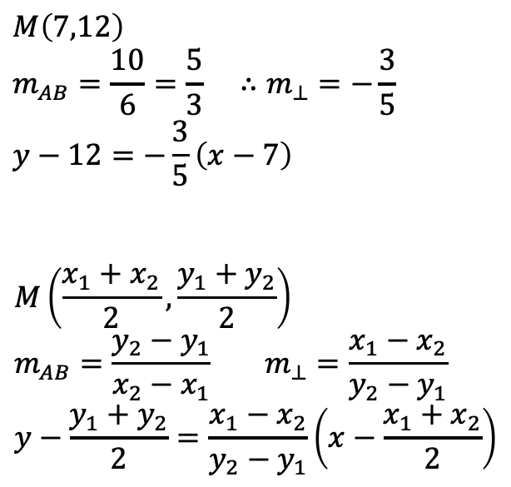

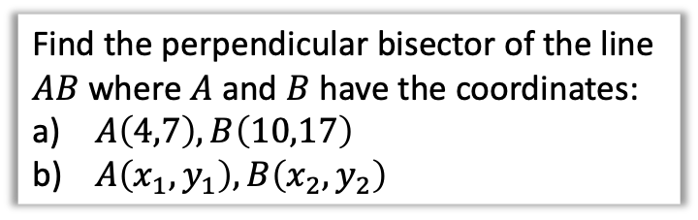


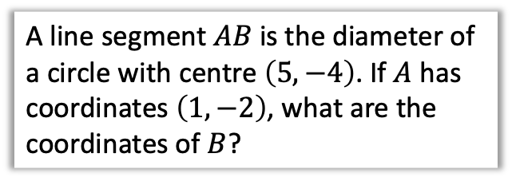
Test Your Understanding
Find the perpendicular bisector of the line $AB$ where $A$ and $B$ have the coordinates:
$A\left(4,7\right), B\left(10,17\right)$
$A\left(x_{1},y_{1}\right), B\left(x_{2},y_{2}\right)$
A line segment $AB$ is the diameter of a circle with centre $\left(5,−4\right)$. If $A$ has coordinates $\left(1,−2\right)$, what are the coordinates of $B$?
a
$$M\left(7,12\right) \\ m_{AB}=\frac{10}{6}=\frac{5}{3} ∴m_{⊥}=−\frac{3}{5} \\ y−12=−\frac{3}{5}\left(x−7\right)$$
$$M\left(\frac{x_{1}+x_{2}}{2},\frac{y_{1}+y_{2}}{2}\right) \\ m_{AB}=\frac{y_{2}−y_{1}}{x_{2}−x_{1}} m_{⊥}=\frac{x_{1}−x_{2}}{y_{2}−y_{1}} \\ y−\frac{y_{1}+y_{2}}{2}=\frac{x_{1}−x_{2}}{y_{2}−y_{1}}\left(x−\frac{x_{1}+x_{2}}{2}\right)$$
?
$$A\left(1,−2\right)$$
$$M\left(5,−4\right)$$
$$B$$
b
?
?
We could use the formula $\left(\frac{x_{1}+x_{2}}{2},\frac{y_{1}+y_{2}}{2}\right)$, but it is easy to see from the diagram that whatever movement there is from $A$ to $M$, we can continue to get to $B$.
$$5+4=9 \\ −4−2=−6 \\ B\left(9,−6\right)$$
Note: Do not try to memorise this!

Slide 6
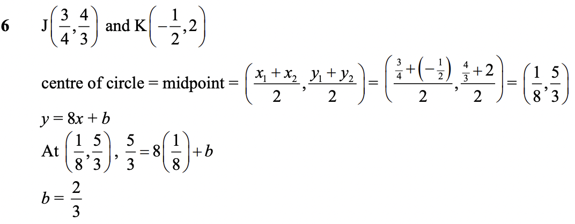
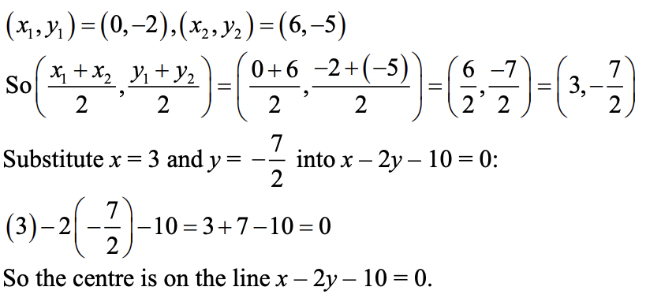
Exercise 6A - Y1 Page 115
?
?

Slide 7
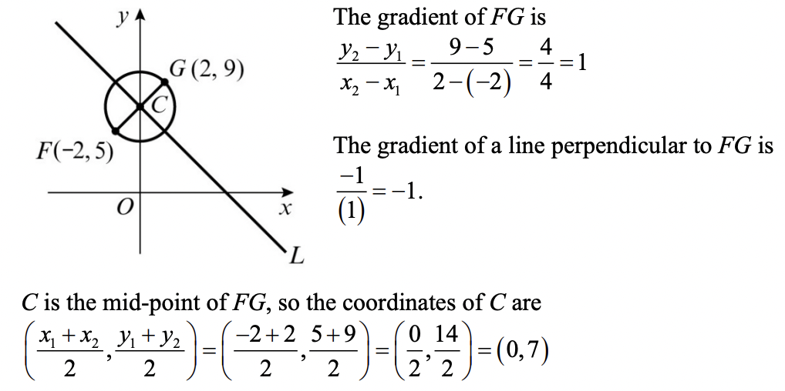
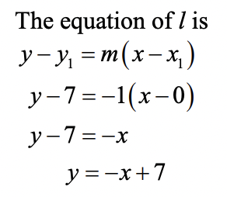
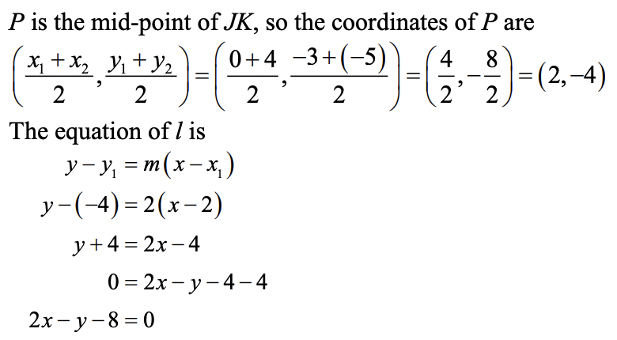
Exercise 6B - Y1 Page 116
?
?

Slide 8
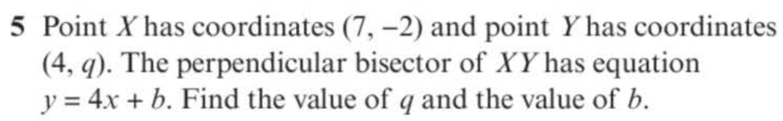
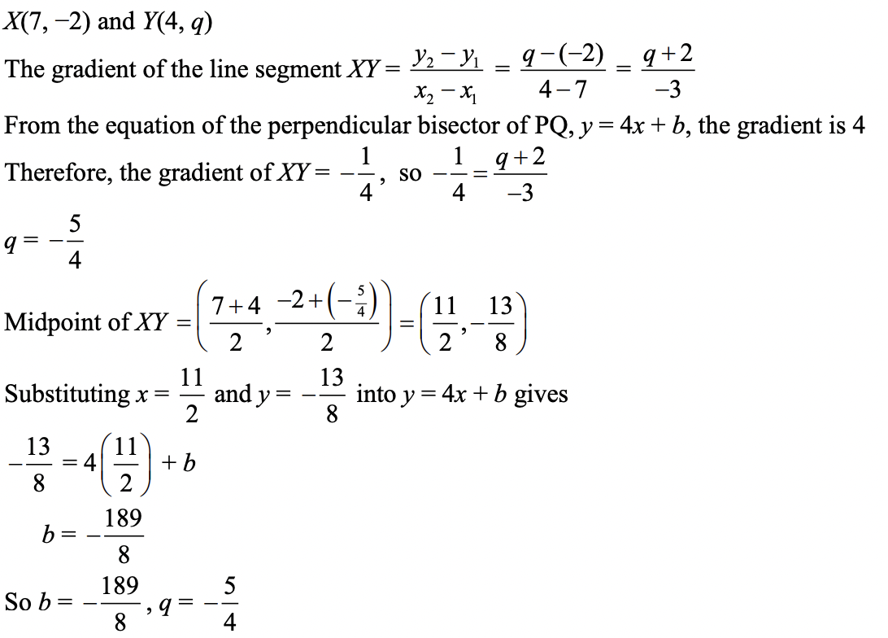
Exercise 6B - Y1 Page 117
?

Slide 9





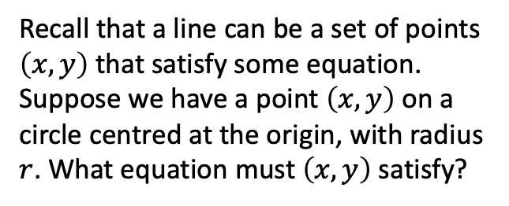
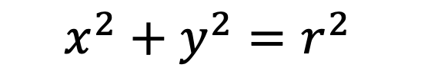



Equation of a circle
$$y$$
Recall that a line can be a set of points $\left(x,y\right)$ that satisfy some equation.
Suppose we have a point $\left(x,y\right)$ on a circle centred at the origin, with radius $r$. What equation must $\left(x,y\right)$ satisfy?
$$r$$
$$(x,y)$$
$$r$$
$$y$$
(Hint: draw a right-angled triangle inside your circle, with one vertex at the origin and another at the circumference)
$$x$$
$$x$$
$$r$$
?
$$x^{2}+y^{2}=r^{2}$$

Slide 10



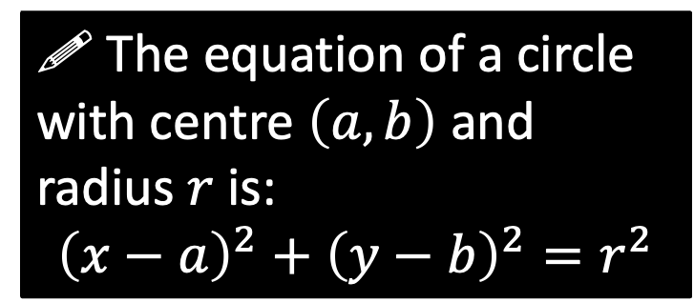
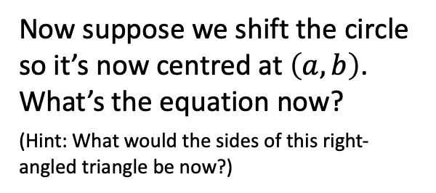
Equation of a circle
$$y$$
$$(x,y)$$
Now suppose we shift the circle so it’s now centred at $\left(a,b\right)$. What’s the equation now?
(Hint: What would the sides of this right-angled triangle be now?)
$$r$$
$$(a,b)$$
$$x$$
?
! The equation of a circle with centre $\left(a,b\right)$ and radius $r$ is:
$${\left(x−a\right)}^{2}+{\left(y−b\right)}^{2}=r^{2}$$

Slide 11





















Quickfire Questions
Centre
Radius
Equation
$$(0,0)$$
$$5$$
?
$$x^{2}+y^{2}=25$$
$$(1,2)$$
$$6$$
?
$${\left(x−1\right)}^{2}+{\left(y−2\right)}^{2}=36$$
?
?
$$(−3,5)$$
$$1$$
$${\left(x+3\right)}^{2}+{\left(y−5\right)}^{2}=1$$
?
?
$$(−5,2)$$
$$7$$
$${\left(x+5\right)}^{2}+{\left(y−2\right)}^{2}=49$$
?
?
$$(−6,0)$$
$$4$$
$${\left(x+6\right)}^{2}+y^{2}=16$$
?
?
$$(1,−1)$$
$$\sqrt{3}$$
$${\left(x−1\right)}^{2}+{\left(y+1\right)}^{2}=3$$
?
?
$$(−2,3)$$
$$2\sqrt{2}$$
$${\left(x+2\right)}^{2}+{\left(y−3\right)}^{2}=8$$

Slide 12


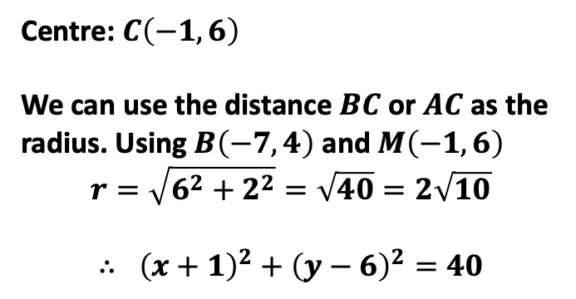
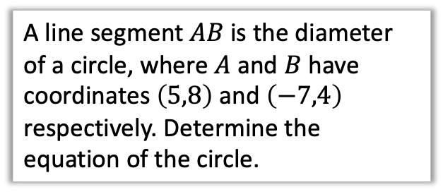
Finding the equation using points
A line segment $AB$ is the diameter of a circle, where $A$ and $B$ have coordinates $\left(5,8\right)$ and $\left(−7,4\right)$ respectively. Determine the equation of the circle.
$$A\left(5,8\right)$$
$$B\left(−7,4\right)$$
Hint: What two things do we need to use the circle formula?
?
Centre: $C\left(−1, 6\right)$
We can use the distance $BC$ or $AC$ as the radius. Using $B\left(−7,4\right)$ and $M\left(−1,6\right)$
$$r=\sqrt{6^{2}+2^{2}}=\sqrt{40}=2\sqrt{10}$$
$$∴ {\left(x+1\right)}^{2}+{\left(y−6\right)}^{2}=40$$

Slide 13
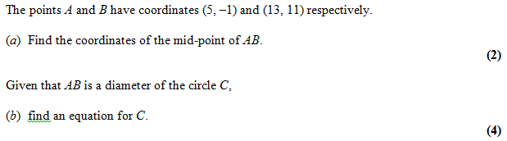
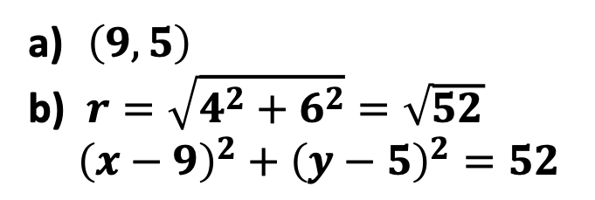
Test Your Understanding
Edexcel C2 Jan 2005 Q2
?
$\left(9, 5\right)$
$r=\sqrt{4^{2}+6^{2}}=\sqrt{52}$
${\left(x−9\right)}^{2}+{\left(y−5\right)}^{2}=52$
?

Slide 14
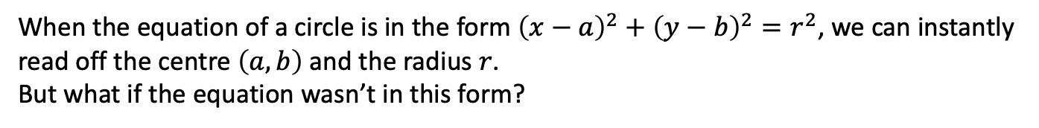
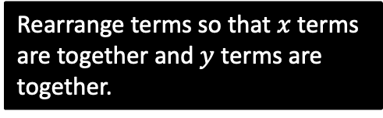
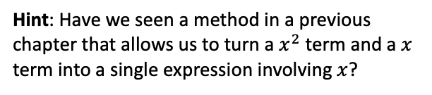
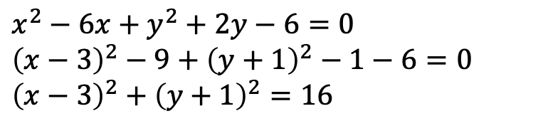
Completing the square
When the equation of a circle is in the form ${\left(x−a\right)}^{2}+{\left(y−b\right)}^{2}=r^{2}$, we can instantly read off the centre $\left(a,b\right)$ and the radius $r$.
But what if the equation wasn’t in this form?
Find the centre and radius of the circle with equation $x^{2}+y^{2}−6x+2y−6=0$
Hint: Have we seen a method in a previous chapter that allows us to turn a $x^{2}$ term and a $x$ term into a single expression involving $x$?
?
$$x^{2}−6x+y^{2}+2y−6=0 \\ {\left(x−3\right)}^{2}−9+{\left(y+1\right)}^{2}−1−6=0 \\ {\left(x−3\right)}^{2}+{\left(y+1\right)}^{2}=16$$
Rearrange terms so that $x$ terms are together and $y$ terms are together.
Complete the square!
Textbook Note: There’s a truly awful method, initially presented in the textbook, that allows you to find the centre/radius without completing the square. Don’t even contemplate using it.

Slide 15
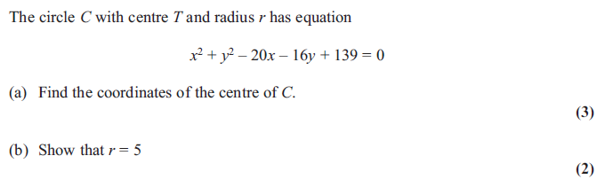
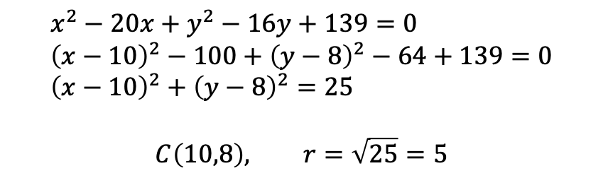
Further Example
Edexcel C2 June 2012 Q3a,b
?
$$x^{2}−20x+y^{2}−16y+139=0 \\ {\left(x−10\right)}^{2}−100+{\left(y−8\right)}^{2}−64+139=0 \\ {\left(x−10\right)}^{2}+{\left(y−8\right)}^{2}=25$$
$$C\left(10,8\right), r=\sqrt{25}=5$$

Slide 16
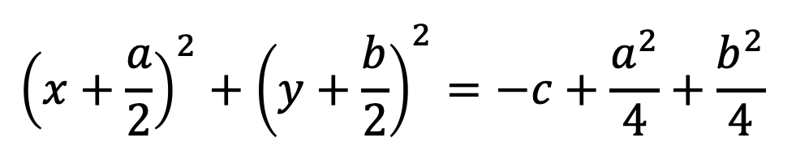
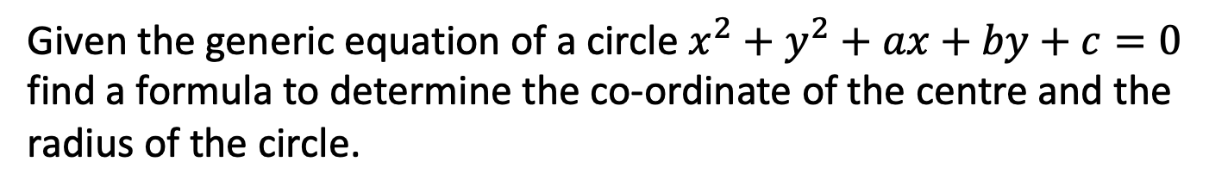
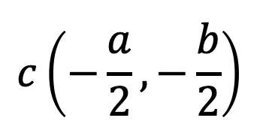
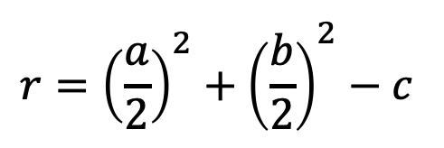
Example
Given the generic equation of a circle $x^{2}+y^{2}+ax+by+c=0$ find a formula to determine the co-ordinate of the centre and the radius of the circle.
?
$${\left(x+\frac{a}{2}\right)}^{2}+{\left(y+\frac{b}{2}\right)}^{2}=−c+\frac{a^{2}}{4}+\frac{b^{2}}{4}$$
$$r={\left(\frac{a}{2}\right)}^{2}+{\left(\frac{b}{2}\right)}^{2}−c$$
$$c\left(−\frac{a}{2},−\frac{b}{2}\right)$$

Slide 17
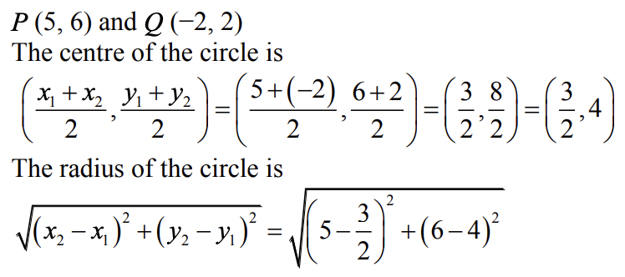
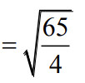
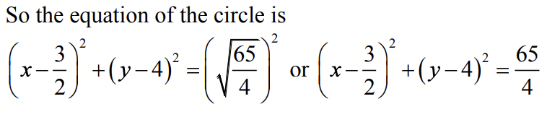
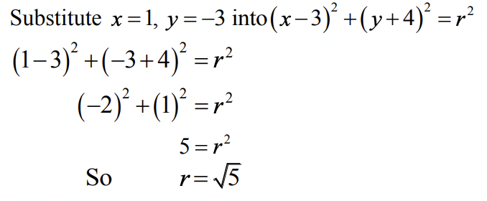
Exercise 6C - Y1 Page 120
?
?

Slide 18
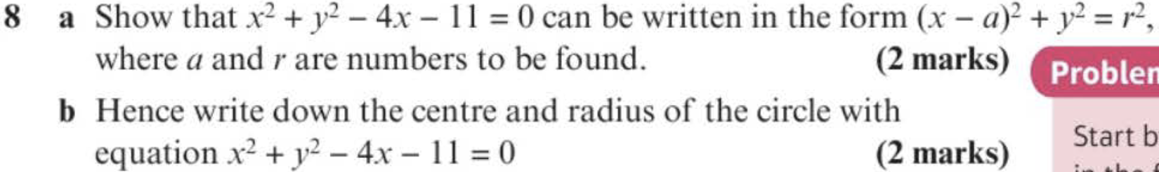
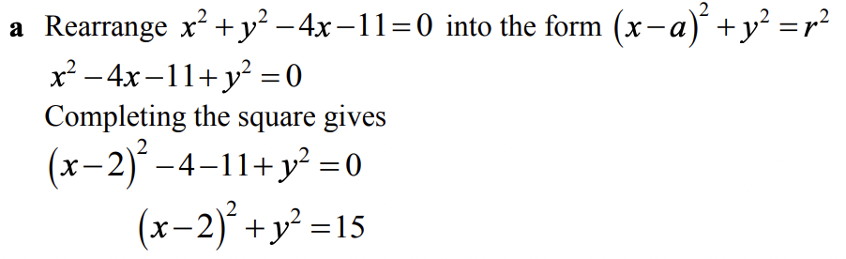

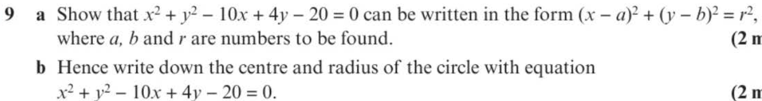
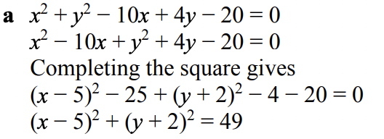

Exercise 6C - Y1 Page 120
?
?
?
?

Slide 19
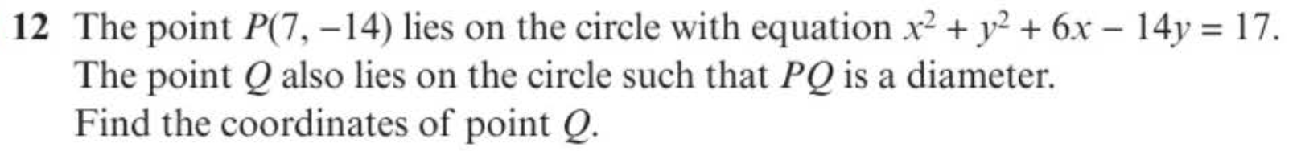
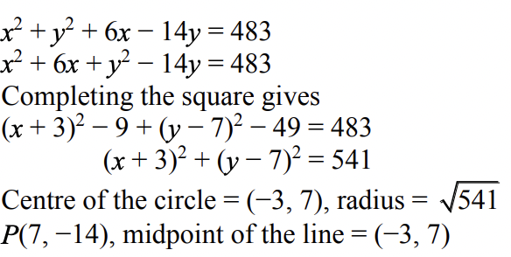
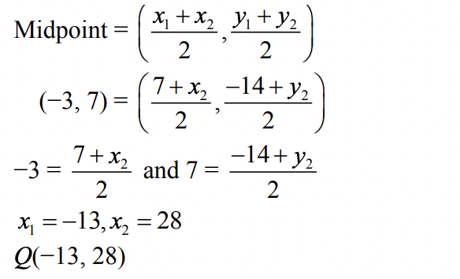
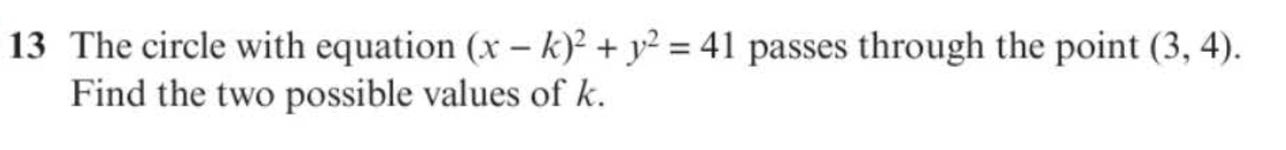

Exercise 6C - Y1 Page 120
?
?

Slide 20
















Extension
2
1
[MAT 2009 1B] The point on the circle $x^{2}+y^{2}+6x+8y=75$ which is closest to the origin, is at what distance from the origin?
$${\left(x+3\right)}^{2}+{\left(y+4\right)}^{2}=100 \\ ∴C\left(−3,−4\right), r=10$$
The closest point $P$ lies on the line between the circle centre and the origin. Since $\left(−3,−4\right)$ is 5 away from the origin, the distance between the origin and $P$ must be $10−5=5$
[MAT 2007 1D]
The point on the circle
$${\left(x−5\right)}^{2}+{\left(y−4\right)}^{2}=4$$
which is closest to the circle
$${\left(x−1\right)}^{2}+{\left(y−1\right)}^{2}=1$$
has what coordinates?
Drawing the circles on the same axes, and drawing a straight line connecting their centres, the point is where the straight line intersects the first circle.
The circle centres are 5 apart, so we need to go $\frac{2}{5}$ of the way across this line, giving $(3.4, 2.8)$
3
[MAT 2016 1I] Let $a$ and $b$ be positive real numbers. If
$x^{2}+y^{2}≤1$ then the largest that $ax+by$ can equal is what? Give your expression in terms of $a$ and $b$.
Many MAT questions consider maximising an expression in terms of $x$ and $y$. Consider for example the simple case
$x+y=k$. As we increase $k$, the line stays in the same direction but ‘sweeps’ across:
?
?
?
$$y$$
$$k=3$$
$k$, and therefore $x+y$, increase as we move in this direction.
$$k=2$$
$$k=1$$
$$x$$
If we similarly consider the line $ax+by=k$, $ax+by$ is therefore maximised when the line is tangent to the unit circle.
$$\sqrt{\frac{k^{2}}{a^{2}}+\frac{k^{2}}{b^{2}}}$$
$$\frac{k}{b}$$
$$\frac{k}{b}$$
$$\left(−3,−4\right)$$
$$ax+by=k$$
1
1
$$\frac{k}{a}$$
$$\frac{k}{a}$$
Using similar triangles, we can obtain $k=\sqrt{a^{2}+b^{2}}$

Slide 21


Intersections of Lines and Circles
Recall that to consider the intersection of two lines, we attempt to solve them simultaneously by substitution, potentially using the discriminant to show that there are no solutions (and hence no points of intersection).
Show that the line $y=x+3$ never intersects the circle with equation $x^{2}+y^{2}=1$.
?
Using substitution:
$$x^{2}+{\left(x+3\right)}^{2}=1 \\ x^{2}+x^{2}+6x+9=1 \\ 2x^{2}+6x+8=0 \\ x^{2}+3x+4=0$$
Discriminant:
$$a=1, b=3, c=4 \\ 9−16=−7$$
$−7<0$ therefore no solutions.
2 intersections (such a line is known as a secant of the circle)
1 intersections (such a line is known as a tangent of the circle)
0 intersections

Slide 22




Test Your Understanding
Find the points of intersection where the line $y=x+6$ meets
$x^{2}+{\left(y−3\right)}^{2}=29$.
Using an algebraic (and not geometric) method, determine the $k$ such that the line $y=x+k$ touches the circle with equation $x^{2}+y^{2}=1$.
?
$$x^{2}+{\left(x+6−3\right)}^{2}=29 \\ x^{2}+x^{2}+6x+9=29 \\ 2x^{2}+6x−20=0 \\ x^{2}+3x−10=0 \\ \left(x+5\right)\left(x−2\right)=0 \\ x=−5 or x=2 \\ y=1 or y=8 \\ \left(−5, 1\right), \left(2,8\right)$$
?
$$x^{2}+{\left(x+k\right)}^{2}=1 \\ x^{2}+x^{2}+2kx+k^{2}=1 \\ 2x^{2}+2kx+k^{2}−1=0$$
If the line touches the circle, one point of intersection and therefore one solution.
Discriminant:
$$a=2, b=2k, c=k^{2}−1 \\ 4k^{2}−4\left(2\right)\left(k^{2}−1\right)=0 \\ 4k^{2}−8k^{2}+8=0 \\ 4k^{2}−8=0 \\ k=±\sqrt{2}$$

Slide 23



Exercise 6D - Y1 Page 122
a?
a?

Slide 24








Exercise 6D - Y1 Page 122
b?
a?
?

Slide 25
Tangents, Chords, Perpendicular Bisectors
There are two circle theorems that are of particular relevance to problems in this chapter, the latter you might be less familiar with:
tangent
perpendicular bisector
radius
chord
The tangent is perpendicular to the radius (at the point of intersection).
The perpendicular bisector of any chord passes through the centre of the circle.
Why this will help:
If we knew the centre of the circle and the point of intersection, we can easily find the gradient of the radius, and thus the gradient and hence equation of the tangent.
Why this will help:
The first thing we did in this chapter is find the equation of the perpendicular bisector. If we had two chords, and hence found two bisectors, we could find the point of intersection, which would be the centre of the circle.

Slide 26







Examples
A circle $C$ has equation
$${\left(x−4\right)}^{2}+{\left(y+4\right)}^{2}=10$$
The line $l$ is a tangent to the circle and has gradient -3. Find two possible equations for $l$, giving your answers in the form $y=mx+c$.
The circle $C$ has equation
${\left(x−3\right)}^{2}+{\left(y−7\right)}^{2}=100$.
Verify the point $P\left(11,1\right)$ lies on $C$.
Find an equation of the tangent to $C$ at the point $P$, giving your answer in the form $ax+by+c=0$
This time we have the gradient, but don’t have the points where the tangent(s) intersect the radius.
?
Equation of radius/diameter:
$$y+4=\frac{1}{3}\left(x−4\right) \\ y=\frac{1}{3}x−\frac{16}{3}$$
Intersecting with circle:
$${\left(x−4\right)}^{2}+{\left(\frac{1}{3}x−\frac{16}{3}+4\right)}^{2}=10$$
?
$$m=−3$$
${\left(11−3\right)}^{2}+{\left(1−7\right)}^{2}$
$=8^{2}+6^{2}=100$
Circle centre: $\left(3,7\right)$
Gradient of radius:
$m_{r}=\frac{1−7}{11−3}=−\frac{3}{4}$
$∴m_{t}=\frac{4}{3}$
$y−1=\frac{4}{3}\left(x−11\right)$
$3y−3=4\left(x−11\right)$
$3y−3=4x−44$
$4x−3y−41=0$
$$\left(4,−4\right)$$
Tip: Use ‘subscripting’ of variables to make clear to the examiner (and yourself!) what you’re calculating.
Solving results in the points $\left(1,−5\right), \left(7,−3\right)$.
Then equations of tangents:
$$y+5=−3\left(x−1\right) → y=−3x−2 \\ y+3=−3\left(x−7\right) → y=−3x+18$$

Slide 27










Determining the Circle Centre
$$y$$
The points $P$ and $Q$ lie on a circle with centre $C$, as shown in the diagram. The point $P$ has coordinates $(−8,−2)$ and the point $Q$ has coordinates $\left(2,−6\right)$. $M$ is the midpoint of the line segment $PQ$.
The line $l$ passes through the points $M$ and $C$.
a) Find an equation for $l$.
b) Given that the $y$-coordinate of $C$ is -9:
i) show that the $x$-coordinate of $C$ is -5.
ii) find an equation of the circle.
$$x$$
$$P\left(−8,−2\right)$$
$$M$$
$$Q\left(2,−6\right)$$
$$C$$
$$l$$
a
We know the line going through the midpoint of a chord and a centre of the circle is the perpendicular bisector of the chord.
$M(−3, −4)$
$m_{PQ}=−\frac{4}{10}=−\frac{2}{5} ∴ m_{MC}=\frac{5}{2}$
Equation of $l$: $y+4=\frac{5}{2}\left(x+3\right)$
?
Exam Tip: If you’re not asked for the equation in a particular form, just leave it as it is.
b
When $y=−9$: $−9+4=\frac{5}{2}\left(x+3\right) … x=−5 → C(−5,−9)$
Use either $PC$ or $CQ$ for the radius.
$r=PC=\sqrt{3^{2}+7^{2}}=\sqrt{58}$
$∴ {\left(x+5\right)}^{2}+{\left(y+9\right)}^{2}=58$
?
c
?

Slide 28




Test Your Understanding
A circle has centre $C\left(3,5\right)$, and goes through the point $P(6,9)$. Find the equation of the tangent of the circle at the point $P$, giving your equation in the form $ax+by+c=0$ where $a,b,c$ are integers..
A circle passes through the points $A(0,0)$ and $B\left(4,2\right)$. The centre of the circle has $x$ value -1. Determine the equation of the circle.
?
$$m_{AB}=\frac{2}{4}=\frac{1}{2} m_{⊥}=−2 \\ M\left(2,1\right)$$
Equation of perpendicular bisector of chord:
$$y−1=−2\left(x−2\right)$$
When $x=−1$:
$$y−1=−2\left(−1−2\right) \\ y−1=6 \\ y=7$$
Centre: $C(−1,7)$
Radius (using length $AC$): $\sqrt{1^{2}+7^{2}}=\sqrt{50}$
$${\left(x+1\right)}^{2}+{\left(y−7\right)}^{2}=50$$
?
$$m_{r}=\frac{4}{3} ∴m_{t}=−\frac{3}{4} \\ y−9=−\frac{3}{4}\left(x−6\right) \\ 4y−36=−3\left(x−6\right) \\ 4y−36=−3x+18 \\ 3x+4y−54=0$$

Slide 29





Exercise 6E - Y1 Page 126-128
a?
b?

Slide 30




Exercise 6E - Y1 Page 126-128
a?
d?
b?
c?

Slide 31



Exercise 6E - Y1 Page 126-128
Extension:
2
[AEA 2006 Q4] The line with equation $y=mx$ is a tangent to the circle $C_{1}$ with equation ${\left(x+4\right)}^{2}+{\left(y−7\right)}^{2}=13$
(a) Show that $m$ satisfies the equation $3m^{2}+56m+36=0$
The tangents from the origin $O$ to $C_{1}$ touch $C_{1}$ at the points $A$ and $B$.
(b) Find the coordinates of the points $A$ and $B$.
Another circle $C_{2}$ has equation $x^{2}+y^{2}=13$. The tangents from the point $\left(4,−7\right)$ to $C_{2}$ touch it at the points $P$ and $Q$.
(c) Find the coordinates of either the point $P$ or the point $Q$.
Mark scheme on next slide.
1
[MAT 2012 1A] Which of the following lines is a tangent to the circle with equation
$x^{2}+y^{2}=4$?
$x+y=2$
$y=x−2\sqrt{2}$
$x=\sqrt{2}$
$y=\sqrt{2}−x$
Solution: B. Note that we could avoid using algebra by using a suitable diagram and simple use of Pythagoras to get the $y$-intercept.
(This is not a tangent/chord question but is worthwhile regardless!)
3
[STEP 2005 Q6]
The point $A$ has coordinates $\left(5,16\right)$ and the point $B$ has coordinates $\left(4,−4\right)$. The variable $P$ has coordinates $\left(x,y\right)$ and moves on a path such that $AP=2BP$. Show that the Cartesian equation of the path of $P$ is ${\left(x+7\right)}^{2}+y^{2}=100$.
The point $C$ has coordinates $\left(a,0\right)$ and the point $D$ has coordinates $\left(b,0\right)$. The variable point $Q$ moves on a path such that $QC=k×QD$, where $k>1$.
Given that the path of $Q$ is the same as the path of $P$, show that
$\frac{a+7}{b+7}=\frac{a^{2}+51}{b^{2}+51}$
Show further that $\left(a+7\right)\left(b+7\right)=100$, in the case $a≠b$.
?
Mark scheme on next slide.

Slide 32


Mark Scheme for Extension Question 2
?
?
?

Slide 33

Mark Scheme for Extension Question 3
?
?

Slide 34
Triangles in Circles
We’d say:
The triangle inscribes the circle.
(A shape inscribes another if it is inside and its boundaries touch but do not intersect the outer shape)
The circle circumscribes the triangle.
If the circumscribing shape is a circle, it is known as the circumcircle of the triangle.
The centre of a circumcircle is known as the circumcentre.

Slide 35




Triangles in Circles
$$B$$
$$C$$
$$A$$
If $∠ABC=90°$ then:
$AC$ is the diameter of the circumcircle of triangle $ABC$.
Similarly if $AC$ is the diameter of a circle:
$∠ABC=90°$ therefore $AB$ is perpendicular to $BC$.
$AB^{2}+BC^{2}=AC^{2}$
Given three points/a triangle we can find the centre of the circumcircle by:
Finding the equation of the perpendicular bisectors of two different sides.
Find the point of intersection of the two bisectors.
?
?
?

Slide 36







Example
$$C\left(−4,9\right)$$
[Textbook] The points $A\left(−8,1\right), B\left(4,5\right),C\left(−4,9\right)$ lie on a circle.
a) Show that $AB$ is a diameter of the circle.
$$B\left(4,5\right)$$
$$A\left(−8,1\right)$$
Method 1:
Show that $AC^{2}+BC^{2}=AB^{2}$
$$AC=\sqrt{4^{2}+8^{2}}=\sqrt{80} \\ BC=\sqrt{8^{2}+4^{2}}=\sqrt{80} \\ AB=\sqrt{{12}^{2}+4^{2}}=\sqrt{160} \\ 80+80=160$$
Therefore $AB$ is the diameter.
Method 2: (not in textbook!)
Show that $AC$ is perpendicular to $BC$.
$$m_{AC}=\frac{8}{4}=2 \\ m_{CB}=−\frac{4}{8}=−\frac{1}{2} \\ 2×−\frac{1}{2}=−1$$
$∴$ $AC$ is perpendicular to $BC$
Therefore $AB$ is the diameter.
?
?
b) Hence find the equation of the circle.
?
Centre is midpoint of $AB$: $M\left(−2,3\right)$
Radius: $r=AM=\sqrt{6^{2}+2^{2}}=\sqrt{40}$
$${\left(x+2\right)}^{2}+{\left(y−3\right)}^{2}=40$$

Slide 37





Example
$$C\left(8,18\right)$$
The points $A\left(0,2\right), B\left(2,0\right),C\left(8,18\right)$ lie on the circumference of a circle. Determine the equation of the circle.
Perpendicular bisector of $AB$:
By inspection, $y=x$
Perpendicular bisector of $AC$:
Midpoint: $\left(4,10\right)$
$$m_{AC}=\frac{16}{8}=2 ∴m_{⊥}=−\frac{1}{2}$$
$$y−10=−\frac{1}{2}\left(x−4\right)$$
Solving simultaneously with $y=x$:
$$x−10=−\frac{1}{2}\left(x−4\right) \\ 2x−20=−x+4 \\ 3x=24 \\ x=8 ∴y=8$$
Centre is $(8,8)$.
Using $A$ and centre of circle: $r=\sqrt{8^{2}+6^{2}}=10$
Equation of circle: ${\left(x−8\right)}^{2}+{\left(y−8\right)}^{2}=100$
?
$$A\left(0,2\right)$$
$$B\left(2,0\right)$$

Slide 38




Exercise 6F - Y1 Page 131-132
a?
b?

Slide 39


Exercise 6F - Y1 Page 131-132
a?
b?
c?

Slide 40

Exercise 6F - Y1 Page 131-132
Extension:
1
[STEP 2009 Q8 Edited] If equation of the circle $C$ is ${\left(x−2t\right)}^{2}+{\left(y−t\right)}^{2}=t^{2}$, where $t$ is a positive number, it can be shown that $C$ touches the line $y=0$ as well as the line $3y=4x$.
Find the equation of the incircle of the triangle formed by the lines $y=0$, $3y=4x$ and $4y+3x=15$.
Note: The incircle of a triangle is the circle, lying totally inside the triangle, that touches all three sides.
Solution: ${\left(x−2\right)}^{2}+{\left(y−1\right)}^{2}=1$
?

