Slide 1
Y1 Chapter 8
Binomial Expansion

Slide 2
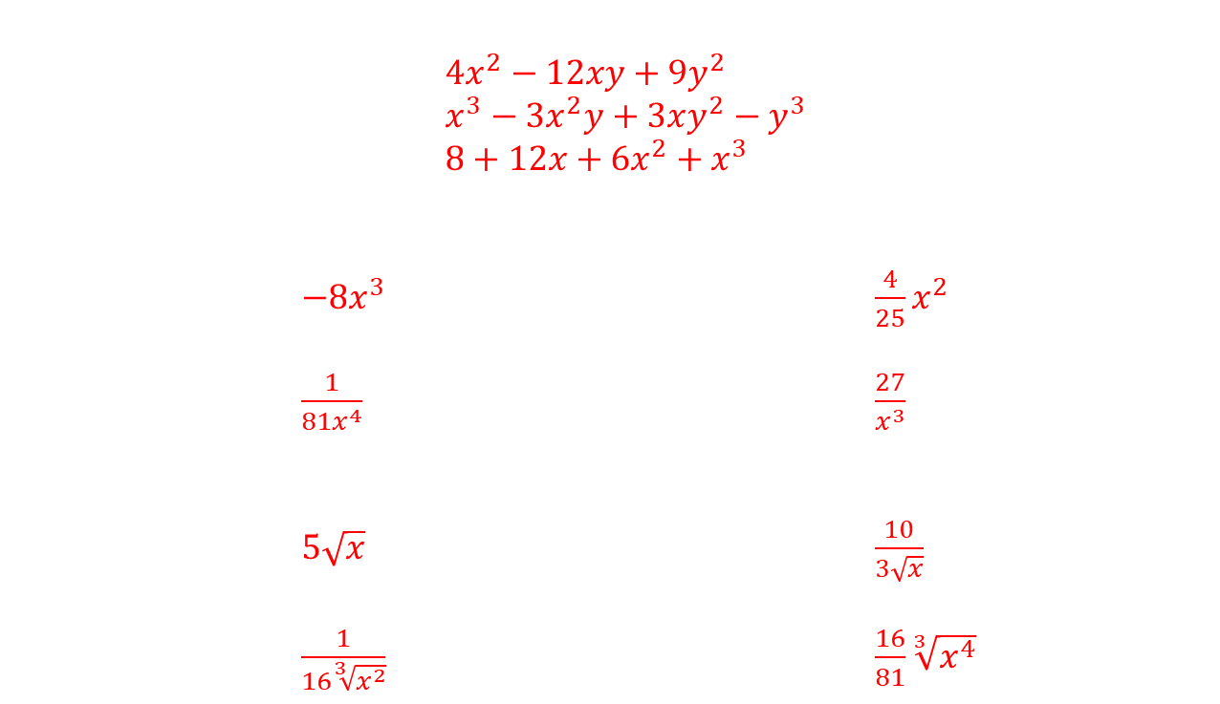
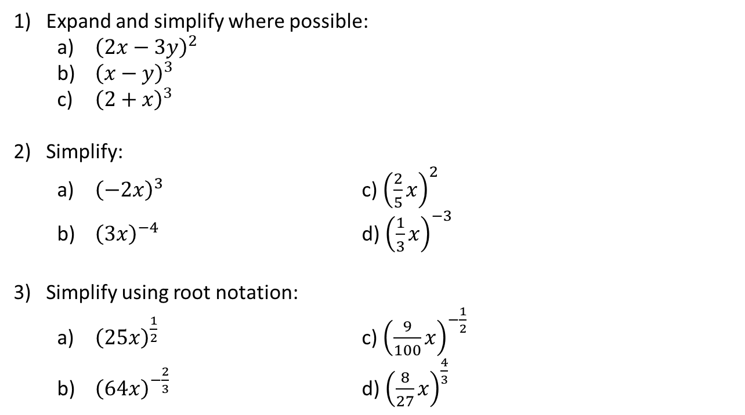
Starters
$4x^{2}−12xy+9y^{2}$
$x^{3}−3x^{2}y+3xy^{2}−y^{3}$
$8+12x+6x^{2}+x^{3}$
$−8x^{3}$ $\frac{4}{25}x^{2}$
$\frac{1}{81x^{4}}$ $\frac{27}{x^{3}}$
$5\sqrt{x}$ $\frac{10}{3\sqrt{x}}$
$\frac{1}{16\sqrt[3]{x^{2}}}$ $\frac{16}{81}\sqrt[3]{x^{4}}$
Expand and simplify where possible:
  ${\left(2x−3y\right)}^{2}$
  ${\left(x−y\right)}^{3}$
  ${\left(2+x\right)}^{3}$
Simplify:
  ${\left(−2x\right)}^{3}$ c) ${\left(\frac{2}{5}x\right)}^{2}$
  ${\left(3x\right)}^{−4}$ d) ${\left(\frac{1}{3}x\right)}^{−3}$
Simplify using root notation:
  ${\left(25x\right)}^{\frac{1}{2}}$ c) ${\left(\frac{9}{100}x\right)}^{−\frac{1}{2}}$
  ${\left(64x\right)}^{−\frac{2}{3}}$ d) ${\left(\frac{8}{27}x\right)}^{\frac{4}{3}}$

Slide 3

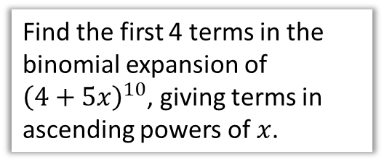

Chapter Overview
1: Pascal’s Triangle
1
1 1
1 2 1
1 3 3 1
2: Factorial Notation
Given that $\left(\begin{matrix}8 \\ 3\end{matrix}\right)=\frac{8!}{3!a!}$, find the value of $a$.
4: Using expansions for estimation
3: Binomial Expansion
Use your expansion to estimate the value of ${1.05}^{10}$ to 5 decimal places.
Find the first 4 terms in the binomial expansion of ${\left(4+5x\right)}^{10}$, giving terms in ascending powers of $x$.

Slide 4
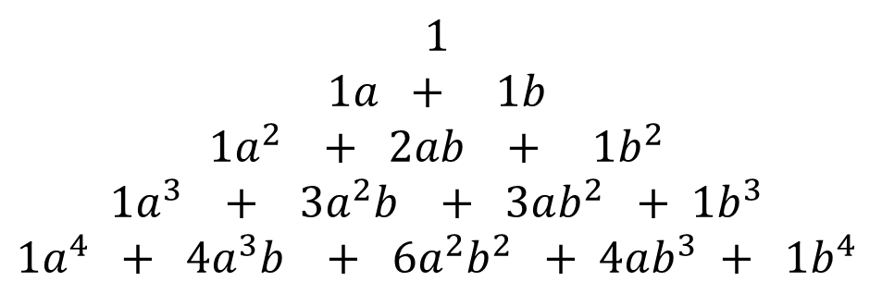
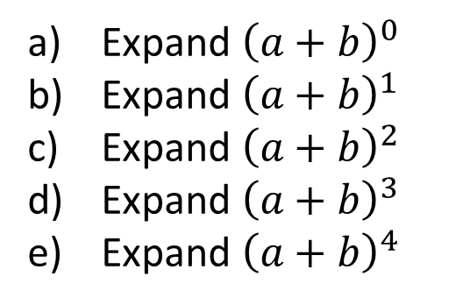

Starter
Expand ${\left(a+b\right)}^{0}$
Expand ${\left(a+b\right)}^{1}$
Expand ${\left(a+b\right)}^{2}$
Expand ${\left(a+b\right)}^{3}$
Expand ${\left(a+b\right)}^{4}$
$$1$$
$$1a + 1b$$
$$1a^{2} + 2ab + 1b^{2}$$
$$1a^{3} + 3a^{2}b + 3ab^{2} + 1b^{3}$$
$$1a^{4} + 4a^{3}b + 6a^{2}b^{2} + 4ab^{3} + 1b^{4}$$
?
?
?
?
?
What do you notice about:
?
The coefficients: They follow Pascal’s triangle (we’ll explore on next slide).
The powers of $a$ and $b$: Power of $a$ decreases each time (starting at the power)
Power of $b$ increases each time (starting at 0)
?

Slide 5
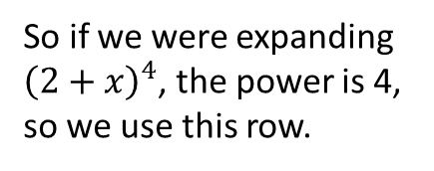
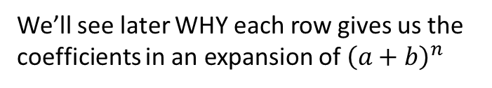
More on Pascal’s Triangle
The second number of each row tells us what row we should use for an expansion.
In Pascal’s Triangle, each term (except for the 1s) is the sum of the two terms above.
1
So if we were expanding ${\left(2+x\right)}^{4}$, the power is 4, so we use this row.
1
1
1
2
1
Tip: memorise each row up to what you see here.
1
3
3
1
1
4
6
4
1
1
5
10
10
5
1
We’ll see later WHY each row gives us the coefficients in an expansion of ${\left(a+b\right)}^{n}$

Slide 6

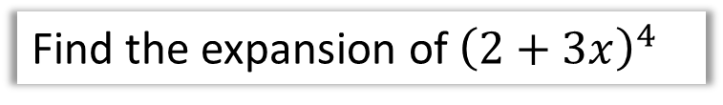
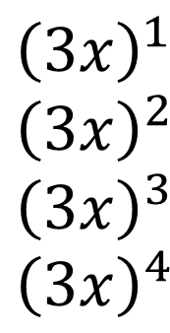
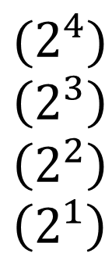
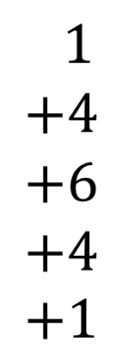
Example
Next have descending or ascending powers of one of the terms, going between 0 and 4 (note that if the power is 0, the term is 1, so we need not write it).
Find the expansion of ${\left(2+3x\right)}^{4}$
$$1 \\ +4 \\ +6 \\ +4 \\ +1$$
$$(2^{4}) \\ \left(2^{3}\right) \\ \left(2^{2}\right) \\ \left(2^{1}\right)$$
$${\left(2+3x\right)}^{4}=$$
$${\left(3x\right)}^{1} \\ {\left(3x\right)}^{2} \\ {\left(3x\right)}^{3} \\ {\left(3x\right)}^{4}$$
First fill in the correct row of Pascal’s triangle.
And do the same with the second term but with powers going the opposite way, noting again that the ‘power of 0’ term does not appear.
Simplify each term (ensuring any number in a bracket is raised to the appropriate power)
$$=16+96x+216x^{2}+216x^{3}+81x^{4}$$
Tip: Initially write one line per term for your expansion (before you simplify at the end), as we have done above. There will be less faffing trying to ensure you have enough space for each term.

Slide 7
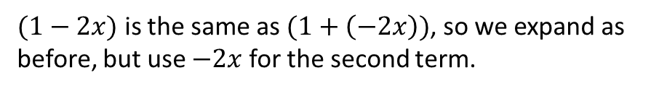


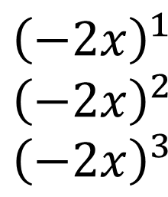
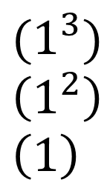
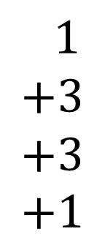
Another Example
$(1−2x)$ is the same as $(1+\left(−2x\right))$, so we expand as before, but use $−2x$ for the second term.
$${\left(1−2x\right)}^{3}=$$
$$1 \\ +3 \\ +3 \\ +1$$
$$(1^{3}) \\ \left(1^{2}\right) \\ \left(1\right)$$
$${\left(−2x\right)}^{1} \\ {\left(−2x\right)}^{2} \\ {\left(−2x\right)}^{3}$$
$$=1−6x+12x^{2}−8x^{3}$$
Tip: If one of the terms in the original bracket is negative, the terms in your expansion will oscillate between positive and negative. If they don’t (e.g. two consecutive negatives), you’ve done something wrong!

Slide 8
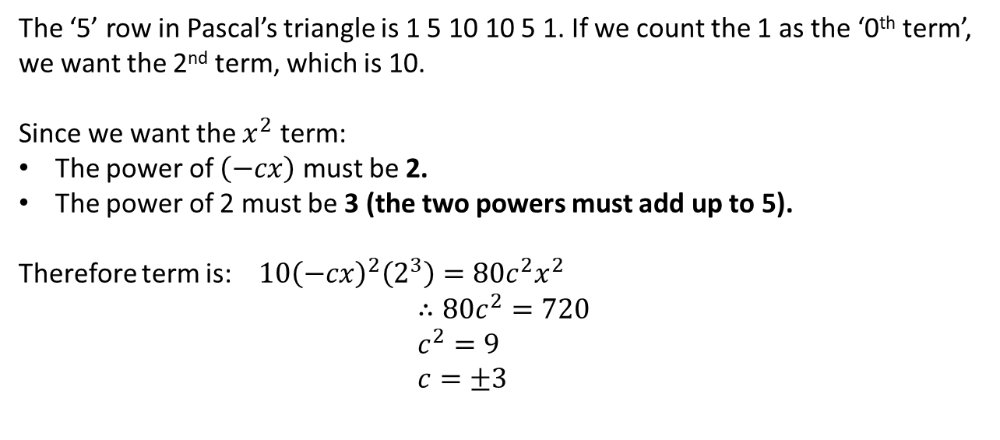
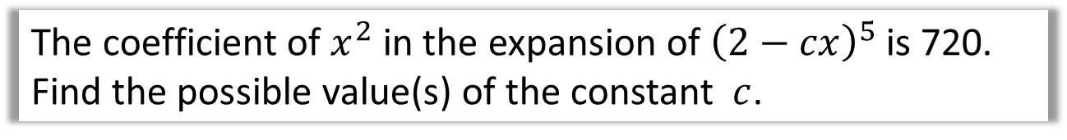
Getting a single term in the expansion
The coefficient of $x^{2}$ in the expansion of ${\left(2−cx\right)}^{5}$ is 720. Find the possible value(s) of the constant $c$.
The ‘5’ row in Pascal’s triangle is 1 5 10 10 5 1. If we count the 1 as the ‘0th term’, we want the 2nd term, which is 10.
Since we want the $x^{2}$ term:
The power of $\left(−cx\right)$ must be 2.
The power of 2 must be 3 (the two powers must add up to 5).
Therefore term is: $10{\left(−cx\right)}^{2}\left(2^{3}\right)={80c}^{2}x^{2}$
$$∴80c^{2}=720 \\ c^{2}=9 \\ c=±3$$
?
?
?

Slide 9
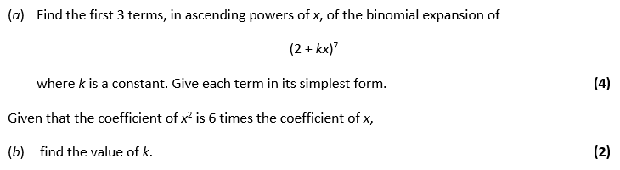
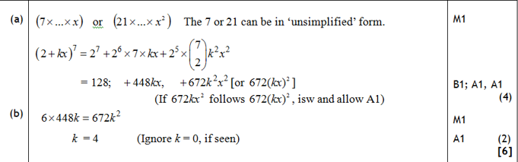
Test Your Understanding
Edexcel C2
?
?

Slide 10
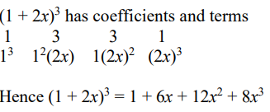
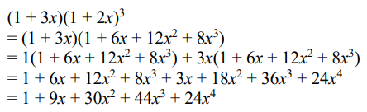
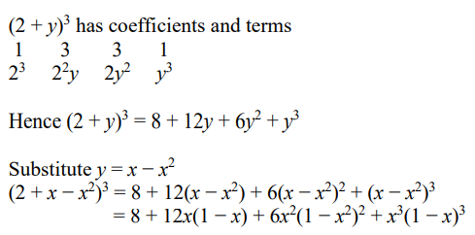
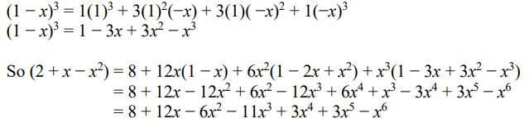
Exercise 8A – Y1 page 160-161
?
?

Slide 11
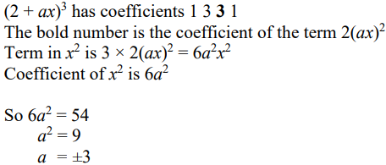
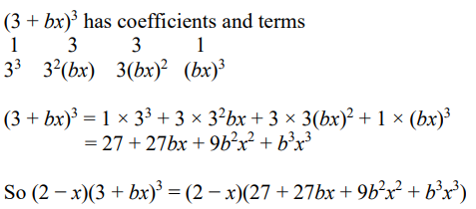
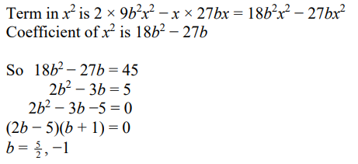
Exercise 8A – Y1 page 160-161
?
?

Slide 12


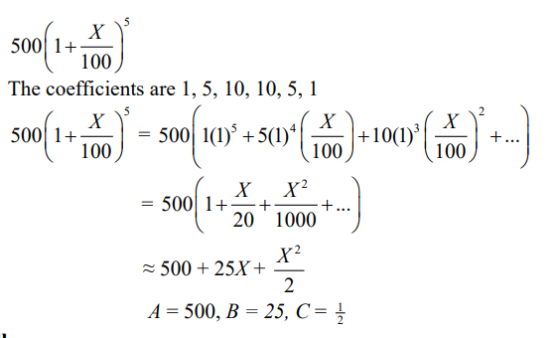
Exercise 8A – Y1 page 160-161
?
?

Slide 13
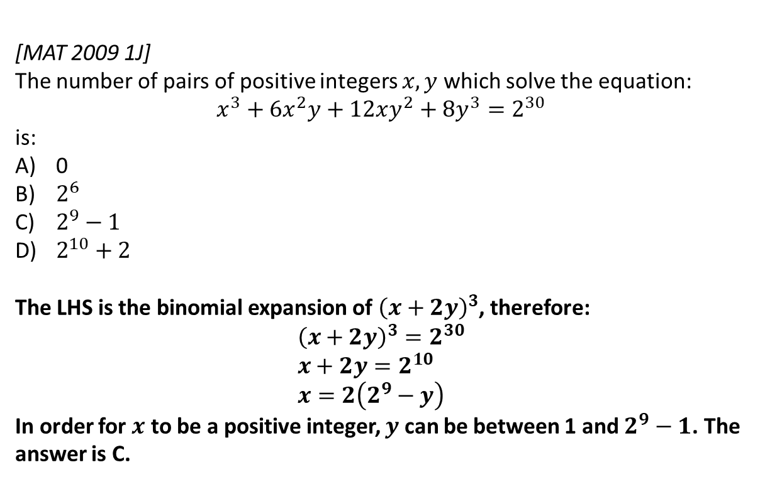
Extension
[MAT 2009 1J]
The number of pairs of positive integers $x,y$ which solve the equation:
$$x^{3}+6x^{2}y+12xy^{2}+8y^{3}=2^{30}$$
is:
0
$2^{6}$
$2^{9}−1$
$2^{10}+2$
The LHS is the binomial expansion of ${\left(x+2y\right)}^{3}$, therefore:
$${\left(x+2y\right)}^{3}=2^{30} \\ x+2y=2^{10} \\ x=2\left(2^{9}−y\right)$$
In order for $x$ to be a positive integer, $y$ can be between 1 and $2^{9}−1$. The answer is C.
1
?

Slide 14
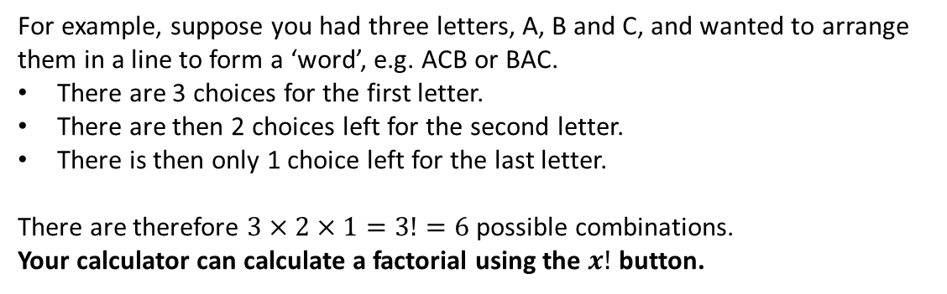

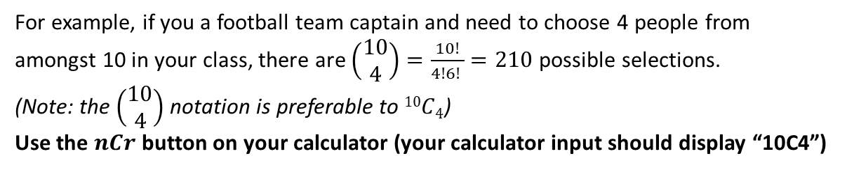
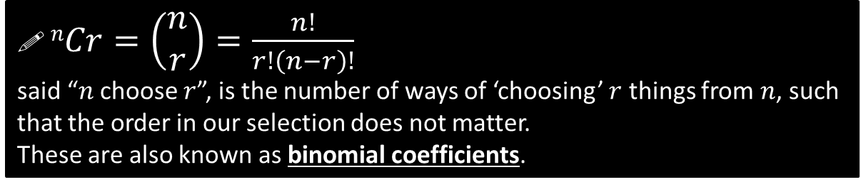
Factorial and Choose Function
! $n!=n×\left(n−1\right)×\left(n−2\right)×…×2×1$
said “$n$ factorial”, is the number of ways of arranging $n$ objects in a line.
For example, suppose you had three letters, A, B and C, and wanted to arrange them in a line to form a ‘word’, e.g. ACB or BAC.
There are 3 choices for the first letter.
There are then 2 choices left for the second letter.
There is then only 1 choice left for the last letter.
There are therefore $3×2×1=3!=6$ possible combinations.
Your calculator can calculate a factorial using the $x!$ button.
! $nCr=\left(\begin{matrix}n \\ r\end{matrix}\right)=\frac{n!}{r!\left(n−r\right)!}$
said “$n$ choose $r$”, is the number of ways of ‘choosing’ $r$ things from $n$, such that the order in our selection does not matter.
These are also known as binomial coefficients.
For example, if you a football team captain and need to choose 4 people from amongst 10 in your class, there are $\left(\begin{matrix}10 \\ 4\end{matrix}\right)=\frac{10!}{4!6! }=210$ possible selections.
(Note: the $\left(\begin{matrix}10 \\ 4\end{matrix}\right)$ notation is preferable to $10C4$)
Use the $nCr$ button on your calculator (your calculator input should display “10C4”)

Slide 15
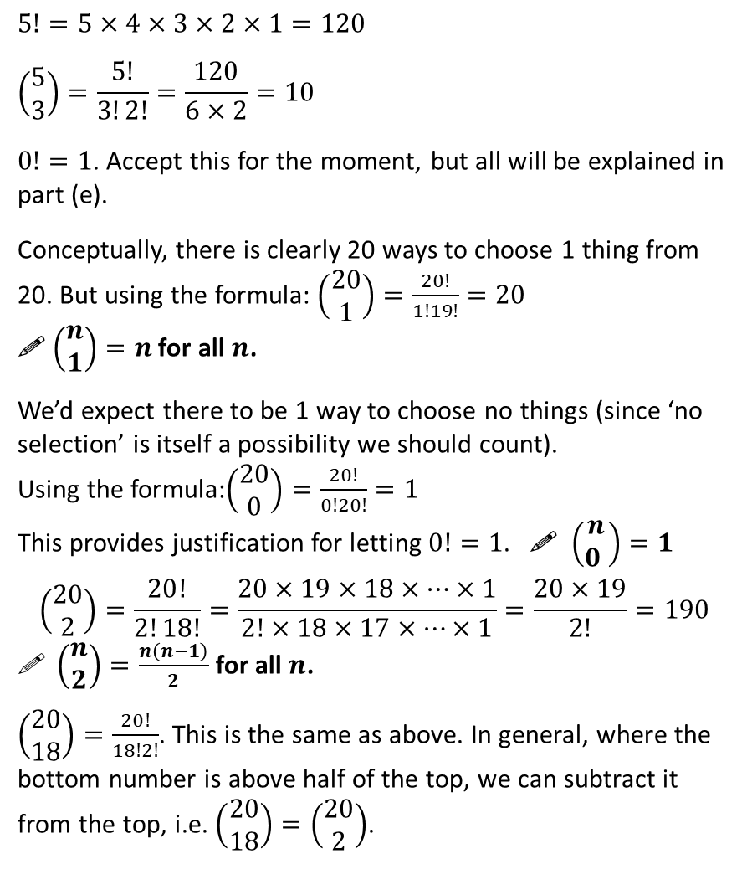
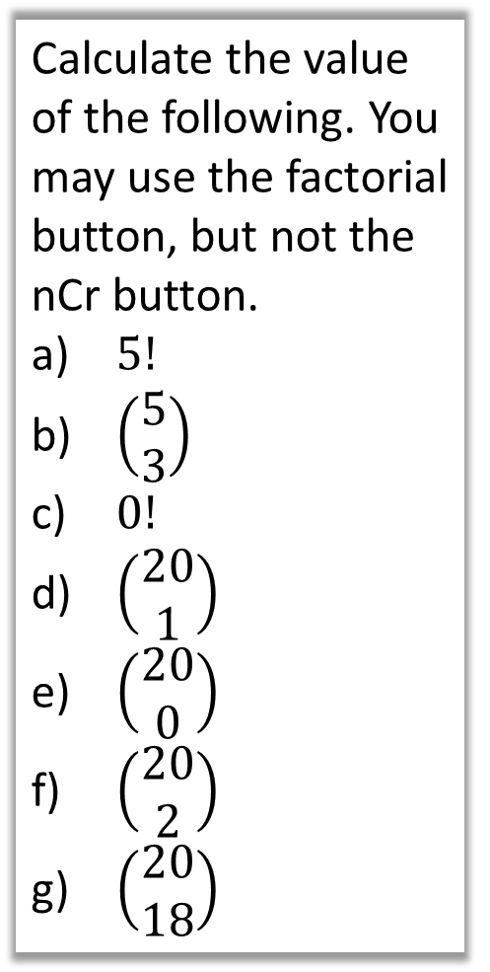
Examples
$$5!=5×4×3×2×1=120$$
$$\left(\begin{matrix}5 \\ 3\end{matrix}\right)=\frac{5!}{3!2!}=\frac{120}{6×2}=10$$
$0!=1$. Accept this for the moment, but all will be explained in part (e).
Conceptually, there is clearly 20 ways to choose 1 thing from 20. But using the formula: $\left(\begin{matrix}20 \\ 1\end{matrix}\right)=\frac{20!}{1!19!}=20$
! $\left(\begin{matrix}n \\ 1\end{matrix}\right)=n$ for all $n$.
We’d expect there to be 1 way to choose no things (since ‘no selection’ is itself a possibility we should count).
Using the formula:$\left(\begin{matrix}20 \\ 0\end{matrix}\right)=\frac{20!}{0!20!}=1$
This provides justification for letting $0!=1$. ! $\left(\begin{matrix}n \\ 0 \end{matrix}\right)=1$
$$\left(\begin{matrix}20 \\ 2\end{matrix}\right)=\frac{20!}{2!18!}=\frac{20×19×18×…×1}{2!×18×17×…×1}=\frac{20×19}{2!}=190$$
$\left(\begin{matrix}n \\ 2\end{matrix}\right)=\frac{n\left(n−1\right)}{2}$ for all $n$.
$\left(\begin{matrix}20 \\ 18\end{matrix}\right)=\frac{20!}{18!2!}$. This is the same as above. In general, where the bottom number is above half of the top, we can subtract it from the top, i.e. $\left(\begin{matrix}20 \\ 18\end{matrix}\right)=\left(\begin{matrix}20 \\ 2\end{matrix}\right)$.
Calculate the value of the following. You may use the factorial button, but not the nCr button.
$5!$
$\left(\begin{matrix}5 \\ 3\end{matrix}\right)$
$0!$
$\left(\begin{matrix}20 \\ 1\end{matrix}\right)$
$\left(\begin{matrix}20 \\ 0\end{matrix}\right)$
$\left(\begin{matrix}20 \\ 2\end{matrix}\right)$
$\left(\begin{matrix}20 \\ 18\end{matrix}\right)$
a
?
b
?
c
?
d
?
e
?
f
?
g
?

Slide 16


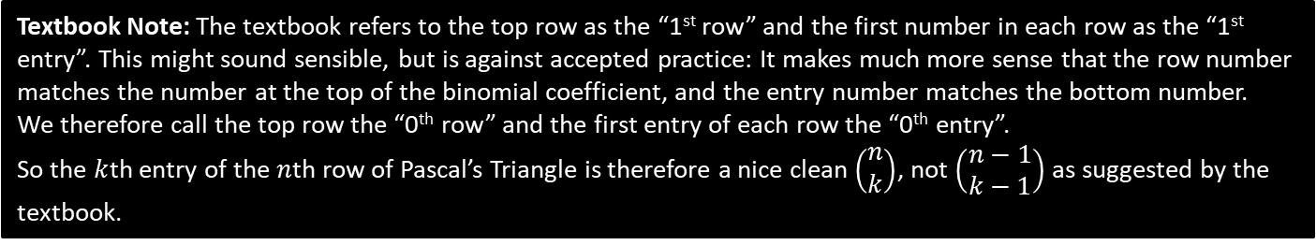



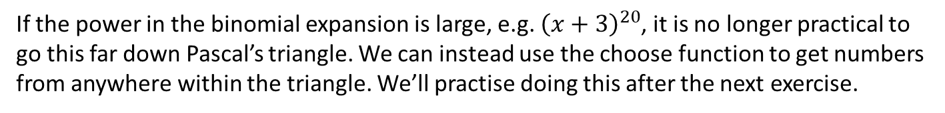







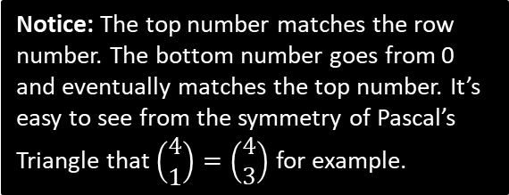



Why do we care?
If the power in the binomial expansion is large, e.g. ${\left(x+3\right)}^{20}$, it is no longer practical to go this far down Pascal’s triangle. We can instead use the choose function to get numbers from anywhere within the triangle. We’ll practise doing this after the next exercise.
1
0th row
$$\left(\begin{matrix}0 \\ 0\end{matrix}\right)$$
Notice: The top number matches the row number. The bottom number goes from 0 and eventually matches the top number. It’s easy to see from the symmetry of Pascal’s Triangle that $\left(\begin{matrix}4 \\ 1\end{matrix}\right)=\left(\begin{matrix}4 \\ 3\end{matrix}\right)$ for example.
1
1
1st row
$$\left(\begin{matrix}1 \\ 0\end{matrix}\right)$$
$$\left(\begin{matrix}1 \\ 1\end{matrix}\right)$$
1
2
1
2nd row
$$\left(\begin{matrix}2 \\ 0\end{matrix}\right)$$
$$\left(\begin{matrix}2 \\ 1\end{matrix}\right)$$
$$\left(\begin{matrix}2 \\ 2\end{matrix}\right)$$
1
3
3
1
3rd row
$$\left(\begin{matrix}3 \\ 0\end{matrix}\right)$$
$$\left(\begin{matrix}3 \\ 1\end{matrix}\right)$$
$$\left(\begin{matrix}3 \\ 2\end{matrix}\right)$$
$$\left(\begin{matrix}3 \\ 3\end{matrix}\right)$$
1
4
6
4
1
$$\left(\begin{matrix}4 \\ 0\end{matrix}\right)$$
$$\left(\begin{matrix}4 \\ 1\end{matrix}\right)$$
$$\left(\begin{matrix}4 \\ 2\end{matrix}\right)$$
$$\left(\begin{matrix}4 \\ 3\end{matrix}\right)$$
$$\left(\begin{matrix}4 \\ 4\end{matrix}\right)$$
Textbook Note: The textbook refers to the top row as the “1st row” and the first number in each row as the “1st entry”. This might sound sensible, but is against accepted practice: It makes much more sense that the row number matches the number at the top of the binomial coefficient, and the entry number matches the bottom number.
We therefore call the top row the “0th row” and the first entry of each row the “0th entry”.
So the $k$th entry of the $n$th row of Pascal’s Triangle is therefore a nice clean $\left(\begin{matrix}n \\ k\end{matrix}\right)$, not $\left(\begin{matrix}n−1 \\ k−1\end{matrix}\right)$ as suggested by the textbook.

Slide 17


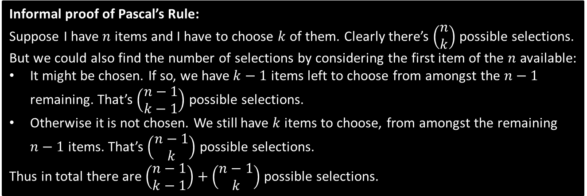



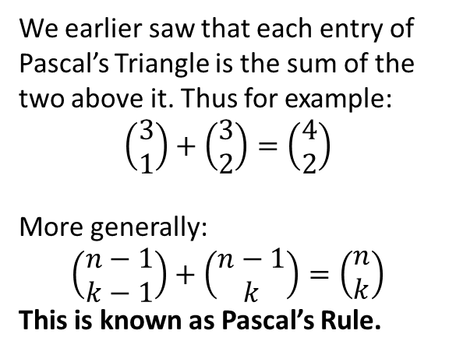










Interesting facts
$$\left(\begin{matrix}0 \\ 0\end{matrix}\right)$$
(You are not required to know this, but it is helpful for STEP)
$$\left(\begin{matrix}1 \\ 0\end{matrix}\right)$$
$$\left(\begin{matrix}1 \\ 1\end{matrix}\right)$$
We earlier saw that each entry of Pascal’s Triangle is the sum of the two above it. Thus for example:
$$\left(\begin{matrix}3 \\ 1\end{matrix}\right)+\left(\begin{matrix}3 \\ 2\end{matrix}\right)=\left(\begin{matrix}4 \\ 2\end{matrix}\right)$$
More generally:
$$\left(\begin{matrix}n−1 \\ k−1\end{matrix}\right)+\left(\begin{matrix}n−1 \\ k\end{matrix}\right)=\left(\begin{matrix}n \\ k\end{matrix}\right)$$
This is known as Pascal’s Rule.
$$\left(\begin{matrix}2 \\ 0\end{matrix}\right)$$
$$\left(\begin{matrix}2 \\ 1\end{matrix}\right)$$
$$\left(\begin{matrix}2 \\ 2\end{matrix}\right)$$
$$\left(\begin{matrix}3 \\ 0\end{matrix}\right)$$
$$\left(\begin{matrix}3 \\ 1\end{matrix}\right)$$
$$\left(\begin{matrix}3 \\ 2\end{matrix}\right)$$
$$\left(\begin{matrix}3 \\ 3\end{matrix}\right)$$
$$\left(\begin{matrix}4 \\ 0\end{matrix}\right)$$
$$\left(\begin{matrix}4 \\ 1\end{matrix}\right)$$
$$\left(\begin{matrix}4 \\ 2\end{matrix}\right)$$
$$\left(\begin{matrix}4 \\ 3\end{matrix}\right)$$
$$\left(\begin{matrix}4 \\ 4\end{matrix}\right)$$
Informal proof of Pascal’s Rule:
Suppose I have $n$ items and I have to choose $k$ of them. Clearly there’s $\left(\begin{matrix}n \\ k\end{matrix}\right)$ possible selections. But we could also find the number of selections by considering the first item of the $n$ available:
It might be chosen. If so, we have $k−1$ items left to choose from amongst the $n−1$ remaining. That’s $\left(\begin{matrix}n−1 \\ k−1\end{matrix}\right)$ possible selections.
Otherwise it is not chosen. We still have $k$ items to choose, from amongst the remaining $n−1$ items. That’s $\left(\begin{matrix}n−1 \\ k\end{matrix}\right)$ possible selections.
Thus in total there are $\left(\begin{matrix}n−1 \\ k−1\end{matrix}\right)+\left(\begin{matrix}n−1 \\ k\end{matrix}\right)$ possible selections.

Slide 18

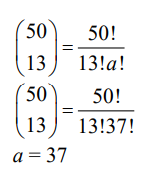

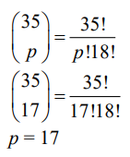
Exercise 8B – Y1 page 162
?
?

Slide 19
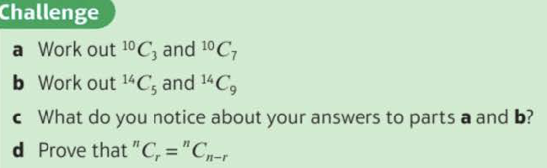
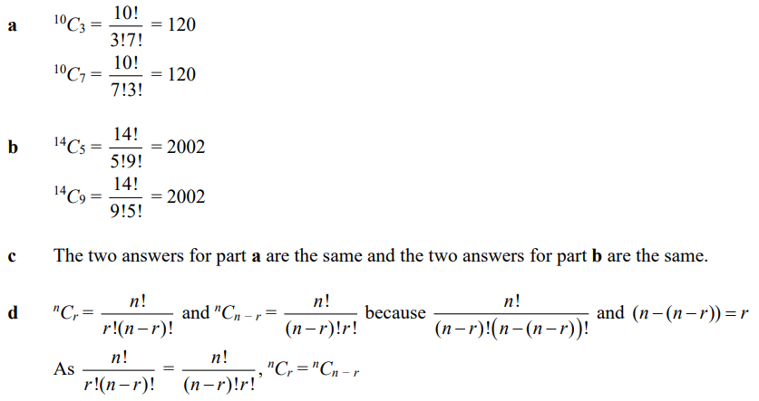
Exercise 8B – Y1 page 162
a?
b?
c?
d?

Slide 20
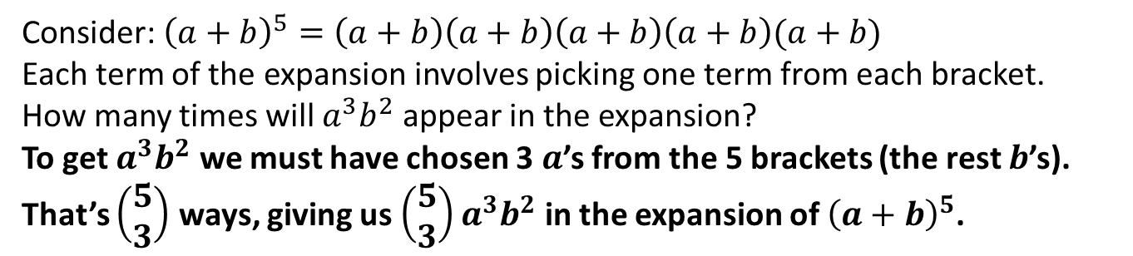
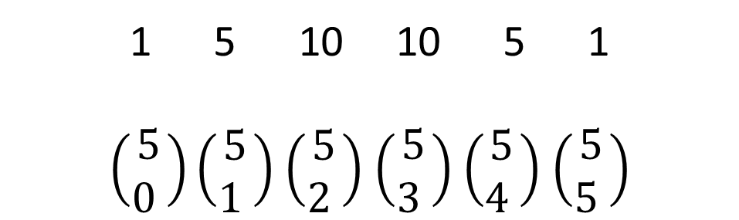
Using Binomial Coefficients to Expand
In the previous section we learnt about the ‘choose’ function and how this related to Pascal’s Triangle.
1 5 10 10 5 1
$\left(\begin{matrix}5 \\ 0 \end{matrix}\right)\left(\begin{matrix}5 \\ 1 \end{matrix}\right)$ $\left(\begin{matrix}5 \\ 2 \end{matrix}\right)$ $\left(\begin{matrix}5 \\ 3 \end{matrix}\right)$ $\left(\begin{matrix}5 \\ 4 \end{matrix}\right)$ $\left(\begin{matrix}5 \\ 5 \end{matrix}\right)$
Why do rows of Pascal’s Triangle give us the coefficients in a Binomial Expansion?
One possible selection of terms from each bracket.
Consider: ${\left(a+b\right)}^{5}=\left(a+b\right)\left(a+b\right)\left(a+b\right)\left(a+b\right)(a+b)$
Each term of the expansion involves picking one term from each bracket.
How many times will $a^{3}b^{2}$ appear in the expansion?
To get $a^{3}b^{2}$ we must have chosen 3 $a$’s from the 5 brackets (the rest $b$’s). That’s $\left(\begin{matrix}5 \\ 3\end{matrix}\right)$ ways, giving us $\left(\begin{matrix}5 \\ 3\end{matrix}\right)a^{3}b^{2}$ in the expansion of ${\left(a+b\right)}^{5}$.
?

Slide 21
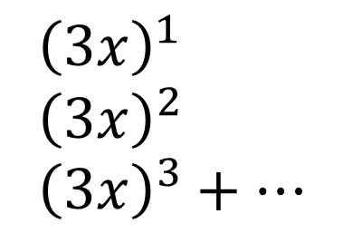
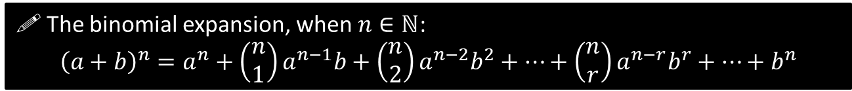
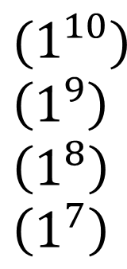
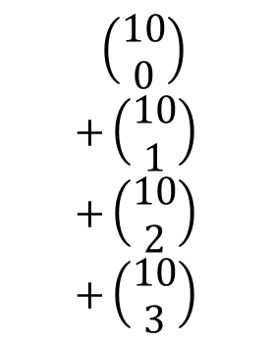

Using Binomial Coefficients to Expand
$ℕ$ is the set of natural numbers, i.e. positive integers. This formula is only valid for positive integers $n$. In Year 2 you will see how to deal with fractional/negative $n$.
! The binomial expansion, when $n∈ℕ$:
$${\left(a+b\right)}^{n}=a^{n}+\left(\begin{matrix}n \\ 1\end{matrix}\right)a^{n−1}b+\left(\begin{matrix}n \\ 2\end{matrix}\right)a^{n−2}b^{2}+…+\left(\begin{matrix}n \\ r\end{matrix}\right)a^{n−r}b^{r}+…+b^{n}$$
Find the first 4 terms in the expansion of ${\left(3x+1\right)}^{10}$, in ascending powers of $x$.
?
$$\left(\begin{matrix}10 \\ 0\end{matrix}\right) \\ +\left(\begin{matrix}10 \\ 1\end{matrix}\right) \\ +\left(\begin{matrix}10 \\ 2\end{matrix}\right) \\ +\left(\begin{matrix}10 \\ 3\end{matrix}\right)$$
This is exactly the same method as before, except we’ve just had to calculate the Binomial coefficients ourselves rather than read them off Pascal’s Triangle.
$${\left(3x+1\right)}^{10}=$$
$$(1^{10}) \\ \left(1^{9}\right) \\ \left(1^{8}\right) \\ \left(1^{7}\right)$$
$${\left(3x\right)}^{1} \\ {\left(3x\right)}^{2} \\ {\left(3x\right)}^{3}+…$$
$$=1+30x+405x^{2}+3240x^{3}+…$$

Slide 22
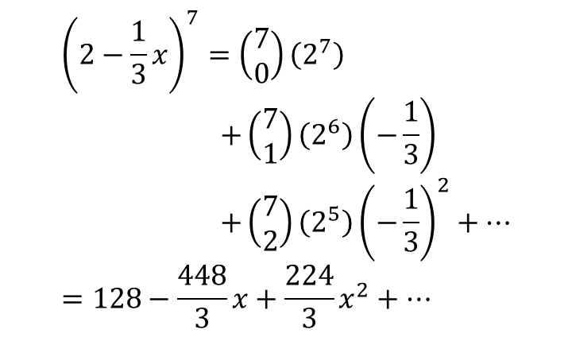

Test Your Understanding
Find the first 3 terms in the expansion of ${\left(2−\frac{1}{3}x\right)}^{7}$, in ascending powers of $x$.
?
$${\left(2−\frac{1}{3}x\right)}^{7}=\left(\begin{matrix}7 \\ 0\end{matrix}\right)\left(2^{7}\right) \\ +\left(\begin{matrix}7 \\ 1\end{matrix}\right)\left(2^{6}\right)\left(−\frac{1}{3}\right) \\ +\left(\begin{matrix}7 \\ 2\end{matrix}\right)\left(2^{5}\right){\left(−\frac{1}{3}\right)}^{2}+… \\ =128−\frac{448}{3}x+\frac{224}{3}x^{2}+…$$
Note: The “$+…“$ indicates that there would have been other terms in the expansion.

Slide 23
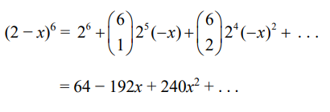


Exercise 8C – Y1 page 164
?
?
?

Slide 24




Extension
[AEA 2013 Q1a] In the binomial expansion of ${\left(1+\frac{12n}{5}x\right)}^{n}$ the coefficients of $x^{2}$ and $x^{3}$ are equal and non-zero.
Find the possible values of $n$.
Hint: Remember that
$$\left(\begin{matrix}n \\ 2\end{matrix}\right)=\frac{n\left(n−1\right)}{2!}$$
Can you similarly simplify $\left(\begin{matrix}n \\ 3\end{matrix}\right)$ using $\left(\begin{matrix}n \\ r\end{matrix}\right)=\frac{n!}{r!\left(n−r\right)!}$?
1
?
reflection: This means that the sum of each row in Pascal’s Triangle gives successive powers of 2. Safe!
2
[STEP I 2010 Q5a] By considering the expansion of ${\left(1+x\right)}^{n}$, where $n$ is a positive integer, or otherwise, show that:
$$\left(\begin{matrix}n \\ 0\end{matrix}\right)+\left(\begin{matrix}n \\ 1\end{matrix}\right)+\left(\begin{matrix}n \\ 2\end{matrix}\right)+…+\left(\begin{matrix}n \\ n\end{matrix}\right)=2^{n}$$
$${\left(1+x\right)}^{n}=\left(\begin{matrix}n \\ 0\end{matrix}\right)+\left(\begin{matrix}n \\ 1\end{matrix}\right)x+\left(\begin{matrix}n \\ 2\end{matrix}\right)x^{2}+…+\left(\begin{matrix}n \\ n\end{matrix}\right)x^{n}$$
Letting $x=1$ gives the desired result.
?

Slide 25













Getting a single term in the expansion
In the expansion of ${\left(a+b\right)}^{n}$ the general term is given by $\left(\begin{matrix}n \\ r\end{matrix}\right)a^{n−r}b^{r}$
Expression
Power of $x$ in term wanted.
Term in expansion
?
$${\left(a+x\right)}^{10}$$
$$3$$
$$\left(\begin{matrix}10 \\ 3\end{matrix}\right){a^{7}x}^{3}$$
Note: The two powers add up to 10.
$$\left(\begin{matrix}75 \\ 50\end{matrix}\right){\left(−1\right)}^{25}{\left(2x\right)}^{50}$$
$${\left(2x−1\right)}^{75}$$
$$50$$
?
$$\left(\begin{matrix}12 \\ 7\end{matrix}\right){\left(3\right)}^{5}{\left(−x\right)}^{7}$$
$${\left(3−x\right)}^{12}$$
$$7$$
?
?
$${\left(3x+4\right)}^{16}$$
$$3$$
$$\left(\begin{matrix}16 \\ 3\end{matrix}\right){\left(4\right)}^{13}{\left(3x\right)}^{3}$$

Slide 26


Getting a single term in the expansion
The coefficient of $x^{4}$ in the expansion of ${\left(1+qx\right)}^{10}$ is 3360. Find the possible value(s) of the constant $q$.
Term is:
$$\left(\begin{matrix}10 \\ 4\end{matrix}\right)\left(1^{6}\right){\left(qx\right)}^{4}=210q^{4}x^{4}$$
Therefore:
$$210q^{4}=3360 \\ q^{4}=16 \\ q=±2$$
?
?

Slide 27


Test Your Understanding
In the expansion of ${\left(1+ax\right)}^{10}$, where $a$ is a non-zero constant the coefficient of $x^{3}$ is double the coefficient of $x^{2}$. Find the value of $a$.
?
$x^{2}$ term: $\left(\begin{matrix}10 \\ 2\end{matrix}\right)\left(1^{8}\right){\left(ax\right)}^{2}=45a^{2}x^{2}$
$x^{3}$ term: $\left(\begin{matrix}10 \\ 3\end{matrix}\right)\left(1^{7}\right){\left(ax\right)}^{3}=120a^{3}x^{3}$
$$∴120a^{3}=2\left(45a^{2}\right) \\ 120a^{3}=90a^{2} \\ 4a^{3}−3a^{2}=0 \\ a^{2}\left(4a−3\right)=0 \\ a=0 or a=\frac{3}{4}$$
But $a$ is non-zero, so $a=\frac{3}{4}$

Slide 28



Exercise 8D – Y1 page 166-167
a?
b?

Slide 29


Exercise 8D – Y1 page 166-167
a?
b?

Slide 30


Exercise 8D – Y1 page 166-167
a?
b?

Slide 31


Exercise 8D – Y1 page 166-167
a?
b?

Slide 32


Exercise 8D – Y1 page 166-167
a?
b?

Slide 33

Exercise 8D – Y1 page 166-167
?

Slide 34


Extension
1
[MAT 2014 1G] Let $n$ be a positive integer. The coefficient of $x^{3}y^{5}$ in the expansion of ${\left(1+xy+y^{2}\right)}^{n}$ equals:
$n$
$2^{n}$
$\left(\begin{matrix}n \\ 3\end{matrix}\right)\left(\begin{matrix}n \\ 5\end{matrix}\right)$
$4\left(\begin{matrix}n \\ 4\end{matrix}\right)$
$\left(\begin{matrix}n \\ 8\end{matrix}\right)$
Try to imagine $n$ brackets written out. To get $x^{3}y^{5}$, we must have chosen $xy$ from 3 brackets, $y^{2}$ from one and 1 from the remaining brackets. That’s $\left(\begin{matrix}n \\ 3\end{matrix}\right)$ choices for the $xy$ term, and $n−3$ choices for the $y^{2}$ term.
Using the definition of the choose function, you can show that $4\left(\begin{matrix}n \\ 4\end{matrix}\right)=\left(n−3\right)\left(\begin{matrix}n \\ 3\end{matrix}\right)$
2
[STEP I 2013 Q6] By considering the coefficient of $x^{r}$ in the series for $\left(1+x\right){\left(1+x\right)}^{n}$, or otherwise, obtain the following relation between binomial coefficients:
$$\left(\begin{matrix}n \\ r\end{matrix}\right)+\left(\begin{matrix}n \\ r−1\end{matrix}\right)=\left(\begin{matrix}n+1 \\ r\end{matrix}\right)$$
Noting that $\left(1+x\right){\left(1+x\right)}^{n}={\left(1+x\right)}^{n+1}$, the $x^{r}$ term is $\left(\begin{matrix}n+1 \\ r\end{matrix}\right)x^{r}$.
But the $x^{r}$ term could be obtained either by 1 in the first bracket multiplied by $x^{r}$ term in the second, giving $1×\left(\begin{matrix}n \\ r\end{matrix}\right)x^{r}$, or the $x$ in the first bracket multiplied by the $x^{r−1}$ term in the second, $x×\left(\begin{matrix}n \\ r−1\end{matrix}\right)x^{r−1}=\left(\begin{matrix}n \\ r−1\end{matrix}\right)x^{r}$. Thus comparing coefficients:
$$\left(\begin{matrix}n \\ r\end{matrix}\right)+\left(\begin{matrix}n \\ r−1\end{matrix}\right)=\left(\begin{matrix}n+1 \\ r\end{matrix}\right)$$
?
?

Slide 35




Estimating Powers
Edexcel C2 Jan 2012 Q3
Tip: Use your calculator to compare against the exact value of ${1.025}^{8}$.
a
?
b
Comparing ${1.025}^{8}$ to ${\left(1+\frac{x}{4}\right)}^{8}$, then:
$$1.025=1+\frac{x}{4} \\ 0.025=\frac{x}{4} \\ x=0.1$$
Using our expansion with $x=0.1$:
$$1+2\left(0.1\right)+\frac{7}{4}{\left(0.1\right)}^{2}+\frac{7}{8}{\left(0.1\right)}^{3} \\ =1.2184 to 4dp$$
Why should this be a reasonably good approximation of ${1.025}^{8}$ despite the missing terms in the expansion?
$x^{r}$ becomes increasingly small when $x<1$ as the power increases. Thus the ${0.1}^{4}$ terms and beyond will be negligibly small.
?
$${\left(1+\frac{x}{4}\right)}^{8}=\left(\begin{matrix}8 \\ 0\end{matrix}\right)\left(1^{8}\right) \\ +\left(\begin{matrix}8 \\ 1\end{matrix}\right)\left(1^{7}\right)\left(\frac{x}{4}\right) \\ +\left(\begin{matrix}8 \\ 2\end{matrix}\right)\left(1^{6}\right){\left(\frac{x}{4}\right)}^{2} \\ +\left(\begin{matrix}8 \\ 3\end{matrix}\right)\left(1^{5}\right){\left(\frac{x}{4}\right)}^{3} \\ =1+2x+\frac{7}{4}x^{2}+\frac{7}{8}x^{3}+…$$
?

Slide 36


Test Your Understanding
Edexcel C2 Jan 2008 Q3
?
?

Slide 37



Exercise 8E – Y1 Page 168-169
a?
b?

Slide 38


Exercise 8E – Y1 Page 168-169
a?
b?

Slide 39


Exercise 8E – Y1 Page 168-169
a?
b?
c?

