Slide 1
Y1 Chapter 9
Trigonometric Ratios

Slide 2
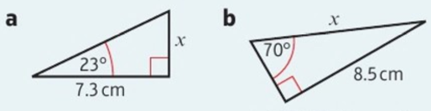
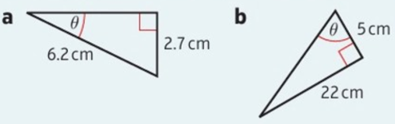
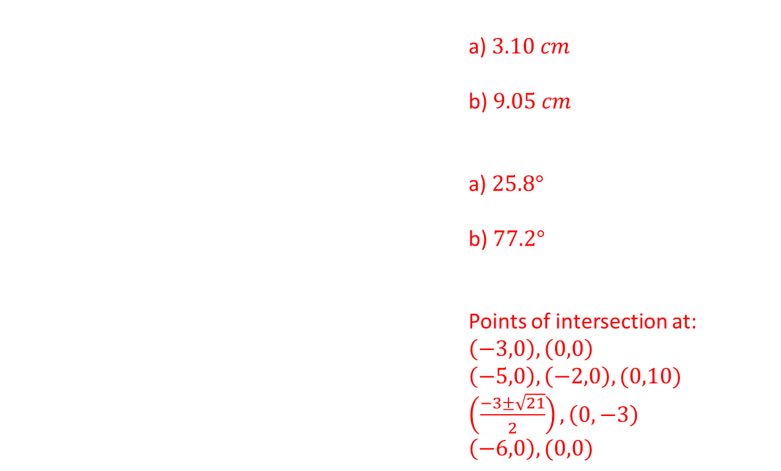
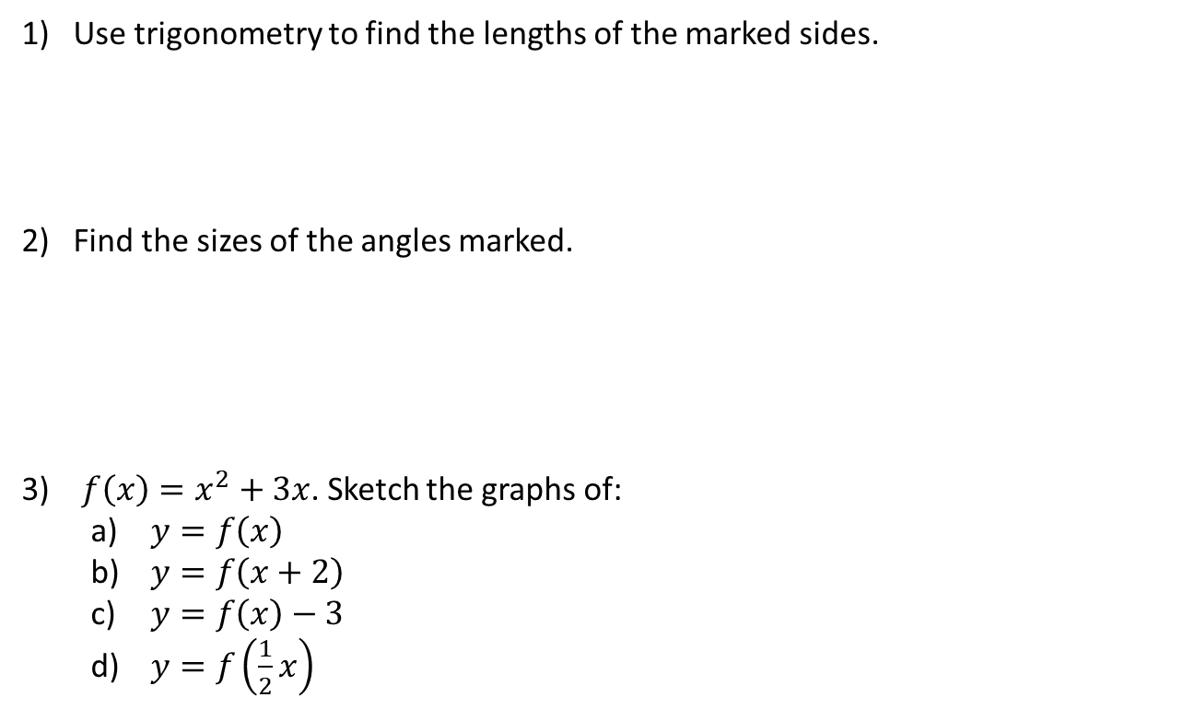
Starters
Use trigonometry to find the lengths of the marked sides.
Find the sizes of the angles marked.
$f\left(x\right)=x^{2}+3x$. Sketch the graphs of:
  $y=f\left(x\right)$
  $y=f\left(x+2\right)$
  $y=f\left(x\right)−3$
  $y=f\left(\frac{1}{2}x\right)$
a) $3.10 cm$
b) $9.05 cm$
a) $25.8°$
b) $77.2°$
Points of intersection at:
$\left(−3,0\right), \left(0,0\right)$
$\left(−5,0\right), \left(−2,0\right),(0,10)$
$\left(\frac{−3±\sqrt{21}}{2}\right),\left(0,−3\right)$
$\left(−6,0\right),(0,0)$

Slide 3

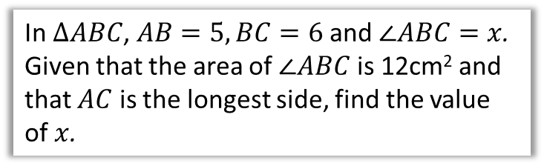





Chapter Overview
There is technically no new content in this chapter since GCSE.
However, the problems might be more involved than at GCSE level.
1: Sine/Cosine Rule
2: Areas of Triangles
$$x$$
$$5$$
In $ΔABC$, $AB=5, BC=6$ and $∠ABC=x$. Given that the area of $∠ABC$ is 12cm² and that $AC$ is the longest side, find the value of $x$.
Determine $x$.
$$60°$$
$$x+2$$
3: Graphs of Sine/Cosine/Tangent
Sketch $y=\sin\left(2x\right)$ for $0≤x≤360°$

Slide 4
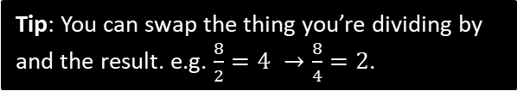
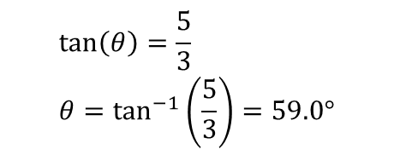
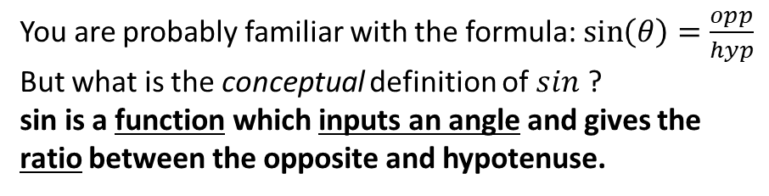
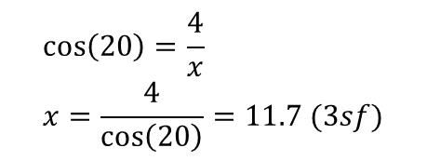








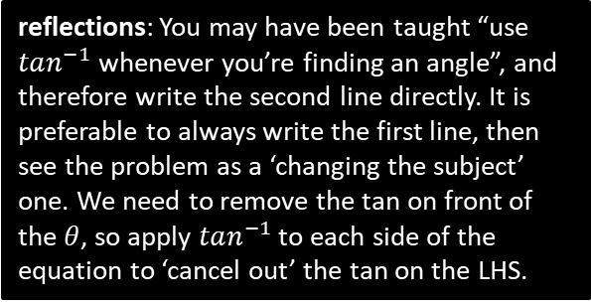
RECAP: Right-Angled Trigonometry
You are probably familiar with the formula: $\sin\left(θ\right)=\frac{opp}{hyp}$
But what is the conceptual definition of $sin$ ?
sin is a function which inputs an angle and gives the ratio between the opposite and hypotenuse.
hyp
opp
?
$$θ$$
adj
Remember that a ratio just means the ‘relative size’ between quantities (in this case lengths). For this reason, sin/cos/tan are known as “trigonometric ratios”.
Find $x$.
Tip: You can swap the thing you’re dividing by and the result. e.g. $\frac{8}{2}=4 →\frac{8}{4}=2$.
4
?
$$\cos\left(20\right)=\frac{4}{x} \\ x=\frac{4}{\cos\left(20\right)}=11.7 (3sf)$$
$$20°$$
$$x$$
reflections: You may have been taught “use $tan^{−1}$ whenever you’re finding an angle”, and therefore write the second line directly. It is preferable to always write the first line, then see the problem as a ‘changing the subject’ one. We need to remove the tan on front of the $θ$, so apply $tan^{−1}$ to each side of the equation to ‘cancel out’ the tan on the LHS.
$$5$$
Find $θ$.
$$\tan\left(θ\right)=\frac{5}{3} \\ θ=\tan^{−1}\left(\frac{5}{3}\right)=59.0°$$
$$3$$
?
$$θ$$

Slide 5
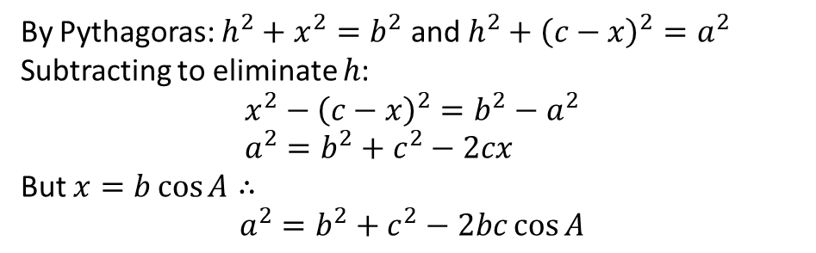

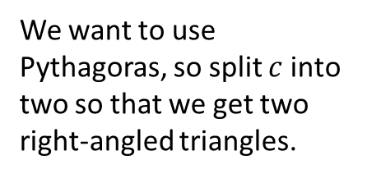





Proof of Cosine Rule
We want to use Pythagoras, so split $c$ into two so that we get two right-angled triangles.
$$b$$
$$a$$
$$h$$
$$A$$
$$c−x$$
$$x$$
By Pythagoras: $h^{2}+x^{2}=b^{2}$ and $h^{2}+{\left(c−x\right)}^{2}=a^{2}$
Subtracting to eliminate $h$:
$$x^{2}−{\left(c−x\right)}^{2}=b^{2}−a^{2} \\ a^{2}=b^{2}+c^{2}−2cx$$
But $x=b\cos{A}∴$
$$a^{2}=b^{2}+c^{2}−2bc\cos{A}$$

Slide 6


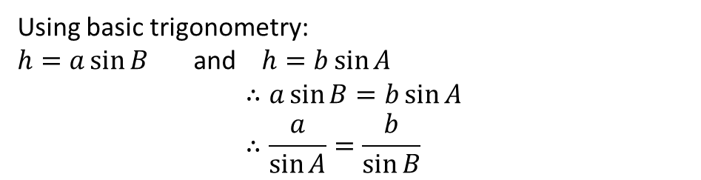

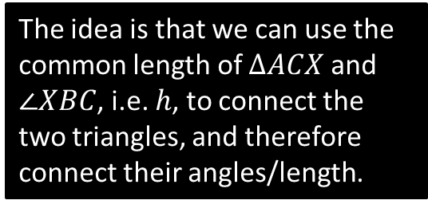





Proof of Sine Rule
$$C$$
The idea is that we can use the common length of $ΔACX$ and $∠XBC$, i.e. $h$, to connect the two triangles, and therefore connect their angles/length.
$$b$$
$$a$$
$$h$$
$$A$$
$$B$$
$$X$$
$$c$$
Using basic trigonometry:
$h=a\sin{B}$ and $h=b\sin{A}$
$$∴a\sin{B}=b\sin{A} \\ ∴\frac{a}{\sin{A}}=\frac{b}{\sin{B}}$$

Slide 7









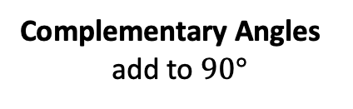


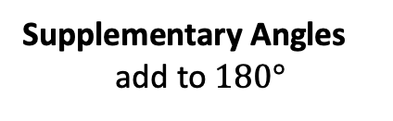


Just for your interest…
Why does “cosine” contains the word “sine”?
$$a$$
$$a$$
$$b$$
$$b$$
$$a$$
$$b$$
Supplementary Angles
add to $180°$
Complementary Angles
add to $90°$
Therefore these angles are complementary.
i.e. The cosine of an angle is the sine of the complementary angle.
Hence cosine = COMPLEMENTARY SINE
?
$$\cos\left(50\right)=\frac{x}{z}$$
$$z$$
$$50°$$
$$x$$
?
$$\sin\left(40\right)=\frac{x}{z}$$
$$40°$$
$$y$$
$$∴\cos\left(50\right)=\sin\left(40\right)$$

Slide 8
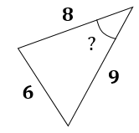
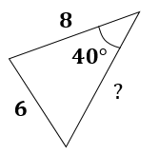
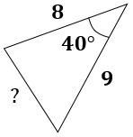
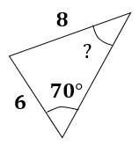
OVERVIEW: Finding missing sides and angles
When triangles are not right-angled, we can no longer use simple trigonometric ratios, and must use the cosine and sine rules.
You have | You want | Use
#1: Two angle-side opposite pairs | Missing angle or side in one pair | Sine rule
#2 Two sides known and a missing side opposite a known angle | Remaining side | Cosine rule
#3 All three sides | An angle | Cosine rule
#4 Two sides known and a missing side not opposite known angle | Remaining side | Sine rule twice
?
?
?
?

Slide 9




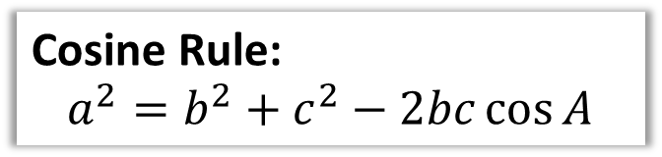
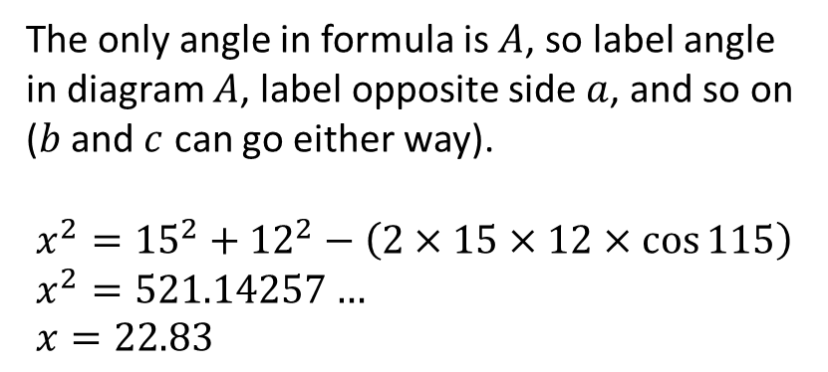




Cosine Rule
We use the cosine rule whenever we have three sides (and an angle) involved.
Proof at end of PowerPoint.
$$b$$
Cosine Rule:
$$a^{2}=b^{2}+c^{2}−2bc\cos{A}$$
$$15$$
$$A$$
How are sides labelled ?
$$115°$$
The only angle in formula is $A$, so label angle in diagram $A$, label opposite side $a$, and so on ($b$ and $c$ can go either way).
$$x^{2}={15}^{2}+{12}^{2}−\left(2×15×12×\cos{115}\right) \\ x^{2}=521.14257… \\ x=22.83$$
$$a$$
$$c$$
$$x$$
$$12$$
Calculation?

Slide 10
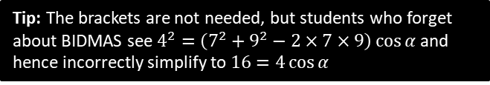



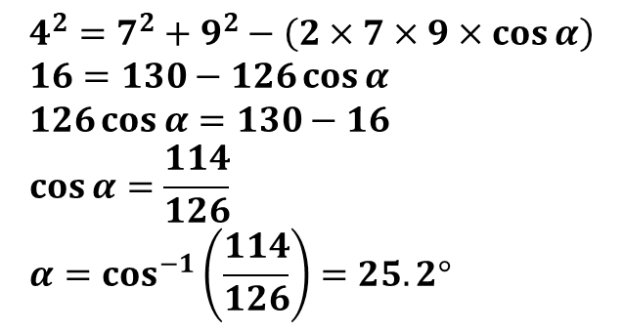


Dealing with Missing Angles
You have | You want | Use
All three sides | An angle | Cosine rule
$$a^{2}=b^{2}+c^{2}−2bc\cos{A}$$
$$7$$
Tip: The brackets are not needed, but students who forget about BIDMAS see $4^{2}=\left(7^{2}+9^{2}−2×7×9\right)\cos{α}$ and hence incorrectly simplify to $16=4\cos{α}$
$$α$$
$$4$$
?
Label sides then substitute into formula.
$$9$$
$$4^{2}=7^{2}+9^{2}−\left(2×7×9×\cos{α}\right) \\ 16=130−126\cos{α} \\ 126\cos{α}=130−16 \\ \cos{α}=\frac{114}{126} \\ α=\cos^{−1}\left(\frac{114}{126}\right)=25.2°$$
?
Simplify each bit of formula.
?
Rearrange “swapping” thing you’re subtracting and result
?
Textbook Note: The textbook presents the rearrangement of the cosine rule: $\cos{A}=\frac{b^{2}+c^{2}−a^{2}}{2bc}$ to find missing angles. It is not advisable to memorise this

Slide 11


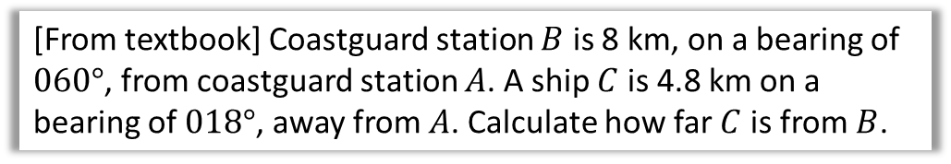



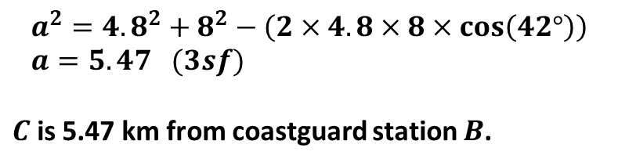


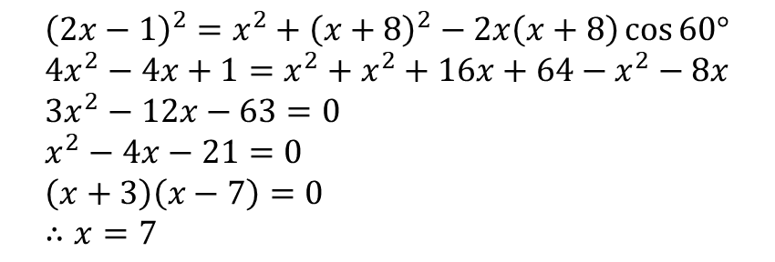







Harder Ones
Determine the value of $x$.
?
$${\left(2x−1\right)}^{2}=x^{2}+{\left(x+8\right)}^{2}−2x\left(x+8\right)\cos{60°} \\ 4x^{2}−4x+1=x^{2}+x^{2}+16x+64−x^{2}−8x \\ 3x^{2}−12x−63=0 \\ x^{2}−4x−21=0 \\ \left(x+3\right)\left(x−7\right)=0 \\ ∴x=7$$
$$x$$
$$2x−1$$
$$60°$$
$$x+8$$
[From textbook] Coastguard station $B$ is 8 km, on a bearing of $060°$, from coastguard station $A$. A ship $C$ is 4.8 km on a bearing of $018°$, away from $A$. Calculate how far $C$ is from $B$.
$$N$$
?
$$C$$
$$a km$$
$$B$$
$$a^{2}={4.8}^{2}+8^{2}−\left(2×4.8×8×\cos\left(42°\right)\right) \\ a=5.47 (3sf)$$
$C$ is 5.47 km from coastguard station $B$.
$$4.8km$$
$$18°$$
$$60°$$
$$8 km$$
$$A$$

Slide 12















Test Your Understanding
1
$$x$$
3
$$2x−3$$
$$5$$
$$70°$$
$$2x−2$$
$$6$$
$$3$$
2
$$60°$$
$$x$$
$$x=6.36°$$
?
$$θ$$
$$8$$
?
$$10$$
$$x=5$$
$$θ=124.2°$$
?
Note: You will get an obtuse angle whenever you inverse cos of a negative value.

Slide 13
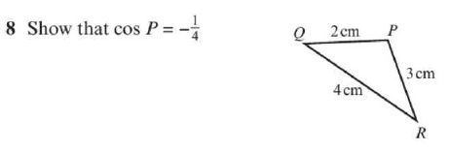
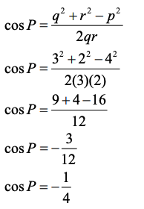

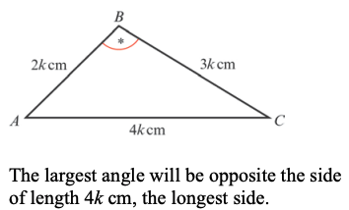
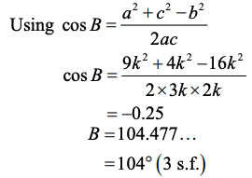
Exercise 9A – Y1 pages 177-179
?
?

Slide 14
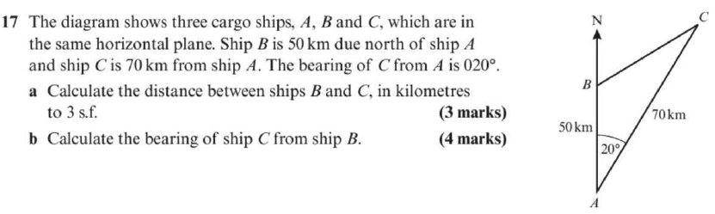
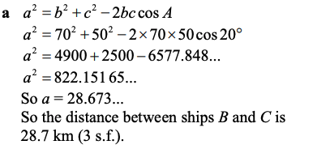
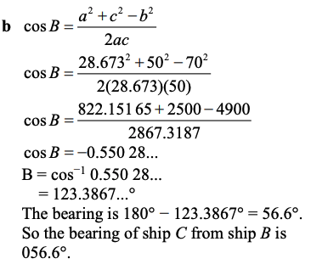
Exercise 9A – Y1 pages 177-179
a?
b?

Slide 15
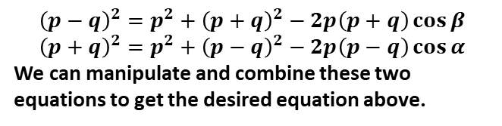


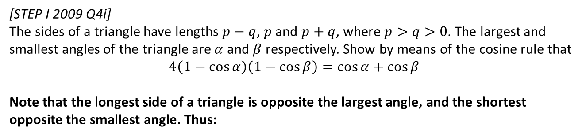



Extension
1
[STEP I 2009 Q4i]
The sides of a triangle have lengths $p−q$, $p$ and $p+q$, where $p>q>0$. The largest and smallest angles of the triangle are $α$ and $β$ respectively. Show by means of the cosine rule that
$$4\left(1−\cos{α}\right)\left(1−\cos{β}\right)=\cos{α+\cos{β}}$$
Note that the longest side of a triangle is opposite the largest angle, and the shortest opposite the smallest angle. Thus:
?
$$p$$
$$p−q$$
$$α$$
$$β$$
$$p+q$$
$${\left(p−q\right)}^{2}=p^{2}+{\left(p+q\right)}^{2}−2p\left(p+q\right)\cos{β} \\ {\left(p+q\right)}^{2}=p^{2}+{\left(p−q\right)}^{2}−2p\left(p−q\right)\cos{α}$$
We can manipulate and combine these two equations to get the desired equation above.

Slide 16
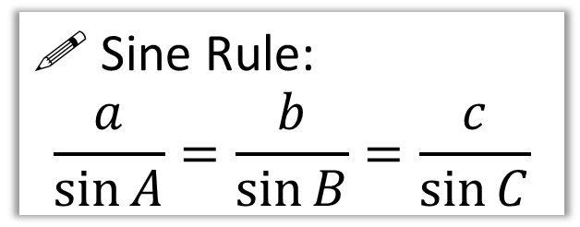
The Sine Rule
b
For this triangle, try calculating each side divided by the sin of its opposite angle. What do you notice in all three cases?
65°
c
5.02
A
10
85°
! Sine Rule:
$$\frac{a}{\sin{A}}=\frac{b}{\sin{B}}=\frac{c}{\sin{C}}$$
?
C
B
30°
9.10
a
You have | You want | Use
#1: Two angle-side opposite pairs | Missing angle or side in one pair | Sine rule

Slide 17
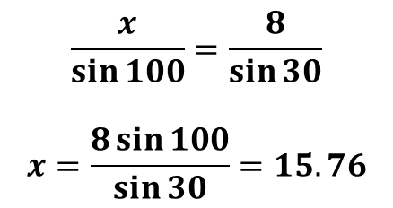
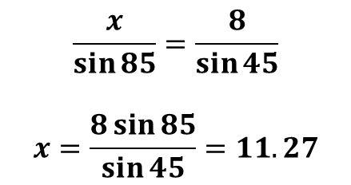
Examples
8
Q2
Q1
8
50°
85°
100°
15.76
45°
?
30°
11.27
?
$$\frac{x}{\sin{85}}=\frac{8}{\sin{45}}$$
$$x=\frac{8\sin{85}}{\sin{45}}=11.27$$
$$\frac{x}{\sin{100}}=\frac{8}{\sin{30}}$$
$$x=\frac{8\sin{100}}{\sin{30}}=15.76$$
You have | You want | Use
#1: Two angle-side opposite pairs | Missing angle or side in one pair | Sine rule

Slide 18
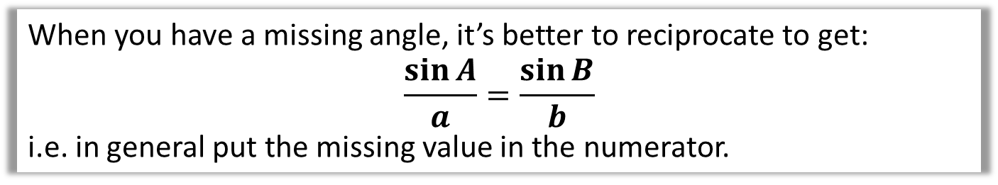
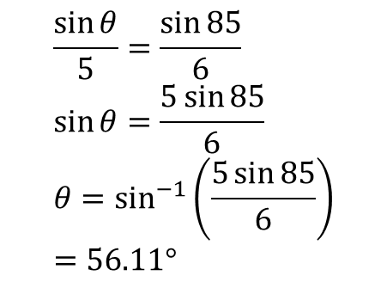
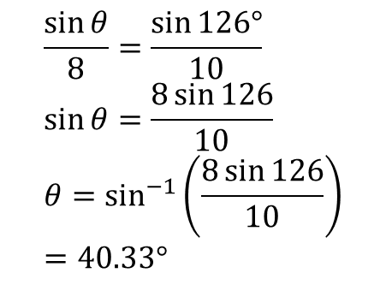
Examples
When you have a missing angle, it’s better to reciprocate to get:
$$\frac{\sin{A}}{a}=\frac{\sin{B}}{b}$$
i.e. in general put the missing value in the numerator.
5
Q3
Q4
8
126°
85°
40.33°
?
56.11°
6
10
?
$$\frac{\sin{θ}}{5}=\frac{\sin{85}}{6} \\ \sin{θ}=\frac{5\sin{85}}{6} \\ θ=\sin^{−1}\left(\frac{5\sin{85}}{6}\right) \\ =56.11°$$
$$\frac{\sin{θ}}{8}=\frac{\sin{126°}}{10} \\ \sin{θ}=\frac{8\sin{126}}{10} \\ θ=\sin^{−1}\left(\frac{8\sin{126}}{10}\right) \\ =40.33°$$

Slide 19
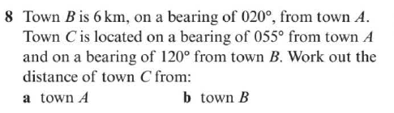
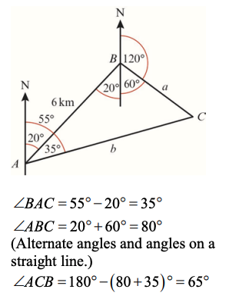
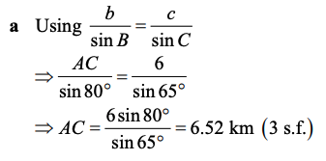
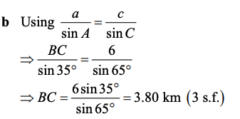
Exercise 9B – Y1 pages 181-183
DIAGRAM?
a?
b?

Slide 20
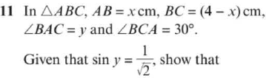

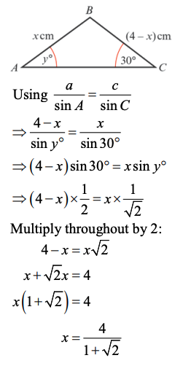
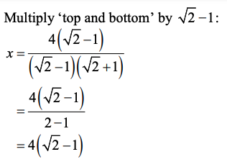
Exercise 9B – Y1 pages 181-183
?

Slide 21
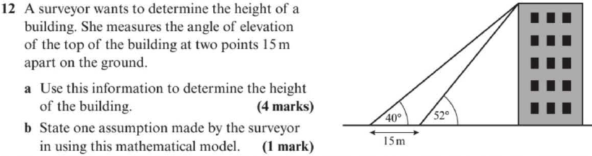


Exercise 9B – Y1 pages 181-183
a?
b?

Slide 22





Extension
1
[MAT 2011 1E]
The circle in the diagram has centre $C$. Three angles $α, β, γ$ are also indicated.
The angles $α, β, γ$ are related by the equation:
$cos α=sin(β+γ)$
$sin β=sin α sin γ$
$sin β\left(1−cos α\right)=sin γ$
$sin\left(α+β\right)=cos γ sin α$
?
If we draw a vertical line down from $C$, we have two triangles with a common length. This common lengths allows us to relate the two triangles. Let the radius be 1.
1
$$x$$
1
Using bottom triangle:
$$1=x\sin{α → x=\frac{1}{\sin{α}}}$$
Using sine rule on top:
$$\frac{x}{\sin{γ}}=\frac{1}{\sin{β}}$$
Substituting in $x$ from the first equation, and rearranging, we obtain (B).

Slide 23

















The ‘Ambiguous Case’
$$A$$
Suppose you are told that $AB=4$, $AC=3$ and $∠ABC=44°$. What are the possible values of $∠ACB$?
$C$ is somewhere on the horizontal line. There’s two ways in which the length could be 3. Using the sine rule:
$$4$$
$$3$$
$$3$$
$$\frac{\sin{C}}{4}=\frac{\sin{44}}{3} \\ C=\sin^{−1}{(}0.9262)$$
$$44°$$
Your calculator will give the acute angle of $67.9°$ (i.e. $C_{2}$). But if we look at a graph of sin, we can see there’s actually a second value for $\sin^{−1}\left(0.9262\right)$, corresponding to angle $C_{1}$.
$$B$$
$$C_{1}$$
$$C_{2}$$
0.9262
! The sine rule produces two possible solutions for a missing angle:
$$\sin{θ}=sin⁡(180°−θ)$$
Whether we use the acute or obtuse angle depends on context.
$$67.9°$$
$$112.1°$$
$$180°$$

Slide 24





Test Your Understanding
Given that the angle $θ$ is obtuse, determine $θ$ and hence determine the length of $x$.
10
$$θ$$
5
?
$$20°$$
$$\frac{\sin{θ}}{10}=\frac{\sin{20°}}{5} \\ \sin^{−1}\left(\frac{10\sin{20°}}{5}\right)=43.1602° \\ ∴θ=180°−43.1602°=136.8398°$$
The other angle is:
$$180°−136.8398°−20°=23.1602°$$
Using sine rule again:
$$\frac{x}{\sin{23.1602°}}=\frac{5}{\sin{20°}}$$
$$x=5.75 (3sf)$$
$$x$$

Slide 25


Exercise 9C – Y1 pages 184-185
?

Slide 26


Exercise 9C – Y1 pages 184-185
?

Slide 27



Exercise 9C – Y1 pages 184-185
a?
b?

Slide 28

Area of Non Right-Angled Triangles
3cm
Area = 0.5 x 3 x 7 x sin(59)
= 9.00cm²
?
59°
7cm
!
Area = $\frac{1}{2}a b\sin\left(C\right)$
where $C$ is the angle between two sides $a$ and $b$.
Tip: You shouldn’t have to label sides/angles before using the formula. Just remember that the angle is between the two sides.

Slide 29










Test Your Understanding
The area of this triangle is 10.
Determine $x$.
$$x$$
?
$$\frac{1}{2}x\left(x+3\right)\sin\left(30°\right)=10 \\ \frac{1}{4}x\left(x+3\right)=10 \\ x\left(x+3\right)=40 \\ x^{2}+3x−40=0 \\ \left(x+8\right)\left(x−5\right)=0$$
As $x>0, x=5$
$$30°$$
$$x+3$$
$$5$$
The area of this triangle is also 10.
If $θ$ is obtuse, determine $θ$.
$$6$$
$$θ$$
?
$$\frac{1}{2}×5×6×\sin\left(θ\right)=10 \\ \sin\left(θ\right)=\frac{10}{15} \\ θ=180°−41.8°=138.2°$$

Slide 30


Exercise 9D – Y1 pages 186-187
?

Slide 31




Exercise 9D – Y1 pages 186-187
a?
b?

Slide 32



Exercise 9D – Y1 pages 186-187
a?
b?

Slide 33
















Sin or cosine rule?
Recall that whenever we have two “side-angle pairs” involved, use sine rule. If there’s 3 sides involved, we can use cosine rule. Sine rule is generally easier to use than cosine rule.
Sine
Cosine
$$3$$
$$3$$
$$100°$$
$$x$$
$$40°$$
$$a$$
$$5$$
$$5$$
Sine
Cosine
$$3$$
$$3$$
$$x$$
$$40°$$
$$2$$
$$45°$$
$$a$$
$$5$$
Sine
Cosine
Sine
Cosine

Slide 34






Using sine rule twice
You have | You want | Use
#4 Two sides known and a missing side not opposite known angle | Remaining side | Sine rule twice
Given there is just one angle involved, you might attempt to use the cosine rule:
$$3^{2}=x^{2}+4^{2}−\left(2×x×4×\cos{32}\right)$$
$$9=x^{2}+16−8x\cos{32}$$
$$4$$
?
$$3$$
$$32°$$
$$x$$
This is a quadratic equation!
It’s possible to solve this using the quadratic formula (using $a=1, b=−8\cos{32} ,$
$c=7$). However, this is a bit fiddly and not the primary method expected in the exam…

Slide 35







Using sine rule twice
You have | You want | Use
#4 Two sides known and a missing side not opposite known angle | Remaining side | Sine rule twice
!
2: Which means we would then know this angle.
$$4$$
?
$$180−32−44.9556=103.0444$$
1: We could use the sine rule to find this angle.
$$32°$$
$$3$$
3: Using the sine rule a second time allows us to find $x$
?
$$\frac{\sin{A}}{4}=\frac{\sin{32}}{3}$$
$$A=44.9556°$$
$$x$$
$$\frac{x}{\sin{103.0444}}=\frac{3}{\sin{32}} \\ x=5.52 to 3sf$$
?

Slide 36









Test Your Understanding
$$9$$
?
$$y=6.97$$
$$y$$
$$61°$$
$$10$$
$$4$$
$$3$$
$$53°$$
?
$$Area=6.00$$

Slide 37











Problem Solving With Sine/Cosine Rule
[From Textbook] The diagram shows the locations of four mobile phone masts in a field, $BC=75 m$.
$CD=80m$, angle $BCD=55°$ and angle $ADC=140°$.
In order that the masts do not interfere with each other, they must be at least 70m apart.
Given that $A$ is the minimum distance from $D$, find:
The distance $A$ is from $B$
The angle $BAD$
The area enclosed by the four masts.
Using triangle $BCD$:
$BD^{2}={75}^{2}+{80}^{2}−2×75×80×\cos{55°}$
$$BD=71.708…$$
Then use sine rule to find $∠BDC$:
$\frac{\sin\left(∠BDC\right)}{75}=\frac{\sin\left(55\right)}{71.708} → ∠BDC=58.954$
$$∴∠BDA=81.045…$$
We can then use cosine rule on $ΔABD$:
$$AB^{2}={70}^{2}+{71.708}^{2}−2×70×71.708×cos\left(81.045\right)$$
$$AB=92.1 m \left(3sf\right)$$
Using sine rule on $ΔABD, ∠BAD=50.3° (3sf)$
By adding areas of $ΔABD$ and $ΔBDC$:
$$Area ABCD=4940 m^{2} (3sf)$$
$$B$$
a
?
$$75 m$$
$$55°$$
$$A$$
$$C$$
$$70 m$$
$$140°$$
$$80 m$$
$$D$$
b
?
c
?

Slide 38


Exercise 9E – Y1 page 189-191
?

Slide 39



Exercise 9E – Y1 page 189-191
a?
b?

Slide 40






Exercise 9E – Y1 page 189-191
c?
a?
b?

Slide 41



Exercise 9E – Y1 page 189-191
?

Slide 42


Extension Problem 1
[AEA 2009 Q5a] The sides of the triangle $ABC$ have lengths $BC=a, AC=b$ and $AB=c$, where $a<b<c$. The sizes of the angles $A, B$ and $C$ form an arithmetic sequence.
Show that the area of triangle $ABC$ is $ac\frac{\sqrt{3}}{4}$.
Given that $a=2$ and $\sin{A}=\frac{\sqrt{15}}{5}$, find
(ii) the value of $b$,
(iii) the value of $c$.
?

Slide 43


Extension Problem 2
[STEP I 2006 Q8] Note that the volume of a tetrahedron is equal to $\frac{1}{3}×area of base×height$
The points $O, A, B, C$ have coordinates $\left(0,0,0\right),\left(a,0,0\right), \left(0,b,0\right)$ and $(0,0,c)$ respectively, where $a,b,c$ are positive.
Find, in terms of $a,b,c$ the volume of the tetrahedron $OABC$.
Let angle $ACB=θ$. Show that
$\cos{θ=\frac{c^{2}}{\sqrt{\left(a^{2}+c^{2}\right)\left(b^{2}+c^{2}\right)}}}$
and find, in terms of $a,b$ and $c$, the area of triangle $ABC$.
Hence show that $d$, the perpendicular distance of the origin from the triangle $ABC$, satisfies $\frac{1}{d^{2}}=\frac{1}{a^{2}}+\frac{1}{b^{2}}+\frac{1}{c^{2}}$
?
This is FM content, but see a few lines below.

Slide 44


Sin Graph
What does it look like?
?
Key Features:
Repeats every $360°$.
Range: $−1<\sin\left(x\right)<1$
-360
-270
-180
-90
90
180
270
360

Slide 45
Sin Graph
What do the following graphs look like?
-360
-270
-180
-90
90
180
270
360
Suppose we know that sin(30) = 0.5. By thinking about symmetry in the graph, how could we work out:
?
?
?
sin(150) = 0.5
sin(-30) = -0.5
sin(210) = -0.5

Slide 46


Cos Graph
What do the following graphs look like?
?
Key Features:
Repeats every $360°$.
Range: $−1<\sin\left(x\right)<1$
-360
-270
-180
-90
90
180
270
360

Slide 47
Cos Graph
What does it look like?
-360
-270
-180
-90
90
180
270
360
Suppose we know that cos(60) = 0.5. By thinking about symmetry in the graph, how could we work out:
?
?
cos(120) = -0.5
cos(-60) = 0.5
cos(240) = -0.5
?

Slide 48


Tan Graph
What does it look like?
?
-360
-270
-180
-90
90
180
270
360
Key Features:
Repeats every $180°$.
Roots: $0,180°,−180°, …$
Range: $\tan\left(x\right)∈ℝ$ (i.e. no min/max value!)
Asymptotes: $x=±90°, ±270°,…$

Slide 49



Tan Graph
What does it look like?
-360
-270
-180
-90
90
180
270
360
Suppose we know that $\tan\left(30°\right)=\frac{1}{\sqrt{3}}$. By thinking about symmetry in the graph, how could we work out:
$$\tan\left(−30°\right)=−\frac{1}{\sqrt{3}}$$
?
$$\tan\left(150°\right)=−\frac{1}{\sqrt{3}}$$
?

Slide 50

















Transforming Trigonometric Graphs
There is no new theory here: just use your knowledge of transforming graphs, i.e. whether the transformation occurs ‘inside’ the function (i.e. input modified) or ‘outside’ the function (i.e. output modified).
Sketch $y=4\sin{x}$, $0≤x≤360°$
Sketch $y=\cos\left(x+45°\right)$, $0≤x≤360°$
?
?
$$y$$
$$y$$
$$×4$$
$$45°$$
$$4$$
$$1$$
$$x$$
$$x$$
$$90°$$
$$180°$$
$$270°$$
$$360°$$
$$−90°$$
$$90°$$
$$180°$$
$$270°$$
$$360°$$
$$−4$$
$$−1$$

Slide 51












Transforming Trigonometric Graphs
Sketch $y=−\tan{x}$, $0≤x≤360°$
Sketch $y=\sin\left(\frac{x}{2}\right)$, $0≤x≤360°$
?
?
$$×(−1)$$
$$y$$
$$×2$$
$$y$$
$$1$$
$$x$$
$$90°$$
$$180°$$
$$270°$$
$$360°$$
$$x$$
$$90°$$
$$180°$$
$$270°$$
$$360°$$
$$−1$$

Slide 52




Exercise 9F – Y1 Page 194
1?
3?
2?

Slide 53



Exercise 9G – Y1 Pages 197-198
a?
b?

Slide 54

Exercise 9G – Y1 Pages 197-198

Slide 55

Exercise 9G – Y1 Pages 197-198

Slide 56





Extension
1
[MAT 2013 1B] The graph of $y=\sin{x}$ is reflected first in the line $x=π$ and then in the line $y=2$. The resulting graph has equation:
$y=\cos{x}$
$y=2+\sin{x}$
$y=4+\sin{x}$
$y=2−\cos{x}$
Solution: C
3
[MAT 2007 1G] On which of the axes is a sketch of the graph
$$y=2^{−x}\sin^{2}\left(x^{2}\right)$$
?
2
[MAT 2011 1D] What fraction of the interval
$0≤x≤360°$ is one (or both) of the inequalities:
$$\sin{x}≥\frac{1}{2}, \sin{2x}≥\frac{1}{2}$$
true?
Solution: $\frac{13}{24}$ (this is clear if you draw the graphs $y=\sin{x}$ and $y=\sin{2x}$ on the same axes)
$2^{−x}$ and $s{in}^{2}$ are always positive eliminating (b). When $x=0, y=0$ eliminating (d). Multiplying by $2^{−x}$ causes the amplitude of the peaks to go down as $x$ increases. The $x^{2}$ increases more rapidly as $x$ increases, hence reducing the wavelength (i.e. distance between peaks). The answer is therefore (a).
?
?

Slide 57
APPENDIX :: Proof of Cosine Rule
We want to use Pythagoras, so split $c$ into two so that we get two right-angled triangles.
$$b$$
$$a$$
$$h$$
$$A$$
$$c−x$$
$$x$$
By Pythagoras: $h^{2}+x^{2}=b^{2}$ and $h^{2}+{\left(c−x\right)}^{2}=a^{2}$
Subtracting to eliminate $h$:
$$x^{2}−{\left(c−x\right)}^{2}=b^{2}−a^{2} \\ a^{2}=b^{2}+c^{2}−2cx$$
But $x=b\cos{A}∴$
$$a^{2}=b^{2}+c^{2}−2bc\cos{A}$$

Slide 58
APPENDIX :: Proof of Sine Rule
$$C$$
The idea is that we can use the common length of $ΔACX$ and $∠XBC$, i.e. $h$, to connect the two triangles, and therefore connect their angles/length.
$$b$$
$$a$$
$$h$$
$$A$$
$$B$$
$$X$$
$$c$$
Using basic trigonometry:
$h=a\sin{B}$ and $h=b\sin{A}$
$$∴a\sin{B}=b\sin{A} \\ ∴\frac{a}{\sin{A}}=\frac{b}{\sin{B}}$$

