Slide 1
Y1 Chapter 10
Trigonometric Identities & Equations

Slide 2
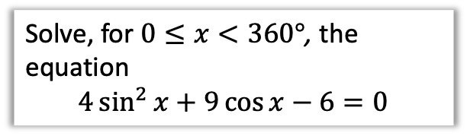
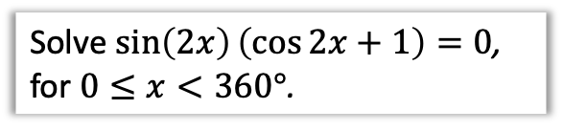
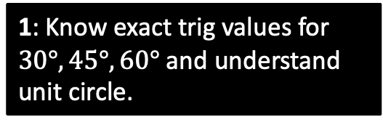
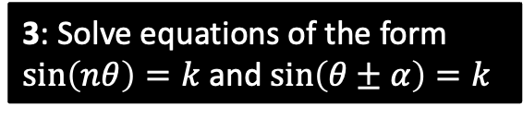
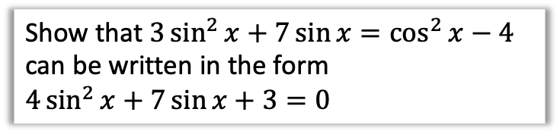
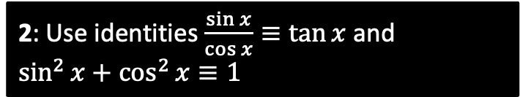
Chapter Overview
1: Know exact trig values for $30°, 45°, 60°$ and understand unit circle.
2: Use identities $\frac{\sin{x}}{\cos{x}}≡\tan{x}$ and
$\sin^{2}{x}+\cos^{2}{x}≡1$
Show that $3\sin^{2}{x}+7\sin{x}=\cos^{2}{x}−4$ can be written in the form
$4\sin^{2}{x}+7\sin{x}+3=0$
3: Solve equations of the form $\sin\left(nθ\right)=k$ and $\sin\left(θ±α\right)=k$
4: Solve equations which are quadratic in sin/cos/tan.
Solve $\sin\left(2x\right)\left(\cos{2x}+1\right)=0$, for $0≤x<360°$.
Solve, for $0≤x<360°$, the equation
$$4\sin^{2}{x}+9\cos{x}−6=0$$

Slide 3





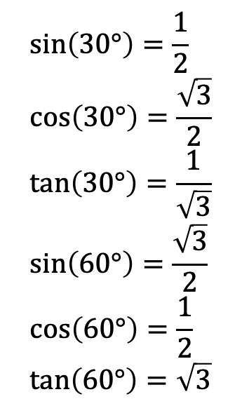

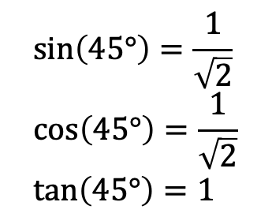



sin/cos/tan of $30°, 45°, 60°$
You will frequently encounter angles of $30°, 60°, 45°$ in geometric problems. Why?
We see these angles in equilateral triangles and half squares.
?
Although you will always have a calculator, you need to know how to derive these.
All you need to remember:
! Draw half a unit square and half an equilateral triangle of side 2.
$$\sin\left(30°\right)=\frac{1}{2} \\ \cos\left(30°\right)=\frac{\sqrt{3}}{2} \\ \tan\left(30°\right)=\frac{1}{\sqrt{3}} \\ \sin\left(60°\right)=\frac{\sqrt{3}}{2} \\ \cos\left(60°\right)=\frac{1}{2} \\ \tan\left(60°\right)=\sqrt{3}$$
?
$$\sin\left(45°\right)=\frac{1}{\sqrt{2}} \\ \cos\left(45°\right)=\frac{1}{\sqrt{2}} \\ \tan\left(45°\right)=1$$
?
?
$$\sqrt{2}$$
?
?
$$1$$
?
?
$$30°$$
$$2$$
?
?
?
$$\sqrt{3}$$
$$45°$$
?
?
$$1$$
?
?
?
$$60°$$
$$1$$
?
?
?

Slide 4
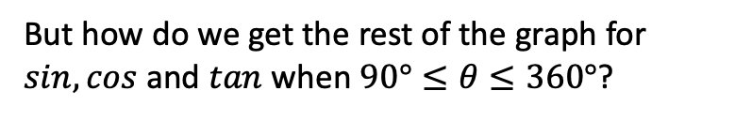


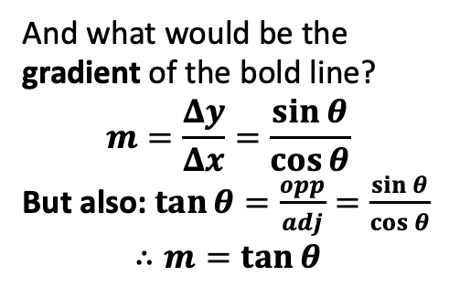

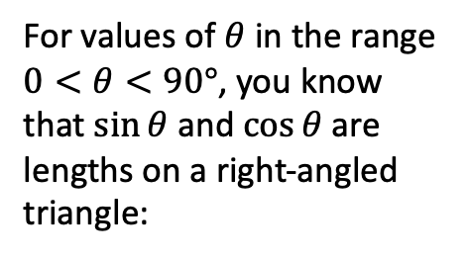




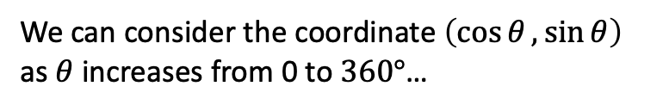


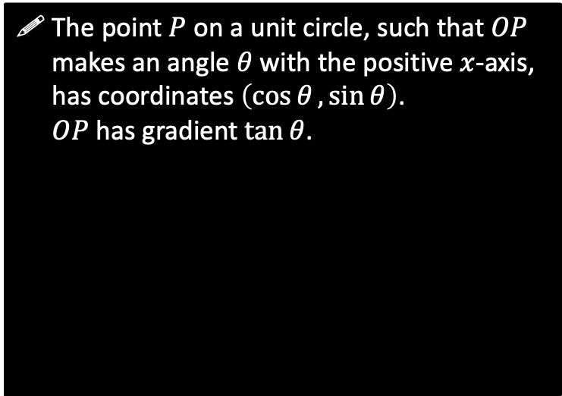

The Unit Circle and Trigonometry
For values of $θ$ in the range $0<θ<90°$, you know that $\sin{θ}$ and $\cos{θ}$ are lengths on a right-angled triangle:
But how do we get the rest of the graph for $sin, cos$ and $tan$ when $90°≤θ≤360°$?
The point $P$ on a unit circle, such that $OP$ makes an angle $θ$ with the positive $x$-axis, has coordinates $\left(\cos{θ},\sin{θ}\right)$.
$OP$has gradient $\tan{θ}$.
$$1$$
?
$$y$$
$$\sin{θ}$$
$$P\left(\cos{θ},\sin{θ}\right)$$
$$θ$$
$$1$$
$$\cos{θ}$$
$$θ$$
?
$$O$$
$$x$$
And what would be the gradient of the bold line?
$$m=\frac{Δy}{Δx}=\frac{\sin{θ}}{\cos{θ}}$$
But also: $\tan{θ}=\frac{opp}{adj}=\frac{\sin{θ}}{\cos{θ}}$
$$∴m=\tan{θ}$$
?
Angles are always measured anticlockwise.
(Further Mathematicians will encounter the same when they get to Complex Numbers)
We can consider the coordinate $\left(\cos{θ},\sin{θ}\right)$ as $θ$ increases from 0 to $360°$…

Slide 5











































Mini-Exercise
Use the unit circle to determine each value in the table, using either “0”, “+ve”, “-ve”, “1”, “-1” or “undefined”. Recall that the point on the unit circle has coordinate $(\cos{θ},\sin{θ})$ and $OP$ has gradient $\tan{θ}$.
$x$-value
$y$-value
Gradient of $OP$.
$$\cos{θ}$$
$$\sin{θ}$$
$$\tan{θ}$$
$$\cos{θ}$$
$$\sin{θ}$$
$$\tan{θ}$$
$$θ=0$$
$$θ=180°$$
?
$$y$$
$$y$$
1
0
0
?
-1
0
0
$$P$$
$$x$$
$$P$$
$$θ$$
$$x$$
$$0<θ<90°$$
?
$$180°<θ<270°$$
?
$$y$$
$$y$$
$$P$$
+ve
+ve
+ve
?
-ve
-ve
+ve
$$1$$
$$θ$$
$$θ$$
$$x$$
$$x$$
$$P$$
$$θ=90°$$
?
$$θ=270°$$
?
$$y$$
$$y$$
?
0
1
Undefined
(vertical lines don’t have a well-defined gradient)
?
0
-1
Undefined
$$P$$
$$θ$$
$$θ$$
$$x$$
$$x$$
$$P$$
$$90°<θ<180°$$
?
$$270°<θ<360°$$
?
$$y$$
-ve
+ve
-ve
$$y$$
+ve
-ve
-ve
?
?
$$P$$
$$θ$$
$$P$$
$$x$$
$$θ$$
$$x$$

Slide 6



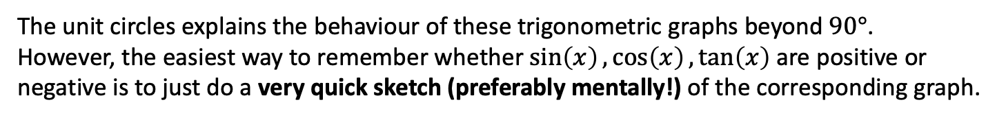



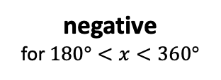

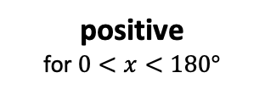
The Unit Circle and Trigonometry
The unit circles explains the behaviour of these trigonometric graphs beyond $90°$.
However, the easiest way to remember whether $\sin\left(x\right),\cos\left(x\right),\tan\left(x\right)$ are positive or negative is to just do a very quick sketch (preferably mentally!) of the corresponding graph.
$$y$$
positive
for $0<x<180°$
Sin
All functions
$$y=sin\left(x\right)$$
Tan
Cos
$$x$$
$$90$$
$$180$$
$$270$$
$$360$$
Note: The textbook uses something called ‘CAST diagrams’, which is an acronym for which quadrants the Cosine, All, Sine and Tangent are positive
negative
for $180°<x<360°$

Slide 7

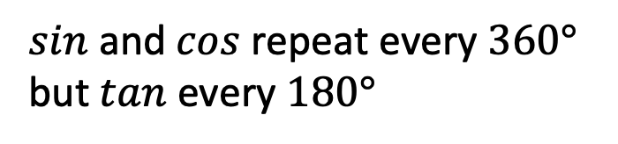


















A Few Trigonometric Angle Laws
The following are all easily derivable using a quick sketch of a trigonometric graph, and are merely a convenience so you don’t always have to draw out a graph every time.
You are highly encouraged to memorise these so that you can do exam questions faster.
$$y=\sin\left(x\right)$$
1
$$\sin\left(x\right)=\sin\left(180°−x\right)$$
We saw this in the previous chapter when covering the ‘ambiguous case’ when using the sine rule.
e.g. $\sin\left(150°\right)=\sin\left(30°\right)$
$$30$$
$$150$$
$$180$$
$$y=\cos\left(x\right)$$
2
$$\cos\left(x\right)=\cos\left(360°−x\right)$$
$$30$$
$$330$$
$$360$$
e.g. $\cos\left(330°\right)=\cos\left(30°\right)$
$sin$ and $cos$ repeat every $360°$
but $tan$ every $180°$
$$y=\sin\left(x\right)$$
3
$$30$$
$$360$$
$$390$$
$$720$$
e.g. $\sin\left(390°\right)=\sin\left(30°\right)$
$\sin\left(x\right)=\cos\left(90°−x\right)$
Remember from the previous chapter that “cosine” by definition is the sine of the “complementary” angle.
This was/is never covered in the textbook but caught everyone by surprise when it came up in a C3 exam.
4
e.g. $\sin\left(50°\right)=\cos\left(40°\right)$

Slide 8



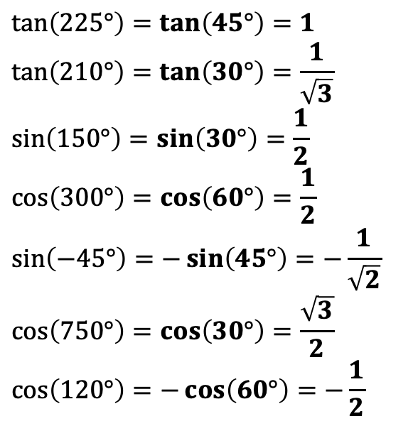
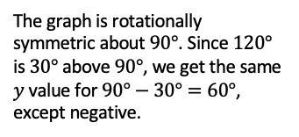
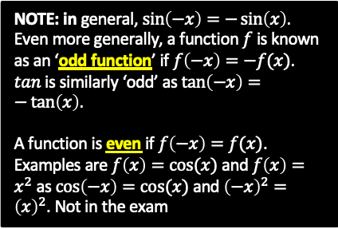


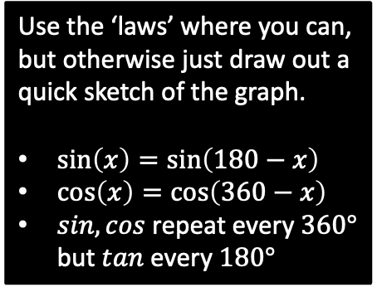












Examples
Without a calculator, work out the value of each below.
$tan$ repeats every $180°$ so can subtract $180°$
Use the ‘laws’ where you can, but otherwise just draw out a quick sketch of the graph.
$\sin\left(x\right)=\sin\left(180−x\right)$
$\cos\left(x\right)=\cos\left(360−x\right)$
$sin,cos$ repeat every $360°$ but $tan$ every $180°$
?
$$\tan\left(225°\right)=\tan\left(45°\right)=1$$
$$\tan\left(210°\right)=\tan\left(30°\right)=\frac{1}{\sqrt{3}} \\ \sin\left(150°\right)=\sin\left(30°\right)=\frac{1}{2} \\ \cos\left(300°\right)=\cos\left(60°\right)=\frac{1}{2} \\ \sin\left(−45°\right)=−\sin\left(45°\right)=−\frac{1}{\sqrt{2}}$$
$$\cos\left(750°\right)=\cos\left(30°\right)=\frac{\sqrt{3}}{2}$$
$$\cos\left(120°\right)=−\cos\left(60°\right)=−\frac{1}{2}$$
?
For $sin$ we can subtract from $180°$.
?
?
For $cos$ we can subtract from $360°$.
?
We have to resort to a sketch for this one.
$$y=\sin\left(x\right)$$
NOTE: in general, $\sin\left(−x\right)=−\sin\left(x\right)$.
Even more generally, a function $f$ is known as an ‘odd function’ if $f\left(−x\right)=−f(x)$.
$tan$ is similarly ‘odd’ as $\tan\left(−x\right)=−\tan\left(x\right)$.
A function is even if $f\left(−x\right)=f(x)$. Examples are $f\left(x\right)=cos⁡(x)$ and $f\left(x\right)=x^{2}$ as $\cos\left(−x\right)=cos⁡(x)$ and ${\left(−x\right)}^{2}={\left(x\right)}^{2}$. Not in the exam
?
cos repeats every $360°$.
$$\frac{1}{\sqrt{2}}$$
$$−45$$
$$45$$
$$x$$
?
$$−\frac{1}{\sqrt{2}}$$
Again, let’s just use a graph.
$$y=\cos\left(x\right)$$
$$\frac{1}{2}$$
The graph is rotationally symmetric about $90°$. Since $120°$ is $30°$ above $90°$, we get the same $y$ value for $90°−30°=60°$, except negative.
$$60$$
$$120$$
$$x$$
$$90$$
$$180$$

Slide 9
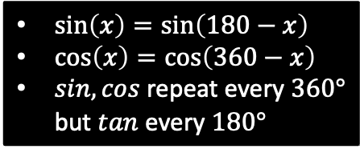
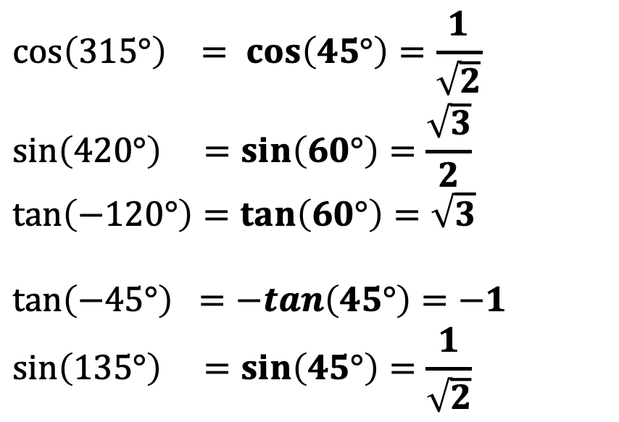
Test Your Understanding
Without a calculator, work out the value of each below.
?
$$\cos\left(315°\right) = \cos\left(45°\right)=\frac{1}{\sqrt{2}}$$
$$\sin\left(420°\right) =\sin\left(60°\right)=\frac{\sqrt{3}}{2} \\ \tan\left(−120°\right)=\tan\left(60°\right)=\sqrt{3}$$
$$\tan\left(−45°\right) =−tan\left(45°\right)=−1 \\ \sin\left(135°\right) =\sin\left(45°\right)=\frac{1}{\sqrt{2}}$$
$\sin\left(x\right)=\sin\left(180−x\right)$
$\cos\left(x\right)=\cos\left(360−x\right)$
$sin,cos$ repeat every $360°$ but $tan$ every $180°$
?
?
?
?

Slide 10
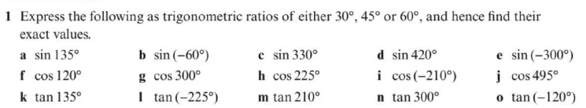
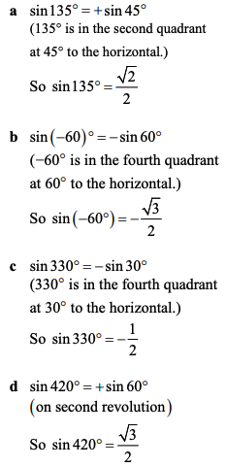
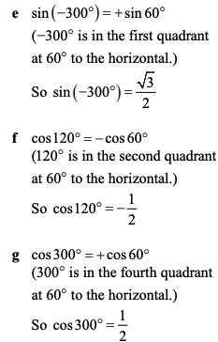
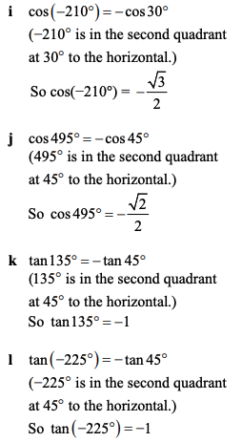
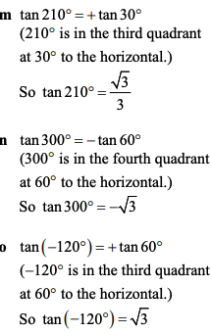
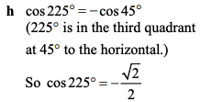
Exercise 10B – Y1 Page 209
a?
e?
i?
m?
b?
f?
j?
n?
c?
g?
o?
k?
h?
l?
d?

Slide 11
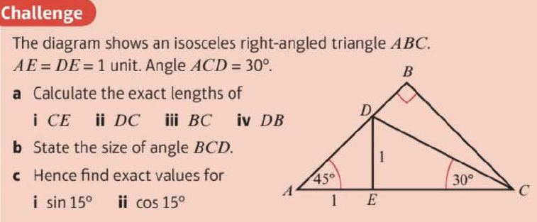
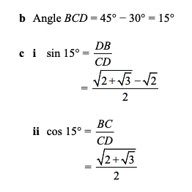
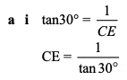





Exercise 10A/B – Y1 Page 207, 209
a?
b?
b?

Slide 12
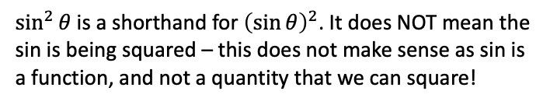
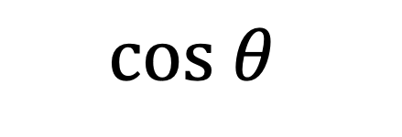
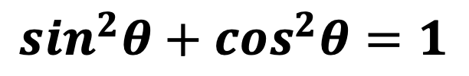


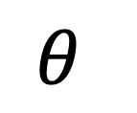

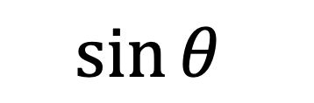
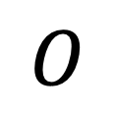
Trigonometric Identities
$$P$$
Returning to our point on the unit circle…
$$1$$
?
$$\sin{θ}$$
$$θ$$
$$O$$
$$cos θ$$
?
?
1
Then $tan θ=\frac{sin θ}{cos θ}$
?
2
Pythagoras gives you...
$$sin^{2}θ+cos^{2}θ=1$$
$\sin^{2}{θ}$ is a shorthand for ${\left(\sin{θ}\right)}^{2}$. It does NOT mean the sin is being squared – this does not make sense as sin is a function, and not a quantity that we can square!

Slide 13
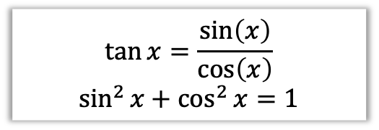
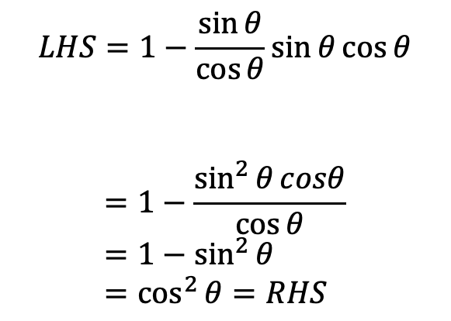
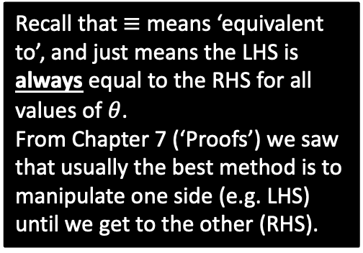
Application of identities #1: Proofs
Prove that $1−\tan{θ}\sin{θ}\cos{θ}≡\cos^{2}{θ}$
?
$$\tan{x}=\frac{\sin\left(x\right)}{\cos\left(x\right)}$$
$$\sin^{2}{x}+\cos^{2}{x}=1$$
Tip #1: Turn any tan’s into sin’s and cos’s.
$$LHS=1−\frac{\sin{θ}}{\cos{θ}}\sin{θ}\cos{θ}$$
$$=1−\frac{\sin^{2}{θ}cosθ}{\cos{θ}} \\ =1−\sin^{2}{θ} \\ =\cos^{2}{θ}=RHS$$
?
Recall that $≡$ means ‘equivalent to’, and just means the LHS is always equal to the RHS for all values of $θ$.
From Chapter 7 (‘Proofs’) we saw that usually the best method is to manipulate one side (e.g. LHS) until we get to the other (RHS).
?
?

Slide 14
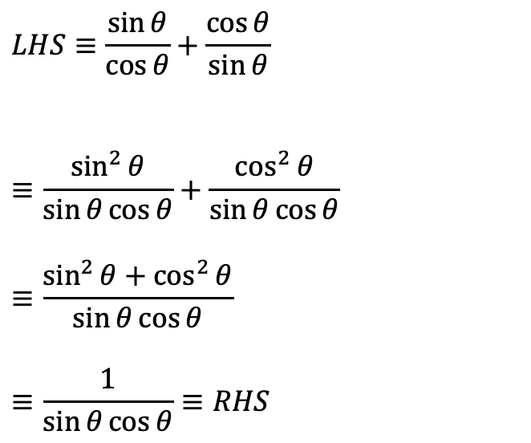
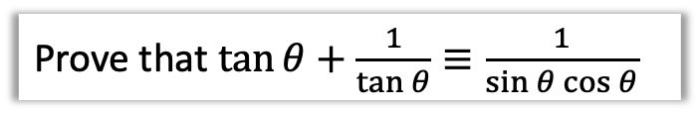
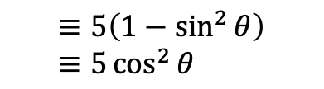
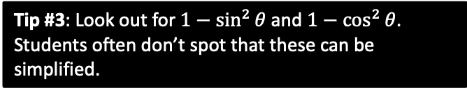

More Examples
Edexcel C2 June 2012 Paper 1 Q16
Prove that $\tan{θ}+\frac{1}{\tan{θ}}≡\frac{1}{\sin{θ}\cos{θ}}$
Simplify $5−5\sin^{2}{θ}$
?
?
$$≡5\left(1−\sin^{2}{θ}\right) \\ ≡5\cos^{2}{θ}$$
$$LHS≡\frac{\sin{θ}}{\cos{θ}}+\frac{\cos{θ}}{\sin{θ}}$$
$$≡\frac{\sin^{2}{θ}}{\sin{θ}\cos{θ}}+\frac{\cos^{2}{θ}}{\sin{θ}\cos{θ}}$$
$$≡\frac{\sin^{2}{θ}+\cos^{2}{θ}}{\sin{θ}\cos{θ}}$$
$$≡\frac{1}{\sin{θ}\cos{θ}}≡RHS$$
?
Tip #3: Look out for $1−\sin^{2}{θ}$ and $1−\cos^{2}{θ}$.
Students often don’t spot that these can be simplified.
?
?
Tip #2: In any addition/subtraction involving at least one fraction (with trig functions), always combine algebraically into one.

Slide 15
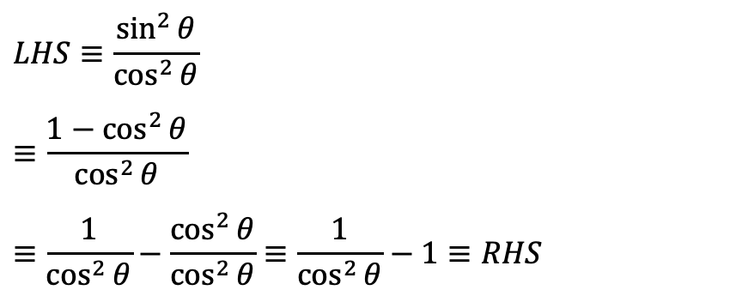
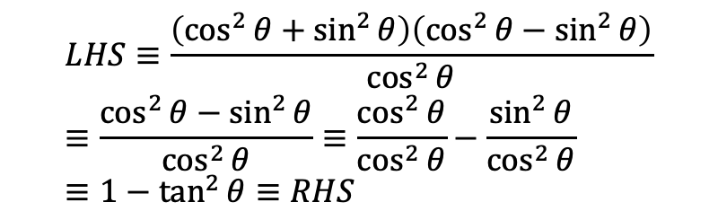
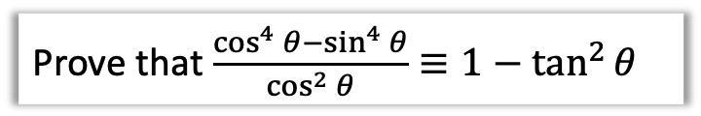
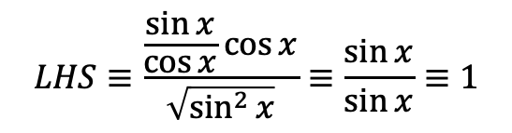
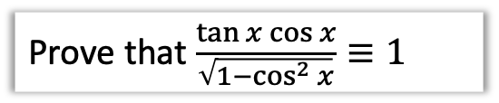
Test Your Understanding
Prove that $\frac{\tan{x}\cos{x}}{\sqrt{1−\cos^{2}{x}}}≡1$
Prove that $\frac{\cos^{4}{θ}−\sin^{4}{θ}}{\cos^{2}{θ}}≡1−\tan^{2}{θ}$
?
?
$$LHS≡\frac{\frac{\sin{x}}{\cos{x}}\cos{x}}{\sqrt{\sin^{2}{x}}}≡\frac{\sin{x}}{\sin{x}}≡1$$
$$LHS≡\frac{\left(\cos^{2}{θ}+\sin^{2}{θ}\right)\left(\cos^{2}{θ}−\sin^{2}{θ}\right)}{\cos^{2}{θ}} \\ ≡\frac{\cos^{2}{θ}−\sin^{2}{θ}}{\cos^{2}{θ}}≡\frac{\cos^{2}{θ}}{\cos^{2}{θ}}−\frac{\sin^{2}{θ}}{\cos^{2}{θ}} \\ ≡1−\tan^{2}{θ}≡RHS$$
AQA IGCSE Further Maths Worksheet
Prove that $\tan^{2}{θ}≡\frac{1}{\cos^{2}{θ}}−1$
?
$$LHS≡\frac{\sin^{2}{θ}}{\cos^{2}{θ}}$$
$$≡\frac{1−\cos^{2}{θ}}{\cos^{2}{θ}}$$
$$≡\frac{1}{\cos^{2}{θ}}−\frac{\cos^{2}{θ}}{\cos^{2}{θ}}≡\frac{1}{\cos^{2}{θ}}−1≡RHS$$

Slide 16




Exercise 10C – Y1 Page 211-212
a?
c?
b?
d?

Slide 17









Exercise 10C – Y1 Page 211-212
a?
b?
a?
b?

Slide 18


Extension
?
[MAT 2008 1C] The simultaneous equations in $x,y$,
$$\left(\cos{θ}\right)x−\left(\sin{θ}\right)y=2 \\ \left(\sin{θ}\right)x+\left(\cos{θ}\right)y=1$$
are solvable:
for all values of $θ$ in range
$0≤θ<2π$
except for one value of $θ$ in range $0≤θ<2π$
except for two values of $θ$ in range $0≤θ<2π$
except for three values of $θ$ in range $0≤θ<2π$
For convenience let $s=\sin{θ}$ and $c=\cos{θ}$. As we’d usually do for simultaneous equations, we could make coefficients of $x$ terms the same:
$$scx−s^{2}y=2s \\ scx+c^{2}y=c$$
Then subtracting:
$$\left(s^{2}+c^{2}\right)y=c−2s \\ ∴y=c−2s$$
Similarly making $y$ terms the same, we yield $x=2c+s$
$x,y$ are defined for every value of $θ$, so the answer is (A). Why might it have not been (A)? Suppose $x=\frac{2\cos{θ}+sinθ}{sin θ}$. This would not be defined whenever $sin θ=0$.

Slide 19







Solving Trigonometric Equations
Remember those trigonometric angle laws (on the right) earlier this chapter? They’re about to become very useful!
Reminder of ‘trig laws’:
$\sin\left(x\right)=\sin\left(180−x\right)$
$\cos\left(x\right)=\cos\left(360−x\right)$
$sin,cos$ repeat every $360°$ but $tan$ every $180°$
Solve $\sin{θ}=\frac{1}{2}$ in the interval $0≤θ≤360°$.
?
Calculator Note:
When you do $sin^{−1}$, $cos^{−1}$ and $tan^{−1}$ on a calculator, it gives you only one value, known as the principal value.
$$θ=\sin^{−1}\left(\frac{1}{2}\right)=30°$$
or $θ=180°−30°=150°$
Solve $5\tan{θ}=10$ in the interval $−180°≤θ<180°$
$$\tan{θ}=\frac{10}{5}=2 \\ θ=\tan^{−1}{(2})=63.4° (1dp)$$
or $θ=63.4°−180°=−116.6° \left(1dp\right)$
Tip: Look out for the solution range required. $−180≤θ<180°$ is a particularly common one.
?
$tan$ repeats every $180°$, so can add/subtract $180°$ as we please.

Slide 20





Slightly Harder Ones…
Solve $\sin{θ}=−\frac{1}{2}$ in the interval $0≤θ≤360°$.
?
$$θ=\sin^{−1}\left(−\frac{1}{2}\right)=−30°$$
or $θ=180°−\left(−30°\right)=210°$
or $θ=−30°+360°=330°$
This is not in range. In general you should have 2 solutions per $360°$ (except when at a peak or trough of the trig graph)
Note that we’ve had to use a second law, i.e. that $sin$ repeats every $360°$.
Solve $\sin{θ}=\sqrt{3}\cos{θ}$ in the interval $0≤θ≤360°$.
?
$$\frac{\sin{θ}}{\cos{θ}}=\sqrt{3}$$
$$\tan{θ}=\sqrt{3}$$
$$θ=\tan^{−1}\left(\sqrt{3}\right)=60°$$
or $θ=60°+180°=240°$
Hint: The problem here is that we have two different trig functions. Is there anything we can divide both sides by so we only have one trig function?

Slide 21



Test Your Understanding
Solve $2\cos{θ}=\sqrt{3}$ in the interval $0≤θ≤360°$.
?
$$\cos{θ=\frac{\sqrt{3}}{2}}$$
$$θ=\cos^{−1}\left(\frac{\sqrt{3}}{2}\right)=30°$$
or $θ=360°−30°=330°$
Solve $\sqrt{3}\sin{θ}=\cos{θ}$ in the interval $−180°≤θ≤180°$.
$$\tan{θ=\frac{1}{\sqrt{3}}} \\ θ=\tan^{−1}\left(\frac{1}{\sqrt{3}}\right)=30°$$
or $θ=30°−180°=−150°$
?

Slide 22





Exercise 10D – Y1 215-216
a?
b?
c?
9 Find all the values of $θ$, to 1 decimal place, in the interval $0<θ<360°$ for which $\tan^{2}θ=9$
?

Slide 23






Exercise 10D – Y1 215-216
a?
b?
a?
b?

Slide 24










Harder Equations
Harder questions replace the angle $θ$ with a linear expression.
Solve $\cos{3x=−\frac{1}{2}}$ in the interval $0≤x≤360°$.
?
STEP 1: Adjust the range of values for $θ$ to match the expression inside the cos.
$$0≤3x<1080° \\ 3x=\cos^{−1}\left(−\frac{1}{2}\right)=120° \\ 3x=120°,240°,480°,600°,840°,960° \\ x=40°,80°,160°,200°,280°,320°$$
STEP 2: Immediately after applying an inverse trig function (and BEFORE dividing by 3!), find all solutions up to the end of the interval.
In general you tend to get a pair of values per $360°$ (for any of sin/cos/tan), except for $\cos{θ=±1}$ or $\sin{θ}=±1$:
Thus once getting your first pair of values (e.g. using $\sin\left(180−θ\right)$ or $cos⁡(360−θ)$ to get the second value), keep adding $360°$ to generate new pairs.
$$y$$
STEP 3: Then do final manipulation to each value.
$$y=\cos\left(x\right)$$
$$90$$
$$180$$
$$270$$
$$360$$
$$x$$

Slide 25




Further Examples
Solve $\sin{(2x+30°)=\frac{1}{\sqrt{2}}}$ in the interval $0≤x≤360°$.
?
$$30°≤2x+30°≤750° \\ 2x+30°=45°, 135°, 405°,495° \\ 2x=15°,105°,375°,465° \\ x=7.5°,52.5°,187.5°,232.5°$$
To get from $x$ to $2x+30°$ we double and add $30°$. So do the same to the upper and lower bound!
Solve $\sin{x}=2\cos{x}$ in the interval $0≤x<300°$
?
$$\tan{x}=2 \\ x=\tan^{−1}{2}=63.43°, 243.43°$$
By dividing both sides by $\cos{x}$, the $\sin{x}$ becomes $\tan{x}$ and the $\cos{x}$ disappears, leaving a trig equation helpfully only in terms of one trig function.

Slide 26


Test Your Understanding
Edexcel C2 Jan 2013 Q4
?

Slide 27






Exercise 10E – Y1 p219
a?
b?
a?
b?

Slide 28





Exercise 10E – Y1 p219
a?
b?
a?
b?

Slide 29



Quadratics in sin/cos/tan
We saw that an equation can be ‘quadratic in’ something, e.g. $x−2\sqrt{x}+1=0$ is ‘quadratic in $\sqrt{x}$’, meaning that $\sqrt{x}$ could be replaced with another variable, say $y$, to produce a quadratic equation $y^{2}−2y+1=0$.
Solve $5\sin^{2}{x}+3\sin{x}−2=0$ in the interval $0≤x≤360°$.
Method 1: Use a substitution.
Let $y=\sin{x}$
Then $5y^{2}+3y−2=0$
$$\left(5y−2\right)\left(y+1\right)=0 \\ y=\frac{2}{5} or y=−1 \\ ∴\sin{x}=\frac{2}{5} or\sin{x}=−1 \\ x=23.6°, 156.4°, \\ or x=270°$$
Method 2: Factorise without substitution.
This is the same, but we ‘imagine’ $\sin{x}$ as a single variable and hence factorise immediately.
$$\left(5\sin{x}−2\right)\left(\sin{x}+1\right)=0 \\ \sin{x}=\frac{2}{5} or\sin{x}=−1 \\ x=23.6°, 156.4°, \\ or x=270°$$
?
?

Slide 30




More Examples
Solve $\tan^{2}{θ}=4$ in the interval $0≤x≤360°$.
?
Missing the negative case would result in the loss of multiple marks. Beware!
$$\tan{θ}=2 or \tan{θ}=−2 \\ θ=63.4°, 243.4° \\ or θ=−63.4°, 116.6°,296.6°$$
$−63.4°$ was outside the range so we had to add $180°$ twice.
Solve $2\cos^{2}{x}+\sin{x}=3\sin^{2}{x}$ in the interval $−180°≤x≤180°$.
?
$$2\left(1−\sin^{2}{x}\right)+\sin{x}=3\sin^{2}{x} \\ 2−2\sin^{2}{x}+\sin{x}=3\sin^{2}{x} \\ 5\sin^{2}{x}−\sin{x}−2=0 \\ \left(5\sin{x}+1\right)\left(\sin{x}−2\right)=0 \\ \sin{x}=−\frac{1}{5} or\sin{x}=2$$
$$x=−168.5°, −11.5°$$
Tip: We have an identity involving $s{in}^{2}$ and $c{os}^{2}$, so it makes sense to change the squared one that would match all the others.

Slide 31


Test Your Understanding
Edexcel C2 Jan 2010 Q2
?

Slide 32




Exercise 10F – Y1 P221-222
?
?

Slide 33






Exercise 10F – Y1 P221-222
?
a?
b?

Slide 34



Exercise 10F – Y1 P221-222
a?
b?

Slide 35


Extension
1
[MAT 2010 1C] In the range $0≤x<360°$, the equation
$$\sin^{2}{x}+3\sin{x}\cos{x}+2\cos^{2}{x}=0$$
Has how many solutions?
There are multiple ways to do this, including factorising LHS to
$(\sin{x}+\cos{x})(\sin{x}+2\cos{x})$, but dividing by $\cos^{2}{x}$ gives:
$$\tan^{2}{x}+3\tan{x}+2=0 \\ \left(\tan{x}+1\right)\left(\tan{x}+2\right)=0 \\ \tan{x}=−1 or\tan{x}=−2$$
tan always gives a pair of solutions per $360°$, so there are 4 solutions.
2
[MAT 2014 1E] As $x$ varies over the real numbers, the largest value taken by the function
${\left(4\sin^{2}{x}+4\cos{x}+1\right)}^{2}$ equals what?
$${\left(4−4\cos^{2}{x}+4\cos{x}+1\right)}^{2} \\ ={\left(−4\cos^{2}{x}+4\cos{x}+5\right)}^{2} \\ ={\left(6−{\left(1−2\cos{x}\right)}^{2}\right)}^{2}$$
We can make $\cos{x}=\frac{1}{2}$, thus giving a maximum value of $6^{2}=36$.
?
?

