Slide 1
Y1 Chapter 11
Vectors

Slide 2

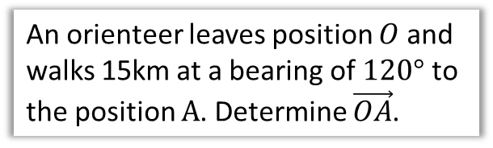
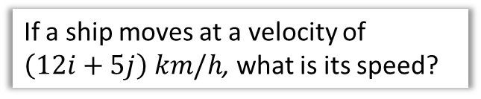
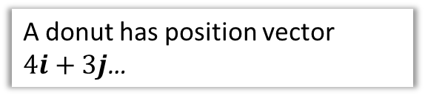
Chapter Overview
1: Add/scale factors and show vectors are parallel.
2: Calculate magnitude and direction of a vector.
If $a=3i+4j$, determine $|a|$.
3: Understand and use position vectors.
4: Solve both geometric problems.
An orienteer leaves position $O$ and walks 15km at a bearing of $120°$ to the position $A$. Determine $\vec{OA}$.
A donut has position vector
$4i+3j$…
5: Understand speed vs velocity
If a ship moves at a velocity of $\left(12i+5j\right) km/h$, what is its speed?

Slide 3







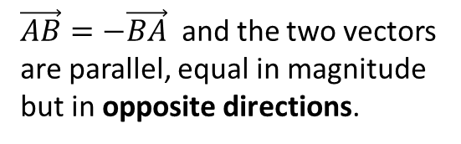
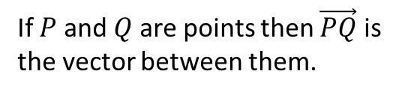




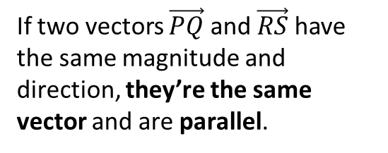


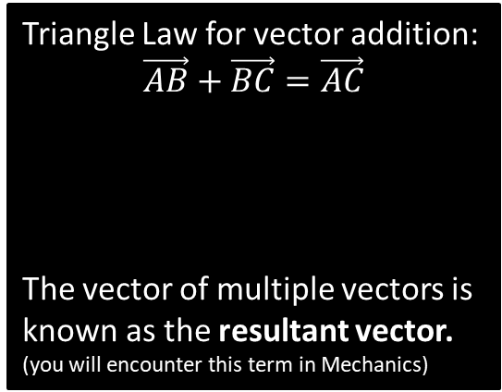





Vector Basics
Whereas a coordinate represents a position in space, a vector represents a displacement in space.
C
$\vec{AB}=−\vec{BA}$ and the two vectors are parallel, equal in magnitude but in opposite directions.
A
$$a$$
$$B$$
A vector has 2 properties:
Direction
Magnitude (i.e. length)
$$B$$
$$A$$
$$−a$$
$$A$$
D
Triangle Law for vector addition:
$$\vec{AB}+\vec{BC}=\vec{AC}$$
The vector of multiple vectors is known as the resultant vector. (you will encounter this term in Mechanics)
If $P$ and $Q$ are points then $\vec{PQ}$ is the vector between them.
$$B$$
$$b$$
$$a$$
$$Q$$
$$C$$
$$P$$
$$A$$
$$a+b$$
B
If two vectors $\vec{PQ}$ and $\vec{RS}$ have the same magnitude and direction, they’re the same vector and are parallel.
$$Q$$
$$P$$
$$S$$
$$R$$

Slide 4

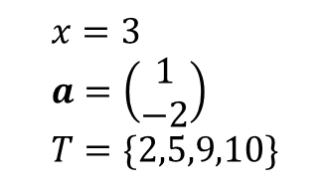

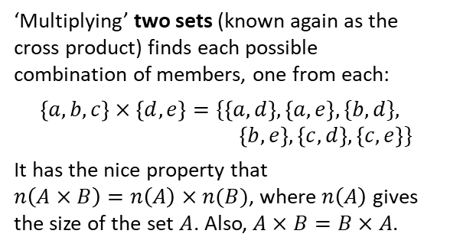

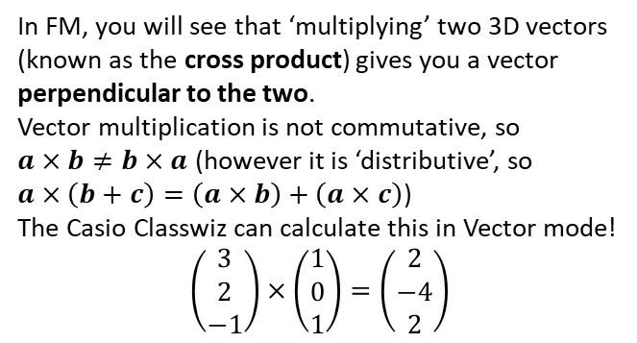
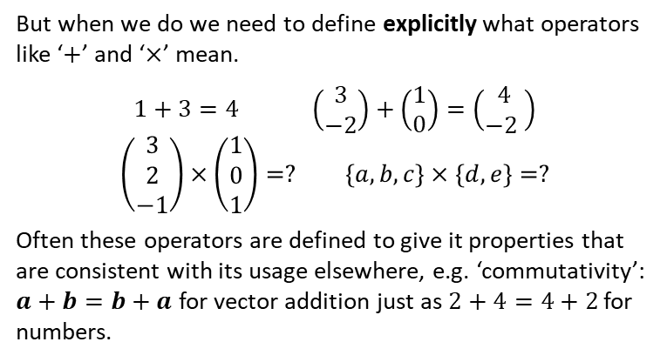
Just for your interest…
Have you ever wondered what happens if you ‘multiply’ two vectors or two sets?
In KS2/3 you probably only experienced variables holding numerical values. You since saw that variables can represent other mathematical types, such as sets or vectors:
But when we do we need to define explicitly what operators like ‘$+$’ and ‘$×$’ mean.
$$1+3=4 \left(\begin{matrix}3 \\ −2\end{matrix}\right)+\left(\begin{matrix}1 \\ 0\end{matrix}\right)=\left(\begin{matrix}4 \\ −2 \end{matrix}\right)$$
$$\left(\begin{matrix}3 \\ 2 \\ −1\end{matrix}\right)×\left(\begin{matrix}1 \\ 0 \\ 1\end{matrix}\right)=? \left\{a,b,c\right\}×\left\{d,e\right\}=?$$
Often these operators are defined to give it properties that are consistent with its usage elsewhere, e.g. ‘commutativity’: $a+b=b+a$ for vector addition just as $2+4=4+2$ for numbers.
$$x=3 \\ a=\left(\begin{matrix}1 \\ −2\end{matrix}\right) \\ T=\{2,5,9,10\}$$
‘Multiplying’ two sets (known again as the cross product) finds each possible combination of members, one from each:
$$\left\{a,b,c\right\}×\left\{d,e\right\}=\{\left\{a,d\right\},\left\{a,e\right\},\{b,d\}, \\ \left\{b,e\right\},\left\{c,d\right\},\left\{c,e\right\}\}$$
It has the nice property that
$n\left(A×B\right)=n\left(A\right)×n(B)$, where $n\left(A\right)$ gives the size of the set $A$. Also, $A×B=B×A$.
In FM, you will see that ‘multiplying’ two 3D vectors (known as the cross product) gives you a vector perpendicular to the two.
Vector multiplication is not commutative, so
$a×b≠b×a$ (however it is ‘distributive’, so
$a×\left(b+c\right)=\left(a×b\right)+\left(a×c\right)$)
The Casio Classwiz can calculate this in Vector mode!
$$\left(\begin{matrix}3 \\ 2 \\ −1\end{matrix}\right)×\left(\begin{matrix}1 \\ 0 \\ 1\end{matrix}\right)=\left(\begin{matrix}2 \\ −4 \\ 2\end{matrix}\right)$$
$$a×b$$
$$b$$
$$a$$

Slide 5
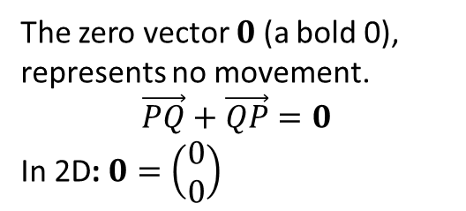



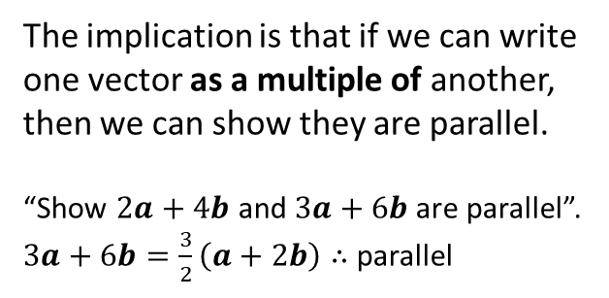
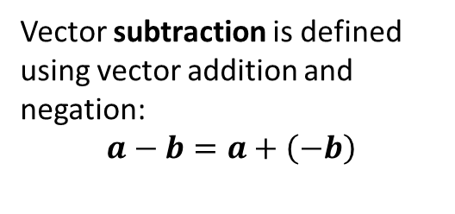






Vector Basics
E
Vector subtraction is defined using vector addition and negation:
$$a−b=a+\left(−b\right)$$
G
A scalar is a normal number, which can be used to ‘scale’ a vector.
The direction will be the same.
But the magnitude will be different (unless the scalar is 1).
$$a$$
$$a$$
$$b$$
$$−b$$
$$a$$
$$a−b$$
$$2a$$
If scalar is negative, opposite direction.
F
The zero vector $0$ (a bold 0), represents no movement.
$$\vec{PQ}+\vec{QP}=0$$
In 2D: $0=\left(\begin{matrix}0 \\ 0\end{matrix}\right)$
$$−\frac{1}{2}a$$
H
Any vector parallel to the vector $a$ can be written as $λa$, where $λ$ is a scalar.
The implication is that if we can write one vector as a multiple of another, then we can show they are parallel.
“Show $2a+4b$ and $3a+6b$ are parallel”.
$3a+6b=\frac{3}{2}\left(a+2b\right)∴$parallel

Slide 6
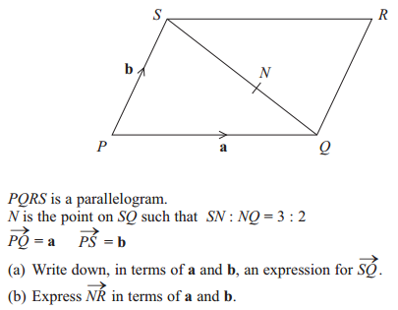

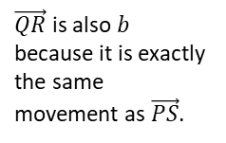
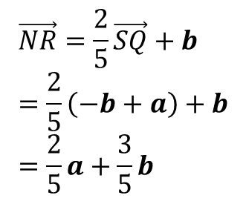
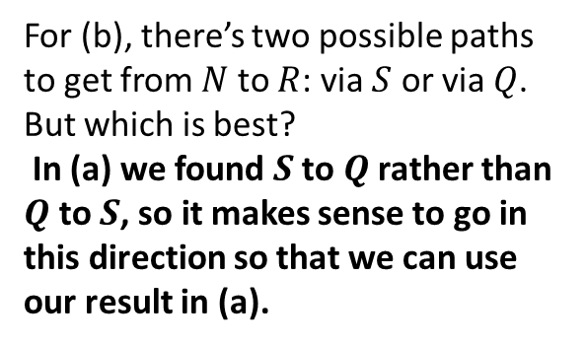
Example
Edexcel GCSE June 2013 1H Q27
Tip: This ratio wasn’t in the original diagram. I like to add the ratio as a visual aid.
$$\vec{SQ}=−b+a$$
a
?
For (b), there’s two possible paths to get from $N$ to $R$: via $S$ or via $Q$. But which is best?
In (a) we found $S$ to $Q$ rather than $Q$ to $S$, so it makes sense to go in this direction so that we can use our result in (a).
3 : 2
?
$$\vec{NR}=\frac{2}{5}\vec{SQ}+b \\ =\frac{2}{5}\left(−b+a\right)+b \\ =\frac{2}{5}a+\frac{3}{5}b$$
$\vec{QR}$ is also $b$ because it is exactly the same movement as $\vec{PS}$.
b
?
Tip: start your working with the first line so that your chosen route is clearer.

Slide 7
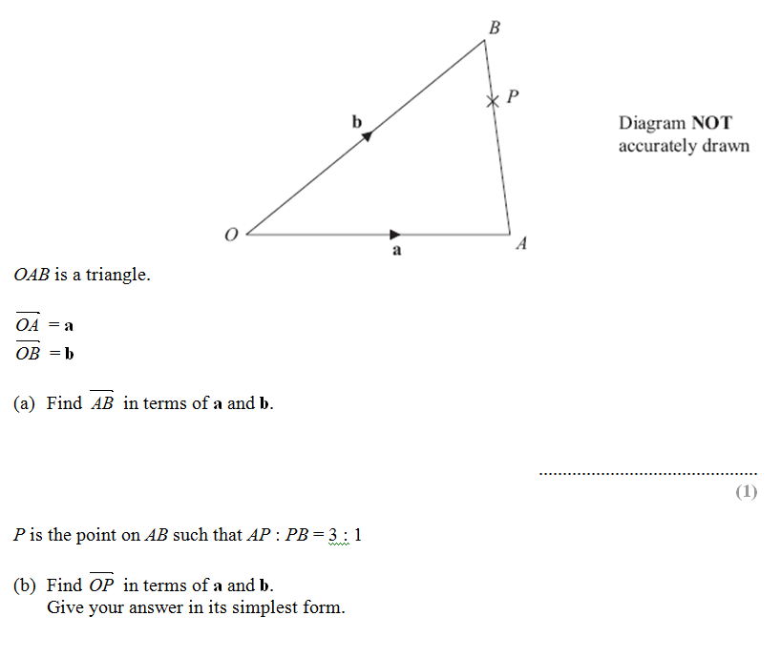
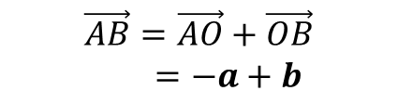
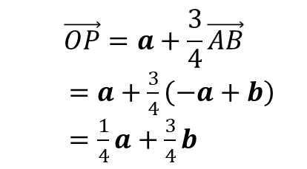
Test Your Understanding
Edexcel GCSE June 2012
$$\vec{AB}=\vec{AO}+\vec{OB}$$
$=−a+b$
?
?
$$\vec{OP}=a+\frac{3}{4}\vec{AB}$$
$=a+\frac{3}{4}\left(−a+b\right)$
$=\frac{1}{4}a+\frac{3}{4}b$

Slide 8
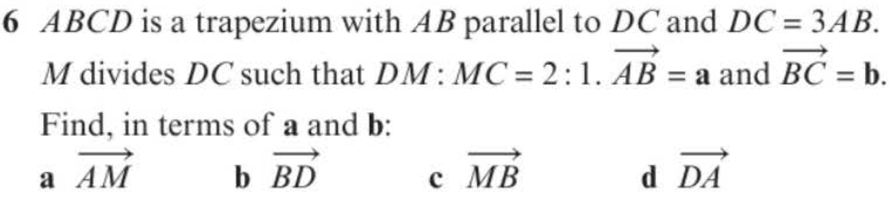
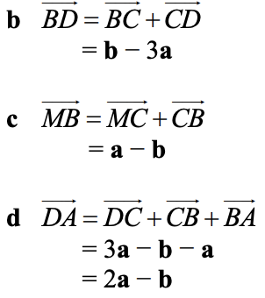
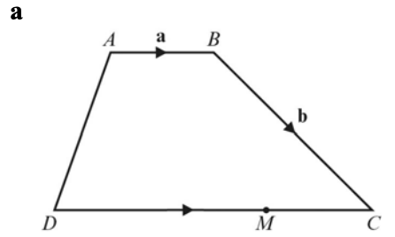
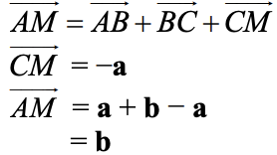
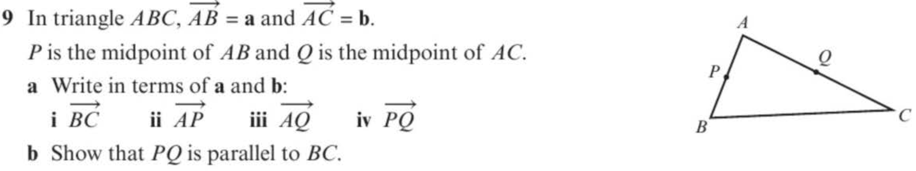
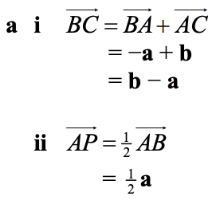
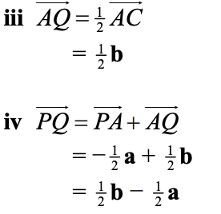
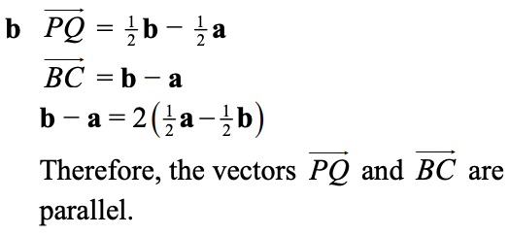
Exercise 11A - Year 1 Pages 234-235
b?
a?
c?
d?
a?
b?

Slide 9
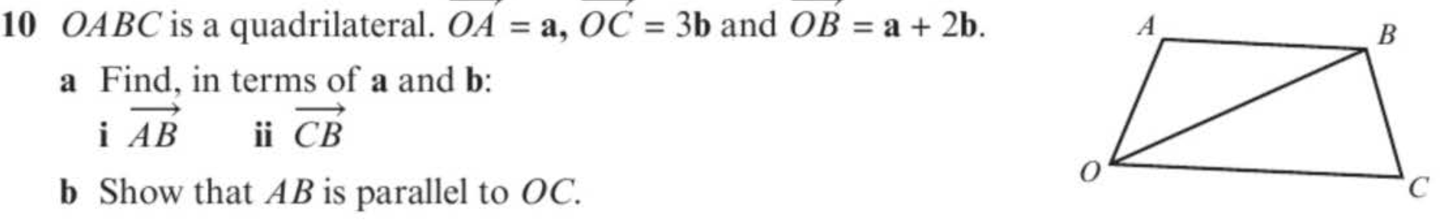
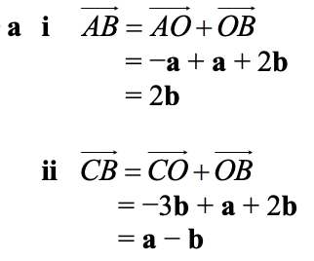
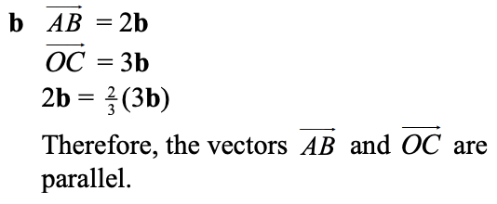
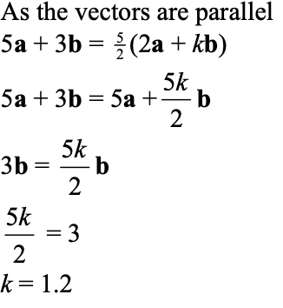
Exercise 11A - Year 1 Pages 234-235
a?
b?
?

Slide 10


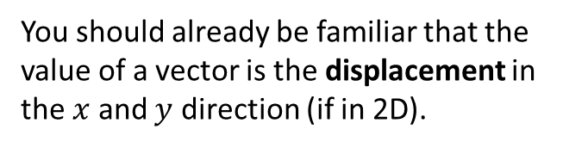

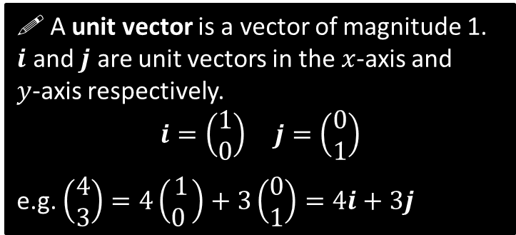
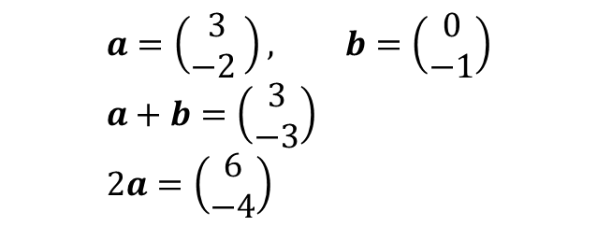
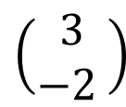
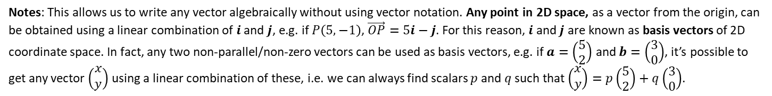
Representing Vectors
You should already be familiar that the value of a vector is the displacement in the $x$ and $y$ direction (if in 2D).
$$\left(\begin{matrix}3 \\ −2 \end{matrix}\right)$$
$$a=\left(\begin{matrix}3 \\ −2 \end{matrix}\right), b=\left(\begin{matrix}0 \\ −1\end{matrix}\right) \\ a+b=\left(\begin{matrix}3 \\ −3\end{matrix}\right) \\ 2a=\left(\begin{matrix}6 \\ −4\end{matrix}\right)$$
?
?
! A unit vector is a vector of magnitude 1.
$i$ and $j$ are unit vectors in the $x$-axis and
$y$-axis respectively.
$$i=\left(\begin{matrix}1 \\ 0\end{matrix}\right) j=\left(\begin{matrix}0 \\ 1\end{matrix}\right)$$
e.g. $\left(\begin{matrix}4 \\ 3\end{matrix}\right)=4\left(\begin{matrix}1 \\ 0 \end{matrix}\right)+3\left(\begin{matrix}0 \\ 1\end{matrix}\right)=4i+3j$
$$j$$
$$i$$
Notes: This allows us to write any vector algebraically without using vector notation. Any point in 2D space, as a vector from the origin, can be obtained using a linear combination of $i$ and $j$, e.g. if $P\left(5,−1\right)$, $\vec{OP}=5i−j$. For this reason, $i$ and $j$ are known as basis vectors of 2D coordinate space. In fact, any two non-parallel/non-zero vectors can be used as basis vectors, e.g. if $a=\left(\begin{matrix}5 \\ 2\end{matrix}\right)$ and $b=\left(\begin{matrix}3 \\ 0\end{matrix}\right)$, it’s possible to get any vector $\left(\begin{matrix}x \\ y\end{matrix}\right)$ using a linear combination of these, i.e. we can always find scalars $p$ and $q$ such that $\left(\begin{matrix}x \\ y\end{matrix}\right)=p\left(\begin{matrix}5 \\ 2\end{matrix}\right)+q\left(\begin{matrix}3 \\ 0\end{matrix}\right)$.

Slide 11
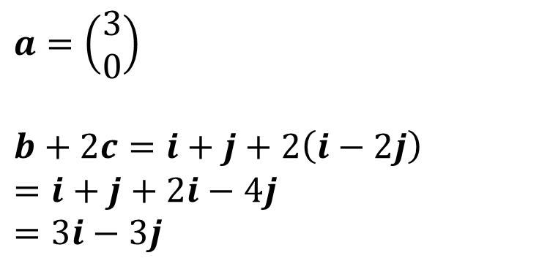
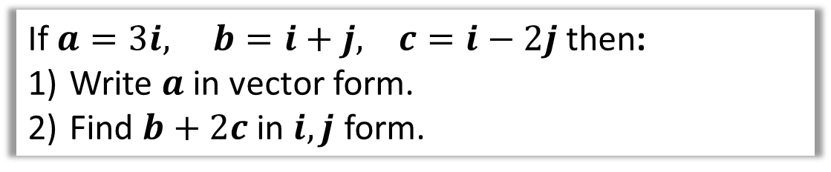
Examples
If $a=3i, b=i+j, c=i−2j$ then:
Write $a$ in vector form.
Find $b+2c$ in $i,j$ form.
$$a=\left(\begin{matrix}3 \\ 0\end{matrix}\right)$$
$$b+2c=i+j+2\left(i−2j\right) \\ =i+j+2i−4j \\ =3i−3j$$
1
?
2
?

Slide 12
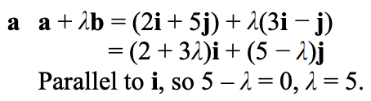
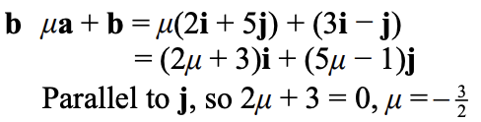
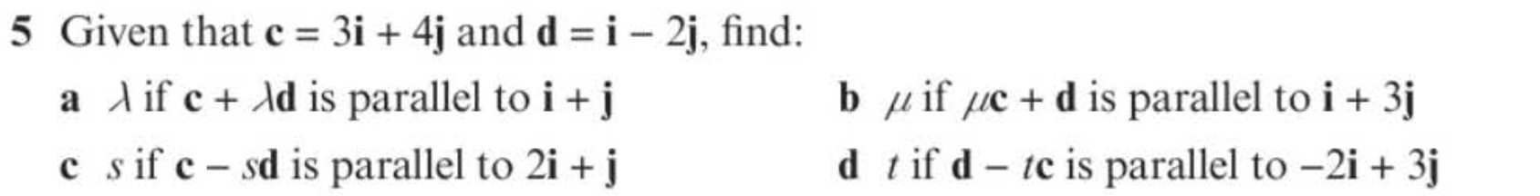
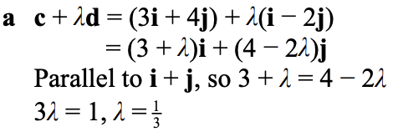
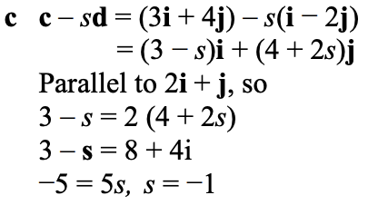
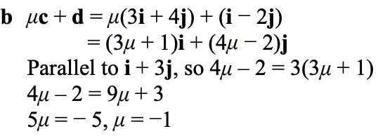
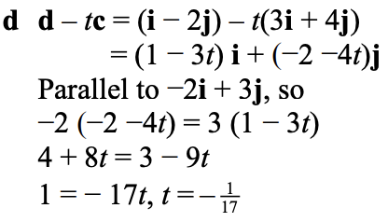
Exercise 11B - Year 1 Pages 237-238
a?
b?
a?
c?
b?
d?

Slide 13
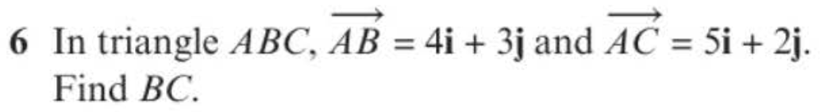
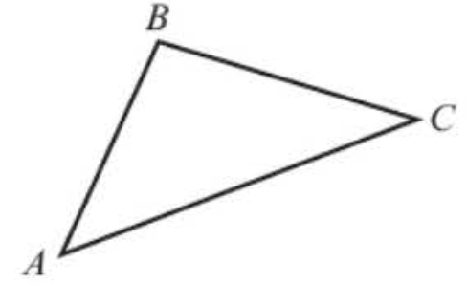
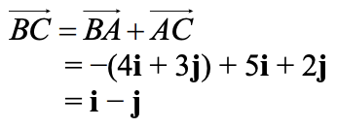





Exercise 11B - Year 1 Pages 237-238
?
a?
b?
c?

Slide 14









Exercise 11B - Year 1 Pages 237-238
8?
9?
a?
b?

Slide 15









Magnitude of a Vector
! The magnitude $|a|$ of a vector $a$ is its length.
If $a=\left(\begin{matrix}x \\ y\end{matrix}\right) \left|a\right|=\sqrt{x^{2}+y^{2}}$
$$\left(\begin{matrix}3 \\ 4\end{matrix}\right)$$
$$B$$
?
4
$$\left|\vec{AB}\right|=\sqrt{3^{2}+4^{2}}=5$$
$$A$$
3
?
?
$$\left|\left(\begin{matrix}1 \\ −1\end{matrix}\right)\right|=\sqrt{2}$$
$$\left|\left(\begin{matrix}−5 \\ −12\end{matrix}\right)\right|=13$$
$$a=\left(\begin{matrix}4 \\ −1\end{matrix}\right) \left|a\right|=\sqrt{4^{2}+1^{2}}=\sqrt{17}$$
?
?
$$b=\left(\begin{matrix}2 \\ 0\end{matrix}\right) \left|b\right|=\sqrt{2^{2}+0^{2}}=2$$

Slide 16




Unit Vectors
! A unit vector is a vector whose magnitude is 1
There’s certain operations on vectors that require the vectors to be ‘unit’ vectors. We just scale the vector so that its magnitude is now 1.
$$a=\left(\begin{matrix}3 \\ 4\end{matrix}\right) \\ \left|a\right|=\sqrt{3^{2}+4^{2}}=5 \\ \hat{a}=\left(\begin{matrix}3/5 \\ 4/5\end{matrix}\right)$$
If $a$ is a vector, then the unit vector $\hat{a}$in the same direction is
$$\hat{a}=\frac{a}{\left|a\right|}$$
?
Test Your Understanding: Convert the following vectors to unit vectors.
$$a=\left(\begin{matrix}12 \\ −5\end{matrix}\right)$$
$$\left|a\right|=\sqrt{{12}^{2}+5^{2}}=13 \\ ∴\hat{a}=\left(\begin{matrix}\frac{12}{13} \\ −\frac{5}{13}\end{matrix}\right)$$
$$b=\left(\begin{matrix}1 \\ 1\end{matrix}\right)$$
$$\left|b\right|=\sqrt{1^{2}+1^{2}}=\sqrt{2} \\ ∴\hat{b}=\left(\begin{matrix}\frac{1}{\sqrt{2}} \\ \frac{1}{\sqrt{2}}\end{matrix}\right)$$
?
?

Slide 17




Exercise 11C - Year 1 Pages 240-242
?
?

Slide 18




Exercise 11C - Year 1 Pages 240-242
a?
b?

Slide 19











Position Vectors
$$y$$
Suppose we started at a point $\left(3,2\right)$ and translated by the vector $\left(\begin{matrix}4 \\ 0\end{matrix}\right)$:
$$a=\left(\begin{matrix}3 \\ 2\end{matrix}\right)$$
$$A\left(3,2\right)$$
$$\left(\begin{matrix}4 \\ 0\end{matrix}\right)$$
$$O$$
$$x$$
$$A\left(3,2\right)$$
$$?$$
A vector used to represent a position is unsurprisingly known as a position vector.
A position can be thought of as a translation from the origin, as per above. It enables us to use positions in all sorts of vector (and matrix!) calculations.
You might think we can do something like:
$\left(3,2\right)+\left(\begin{matrix}4 \\ 0\end{matrix}\right)=\left(7,2\right)$
But only vectors can be added to other vectors.
If we treated the point $\left(3,2\right)$ as a vector, then this solves the problem:
$$\left(\begin{matrix}3 \\ 2\end{matrix}\right)+\left(\begin{matrix}4 \\ 0\end{matrix}\right)=\left(\begin{matrix}7 \\ 2\end{matrix}\right)$$
! The position vector of a point $A$ is the vector$\vec{OA}$, where $O$ is the origin. $\vec{OA}$ is usually written as $a$.

Slide 20





Example
The points $A$ and $B$ have coordinates $\left(3,4\right)$ and $(11,2)$ respectively.
Find, in terms of $i$ and $j$:
The position vector of $A$
The position vector of $B$
The vector $\vec{AB}$
?
You can see this by inspection of the change in $x$ and the change in $y$:
$$A\left(3,4\right) → B(11,2)$$
More formally:
$$\vec{AB}=\vec{OB}−\vec{OA} \\ =\left(\begin{matrix}11 \\ 2\end{matrix}\right)−\left(\begin{matrix}3 \\ 4\end{matrix}\right)=\left(\begin{matrix}8 \\ −2\end{matrix}\right)$$
a
$$\vec{OA}=3i+4j$$
$$\vec{OB}=11i+2j$$
$$\vec{AB}=8i−2j$$
b
?
$$+8$$
$$−2$$
c
?

Slide 21



Further Example
$\vec{OA}=5i−2j$ and $\vec{AB}=3i+4j$. Find:
a) The position vector of $B$.
b) The exact value of $\left|\vec{OB}\right|$ in simplified surd form.
Either a quick sketch will help you see this, or thinking of $\vec{OA}$ as the original position and $\vec{AB}$ as the translation.
?
a
$$\vec{OB}=\vec{OA}+\vec{AB}=\left(\begin{matrix}5 \\ −2\end{matrix}\right)+\left(\begin{matrix}3 \\ 4\end{matrix}\right)=\left(\begin{matrix}8 \\ 2\end{matrix}\right)$$
$$\left|\vec{OB}\right|=\sqrt{8^{2}+2^{2}}=2\sqrt{17}$$
?
b

Slide 22











Exercise 11D - Year 1 Pages 243-244
a?
b?
c?
?

Slide 23





Exercise 11D - Year 1 Pages 243-244
a?
b?
?

Slide 24











Solving Geometric Problems
$$A$$
$$C$$
$$a$$
$$X$$
$$M$$
$$O$$
$$b$$
$$B$$
$X$ is a point on $AB$ such that $AX:XB=3:1$. $M$ is the midpoint of $BC$.
Show that $\vec{XM}$ is parallel to $\vec{OC}$.
?
For any proof question always find the vectors involved first, in this case $\vec{XM}$ and $\vec{OC}$.
$$\vec{OC}=a+b \\ \vec{XM}=\frac{1}{4}\left(−a+b\right)+\frac{1}{2}a=\frac{1}{4}a+\frac{1}{4}b \\ =\frac{1}{4}\left(a+b\right)$$
$\vec{XM}$ is a multiple of $\vec{OC}$ $∴$ parallel.
The key is to factor out a scalar such that we see the same vector.
The magic words here are “is a multiple of”.

Slide 25












Introducing Scalars and Comparing Coefficients
Remember when we had identities like: $ax^{2}+3x≡2x^{2}+bx$
we could compare coefficients, so that $a=2$ and $3=b$.
We can do the same with (non-parallel) vectors!
$$O$$
$$a$$
$$A$$
$$X$$
$$b$$
$OACB$ is a parallelogram, where $\vec{OA}=a$ and $\vec{OB}=b$. The diagonals $OC$ and $AB$ intersect at a point $X$. Prove that the diagonals bisect each other.
(Hint: Perhaps find $\vec{OX}$ in two different ways?)
$$B$$
$$C$$
By considering the route $O→B→X$:
$$\vec{OX}=b+λ \vec{BA} \\ =b+λ\left(−b+a\right)=b−λb+λa \\ =λa+\left(1−λ\right)b$$
Similarly, considering the line $OC$:
$$\vec{OX}=μ \vec{OC}=μ\left(a+b\right)=μa+μb$$
$$∴μa+μb=λa+\left(1−λ\right)b$$
Comparing coefficients of $a$: $μ=λ$
Comparing coefficients of $b$: $μ=1−λ$
$$∴μ=λ=\frac{1}{2}$$
$∴X$ is the midpoint of each of the diagonals.
?
We don’t know what fraction of the way across $\vec{BA}$ the point $X$ is, so let $λ$ be the fraction of the way across. We’re hoping that $λ=\frac{1}{2}$, so that $X$ is exactly halfway across and therefore bisects $BA$.
We need to use a different scalar constant, this time $μ$.
It is common to use the letters $λ$ and $μ$ for scalars.

Slide 26











Test Your Understanding
$$a$$
$$O$$
$$Q$$
$$A$$
$$X$$
$$b$$
$$B$$
$$C$$
In the above diagram, $\vec{OA}=a, \vec{OB}=b$ and $\vec{OQ}=\frac{1}{3}a$. We wish to find the ratio $OX:XC$.
If $\vec{OX}=λ \vec{OC}$, find an expression for $\vec{OX}$ in terms of $a,b$ and $λ$.
If $\vec{BX}=μ \vec{BQ}$, find an expression for $\vec{OX}$ in terms of $a,b$ and $μ$.
By comparing coefficients or otherwise, determine the value of $λ$, and hence the ratio $OX:XC$.
$$\vec{OX}=λ \vec{OC}=λ\left(a+b\right)=λa+λb \\ \vec{OX}=b+μ \vec{BQ}=b+μ\left(−b+\frac{1}{3}a\right)=\frac{1}{3}μa+\left(1−μ\right)b$$
Comparing coefficients: $λ=\frac{1}{3}μ$ and $λ=1−μ$, $∴λ=\frac{1}{4}$
If $\vec{OX}=\frac{1}{4} \vec{OC}$, then $OX:XC=1:3$.
a
?
Expand and collect $a$ terms and collect $b$ terms, so that we can compare coefficients later.
b
?
c
?

Slide 27











Area of a Triangle
$\vec{AB}=3i−2j$ and $\vec{AC}=i−5j$. Determine $∠BAC$.
?
Strategy: Find 3 lengths of triangle then use cosine rule to find angle.
$$A$$
$$\left(\begin{matrix}3 \\ −2\end{matrix}\right)$$
?
$$\left|\vec{AB}\right|=\sqrt{13}$$
$$B$$
$$\left(\begin{matrix}1 \\ −5\end{matrix}\right)$$
$$\left(\begin{matrix}2 \\ 3\end{matrix}\right)$$
?
?
$$\left|\vec{CB}\right|=\sqrt{13}$$
?
$$\left|\vec{AC}\right|=\sqrt{26}$$
$$C$$
A clever student might at this point realise that we can divide all the lengths by $\sqrt{13}$ without changing $∠BAC$, giving a $1:1:\sqrt{2}$ triangle (one of our ‘special’ triangles!), and thus instantly getting $∠BAC=45°$.
But let’s use a more general method of using the cosine rule:
$$a=\sqrt{13}, b=\sqrt{13}, c=\sqrt{26} \\ 13=13+26−2×\sqrt{13}×\sqrt{26}×\cos\left(A\right) \\ \cos\left(A\right)=\frac{1}{\sqrt{2}} → A=45°$$
?

Slide 28


Exercise 11E - Year 1 Pages 246-247
?

Slide 29





Exercise 11E - Year 1 Pages 246-247
a?
b?

Slide 30






Exercise 11E - Year 1 Pages 246-247
a?
b?

Slide 31






Exercise 11E - Year 1 Pages 246-247
a?
b?

Slide 32



Exercise 11E - Year 1 Pages 246-247
a?
b?

Slide 33

EXTENSION
1
[STEP 2010 Q7]
Relative to a fixed origin $O$, the points $A$ and $B$ have position vectors $a$ and $b$, respectively. (The points $O, A$ and $B$ are not collinear.) The point $C$ has position vector $c$ given by
$$c=αa+βb,$$
where $α$ and $β$ are positive constants with $α+β<1$. The lines $OA$ and $BC$ meet at the point $P$ with position vector $p$ and the lines $OB$ and $AC$ meet at the point $Q$ with position vector $q$. Show that
$$p=\frac{αa}{1−β}$$
and write down $q$ in terms of $α, β$ and $b$.
Show further that the point $R$ with position vector $r$ given by
$$r=\frac{αa+βb}{α+β},$$
lies on the lines $OC$ and $AB$.
The lines $OB$ and $PR$ intersect at the point $S$. Prove that $\frac{OQ}{BQ}=\frac{OS}{BS}$.
Click here for the solution:
http://www.mathshelper.co.uk/STEP%202010%20Solutions.pdf
(go to Q7)

Slide 34








Modelling
In Mechanics, you will see certain things can be represented as a simple number (without direction), or as a vector (with direction):
Remember a ‘scalar’ just means a normal number (in the context of vectors). It can be obtained using the magnitude of the vector.
Vector Quantity
Equivalent Scalar Quantity
Velocity
e.g. $\left(\begin{matrix}3 \\ 4\end{matrix}\right) km/h$
?
Speed
$= 5 km/h$
This means the position vector of the object changes by $\left(\begin{matrix}3 \\ 4\end{matrix}\right)$ each hour.
…which is equivalent to moving 5km each hour.
$$5$$
$$4$$
$$3$$
Displacement
e.g. $\left(\begin{matrix}−5 \\ 12\end{matrix}\right) km$
?
Distance
$$=13 km$$

Slide 35








Example
[Textbook] A girl walks 2 km due east from a fixed point $O$ to $A$, and then 3 km due south from $A$ to $B$. Find
the total distance travelled
the position vector of $B$ relative to $O$
$\left|\vec{OB}\right|$
The bearing of $B$ from $O$.
N
$$2+3=5km \\ \vec{OB}=\left(\begin{matrix}2 \\ 3\end{matrix}\right) km$$
$\left|\vec{OB}\right|=\sqrt{2^{2}+3^{2}}=\sqrt{13}=3.61km$ (3sf)
$$90°+\tan^{−1}\left(\frac{3}{2}\right)=56.3°$$
$$2$$
$$A$$
a
?
$$O$$
b
?
$$θ$$
$$3$$
c
?
d
?
$$B$$

Slide 36























Further Example
[Textbook] In an orienteering exercise, a cadet leaves the starting point $O$ and walks 15 km on a bearing of $120°$ to reach $A$, the first checkpoint. From $A$ he walks 9 km on a bearing of $240°$ to the second checkpoint, at $B$. From $B$ he returns directly to $O$.
Find:
the position vector of $A$ relative to $O$
$\left|\vec{OB}\right|$
the bearing of $B$ from $O$
the position vector of $B$ relative $O$.
I have no specific advice to offer except:
Draw a BIG diagram.
Remember bearings are measured clockwise from North.
Don’t forget units (on vectors!)
N
?
N
b
Using cosine rule on $ΔOAB$, $\left|\vec{OB}\right|=13.1km$ (3sf)
?
a
$$120°$$
$$O$$
N
$$O$$
N
$$30°$$
$$30°$$
$$θ$$
$$60°$$
$$θ$$
$$15 km$$
$$A$$
$$15 km$$
$$A$$
$$60°$$
$$240°$$
$$240°$$
$$9 km$$
$$9 km$$
$$B$$
$$B$$
?
$$\vec{OA}=\left(\begin{matrix}15\cos{30°} \\ 15\sin{30°}\end{matrix}\right)=\left(\begin{matrix}13.0 \\ 7.5\end{matrix}\right) km$$
c
Using sine rule on $ΔOAB$:
$$θ=36.6…°$$
$∴$Bearing $=120+36.6°=157°$ (3sf)

Slide 37







Further Example
[Textbook] In an orienteering exercise, a cadet leaves the starting point $O$ and walks 15 km on a bearing of $120°$ to reach $A$, the first checkpoint. From $A$ he walks 9 km on a bearing of $240°$ to the second checkpoint, at $B$. From $B$ he returns directly to $O$.
Find:
the position vector of $A$ relative to $O$
$\left|\vec{OB}\right|$
the bearing of $B$ from $O$
the position vector of $B$ relative $O$.
N
d
?
$$120°$$
$$O$$
N
$$30°$$
$$\vec{OB}=\left(\begin{matrix}13.07\sin{23.41°} \\ −13.07\cos{23.41°}\end{matrix}\right)=\left(\begin{matrix}5.19 \\ −12.0\end{matrix}\right) km$$
$$36.59°$$
$$15 km$$
$$23.41°$$
$$A$$
$$13.07 km$$
$$9 km$$
(I think the textbook made a rounding error due to use of rounded values. They put $\left(\begin{matrix}5.1 \\ −12.1\end{matrix}\right)$)
$$B$$

Slide 38







Exercise 11F - Year 1 Pages 250-251
a?
b?
a?
b?
c?

Slide 39





Exercise 11F - Year 1 Pages 250-251
a?
b?
c?

Slide 40




Exercise 11F - Year 1 Pages 250-251
a?
c?
d?
e?
b?

