Slide 1
Y1 Chapter 13
Integration

Slide 2
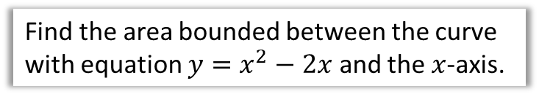

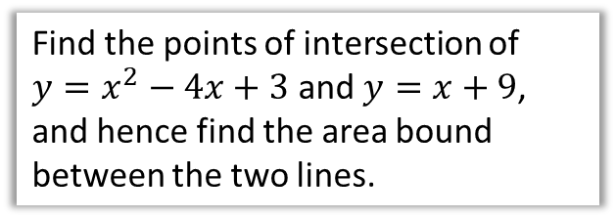
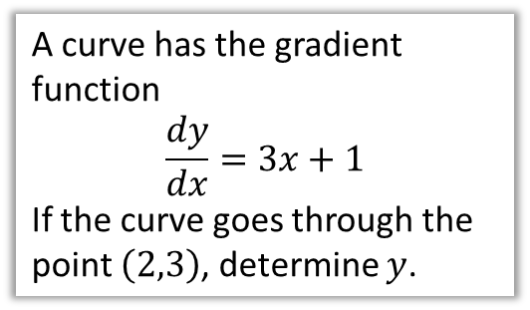
Chapter Overview
This chapter is roughly divided into two parts: the first, indefinite integration, is the opposite of differentiation. The second, definite integration, allows us to find areas under graphs (as well as surface areas and volumes) or areas between two graphs.
1: Find $y$ given $\frac{dy}{dx}$
2: Evaluate definite integrals, and hence the area under a curve.
A curve has the gradient function
$$\frac{dy}{dx}=3x+1$$
If the curve goes through the point $\left(2,3\right)$, determine $y$.
Find the area bounded between the curve with equation $y=x^{2}−2x$ and the $x$-axis.
3: Find areas bound between two different lines.
Find the points of intersection of $y=x^{2}−4x+3$ and $y=x+9$, and hence find the area bound between the two lines.

Slide 3


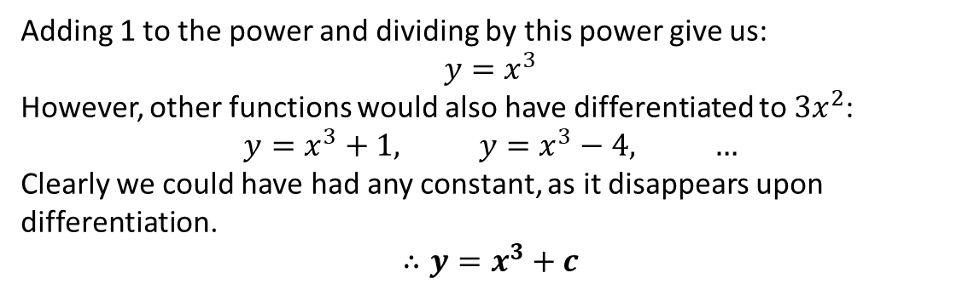


Integrating $x^{n}$ terms
Integration is the opposite of differentiation.
(For this reason it is also called ‘antidifferentiation’)
Gradient Function
Function
multiply by power
reduce power by 1
$$15x^{2}$$
$$5x^{3}$$
?
?
divide by new power
increase power by 1
However, there’s one added complication…
Find $y$ when $\frac{dy}{dx}=3x^{2}$
?
Adding 1 to the power and dividing by this power give us:
$$y=x^{3}$$
However, other functions would also have differentiated to $3x^{2}$:
$$y=x^{3}+1, y=x^{3}−4, …$$
Clearly we could have had any constant, as it disappears upon differentiation.
$$∴y=x^{3}+c$$
$c$ is known as a constant of integration

Slide 4
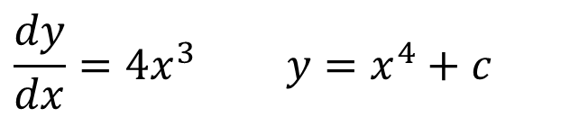

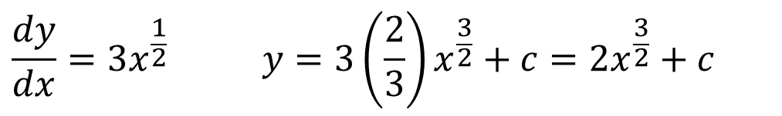

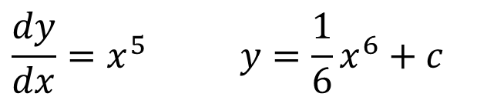
Examples
Find $y$ when:
You should always include the c.
$$\frac{dy}{dx}=4x^{3} y=x^{4}+c$$
?
$$\frac{dy}{dx}=x^{5} y=\frac{1}{6}x^{6}+c$$
?
You could also write as $\frac{x^{6}}{6}$
?
$$\frac{dy}{dx}=3x^{\frac{1}{2}} y=3\left(\frac{2}{3}\right)x^{\frac{3}{2}}+c=2x^{\frac{3}{2}}+c$$
When you divide by a fraction, you multiply by the reciprocal.
Textbook Error on Pg289: “When integrating polynomials”, but Example 3 is not a polynomial because it has negative and fractional powers.

Slide 5
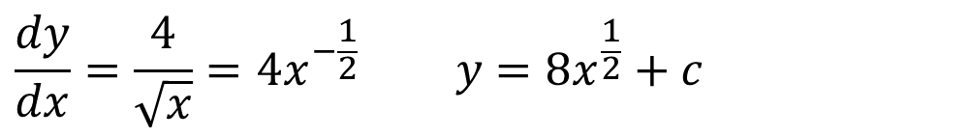
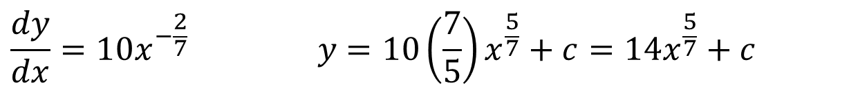
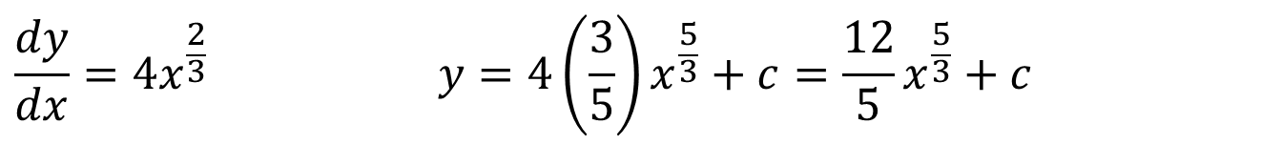
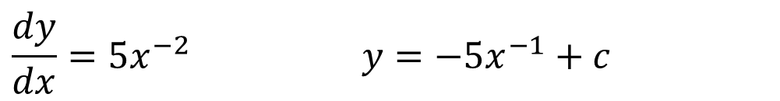
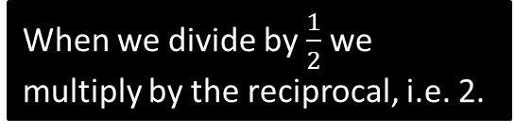
More Fractional Examples
Find $y$ when:
When we divide by $\frac{1}{2}$ we multiply by the reciprocal, i.e. 2.
?
?
$$\frac{dy}{dx}=\frac{4}{\sqrt{x}}=4x^{−\frac{1}{2}} y=8x^{\frac{1}{2}}+c$$
?
$$\frac{dy}{dx}=5x^{−2} y=−5x^{−1}+c$$
?
$$\frac{dy}{dx}=4x^{\frac{2}{3}} y=4\left(\frac{3}{5}\right)x^{\frac{5}{3}}+c=\frac{12}{5}x^{\frac{5}{3}}+c$$
?
$$\frac{dy}{dx}=10x^{−\frac{2}{7}} y=10\left(\frac{7}{5}\right)x^{\frac{5}{7}}+c=14x^{\frac{5}{7}}+c$$

Slide 6
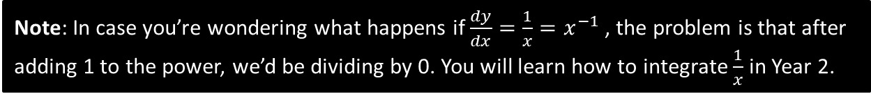
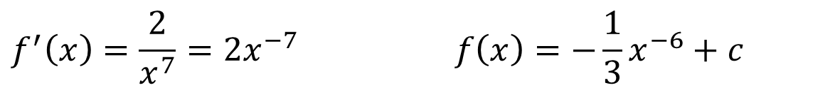
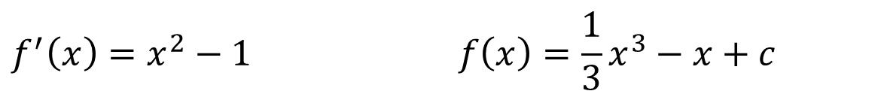

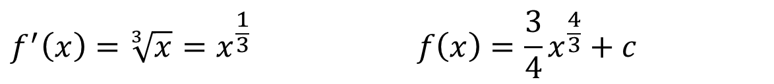
Test Your Understanding
Find $f(x)$ when:
?
$$f^{′}\left(x\right)=2x+7 f\left(x\right)=x^{2}+7x+c$$
$$f^{′}\left(x\right)=x^{2}−1 f\left(x\right)=\frac{1}{3}x^{3}−x+c$$
?
?
?
$$f^{′}\left(x\right)=\frac{2}{x^{7}}=2x^{−7} f\left(x\right)=−\frac{1}{3}x^{−6}+c$$
?
?
$$f^{′}\left(x\right)=\sqrt[3]{x}=x^{\frac{1}{3}} f\left(x\right)=\frac{3}{4}x^{\frac{4}{3}}+c$$
$$f^{′}\left(x\right)=33x^{\frac{5}{6}} f\left(x\right)=18x^{\frac{11}{6}}+c$$
?
Note: In case you’re wondering what happens if $\frac{dy}{dx}=\frac{1}{x}=x^{−1}$ , the problem is that after adding 1 to the power, we’d be dividing by 0. You will learn how to integrate $\frac{1}{x}$ in Year 2.

Slide 7
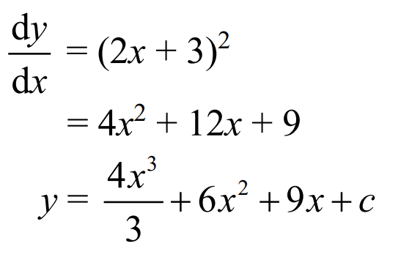
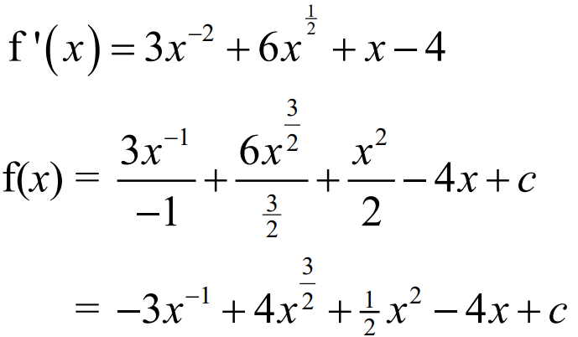


Exercise 13A – Y1 pages 289-290
4. Find $y$ given that $\frac{dy}{dx}={\left(2x+3\right)}^{2}$
?
5. Find $f(x)$ given that $f^{′ }\left(x\right)={3x}^{−2}+{6x}^{\frac{1}{2}}+x−4$
?

Slide 8
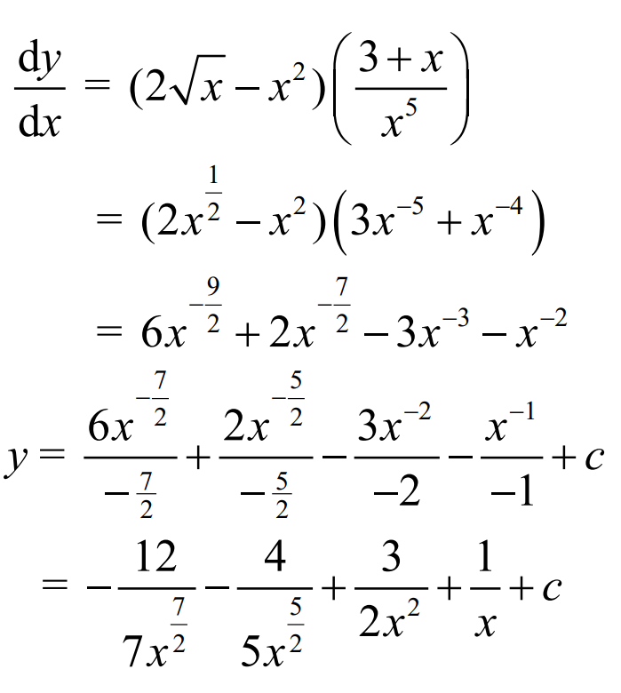
Exercise 13A – Y1 pages 290
Challenge. Find $y$ given that $\frac{dy}{dx}=\left(2\sqrt{x}−x^{2}\right)\left(\frac{3+x}{x^{5}}\right)$
?

Slide 9
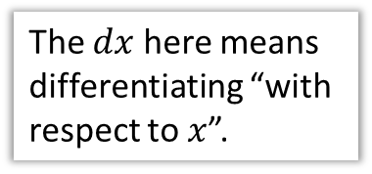
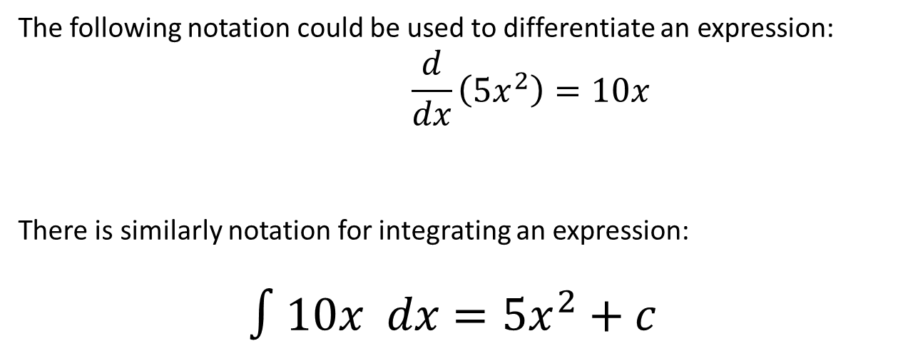
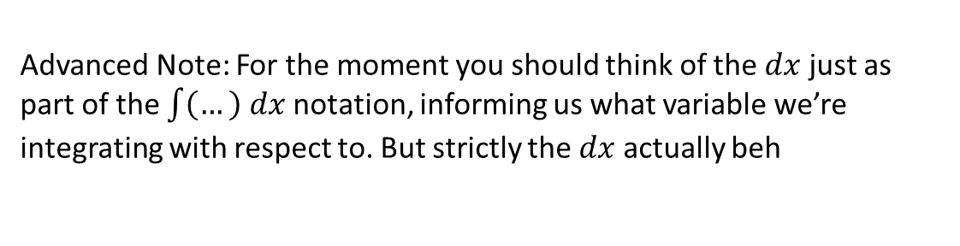
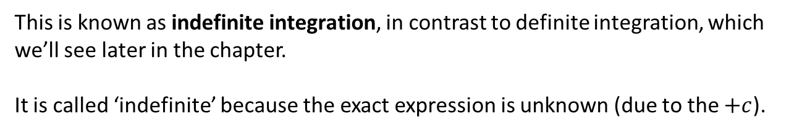
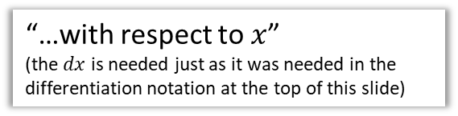
Integration notation
The following notation could be used to differentiate an expression:
$$\frac{d}{dx}\left(5x^{2}\right)=10x$$
There is similarly notation for integrating an expression:
$$∫10x dx=5x^{2}+c$$
The $dx$ here means differentiating “with respect to $x$”.
“Integrate…”
“…with respect to $x$”
(the $dx$ is needed just as it was needed in the differentiation notation at the top of this slide)
“…this expression”
This is known as indefinite integration, in contrast to definite integration, which we’ll see later in the chapter.
It is called ‘indefinite’ because the exact expression is unknown (due to the $+c$).
Advanced Note: For the moment you should think of the $dx$ just as part of the $\int{\left(…\right) dx}$ notation, informing us what variable we’re integrating with respect to. But strictly the $dx$ actually beh

Slide 10
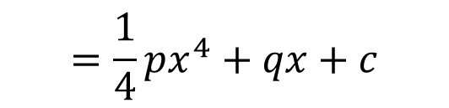

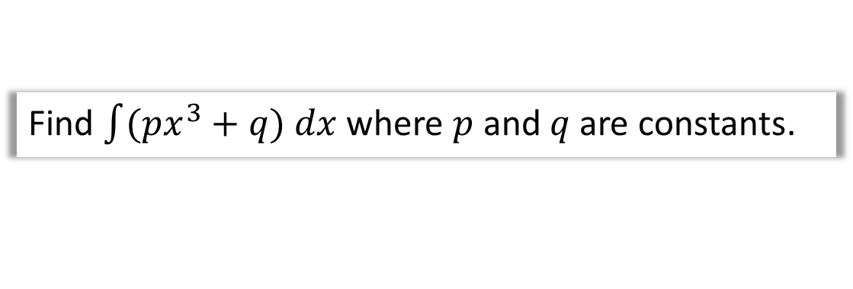
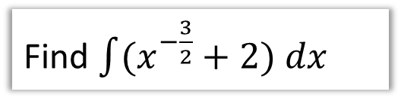


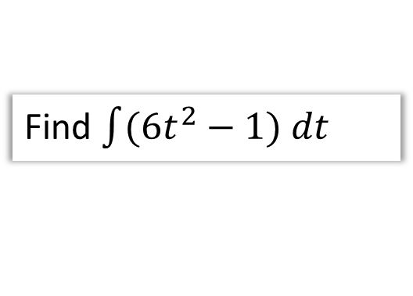
Examples
Note: The brackets are required if there’s multiple terms.
Find $\int{(x^{−\frac{3}{2}}+2) dx}$
?
$$=−2x^{−\frac{1}{2}}+2x+c$$
Find $\int{(6t^{2}−1) dt}$
Note the $dt$ instead of $dx$.
$$=2t^{3}−t+c$$
?
Find $\int{(px^{3}+q) dx}$ where $p$ and $q$ are constants.
$$=\frac{1}{4}px^{4}+qx+c$$
?

Slide 11


Test Your Understanding
Edexcel C1 May 2014(R) Q4b
$$y=2x^{5}+6x^{−\frac{1}{2}} \\ \int{y dx}=\frac{1}{3}x^{6}+12x^{\frac{1}{2}}+c$$
?

Slide 12
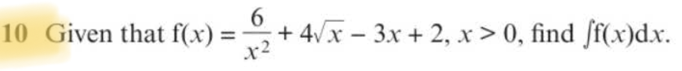
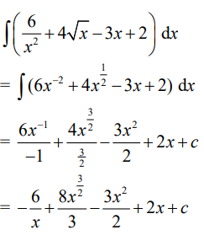
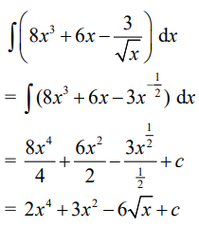
Exercise 13B – Y1 pages 291-293
?
?

Slide 13
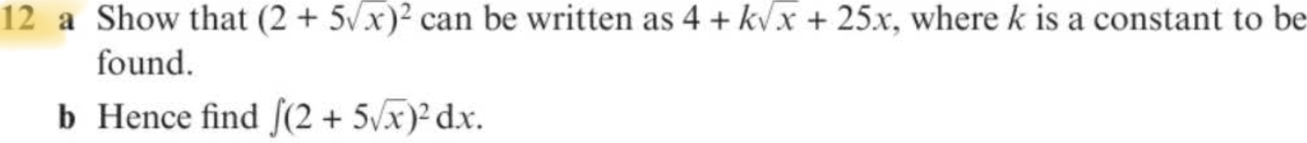
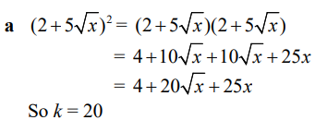
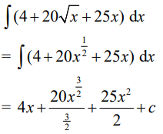

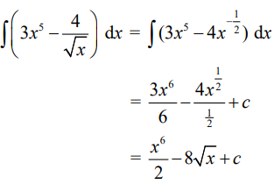
Exercise 13B – Y1 pages 291-293
a?
b?
?

Slide 14
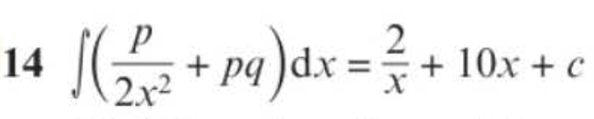
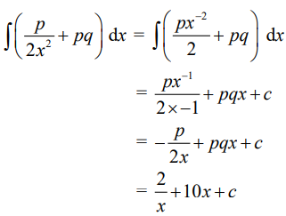

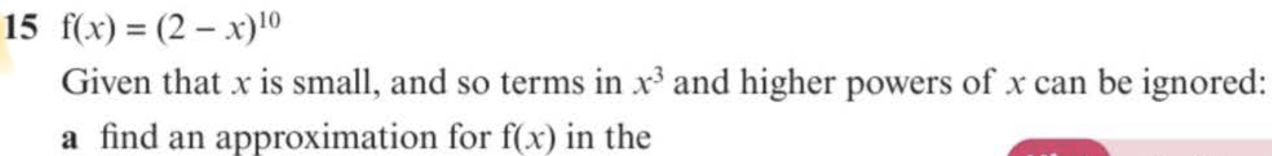
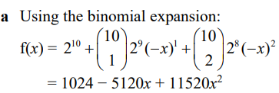
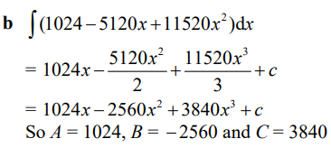
Exercise 13B – Y1 pages 291-293
?
a?
b?

Slide 15

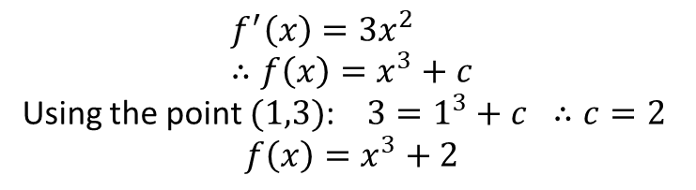


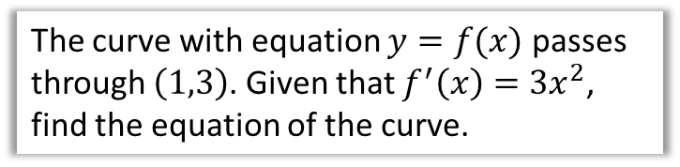







Finding constant of integration
Recall that when we integrate, we get a constant of integration, which could be any real value. This means we don’t know what the exact original function was.
$$y$$
$$y$$
$$f\left(x\right)=x^{3}+c$$
$$f^{′}\left(x\right)=3x^{2}$$
$$∫$$
$$\left(1,3\right)$$
$$f\left(x\right)=x^{3}$$
$$f\left(x\right)=x^{3}−1$$
?
$$x$$
$$x$$
But if we know one point on the curve, it leaves only one possibility.
The curve with equation $y=f(x)$ passes through $\left(1,3\right)$. Given that $f^{′}\left(x\right)=3x^{2}$, find the equation of the curve.
?
$$f^{′}\left(x\right)=3x^{2} \\ ∴f\left(x\right)=x^{3}+c$$
Using the point $(1,3)$: $3=1^{3}+c ∴c=2$
$$f\left(x\right)=x^{3}+2$$

Slide 16
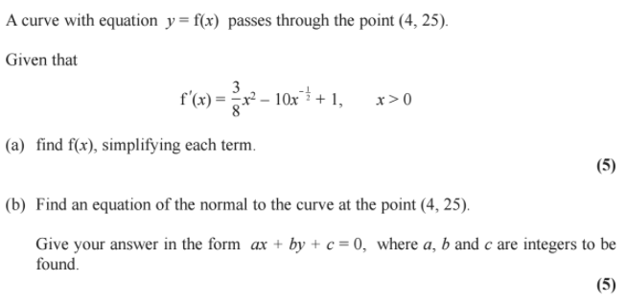
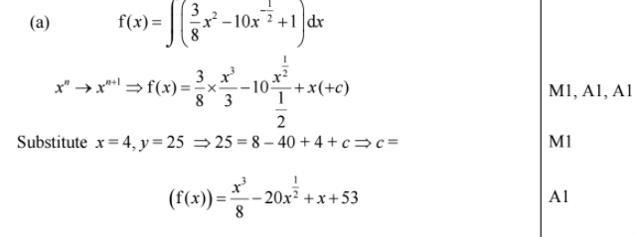
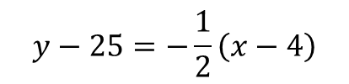
Test Your Understanding
Edexcel C1 May 2014 Q10
? a
$$y−25=−\frac{1}{2}\left(x−4\right)$$
? b
(b)

Slide 17
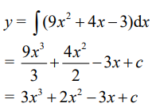
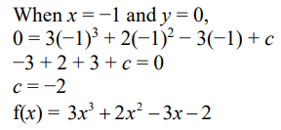
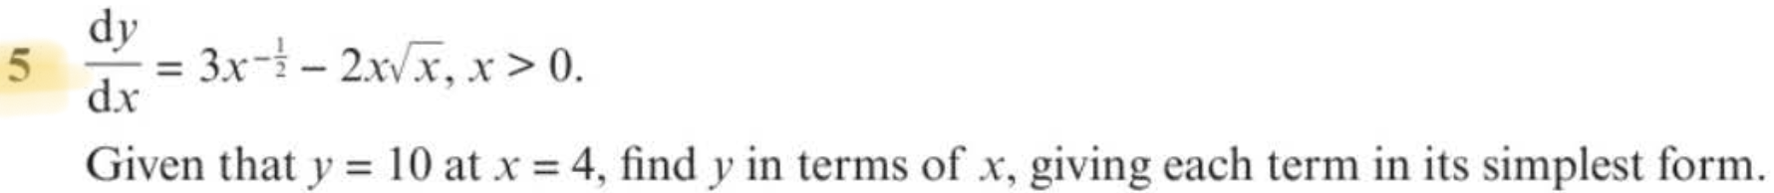
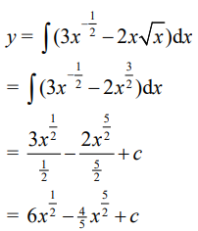
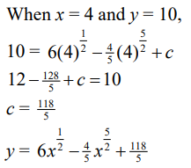
Exercise 13C – Y1 pages 294-295
?
?

Slide 18




Exercise 13C – Y1 pages 294-295
a?
b?

Slide 19













Definite Integration
So far we’ve seen integration as ‘the opposite of differentiation’, allowing us to find $y=f\left(x\right)$ when we know the gradient function
$y=f^{′}\left(x\right)$.
In practical settings however the most useful use of integration is that it finds the area under a graph. Remember at GCSE for example when you estimated the area under a speed-time graph, using trapeziums, to get the distance?
If you knew the equation of the curve, you could get the exact area!
Before we do this, we need to understand how to find a definite integral:
speed
$$Area=distance$$
time
These are known as limits, which give the values of $x$ we’re finding the area between.
We integrate as normal, but put expression in square brackets, meaning we still need to evaluate the integrated expression using the limits.
$$y$$
$$y=4x^{3}$$
$$\int_{1}^{5}{4x^{3} dx}=$$
$${\left[x^{4}\right]}_{1}^{5}$$
$$=\left(5^{4}\right)−\left(1^{4}\right) \\ =624$$
$$?$$
$$Area=distance$$
$$x$$
$$1$$
$$5$$
Write $\left(…\right)−(…)$ and evaluate the expression for each of the limits, top one first.

Slide 20



Another Example
?
$$\int_{−3}^{3}{x^{2}+1 dx}={\left[\frac{1}{3}x^{3}+x\right]}_{−3}^{3} \\ =\left(\frac{1}{3}{\left(3\right)}^{3}+3\right)−\left(\frac{1}{3}{\left(−3\right)}^{3}−3\right) \\ =12−−12 \\ =24$$
We DON’T have a constant of integration when doing definite integration. I’ll explain why later.
?
?
Write out you working EXACTLY as seen here. The $\left(…\right)−(…)$ brackets are particularly crucial as you’ll otherwise likely make a sign error.
You can use the $⟦\int_{b}^{a}{□}⟧$ button on your calculator to evaluate definite integrals.
But only use it to check your answer.

Slide 21



Problem Solving
Given that $P$ is a constant and $\int_{1}^{5}{\left(2Px+7\right) dx}=4P^{2}$, show that there are two possible values for $P$ and find these values.
?
Remember: $P$ is a constant, so just treat it as a number.
$$\int_{1}^{5}{\left(2Px+7\right) dx}={\left[Px^{2}+7x\right]}_{1}^{5} \\ =\left(25P+35\right)−\left(P+7\right) \\ =24P+28$$
$$∴24P+28=4P^{2} \\ P^{2}−6P−7=0 \\ \left(P+1\right)\left(P−7\right)=0 \\ P=−1 or 7$$

Slide 22



Exercise 13D – Y1 page 297
?

Slide 23






Exercise 13D – Y1 page 297
?
?

Slide 24


Exercise 13D – Y1 page 297
?

Slide 25


EXTENSION
2
[MAT 2015 1D] Let
$f\left(x\right)=\int_{0}^{1}{{\left(xt\right)}^{2} dt}$ and $g\left(x\right)=\int_{0}^{x}{t^{2} dt}$
Let $A>0$. Which of the following statements are true?
$g\left(f\left(A\right)\right)$ is always bigger than $f\left(g\left(A\right)\right)$
$f\left(g\left(A\right)\right)$ is always bigger than $g\left(f\left(A\right)\right)$
They are always equal.
$f\left(g\left(A\right)\right)$ is bigger if $A<1$, and $g\left(f\left(A\right)\right)$ is bigger if $A>1$.
$g\left(f\left(A\right)\right)$ is bigger if $A<1$, and $f\left(g\left(A\right)\right)$ is bigger if $A>1$.
(Official Sln) Evaluating: $f\left(x\right)=\frac{x^{2}}{3}$ and $g\left(x\right)=\frac{x^{3}}{3}$. Hence $g\left(f\left(A\right)\right)=\frac{A^{6}}{3^{4}}$ and $f\left(g\left(A\right)\right)=\frac{A^{6}}{3^{3}}$. Hence answer is (B).
1
[MAT 2009 1A] The smallest value of
$$I\left(a\right)=\int_{0}^{1}{{\left(x^{2}−a\right)}^{2} dx}$$
as $a$ varies, is what?
$$I\left(a\right)=\int_{0}^{1}{x^{4}−2ax^{2}+a^{2}} dx \\ ={\left[\frac{1}{5}x^{5}−\frac{2}{3}ax^{3}+a^{2}x\right]}_{0}^{1} \\ =\frac{1}{5}−\frac{2}{3}a+a^{2}$$
We then use differentiation or completing the square to find that the minimum value of $\frac{1}{5}−\frac{2}{3}a+a^{2}$ is $\frac{4}{45}$.
?
?

Slide 26











Areas under curves
$$y$$
$$y=f(x)$$
Earlier we saw that the definite integral $\int_{a}^{b}{f(x)} dx$ gives the area between a positive curve $y=f(x)$, the $x$-axis, and the lines $x=a$ and $x=b$.
(We’ll see why this works in a sec)
$$Area$$
$$Area=distance$$
$$x$$
$$a$$
$$b$$
Find the area of the finite region between the curve with equation $y=20−x−x^{2}$ and the $x$-axis.
?
Factorise in order to find roots:
$$20−x−x^{2}=0 \\ x^{2}+x−20=0 \\ \left(x+5\right)\left(x−4\right)=0 \\ x=−5 or x=4$$
Therefore area between curve and $x$-axis is:
$$\int_{−5}^{4}{20−x−x^{2} dx}={\left[20x−\frac{1}{2}x^{2}−\frac{1}{3}x^{3}\right]}_{−5}^{4} \\ =\left(80−8−\frac{64}{3}\right)−\left(−100−\frac{25}{2}+\frac{125}{3}\right) \\ =\frac{243}{2}$$
$$y$$
$$x$$
$$−5$$
$$4$$

Slide 27







Just for your interest…
Why does integrating a function give you the area under the graph?
Part 1:
You’re already familiar with the idea that gradient is the rate at which a quantity changes, and we consider an infinitesimally small change in the variable.
You could consider the gradient as the little bit you’re adding on each time.
Here’s some practical examples using formulae you covered in your younger years!
So to draw a shaded circle (which has area!), it’s a bit like repeatedly drawing the circumference of a circle with gradually increasing radius.
Since the circumference is what the area is increasing by each time, the circumference is the gradient of the area of the circle, and conversely (by the definition of integration being the opposite of differentiation), the area is the integral of the circumference.
you can’t add a length to an area
But by considering the infinitely thin width $dr$ of the circumference you’re drawing, it does have area!
$$\frac{dA}{dr}=2πr → dA=2πr dr$$
i.e. the change in area, $dA$, is $2πr×dr$
If we ‘roll out’ the added area we’re adding each time, this forms a rectangle, whose length hopefully corresponds to the circumference of the circle:
$$dr$$
If you wanted to consider the rate at which the area of a circle increases with respect to the radius, consider a small change $dr$ in the radius.
The change in area is an infinitely thin ring, which looks like you’ve drawn a circumference.
So what is this rate?
$$A=πr^{2} \\ ∴\frac{dA}{dr}=2πr$$
$$r$$
$$?$$
$$dr$$
If the added area is $2πr dr$ and the thickness is $dr$, then the length is $\frac{2πr dr}{dr}=2πr$ as expected.

Slide 28













Part 2:
$$f(x)$$
Consider the volume of a sphere:
$$V=\frac{4}{3}πr^{3} \\ \frac{dV}{dr}=4πr^{2}$$
$$A(x)$$
$$x$$
$$x+h$$
$$h$$
And the same principle applies to area under a graph. If $A(x)$ gives the area up to $x$, then what we’re ‘adding on each time’ (i.e. the gradient) is sort of like drawing a line of length $f(x)$ at the right-most end each time (or more accurately, an infinitely thin rectangle of area $f\left(x\right)×h$). Thus if $f(x)$ is the gradient of the area, then conversely the area is the integral of $f\left(x\right)$.
This works for a similar reason to before.
This gives us an intuitive sense of why it works, but we need a formal proof:
One final Note: Why does $\int_{b}^{a}{f\left(x\right) dx}$ give the area between $x=a$ and $x=b$?
Using the diagram above, the area up to $x+h$, i.e. $A(x+h)$, is approximately the area up to $x$ plus the added rectangular strip:
$$A\left(x+h\right)≈A\left(x\right)+(f\left(x\right)×h)$$
Rearranging:
$$f\left(x\right)≈\frac{A\left(x+h\right)−A\left(x\right)}{h}$$
In the limit, as the rectangle becomes infinitely thin, this becomes an equality:
$$f\left(x\right)=\lim_{h→0}{\frac{A\left(x+h\right)−A\left(x\right)}{h}}$$
But we know from differentiating by first principles that:
$$A^{′}\left(x\right)=\lim_{h→0}{\frac{A\left(x+h\right)−A\left(x\right)}{h}}$$
$$∴f\left(x\right)=A′(x)$$
And thus we have proven that the gradient of the area function is indeed $f(x)$ (and hence the integral of $f(x)$ the area).
Since $f\left(x\right)=A′(x)$, the area function $A(x)$ is the integral of $f(x)$. Thus:
$$\int_{b}^{a}{f\left(x\right) dx}={\left[A\left(x\right)\right]}_{a}^{b} =A\left(b\right)−A(a)$$
The area between $a$ and $b$ is the area up to $b$, i.e. $A(b)$, with the area up to $a$, i.e. $A\left(a\right)$, cut out. This gives $A\left(b\right)−A\left(a\right)$ as expected.
Because we obtained $A(x)$ by an integration, we have a constant of integration $+c$. But because of the subtraction $A\left(b\right)−A(a)$, these constants in each of $A(b)$ and $A\left(a\right)$ cancel, which explains why the constant is not present in definite integration.
$$a$$
$$b$$
This is known as the Fundamental Theorem of Calculus.

Slide 29

Test Your Understanding
Edexcel C2 Jan 2013 Q9c
?
Solution: 12

Slide 30




Exercise 13E – Y1 pages 299-300
a?
a?

Slide 31


Exercise 13E – Y1 pages 299-300
?

Slide 32



EXTENSION
2
[MAT 2011 1G]
A graph of the function $y=f\left(x\right)$ is sketched on the axes below:
What is the value of $\int_{−1}^{1}{f(x^{2}−1)} dx$?
We first need to reflect on what part of the function $f$ we’re actually using. $x$ in the integral varies between -1 and 1, thus $x^{2}−1$, i.e. the input of $f$, varies between -1 and 0.
We’re therefore only using the left half of the graph, and thus $f\left(x\right)=x+1$
$$∴\int_{−1}^{1}{f(x^{2}−1)} dx=\int_{−1}^{1}{\left(x^{2}−1\right)+1 dx} \\ ={\left[\frac{1}{3}x^{3}\right]}_{−1}^{1}=\left(\frac{1}{3}\right)−\left(−\frac{1}{3}\right)=\frac{2}{3}$$
1
[MAT 2007 1H] Given a function $f(x)$, you are told that
$$\int_{0}^{1}{3f\left(x\right) dx}+\int_{1}^{2}{2f\left(x\right) dx}=7 \\ \int_{0}^{2}{f\left(x\right) dx}+\int_{1}^{2}{f\left(x\right) dx}=1$$
It follows that $\int_{0}^{2}{f(x)} dx$ equals what?
Because the area between $x=0$ and 2 is the sum of the area between 0 and 1, and between 1 and 2, it follows that $\int_{0}^{2}{f\left(x\right) dx}=\int_{1}^{2}{f\left(x\right) dx}+\int_{1}^{2}{f\left(x\right) dx}$. Also note that $\int{kf\left(x\right) dx}=k\int{f(x)} dx$
Letting $a=\int_{0}^{1}{f\left(x\right) dx}$ and $b=\int_{1}^{2}{f\left(x\right) dx}$ purely for convenience, then:
$$3a+2b=7 \\ \left(a+b\right)+b=1$$
Solve, $a=3, b=−1$, $∴a+b=2$
?
?

Slide 33










‘Negative Areas’
Sketch the curve $y=x(x−1)(x−2)$ (which expands to give $y=x^{3}−3x^{2}+2x$).
Now calculate $\int_{0}^{2}{x\left(x−1\right)\left(x−2\right)} dx$. Why is this result surprising?
?
$$y$$
$$\int_{0}^{2}{x^{3}−3x^{2}+2x} dx={\left[\frac{1}{4}x^{4}−x^{3}+x^{2}\right]}_{0}^{2}=0$$
So the total ‘area’ is 0!
$$f(x)$$
Integration $∫f\left(x\right) dx$ is just the sum of areas of infinitely thin rectangles, where the current $y$ value (i.e. $f(x)$) is each height, and the widths are $dx$.
i.e. The area of each is $f\left(x\right)×dx$
The problem is, when $f(x)$ is negative, then $f\left(x\right)×dx$ is negative, i.e. a negative area!
The result is that the ‘positive area’ from 0 to 1 is cancelled out by the ‘negative area’ from 1 to 2, giving an overall ‘area’ of 0.
So how do we resolve this?
$$x$$
$$dx$$
$$1$$
$$2$$
Note: This explains the $dx$ in the $\int{f\left(x\right) dx}$, which effectively means “the sum of the areas of strips, each of area $f\left(x\right)×dx$. So the $dx$ is not just part of the $∫$ notation, it’s behaving as a physical quantity! (i.e. length)

Slide 34






Example
Find the total area bound between the curve $y=x(x−1)(x−2)$ and the $x$-axis.
$$y$$
Strategy:
Separately find the area between $x=0$ and 1, and between 1 and 2. Treat any negative areas as positive.
?
$$x$$
$$1$$
$$2$$
? Solution
$$x\left(x−1\right)\left(x−2\right)=x^{3}−3x^{2}+2x$$
$$\int_{0}^{1}{x^{3}−3x^{2}+2x} dx={\left[\frac{1}{4}x^{4}−x^{3}+x^{2}\right]}_{0}^{1}=\frac{1}{4} \\ \int_{1}^{2}{x^{3}−3x^{2}+2x} dx={\left[\frac{1}{4}x^{4}−x^{3}+x^{2}\right]}_{1}^{2}=−\frac{1}{4}$$
Treating both as positive:
$$Area=\frac{1}{4}+\frac{1}{4}=\frac{1}{2}$$

Slide 35


Test Your Understanding
Edexcel C2 May 2013 Q6
?
?

Slide 36




Exercise 13F – Y1 pages 301-302
a?
b?

Slide 37







Exercise 13F – Y1 pages 301-302
a?
e?
b?
c?
d?

Slide 38










EXTENSION
Hint: It’s not actually even possible to integrate $2^{x^{2}}$, but we can still sketch the graph. Reflect on what $\frac{dI}{da}$ actually means.
Extension
1
[MAT 2010 1I] For a positive number $a$, let
$$I\left(a\right)=\int_{0}^{a}{\left(4−2^{x^{2}}\right)dx}$$
Then $\frac{dI}{da}=0$ when $a$ is what value?
2
[STEP I 2014 Q3]
The numbers $a$ and $b$, where $b>a≥0$, are such that
$$\int_{a}^{b}{x^{2} dx}={\left(\int_{a}^{b}{x dx}\right)}^{2}$$
In the case $a=0$ and $b>0$, find the value of $b$.
In the case $a=1$, show that $b$ satisfies
$3b^{3}−b^{2}−7b−7=0$
Show further, with the help of a sketch, that there is only one (real) value of $b$ that satisfies the equation and that it lies between 2 and 3.
Show that $3p^{2}+q^{2}=3p^{2}q$, where $p=b+a$ and $q=b−a$, and express $p^{2}$ in terms of $q$. Deduce that $1<b−a≤\frac{4}{3}$
Guidance for this problem on next slide.
?
$$y$$
$I\left(a\right)$ represents the area from $x=0$ up to $a$.
$$I\left(a\right)$$
$$y=4−2^{x^{2}}$$
$$x$$
$$a$$
$\frac{dI}{da}$ represents the rate of change of area as $a$ increases. Thus if $\frac{dI}{da}=0$, the area is not changing. This must happen at the $x$-intercept of the graph, because once the curve goes negative, the total area will start to decrease.
$$4−2^{x^{2}}=0 → x=\sqrt{2}$$
The answer is $a=\sqrt{2}$.

Slide 39


Guidance for Extension Problem 2
[STEP I 2014 Q3] The numbers $a$ and $b$, where $b>a≥0$, are such that $\int_{a}^{b}{x^{2} dx}={\left(\int_{a}^{b}{x dx}\right)}^{2}$
In the case $a=0$ and $b>0$, find the value of $b$.
In the case $a=1$, show that $b$ satisfies
$3b^{3}−b^{2}−7b−7=0$
Show further, with the help of a sketch, that there is only one (real) value of $b$ that satisfies the equation and that it lies between 2 and 3.
Show that $3p^{2}+q^{2}=3p^{2}q$, where $p=b+a$ and $q=b−a$, and express $p^{2}$ in terms of $q$. Deduce that $1<b−a≤\frac{4}{3}$

Slide 40






Areas between curves and lines
$$y$$
$$y=x$$
How could we find the area between the line and the curve?
$$?$$
Start with the area under $y=x\left(4−x\right)$ up to the point of intersection, then subtract the area of the triangle to ‘cut it out’.
?
$$y=x\left(4−x\right)$$
Click for
animation >
Determine the area between the lines with equations $y=x\left(4−x\right)$ and $y=x$
?
Find point of intersection:
$$x\left(4−x\right)=x \\ ∴x=0 or x=3$$
Area under curve:
$$\int_{0}^{3}{x\left(4−x\right) dx}={\left[2x^{2}−\frac{1}{3}x^{3}\right]}_{0}^{3}=9$$
Area of triangle $=\frac{1}{2}×3×3=\frac{9}{2}$
$∴$ Shaded area $=9−\frac{9}{2}=\frac{9}{2}$

Slide 41









A Harder One
[Textbook] The diagram shows a sketch of the curve with equation $y=x\left(x−3\right)$ and the line with equation $y=2x$.
Find the area of the shaded region $OAC$.
$$y=x(x−3)$$
$$C$$
$$y=2x$$
What areas should we subtract this time?
Start with triangle $OBC$ and subtract the area under the curve $AC$.
$$O$$
$$A$$
$$B$$
?
First find points of intersection:
$$x\left(x−3\right)=2x → x=0 or x=5$$
When $x=5, y=10 → C\left(5,10\right)$
Also need to find the point $A$:
$$x\left(x−3\right)=0 → A(3,0)$$
$∴$ Area of triangle $OBC=\frac{1}{2}×5×10=25$
Area under $AC$: $\int_{3}^{5}{x\left(x−3\right)dx}= …=\frac{26}{3}$
$∴$ Shaded area $=25−\frac{26}{3}=\frac{49}{3}$
?

Slide 42




Test Your Understanding
Edexcel C2 May 2012 Q5
Alternative Method:
If the top curve has equation $y=f\left(x\right)$ and the bottom curve $y=g\left(x\right)$, the area between them is:
$$\int_{b}^{a}{\left(f\left(x\right)−g\left(x\right)\right) dx}$$
This means you can integrate a single expression to get the final area, without any adjustment required after.
a
? a
$$A\left(2,8\right), B\left(9,1\right)$$
b
? b
$57\frac{1}{6}$ or $\frac{343}{6}$

Slide 43



Exercise 13G – Y1 pages 304-306
a?
b?

Slide 44




Exercise 13G – Y1 pages 304-306
?

Slide 45





Exercise 13G – Y1 pages 304-306
a?
b?

Slide 46


EXTENSION
[MAT 2005 1A] What is the area of the region bounded by the curves $y=x^{2}$ and $y=x+2$?
$$\frac{9}{2}$$
[MAT 2016 1H] Consider two functions
$$f\left(x\right)=a−x^{2} \\ g\left(x\right)=x^{4}−a$$
For precisely which values of $a>0$ is the area of the region bounded by the $x$-axis and the curve $y=f\left(x\right)$ bigger than the area of the region bounded by the $x$-axis and the curve $y=g\left(x\right)$?
(Your answer should be an inequality in terms of $a$)
b?
a
(Official solution)
The area bounded by the $x$-axis and the curve $y=f\left(x\right)$, $A_{1}$ is equal to
$$A_{1}=\int_{\sqrt{a}}^{\sqrt{a}}{f(x)} dx=\frac{4}{3}a^{\frac{3}{2}}$$
whilst the area bounded by the $x$-axis and the curve $y=g\left(x\right)$, $A_{2}$ is equal to
$$A_{2}=\left|\int_{−\sqrt[4]{a}}^{\sqrt[4]{a}}{g\left(x\right)dx} \right|=\frac{8}{5}a^{\frac{5}{4}}$$
We require an $a$ such that $A_{1}>A_{2}$ so
$$\frac{4}{3}a^{\frac{3}{2}}>\frac{8}{5}a^{\frac{5}{4}} \\ 20a^{\frac{6}{4}}>24a^{\frac{5}{4}} \\ a^{\frac{1}{4}}>\frac{6}{5}$$
and so the answer is (e).
a?
b

