Slide 1

Portland State University CS-510 Data Engineering
Team Abraca-Data
Vysali Kallepalli
Soham Nandi
Tejesh Vuddagiri
Pratyusha Sanapathi
Instructors
Prof. Bruce Irvin
TA : Mina Vu

Slide 2
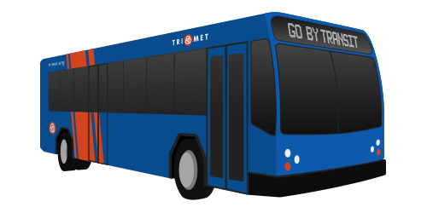
Introduction
TriMet is a public transportation agency providing bus, light rail, and commuter rail services in the metropolitan area.
Our project focuses on the real-time ingestion of TriMet data, specifically trip and stop events.
By ingesting this data in real-time, we can ensure up-to-date information for analysis and decision-making.
Vysali

Slide 3
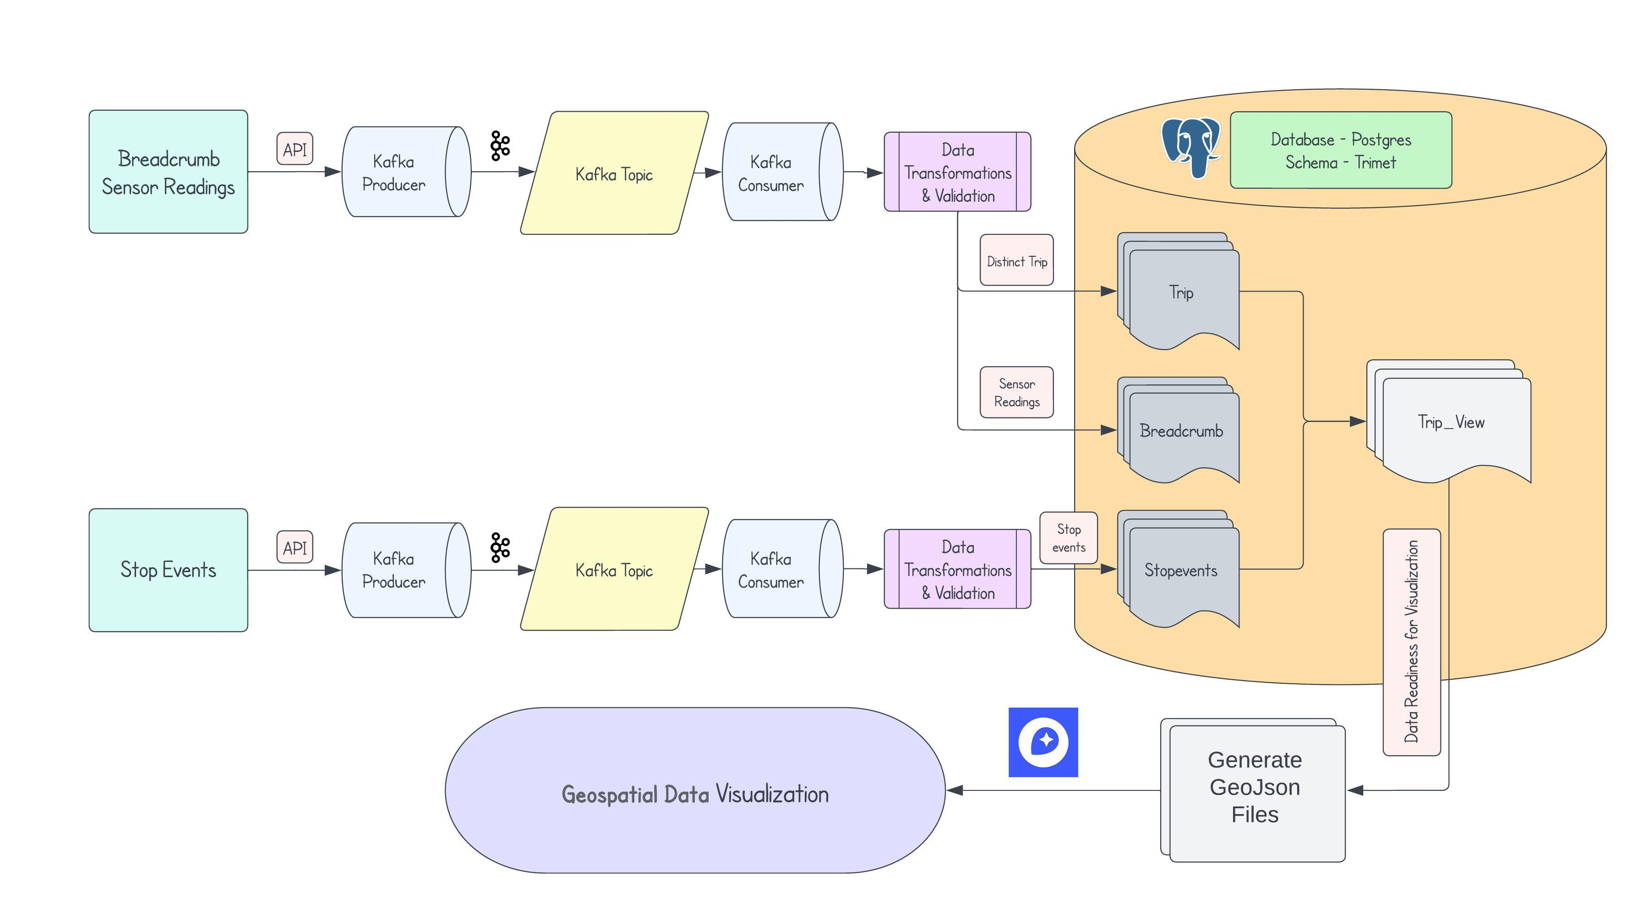
Design
Vysali

Slide 4

Implementation
Part – 1
Create a Kafka topic for TriMet data.
Implement a Kafka producer module to publish messages to the Kafka topic.
Develop a Kafka consumer that consumes data from the topic and writes it to files.
Part -2
Utilize the same Kafka producer module for TriMet data.
Enhance the Kafka consumer to perform data transformation and validations.
Write the transformed data to a Postgres database.
Part - 3
Implement an end-to-end pipeline for real-time ingestion of TriMet stop events
Perform data transformation and validations in real-time before writing to Postgres database.
Utilize Mapbox to develop visualizations of the TriMet data.
Vysali

Slide 5
Challenges
Part – 1
Delay in Publishing data to Kafka Topic
Part -2
Batching Data and performing calculations
Inserting Data into Trip Table
Part - 3
Unexpected Values in data
Issues in generating Visualization
Vysali

Slide 6

Data Gathering
Collected Trimet bus data from a web server for monitoring bus movements and locations
Implemented time-based job scheduling utility (cron) to ensure regular data retrieval and processing.
Used a systemd service to keep the consumer running continuously for consuming the collected data.
Tejesh

Slide 7

Data Volume
On an average, a minimum of 100MB is flowing through the pipelines
Per Day : 114MB
Weekends : 103MB
#Breadcrumb Readings : 6018873 (409 MB)
#Trip Records : 15070 (1272 KB)
#Stop Events: 4988 (288 KB)
Pratyusha

Slide 8
Visualization
// Bus Speeds for all outbound trips of Route 72 on 13/01/2023 between 4 and 6PM SELECT b.longitude, b.latitude, b.speed
FROM trimet.breadcrumb b , trimet.trip_view t
WHERE b.trip_id = t.trip_id
AND t.direction = 'Out'
AND t.route_id = '72'
AND EXTRACT(HOUR FROM b.tstamp) >= 16
AND EXTRACT(HOUR FROM b.tstamp) < 18
AND DATE(tstamp) = DATE '2023-01-13';
// Bus Speeds of top 5 trip with highest average speed SELECT b.longitude, b.latitude, b.speed,
FROM (
SELECT t.trip_id, t.route_id, AVG(b.speed) AS trip_average
FROM trimet.breadcrumb b, trimet.trip_view t
WHERE b.trip_id = t.trip_id
GROUP BY t.trip_id, t.route_id
ORDER BY trip_average DESC
LIMIT 5) AS avg_speed
JOIN trimet.breadcrumb b ON b.trip_id = avg_speed.trip_id;
Soham

Slide 9

Thank you!!
Bruce & Mina

