Slide 1
MWR Labs
One Template To Rule Them All
Kostas Lintovois and Vincent Yiu
29th June 2016
Notes:
Hello everyone, our talk is titled ‘One Template To Rule Them All’
Kostas and I are security consultants for MWR in the UK and today we’ll be sharing an overview of how Microsoft Office macros can be used in different ways as part of an APT.

Slide 2
What is EMET?
EMET
Exploitation Defense
Export Address Table Filtering (EAF)
Macro Payloads (VBA)
Notes:
So, how many of you are familiar with EMET?
The Enhanced Mitigation Experience Toolkit also known as EMET, is provided by Microsoft as a tool to configure additional layers of defense against exploitation.

Slide 3
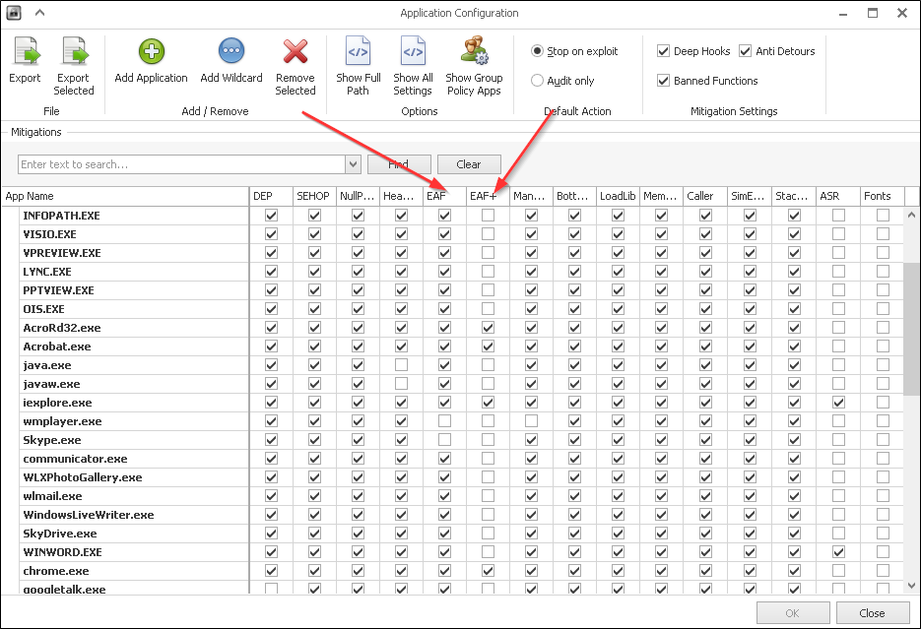
What is EMET?
EMET
Notes:
EMET offers a range of protections against exploitation such as Data Execution Prevention, Heap Spray Protection, Address Space Reduction. As we are not limited in buffer space and are simply relying on a user to execute a macro, a lot of these protections do not serve any purpose. Execution of macros is a legitimate function that a normal Office user may want to use.
EMET has a mechanism named EAF and EAF+.

Slide 4
What is EMET?
EMET
Exploitation Defense
Export Address Table Filtering (EAF)
Macro Payloads (VBA)
Notes:
EAF stands for Export Address Table Filtering. This mechanism prevents shell code from being able to lookup useful addresses to windows function calls.
Macro payloads can be generated through popular frameworks such as the Metasploit Framework, Cobalt Strike and PowerShell Empire. Some of these payloads will be blocked by EMET.

Slide 5
Existing Implants
Current Macro Payloads (Metasploit Framework)
Spawn PowerShell (VBA-PSH)
File Drop & Execute (VBA-EXE)
Self Injection (VBA)
Notes:
Starting with Metasploit, there are three formats available to the user.
VBA-PSH. This particular method spawns a PowerShell payload that will inject shell code into itself. If PowerShell is blocked or EMET is protecting it, the payload will fail on two scenarios.
VBA-EXE. An executable binary is written to a file then it is executed. We can make the payload it drops FUD but we want to prevent having multiple files on disk. This payload will fail when failing to write to disk or AV picks it up.
The VBA format in Metasploit outputs a payload that makes use of VBA code to inject shell code into itself. For example, if the payload was opened in Microsoft Word, it would run in WINWORD.exe. This payload would fail if EMET is enabled on Word.

Slide 6
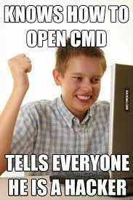
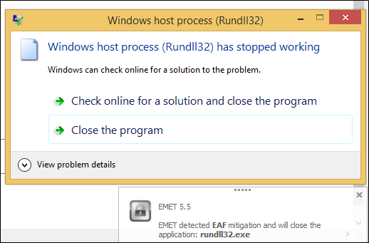
Existing Implants
Current Macro Payloads (Cobalt Strike / Empire)
Inject into Rundll32 (32 Bit)
EMET Protect Rundll32.exe
Native PowerShell
Notes:
So other than Metasploit, we have Cobalt Strike and Empire which are two upcoming and widely used frameworks for managing listeners and callbacks.
In CobaltStrike, the macro payload generated will spawn Rundll32.exe in it’s 32 bit format regardless of the system architecture it is ran on and inject shell code into it. This payload would fail if Rundll32.exe is blocked or EMET is protecting Rundll32.exe.
Suggestion in general to stop all the CobaltStrike copy and pasters. EMET Protect Rundll32.exe.
The Empire payload will make use of the popular download cradle to connect to your server and pull the second stage of the payload. This payload however, runs in pure PowerShell and does not need to inject shell code. This payload fails when PowerShell.exe is blocked.

Slide 7
WePWNise
Introducing WePWNise
Generate Macros
Enumerate Configuration
Determine Weaknesses
Compatiblity / Dynamic Payload Injection
Integrate
Notes:
I wanted to create a tool that could generate an implant that would have a certain level of basic automation that would be able to find its way around a victim’s machine to call back to an attacker.
That would run on the target machine to enumerate configurations for mechanisms such as Software Restriction Policies and EMET.
After obtaining this information, the implant would then automatically target weaknesses in the configuration to keep itself alive and reach back out to the attacker.
The macros generated would need to be compatible and should be able to integrate operations with tools such as Metasploit Framework and Cobalt Strike. We do not want to create the new Metasploit, Cobalt Strike or Empire for capturing call backs.

Slide 8
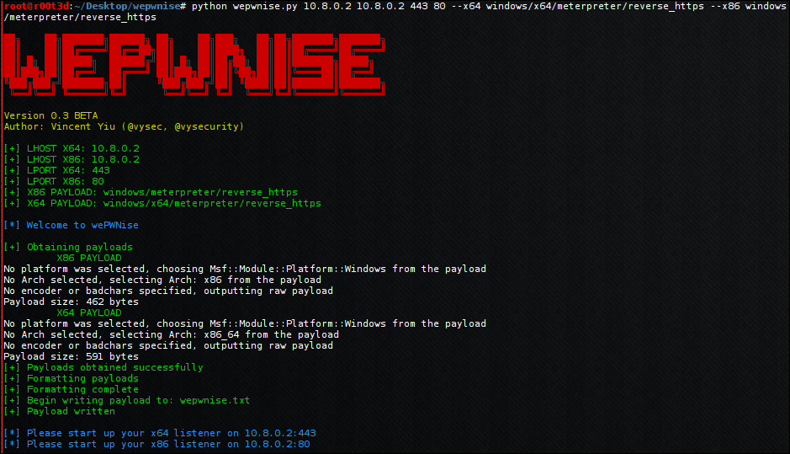
WePWNise
Notes:
Currently WePWNise offers the ability for a consultant to provide a one line command to generate a reasonably sophisticated Macro implant.
It is possible for the consultant to specify specific popular payloads to use such as stagers from Metasploit.
There is basic anti-automated analysis for services such as VirusTotal.
The tester can specify where to deploy their listeners, it could be on two separate IP addresses.
Automatically determines VBA version in use, the Office architecture, the System architecture and later on we will see that it also determines the target binary architecture. The macro looks for potential targets and determines what architecture payload it must inject to get the consultant a shell. I like to call this feature, dynamic payload injection.
Decent memory management, the Macro will free up allocated memory should some sort of error occur.

Slide 9
WePWNise
WePWNise? The How.
Enumerate Configuration
Avoid EMET Protected Paths
Injection via Native VBA
Notes:
In the case of EMET, WePWNise grabs the EMET configuration through registry and determines what is protected.
EMET is then avoided by providing the macro with a list of directories to scan for unprotected executables. Once an executable is found, the process is spawned then shell code is injected.
WePWNIse creates a call back through the use of shell code injection. This is written in native VBA as we do not want to have a dependency on PowerShell.

Slide 10
WePWNise
How do you inject?
Native VBA code
CreateProcessA
VirtualAllocEx
WriteProcessMemory
CreateRemoteThread
Notes:
<WRITE DISCUSSION ABOUT WEPWNISE MACRO CODE AND WHAT IT DOES>

Slide 11
WePWNise
Memory management for failed attempts?
VirtualFreeEx
TerminateProcess
Notes:
<WRITE DISCUSSION ABOUT WEPWNISE MACRO CODE AND WHAT IT DOES>

Slide 12
WePWNise
Enumeration?
Wscript.Shell
HKLM\SOFTWARE\Microsoft\EMET\AppSettings
Metasploit:
use post/windows/gather/enum_emet
Notes:
a

Slide 13
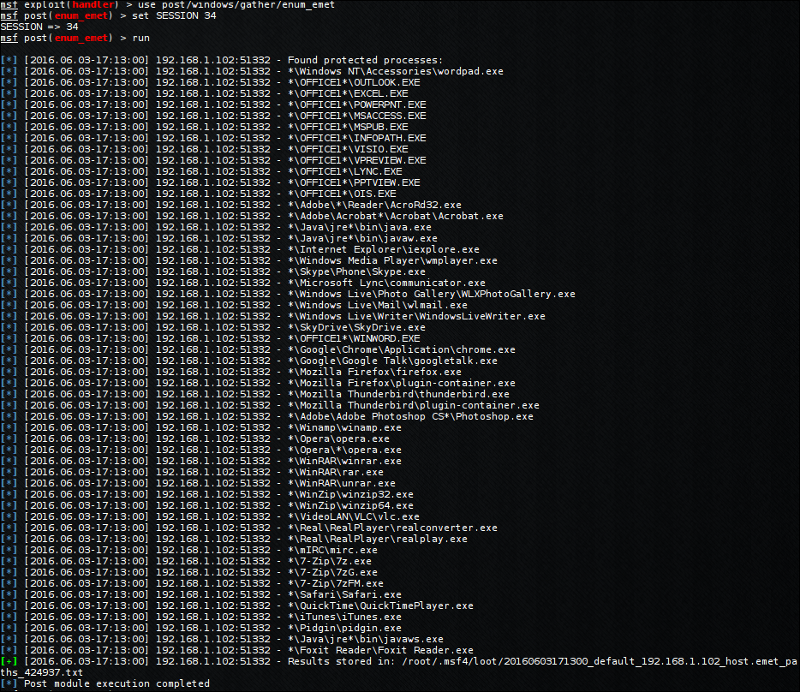
WePWNise
Enumeration?
Notes:
Output of enum_emet

Slide 14
WePWNise
Demonstration
Notes:
------------------ TALK AUDIENCE THROUGH VIDEO ------------------------
I will write this later.

Slide 15
Anti-WePWNise
What if I block X, Y and EMET Z?
Blocked? No way.
EMET? Good luck with that.
Notes:
In the case of EMET, WePWNise grabs the EMET configuration through registry and determines what is protected.
EMET is then avoided by providing the macro with a list of directories to scan for unprotected executables. Once an executable is found, the process is spawned then shell code is injected.
WePWNIse creates a call back through the use of shell code injection. This is written in native VBA as we do not want to have a dependency on PowerShell.

Slide 16
Anti-WePWNise
The Solution
Whitelist X.exe
EMET X.exe
Winlogon.exe
EMET all Windows Default Executables
Viable? Probably not
Notes:
There is a solution!
If you white list and allow for example, calc.exe – then you should also EMET calc.exe
In the scenario where an attacker can spawn calc.exe, they would then be able to inject into it if it was not protected. Therefore, EMET should be turned on for every binary that is white listed.
It is important to note that, windows will not block applications such as Winlogon.exe
This implies that we should EMET all windows default executables.

