Slide 1
MWR Labs
One Template To Rule Them All
Kostas Lintovois and Vincent Yiu
29th June 2016
Notes:
Hello everyone, thanks for your invitation. our talk is titled ‘One Template To Rule Them All’
Kostas and I are security consultants for MWR in the UK and today we’ll be sharing some of our experiences and lessons learned from our red team engagements, and more specifically describe how Office macros and Templates still remain very relevant against current security controls
in particular, can be used in different ways as part of an APT.

Slide 2
MWR Labs
Outline
Quick Macros and Office GPOs recap
Office Trusts and Templates
VDIs and covert persistence with Templates
Raising the bar – Application Control & EMET
EMET Configuration Abuse Technique
WePWNise demo
Conclusions & Questions
Notes:
Here’s an overview of what we're gonna go through today

Slide 3
Macros recap
Visual Basic for Applications (VBA)
The VBA component is installed by default as part of Office’s installation
VBA enables the use of multiple technologies (e.g. Macros, add-ins, ActiveX controls, links)
Office settings can either be locally or centrally controlled via GPO
Notes:
May be many of you think that you’re a click away from success with the first thing in mind being this (give image) but let’s have a quick recap..
Microsoft Office documents - Word, Excel, PowerPoint, Outlook and other types of documents can contain embedded code written in a programming language known as Visual Basic for Applications (VBA).
add-ins, ActiveX controls
Mention that all testing was conducted against the default configs, offered for both local or via GPO enforced settings.

Slide 4
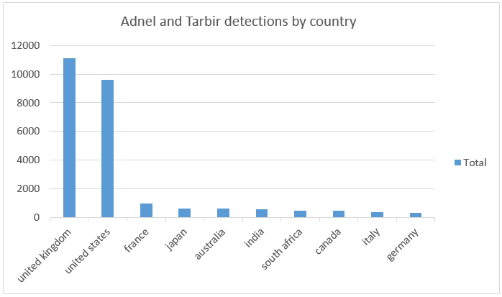
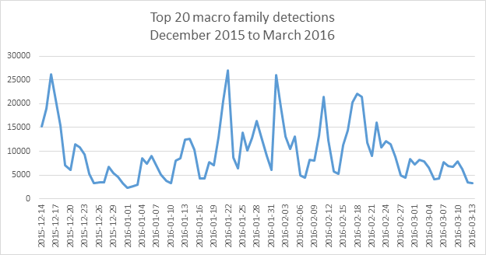
Macros recap
Visual Basic for Applications (VBA)
Macros functionality is predominately abused as an implant delivery mechanism
Notes:
there has been a dramatic increase in threats using macros to spread malware via spam and social engineering over the last years, in particular for targeted attacks
In the enterprise, recent data from our Office 365 Advanced Threat Protection service indicates 98% of Office-targeted threats use macros. Which confirms what everyone knows and out of experience from red teaming engagements, it has been the most prevalent delivery mechanism.
https://www.microsoft.com/security/portal/enterprise/threatreports_july_2015.aspx#tab2
https://threatpost.com/microsoft-reports-massive-increase-in-macros-enabled-threats/110204/
Add an image with the enable content bar

Slide 5
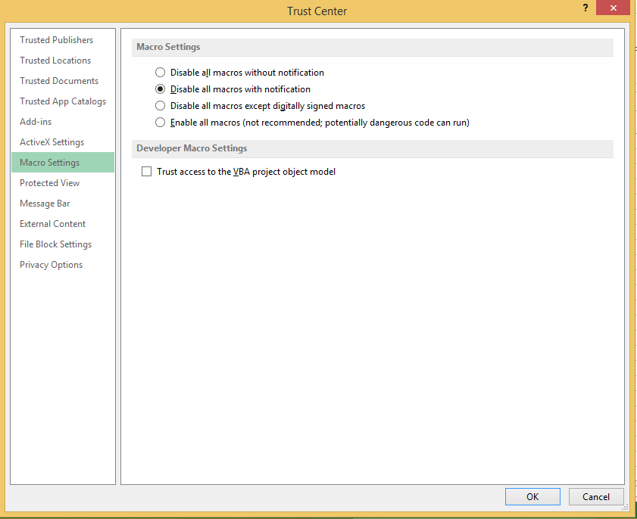
Macros recap
Macros security settings
Notes:
Mention the default values
Say that all testing during this research has been confirmed on both local and gpo configurations.

Slide 6
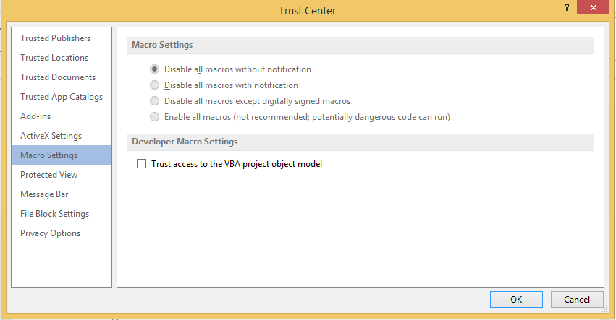
Macros recap
Office settings via GPO
Every Office version ships with its own GPO Templates (ADMX/ADML)
Multiple settings within the GPO
+ Machine > Administrative Templates > Microsoft Office {version}
+ User > Administrative Templates > Microsoft Office {version} > Security Settings
+ User > Administrative Templates > AppName {version} > AppName Options > Security > Trust Center
Notes:
Can be downloaded from ms and once copied to the policy definitions directory on the dc the group policy is extended to include the office settings.
/*
Templates have to be downloaded separately
https://www.microsoft.com/en-gb/download/details.aspx?Id=35554
Templates should be copied on the DC’s <SystemDrive>\Windows\PolicyDefinitions file system folder and the .adml file to the <SystemDrive>\Windows\PolicyDefinitions\en-US folder and then the group policy is extended to include the defined settings. */
Multiple settings within the GPO effectively giving full control of the application options.
Both the machine and the user portion contains a setting to disable vba “Disable VBA for Office applications”, default to not configured which effectively results in allowing the use of macros.
Macros settings are configured individually per app using the “VBA Macro Notification Settings”. From the same GPO configuration areas ActiveX, add-ins etc can also be configured.
Companies rarely use this settings. I’ve only experienced once in a host build review. Not many colleagues have :)
This can all bypassed as we will shortly see.
As can someone can easily observe, the predominant word in this configuration window is trust.

Slide 7

Office Trusts and Templates
Too many trusts
Trusted Locations
Trusted Documents
Trusted Publishers
Trusted App Catalogs
Notes:
May be say a quick sentence for each ?
paths where security policies do not apply and are user writable by default
sometimes writable shares if you're lucky.
With a bit of manouvering someone will be able to properly lock down the trusted locations.

Slide 8
Office Trusts and Templates
Trusted Locations
Trusted locations are paths where security policies do not apply
Each Office application comes with its own predefined set of trusted locations, including user writable paths…
+ {User Home}\AppData\Roaming\Microsoft\Templates
+ {User Home}\AppData\Roaming\Microsoft\Word\Startup
+ {User Home}\AppData\Roaming\Microsoft\Excel\XLSTART
Notes:
Trusted locations. By far the most important from a security perspective,
https://support.office.com/en-gb/article/Create-remove-or-change-a-trusted-location-for-your-files-f5151879-25ea-4998-80a5-4208b3540a62
paths where security policies do not apply and are user writable by default
The Microsoft Templates applies to all applications, in addition to application specific ones. The Templates directory contains the normal.dotm which is word’s default template and plays a key role is persistence as we will later see.
Trusted locations are saved into the user’s portion of the registry.
Office’s installation dir within program also includes trusted locations (C:\program files\Microsoft Office\Templates).
sometimes writable shares if you're lucky.
With a bit of manouvering someone will be able to properly lock down the trusted locations.
User Configuration/Administrative Templates/Microsoft Office Access 2007/Application Settings/Security/Trust Center/Trusted Locations
User Configuration/Administrative Templates/Microsoft Office Excel 2007/Excel Options/Security/Trust Center/Trusted Locations
User Configuration/Administrative Templates/Microsoft Office PowerPoint 2007/PowerPoint Options/Security/Trust Center/Trusted Locations
User Configuration/Administrative Templates/Microsoft Office Visio 2007/Tools|Options/Security/Trust Center
User Configuration/Administrative Templates/Microsoft Office Word 2007/Word Options/Security/Trust Center/Trusted Locations
In the details pane, double-click Disable all trusted locations, click Enabled and click OK.
User Configuration/Administrative Templates/Microsoft Office 2007 system/Security Settings/Trust Center
In the details pane, double-click Allow mix of policy and user locations, click Disabled and click OK.

Slide 9
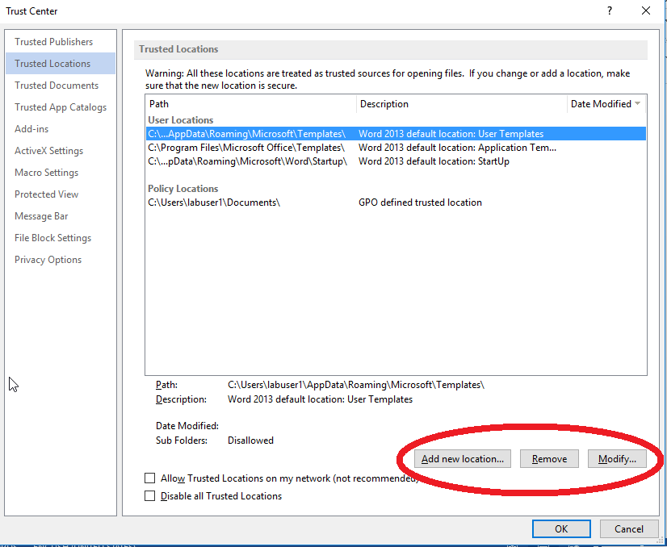
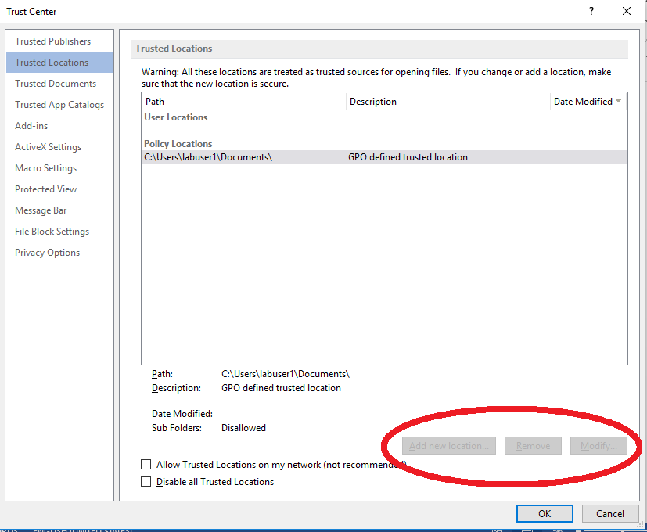
Office Trusts and Templates
Trusted Locations GPOs
Trusted locations can be controlled via GPO
Settings are defined within the user’s GPO configuration
+ User > Administrative Templates > AppName {version} > AppName Options > Security Settings > Trust Center > Trusted Locations
+ User > Administrative Templates > Office {version} > Security Settings > Trust Center
Notes:
Trusted locations are saved into the user’s portion of the registry.
sometimes writable shares if you're lucky.
With a bit of manouvering someone will be able to properly lock down the trusted locations. Allow mix of policy and user locations -> needs to be set to disabled. By default not.
User Configuration/Administrative Templates/Microsoft Office Access 2007/Application Settings/Security/Trust Center/Trusted Locations
User Configuration/Administrative Templates/Microsoft Office Excel 2007/Excel Options/Security/Trust Center/Trusted Locations
User Configuration/Administrative Templates/Microsoft Office PowerPoint 2007/PowerPoint Options/Security/Trust Center/Trusted Locations
User Configuration/Administrative Templates/Microsoft Office Visio 2007/Tools|Options/Security/Trust Center
User Configuration/Administrative Templates/Microsoft Office Word 2007/Word Options/Security/Trust Center/Trusted Locations
In the details pane, double-click Disable all trusted locations, click Enabled and click OK.
User Configuration/Administrative Templates/Microsoft Office 2007 system/Security Settings/Trust Center
In the details pane, double-click Allow mix of policy and user locations, click Disabled and click OK.

Slide 10
Office Trusts and Templates
Trusted Documents and more
Trusted Documents are files containing active content that has been enabled by the user
Trusted Publishers are entities provided with digital certificates that can be used to sign code (e.g. macros)
Trusted Add-ins enable the extension of functionality of Office applications using web technologies (e.g. JavaScript)
Notes:
When you open a new file that has active content (data connections, macros, and so on) the Message Bar appears because active content may contain viruses and other security hazards that could harm your computer or your organization’s network. However, if you trust the source of the file, or know that the active content is secure (for example, the macro is signed by a trusted publisher), then you can enable the file’s active content. This makes it a trusted document.
Add-ins are disabled by default.

Slide 11
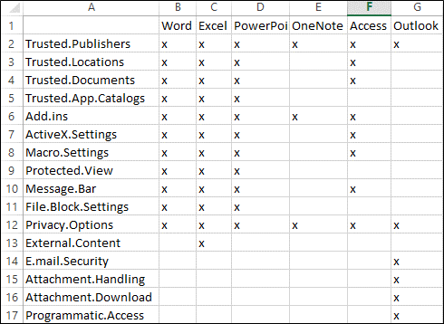
Office Trusts and Templates
Office security settings summary

Slide 12
Office Trusts and Templates
Templates
Templates are special Office files that standardise presentation and actions of documents
All Office applications have their own template types (dot, xlt, dotm, xltm, oft etc)
All Template locations include user writable paths
Templates use is a common practice in enterprise environments
Notes:
Formatting consistency is a typical business requirement for various business processing.
In enterprise environments templates paths (typically residing on file servers) are have been found on file shares, often user writable ;)
Exploitation benefits.
Natively asynchronous but consistent execution mechanism.
Is not included in any startup location, however it is pretty certain that at some point office documents will be opened.
Everything is in memory
Can “bridge” segmented environments

Slide 13
Office Trusts and Templates
Demonstration – Word Only Application Whitelisting
https://www.youtube.com/watch?v=gGQ_yxRtfI0
Notes:
https://msdn.microsoft.com/en-us/library/office/ff197417.aspx

Slide 14
Office Trusts and Templates
Word Templates
Word has two user writable Template locations that may contain template files (dot, dotx, dotm)
+ {User Home}\AppData\Roaming\Microsoft\Templates
+ {User Home}\AppData\Roaming\Microsoft\Word\Startup
There is plenty of predefined VBA functions that are convenient for an attacker’s objectives (e.g. AutoExec, AutoOpen, AutoNew, AutoClose, AutoExit, Document_Open, Document_New etc)
Notes:
Normal dotm can be found in %USERPOFILE%\Microsoft\Templates. If Normal.dotm is renamed, damaged, or moved, Word automatically creates a new version (which uses the original default settings) the next time
But by far the most popular and strong template is one of outlook, especially if a daily comms are expected.
https://msdn.microsoft.com/en-us/library/office/ff197417.aspx

Slide 15
Office Trusts and Templates
Excel Templates
Excel has two default locations that may contain template files (xlt, xltx, xltm)
+ {UserHome}\AppData\Roaming\Microsoft\Templates
+ {UserHome}\AppData\Roaming\Microsoft\Excel\XSLSTART
Similar to Word there is a number of handlers for different events (e.g. Auto_Open, Workgroup_Open, Auto_Close etc)
Notes:
https://msdn.microsoft.com/en-us/library/office/ff197417.aspx

Slide 16
Office Trusts and Templates
Outlook Templates
Outlook stores its templates (oft) in Office’s default template location
+ {User Home}\AppData\Roaming\Microsoft\Templates
Outlook comes with a number of events that may result in numerous combinations (e.g. Application_Startup, NewMail, ItemAdd, ItemSend, MAPILogonComplete etc)
It has a default Macro security set to “Notifications for digitally signed macros, all other macros disabled”
Outlook Event processing takes place prior to rule processing
Notes:
But by far the most popular and strong template is one of outlook, especially if a daily callbacks are needed.
Doesn’t have trusted locations
Has a default security setting for signed only macros, but the certificate signing application is available in every office installation.
The NewMailEx event fires when a new message arrives in the Inbox and before client rule processing occurs.

Slide 17
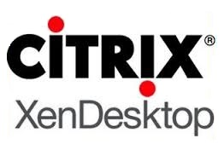

VDIs and persistence
Virtual Desktop Infrastructure (VDI)
Centralised IT desktop management
Reduced cost and hardware
Increased mobility and remote access
Notes:
Virtual desktop infrastructure (VDI) is the practice of hosting a desktop operating system within a virtual machine (VM) running on a centralized server.
Centralized and simplified IT desktop management
Reduced cost and hardware
Increased mobility and remote access
Gives employees the freedom to work from anywhere while cutting IT costs
Two predominant technologies, citrix and vmware
typical on-premise server-hosted virtual desktop model, focusing on the data center. As VDI and cloud computing have matured, a second software-as-a-service model of desktop computing has been reborn in the form as DaaS.
Although not a security control, the deployment of this technology has a significant implications in persistence, especially in user land persistence.
Recently seen more often in red team engagements.
Desktop virtualization implementations are classified based on whether the virtual desktop runs remotely or locally, on whether the access is required to be constant or is designed to be intermittent, and on whether or not the virtual desktop persists between sessions.
Persist in VDIs

Slide 18
VDIs and persistence
VDI persistence challenges
Registry/File system do not persist across reboots
Services/Scheduled tasks are not maintained either
Only a subset of the user’s profile is remapped across sessions. This typically includes trusted locations ;)
Notes:
Although not a security control, the deployment of this technology has a significant implications in persistence, especially in user land persistence.

Slide 19

VDIs and persistence
Template Persistence
By design provides an asynchronous invocation mechanism
VBA functionality hooks on a number of events (Open, Close, New etc)
Trusted locations are not evaluated as start-up items
Macro enabled templates are not deemed as executable types
Templates can be password protected to defend against automated analysis
If a writable share with a trusted location is present
Notes:
Persisting through templates offers multiple advantages and in some scenarios the only vector.
Office events defined as macros provide a by design asynchronous mechanism from the perspective of an OS. It’s very likely that a user will run office applications at regular intervals
The template locations are not deemed as startup locations from an os perspective, however execution is guaranteed as long as the office app is used. Outlook is the most used followed by Word and excel, therefore most common to be back doored.
Share writable trusted locations
Templates can be password protected to defend against automated analysis tools. Password can be reset as described by enigma, therefore not a strong defence against IR.
“C:\Program Files\Microsoft Office\OFFICE11\OUTLOOK.EXE" /autorun hello
Bypasses by design application control as we will later see.
Templates can be password protected to defend against automated analysis tools. Password can be reset as described by enigma, therefore not a strong defence against IR.

Slide 20
VDIs and persistence
Demonstration – VDI Persistence
https://www.youtube.com/watch?v=qy_FVCrGW5s

Slide 21
Raising the bar
Raising the bar – Application Control
Prevents unauthorised software from running
Doesn’t affect macros as Office binaries have to be whitelisted
However, it can be effective in restricting other MS binaries (e.g. powershell.exe, rundll32.exe, regsvr32.exe, installutil.exe etc)
Notes:
So we decided to raise the bar. On a host with macros disabled explicitly we have enabled application control.
The use of office applications transparently bypasses this security control, as applications have been granted execution rights. Office VBA effectively provides by design, a native code execution container-framework.
https://technet.microsoft.com/en-us/library/ee844118.aspx
Now in some cases what the vba code does is to call a whitelisted binary on the compromised host to do the actual loading of the shellcode (e.g. powershell.exe, along with a number of others, many of those described in some awesome work made by Casey Smith (e.g. installutil.exe, regsvr32, regasm, mshta.exe click once - dfsvc.exe
Defining a singed binary whitelisting policy may come with a tradeoff that could offer
an attacker opportunities to execute arbitrary code (e.g. running an ms signed debugger and to debug a process that the user owns and directly manipulating its memory to execute code - cdb.exe)
. Fix this by allowing signed binaries from non-user writable locations.
So we’re on a host with macros explicitly disabled we’ve blocked a number of binaries that are typically invoked within macros to do all sorts of cool stuff. E.g powershell, rundll32, installutlil, regsvr32 and a number of other cool techniques described by @subtee and others

Slide 22
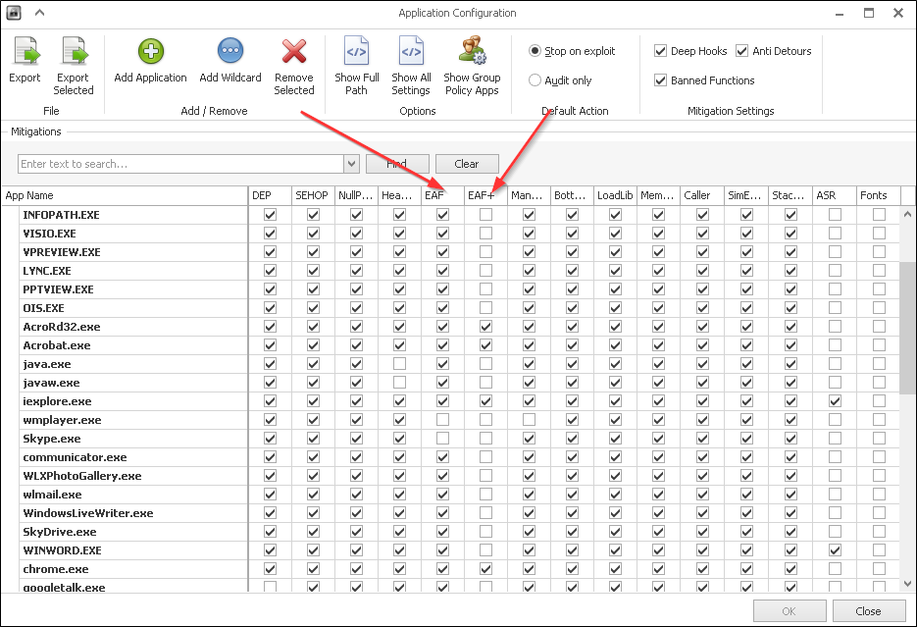
What is EMET?
Raising the bar - EMET
Enhanced Mitigation Experience Toolkit
Exploitation Defense
Export Address Table Filtering (EAF)
Macro Payloads (VBA)
Not designed to prevent VBA Code execution
Notes:
So, how many of you are familiar with EMET?
The Enhanced Mitigation Experience Toolkit also known as EMET, is provided by Microsoft as a tool to configure additional layers of defense against exploitation. EAF stands for Export Address Table Filtering. This mechanism prevents shell code from being able to lookup useful addresses to windows function calls.
EMET offers a range of protections against exploitation such as Data Execution Prevention, Heap Spray Protection, Address Space Reduction. As we are not limited in buffer space and are simply relying on a user to execute a macro, a lot of these protections do not serve any purpose. Execution of macros is a legitimate function that a normal Office user may want to use.
EMET has a mechanism named EAF and EAF+.
Macro payloads can be generated through popular frameworks such as the Metasploit Framework, Cobalt Strike and PowerShell Empire. Some of these payloads will be blocked by EMET.

Slide 23
Existing Implants
Current Macro Payloads (Metasploit Framework)
VBA-PSH: Spawn PowerShell and Inject Shellcode
VBA-EXE: File Drop Executable & Execute
VBA: Inject Shellcode into WINWORD.exe
Notes:
Starting with Metasploit, there are three formats available to the user.
VBA-PSH. This particular method spawns a PowerShell payload that will inject shell code into itself. If PowerShell is blocked or EMET is protecting it, the payload will fail on two scenarios.
VBA-EXE. An executable binary is written to a file then it is executed. We can make the payload it drops FUD but we want to prevent having multiple files on disk. This payload will fail when failing to write to disk or AV picks it up.
The VBA format in Metasploit outputs a payload that makes use of VBA code to inject shell code into itself. For example, if the payload was opened in Microsoft Word, it would run in WINWORD.exe. This payload would fail if EMET is enabled on Word.

Slide 24
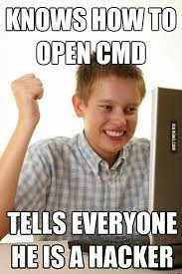
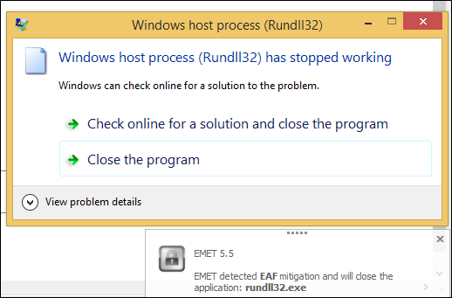
Existing Implants
Current Macro Payloads (Cobalt Strike / Empire)
CS: Inject into Rundll32
EMET protect Rundll32.exe
Empire: Native PowerShell
Notes:
So other than Metasploit, we have Cobalt Strike and Empire which are two upcoming and widely used frameworks for managing listeners and callbacks.
In CobaltStrike, the macro payload generated will spawn Rundll32.exe in it’s 32 bit format regardless of the system architecture it is ran on and inject shell code into it. This payload would fail if Rundll32.exe is blocked or EMET is protecting Rundll32.exe.
Suggestion in general to stop all the CobaltStrike copy and pasters. EMET Protect Rundll32.exe.
The Empire payload will make use of the popular download cradle to connect to your server and pull the second stage of the payload. This payload however, runs in pure PowerShell and does not need to inject shell code. This payload fails when PowerShell.exe is blocked.

Slide 25
WePWNise
Introducing WePWNise
Generate Macros
Enumerate Configuration
Determine Weaknesses
Compatibility / Dynamic Payload Injection
Integrate
Notes:
I wanted to create a tool that could generate an implant that would have a certain level of basic automation that would be able to find its way around a victim’s machine to call back to an attacker.
That would run on the target machine to enumerate configurations for mechanisms such as Software Restriction Policies and EMET.
After obtaining this information, the implant would then automatically target weaknesses in the configuration to keep itself alive and reach back out to the attacker.
The macros generated would need to be compatible and should be able to integrate operations with tools such as Metasploit Framework and Cobalt Strike. We do not want to create the new Metasploit, Cobalt Strike or Empire for capturing call backs.

Slide 26
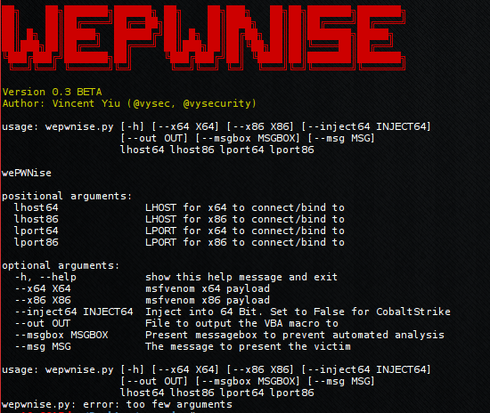
WePWNise

Slide 27
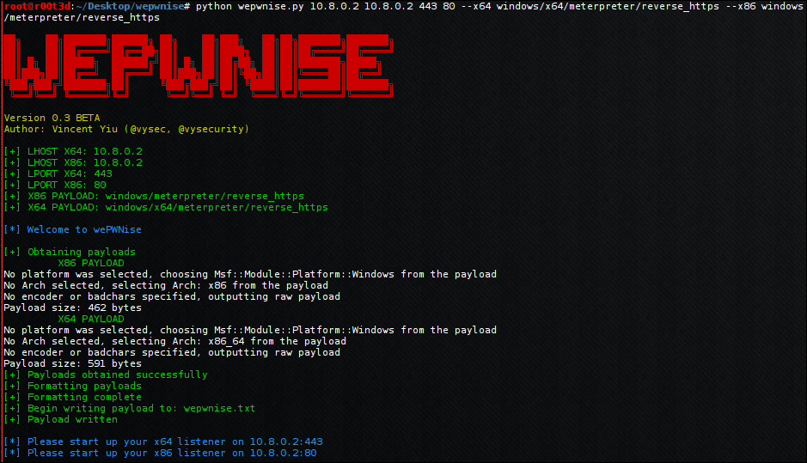
WePWNise
Notes:
Currently WePWNise offers the ability for a consultant to provide a one line command to generate a reasonably sophisticated Macro implant.
It is possible for the consultant to specify specific popular payloads to use such as stagers from Metasploit.
There is basic anti-automated analysis for services such as VirusTotal.
The tester can specify where to deploy their listeners, it could be on two separate IP addresses.
Automatically determines VBA version in use, the Office architecture, the System architecture and later on we will see that it also determines the target binary architecture. The macro looks for potential targets and determines what architecture payload it must inject to get the consultant a shell. I like to call this feature, dynamic payload injection.

Slide 28
WePWNise
The How
Enumerate Configuration
Avoid EMET Protected Paths
Injection via Native VBA
Notes:
In the case of EMET, WePWNise grabs the EMET configuration through registry and determines what is protected.
EMET is then avoided by providing the macro with a list of directories to scan for unprotected executables. Once an executable is found, the process is spawned then shell code is injected.
WePWNIse creates a call back through the use of shell code injection. This is written in native VBA as we do not want to have a dependency on PowerShell.

Slide 29
WePWNise
How do you inject?
Native VBA code
CreateProcessA
VirtualAllocEx
WriteProcessMemory
CreateRemoteThread
Notes:
The WePWNise macro makes use of Native VBA code to perform shell code inject into a target binary without dependency on PowerShell.
As per the regular routine of injection, we can either open a process or create one. We have chosen to create processes as this is safer than using an existing one and accidentally crashing it.
VirtualAlloc allows us to reserve a space of unused memory in a process and get the memory location address for this space.
We then make use of WriteProcessMemory to write the shell code into this reserved space byte by byte. In the scenario where memory signature scanning is used, this will be detected. However, I’ve only seen this used in Anti Cheat Engnies for games as opposed to Anti Virus solutions. To bypass this, we can simply mutate the shell code so that it cannot be signaturable – this is mentioned in the further work section later on.
Create Remote Thread basically instantiates and runs the shell code we injected.

Slide 30
WePWNise
Memory management for failed attempts
VirtualFreeEx
TerminateProcess
Notes:
So WePWNise can get us remote access on a machine. It is also pretty good at memory management.
It will make use of virtual free to free up reserved memory space that is no longer used if an injection attempt fails.
It will terminate the process if a suspended process is made but for some reason defences stopped it from being able to create a connection back to our C2 server.

Slide 31
WePWNise
Enumeration
Native Registry Calls (Wscript.Shell)
HKLM\SOFTWARE\Microsoft\EMET\AppSettings
Metasploit:
use post/windows/gather/enum_emet
Notes:
To query registry, a Wscript.Shell object is used, being an easy way to query registry in VBA.
In order to perform the enumeration, we will look for the protected paths configuration in the registry. In order to do this, light reverse engineering of the EMET binary was required but I quickly found that the paths were stored under the following registry key.
After doing so, I also wrote a quick post exploitation module to enumerate these paths from registry for use within the Metasploit framework when EMET Is found to be running. We will see why this is important later.

Slide 32
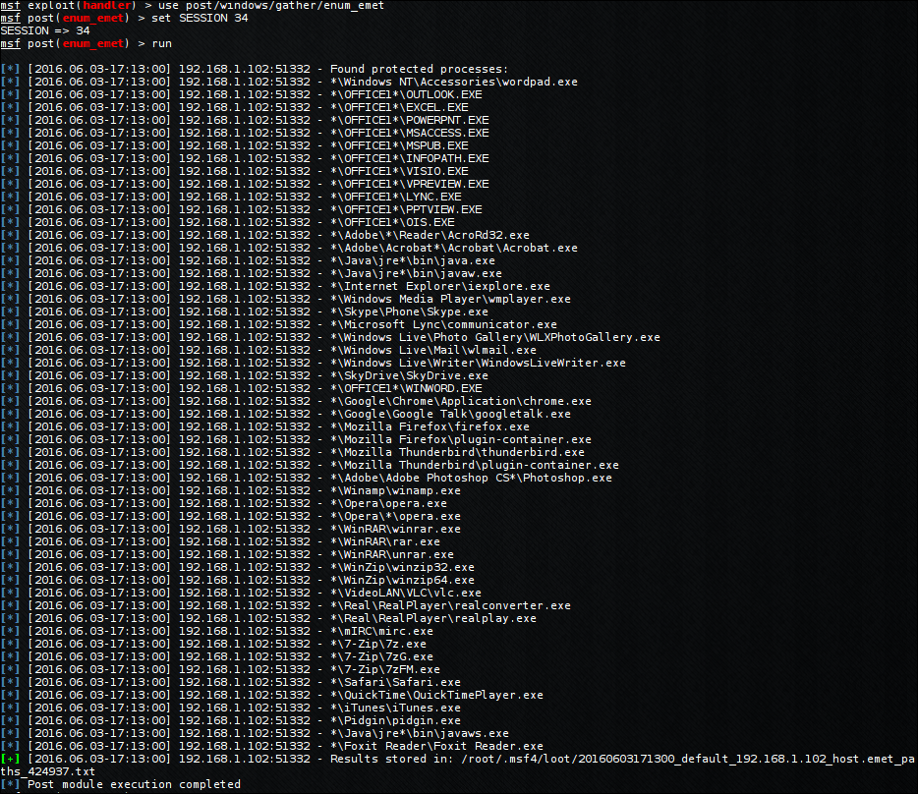
WePWNise
Notes:
This is the output of the enum_emet post exploitation module from Metasploit.
As I understand no one can read this, let’s zoom in and focus on WINWORD.exe
As we can see, the format in registry is an easily understandable wildcard format to match against any version of WINWORD.exe running from a folder that begins with OFFICE.

Slide 33
WePWNise
Demonstration
https://www.youtube.com/watch?v=trDr3cZRWSA
Notes:
------------------ TALK AUDIENCE THROUGH VIDEO ------------------------
On the right hand side, we have a Windows machine that will act as both the Victim and the creator of a trojan document. On the left hand side we have a machine that will generate the macro code as well as act as the command and control server.
Both machines are on the same network for demonstration purposes. However, this currently can be used in practice and engagements.
On the left, we begin generating a wepwnise payload that will call back to our command and control server over HTTPS on port 443 and 80 for two different architectures. These can be caught on two separate machines if required.
Now on the right, we can see the current configuration of EMET by default. We will enable all mitigations for everything. In some cases, there are compatibility reasons for why by default Skype.exe is not protected by EAF.
As the script tells us, we must start up our listeners. So we do that on the left now.
Now on the right, we will begin creating the trojan document. Take and display some images to gain the user’s trust. Add some look to be encrypted text to make them think its encrypted!
Now we add the macros. We must make sure to add it to the document and not Word.
We now run the macro. We have received a connection back from the machine. Now we need to check what process it is running in. It appears to be PING.exe.
Now we go back to the machine and protect Ping.exe with EMET.
If all goes well, our code should automatically know this and select a different binary.
We have now injected into EMET_Agent.exe which is unprotected by default ☺
So as mentioned earlier, I have submitted a quick post exploitation module to the Metasploit Framework which can enumerate all protected paths for safe migration afterwards.
As WINWORD.exe is protected, we try and inject into it to prove that we lose our shell due to it being protected.
This is why it’s important to not migrate wrecklessly without first enumerating the system.

Slide 34
Anti-WePWNise
The Solution
Whitelist A.exe
Then we must EMET protect A.exe
Winlogon.exe
EMET all Windows Default Executables
Viable? Probably not (Issues with Mitigations)
Notes:
There is a solution!
If you white list and allow for example, calc.exe – then you should also EMET calc.exe
In the scenario where an attacker can spawn calc.exe, they would then be able to inject into it if it was not protected. Therefore, EMET should be turned on for every binary that is white listed.
It is important to note that, windows will not block applications such as Winlogon.exe
This implies that we should EMET all windows default executables.
Now the question is whether setting up this actual configuration is viable? Probably not. === Some binaries are required such as WINLOGON.exe which is used to perform the logon process on Windows. There’s going to be processes that will not be blocked as an employee must be using the computer in order to run some software.
In the case of EMET, WePWNise grabs the EMET configuration through registry and determines what is protected.
EMET is then avoided by providing the macro with a list of directories to scan for unprotected executables. Once an executable is found, the process is spawned then shell code is injected.
WePWNIse creates a call back through the use of shell code injection. This is written in native VBA as we do not want to have a dependency on PowerShell.
We later found that using EMET protected paths on all binaries is not viable.

Slide 35
Anti-WePWNise
Drawbacks
Enumeration of Registry causes Noise.
Can be slow depending on parameters.
Code prone to error and requires lots of testing.
Notes:
Enumeration of the registry can cause noise for incident response to detect.
However, the improvement of implant reliability outweighs the noise.

Slide 36
Anti-WePWNise
Future Work in Configuration
Applicable to Many Areas
Not only EMET
AppLocker
AntiVirus Excluded Paths / Binaries
Firewall Excluded Paths / Binaries
Notes:
In terms of future work, it is important to note that the concept of enumerating a configuration and instructing automated targeting depending on configuration can apply to many areas.
This doesn’t apply only to EMET.
We can implement this to enumerate AppLocker and attack the system by finding weaknesses.
This can apply to AntiVirus software where Excluded Paths and Binaries can be enumerated off the system and further attacked. There’s no need to bypass AV at this point.
In terms of Firewall Excluded Paths / Binaries, we can use this to find out which binaries are more privileged when being allowed to transmit traffic out of the host. For example, in Comodo Internet Security, you can specify to allow all connections from a particular excecutable. If ping.exe is allowed to transmit traffic out of the host on any port, we can spawn the ping executable and inject shell code into it and essentially bypassing the host based firewall.

Slide 37
Anti-WePWNise
Future Work in Implant Generation
Implants to gather Intel (round 1)
Targeted implants with Keying (round 2)
VBA Code Obfuscation
Shellcode mutation
Flow obfuscation
Notes:
In terms of implant generation. I hope to eventually implement dummy implant generation that can log essential information about a system back to a C2. With Sandbox based virtualisation security solutions such as FireEye and Bromium, we may be able to obtain values of essentially identifiable indicators for these VMs from a blackbox perspsective. We can then go away and further enhance our payloads on the fly with keying to prevent execution when in a VM.
In terms of the code obfuscation, currently there is none. As it’s currently FUD, I don’t see a need for code obfuscation. However, in the future if it becomes a publicly available tool, we want each generation to be different from each other to prevent the Blue team from creating signatures for our code.
Shell code mutation. Currently the shell code is provided as an array of numbers. These numbers represent assembly instructions that will be written into memory. With shell code mutation we are able to completely change what this shell code looks like by replacing instructions with equivalent sets of instructions. This will prevent security solutions from being able to signature an array of numbers of scan memory for known signatures after injection.
Flow obfuscation can be used to prevent IR from determining the real flow of execution and can slow them down. In terms of flow obfuscation, I have created a proof of concept last year in 2015 where multiple dummy branches of flow can be created so that an attacker needs to trace through every line to determine what it’s really doing.

Slide 38
MWR Labs
Conclusions
VBA is still a very reliable arbitrary code execution container
Macro Templates are a relevant VDI persistence mechanism
EMET is only as good as its policy is configured
Configuration Enumeration is proven to work
Adds reliability to implants in unknown environments
You Know What’s Happening but there’s no holistic solution
WePWNise abuses configurations to get you shells
Notes:
To prevent vba from running someone should either uninstall office’s vba component or disable it via gpo. As far as our research has shown there were no opportunities to circumvent this control.
So in conclusion, we know that enumerating a configuration and attacking weaknesses does indeed work.
It adds reliability to the payload so that it can circumvent mechanisms that try to stop it from calling out back to the attacker.
So, the sysadmins know what’s happening, can probably see that the enumeration being performed, but there’s no reliable solution to prevent this.

Slide 39
Previous Research / Credits
We need to write it in bullets etc but I’d say @enigma0x3, @subtee, didier stevens, the recent one that Alex sent for the EMET bypasses
Matt Nelson (@enigma0x3) https://enigma0x3.net/
Carey Smith (@subtee) http://subt0x10.blogspot.co.uk/
@DidierStevens https://blog.didierstevens.com/
https://www.fireeye.com/blog/threat-research/2016/06/angler_exploit_kite.html
Secret Squirrel IAT Parser Reverse TCP https://gist.github.com/secretsquirrel/2ad8fba6b904c2c952b8

Slide 40
MWR Labs
< /dev/audience
@mwrlabs
https://labs.mwrinfosecurity.com/
Publishing WePWNise code shortly.
Metasploit Post Exploitation modules already approved by Rapid7.

