Slide 1
MWR Labs
One Template To Rule Them All
Kostas Lintovois and Vincent Yiu
29th June 2016
Notes:
Hello everyone, our talk is titled ‘One Template To Rule Them All’
Kostas and I are security consultants for MWR in the UK and today we’ll be sharing an overview of how Microsoft Office macros can be used in different ways as part of an APT.

Slide 2
What is EMET?
EMET
Exploitation Defense
Export Address Table Filtering (EAF)
Macro Payloads (VBA)
Notes:
So, how many of you are familiar with EMET?
The Enhanced Mitigation Experience Toolkit also known as EMET, is provided by Microsoft as a tool to configure additional layers of defense against exploitation.

Slide 3
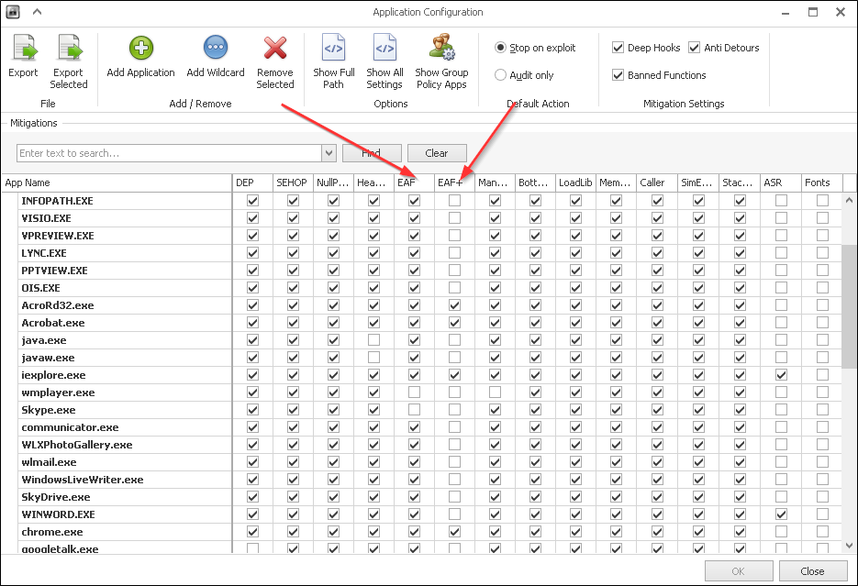
What is EMET?
EMET
Notes:
EMET offers a range of protections against exploitation such as Data Execution Prevention, Heap Spray Protection, Address Space Reduction. As we are not limited in buffer space and are simply relying on a user to execute a macro, a lot of these protections do not serve any purpose. Execution of macros is a legitimate function that a normal Office user may want to use.
EMET has a mechanism named EAF and EAF+.

Slide 4
What is EMET?
EMET
Exploitation Defense
Export Address Table Filtering (EAF)
Macro Payloads (VBA)
Notes:
EAF stands for Export Address Table Filtering. This mechanism prevents shell code from being able to lookup useful addresses to windows function calls.
Macro payloads can be generated through popular frameworks such as the Metasploit Framework, Cobalt Strike and PowerShell Empire. Some of these payloads will be blocked by EMET.

Slide 5
Existing Implants
Current Macro Payloads (Metasploit Framework)
Spawn PowerShell (VBA-PSH)
File Drop & Execute (VBA-EXE)
Self Injection (VBA)
Notes:
Starting with Metasploit, there are three formats available to the user.
VBA-PSH. This particular method spawns a PowerShell payload that will inject shell code into itself. If PowerShell is blocked or EMET is protecting it, the payload will fail on two scenarios.
VBA-EXE. An executable binary is written to a file then it is executed. We can make the payload it drops FUD but we want to prevent having multiple files on disk. This payload will fail when failing to write to disk or AV picks it up.
The VBA format in Metasploit outputs a payload that makes use of VBA code to inject shell code into itself. For example, if the payload was opened in Microsoft Word, it would run in WINWORD.exe. This payload would fail if EMET is enabled on Word.

Slide 6
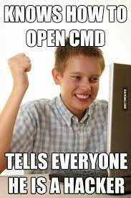
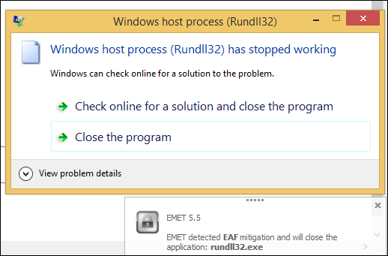
Existing Implants
Current Macro Payloads (Cobalt Strike / Empire)
Inject into Rundll32 (32 Bit)
EMET Protect Rundll32.exe
Native PowerShell
Notes:
So other than Metasploit, we have Cobalt Strike and Empire which are two upcoming and widely used frameworks for managing listeners and callbacks.
In CobaltStrike, the macro payload generated will spawn Rundll32.exe in it’s 32 bit format regardless of the system architecture it is ran on and inject shell code into it. This payload would fail if Rundll32.exe is blocked or EMET is protecting Rundll32.exe.
Suggestion in general to stop all the CobaltStrike copy and pasters. EMET Protect Rundll32.exe.
The Empire payload will make use of the popular download cradle to connect to your server and pull the second stage of the payload. This payload however, runs in pure PowerShell and does not need to inject shell code. This payload fails when PowerShell.exe is blocked.

Slide 7
WePWNise
Introducing WePWNise
Generate Macros
Enumerate Configuration
Determine Weaknesses
Compatiblity / Dynamic Payload Injection
Integrate
Notes:
I wanted to create a tool that could generate an implant that would have a certain level of basic automation that would be able to find its way around a victim’s machine to call back to an attacker.
That would run on the target machine to enumerate configurations for mechanisms such as Software Restriction Policies and EMET.
After obtaining this information, the implant would then automatically target weaknesses in the configuration to keep itself alive and reach back out to the attacker.
The macros generated would need to be compatible and should be able to integrate operations with tools such as Metasploit Framework and Cobalt Strike. We do not want to create the new Metasploit, Cobalt Strike or Empire for capturing call backs.

Slide 8
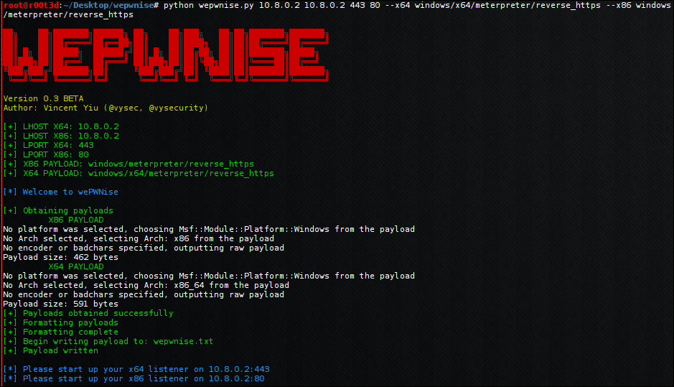
WePWNise
Notes:
Currently WePWNise offers the ability for a consultant to provide a one line command to generate a reasonably sophisticated Macro implant.
It is possible for the consultant to specify specific popular payloads to use such as stagers from Metasploit.
There is basic anti-automated analysis for services such as VirusTotal.
The tester can specify where to deploy their listeners, it could be on two separate IP addresses.
Automatically determines VBA version in use, the Office architecture, the System architecture and later on we will see that it also determines the target binary architecture. The macro looks for potential targets and determines what architecture payload it must inject to get the consultant a shell. I like to call this feature, dynamic payload injection.
Decent memory management, the Macro will free up allocated memory should some sort of error occur.

Slide 9
WePWNise
WePWNise? The How.
Enumerate Configuration
Avoid EMET Protected Paths
Injection via Native VBA
Notes:
In the case of EMET, WePWNise grabs the EMET configuration through registry and determines what is protected.
EMET is then avoided by providing the macro with a list of directories to scan for unprotected executables. Once an executable is found, the process is spawned then shell code is injected.
WePWNIse creates a call back through the use of shell code injection. This is written in native VBA as we do not want to have a dependency on PowerShell.

Slide 10
WePWNise
How do you inject?
Native VBA code
CreateProcessA
VirtualAllocEx
WriteProcessMemory
CreateRemoteThread
Notes:
The WePWNise macro makes use of Native VBA code to perform shell code inject into a target binary without dependency on PowerShell.
As per the regular routine of injection, we can either open a process or create one. We have chosen to create processes as this is safer than using an existing one and accidentally crashing it.
VirtualAlloc allows us to reserve a space of unused memory in a process and get the memory location address for this space.
We then make use of WriteProcessMemory to write the shell code into this reserved space byte by byte. In the scenario where memory signature scanning is used, this will be detected. However, I’ve only seen this used in Anti Cheat Engnies for games as opposed to Anti Virus solutions. To bypass this, we can simply mutate the shell code so that it cannot be signaturable – this is mentioned in the further work section later on.
Create Remote Thread basically instantiates and runs the shell code we injected.

Slide 11
WePWNise
Memory management for failed attempts?
VirtualFreeEx
TerminateProcess
Notes:
So WePWNise can get us remote access on a machine. It is also pretty good at memory management.
It will make use of virtual free to free up reserved memory space that is no longer used if an injection attempt fails.
It will terminate the process if a suspended process is made but for some reason defences stopped it from being able to create a connection back to our C2 server.

Slide 12
WePWNise
Enumeration?
Wscript.Shell
HKLM\SOFTWARE\Microsoft\EMET\AppSettings
Metasploit:
use post/windows/gather/enum_emet
Notes:
To query registry, a Wscript.Shell object is used, being an easy way to query registry in VBA.
In order to perform the enumeration, we will look for the protected paths configuration in the registry. In order to do this, light reverse engineering of the EMET binary was required but I quickly found that the paths were stored under the following registry key.
After doing so, I also wrote a quick post exploitation module to enumerate these paths from registry for use within the Metasploit framework when EMET Is found to be running. We will see why this is important later.

Slide 13
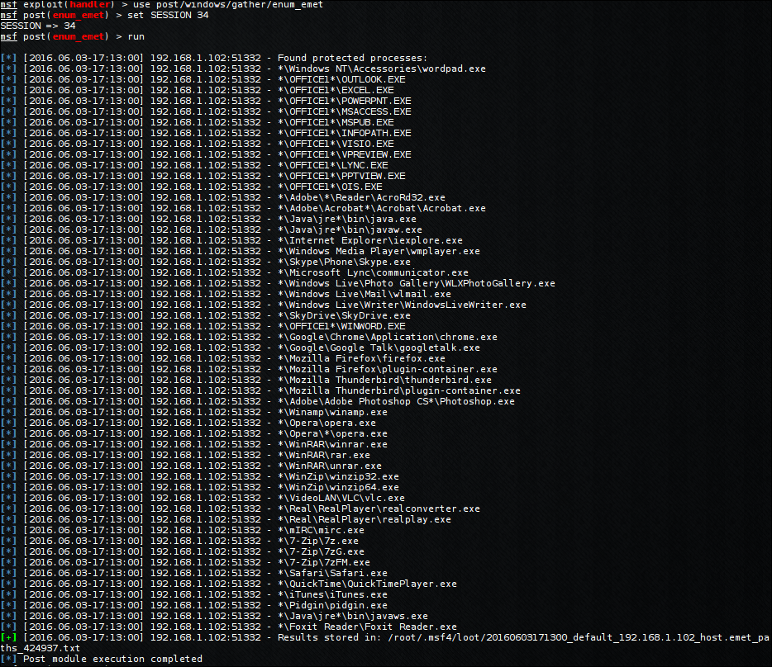
WePWNise
Notes:
This is the output of the enum_emet post exploitation module from Metasploit.
As I understand no one can read this, let’s zoom in and focus on WINWORD.exe
As we can see, the format in registry is an easily understandable wildcard format to match against any version of WINWORD.exe running from a folder that begins with OFFICE.

Slide 14
WePWNise
Demonstration
Notes:
------------------ TALK AUDIENCE THROUGH VIDEO ------------------------
On the right hand side, we have a Windows machine that will act as both the Victim and the creator of a trojan document. On the left hand side we have a machine that will generate the macro code as well as act as the command and control server.
Both machines are on the same network for demonstration purposes. However, this currently can be used in practice and engagements.
On the left, we begin generating a wepwnise payload that will call back to our command and control server over HTTPS on port 443 and 80 for two different architectures. These can be caught on two separate machines if required.
Now on the right, we can see the current configuration of EMET by default. We will enable all mitigations for everything. In some cases, there are compatibility reasons for why by default Skype.exe is not protected by EAF.
As the script tells us, we must start up our listeners. So we do that on the left now.
Now on the right, we will begin creating the trojan document. Take and display some images to gain the user’s trust. Add some look to be encrypted text to make them think its encrypted!
Now we add the macros. We must make sure to add it to the document and not Word.
We now run the macro. We have received a connection back from the machine. Now we need to check what process it is running in. It appears to be PING.exe.
Now we go back to the machine and protect Ping.exe with EMET.
If all goes well, our code should automatically know this and select a different binary.
We have now injected into EMET_Agent.exe which is unprotected by default ☺
So as mentioned earlier, I have submitted a quick post exploitation module to the Metasploit Framework which can enumerate all protected paths for safe migration afterwards.
As WINWORD.exe is protected, we try and inject into it to prove that we lose our shell due to it being protected.
This is why it’s important to not migrate wrecklessly without first enumerating the system.

Slide 15
Anti-WePWNise
What if I block X, Y and EMET Z?
Blocked? No way.
EMET? Good luck with that.
Notes:
Some binaries are required such as WINLOGON.exe which is used to perform the logon process on Windows. There’s going to be processes that will not be blocked as an employee must be using the computer in order to run some software.
In the case of EMET, WePWNise grabs the EMET configuration through registry and determines what is protected.
EMET is then avoided by providing the macro with a list of directories to scan for unprotected executables. Once an executable is found, the process is spawned then shell code is injected.
WePWNIse creates a call back through the use of shell code injection. This is written in native VBA as we do not want to have a dependency on PowerShell.
We later found that using EMET protected paths on all binaries is not viable.

Slide 16
Anti-WePWNise
The Solution
Whitelist X.exe
EMET X.exe
Winlogon.exe
EMET all Windows Default Executables
Viable? Probably not
Notes:
There is a solution!
If you white list and allow for example, calc.exe – then you should also EMET calc.exe
In the scenario where an attacker can spawn calc.exe, they would then be able to inject into it if it was not protected. Therefore, EMET should be turned on for every binary that is white listed.
It is important to note that, windows will not block applications such as Winlogon.exe
This implies that we should EMET all windows default executables.
Now the question is whether setting up this actual configuration is viable? Probably not.

Slide 17
Anti-WePWNise
Future Work in Configuration
Applicable to Many Areas
Not only EMET
AppLocker
AntiVirus Excluded Paths / Binaries
Firewall Excluded Paths / Binaries
Notes:
In terms of future work, it is important to note that the concept of enumerating a configuration and instructing automated targeting depending on configuration can apply to many areas.
This doesn’t apply only to EMET.
We can implement this to enumerate AppLocker and attack the system by finding weaknesses.
This can apply to AntiVirus software where Excluded Paths and Binaries can be enumerated off the system and further attacked. There’s no need to bypass AV at this point.
In terms of Firewall Excluded Paths / Binaries, we can use this to find out which binaries are more privileged when being allowed to transmit traffic out of the host. For example, in Comodo Internet Security, you can specify to allow all connections from a particular excecutable. If ping.exe is allowed to transmit traffic out of the host on any port, we can spawn the ping executable and inject shell code into it and essentially bypassing the host based firewall.

Slide 18
Anti-WePWNise
Future Work in Implant Generation
Dummy Implants to Gather Intel
Targeted Implants with Keying
VBA Code Obfuscation
Shell Code Mutation
Flow Obfuscation
Notes:
In terms of implant generation. I hope to eventually implement dummy implant generation that can log essential information about a system back to a C2. With Sandbox based virtualisation security solutions such as FireEye and Bromium, we may be able to obtain values of essentially identifiable indicators for these VMs from a blackbox perspsective. We can then go away and further enhance our payloads on the fly with keying to prevent execution when in a VM.
In terms of the code obfuscation, currently there is none. As it’s currently FUD, I don’t see a need for code obfuscation. However, in the future if it becomes a publicly available tool, we want each generation to be different from each other to prevent the Blue team from creating signatures for our code.
Shell code mutation. Currently the shell code is provided as an array of numbers. These numbers represent assembly instructions that will be written into memory. With shell code mutation we are able to completely change what this shell code looks like by replacing instructions with equivalent sets of instructions. This will prevent security solutions from being able to signature an array of numbers of scan memory for known signatures after injection.
Flow obfuscation can be used to prevent IR from determining the real flow of execution and can slow them down. In terms of flow obfuscation, I have created a proof of concept last year in 2015 where multiple dummy branches of flow can be created so that an attacker needs to trace through every line to determine what it’s really doing.

