Slide 1
PREDICTIVE MAINTENANCE
Analyzing Machine Sensor Data to
Predict Industrial Equipment Failure
A Data Analytics Final Project — Exploratory Data Analysis using Python
Prepared by Vyshakh
Data Analytics Coursework | Mechanical Engineering | August 2026

Slide 2
INDUSTRY CONTEXT
Unplanned Downtime Is a Costly Problem
In manufacturing, machines fail without warning — halting production, delaying orders, and driving up repair costs. Most factories still rely on two outdated strategies:
THE SHIFT THE INDUSTRY NEEDS
Predictive
Maintenance
Reactive Maintenance
Fix the machine only after it breaks — resulting in expensive, unplanned downtime.
Using real-time sensor data — temperature, torque, rotational speed, and tool wear — to detect early warning signs of failure before it happens.
Scheduled Maintenance
Service machines at fixed intervals, regardless of their actual condition — wasteful and imprecise.
Result: less downtime, lower repair cost, longer machine life.
2

Slide 3
PROJECT OBJECTIVE
What This Project Set Out to Do
To perform exploratory data analysis on industrial machine sensor data, in order to identify which conditions and readings are most strongly associated with machine failure — laying the groundwork for a predictive maintenance strategy.
P = τ × ω
Mechanical engineering formulas were used to engineer new features from raw sensor data — bridging domain knowledge with data analytics.
Understand the structure and quality of real industrial sensor data
Engineer features grounded in mechanical engineering principles
Identify the strongest drivers of machine failure
A differentiator that connects a mechanical engineering degree to a data analytics skillset.
Translate findings into actionable maintenance recommendations
3

Slide 4
THE DATASET
AI4I Predictive Maintenance Dataset
Sourced from the UCI Machine Learning Repository — a trusted academic source for real, structured industrial data.
10,000
14
5
3.4%
Machine Records
Original Features
Failure Modes Tracked
Overall Failure Rate
FEATURES INCLUDED
Air & Process Temperature (K)
Rotational Speed (rpm)
Torque (Nm)
Tool Wear (min)
Product Quality Type (L / M / H)
Failure Type Flags (TWF, HDF, PWF, OSF, RNF)
4

Slide 5
APPROACH
Project Workflow
01
02
03
04
05
Data Loading
Cleaning & Feature Engineering
Exploratory Data Analysis
Visualization
Insights & Recommendations
→
→
→
→
Import and inspect the raw dataset
Handle quality checks, engineer new features
Univariate, bivariate & multivariate analysis
13+ charts uncovering failure patterns
Translate findings into action
5

Slide 6
DATA PREPARATION
Data Quality & Cleaning
QUALITY CHECKS
CLEANED DATASET SAVED
✓
Missing Values
A best-practice pipeline:
0 found across all 14 columns
Raw Data (.csv)
✓
Duplicate Rows
0 found in 10,000 records
Cleaning & Feature Engineering
✓
Column Naming
Cleaned Dataset (.csv)
Standardized for clarity & consistency
Analysis-Ready
A clean, verified dataset means every downstream insight can be trusted.
6

Slide 7
FEATURE ENGINEERING
Engineering Features Using Mechanical Principles
Two new features were derived from raw sensor readings, each grounded in real engineering logic — not arbitrary math.
Δ
Temp_Diff_K
P
Power_W
Process Temp − Air Temp
Torque × Angular Velocity (P = τω)
A shrinking gap between process and air temperature signals poor heat dissipation — a machine struggling to cool itself efficiently.
Standard rotational dynamics formula, converting torque and rotational speed (RPM → rad/s) into true mechanical power output.
Directly linked to Heat Dissipation Failure (HDF) — the most common failure mode in this dataset.
One of the strongest individual predictors of machine failure found in this analysis.
7

Slide 8
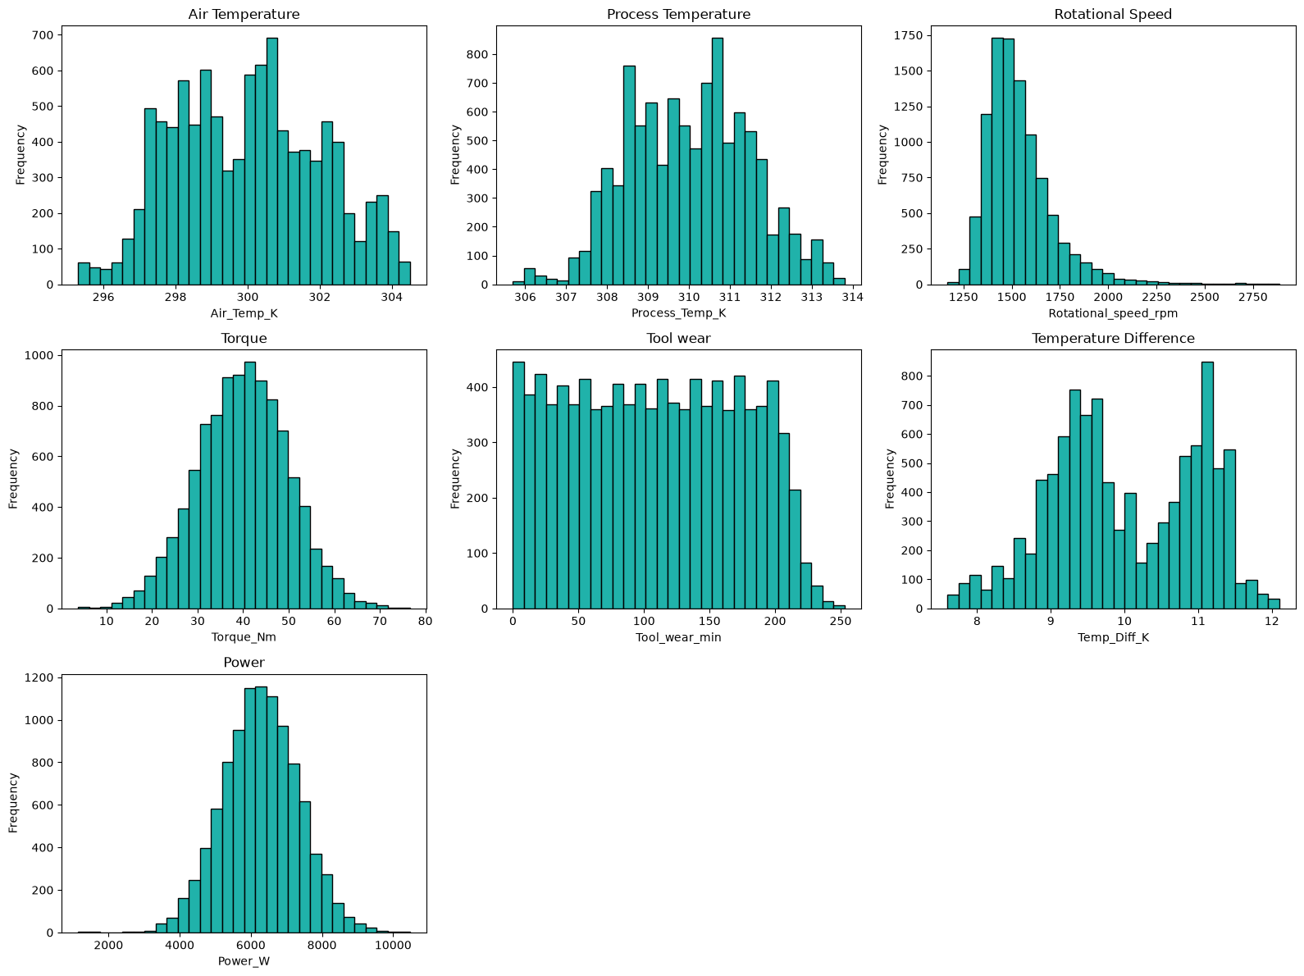
UNDERSTANDING THE DATA
Sensor Reading Distributions
WHAT WE LOOKED AT
Rotational speed is right-skewed, with high-speed outliers
Tool wear is evenly distributed (0–250 min)
Temperature difference shows two distinct peaks
Torque, temperature & power follow near-normal curves
8

Slide 9
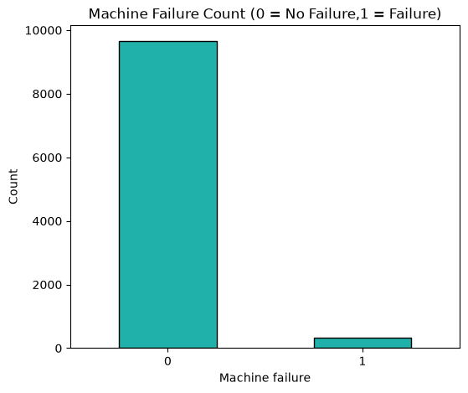
FINDING 01 — UNIVARIATE ANALYSIS
A Rare but Costly Event
3.39%
of machines in the dataset
experienced failure
Only 339 of 10,000 machines failed. This class imbalance reflects real-world industrial reliability — failures are rare, high-impact events, which makes each one worth understanding deeply.
Insight #1
9

Slide 10
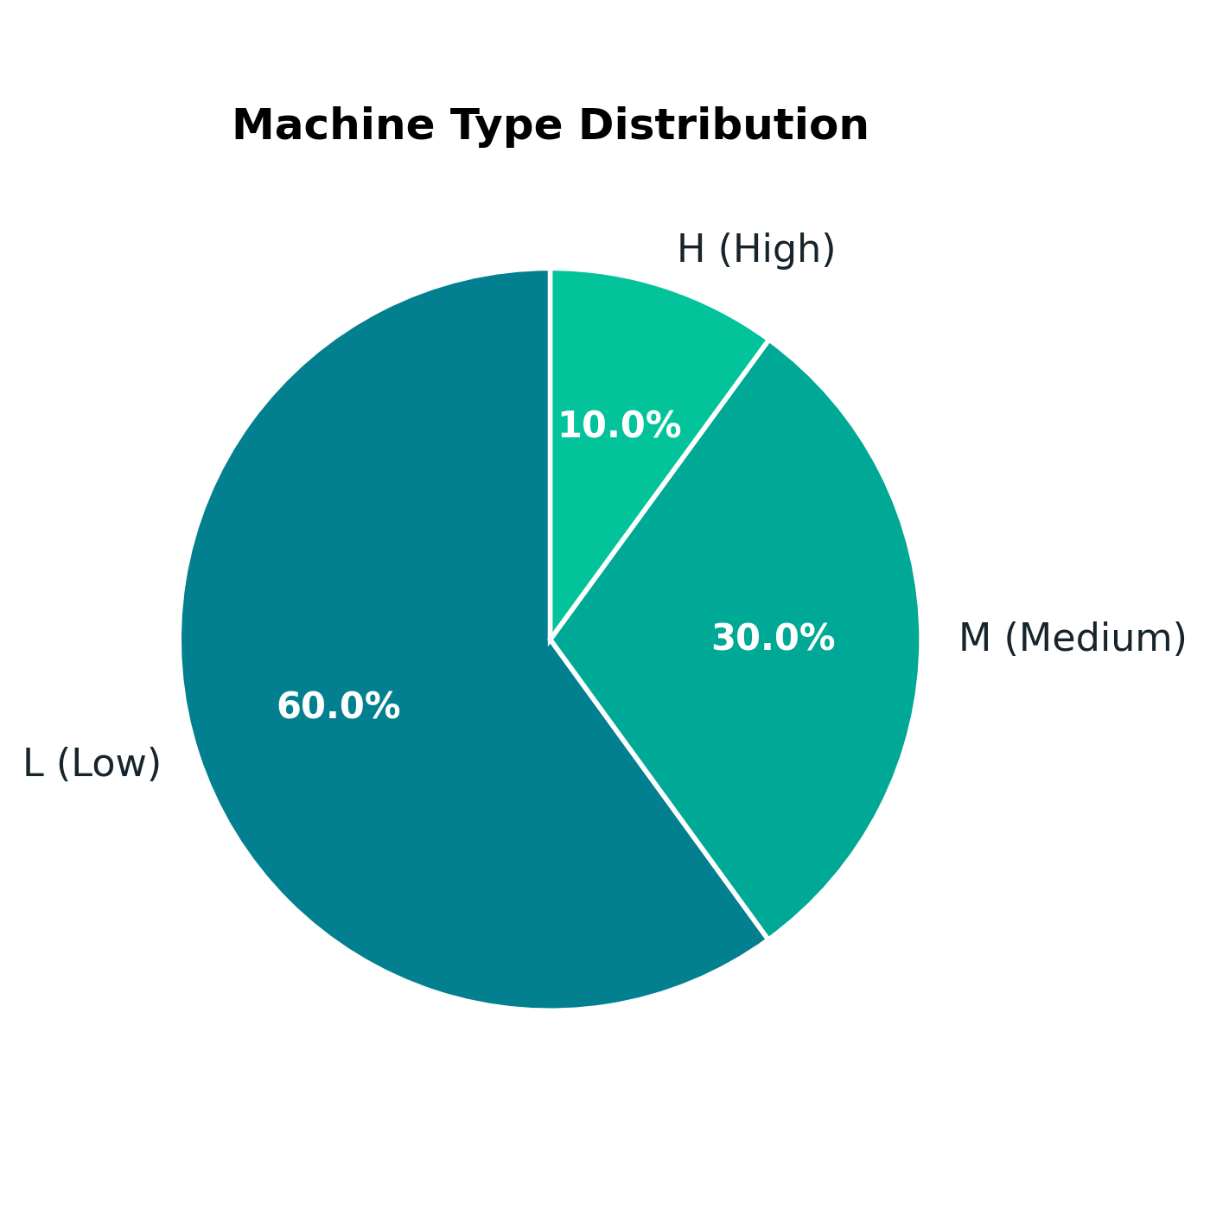
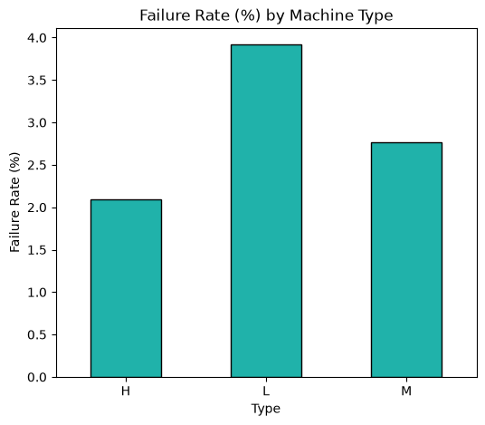
FINDING 02 — BIVARIATE ANALYSIS
Quality Grade Predicts Failure Risk
L: 3.92%
M: 2.77%
H: 2.09%
Low-quality machines fail nearly 2× as often as high-quality ones.
Insight #2 — component/build quality is a meaningful reliability factor.
10

Slide 11
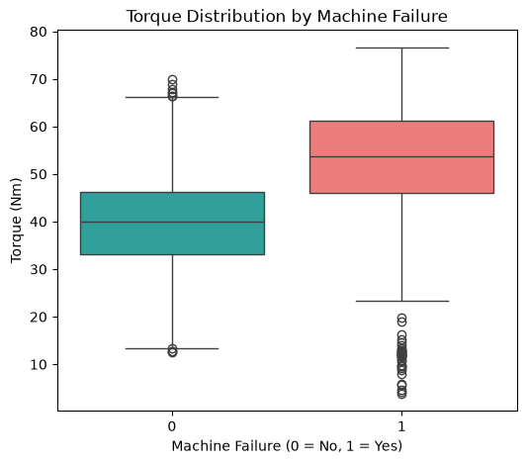
FINDING 03 — BIVARIATE ANALYSIS
Higher Torque, Higher Failure Risk
Failed machines show visibly higher torque
Machines that failed carry noticeably higher torque loads than those that didn't. Excess torque places greater mechanical stress on components, raising failure likelihood — consistent with the dataset's Overstrain Failure (OSF) category.
Insight #3
11

Slide 12
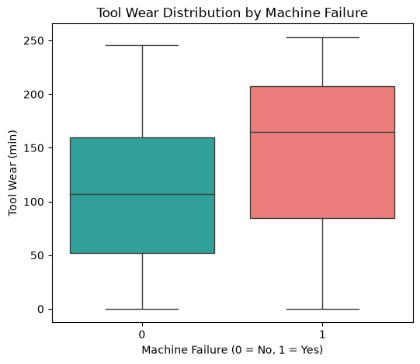
FINDING 04 — BIVARIATE ANALYSIS
Worn Tools Fail More Often
Failed machines show higher tool wear
As cutting tools wear down, friction, heat, and mechanical stress increase — raising the likelihood of failure. This pattern directly supports the dataset's Tool Wear Failure (TWF) category.
Insight #4
12

Slide 13
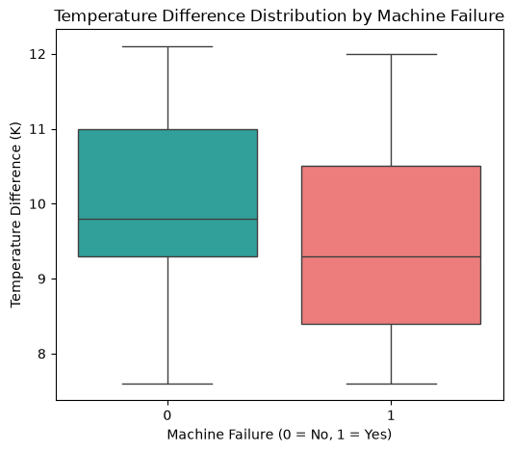
FINDING 05 — BIVARIATE ANALYSIS
Poor Heat Dissipation Signals Failure
Failed machines show a smaller temperature gap
Machines that failed show a smaller Temp_Diff_K — meaning process temperature stays too close to air temperature. This confirms poor heat dissipation is linked to failure, validating the engineered feature.
Insight #5 — an engineered feature that proved genuinely predictive
13

Slide 14
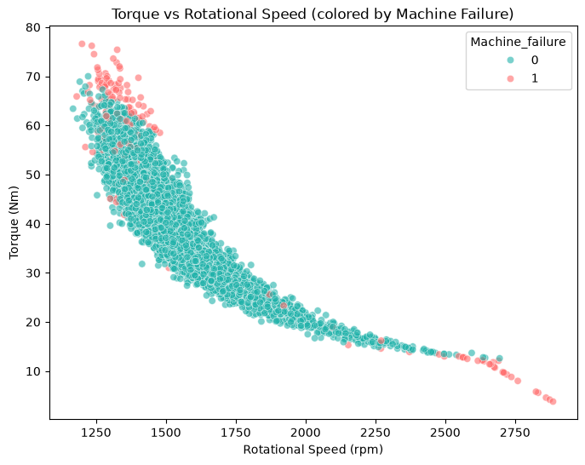
FINDING 06 — BIVARIATE ANALYSIS
Failures Cluster Around Two Operating Zones
Zone A
High torque + low-to-moderate speed → Overstrain Failure risk
Zone B
High speed + low torque → Power Failure risk
Failure isn't driven by one variable — it's specific combinations of torque and speed. This is exactly what our Power_W feature (Torque × Speed) was built to capture.
Insight #6
14

Slide 15
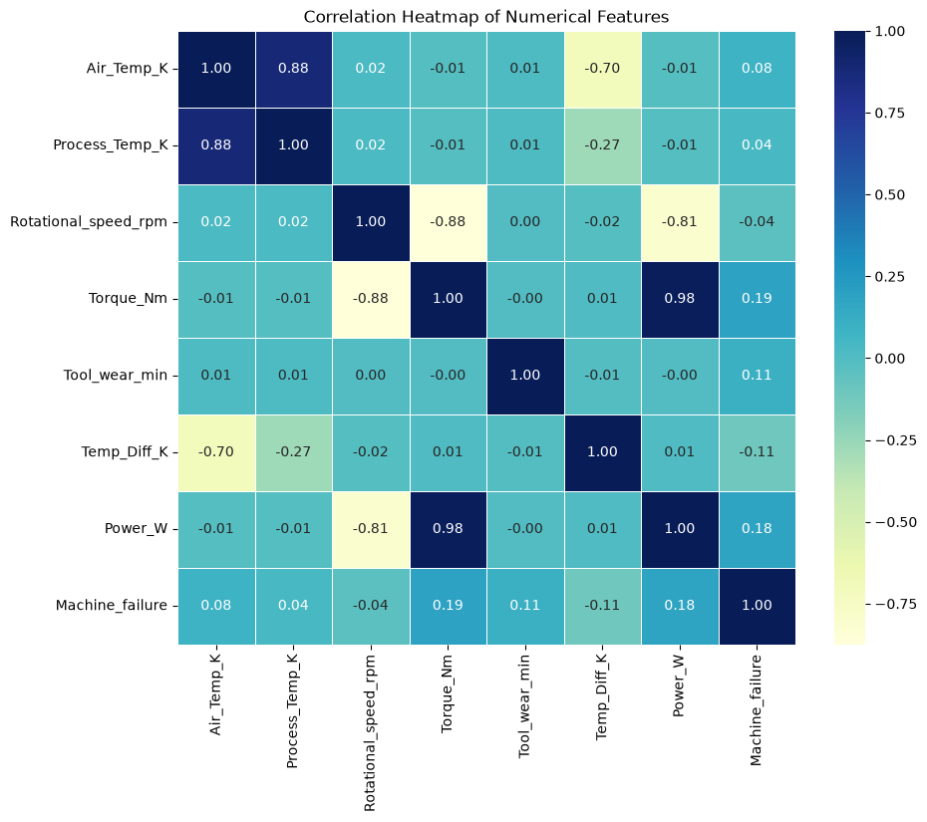
FINDING 07 — MULTIVARIATE ANALYSIS
What Correlates Most With Failure?
STRONGEST LINKS TO FAILURE
Torque_Nm
0.19
Power_W
0.18
Tool_wear_min
0.11
Temp_Diff_K
-0.11
No single variable dominates — failure emerges from a combination of conditions, not one factor alone.
15

Slide 16
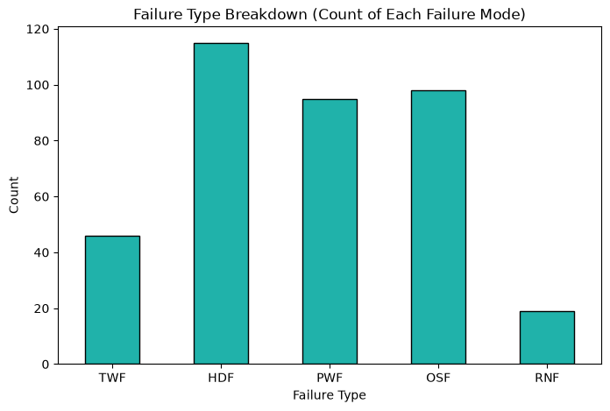
FINDING 08 — UNIVARIATE ANALYSIS
Heat Dissipation: The #1 Failure Mode
HDF
Heat Dissipation
115
OSF
Overstrain
98
PWF
Power
95
TWF
Tool Wear
46
RNF
Random
19
16

Slide 17
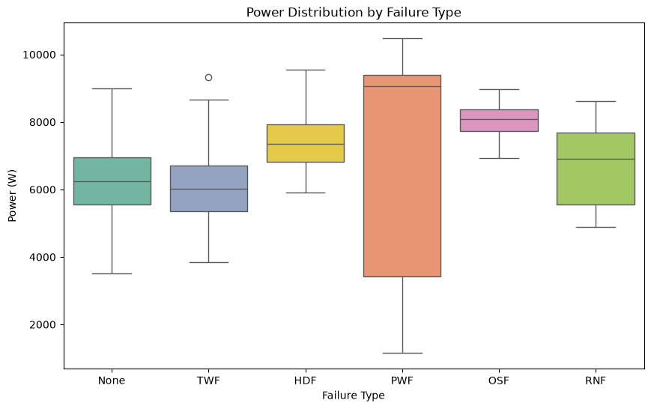
FINDING 09 — MULTIVARIATE ANALYSIS
Power Failure Spans Both Extremes
WHY THIS MATTERS
Power Failure (PWF) shows the widest spread in power output — occurring at both extremes: too little power to operate, or too much straining the machine.
Other failure modes (HDF, OSF) stay closer to normal power ranges — confirming they're driven by their own specific root causes, not power extremes.
17

Slide 18
SUMMARY
Five Key Insights
01
02
03
Class imbalance
Quality grade matters
Torque & power lead
Only 3.39% of machines failed — rare, high-impact events typical of real industrial data.
Type L machines fail nearly 2× as often as Type H — build quality drives reliability.
Torque_Nm and Power_W show the strongest individual correlation with failure.
04
05
Heat dissipation is #1
Failure is combinatorial
HDF is the most frequent failure mode — validated by our Temp_Diff_K feature.
Two distinct torque-speed zones drive failure — not any single variable alone.
18

Slide 19
SO WHAT?
Recommendations for a Manufacturing Plant
1
Prioritize heat dissipation monitoring
HDF is the leading failure mode — regular checks on cooling systems would have the biggest impact.
2
Set torque & power alert thresholds
These showed the strongest correlation with failure — early warning systems could flag risk before breakdown.
3
Apply quality-specific maintenance schedules
Type L machines warrant more frequent inspection, given their higher failure rate.
4
Build a predictive model as a next step
A classifier (e.g. Random Forest) using these engineered features could move maintenance from reactive to predictive.
19

Slide 20
CONCLUSION
Domain Knowledge + Data
Make the Strongest Case
Machine failure isn't driven by any single sensor reading — it emerges from combinations of torque, power, heat dissipation, and build quality. By engineering features grounded in real mechanical engineering principles, this project shows how domain knowledge can meaningfully strengthen a data analytics workflow.
Thank you
Vyshakh | Predictive Maintenance Analysis | Data Analytics Final Project

