Slide 1
AUTOMATED HIERARCHICAL MANAGEMENT SYSTEM

Slide 2
Contents
Objectives
Introduction
Background Study and Proposed System
Design and Implementation
Snap Shots
Advantages and Limitations
Applications

Slide 3
Objectives
To check disinclination of employees in an organization.
Improved efficiency in management of organization.
User-System interaction with greater transparency.
Ensuring appropriate services for the user.

Slide 4
Introduction
This project aims at providing an automated management system for any hierarchical organization.
Service Oriented Architecture (SOA).
This system uses 3-tier architecture.

Slide 5
Background Study
Work done manually, mostly in paper.
Large Volumes of Paper led to overhead of space .
Manual work increased consumption of time.
Co-ordination of large support staff was a very tedious task.

Slide 6
Proposed System
Implementation of Centralized Information System made tasks more transparent and easily accessible.
Reduces Time Overhead.
Reduces Space Overhead.
Collaborative Environment making complex decision making easier.

Slide 7
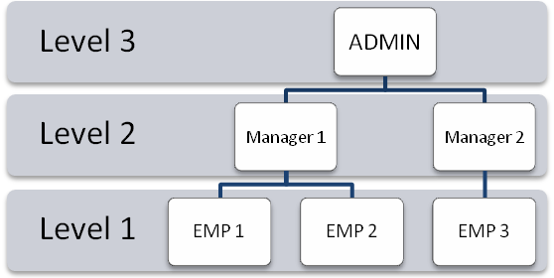
Design
Overview: The aim is to provide User-System interaction in transparent manner ensuring appropriate services to the user.
Service Classifier
user

Slide 8
ACTIVITY FLOW
Home
Home
Login
Services
About US
Contact
Valid?
No
Login Error
Yes
Internal
External
C
Student
My Home
Employees
My Home
A
B
Notes:
Yes

Slide 9
Students
A
My Home
My History
Services
Help
Logout
My Mail
Documentation
Leave Management System
Miscellaneous Requests
Bonafide
No-Dues
Study-Certificate
MySQL

Slide 10
Employees
B
My Home
My History
Services
My
Job Queue
My Mail
Logout
Help
Leave Management System
Miscellaneous Requests
MySQL

Slide 11
External Services
C
Collaborations
Internship
Employment
MySQL

Slide 12
Study-Certificate Issuer
Employees
Login
Valid?
No
Login Error
Yes
Details
Issue
MySQL
Notes:
No

Slide 13
No-Dues
Issuer
Employees
Login
Valid?
No
Login Error
Yes
Update No-Dues
Pay No-Dues
MySQL

Slide 14
Bonafide Certificate
Issuer
Employees
Login
Valid?
No
Login Error
Yes
Details
Issue
MySQL

Slide 15
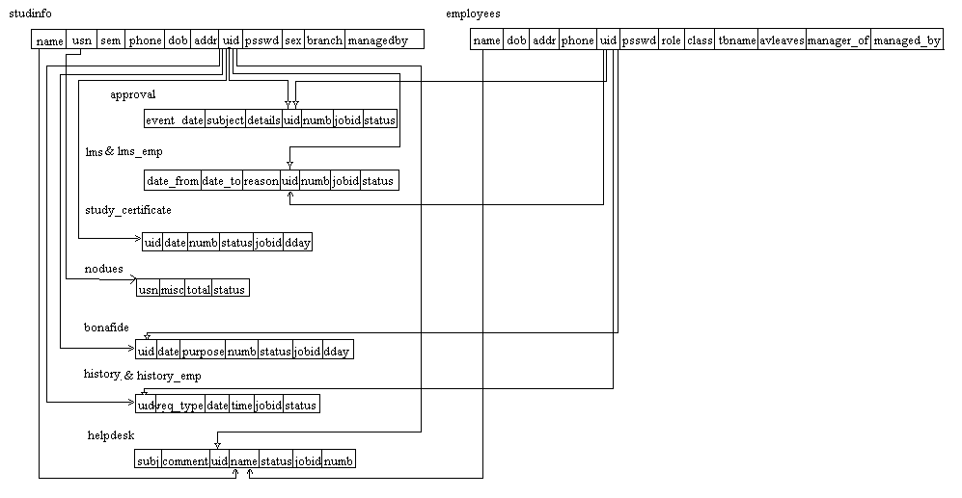
Schema Diagram

Slide 16
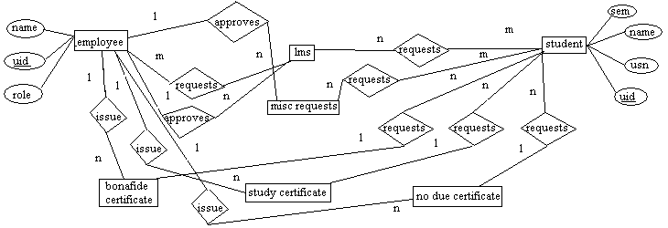
ER Diagram

Slide 17
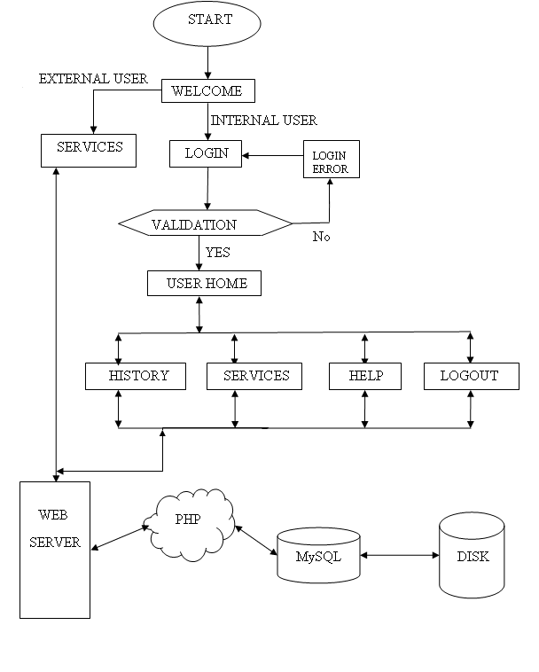
Implementation
Start represents the start of the browser.
Welcome is the entry to the AHMS service page.
The Welcome page is subdivided into set of services for Internal and External members or users.
The External users are those who are not part of the Organization.
The registered users of the Organization are provided with user name and password.
The validation for user name and password is made for the user.
The Home page is displayed according to the logged-in user with his/her set of services.
The user can request any services available to him.
The users request will be served accordingly, depending on the time allocated for the service.
A history is maintained about all the activities of the system, which helps in monitoring the progress of the actors.
All the information is stored in the disk in the form of a database which is accessed using a PHP script embedded in an HTML page.
The session ends when the user logs out.

Slide 18
Implemented Using
PHP (Hypertext Preprocessor)
PHP is a scripting language
PHP is a server-side, cross-platform technology.
Syntax is similar to C , C++, Perl and uses OOP concepts.

Slide 19
Some of the PHP functions used :
session_start( ) — Initializes session data.
session_destroy( ) — Destroys all data registered to a session.
date( ) — Format a local time/date.
isset( ) — Determine whether a variable is set.
mysql_connect( ) — Connects to mysql server.
mysql_db_query( ) — Executes a Query.
mysql_fetch_row( ) — Fetch a row as an enumerated array.
die( ) — Equivalent to exit( ).

Slide 20
MySQL
MySQL is a database management system.
Its an Open Source Standard Query Language(SQL).
Fast and Reliable .
Easy to Use and Secure.
Its Platform Independent.

Slide 21
Some of the MySQL commands used :
create database - Creates a Database.
use – Connecting to a Database.
select- Selects records from the database.
delete- Deletes records from the database.
update- updates records from the database.
grant- grants various permissions to the database.
insert- inserts records from the database.

Slide 22
HTML
HTML is a language for describing web pages.
HTML stands for Hyper Text Markup Language.
HTML is not a programming language, it is a markup language.
A markup language is a set of markup tags.
HTML uses markup tags to describe web pages.

Slide 23
Some of the HTML tags used :
<script> - used for declaring a script (such as JavaScript) within HTML document.
<form> - used in conjunction with form-associated elements.
<textarea> - allows the user to input text over multiple rows.
<option> - used for defining option items within the select list.
<font> - used to specify the font size to use.

Slide 24
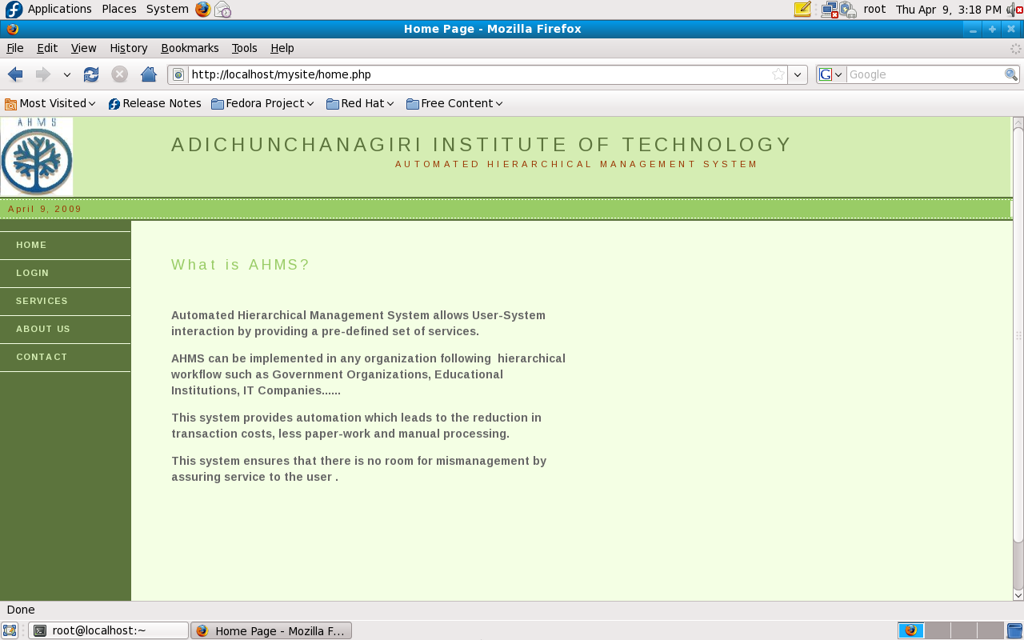
Snapshots

Slide 25
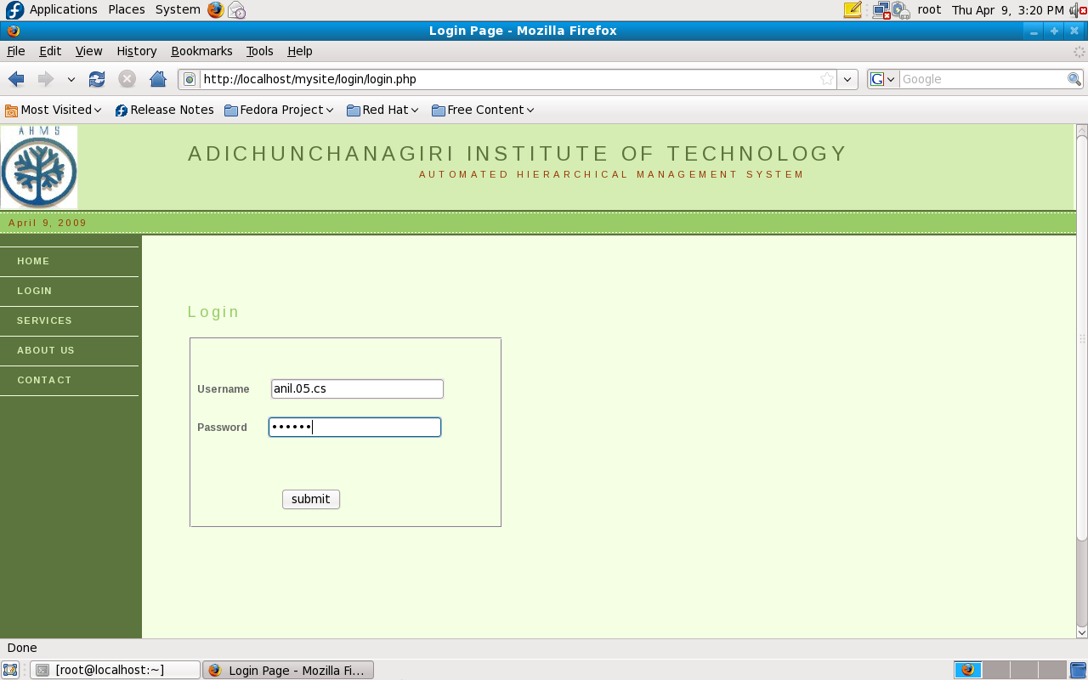

Slide 26
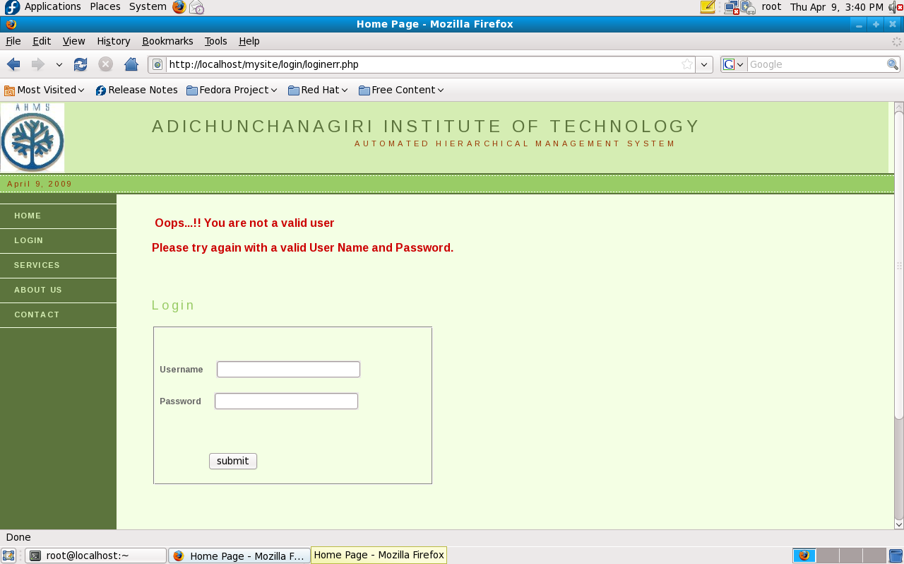

Slide 27
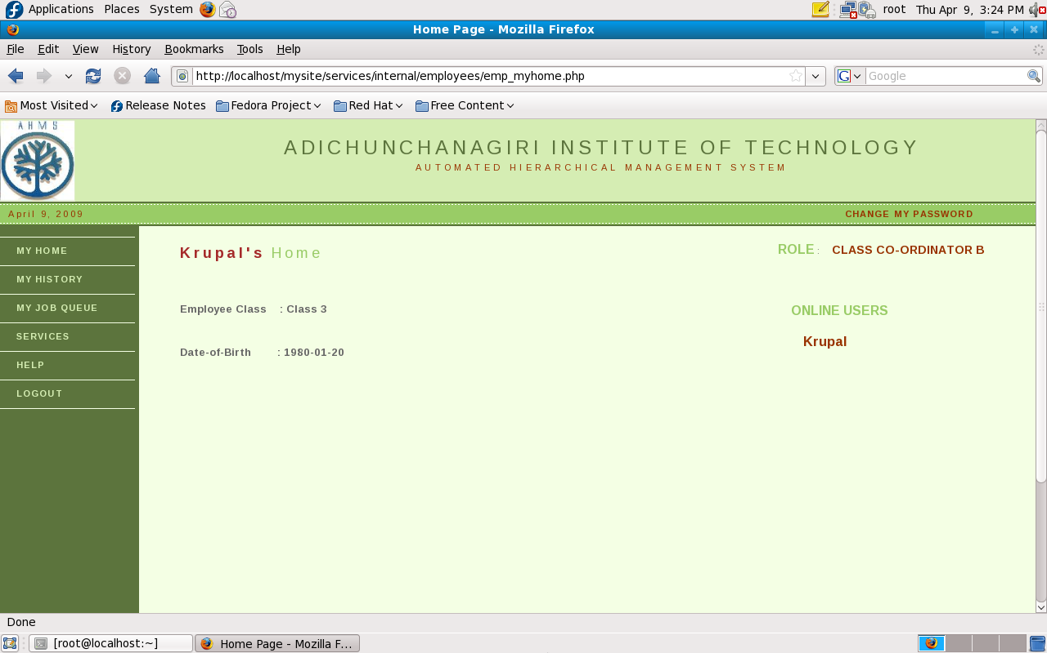

Slide 28
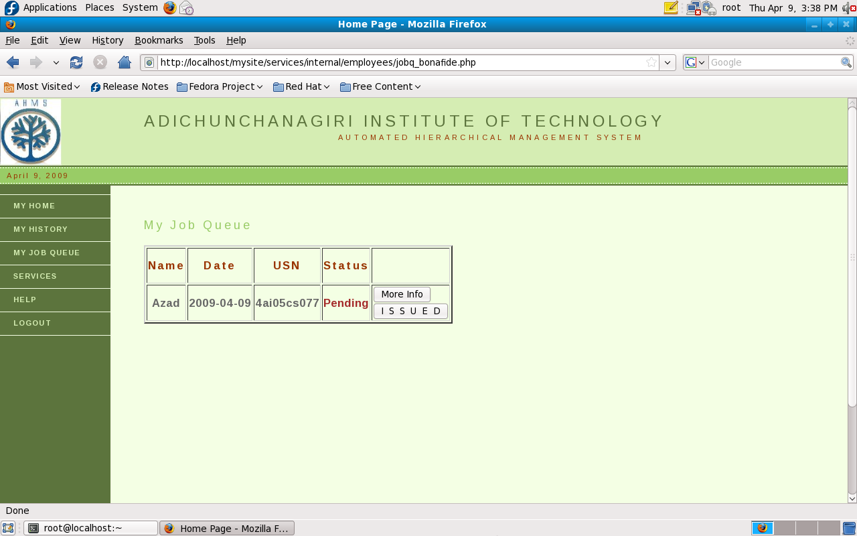

Slide 29
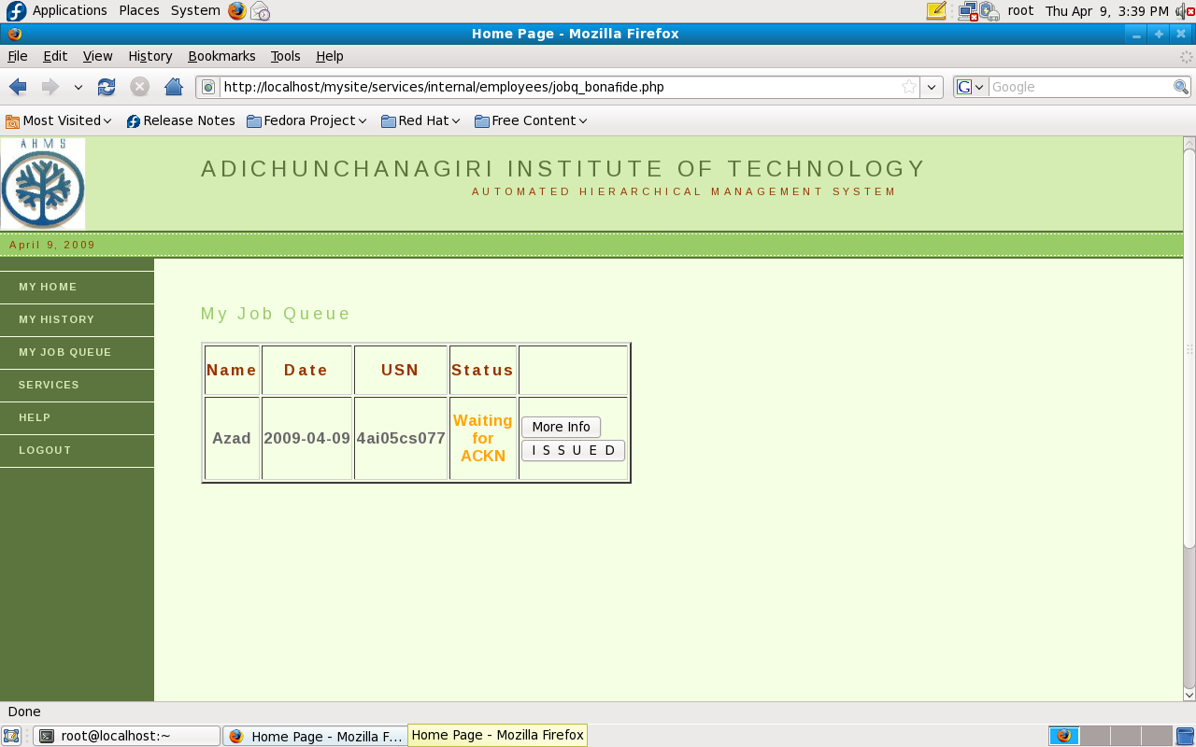

Slide 30


Slide 31
ADVANTAGES
Reduction in transaction costs.
Automation, which leads to reduction in manual processing.
Paperless work.
Guaranteed service to the user.
No room for mismanagement.
Implementation of a friendly user interface.

Slide 32
Disadvantages
The main disadvantage is when every employee in the Organization is disinclined. Our proposal considers at least one employee in the whole hierarchy to be inclined towards his work.
Issues of a centralized systems

Slide 33
Application
Can be implemented in any organization following hierarchical workflow.
In Educational Institutions, a common service point is provided where all kinds of services can be obtained.
In Banks, all the Transaction Processes can be automated which leads to very less response time thereby increasing the number of transaction per unit time.
In Government Organizations, wherein disinclination of employees can be checked up to a certain extent.
In IT Sectors, uses of this system will add-on to the efficiency and better productivity because of the guaranteed results by the employees.

Slide 34
A Presentation by
Gagan.M , Gagan.B.S and Vyshakh.A.S
Guided by:
Mr.Vivekananda

