Slide 1

PROJECT REVIEW
RETAIL
SALES
FORECASTING
An Explainable and Time-Aware Comparative Framework for Retail Sales Forecasting Using Machine Learning Regression Models
PROJECT REVIEW – 2
Under the Guidance of
Dr. K. Swapnika
Assistant Professor
Department of Computer Science and Engineering
Submitted by: Batch 19
2420080038 – B. Vyshnavi
DATA ANALYTICS
& VISUALIZATION

Slide 2
Project Overview
What the proposed framework does
Project idea
Expected system output
Use historical retail sales data to train and compare regression models, evaluate their predictions over later time periods, and explain the factors influencing model outputs.
A working dashboard for dataset selection, sales exploration, model comparison, held-out predictions, baseline forecast outputs and explainability views.
Core contribution
A unified comparative workflow across three retail datasets, combining time-ordered evaluation with SHAP and LIME interpretation.
DATA ANALYTICS & VISUALIZATION | RETAIL SALES FORECASTING
2

Slide 3
Problem Statement & Objectives
Why retail sales forecasting matters
Problem statement
Project objectives
Retail businesses need reliable estimates of sales to support inventory, staffing and operational planning. Sales patterns vary across stores, departments, products, promotions and calendar periods. A single model may not perform equally well across different retail datasets, and predictions can be difficult to interpret without explanation tools.
1. Prepare and analyze Rossmann, Walmart and Superstore datasets.
2. Engineer useful date and business-related features.
3. Train and compare multiple regression algorithms.
4. Evaluate using MAE, RMSE and R² with time-ordered splitting.
5. Provide SHAP/LIME explanations and an interactive dashboard.
DATA ANALYTICS & VISUALIZATION | RETAIL SALES FORECASTING
3

Slide 4
Datasets Used
Three retail datasets with different sales granularities
Rossmann Store Sales
Walmart Sales
Superstore Sales
Daily store-level sales with fields such as Date, Store, Sales, Customers, Promo, holidays and weekday.
Weekly department/store sales with holiday indicators; supplementary features include store type, size and economic/markdown variables.
Order-level retail data with order dates, sales, products, categories, regions, discounts and profit.
Note: the datasets have different time granularities and feature definitions; metrics should be interpreted within each dataset.
DATA ANALYTICS & VISUALIZATION | RETAIL SALES FORECASTING
4

Slide 5
Proposed Methodology
End-to-end processing pipeline
1
Retail datasets
2
Preprocessing
3
Feature engineering
4
Model training
5
Evaluation
6
Explainability
7
Dashboard
›
›
›
›
›
›
Rossmann • Walmart • Superstore
Clean records, parse dates, handle missing values
Calendar and available business features
Five regression algorithms
Time-ordered 80/20 split; MAE, RMSE, R²
SHAP global and LIME local explanations
Interactive analysis and prediction views
Project workflow
Dataset → Preprocessing → Feature Engineering → Regression → Evaluation → Explainability → Forecasting Dashboard
DATA ANALYTICS & VISUALIZATION | RETAIL SALES FORECASTING
5

Slide 6
Dataset Preparation & Feature Engineering
Preparing consistent model inputs
• Load the source CSV files and inspect their columns and data types.
• Parse date columns and sort records chronologically where available.
• Remove duplicate records and handle missing target values.
• Convert categorical fields to numeric representations for model training.
• Create calendar attributes such as year, month, day, weekday, quarter and week number.
• Prepare numeric feature matrices and target sales values.
Target variables
Rossmann: Sales
Walmart: Weekly_Sales
Superstore: Sales
Important data note
Walmart includes substantial missing values in some supplementary markdown/economic features. Preprocessing must be checked for each dataset.
DATA ANALYTICS & VISUALIZATION | RETAIL SALES FORECASTING
6

Slide 7
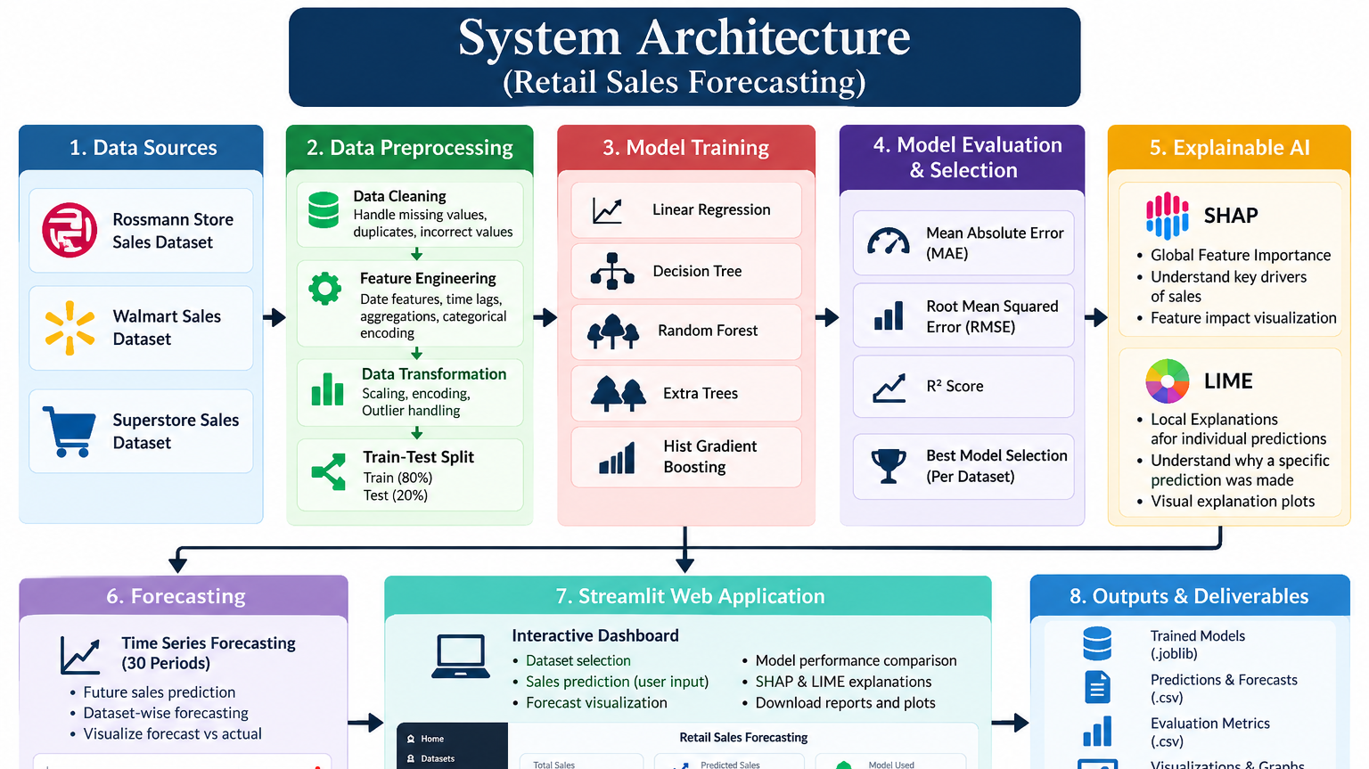

Slide 8
Regression Models Compared
A common evaluation workflow for five algorithms
Linear Regression
Baseline linear model
Decision Tree
Nonlinear rule-based regression
Random Forest
Ensemble of decision trees
Extra Trees
Randomized tree ensemble
Hist Gradient Boosting
Boosting-based regression
Model selection in the current run is performed separately for each dataset using the lowest test RMSE.
DATA ANALYTICS & VISUALIZATION | RETAIL SALES FORECASTING
8

Slide 9
Evaluation Strategy
Time-ordered hold-out validation
MAE
RMSE
R²
Mean Absolute Error
Average magnitude of prediction errors. Lower is better.
Root Mean Squared Error
Penalizes larger errors more strongly. Lower is better.
Coefficient of determination
Measures variance explained by the model. Higher is generally better.
Validation design
Records are sorted by date where available. The first 80% are used for training and the later 20% are held out for testing. This is more appropriate for forecasting than a random split, but further rolling-origin validation is recommended.
DATA ANALYTICS & VISUALIZATION | RETAIL SALES FORECASTING
9

Slide 10
Experimental Results
Best model from the current execution
Dataset | Best model | MAE | RMSE | R²
Rossmann | Hist Gradient Boosting | 957.95 | 1,323.53 | 0.8599
Walmart | Random Forest | 2,862.00 | 5,373.69 | 0.9440
Superstore | Extra Trees | 94.69 | 194.44 | 0.7599
Interpretation: Walmart achieved the highest R² in this run, while Superstore's error values are on a different sales scale. Error magnitudes should not be compared directly across datasets.
DATA ANALYTICS & VISUALIZATION | RETAIL SALES FORECASTING
10

Slide 11
Best-Model Performance Across Datasets
R² values from the reported execution
These are dataset-specific test results from the current run, not a direct cross-dataset benchmark.
DATA ANALYTICS & VISUALIZATION | RETAIL SALES FORECASTING
11

Slide 12
Time-Aware Forecasting
Historical ordering and forecast outputs
Implemented
Generated outputs
Date parsing and chronological sorting where dates are available; ordered 80/20 train-test split; actual-versus-predicted test output.
A baseline 30-period forecast CSV for each successfully processed dataset, using recent feature profiles with updated calendar attributes.
Important limitation
The current 30-period output is a baseline scenario, not a validated recursive multi-step time-series model. Forecast accuracy over future periods has not been established. A stronger version should use lag features and rolling-origin backtesting.
DATA ANALYTICS & VISUALIZATION | RETAIL SALES FORECASTING
12

Slide 13
Explainable AI: SHAP & LIME
Understanding global and individual model behaviour
SHAP – Global explanation
LIME – Local explanation
SHAP assigns contribution values to features and can summarize which inputs influence predictions across a sample of records.
Example features to inspect: promotions, customers, store/department and calendar attributes.
LIME explains one selected prediction by fitting an interpretable approximation around that input record.
It helps answer: which input values pushed this prediction higher or lower?
The dashboard includes SHAP and LIME views. Explanation quality measures such as fidelity, infidelity and stability have not been calculated in the current experiment.
DATA ANALYTICS & VISUALIZATION | RETAIL SALES FORECASTING
13

Slide 14
Interactive Streamlit Dashboard
Frontend features in the current prototype
Dataset selector
Sales overview
Choose Rossmann, Walmart or Superstore
Record counts, sales summaries and trends
Model comparison
Prediction view
MAE, RMSE and R² tables and charts
Actual versus predicted test records
Explainability
Dataset details
SHAP feature importance and LIME local explanation
Preview rows and missing-value summaries
DATA ANALYTICS & VISUALIZATION | RETAIL SALES FORECASTING
14

Slide 15
Tools & Technologies
Implementation stack
Python
Pandas / NumPy
Core programming language
Data preparation and numerical operations
Scikit-learn
Matplotlib / Plotly
Regression models and evaluation metrics
Static and interactive visualizations
SHAP / LIME
Streamlit
Model explanation
Interactive web dashboard
Joblib
Saving trained model artifacts
DATA ANALYTICS & VISUALIZATION | RETAIL SALES FORECASTING
15

Slide 16
Project Outputs & Artifacts
Files generated by the execution pipeline
models/
results/
figures/ & reports/
Best model joblib files for Rossmann, Walmart and Superstore.
Model comparison CSVs, held-out test predictions, 30-period baseline forecast CSVs and combined metrics.
Model comparison, actual-versus-predicted and forecast plots; Markdown report and PowerPoint draft.
The execution report is generated from the experiment outputs and should be reviewed before academic submission.
DATA ANALYTICS & VISUALIZATION | RETAIL SALES FORECASTING
16

Slide 17
Limitations & Future Improvements
What should be strengthened before final submission
• Use dataset-specific preprocessing and encoding pipelines; the current prototype uses simplified numeric encoding.
• Audit possible leakage and ensure all features are available at the time a forecast is made.
• Use rolling-origin or expanding-window validation and compare against seasonal-naive baselines.
• Build proper lag and rolling-window features and validate true multi-step future forecasts.
• Calculate and report SHAP/LIME explanation quality and stability only after implementing the corresponding tests.
• Extend the dashboard so saved forecast outputs are displayed as future forecasts, not only test-record predictions.
DATA ANALYTICS & VISUALIZATION | RETAIL SALES FORECASTING
17

Slide 18
Conclusion
Summary of the current project implementation
What has been achieved
A working Streamlit prototype, three successfully processed retail datasets, five regression models per dataset, model evaluation, saved model artifacts, test predictions, baseline forecast files and SHAP/LIME dashboard views.
Project contribution
The project brings together comparative regression analysis, time-aware evaluation and explainable AI in one retail sales analytics workflow.
The current results are preliminary and should be strengthened through additional validation before drawing final research conclusions.
DATA ANALYTICS & VISUALIZATION | RETAIL SALES FORECASTING
18

Slide 19
THANK YOU
Questions & Discussion
An Explainable and Time-Aware Comparative Framework for Retail Sales Forecasting
KL Deemed to be University | Data Analytics & Visualization

