Slide 1


Slide 2
THE PROBLEM
Financial data is fragmented across multiple tools.
Risk, correlations and strategy performance are difficult to analyze together.
Researchers need one unified quantitative platform.

Slide 3

Proposed Solution
QUANT-X unifies multi-asset analysis, risk measurement and backtesting.
Adaptive Market Regime Radar
Strategy X-Ray , Strategy Stress Lab
Portfolio What-If
Historical “What If?” Replay

Slide 4

Quantitative Analysis
SMA , EMA , Returns , Volatility , Sharpe , Drawdown
Correlation and rolling analysis reveal asset relationships.
Interactive charts turn data into clear insights.

Slide 5
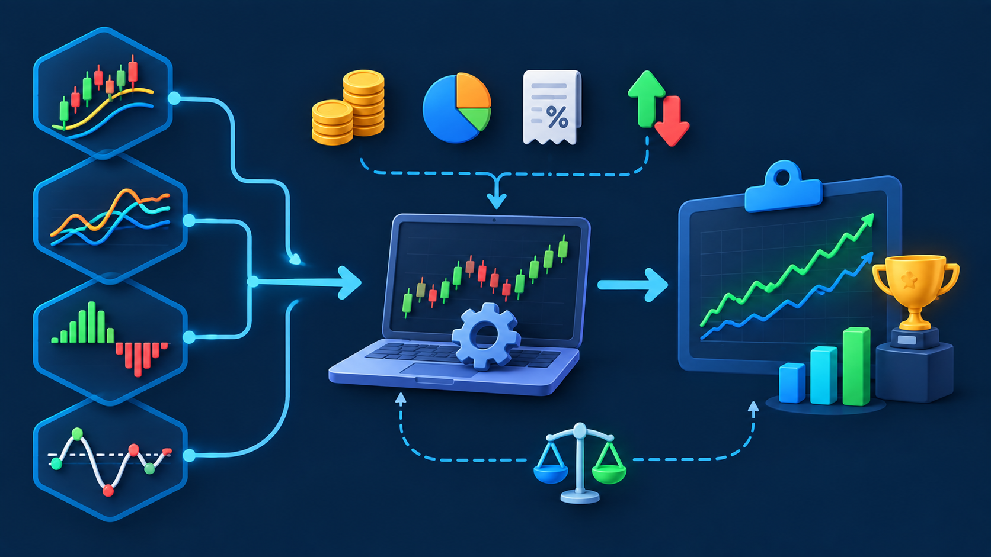
BackTesting
SMA Crossover
EMA Trend
Momentum
Mean Reversion
Simulate capital, position sizing, transaction costs and trades.
Compare strategies against Buy & Hold.

Slide 6

Intelligence Layer
Market Radar ,Strategy X-Ray ,Stress Lab
Relationship Radar
Portfolio What-If
Historical Replay
Understand strategy behaviour across changing market conditions.
6

Slide 7
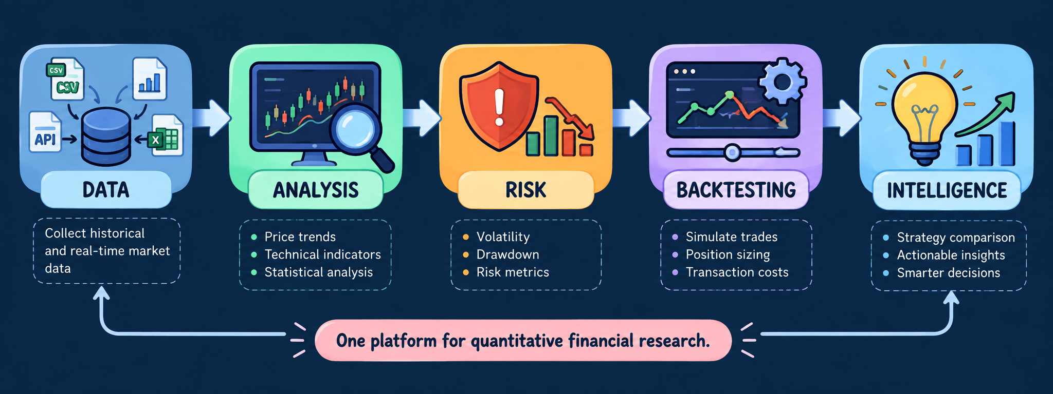
QUANT-X IMPACT

