Slide 1
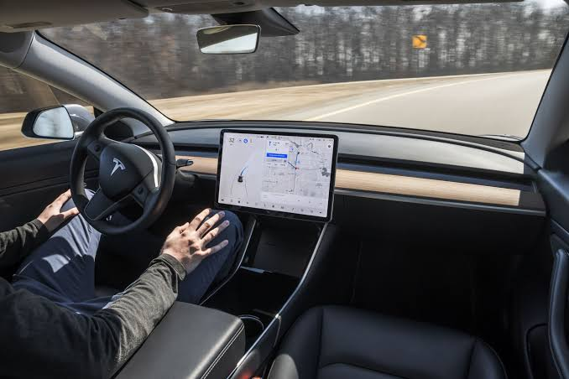
Tesla: Real-time Vehicle Data Analysis Case Study
By: Mythili S N

Slide 2
Executive Summary
Tesla revolutionized automotive data collection and analysis using Industrial Internet of Things (IIoT) technology.
By using sensors and internet-connected systems, Tesla can monitor its cars remotely, fix problems through software updates, and improve performance over time—all without the customer needing to visit a service center.
Creates a continuously improving product and service ecosystem, delivering significant competitive advantages.

Slide 3
Tesla’s Data Ecosystem
Each vehicle is part of a comprehensive IIoT ecosystem, connected to Tesla’s cloud.
Continuous data collection from ~100 microcontrollers and hundreds of sensors per vehicle.
Real-time analysis for actionable insights on performance, health, and driving patterns.
Data helps Tesla understand how cars are performing and how people are using them. The best part is that this data is shared across all cars, so if one car learns something, all cars benefit."

Slide 4
Data Collection Architecture
"Tesla cars have lots of sensors—like cameras and radars—to understand their surroundings.
They also have powerful computers inside to process this information quickly.
Only the most important data is sent to the cloud, saving bandwidth.
Tesla also uses this data to improve the software and send updates to the car."

Slide 5
Technical Requirements
Hardware: 8–12 cameras, 5–12 ultrasonic sensors, radar, GPS, custom AI chips, high-capacity storage.
Tesla needs special hardware and software to make this work.
Each car has multiple cameras and sensors, custom chips for AI, and high-speed internet like 5G or WiFi.
On the back end, Tesla uses big data centers with powerful computers to store and analyze all the information.

Slide 6
Data and Network Requirements
Data Volume: 1–2 TB per vehicle annually; >10 exabytes fleet-wide.
Selective Transmission: Only 10–15% of data sent to servers, prioritized for value.
Each Tesla creates a lot of data—around 1 to 2 terabytes per year.
But instead of sending all of it, Tesla picks and chooses the most useful parts.
The data travels through different networks, depending on where the car is. For example, cities may use 5G, but rural areas might need satellite.

Slide 7
Edge, Fog, and Cloud Computing
This system works in three layers:
The Edge is inside the car, making fast decisions.
The Fog is in between, managing data in local areas.
The Cloud is Tesla’s main system where large-scale analysis and learning happen.

Slide 8
Challenges and Solutions
Handling this much data is not easy.
Tesla solved it with smart design—like only sending important data, compressing it, and having backup systems.
They also make sure data is secure and follow privacy rules for different countries.

Slide 9
Results and Impact
Benefits: Improved vehicle performance, reduced service costs, enhanced customer satisfaction.
And it’s better for the environment too because cars use energy more efficiently.
Environmental: Efficiency gains and sustainability through optimized operations.

Slide 10
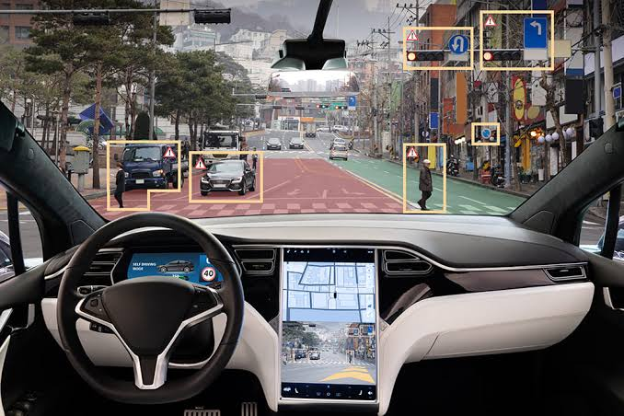
Future Developments
In the future, Tesla plans to make their cars even smarter—by using better computers, collecting more types of data, and working with other transportation systems. They are also helping shape the future of smart vehicles across the industry.

Slide 11
THANK YOU

