Slide 1


Travelling Salesman Problem
A Classic Optimization Problem

Slide 2
Introduction
A classic optimization problem in graph theory & computer science.
Objective: find the shortest possible route that visits each city exactly once and returns to the starting city.
Known as an NP-hard problem – easy to state but extremely challenging to solve efficiently for large inputs.
Important in real-world applications: logistics, routing, scheduling, chip design, and bioinformatics.

Slide 3
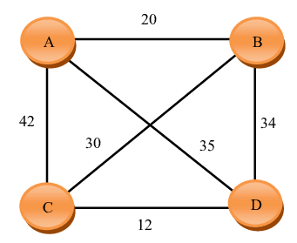
Problem Statement
Input:
A set of n cities
Pairwise distances or costs between every two cities
Objective:
Find the shortest possible route that visits each city exactly once and returns to the starting city
Key Point:
The problem can be modeled as finding the minimum-cost Hamiltonian cycle in a weighted complete graph
Complexity:
Decision version: NP-Complete
Optimization version: NP-Hard

Slide 4
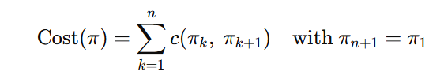
Objective Function
Let c(i, j) be cost from city i to j
Find permutation π of cities minimizing
Output: best tour (order of cities) and its total cost

Slide 5
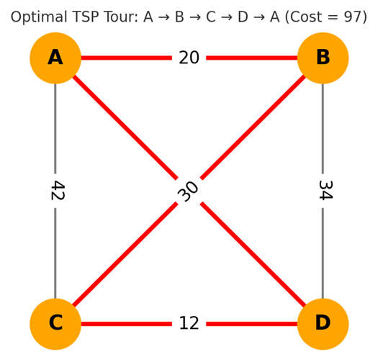
Solved Example
Distance Matrix derived from graph.
All possible tours checked (6 permutations).
Minimum cost found = 97.
Optimal Routes:
A → B → C → D → A
A → D → C → B → A

Slide 6
Solving Approaches
Brute Force
Dynamic Programming
Branch & Bound
Tries all possible tours (n−1)!
Computes cost of each and selects the minimum.
Guarantees optimal solution but impractical for large inputs (exponential time).
Uses overlapping subproblems and stores results in a DP table.
Time Complexity: O(n²·2ⁿ)
Space Complexity: O(n·2ⁿ)
Faster than brute force but still exponential.
Explores partial tours and uses lower bounds to prune bad paths.
Much faster than brute force in practice.
Time: Best case efficient, worst case O(n!)
Space: About O(n^2)
Good for medium-sized problems.

Slide 7
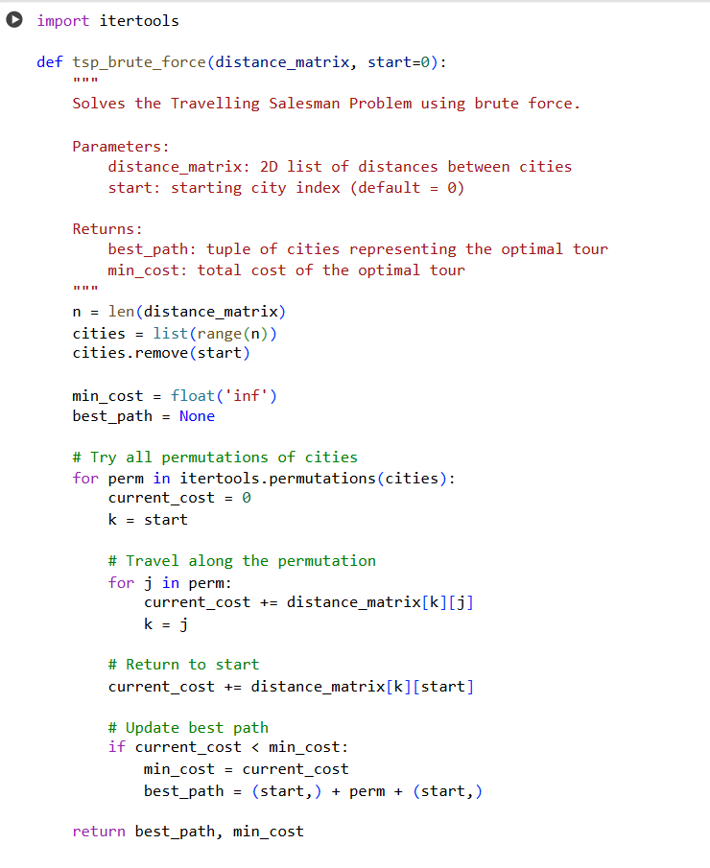
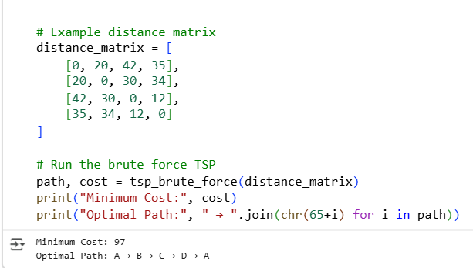
TSP using brute force

Slide 8
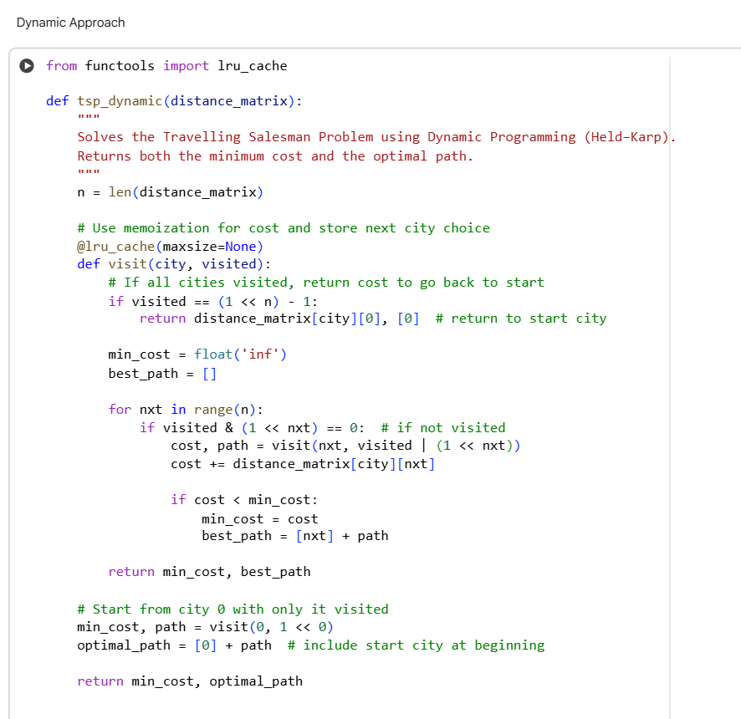
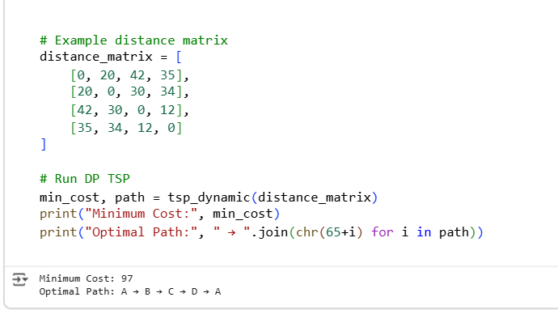
TSP using Dynamic Programming Code

Slide 9
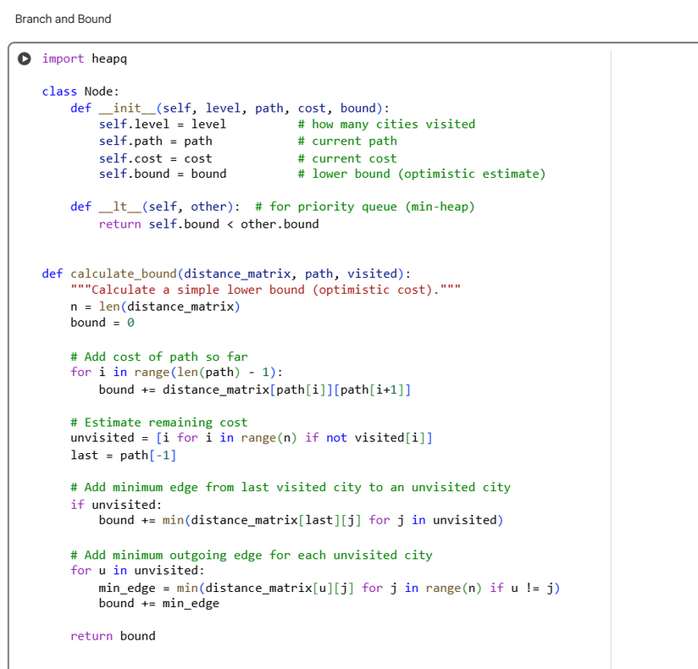
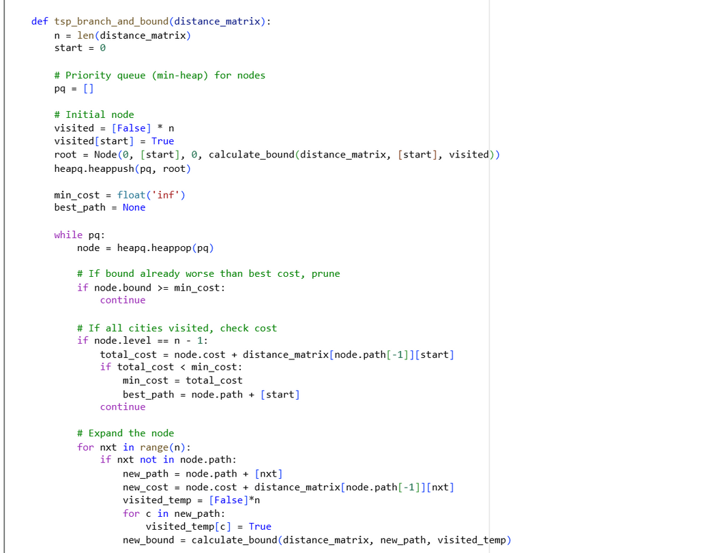
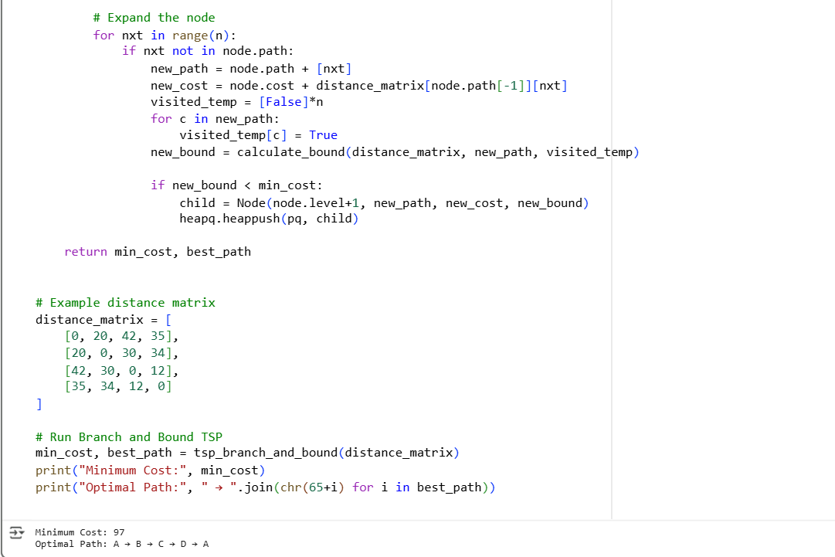
TSP using Branch and Bound

Slide 10
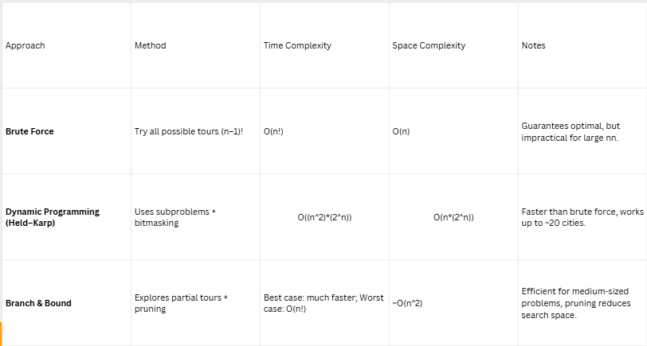
Comparison of TSP Solving Approaches

Slide 11
Applications
Logistics & Delivery Routing
Optimize courier or food delivery routes.
Transportation & Scheduling
Airline, railway, and bus timetable optimization.
Manufacturing & Chip Design
Drill routing on PCBs, reducing tool movement.
Bioinformatics
DNA sequencing and genome assembly.
Telecommunications & Networks
Data packet routing and network optimization.

Slide 12
Limitations & Challenges
Scalability Issue
Exact methods (Brute Force, DP, Branch & Bound) become infeasible for large nnn.
Computational Complexity
TSP is NP-hard, meaning no known polynomial-time algorithm exists.
Approximation Gap
Heuristics/metaheuristics give near-optimal solutions, but no guarantee of true optimality.
Real-World Constraints
Practical problems often add constraints (e.g., time windows, multiple salesmen), making them even harder.
Trade-off
Need to balance speed vs accuracy in real applications.

Slide 13
Conclusion
The Travelling Salesman Problem (TSP) is simple to state but hard to solve.
Belongs to the class of NP-hard problems — no efficient algorithm for large nnn.
Exact methods ensure optimal solutions but don’t scale.
Heuristics & metaheuristics provide near-optimal solutions quickly.
TSP has huge real-world impact in logistics, scheduling, networks, and bioinformatics.

Slide 14


