Slide 1

Hybrid-Enhanced Two-Step Quantum Search (H-TSQS)
(Batch No: CBIT/IT/2025-26/IT1/108)
Under the Guidance of:
Dr. T. Satyanarayana Murthy
Associate Professor, IT, CBIT
Presented By
G.Vyshnavi, 160122737005
J. Sai Teja, 160122737044
N. Shresta, 160122737307
Review-1: Project Part-1, Department of Information Technology

Slide 2
AGENDA
Abstract
Problem Statement
Objectives
Literature Review
Existing Idea
Proposed Methodology
Results
References
Department of Information Technology

Slide 3
PROBLEM STATEMENT
The Traveling Salesman Problem (TSP) is an NP-hard optimization challenge that becomes computationally expensive as the number of cities increases. Classical algorithms lack scalability, while the original Two-Step Quantum Search (TSQS), though offering quadratic speed-up, remains theoretical—limited by fixed parameters, high circuit depth, and lack of adaptability to noise.
To overcome these limitations, the Hybrid-Enhanced TSQS (H-TSQS) framework integrates classical heuristics, adaptive iteration tuning, and noise-aware simulation to achieve a practical, scalable, and executable hybrid quantum solution for real-world optimization problems.
Department of Information Technology

Slide 4
ABSTRACT
The Traveling Salesman Problem (TSP) is a classical NP-hard optimization problem with applications in logistics and network design. Quantum computing offers a potential quadratic speedup using Grover’s algorithm; however, existing quantum approaches like the Two-Step Quantum Search (TSQS) face challenges such as large circuit depth and scalability issues. In this project, we implement an enhanced TSQS algorithm for solving TSP using a hybrid classical–quantum approach. Our improvements include classical preprocessing with nearest neighbor and local optimization to reduce the search space, symmetry reduction to eliminate redundant tours, and a simplified threshold-based oracle to improve solution accuracy. Additionally, we apply iteration tuning and error mitigation techniques to improve performance. Experiments using Qiskit on small-scale TSP instances (n=3 and n=4) demonstrate reduced circuit complexity and higher success probabilities compared to the original TSQS, providing a more practical pathway toward scalable quantum optimization for combinatorial problems.
Department of Information Technology

Slide 5
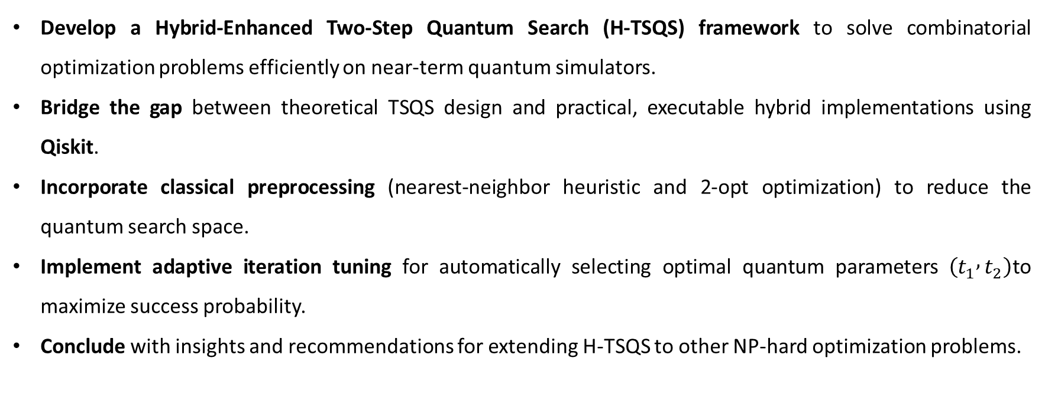
PROJECT OBJECTIVES
Develop a Hybrid-Enhanced Two-Step Quantum Search (H-TSQS) framework to solve combinatorial optimization problems efficiently on near-term quantum simulators.
Bridge the gap between theoretical TSQS design and practical, executable hybrid implementations using Qiskit.
Incorporate classical preprocessing (nearest-neighbor heuristic and 2-opt optimization) to reduce the quantum search space.
Implement adaptive iteration tuning for automatically selecting optimal quantum parameters $\left(t_{1} , t_{2}\right)$to maximize success probability.
Conclude with insights and recommendations for extending H-TSQS to other NP-hard optimization problems.
Department of Information Technology

Slide 6
PROJECT PLAN
Task | Description | Duration | Remarks
Literature Review | Study existing TSQS, Grover-based, and hybrid quantum algorithms. | Week 1–2 | Identify research gaps and hybrid opportunities.
Architecture Design | Design the H-TSQS hybrid workflow integrating classical preprocessing and quantum execution. | Week 3 | Define module structure and execution logic.
Implementation | Develop classical heuristics and quantum circuit synthesis in Qiskit. | Week 4–5 | Build HOBO-based oracles and tour generation.
Adaptive Tuning Module | Implement a data-driven optimizer for iteration parameters (t₁, t₂). | Week 6 | Automate success probability maximization.
Simulation & Testing | Run experiments under ideal and noisy (FakeVigo) modes. | Week 7 | Evaluate efficiency and correctness.
Analysis & Documentation | Compare H-TSQS vs. base TSQS performance and prepare final report. | Week 8 | Summarize results and propose future work.
Department of Information Technology

Slide 7
LITERATURE REVIEW
Classical algorithms like dynamic programming and branch-and-bound scale poorly for large TSP instances, while heuristics such as Nearest Neighbor and 2-Opt improve speed but lose optimality. Quantum algorithms like Grover’s Search and QAOA offer theoretical speedups but face issues with circuit depth, noise, and parameter tuning on NISQ devices.
The Two-Step Quantum Search (TSQS) proposed by Sato et al. (2025) achieves quadratic speed-up using dual operators for superposition and amplification but remains theoretical due to fixed iterations and lack of noise handling. Hybrid quantum–classical models address these gaps by integrating classical preprocessing, adaptive iteration tuning, and noise-aware simulation.
The proposed H-TSQS framework builds on these advances, combining classical heuristics, adaptive tuning, and Qiskit-based noise modeling to create an executable, scalable, and reproducible hybrid solution for quantum optimization.
Department of Information Technology

Slide 8
EXISTING IDEA
The existing Two-Step Quantum Search (TSQS) algorithm, proposed by Sato et al. (2025), is a quantum optimization approach designed to solve the Traveling Salesman Problem (TSP) more efficiently than classical methods. It operates in two key phases: the first constructs a uniform superposition of all feasible tours using HOBO-based encoding, and the second amplifies the optimal (minimum-cost) tour through Grover-style iterations.
This dual-operator structure achieves a quadratic speed-up compared to classical brute-force search and demonstrates effective path amplification in small-scale simulations. However, the original TSQS model is primarily theoretical, with fixed iteration parameters, high circuit depth, and no noise modeling, which limit its scalability on current NISQ hardware. These constraints highlight the need for an enhanced, hybrid, and adaptive extension to make TSQS practical and executable on real quantum systems.
Department of Information Technology

Slide 9
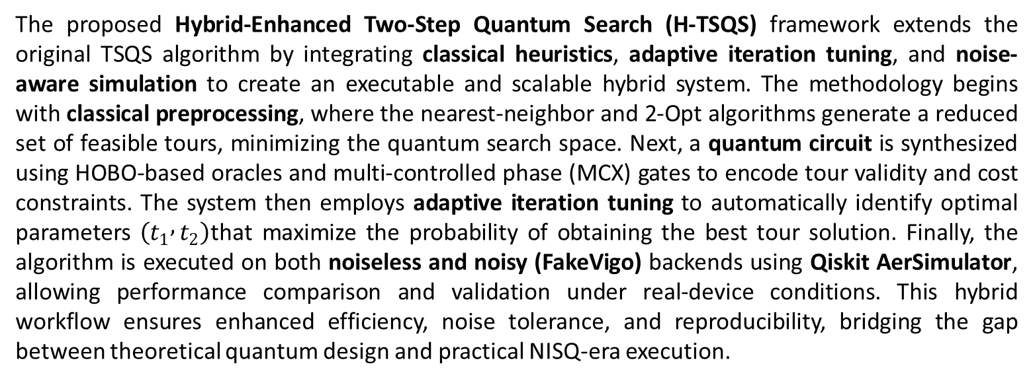
PROPOSED METHODOLOGY
The proposed Hybrid-Enhanced Two-Step Quantum Search (H-TSQS) framework extends the original TSQS algorithm by integrating classical heuristics, adaptive iteration tuning, and noise-aware simulation to create an executable and scalable hybrid system. The methodology begins with classical preprocessing, where the nearest-neighbor and 2-Opt algorithms generate a reduced set of feasible tours, minimizing the quantum search space. Next, a quantum circuit is synthesized using HOBO-based oracles and multi-controlled phase (MCX) gates to encode tour validity and cost constraints. The system then employs adaptive iteration tuning to automatically identify optimal parameters $\left(t_{1} , t_{2}\right)$that maximize the probability of obtaining the best tour solution. Finally, the algorithm is executed on both noiseless and noisy (FakeVigo) backends using Qiskit AerSimulator, allowing performance comparison and validation under real-device conditions. This hybrid workflow ensures enhanced efficiency, noise tolerance, and reproducibility, bridging the gap between theoretical quantum design and practical NISQ-era execution.
Department of Information Technology

Slide 10
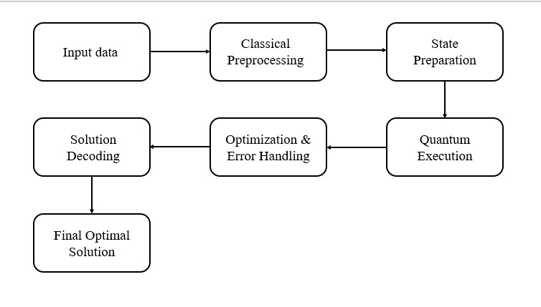
FLOW CHART

Slide 11
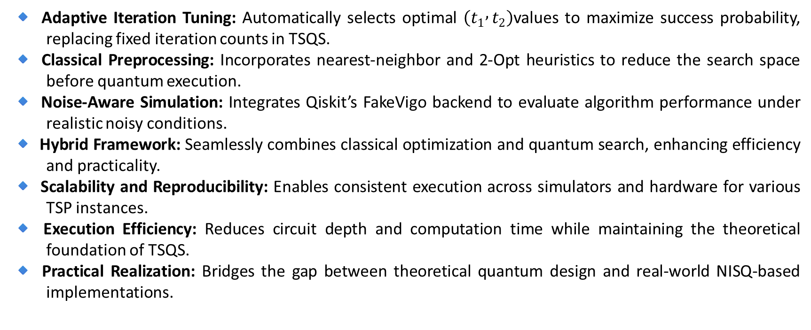
IMPROVEMENTS
🔹 Adaptive Iteration Tuning: Automatically selects optimal $\left(t_{1} , t_{2}\right)$values to maximize success probability, replacing fixed iteration counts in TSQS.
🔹 Classical Preprocessing: Incorporates nearest-neighbor and 2-Opt heuristics to reduce the search space before quantum execution.
🔹 Noise-Aware Simulation: Integrates Qiskit’s FakeVigo backend to evaluate algorithm performance under realistic noisy conditions.
🔹 Hybrid Framework: Seamlessly combines classical optimization and quantum search, enhancing efficiency and practicality.
🔹 Scalability and Reproducibility: Enables consistent execution across simulators and hardware for various TSP instances.
🔹 Execution Efficiency: Reduces circuit depth and computation time while maintaining the theoretical foundation of TSQS.
🔹 Practical Realization: Bridges the gap between theoretical quantum design and real-world NISQ-based implementations.
Department of Information Technology

Slide 12
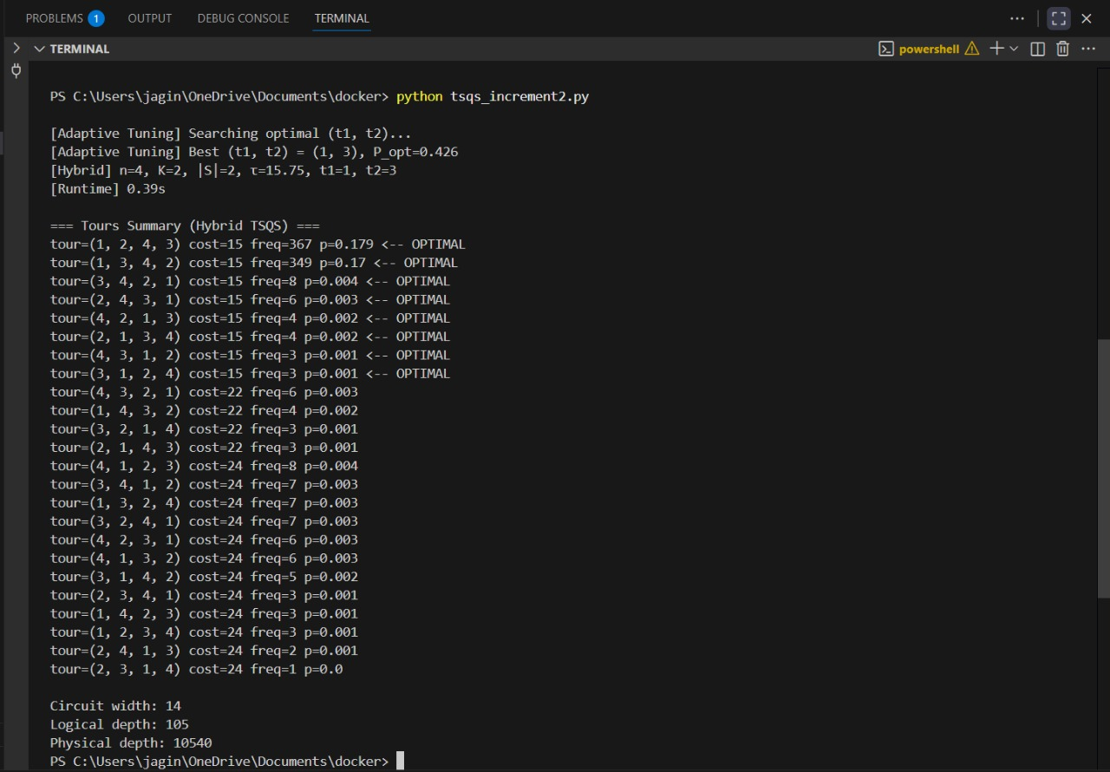
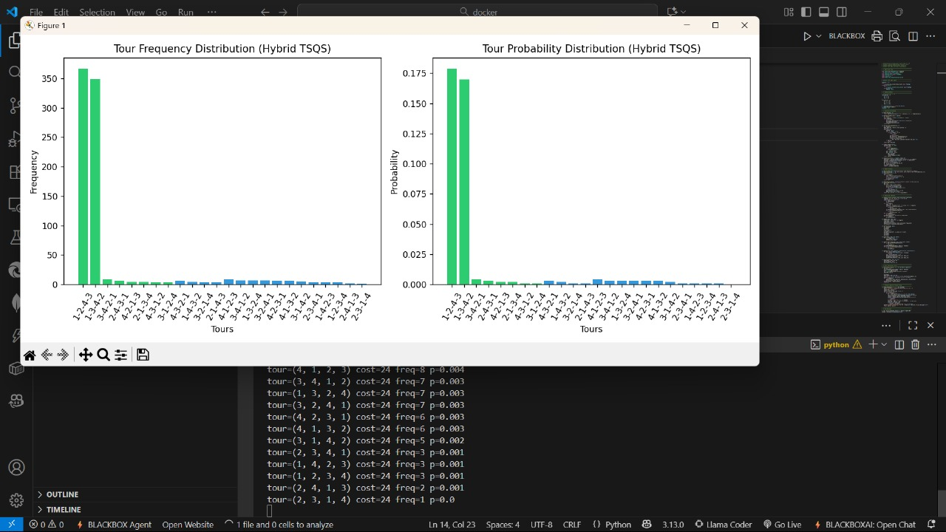
RESULTS
Execution Output and Visualization of Hybrid TSQS (Case 1)
This figure shows the terminal output and simulation plots for the Hybrid Two-Step Quantum Search (H-TSQS) applied to a 4-city TSP instance. The adaptive tuning module identified the optimal parameters $\left(t_{1} , t_{2}\right)=\left(1 , 3\right)$with a peak success probability of 0.426. The histogram plots display the Tour Frequency Distribution and Tour Probability Distribution, highlighting that the minimal-cost tours are successfully amplified.
Department of Information Technology

Slide 13
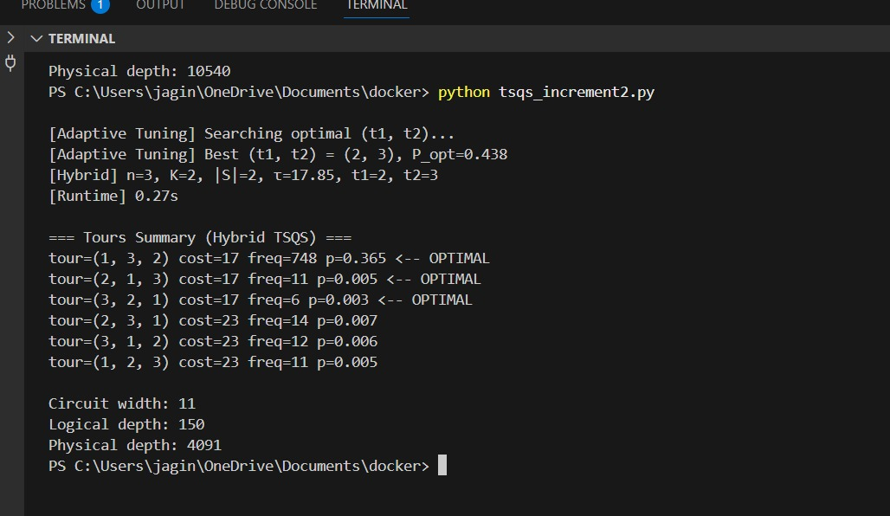
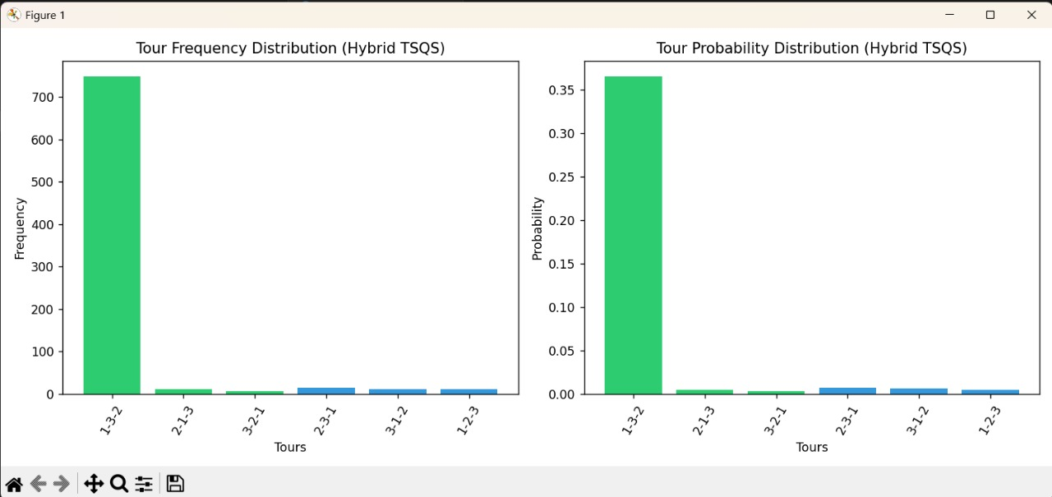
Execution Output and Visualization of Hybrid TSQS (Case 2)
This figure depicts another execution of H-TSQS with different city configuration $\left(n , =3k=2\right)$. The optimal parameters were found as $\left(t_{1} , t_{2}\right)=\left(2 , 3\right)$with a success probability of 0.438. The plots confirm the dominance of the optimal tour “1-3-2” in both frequency and probability distributions. The circuit width was 11 qubits, with a logical depth of 150 and a physical depth of 4091, demonstrating reduced resource requirements compared to the previous run.
Department of Information Technology

Slide 14
PROJECT REQUISITES:
Software Requirements
🐍 Programming Language: Python 3.9 or above
🔬 Quantum Framework: Qiskit & Qiskit Aer Simulators
📦 Supporting Libraries: NumPy, Matplotlib, Pandas
Department of Information Technology

Slide 15
REFERENCES
T. Sato, K. Sakai, and Y. Mitsuhashi, “Two-Step Quantum Search Algorithm for Solving Traveling Salesman Problems,” IEEE Transactions on Quantum Engineering, vol. 6, pp. 1–12, 2025.
H. Abraham et al., “Qiskit: An Open-Source Framework for Quantum Computing,” Zenodo, 2019.
IBM Quantum, “Qiskit Aer: High-Performance Simulators for Quantum Circuits,” IBM Quantum Documentation, 2023.
M. Schuld and F. Petruccione, Machine Learning with Quantum Computers, 2nd ed., Springer, 2021.
L. Zhou et al., “Hybrid Quantum–Classical Algorithms for Optimization on NISQ Devices,” Nature Quantum Information, vol. 7, no. 3, pp. 1–12, 2021.
Department of Information Technology

Slide 16
THANK YOU
Department of Information Technology

