Slide 1
AI-Based Industrial
Maintenance & Process Optimization
FactoryOps Predictive Maintenance Platform
Team: D
Mentor: Miss Selciya
Team Members:
1. Rajeswari Teppala
2. Eswar Reddy Anush
3. Sachin AS
4. Sindhukay Ernapati
5. Vabyasha Mohapatra
6. Vaishnavi Kumari
7. Vyshnavi Ganta

Slide 2
Contents
1. Introduction & Problem Statement
2. Objectives & System Architecture
3. Frontend & Application Access
4. Frontend Dashboard
5. Fleet & Machine Monitoring
6. Predictions & Alerts
7. Maintenance Management
8. Records & Data Management
9. Backend & API Architecture
10. AI/ML Models & System Workflow
11. Results, Advantages & Use Cases
12. Future Scope & Conclusion

Slide 3
1. Introduction & Problem Statement
INTRODUCTION
AI-BASED APPROACH
Industrial assets continuously generate temperature, pressure, vibration, RPM, humidity, oil level, voltage, current and power telemetry.
The challenge is converting this high-volume operational data into timely maintenance intelligence.
The AI-based approach learns patterns in telemetry, flags abnormal behaviour, estimates machine health and supports failure-risk prediction.
This connects monitoring, analytics and maintenance actions in a single operational workflow.
PROBLEM STATEMENT
Unexpected failures interrupt production and can increase repair cost. Manual inspection alone makes continuous monitoring difficult. The system addresses this by turning telemetry and incident data into prioritized alerts and actionable maintenance information.

Slide 4
2. Objectives & System Architecture
OBJECTIVES
• Monitor machine condition and telemetry
• Detect abnormal operating behaviour
• Predict potential failure risk
• Score machine health for prioritization
• Track incidents, work orders and maintenance cost
• Provide APIs and dashboard-based decision support
SYSTEM ARCHITECTURE
Machine & Sensor Data
Telemetry + Incident Records
Feature Engineering + ML
Anomaly / Failure Prediction
Health Score + Maintenance Decision
Presentation Layer
Backend APIs → Frontend Dashboard → Engineers

Slide 5
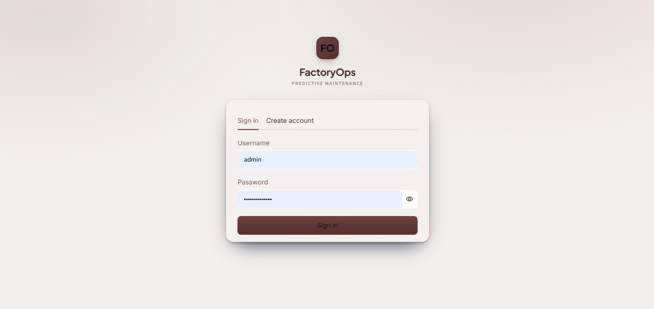
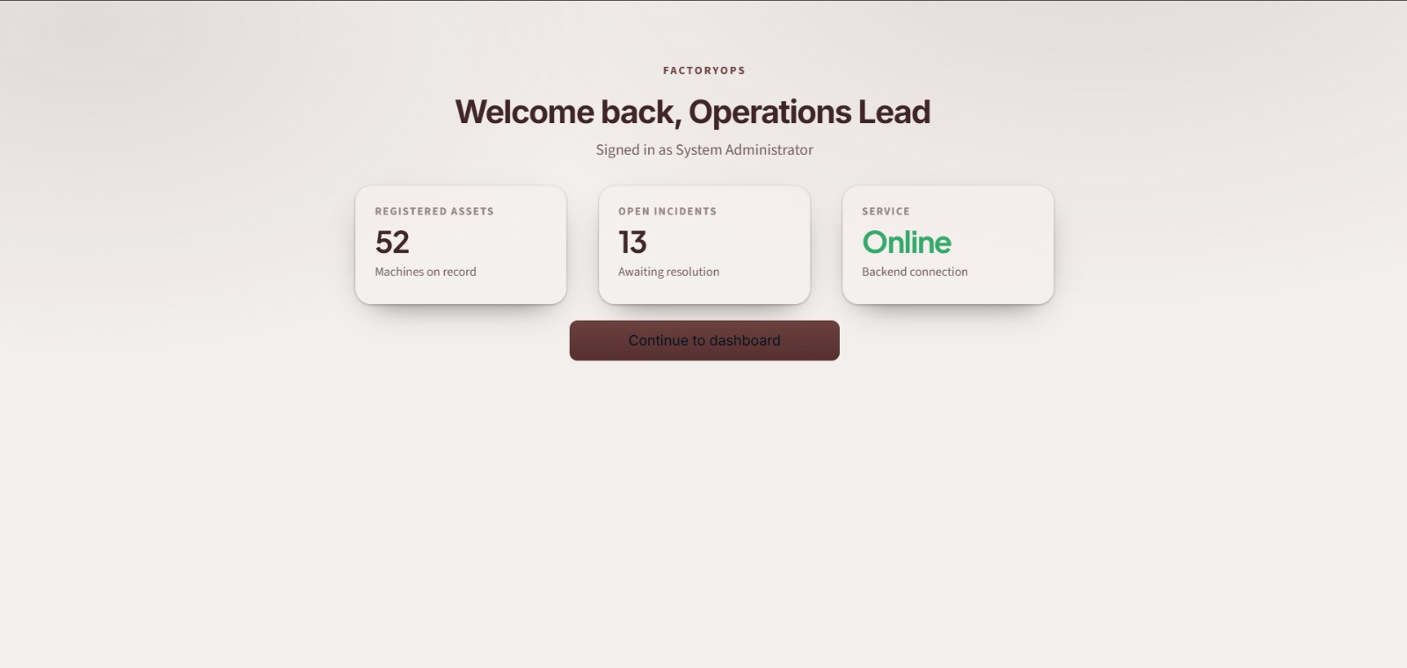
3. Frontend & Application Access
Secure entry point for operational users, with role-aware access to monitoring and maintenance functions.
Login / role-based access
Authenticates the user before operational modules are exposed.
Operations Lead welcome screen
Provides a clear route into machine monitoring and maintenance workflows.

Slide 6
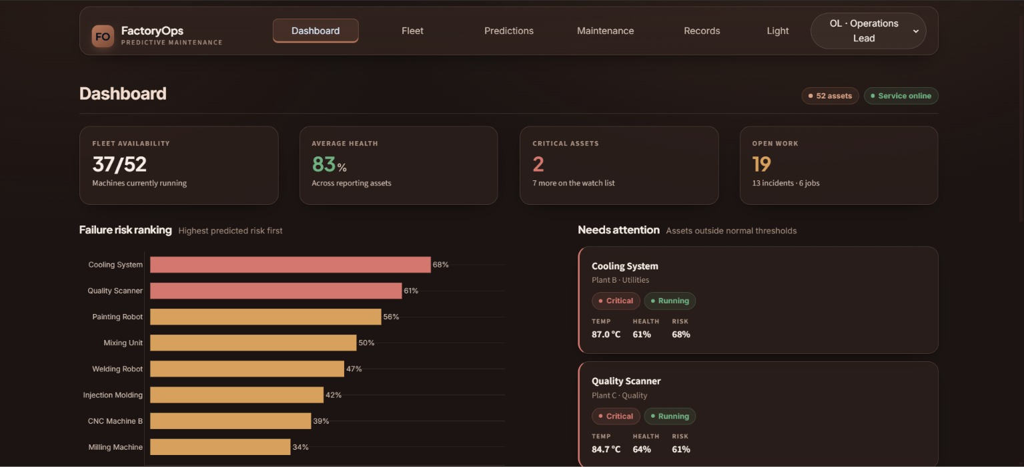
4. Frontend — Dashboard
Central monitoring screen for factory operations -bringing machine status, telemetry trends, alerts and maintenance information together.
Dashboard role: Observe → Interpret → Prioritize → Act

Slide 7
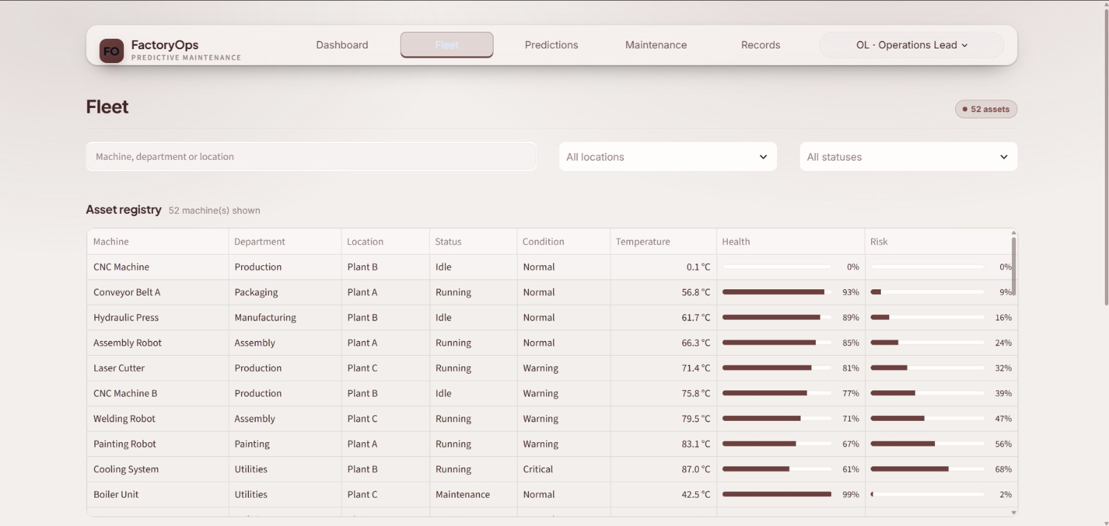
5. Fleet & Machine Monitoring
Asset registry, machine condition and operational status. Fleet-level visibility helps teams identify which assets require attention first.
Asset Registry
Telemetry Monitoring
Health & Status

Slide 8
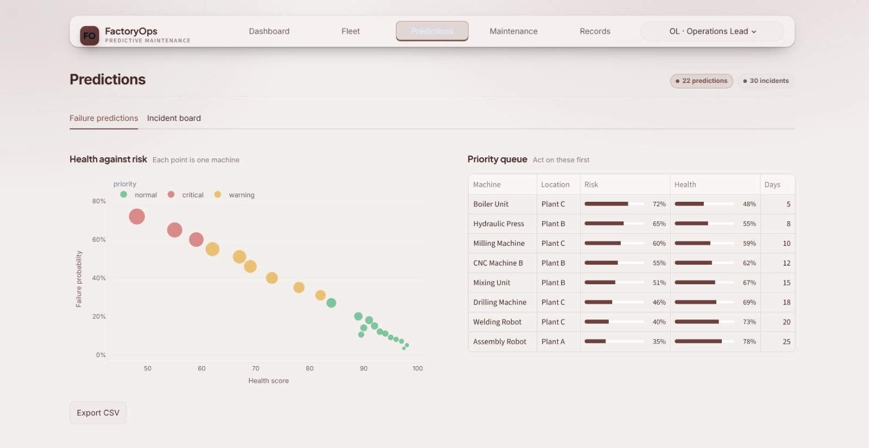
6. Predictions & Alerts
Failure-risk visualization converts model output into a priority queue so maintenance teams can focus on machines showing abnormal or elevated-risk behaviour.
Alert
Priority
Prediction
Record
Maintenance
Action

Slide 9
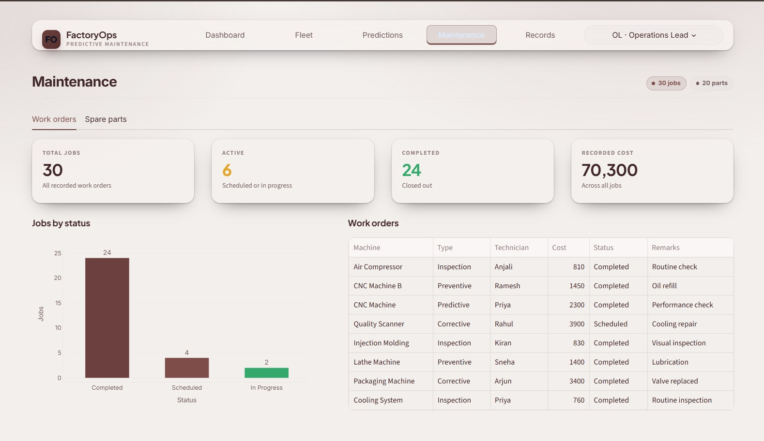
7. Maintenance Management
Work orders connect detected maintenance needs with execution status and recorded cost, creating a traceable maintenance lifecycle.
Issue Identified
Work Order
Status + Cost Record

Slide 10
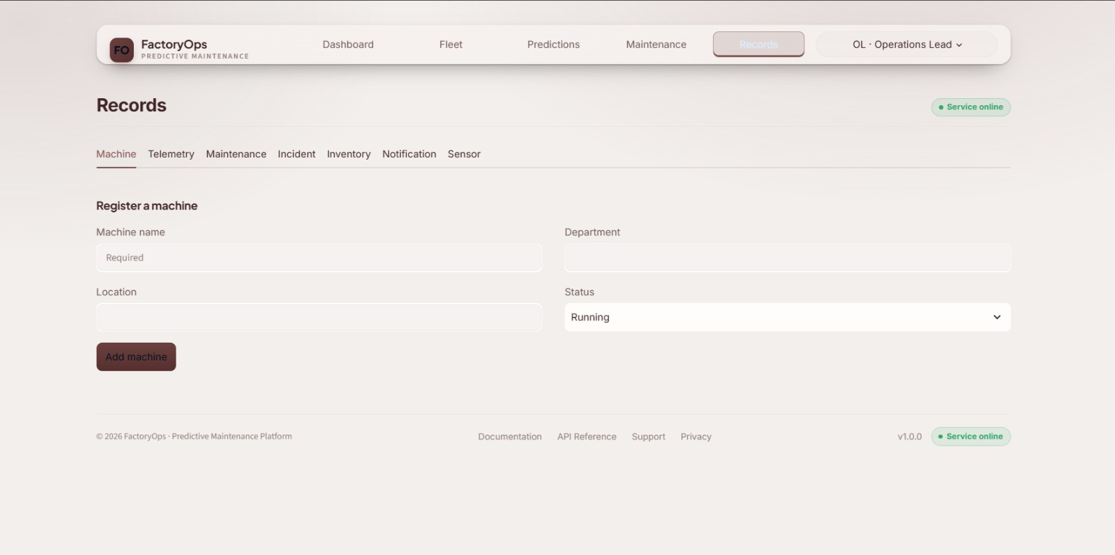
8. Records & Data Management
Operational records provide the data foundation for analytics: machines, telemetry, incidents, maintenance activities and prediction outputs.
Machines
Telemetry
Incidents
Maintenance
Predictions

Slide 11
9. Backend Overview
Layered backend architecture keeps API handling, validation, business logic, persistence and ML analytics modular and maintainable.
API LAYER
DATABASE
SERVICES
REST APIs
FastAPI + Uvicorn
Swagger documentation
Frontend communication
SQLite + SQLAlchemy
Machine data
Telemetry
Incidents & maintenance
Prediction records
Service Layer
Health / anomaly
Prediction
Maintenance
Process business rules
Backend flow:
Frontend request → API endpoint → Schema validation → Service logic → Database / ML service → Structured response.
ML integration: telemetry data is prepared and transformed into model-ready features, predictions are returned to the application, and results are exposed through APIs for dashboard consumption.
Python | FastAPI | SQLAlchemy | SQLite | Pandas | NumPy | Scikit-learn | XGBoost

Slide 12
10. AI/ML Module & System Workflow
1 Collect telemetry data
2 Store & preprocess
3 Feature analysis
4 Detect anomalies
8 Display on dashboard
7 Send through APIs
6 Generate predictions
5 Assess health & risk
AI/ML pipeline: Telemetry → Preprocessing → Feature Engineering → Anomaly Detection → Health Assessment → Failure-Risk Prediction → API Delivery → Dashboard Action
Anomaly Detection: identify deviations from expected machine behaviour
Failure Prediction: estimate potential failure risk from learned patterns
Health Scoring: convert signals into an actionable machine condition view

Slide 13
11. Results & Advantages
RESULTS
OPERATIONAL OUTPUT
The platform centralizes machine health visualization, telemetry trends, alerts, incidents and maintenance/prediction records.
Operational teams receive a single interface for reviewing machine condition, identifying abnormal behaviour and prioritizing maintenance information.
• Early identification of abnormal machine behaviour
• Reduced dependency on continuous manual monitoring
• Better maintenance prioritization through risk information
• Potential reduction in unexpected downtime
• Improved visibility of machine health and operational data
• Data-driven support for industrial decisions
USE CASES
• Manufacturing plants
• Production lines
• Power plants
• Automotive industries
• Process industries

Slide 14
12. Future Scope & Conclusion
FUTURE SCOPE
CONCLUSION
• Real-time IoT sensor integration and streaming telemetry
• Advanced deep-learning models for complex failure patterns
• Remaining Useful Life (RUL) prediction
• Automated maintenance scheduling
• Cloud deployment and scalable data infrastructure
• Digital twin integration and closed-loop process optimization
• AI agents for process and maintenance assistance
The system combines AI/ML, industrial telemetry, FastAPI services, structured records and an interactive Streamlit interface.
It supports machine health assessment, anomaly detection, failure-risk prediction and maintenance tracking.
Goal: move from reactive maintenance toward predictive, data-driven maintenance and improved process reliability.

Slide 15
THANK YOU!
Questions & Discussion
Team D | FactoryOps Predictive Maintenance Platform

