Slide 1

CACHE REPLACEMENT POLICY SIMULATOR(LRU,FIFO,OPTIMAL)
Guided by Presented by
Dr.Kumaragurubaran A Janvi Chowdary (192525455)
Dr.S.Senthilvadivu G Vyshnavi (192525260)

Slide 2
Introduction
Cache memory stores data temporarily for faster access.
When the cache is full, old data must be replaced.
Cache replacement policy decides which data to remove.
This simulator shows how three policies work:
FIFO: Replaces the oldest data.
LRU: Replaces the least recently used data.
Optimal: Replaces the data not needed for the longest time.
It helps to understand cache performance and efficiency

Slide 3
Objectives
To simulate different cache replacement policies such as FIFO, LRU, LFU, and Random.
To understand how cache memory manages data when the cache is full.
To calculate the performance of each policy using hit ratio and miss ratio.
To analyze which replacement policy performs better for a given memory access pattern.

Slide 4
Types of Cache replacement policies
FIFO (First In, First Out)
Replaces the oldest block in cache.
LRU (Least Recently Used)
Replaces the block not used for the longest time.
LFU (Least Frequently Used)
Replaces the block with the fewest accesses.
Random Replacement
Replaces any block randomly.

Slide 5
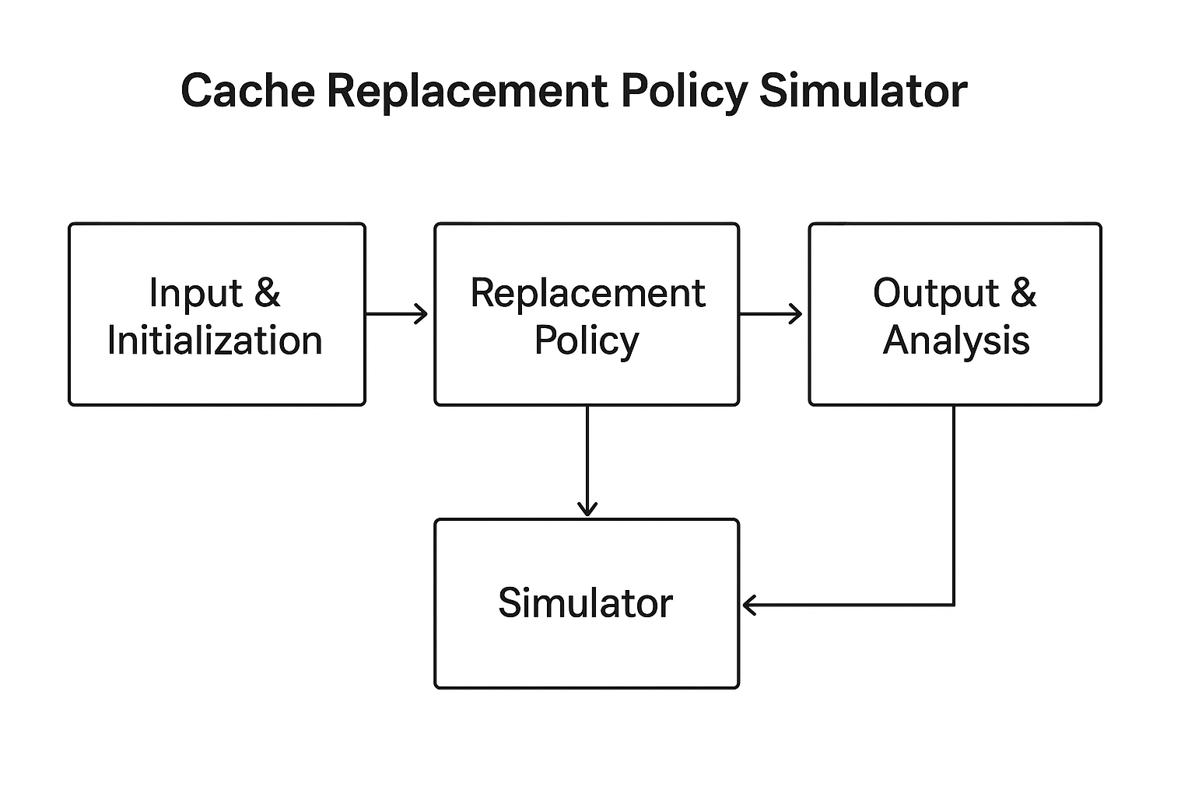
Block Diagram

Slide 6
Problem statement
When a computer’s cache memory becomes full, the system must decide which data block to remove to make space for new data. Choosing the right block to replace is important to improve the system’s speed and reduce cache misses
This project aims to develop a Cache Replacement Policy Simulator that demonstrates and compares the working of FIFO (First-In First-Out), LRU (Least Recently Used), and Optimal replacement policies. The simulator helps to analyze their performance based on hit rate and miss rate for different input sequences and cache sizes.

Slide 7
Methodology
Input Phase
  Enter the reference string and number of cache frames.
Initialization
  Set up empty cache frames for storing data.
Execution Phase
  Run FIFO, LRU, and Optimal algorithms one by one.
Computation
  Record page hits, page faults, and replacements for each algorithm.
Result Analysis
  Compare the performance of all three policies based on hit ratio and miss ratio.
Output
  Display results using tables or graphs for better understanding.

Slide 8
Input and Initialization
Inputs:
  Cache size
  Sequence of memory addresses (reference string)
  Choice of replacement policy
Initialization:
  Start with an empty cache.
  Set hit = 0 and miss = 0 counters.
  Load configuration parameters.
📌 Example:
Memory references → [2, 3, 2, 1, 5, 2, 4, 5, 3, 2]

Slide 9
Replacement policy
Determines which block to replace when cache is full.
Common policies:
  FIFO (First In, First Out) – replace oldest block.
  LRU (Least Recently Used) – replace block not used recently.
  LFU (Least Frequently Used) – replace block with fewest accesses.
  Random – replace any randomly selected block.
💡 Each policy has trade-offs between simplicity and efficiency.

Slide 10
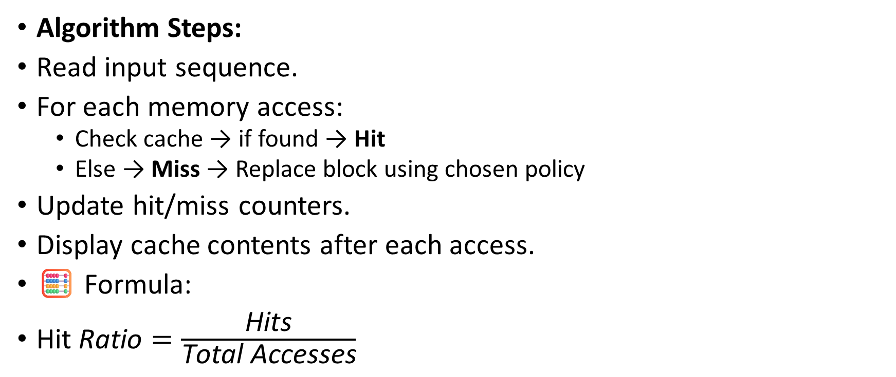
Simulator flow
Algorithm Steps:
Read input sequence.
For each memory access:
  Check cache → if found → Hit
  Else → Miss → Replace block using chosen policy
Update hit/miss counters.
Display cache contents after each access.
🧮 Formula:
$\text{Hit} \text{Ratio}=\frac{\text{Hits}}{\text{Total} \text{Accesses}}$

Slide 11
Output Analysis
Outputs Generated:
Hit/Miss result for each access
Final cache contents
Total hits, misses, and hit ratio
Analysis:
Policy | Hits | Misses | Hit Ratio
FIFO | 10 | 5 | 66.7%
LRU | 12 | 3 | 80%
LFU | 11 | 4 | 73%

Slide 12
Conclusion
The simulator successfully demonstrates FIFO, LRU, and Optimal cache replacement policies.
It helps to understand how cache memory handles data when it becomes full.
Optimal policy gives the best performance (highest hit rate).
LRU policy performs better than FIFO in most practical cases.
The project improves understanding of memory management and system efficiency.

Slide 13
References
Mittal, S. (2023). A Study on Cache Replacement Policies in Modern Processors. IEEE Access.
Sharma, P., & Verma, N. (2024). Simulation of Cache Replacement Policies for Better Performance. Journal of Engineering Research and Technology.
Reddy, D., & Rao, M. (2025). Comparison of Cache Replacement Techniques. IRJMET Journal
.
GeeksforGeeks (2025). Page Replacement Algorithms in Operating Systems. Retrieved from https://www.geeksforgeeks.org/page-replacement-algorithms-in-operating-systems/

