Slide 1

Retail Banking Transaction Analysis

Slide 2
About us
Name : Vyshnavi Mulle
Background: B.Tech in Computer Science and Engineering
Linkedin: Vyshnavi Mulle | LinkedIn
Name : Likhitha Jami
Background: B.Tech in Computer Science and Engineering.
Linkedin: Likhitha Jami | LinkedIn
Name : R. Naina Patel Yadav
Background: B.Tech in Computer Science and Engineering
Linkedin: Naina Patel | LinkedIn

Slide 3
Table of contents
Project Overview
Business Scenario
Business Objectives
Dataset & Database Overview
ER Diagram & Database Structure
Basic Analysis
Analysis of the Objectives
Overall Key Findings
Business Recommendations & Data Quality Notes
Conclusion

Slide 4
Project Overview
A retail bank serves customers through accounts, cards and loans across 40 branches.
The bank handles thousands of customer transactions and loan payments.
Management wants data-driven answers about customers, account activity, transaction patterns, loan performance and product usage.
As a Data Analyst supporting the Retail Banking team, we built the database in MySQL, analysed the data with SQL and recorded business insights.

Slide 5
Business Scenario
The Customer team needs to understand who the customers are and how segments differ.
Management wants to see how accounts are used and how branches perform.
Operations wants to understand how money moves through transactions and channels.
The Loans team wants to know whether customers repay on time.
The Cards team wants to understand card usage and product engagement.

Slide 6
Business Objectives
Understand the customer profile and segmentation.
Understand account usage and branch activity.
Analyze transaction patterns across types, channels and time.
Evaluate loan performance and repayment behaviour.
Understand card usage and product engagement across the customer base.

Slide 7
Dataset & Database Overview
Table Name | No. of Rows | No. of Columns
customers | 500 | 13
accounts | 700 | 10
branches | 40 | 7
loans | 300 | 13
loan_payments | 2,000 | 11
cards | 600 | 10
transactions | 5,000 | 10

Slide 8
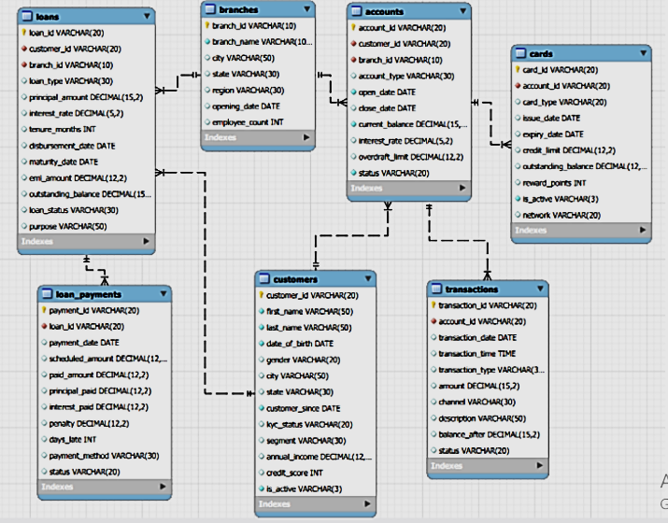
ER Diagram & Database Structure

Slide 9
Basic Analysis
Question | Result
Total customers | 500
Total accounts | 700 (1.4 per customer)
Account types | 6: Business Checking, CD, Checking, IRA, Money Market, Savings
Active customers | 375 of 500 (75.0%)
Transaction types | 6: ATM Withdrawal, Credit, Debit, Fee, Interest, Transfer
Completed transactions amount | $10,976,552.36 (1,688 transactions)
Loan types | 6: Auto, Business, Credit Builder, Education, Home, Personal
Total loans | 300
Card types | 2: Credit, Debit
Outstanding loan balance | $53,441,891.25 (74.0% of $72.21M lent)

Slide 10
4.1 Customer Profile & Segmentation
Output:
Key Insights:
Segments: Student is largest (100, 20%); average income is $140K-$159K and credit score 679-687 in every segment, so labels do not reflect customer value. Redefine segments.
Geography & demographics: No city has more than 3% of customers (the top 10 hold 27%). Gender is balanced. 30-44 is the largest age group (33.6%) and Under 30 is only 14%.
KYC risk: Only 28.6% of customers are fully verified; 241 of 375 active customers (64.3%) have Partial/Pending KYC. Run a KYC completion drive.
Tenure: Average tenure is about 7.4 years; Premium (6.8) and Wealth (6.9) are the newest customers.

Slide 11
4.2 Account Usage & Branch Activity
Output:
Key Insights:
Deposits: $10.2M in total; IRA, CD and Money Market hold 70% at higher rates (3.3%-4.6%). Savings and Checking are popular but small.
Relationships: Customers hold 1.4 accounts on average. One customer has 8 accounts but a zero balance, while others hold several accounts with 100K+ balances.
Branches: BR025 holds $501,926 and BR010 only $58,688. More accounts does not mean more money: BR011 has the most accounts (28) but only $306K.
Closures: 203 of 700 accounts (29%) are closed and hold zero balance. No account is overdrawn. Add retention offers.

Slide 12
4.3 Transaction Patterns
Output:
Key Insights:
Completion problem: Only 33.8% of transactions complete; 33.7% are Pending and 32.6% Failed.
Channels & types: Online and Mobile carry 49.9% of activity, Branch 22.9%; types are evenly spread. Fee and Interest averages (~$7,000) need validation.
Usage: Investment, Utility and Rent dominate; Salary is only 5.6% (payroll opportunity). Business is the most active segment, Premium the least.
Trend: Volume grew 1,279 (2022) to 1,723 (2023) to 1,933 (2024), but growth is slowing; there is no data for Jan 2025.

Slide 13
4.4 Loan Performance & Repayment
Output:
Key Insights:
Loan book: $53.44M of $72.21M (74%) is still outstanding; 169 loans (56.3%) are Defaulted or In Arrears, holding 73.3% of balances. Education, Business, Auto and Home are about 70% of lending.
Repayment: One in four payments (25%) is late across all loan types (21.7% to 28.2%). Penalties total $93,961, under 0.2% of the money owed.
Payment method: Cheque, Bank Transfer and Cash are about 57% of payments. Auto Debit is only 5.6%. Promote Auto Debit.
Branches: The late-payment share runs from 5.9% (BR037) to 45.5% (BR012). Review the worst branches.

Slide 14
4.5 Card Usage & Product Engagement
Output:
Key Insights:
Cards: 93.8% of cards are inactive, credit utilization is healthy at 41.8%.
Rewards: Debit and Credit earn almost the same points; Visa holds the most points (28%).
Engagement: Only 124 customers (24.8%) use accounts, cards and loans together. 267 customers hold a card, and 124 of them also have a loan.
Credit cards: 242 cards (40%), average limit about $24.3K, and customers owe $2.46M.

Slide 15
Overall Key Findings
1
Customers
500 customers, 75% active, spread over many cities. Only 28.6% fully KYC-verified.
2
Accounts
$10.2M in deposits, concentrated in IRA, CD and Money Market; 29% of accounts closed.
3
Transactions
Growing yearly and led by Online/Mobile, but only 33.8% complete.
4
Loans
56.3% of loans are Defaulted or In Arrears, holding 73.3% of the $53.4M still owed. One in four payments is late.
5
Cards
93.8% of cards inactive. Only 124 customers use account, card and loan together.

Slide 16
Business Recommendations
Collections: Follow up the 169 defaulted and in-arrears loans first (73% of the money owed). Tighten approval for Home and Business loans.
Transactions: Fix processing failures; two thirds of transactions fail or stay pending.
KYC: Complete KYC for the 241 active Partial/Pending customers.
Repayment: Push Auto Debit (only 5.6% of payments) and send pre-due reminders.
Cards & cross-sell: Reactivate or close the 563 inactive cards. Offer cards to the 233 customers with none and loans to the 143 card holders with no loan.
Operations: Redefine segments using income and credit bands. Review weak branches (BR010, BR017, BR022 for balances and BR012, BR020 for late payments).

Slide 17
Data Quality Notes
close_date was blank for 497 open accounts; loaded through a staging table using NULLIF().
Primary and foreign key constraints were enforced during import, so there are no duplicate keys or orphan records.
Only a third of transactions are completed, so totals include pending and failed ones. Fee and Interest averages look large (about $7K).
98.7% of transactions fall in 2022-2024 and none in Jan 2025; customer segments differ very little in income or credit score.

Slide 18
Conclusion
SQL analysis turned 7 tables into clear answers on customers, accounts, transactions, loans and cards.
The customer base is balanced and active, but segment labels are weak and KYC completion is the most urgent compliance issue.
The biggest risks are the troubled loan book (56.3% Defaulted or In Arrears) and a transaction completion rate of only 33.8%.
Card engagement is weak but cross-sell potential is large, supporting data-driven decisions to improve retail banking performance.

Slide 19

THANK YOU

