Slide 1

Coronary Heart Disease Risk Study

Slide 2
CONTENT
Introduction
Business Understanding
Exploratory Data Analysis
Data Pre-processing
Modeling
Addressing Business Questions
Conclusion

Slide 3
What is Coronary Heart Disease?
Occurs when the coronary arteries narrow or become blocked
Plague causes narrowing or blockage
The blood cells carrying oxygen to heart cannot travel efficiently
May lead to Heart Attack and Stroke, if unattended

Slide 4
Heart disease deaths: What statistics show?

Slide 5
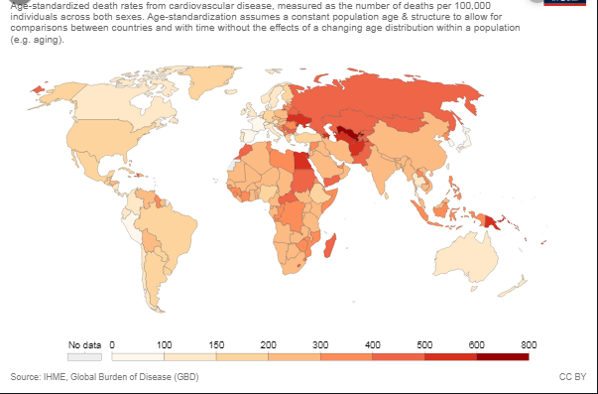
World

Slide 6
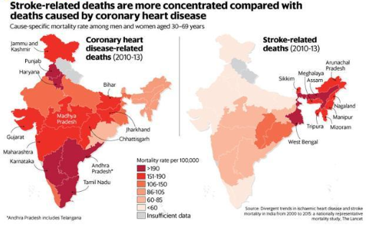
India

Slide 7
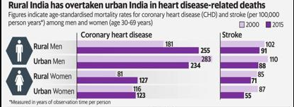
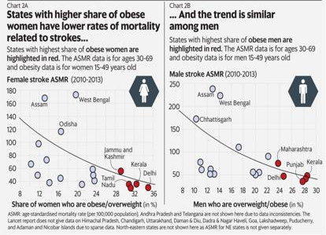
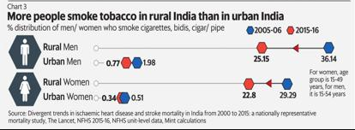

Slide 8
Problem Statement
The dataset provides the risk factors associated with heart disease for ~4200 patients and whether they have a risk of coronary heart disease in the next 10 years.
Based on the dataset provided:
Create a segmentation of the patients based on the demographic, behavioural and health data and analyse the risk propensity of heart disease for each segment
Predict the probability of a patient suffering a coronary heart disease in the next 10 years
Identify the most important factors that influence heart disease
Come up with recommendations for
Preventing / reducing chances of getting a heart disease
Extrapolated applications of the model you build and its findings

Slide 9
Approach
EDA (Exploratory data analysis)
Data Preparation
EDA
Model Building
Model Evaluation
Ensembling
DA(Data analysis) / Insights

Slide 10
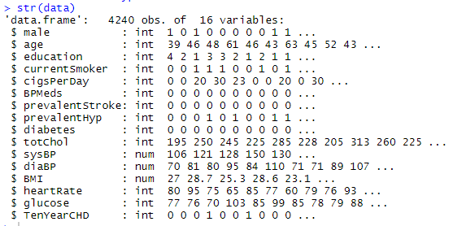
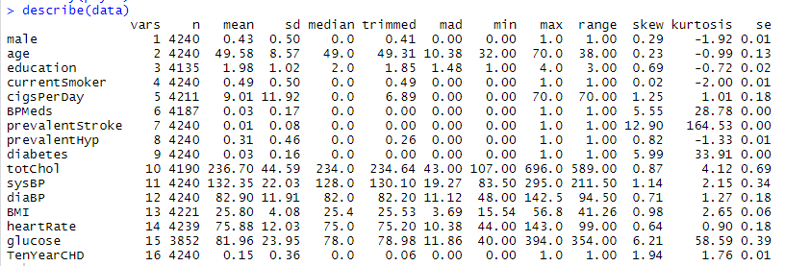
Exploratory Data Analysis

Slide 11
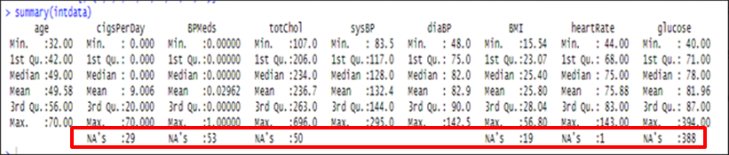
Exploratory Data Analysis
Variables | Education | cigsPerDay | BPMeds | totChol | BMI | heartRate | Glucose
No. of NA | 105 | 29 | 53 | 50 | 19 | 1 | 388

Slide 12
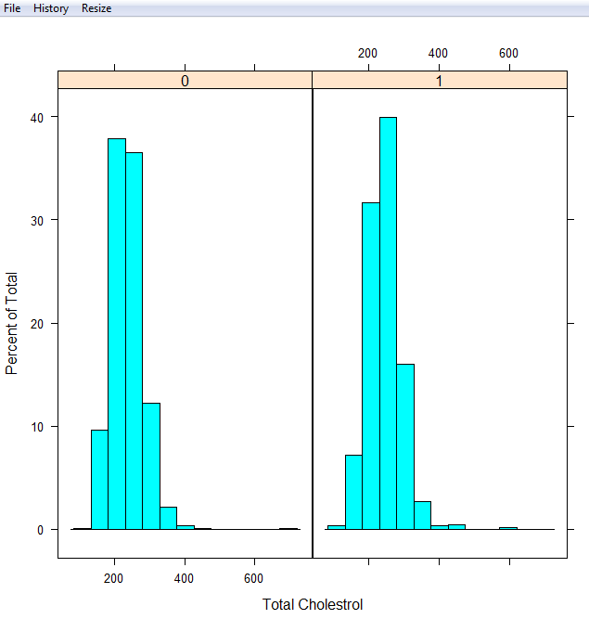
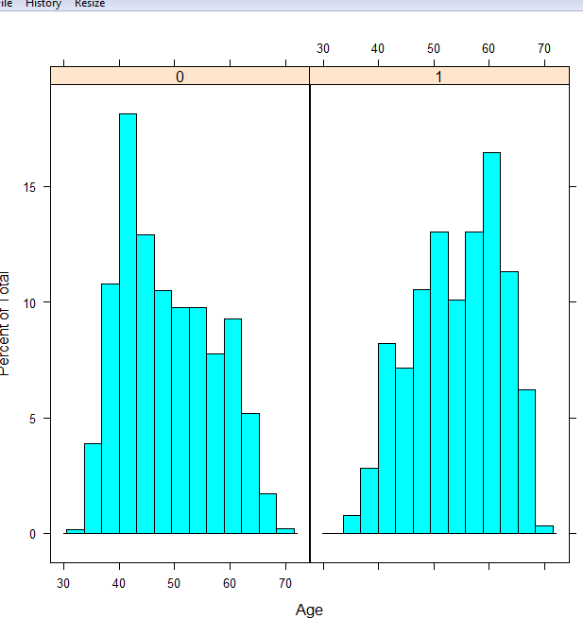
Exploratory Data Analysis

Slide 13
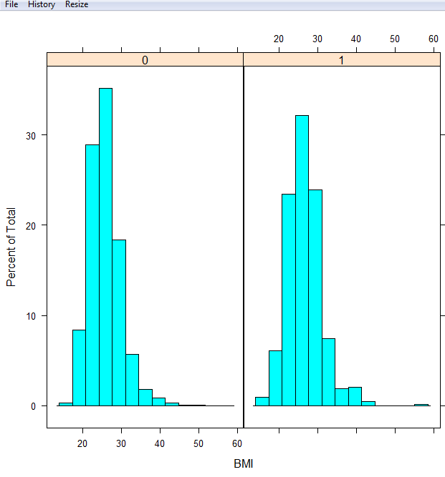
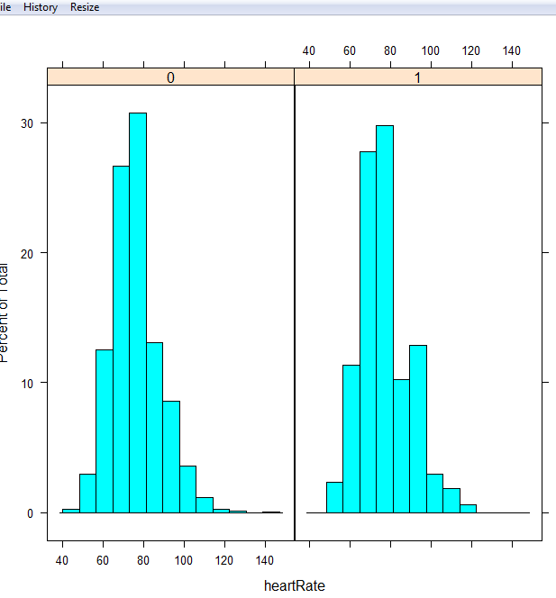
Exploratory Data Analysis

Slide 14
Exploratory Data Analysis
Chi-Square Test results of various categorical variables
“current smoker” is insignificant
 | X-squared | DF | P value
Gender data | 32.618 | 1 | 1.12E-08
hypertension data | 132.46 | 1 | 2.20E-16
diabetes data | 38.482 | 1 | 5.53E-10
smoker data | 1.4972 | 1 | 0.2211
stroke data | 14.034 | 1 | 0.0001796
BP data | 30.646 | 1 | 3.10E-08
education data | 32.017 | 4 | 0.000000519

Slide 15
Data Pre-processing
Missing Value Analysis & Treatment
- Pattern: MCAR
- Null value Imputation using MICE:
- PMM method for Continuous variable and RF method for categorical and ordinal variables
Outlier Treatment
- Capping at 99 percentile
Variable Transformation & Addition of new variable
- Right skewed data
- Square Root transformation
- Dummy Coding on Education with four ordered levels

Slide 16
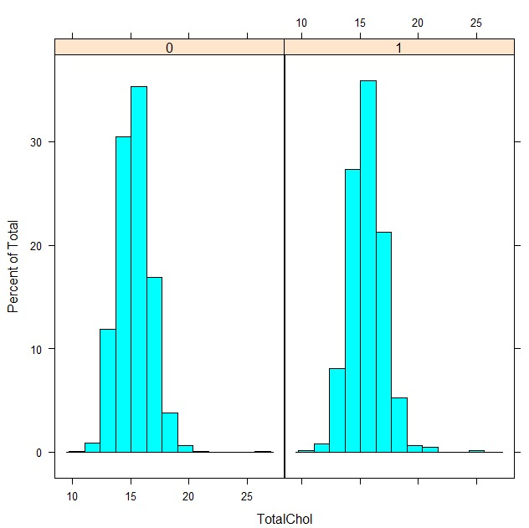
EDA on Transformed Dataset
Before
After

Slide 17
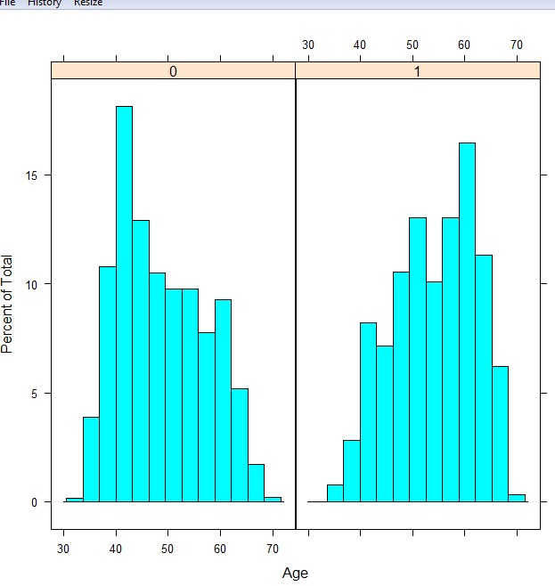
EDA on Transformed Dataset
Before
After

Slide 18
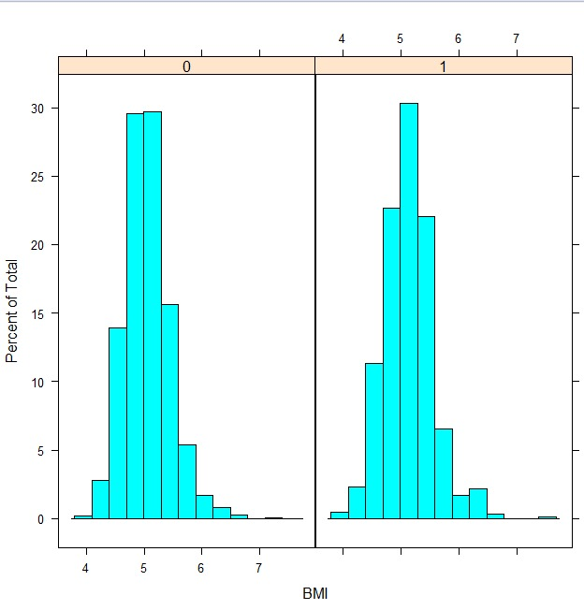
EDA on Transformed Dataset
Before
After

Slide 19
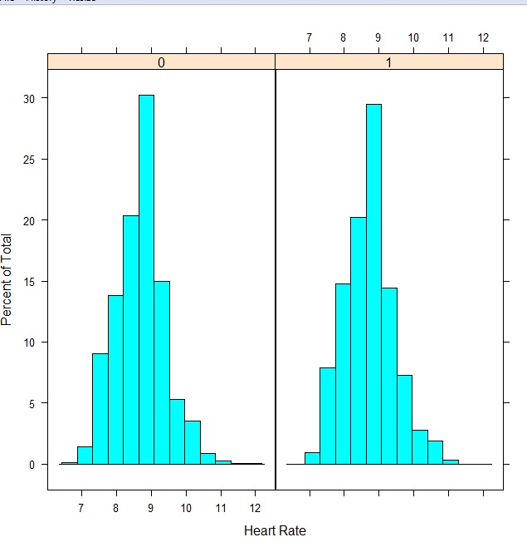
EDA on Transformed Dataset
Before
After

Slide 20
Modeling -by Classification techniques
Logistic Regression
SVM
Naïve Bayes
CART
Random Forest

Slide 21
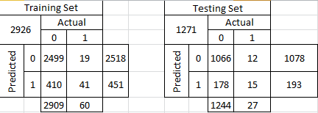
Logistic Regression
Type I Error: 410 Type I Error: 178
Type II Error: 19 Type II Error: 12

Slide 22
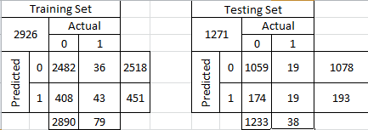
CART
Type I Error: 408 Type I Error: 174
Type II Error: 36 Type II Error: 19

Slide 23
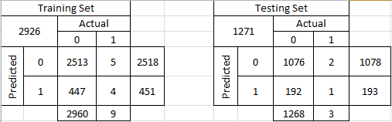
Random Forest
Type I Error: 447 Type I Error: 192
Type II Error: 5 Type II Error: 2

Slide 24
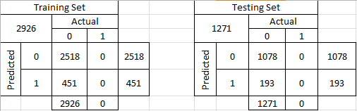
SVM
Type I Error: 451 Type I Error: 193
Type II Error: 0 Type II Error: 0

Slide 25
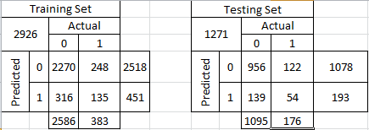
Naïve Bayes
Type I Error: 316 Type I Error: 139
Type II Error: 248 Type II Error: 122

Slide 26
Model Comparison
Upon imputing missing values with MICE (pmm)
 | logistic_train | SVM_linear_train | SVM_poly_train | nb_train | RF_train | CART_train
Accuracy | 0.86 | 0.85 | 0.87 | 0.81 | 0.85 | 0.85
Kappa | 0.14 | 0.03 | 0.26 | 0.22 | 0.04 | 0.09
P-Value | <2e-16 | <2e-16 | <2e-16 | 0.008975 | <2e-16 | <2e-16
Sensitivity | 0.77 | 0.62 | 0.96 | 0.36 | 0.61 | 0.60
Specificity | 0.86 | 0.85 | 0.87 | 0.88 | 0.85 | 0.86
Pos Pred Value | 0.10 | 0.02 | 0.17 | 0.31 | 0.02 | 0.07
Neg Pred Value | 0.99 | 1.00 | 1.00 | 0.90 | 1.00 | 0.99
AUC | 0.73 | 0.51 | 0.58 | 0.60 | 0.51 | 0.53
 | logistic_test | SVM_linear_test | SVM_poly_test | nb_test | RF_test | CART_test
Accuracy | 0.85 | 0.84 | 0.84 | 0.81 | 0.85 | 0.85
Kappa | 0.09 | 0.01 | 0.07 | 0.19 | 0.01 | 0.04
P-Value | <2e-16 | <2e-16 | <2e-16 | 0.004593 | <2e-16 | <2e-16
Sensitivity | 0.60 | 0.25 | 0.39 | 0.34 | 0.40 | 0.44
Specificity | 0.86 | 0.85 | 0.85 | 0.87 | 0.85 | 0.85
Pos Pred Value | 0.06 | 0.02 | 0.07 | 0.26 | 0.01 | 0.04
Neg Pred Value | 0.99 | 0.99 | 0.98 | 0.91 | 1.00 | 0.99
AUC | 0.73 | 0.50 | 0.52 | 0.58 | 0.50 | 0.51

Slide 27
Model Comparison
Upon removing all the observations that had missing values
 | LASSO Train | SVM Linear Train | SVM poly Train | NB train | RF train | CART Train
Accuracy | 0.85 | 0.85 | 0.87 | 0.81 | 0.85 | 0.85
Kappa | 0.11 | 0.00 | 0.26 | 0.22 | 0.00 | 0.07
P-Value | <2e-16 | <2e-16 | <2e-16 | 0.0016 | <2e-16 | <2e-16
Sensitivity | 0.63 |  | 0.99 | 0.36 |  | 0.61
Specificity | 0.86 | 0.85 | 0.87 | 0.88 | 0.85 | 0.85
Pos Pred Value | 0.08 |  | 0.17 | 0.30 |  | 0.05
Neg Pred Value | 0.99 |  | 1.00 | 0.91 |  | 0.99
AUC | 0.74 | 0.50 | 0.58 | 0.61 | 0.50 | 0.52
 | LASSO Test | SVM Linear Test | SVM poly Test | NB Test | RF Test | CART Test
Accuracy | 0.86 | 0.85 | 0.85 | 0.81 | 0.85 | 0.85
Kappa | 0.14 |  | 0.14 | 0.21 | 0.00 | 0.06
P-Value | <2e-16 | <2e-16 | <2e-16 | 0.1125 | <2e-16 | <2e-16
Sensitivity | 0.76 |  | 0.58 | 0.35 |  | 0.50
Specificity | 0.14 | 0.85 | 0.86 | 0.88 | 0.85 | 0.85
Pos Pred Value | 0.10 |  | 0.11 | 0.30 |  | 0.05
Neg Pred Value | 0.99 |  | 0.99 | 0.90 |  | 0.99
AUC | 0.73 | 0.50 | 0.55 | 0.60 | 0.50 | 0.52

Slide 28
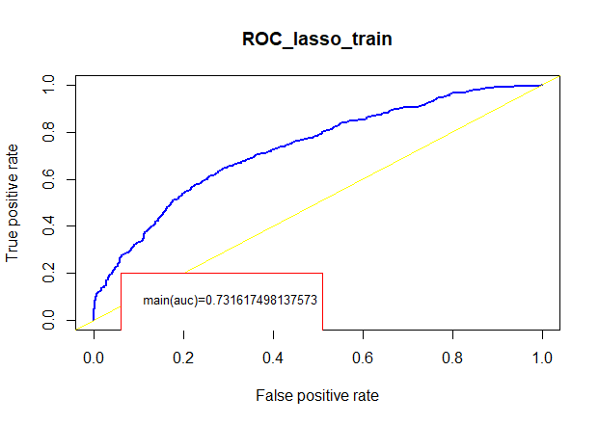
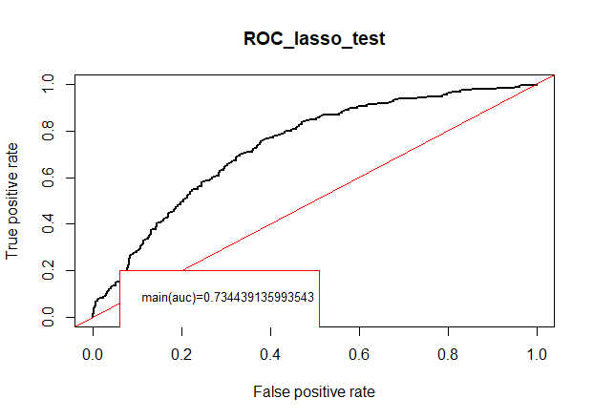
ROC on Best Fit Model
- After missing value imputation with MICE

Slide 29

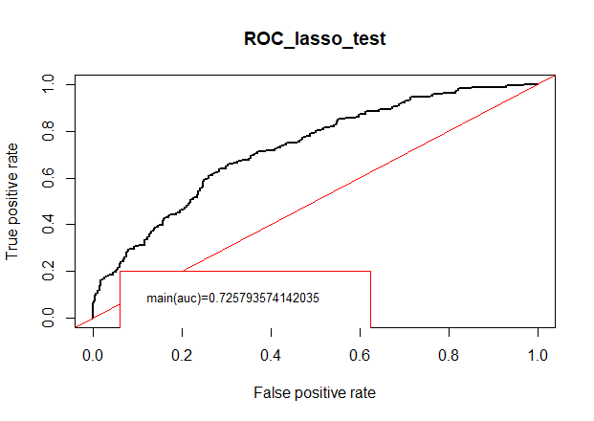
ROC on Best Fit Model
- After removing all rows with NAs

Slide 30
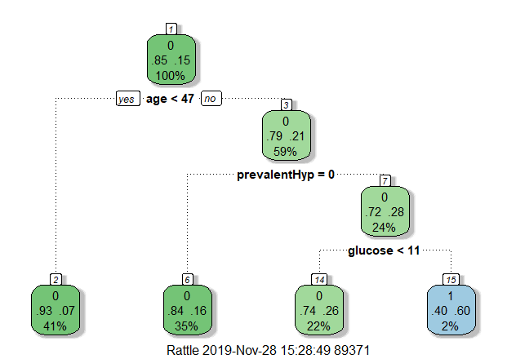
Important Variables
- After missing value imputation with MICE

Slide 31
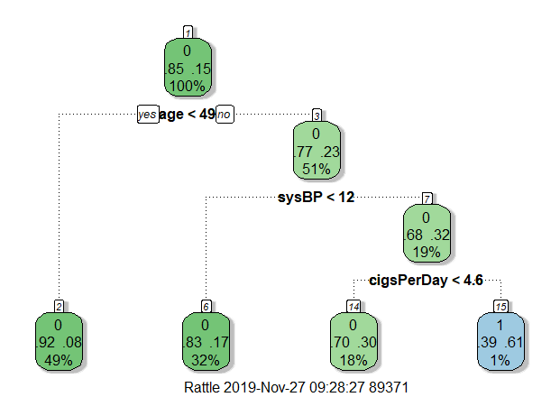
Important Variables
- After removing all rows with NAs

Slide 32
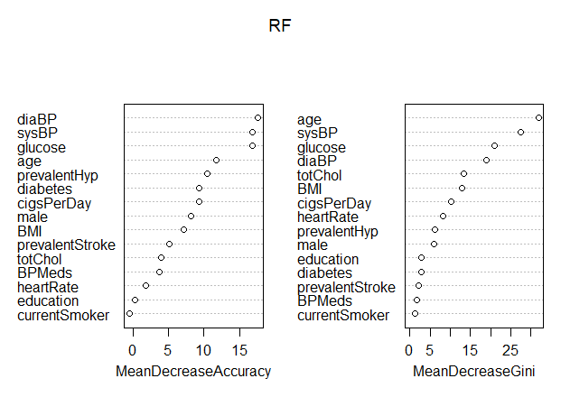
Important Variables
- After missing value imputation with MICE

Slide 33
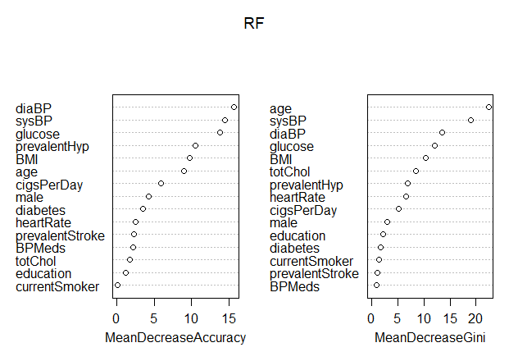
Important Variables
- After removing all rows with NAs

Slide 34
Important Variables
- Summarized from various model outputs
S.No | Logistic | CART | RF
1 | Age | Age | Age
2 | SysBP | SysBP | SysBP
3 | Prevalant Hyp | Prevalant Hyp | Prevalant Hyp
4 | Cigsperday | Cigsperday
5 | Gender
6 |  | Glucose | Glucose
7 |  |  | BMI

Slide 35
Ensembling
Stacking/ Stacked generalization
Accuracy of overall model 84%
Logistic Regression
CART
Random Forest
Naïve Bayes
SVM

Slide 36
Stacking
Training a learning algorithm to combine predictions of several other algorithms
Top Layer : GLM
Bottom Layers : CART , RF , Naïve Bayes , SVM
Comparing predictions of individual classifiers with the stacked classifier
Stacking classifier gives us a slightly better prediction than the predictions of individual classifiers

Slide 37
Stacking
CLASSIFIER | ACCURACY
Support Vector Machines | 0.8418
Naïve Bayes | 0.807
Random Forest | 0.8462
CART | 0.8418
Stacking | 0.8464

Slide 38
Usage of GLM
Logistic Regression is a Generalized Liner Model
Though , Naïve Bayes is the preferred model we do not use this algorithm as Meta Classifier
In simple terms , Naïve Bayes gives out a joint distribution and then predicts the probability whereas Logistic Regression gives out the probability directly by minimizing error
Also , Logistic Regression can be used for large training datasets as there are no chances of overfitting and since it operates linearly , there is no issue if the variables are correlated

Slide 39
Key Insights
Segment Wise – Medical
SQRTBMI<=5
Males are more probability of getting CHD
Education level 4 having more probability getting CHD
People has cholesterol level more than 484(mmol/L) having more probability of getting CHD
People has SysBP level more than 225mmHG having more probability of getting CHD
SQRTBMI>=5 Insights
Males have more probability of getting CHD
Education level 2 and 3 having more probability getting CHD
People has cholesterol level more than 484(mmol/L) having more probability of getting CHD
People has SysBP level more than 225mmHG having more probability of getting CHD
Glucose levels more than 144(mmol/L)having probability of getting CHD

Slide 40
Key Insights
Behavioural
Current Smoker = yes
Males are more prone to heart disease
Education levels 1 are more prone to heart disease
Glucose, heart rate are more than 250(mmol/L) are prone to heart disease
Females whose education level is 2 and 3 are more prone to heart disease
Current Smoke = no
Females are more prone to heart disease than males
Females age range between 40 to 60
Education Level 1 and 3 are more prone to CHD

Slide 41
Key Insights
Demographical
Gender= male, probability of CHD is high in case of
Males in age group 48 to 60
Males consuming more than 15 Cigs per day
Males with Total Cholesterol levels more than 225(mmol/L)
Males with SysBP more than 140mm/HG
Gender = female
Females in age group 50 to 65
Females consuming more than 15 Cigs per day
Females with Total Cholesterol levels more than 240(mmol/L)
Females with SysBP more than 140 mm/HG
Females with BMI more than 25 kg/m².

Slide 42
Recommendations
Age greater than 47 ,should be more precautious and need to maintain a health balance life.
Glucose levels need to maintained below 121,in order to avoid Coronary Heart Disease.
Blood Pressure levels should be maintained below 144mmHG, healthy life style is to maintain blood pressure levels in the range of 120/80mmHG.
Quit Smoking, No-Smoking Campaigns need to be conducted.
Awareness has to be created ,at levels of primary and secondary education as they were more prone to Coronary Heart Disease.
Having Prevalent Hypertension may lead to Coronary Heart Disease. Need to maintain over Hypertension and control stress levels.
Aim for a health weight and be fit.

Slide 43
CONCLUSION
Heart Disease is one of the major concern for the society today.
Evolution of data has given paths to predict the occurrence of Coronary heart disease ,which helps in for the medical field to
spread awareness ,detect and cure Coronary heart Disease, which in addition also requires a work-life balance.

Slide 44
WELL BEING IS APPRECIATED.

Slide 45
Thank You

