Slide 1
Spotify User Engagement, Content Performance & Streaming Analytics
Interactive capstone presentation · click any tile to explore · Vyshnav P S · October 2026
Overview
Users & Premium
Content
Streaming & Playlists
KPIs: 1,000 users, 20,000 streams, 49.2% Premium
Who listens, who pays, where to convert
Genres, top songs and hit-maker artists
Minutes, top users, playlist followers
Actions
Wrap-up & Q&A
Hidden Gems
Recommendations by management goal
Limitations, next steps, quick questions
The 19 artists to promote, and how they were found
Notes:
Hub slide: click a tile to jump to a section; every other slide has a tab bar and a Hub link, so you can answer questions in any order.

Slide 2
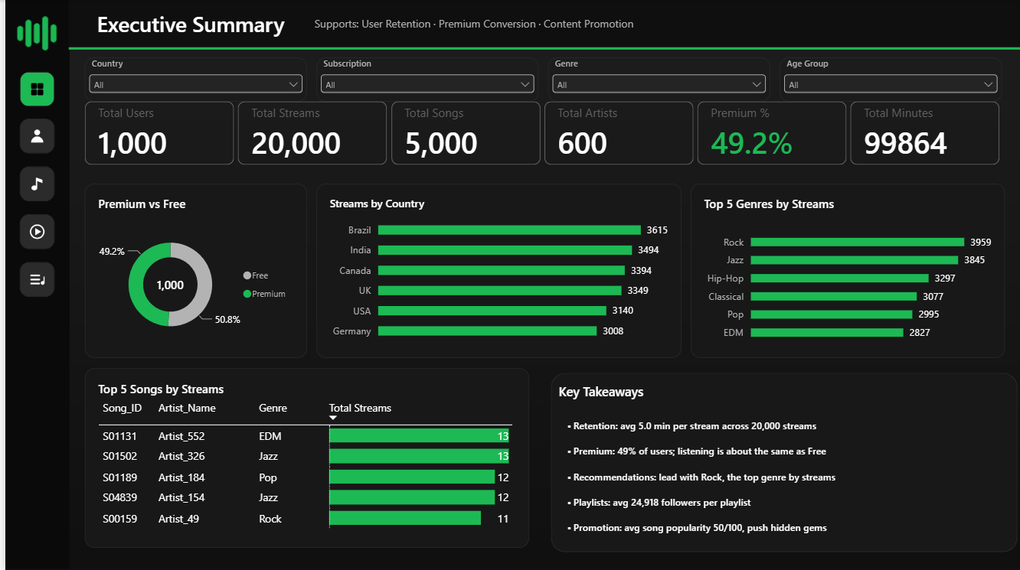
Overview
Users
Content
Streaming
Actions
Wrap-up
Hidden Gems
⌂ Hub
Overview: click a KPI to drill into it
1,000
20,000
5,000
Users
Streams
Songs
600
49.2%
99,864
Artists
Premium
Minutes
Engagement is flat: ≈100 min/user, 4.99 min/stream
Premium does not listen more than Free (−0.75%)
Rock + Jazz = 39% of streams
Dashboard page 1 – Executive Summary
Notes:
Each KPI card links to the slide that explains it.

Slide 3
Overview
Users
Content
Streaming
Actions
Wrap-up
Hidden Gems
⌂ Hub
Users & Premium: adoption differs, engagement does not
Premium 99.5 vs Free 100.2 min/user (p = 0.63): no uplift
Target Canada, UK, India and ages 25–34 / 45–54 (below the 49.2% average)
Open User Analytics dashboard →
Notes:
Premium users do not listen more, so conversion messaging must rely on features.

Slide 4
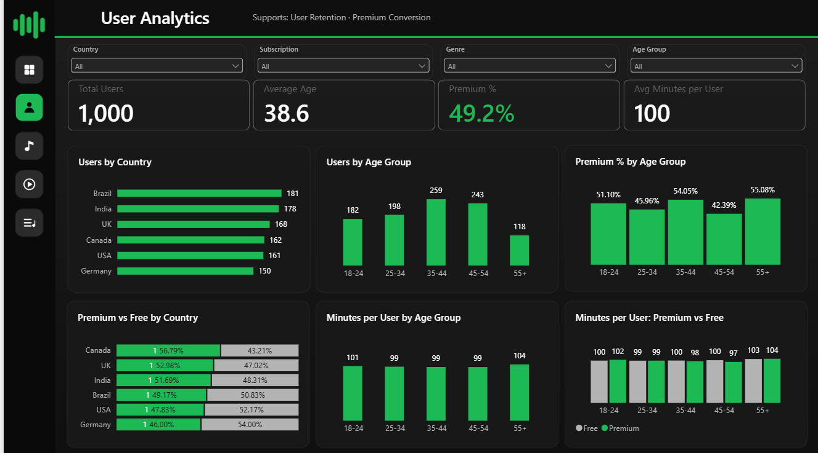
Overview
Users
Content
Streaming
Actions
Wrap-up
Hidden Gems
⌂ Hub
User Analytics dashboard: who listens, who pays
What this page shows
• Brazil (181) and India (178) are the largest user bases
• 35–44 is the biggest age group (259 users)
• Premium share: 55+ 55.1%, 35–44 54.1%; 45–54 only 42.4%
• Minutes per user are ≈ 99–104 in every age group
• Premium listens less than Free at 35–44 (98.2 vs 99.8) and 45–54 (96.5 vs 100.5)
Dashboard page 2 – User Analytics
Premium share by country (from the data): Germany 54.0% · USA 52.2% · Brazil 50.8% · India 48.3% · UK 47.0% · Canada 43.2%
← Users & Premium
Actions →

Slide 5
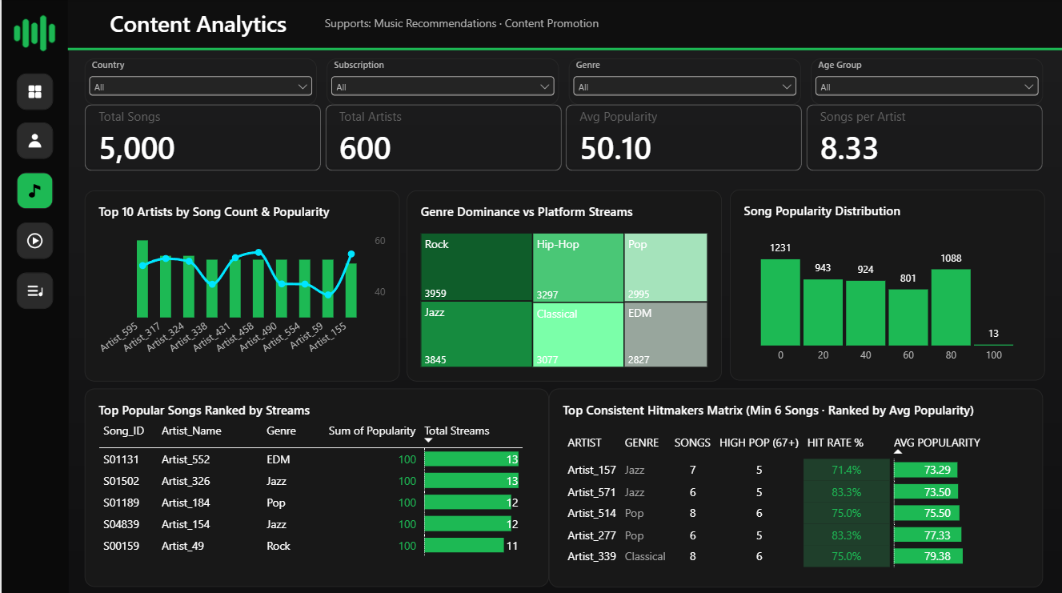
Overview
Users
Content
Streaming
Actions
Wrap-up
Hidden Gems
⌂ Hub
Content: Rock and Jazz lead, hit-makers are identifiable
S01131 and S01502 lead on streams (13 each)
17 Consistent Hitmakers, 19 Hidden Gems
Popularity is derived from stream counts
Dashboard page 3 – Content Analytics
See the 19 Hidden Gems →
Notes:
Disclose that popularity was recalculated from stream counts.

Slide 6
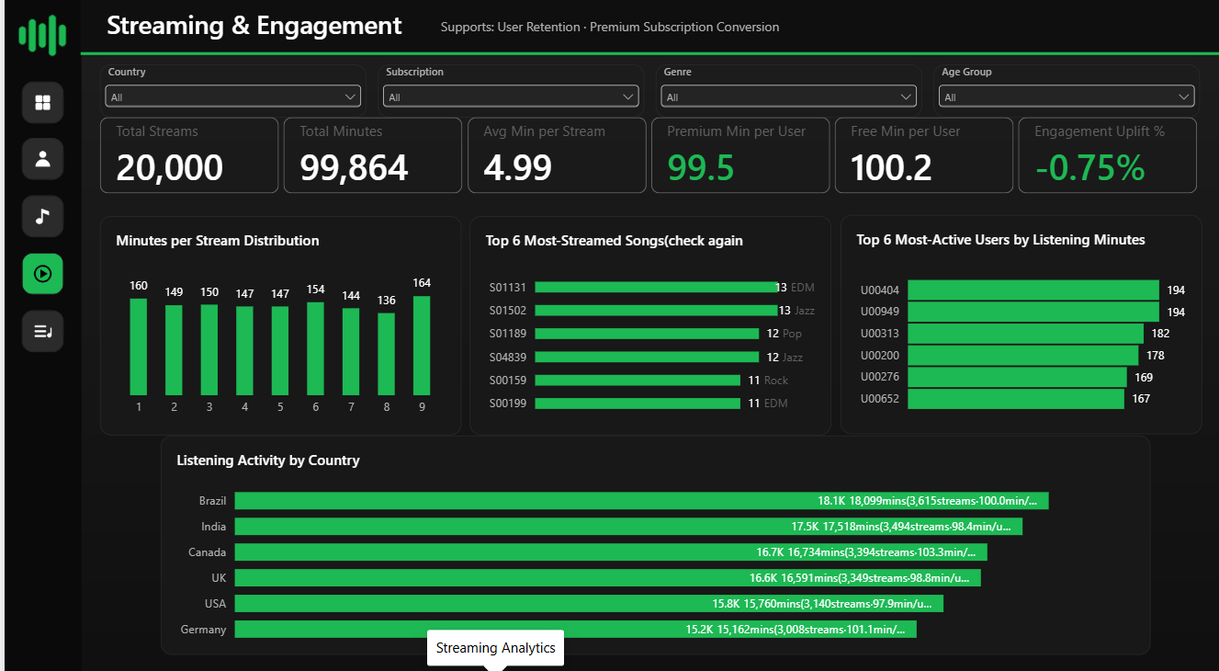
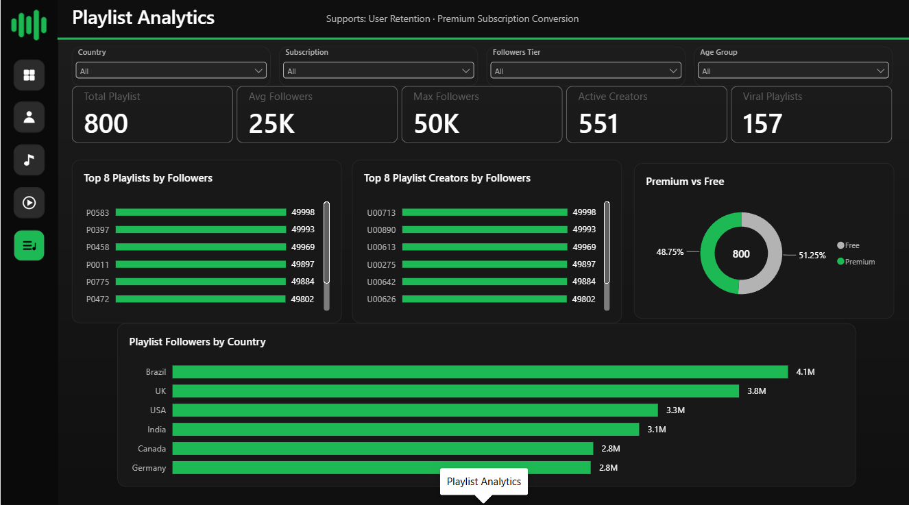
Overview
Users
Content
Streaming
Actions
Wrap-up
Hidden Gems
⌂ Hub
Streaming & Playlists
Dashboard page 4 – Streaming & Engagement
Dashboard page 5 – Playlist Analytics
Top listeners: U00404, U00949 (194 min each)
Brazil leads minutes (18,099) and playlist followers (4.1M)
157 viral playlists; top playlist P0583 (49,998)
449 users own no playlist
Notes:
Brazil is first on both listening and playlist followers.

Slide 7
Overview
Users
Content
Streaming
Actions
Wrap-up
Hidden Gems
⌂ Hub
Hidden Gems: 19 small-catalog artists with top-tier songs
How identified (Artists[Artist Category] in Power BI): average song popularity ≥ 70 and fewer than 8 songs
Genre mix: Hip-Hop 5 · Jazz 5 · Pop 4 · Rock 3 · EDM 1 · Classical 1
# | Artist | Genre | Songs | Avg pop.
1 | Artist_277 | Pop | 6 | 77.3
2 | Artist_460 | Hip-Hop | 5 | 76.6
3 | Artist_342 | Rock | 5 | 76.2
4 | Artist_67 | Jazz | 4 | 75.8
5 | Artist_11 | Hip-Hop | 3 | 75.0
6 | Artist_275 | Rock | 5 | 73.6
7 | Artist_571 | Jazz | 6 | 73.5
8 | Artist_157 | Jazz | 7 | 73.3
9 | Artist_442 | Pop | 3 | 73.0
10 | Artist_252 | Jazz | 7 | 72.7
# | Artist | Genre | Songs | Avg pop.
11 | Artist_260 | Hip-Hop | 7 | 72.7
12 | Artist_18 | Rock | 7 | 72.4
13 | Artist_70 | Pop | 6 | 72.0
14 | Artist_469 | EDM | 6 | 71.8
15 | Artist_123 | Hip-Hop | 7 | 71.7
16 | Artist_491 | Pop | 7 | 71.6
17 | Artist_387 | Jazz | 5 | 71.0
18 | Artist_398 | Classical | 5 | 70.0
19 | Artist_551 | Hip-Hop | 2 | 70.0
Popularity is derived from stream counts, so “hidden” means a small catalog with high per-song streaming rank. The 70 / 8-song cutoffs are model choices.
← Content
Actions →

Slide 8
Overview
Users
Content
Streaming
Actions
Wrap-up
Hidden Gems
⌂ Hub
Business recommendations: goal, action, evidence
Premium conversion
User retention
Music recommendations
Trial offers in Canada, UK, India and ages 25–34 / 45–54. Sell Premium on features (offline, no ads, audio quality), not on listening time.
Re-engage the lowest-engagement segments (USA 97.9, India 98.4 min/user) and add date fields so churn can be measured.
Lead carousels with Rock and Jazz (39% of streams), use Hip-Hop as the third pillar and test EDM.
Evidence: Premium share: Canada 43.2%, UK 47.0%, 45–54 at 42.4%. At 45–54 Premium listens 96.5 vs Free 100.5 min/user.
Evidence: Minutes per user ≈ 99–104 in every age group; platform average 100.
Evidence: Streams: Rock 3,959 · Jazz 3,845 · Hip-Hop 3,297 · EDM 2,827.
Dashboard 2 →
Dashboard 2 →
Dashboard 4 →
Dashboard 3 →
Playlist strategy
Content promotion
Where to start
Feature the 157 viral playlists, partner with top creators (U00464, U00271, U00124) and prompt the 449 non-creators to start one.
Promote the 19 Hidden Gems and 17 Consistent Hitmakers; review the 79 never-streamed songs.
1. Premium conversion in Canada, UK and India
2. Promote the 19 Hidden Gems
3. Activate the 449 users without a playlist
Evidence: 157 playlists ≥ 40K followers; 551 active creators out of 1,000 users.
Evidence: Hidden Gems from 70.0 to 77.3 avg popularity; top Hitmaker Artist_339 at 79.4.
Dashboard 5 →
Dashboard 3 →
Hidden Gems list →
Notes:
Each card links back to the evidence slide.

Slide 9
Overview
Users
Content
Streaming
Actions
Wrap-up
Hidden Gems
⌂ Hub
Wrap-up & Q&A: pick a question
Limitations
Do Premium users listen more?
No dates: no trends or true retention
Popularity derived from streams
Near-uniform data: gaps are directional
No: −0.75%
Which genre leads?
Rock, then Jazz
Who are the top listeners?
Next steps
U00404 and U00949
Add timestamps; link playlists to songs
A/B test Premium offers
What should we do first?
Convert Canada, UK, India
Who are the Hidden Gems?
19 artists: see the full list
Notes:
Question buttons jump to the evidence slide.

