Slide 1
CYBER GYAN VIRTUAL INTERNSHIP PROGRAM Centre for Development of Advanced Computing (CDAC), Noida
Submitted By:
VYSHNAV S
Project Trainee, (May-June) 2024

Slide 2
FILE INCLUSION ATTACKS
Exploiting Vulnerabilities and Implementing Defenses
(Web Application Security)

Slide 3
PROBLEM STATEMENT
File inclusion vulnerabilities pose significant threats to web applications.
Attackers can manipulate file inclusion mechanisms like Local File Inclusion (LFI) and Remote File Inclusion (RFI) to execute unauthorized code or access sensitive information.
Despite advancements in web security, these vulnerabilities persist due to inadequate input validation and insecure coding practices.

Slide 4
TECHNOLOGY/TOOLS TO BE USED
OWASP ZAP: Web application security scanner for detecting file inclusion vulnerabilities.
Burp Suite: Platform for security testing, used for intercepting and modifying HTTP requests.
Curl: Command-line tool for sending HTTP requests to test LFI and RFI exploits.
Netcat: Networking utility for setting up listeners for capturing data from exploited servers.
Metasploit Framework: Penetration testing framework with modules for LFI and RFI exploitation.
DirBuster/Dirsearch: Tools for discovering potentially exploitable directories and files.
Custom Scripts: Python, Perl, or Bash scripts for automating exploitation of file inclusion vulnerabilities.

Slide 5
ABOUT THE ATTACK
OWASP Website for Testing Vulnerability Initial setup on the OWASP platform to test for LFI vulnerabilities.
Local File Inclusion (LFI)
Local File Inclusion (LFI) is a vulnerability that occurs when a web application includes files based on user input without proper sanitization. Attackers exploit LFI to manipulate file paths and include sensitive files from the web server's filesystem. This can lead to unauthorized data exposure, server compromise, and in some cases, remote code execution. Understanding LFI vulnerabilities is essential for implementing robust input validation and secure file inclusion practices in web applications.

Slide 6
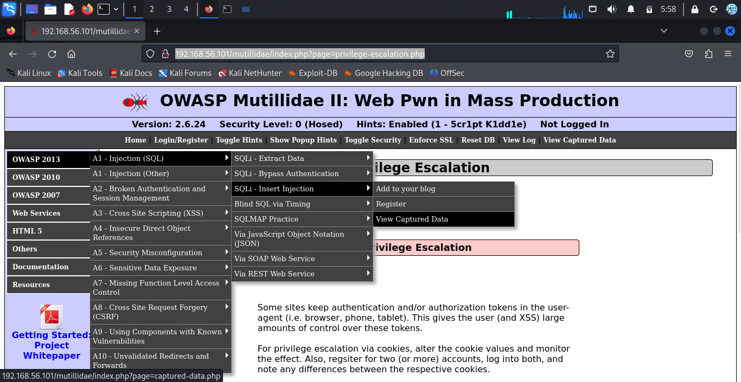
Demonstration of Local File Inclusion (LFI) Attack Steps and Screenshots of LFI Attack: 1.OWASP Website for Testing Vulnerability

Slide 7
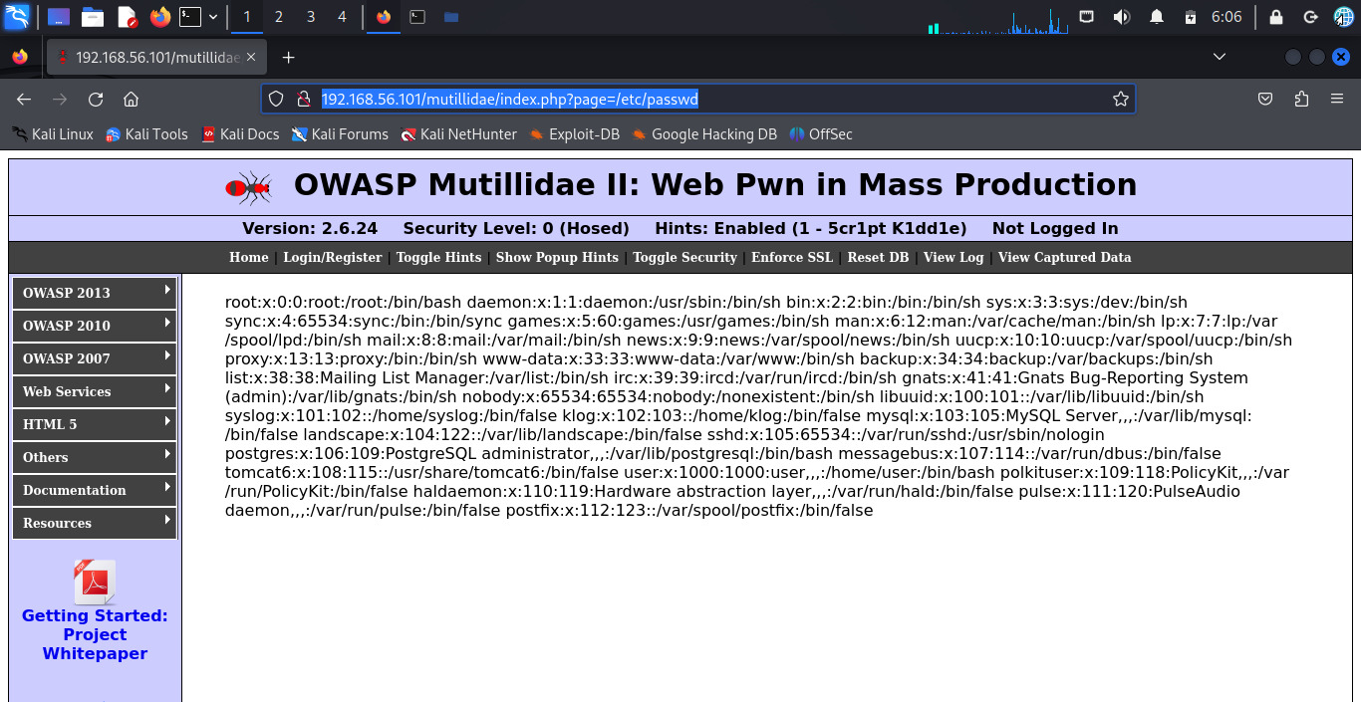
2. Including /etc/passwd File

Slide 8
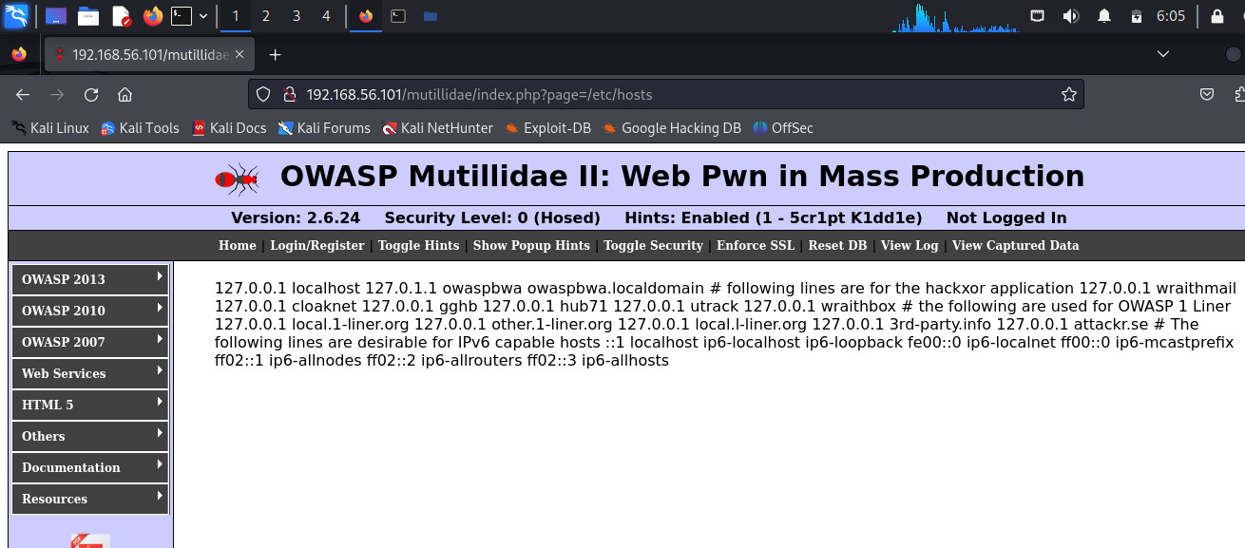
3.Including /etc/hosts File

Slide 9
Remote File Inclusion (RFI)
Remote File Inclusion (RFI) is a web security vulnerability that allows attackers to include malicious files from remote servers into web applications. Exploiting this flaw can lead to unauthorized access, data theft, and even remote code execution, posing significant risks to both application integrity and server security. Understanding RFI vulnerabilities is crucial for implementing effective safeguards and ensuring robust web application security.

Slide 10
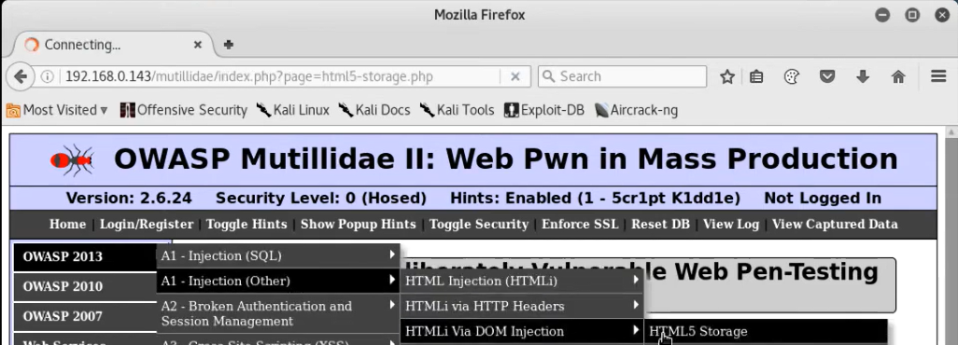
Demonstration of Remote File Inclusion (RFI) Attack
Steps and Screenshots of RFI Attack:
1.OWASP Website for Testing RFI

Slide 11
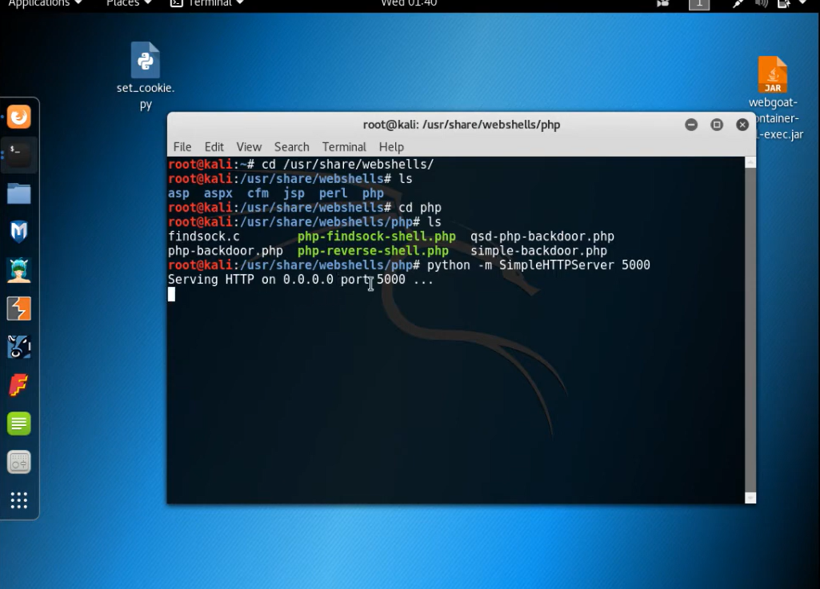
2.Hosting PHP Server for RFI

Slide 12
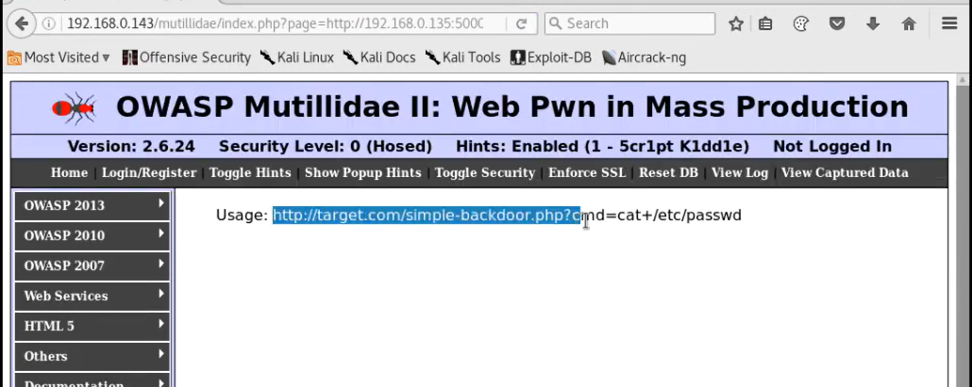
3.Injecting Hosted PHP Web to Testing Website

Slide 13
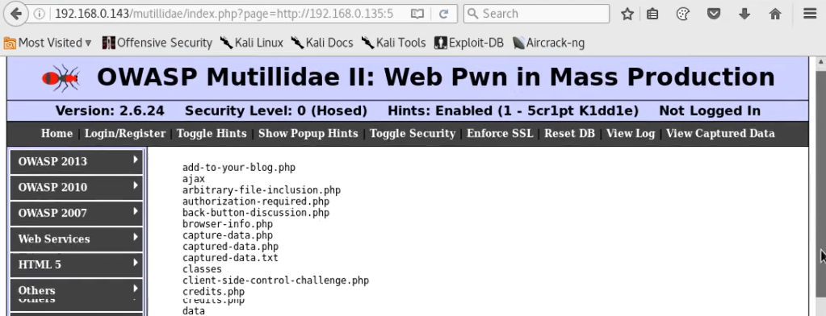

Slide 14
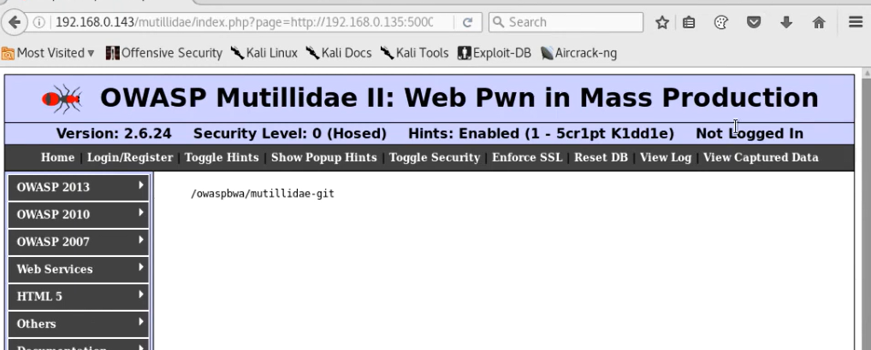

Slide 15
REASONS BEHIND THE PROBLEM
Inadequate Input Validation:
Lack of proper input validation allows attackers to manipulate file paths.
Insecure Coding Practices:
Poor coding practices lead to vulnerabilities in file inclusion mechanisms.
Misconfiguration of Web Servers:
Incorrect server settings can expose file inclusion vulnerabilities.
Lack of Regular Security Assessments:
Without regular assessments, vulnerabilities remain undetected.
Insufficient Awareness and Training:
Developers may not be aware of secure coding practices and common vulnerabilities.

Slide 16
SOLUTIONS AND COUNTERMEASURES
Input Validation and Sanitization:
Implement strict input validation and sanitization techniques.
Use whitelisting approaches to allow only known good inputs.
Secure Coding Practices:
Follow secure coding guidelines from sources like OWASP.
Train developers regularly on secure coding practices.
Web Application Firewall (WAF):
Deploy a WAF to provide an additional layer of defense.
Regularly update and configure WAF rules to adapt to new attack techniques.
Least Privilege Principle:
Restrict access rights for users, processes, and systems to the minimum necessary.
Limit web server and application permissions to reduce the risk of unauthorized access.

Slide 17
SOLUTIONS AND COUNTERMEASURES
Logging and Monitoring:
Implement comprehensive logging and monitoring mechanisms.
Regularly review and analyze logs to detect suspicious activities.
Patch Management:
Keep software components up-to-date with the latest security patches.
Apply security patches promptly to address known vulnerabilities.

Slide 18
CONCLUSION AND RECOMMENDATIONS
Conclusion:
The project explored file inclusion attacks, demonstrated their impact, and implemented effective defenses.
By understanding these attacks and applying robust defense strategies, web application security can be significantly enhanced.
Recommendations:
Conduct regular security assessments.
Implement strict input validation and sanitization.
Follow secure coding practices and train developers.
Deploy and regularly update a WAF.
Apply the principle of least privilege.
Implement comprehensive logging and monitoring.
Maintain an up-to-date patch management process.

Slide 19
THANKYOU

