Slide 1
Distributed Systems
UNIT-1
Introduction
Ref:Tanenbuam & Van Steen
Distributed Systems:Principles and Paradigms

Slide 2
-:Syllabus:-
Course Objectives
To acquire an understanding of the issues in distributed systems.
To learn about Naming and synchronization with different algorithms.
To study architectures and working of Distributed file systems, Distributed web-based system .
To expose the students to distributed transaction management, security issues and replication.
To introduce Emerging trends in distributed computing
Course Outcomes
By the end of this course, the students will be able to
List the principles of distributed systems and describe the problems and challenges associated with these principles
Know about interposes communication and remote communication.
Know Distributed Computing techniques, Synchronous and Processes.
Know Distributed File Systems Apply Distributed web-based system. Understand the importance of security in distributed systems
Know distributed service oriented architecture.
Know about emerging trends in distributed computing.

Slide 3

UNIT-I
Introduction: Characteristics & Properties of Distributes Systems – Taxonomy - Types of Distributed Systems Design goals – Transparency Issues.
Architectures: Architectural Styles, System Architectures, Architectures versus Middleware, and Self- Management in Distributed Systems.
Processes: Threads, Virtualization, Software Agents, Clients, Servers, and Code Migration.
Communication: Inter process communication Mechanisms, Remote Procedure Call, Remote Method Invocation, Message-Oriented Communication, Stream- Oriented Communication, and Multicast Communication.
UNIT-II
Naming: Names, Identifiers and Addresses, Flat Naming, Structured Naming and Attribute-Based Naming.
Synchronization: Clock Synchronization, Logical Clocks, Mutual Exclusion, Global Positioning of Nodes, and Election Algorithms.
Consistency and Replication: Introduction, Data-Centric Consistency Models, Client-Centric Consistency Models, Replica Management, and Consistency Protocols.

Slide 4
UNIT-III
Fault Tolerance: Introduction to Fault Tolerance, Process Resilience, Reliable Client- Server Communication, Reliable Group Communication, Distributed Commit, and Recovery.
Distributed Object-Based Systems: CORBA, DCOM, GLOBE -Architecture, Processes, Communication, Naming, Synchronization, Consistency and Replication, Fault Tolerance, and Security.
UNIT-IV
Distributed File Systems: File system, DFS- definition, Characteristics, Goals, SUN NFS-NFS Architecture, NFS Implementation, Protocols, The CODA file system-Design Overview, An Example , Design Rational, Implementation, The GOOGLE file system-Definition, Architectures, GFS Architecture
Distributed Web-Based Systems: Traditional Web-Based Systems, Web Services Fundamentals, The Apache Web Server, Web Server Clusters, Communication, HTTP Fundamentals, Simple Object Access Protocol SOAP, Web Proxy Caching, Replication for Web Hosting Systems-CDN’S, Service-Oriented Architectures, REST and Web Services

Slide 5
UNIT-V
Distributed Coordination-Based Systems -- Architecture, Naming and Security
Emerging Trends in Distributed Systems - Emerging Trends Introduction, Grid Computing, Cloud Computing and its roots in distributed systems mechanisms and self-management of distributed systems, Virtualization, Service Oriented Architecture, The Future of Emerging Trends.
Map-Reduce: Example, Scaling, Programming Model, Apache Hadoop, Amazon Elastic Map Reduce, Mapreduce.net, Pig and Hive.

Slide 6
-:Syllabus:-
Introduction: Characteristics & Properties of Distributes Systems – Taxonomy - Types of Distributed Systems Design goals – Transparency Issues.

Slide 7
Distributed systems
Distributed systems definition:-
A collection of independent computers that appears to its users as a single coherent system.
(or)
A collection of autonomous computers linked by a computer network and equipped with distributed system software.

Slide 8
Characteristics of D.S
Resource sharing
Openness
Concurrency
Scalability
Fault Tolerance
Transparency

Slide 9

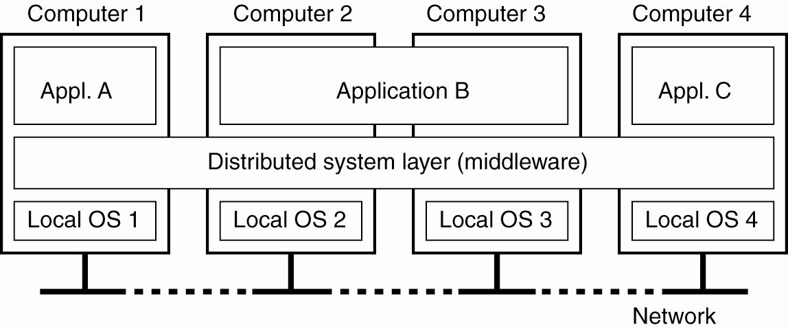
A distributed system organized as middleware
Figure 1-1. A distributed system organized as middleware. The middleware layer runs on all machines, and offers a uniform interface to the system

Slide 10
Why we need Distributed Systems?
Share resources at remote sites
Price/performance advantages
  Support applications with large computational requirements
Cooperative communities – collaborate with colleagues at a distance.
Working towards a common goal.
To provide a viewpoint of being single coherant system to outside world.

Slide 11
Applications of D.S
Finance & commerce
Information society
Creative Industries & Entertainment
Healthcare
Education
Transport & Logistics
Science
Environment management

Slide 12
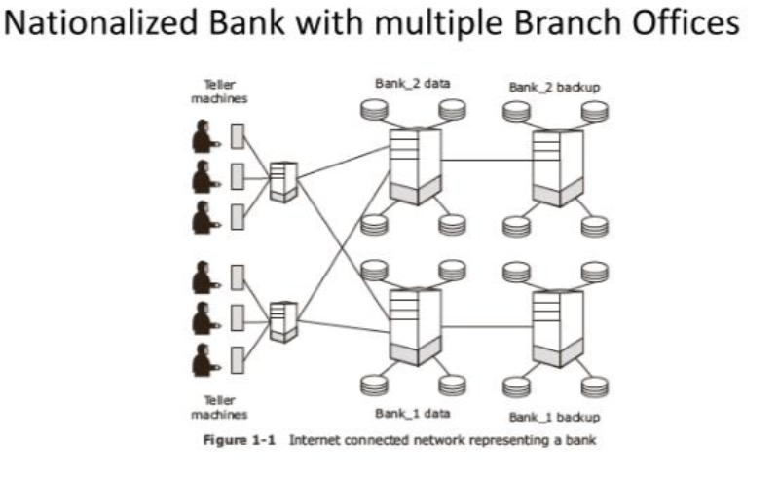
Example of Distributed system

Slide 13
Requirements of Distributed system
Security and reliability
Consistency of replicated data
Concurrent transaction
Fault tolerance

Slide 14
Advantages of Distribution System
1) Reliability: Ensuring that the system continues to function correctly even in the face of partial failures.
2) Availability: the system is almost always ready to satisfy a user’s request.
    An available system is not necessarily reliable: e.g., a system that is down one millisecond/hour has an availability of ~99.99%, but is not very reliable.
3) Fault Tolerance: The ability to continue to operate in spite of failures: hardware or software.

Slide 15
Advantages of Distribution System Continued…
4) Inherently distributed applications.
5) Information sharing among geographically distributed users.
6) Resource sharing.
7) Better price performance ratio.
8) Shorter response time &higher throughput.
9) Higher reliability & availability against component failures.
10)Extensibility & incremental growth.
11) Better flexibility.

Slide 16
Disadvantages of Distribution System
1) Relevant software does not exist currently.
2) Security poses a problem due to easy access to all data.
3) Networking saturation may cause a hurdle in data transfer.

Slide 17
Issues in designing distributed system
1) Transparency
2) Flexibility
3) Reliability
4) Performance
5) Scalability
6) Security

Slide 18
Middleware
Middleware is software that acts as a bridge between applications, databases, and tools, allowing them to communicate and work together. (or)
Middleware is software that lies between an operating system and the applications running on it. Essentially functioning as hidden translation layer, middleware enables communication and data management for distributed applications.
It's often called the "software glue" because it facilitates communication between applications that were not originally designed to work together.
Middleware Examples:-
CORBA (Common Object Request Broker Architecture)
DCOM (Distributed Component Object Management)
Sun’s ONC RPC (Remote Procedure Call)
RMI (Remote Method Invocation)
SOAP (Simple Object Access Protocol)

Slide 19
Types of Distributed Systems
Distributed Computing Systems
  Clusters
  Grids
Distributed Information Systems
  Transaction Processing Systems
  Enterprise Application Integration
Distributed Embedded Systems/Distributed Pervasive Systems
  Home systems
  Electronic Health care systems
  Sensor networks

Slide 20
Distributed Computing Systems:-
The distributed system uses group of computers, that share a common computation problem among them to generate an efficient result in short time span.
Used for high performance computing tasks.
We have two types of distributed computing systems:-
              Clusters
              Grids

Slide 21
i) Cluster Computing:-
It’s a form of distributed computing system ,where a group of computers are linked together in a network to perform a single task and act as a single entity.
A collection of similar processors (PCs, workstations) running the same operating system, connected by a high-speed network.
Cluster Computing is used for parallel programming in which a single (compute intensive) program is run in parallel on multiple machines.
It performs load balancing.
Only the disadvantage is all systems are should be homogenous.

Slide 22
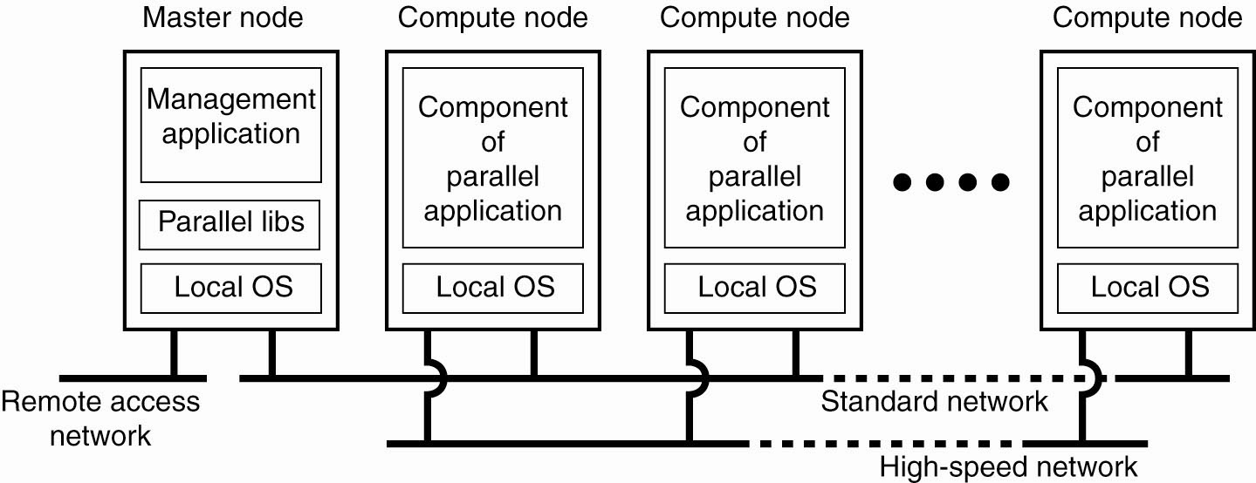
Example of a cluster computing system
Figure :- An example of a cluster computing system

Slide 23
Clusters – Beowulf model
Linux-based
High performance computing(HPC) tasks.
Master-slave paradigm
  One processor is the master; allocates tasks to other processors, maintains batch queue of submitted jobs, handles interface to users
  Master has libraries to handle message-based communication or other features (the middleware).

Slide 24
Clusters – MOSIX model
Provides a symmetric, rather than hierarchical paradigm
  High degree of distribution transparency (single system image)
  Processes can migrate between nodes dynamically and preemptively . Migration is automatic
Used to manage Linux clusters.
MOSIX in cluster computing models simplifies the management of distributed systems, improves load balancing, enhances scalability, and ensures efficient resource utilization across nodes.

Slide 25
ii) Grid Computing Systems:-
Modeled loosely on the electrical grid.
Highly heterogeneous with respect to hardware, software, networks, security policies, etc.
Resources from different organizations are brought together to allow the collaboration of a group of people or institutions. That collaboration is virtual organization.
Grids supports virtual organizations: a collaboration of users who pool resources (servers, storage, databases) and share them.
Grid software is concerned with managing sharing across administrative domains.

Slide 26
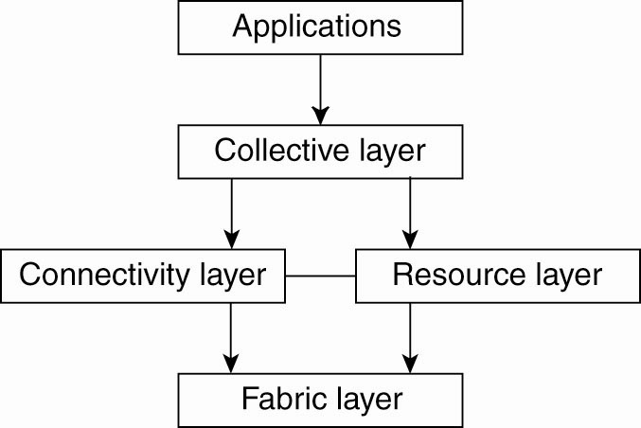
Architecture for Grid Systems
Fabric layer: interfaces to local resources.
Connectivity layer: contains communication protocols that supports usage of multiple resources; e.g., access a remote resource or transfer data between sites
Resource layer: manages a single resource
Collective layer: resource discovery, allocation, etc.
Applications: applications that operate with in a virtual organization. use the grid resources.
The collective, connectivity and resource layers together form the middleware layer for a grid
Figure:-A layered architecture for grid computing systems

Slide 27
OGSA – Another Grid Architecture
Open Grid Services Architecture (OGSA) is a service-oriented architecture
The architecture of the OGSA model is more complex than the previous layered model.
    Layered models are relatively simple, with clear and distinct layers handling separate concerns.
    OGSA necessitates more components, more interdependencies, and a higher level of flexibility, contributing to its increased architectural complexity.

Slide 28
2) Distributed Information Systems:-
It is used to keep track of the information running over the network , which are distributed among various entities.
Business-oriented.
Two types discussed here:
  Transaction Processing Systems
  Enterprise Application Integration

Slide 29
i)Transaction Processing Systems:-
Provide a highly structured client-server approach for database applications
Transactions are the communication model
Obey the ACID properties:-
  Atomic:-To the outside world, the transaction happens indivisibly
  Consistent:-The transaction does not violate system invariants.
  Isolated (serializable):-Concurrent transactions do not interfere with each other.
  Durable:-Once a transaction commits , the changes are permanent.

Slide 30
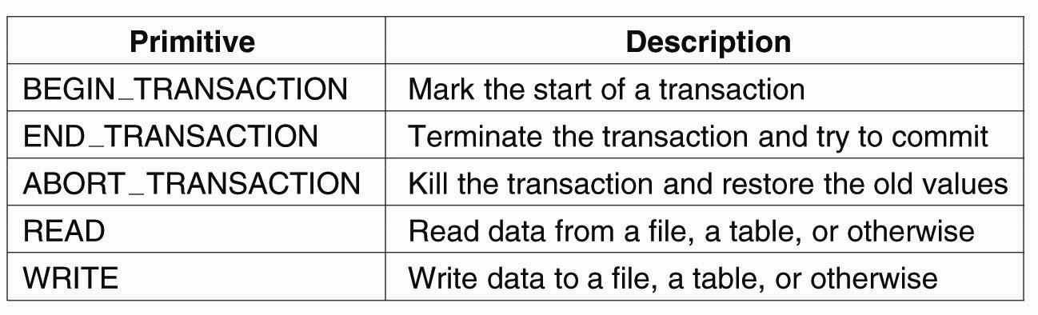
Figure :- Example primitives for transactions.

Slide 31
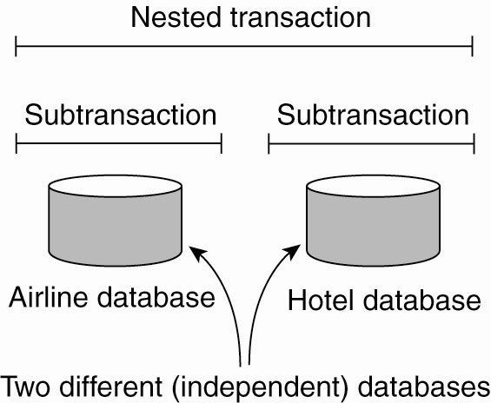
Figure:-A nested transaction.

Slide 32
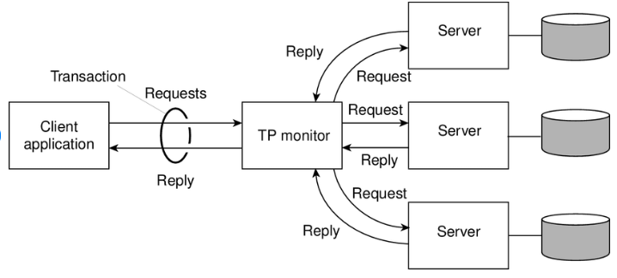
The role of a TP monitor in distributed systems
Figure:-The role of a TP monitor in distributed systems
Nested transactions are suitable for distributed systems.
  Transaction processing monitor may interface between client and multiple data bases.

Slide 33
  ii) Enterprise Application Integration:-
  Enterprise application integration is the process of connecting an organization’s applications , systems and databases to enable data sharing and communication.
Supports a less-structured approach (as compared to transaction-based systems).
    Note:- transaction processing system is tightly coupled-structure,because its using strict ACID process .
Communication mechanisms to support this include CORBA, Remote Procedure Call (RPC) and Remote Method Invocation (RMI).
Bussiness-oriented.

Slide 34
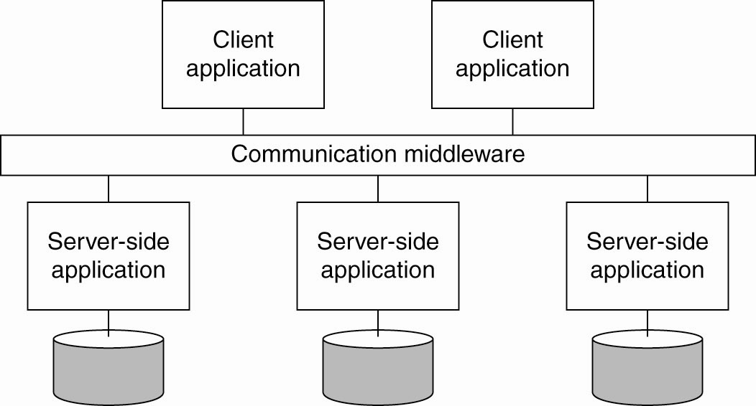
Figure:-Middleware as a communication facilitator in enterprise application integration.

Slide 35
3) Distributed Embedded Systems/ Distributed Pervasive Systems:-
The first two types of systems are characterized by their stability: nodes and network connections are more or less fixed
This type of system is likely to incorporate small, battery-powered, mobile devices
  Home systems
  Electronic health care systems – patient monitoring
  Sensor networks – data collection, surveillance

Slide 36
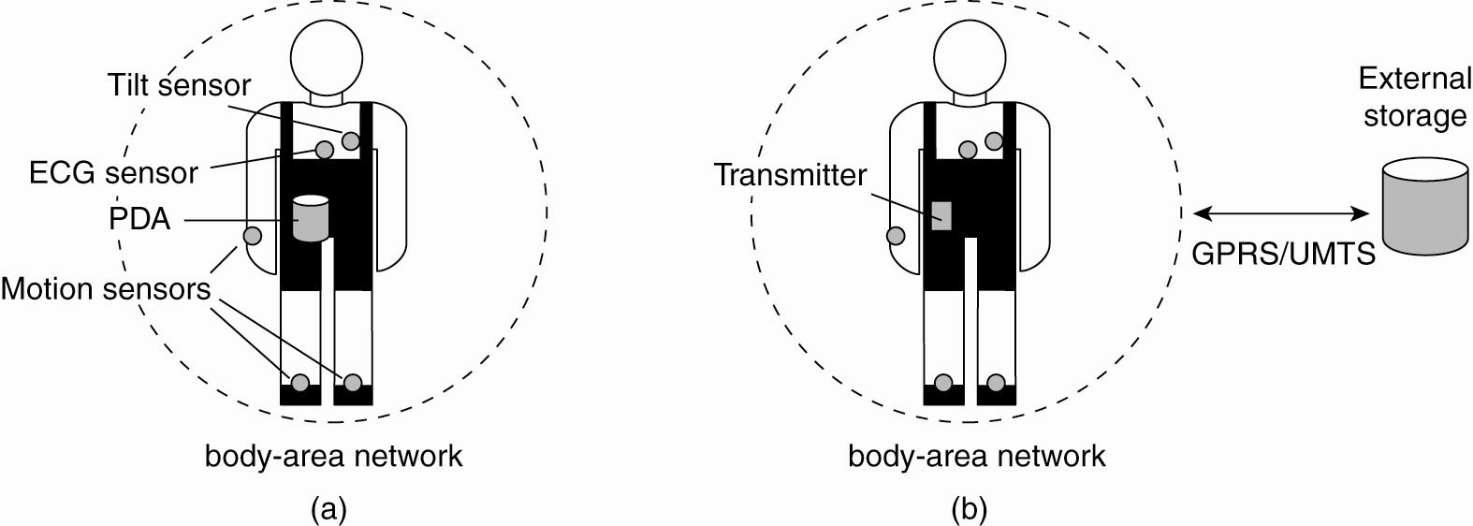
Figure:-Monitoring a person in a pervasive electronic health care system, using (a) a local hub or (b) a continuous wireless connection.
ii) Electronic Health Care Systems:-
Sensors: Multiple sensors are placed on the body, such as:
  Tilt sensor: Tracks body posture or tilt, often used in fall detection systems.
  ECG sensor: Monitors heart activity and can detect irregularities in heart rate or rhythm.
  Motion sensors: Detect movement or physical activity, helping to monitor activity levels, walking patterns, etc.
  PDA (Personal Digital Assistant): Acts as a central device that collects, stores, and processes the data from all the sensors.

Slide 37
Electronic Health Care Systems continued….
Transmitter:-
This unit likely collects data from the sensors and transmits to an external system.
GPRS/UMTS:-
General Packet Radio Services / Universal Mobile Telecommunication System .
these are wireless communication technologies , enabling the transmitter to send data to an External storage system.
External storage system:-
Such as cloud storage and etc..
Both a&b figures shows a Body-Area Network(BAN) used to monitor physiological signals.

Slide 38
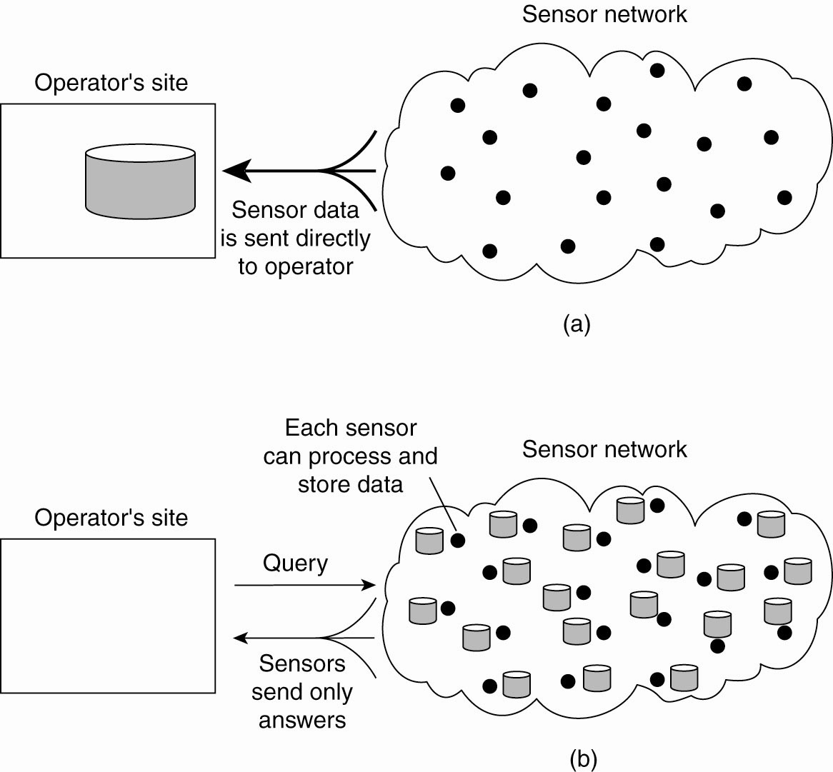
Figure:-Organizing a sensor network database, while storing and processing data (a) only at the operator’s site or …
iii) Sensor Networks:-

Slide 39
Figure :-Organizing a sensor network database, while storing and processing data … or (b) only at the sensors.

Slide 40
Distributed System Goals
Resource Accessibility
Distribution Transparency
Openness
Scalability

Slide 41
1) Goals - Resource Accessibility
To make it easy for users to access remote resources (printers, data files, web pages, CPU cycles) and share them with other users in a controlled way.
With sharing resource we can optimize the cost of functioning.
Performance enhancement – due to multiple processors; also due to ease of collaboration and info exchange
  Groupware: tools to support collaboration
Resource sharing introduces security problems.

Slide 42
2) Goals – Distribution Transparency
Distributed system hides the fact that its processes and resources are physically distributed across multiple computers.
A distributed system that appears to its users & applications to be a single computer system is said to be transparent.
  Users & app’s should be able to access remote resources in the same way they access local resources.

Slide 43
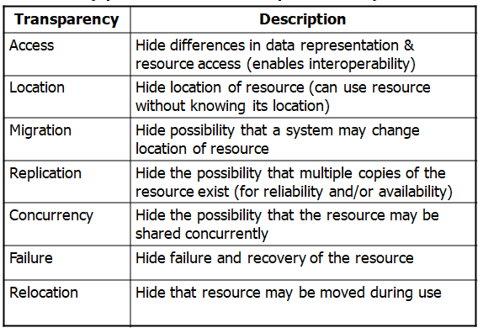
Types of Transparency:-
Figure :- Different forms of transparency in a distributed system.

Slide 44
Degree of Transparency:-
Trade-off: transparency versus other factors
  Reduced performance: multiple attempts to contact a remote server can slow down the system – should you report failure and let user cancel request?
  Convenience: direct the print request to my local printer, not one on the next floor
Too much emphasis on transparency may prevent the user from understanding system behavior.

Slide 45
3) Goal – Openness
An open distributed system “…offers services according to standard rules that describe the syntax and semantics of those services.”
  Compare to network protocols
Open distributed system should be flexible,which makes it easy to add components without affecting already existing components.
Interface Definition Language (IDL): used to describe the interface to a distributed system (parameters, return values, etc.)

Slide 46
Interoperability:- the ability of two different systems or applications to work together “… by relying on each other’s services as specified by a common standard.”
  Any process that needs a service should be able to communicate with a process that provides the service.
  Multiple implementations of the same service may be provided, as long as the interface is maintained
Portability:- the ability of an application designed to run on one distributed system to run on another system which implements the same interface.
Extensibility:- Easy to add new components, features

Slide 47
4) Goal – Scalability
3 different Dimensions that may scale
  i) With respect to size:- that we can easily add more users and resources to the system.
  ii) Geographical scalable system:- A geographically scalable system is one which the users and resources may lie far apart.
  iii) Administratively scalable:- A system can be administratively scalable , meaning that it can still be easy to manage even if it spans many independent administrative organizations.
A scalable system still performs well as it scales up along any of the three dimensions.
Unfortunately , a system that is scalable in one or more of these dimensions often exhibits some loss of performance as the system scales up.

Slide 48
Scalability problems
i) Scaling with respect to size:-
a) Centralized algorithms
b) Decentralized algorithms
a) Centralized algorithms:-
Scalability is negatively affected when the system is based on
  Centralized server: one for all users
  Centralized data: a single data base for all users
  Centralized algorithms: one site collects all information, processes it, distributes the results to all sites.
  Finally , centralized algorithms are also a bad idea, in a large distributed system.
    Complete knowledge: good
    Time and network traffic: bad

Slide 49
b) Decentralized algorithms:-
Decentralized algorithm have the following characteristics, which are distinguish them from centralized algorithms:-
1) No machine has complete information about the system state.
2) Machines make decisions based only on local information.
3) Failure of a single machine doesn’t ruin the algorithm.
4) There is no assumption that a global clock exists.

Slide 50
ii) Geographic Scalability:-
Early distributed systems ran on LANs, relied on synchronous communication.
  May be too slow for wide-area networks
Wide-area network communication is unreliable, point-to-point; LAN communication is based on broadcast.
  Consider how this affects an attempt to locate a particular kind of service

Slide 51
iii) Administrative scalable:-
Different domains may have different policies about resource usage, management, security, etc.
Trust often stops at administrative boundaries.

Slide 52
Scaling Techniques
Scalability affects performance more than anything else.
Three techniques to improve scalability:
  1) Hiding communication latencies
  2) Distribution
  3) Replication

Slide 53
1) Hiding communication latencies:-
Hiding communication latencies is important to achieve geographical scalability.
Structure applications to use asynchronous communication (no blocking for replies)
  While waiting for one answer, do something else; create one thread to wait for the reply and let other threads continue to process or schedule another task
Download part of the computation to the requesting platform to speed up processing
  Filling in forms to access a DB: send a separate message for each field, or download form/code and submit finished version.

Slide 54
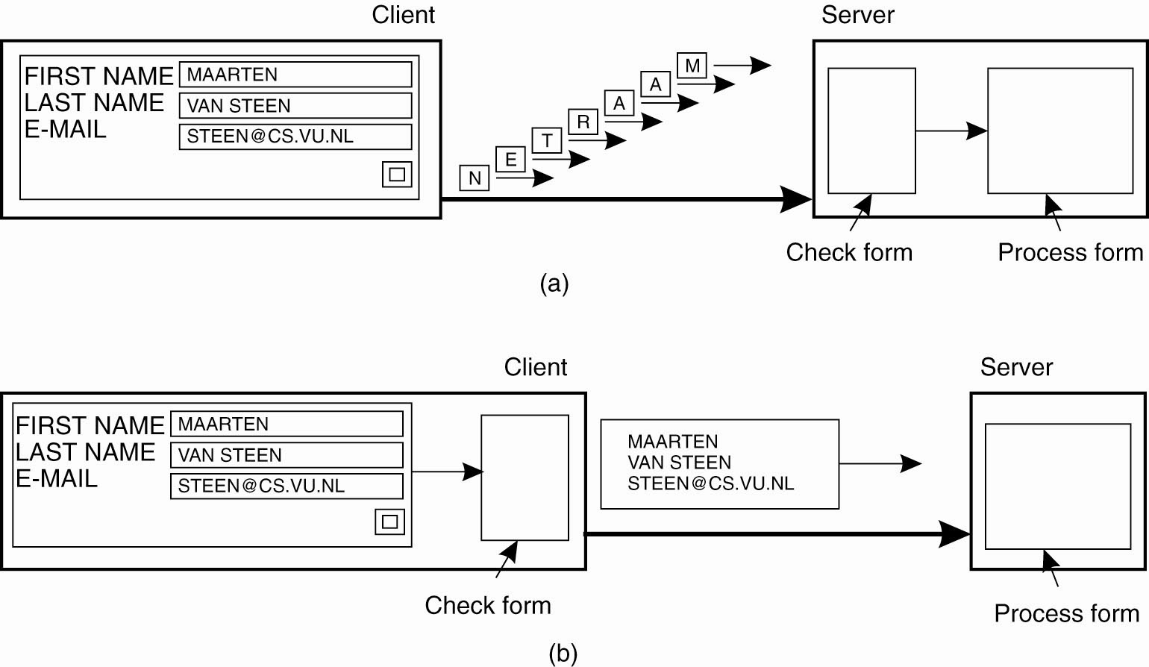
Figure :- The difference between letting (a) a server or (b) a client check forms as they are being filled.

Slide 55
2) Distribution:-
Instead of one centralized service, divide into parts and distribute geographically
  Example: DNS (Domain Name System) namespace is organized as a tree of domains; each domain is divided into zones; names in each zone are handled by a different name server.
  WWW consists of many (millions?) of servers

Slide 56
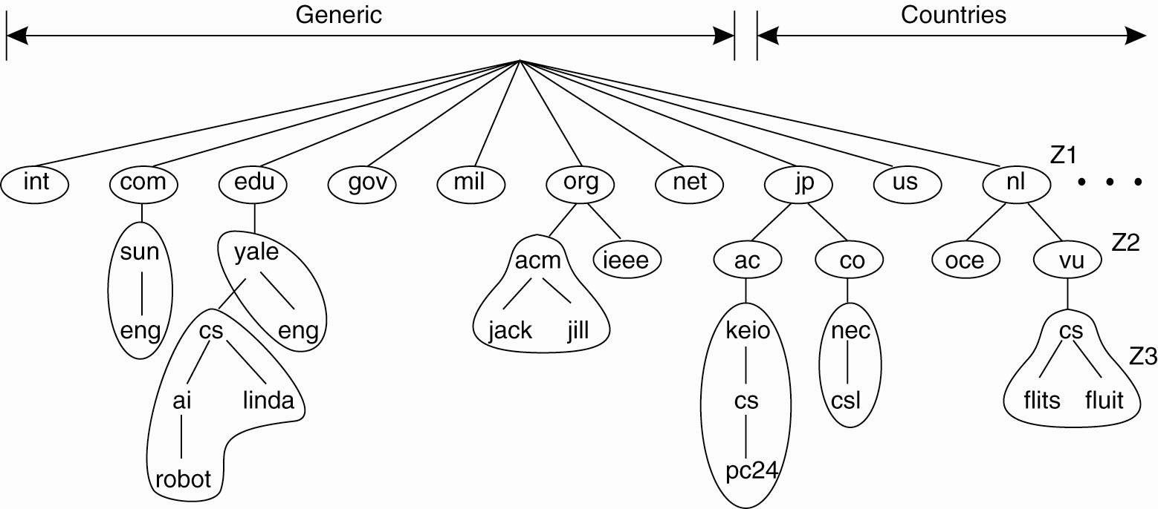
Figure:- an example of dividing the DNS name space into zones.
Splitting of DNS Name Space

Slide 57
3) Replication:-
Replication: multiple identical copies of something.
Replication
  Increases availability
  Improves performance through load balancing
  May avoid latency by improving proximity of resource
Caching:-
Caching is a special form of replication.
  Normally creates a (temporary) replica of something closer to the user
User decides to cache, system decides to replicate
Replication is more permanent
Both lead to consistency problems
Notes:
Scaling techniques
Latecncy:Amount of time taken by data packet to transfer from one place to another

Slide 58
Pitfalls of DS
These mistakes as the following false assumptions that everyone makes when developing a distributed application for the first time:-
1) The network is reliable.
2) The network is secure.
3) The network is homogeneous.
4) The topology does not change.
5) Latency is zero.
6) Bandwidth is infinite.
7) Transport cost is zero.
8) There is one administrator.

Slide 59
Thank you

