Slide 1
Distributed Systems
UNIT-1.2
Architectures
(Ref:Tanenbuam & Van Steen
Distributed Systems:Principles and Paradigms)

Slide 2
Topics in Architectures
Architectural Styles
System Architectures
Architectures v/s Middleware
Self Management in Distributed Systems

Slide 3
Basic definitions:-
Software architectures:- how various software components are organized and how they interact
System architecture:- An instance of a software architecture after deciding on the software components, their interaction and their placement.
Architectural style:- The way the components connected to each other, the data exchanged between components , and finally how these elements are jointly configured into a system.

Slide 4
Architectural Styles
Architectural style:- The way the components connected to each other, the data exchanged between components , and finally how these elements are jointly configured into a system.
Important styles of architecture for distributed systems:-
    Layered architectures
    Object-based architectures
    Data-centered architectures
    Event-based architectures

Slide 5
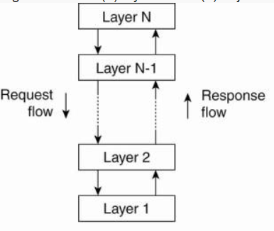
    1) Layered architectures:-
Components are organized in a layered fashion.
Each interaction is sequential.
Control generally flows from layer to layer.
Figure :- layered architectural style

Slide 6
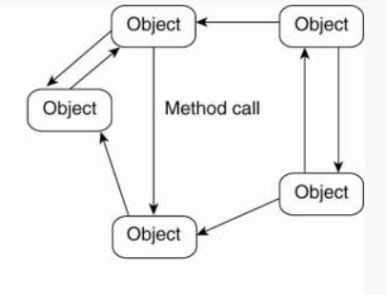
    2) Object-based architectures:-
Loosely Coupled arrangements of objects.
Each object corresponds to component.
Objects interact with the (remote) procedure call mechanism.
Figure :- The object-based architectural style

Slide 7
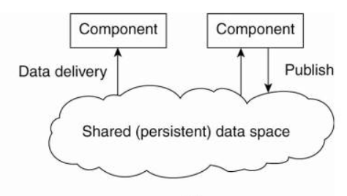
3) Data-centered architectures:-
Processes communicate through common repository.
Nodes information is stored in persistent data space.
Ex:Producer/consumer problem,distributed file system.
Figure :- Shared data-space architectural style.

Slide 8
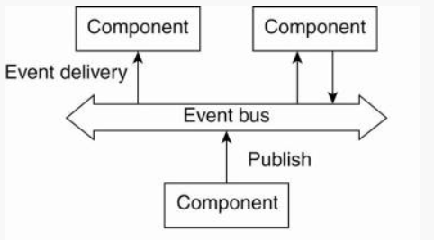
    4) Event-based architectures:-
Processes communicate through propogation of events.
Processes are loosely coupled.
Event can be a data ,url or inf etc.
Processes will publish the events.
Processes that subscribe will receive them.
Components are heterogenous.
Publish/subscribe system.
Figure 4:- The event-based architectural style

Slide 9
System Architectures
System architecture:- An instance of a software architecture after deciding on the software components, their interaction and their placement.
Here we are going to discuss about 3 types:-
        Centralized Organization:-
        Decentralized Organization:-
        Hybrid forms:-

Slide 10
Here we are going to discuss following topics:-
    Centralized Organization:-
      Application Layering
      Multitiered Architectures
          Two-tiered architecture
          Three-tiered architecture
    Decentralized Organization:-
          Structured Peer-to-Peer Architectures
          Unstructured Peer-to-Peer Architectures
          Topology Management of Overlay Networks
          Superpeers
    Hybrid forms:-
          Edge-server Systems
          Collaborative Distributed Systems

Slide 11
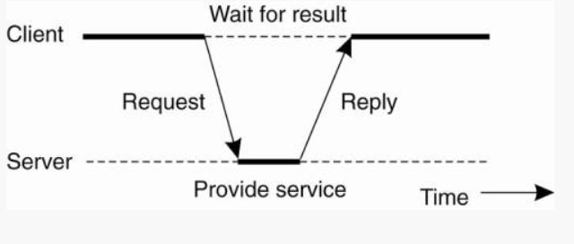
    1) Centralized Organization:-
In the basic client-server model, processes in a distributed system are divided into two (possibly overlapping) groups.
A server is a process implementing a specific service, eg, a file system service or a database service.
A client is a process that requests a service from a server by sending it a request and subsequently waiting for the server's reply.
This client-server interaction, also known as request-reply behavior.
Figure :-General interaction between a client and a server.

Slide 12
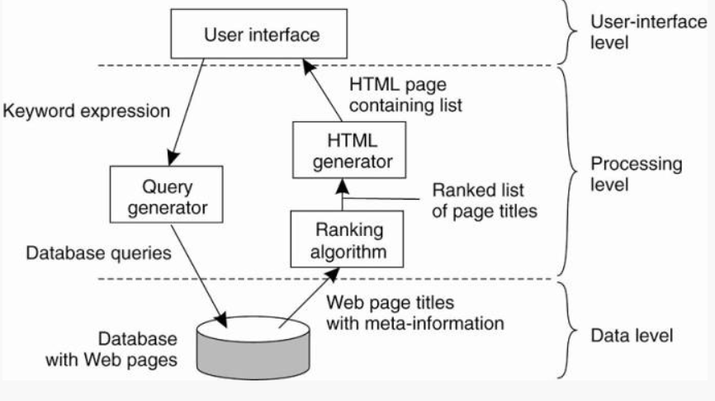
      Application Layering:-
Recall previously mentioned layers of architectural style.
1)The user-interface level 2)The processing level 3) The data level
Figure(Application layering with an example):- The simplified organization of an Internet search engine into three different layers.

Slide 13
      Multitiered Architectures:-
The simplest organization is to have only two types of machines:
      1) A client machine containing only the programs implementing (part of) the user- interface level
      2) A server machine containing the rest , the programs implementing the processing and data level
Here we are going to discuss below Multitiered Architectures:-
    i)Two-tiered architecture
    ii)Three-tiered architecture

Slide 14
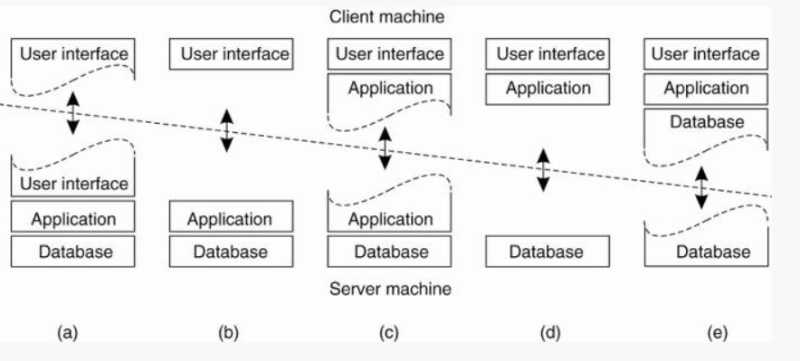
i)Two-tiered architecture:-
Figure :-Alternative client-server organizations (a)—(e).

Slide 15
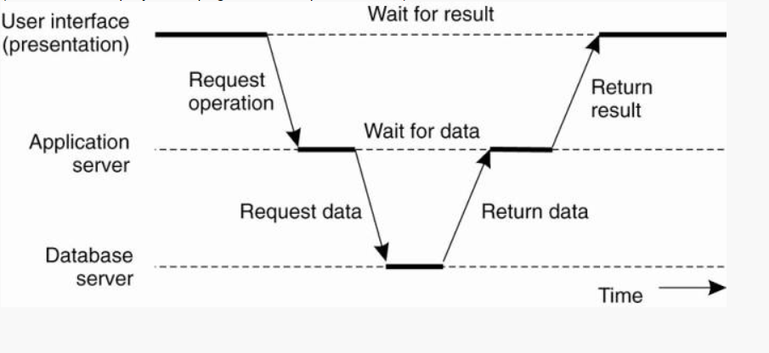
ii)Three-tiered architecture:-
Figure :-An example of a server acting as client.

Slide 16
2)Decentralized Organization:-
Vertical versus horizontal distribution. Horizontal distribution leads to peer-to-peer architectures.
Each process acts as a client and server at the same time. These are referred to as servents. Then the nodes are arranged in an overlay network based on the connections between them.
Here we discus below Architectures:-
  Structured Peer-to-Peer Architectures
  Unstructured Peer-to-Peer Architectures
  Topology Management of Overlay Networks
  Superpeers

Slide 17
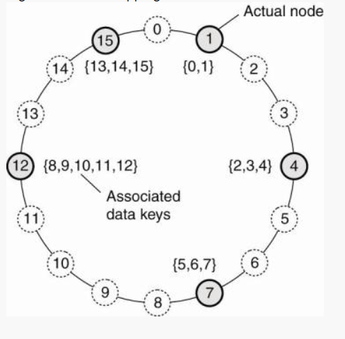
          Structured Peer-to-Peer Architectures:-
Follows deterministic procedure.
It organizes peers (nodes) and resources using a Distributed Hash Table (DHT). Ex:chord
The system is structured as a virtual circle where each node (computational entity) is assigned a unique identifier (like 0, 1, 2, ..., 15 in the example)
Each node is responsible for storing data associated with certain key values.
If a node fails, other nodes take over the responsibility for the associated keys, ensuring redundancy and fault tolerance.
Figure :- The mapping of data items onto nodes in Chord.

Slide 18
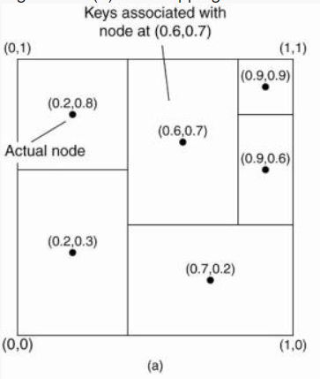
Content Addressable Network (CAN) maps data items onto nodes.
Each node in the system is responsible for a zone (or region) in this coordinate space.
The black dots represent the actual nodes in the CAN.
The entire space is divided among the nodes. Each node manages a rectangular region that is assigned to it based on its position.
A key (data item) is mapped into this coordinate space using a hash function that converts the key into a pair of coordinates.
The node responsible for the area containing the key's coordinates will store that data.
Figure :- (a) The mapping of data items onto nodes in CAN.

Slide 19
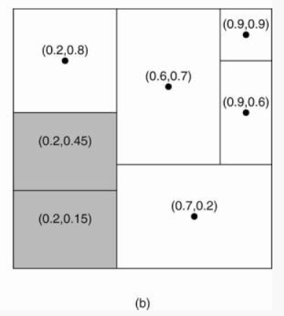
Region splitting in CAN occurs when a new node joins the network.
CAN dynamically redistributes the coordinate space to balance the load as nodes join and leave, ensuring efficient operation even in a large-scale, dynamic environment.
Figure:- (b) Splitting a region when a node joins.

Slide 20
          Unstructured Peer-to-Peer Architectures:-
In unstructured peer-to-peer (P2P) architecture, peers (nodes) connect to one another in a decentralized manner without a fixed or predefined topology.
Nodes form random or loosely organized networks, and connections between them are typically based on local or arbitrary decisions rather than a centralized control.
This leads to networks often modeled as random graphs, where nodes only maintain a partial view of the entire network.

Slide 21
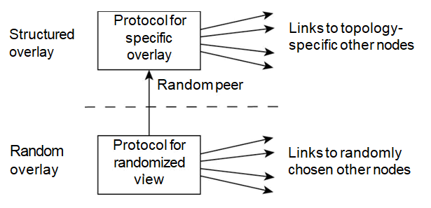
          Topology Management of Overlay Networks:-
Figure :- A two-layered approach for constructing and maintaining specific overlay topologies using techniques from unstructured peer-to-peer systems.
Notes:
topology refers to the arrangement or layout of various elements (links, nodes, etc.) in a system.
A structured overlay, on the other hand, organizes nodes according to a specific algorithm or topology.
A random overlay is a type of network overlay where connections between nodes are established arbitrarily, without following a strict pattern or structure. This is often seen in unstructured P2P networks.

Slide 22
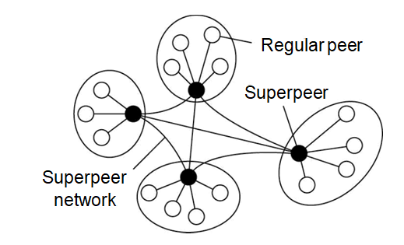
          Superpeers:-
Regular peers: These are standard nodes that connect to and communicate primarily with their assigned superpeers. They don't handle extensive routing or query distribution themselves. These are connected as a client to super peer.
Superpeers: These are nodes with more resources (processing power, storage, or bandwidth) and act as intermediaries for a group of regular peers. They handle query processing and routing on behalf of their connected regular peers, reducing the overall load on the network.
Superpeer network: Superpeers are interconnected, forming a network among themselves to further propagate search queries or data requests between other superpeers. This helps in achieving scalability and more efficient query processing compared to a pure P2P network.
Figure :- A hierarchical organization of nodes into a superpeer network.

Slide 23
    3) Hybrid forms:-
Here we are going to discus about below topics:-
        Edge-server Systems
        Collaborative Distributed Systems
Notes:
Hybrid is the combination of p2p and client server

Slide 24
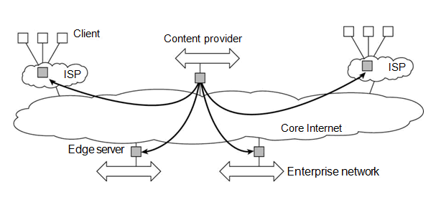
        Edge-server Systems:-
An edge server is a server located closer to the end users in a distributed computing system, typically near the "edge" of the network. It is designed to reduce latency and improve the speed and performance of data processing and content delivery by bringing resources physically closer to the user.
CDNs (Content Delivery Network) use edge servers to deliver web content faster by caching data in multiple edge locations. This reduces the load on the central server and improves content access for users.
Figure :-Viewing the Internet as consisting of a collection of edge servers.

Slide 25
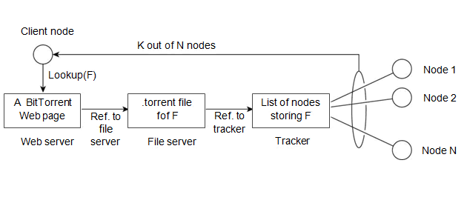
        Collaborative Distributed Systems:-
BitTorrent is a peer-to-peer (P2P) file-downloading system.
When an end user is looking for a file, he downloads chunks of the file from other users until the downloaded chunks can be assembled together yielding the complete file.
To download a file, a user needs to access a global directory, i.eWeb site.
A .torrent file contains the information that is needed to download a specific file.
A tracker is a server of active nodes that have (chunks) of the requested file. An active node is one that is currently downloading the file.
Figure :-The principal working of BitTorrent

Slide 26
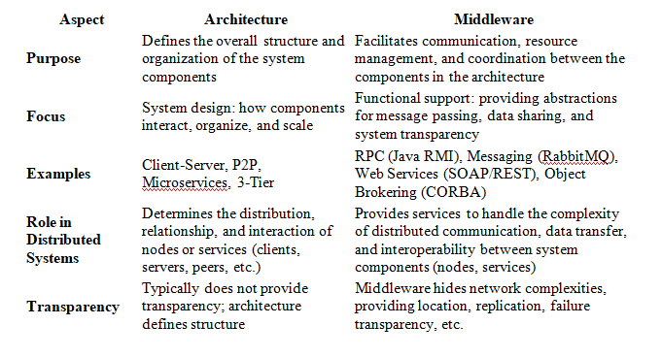
Architectures v/s Middleware

Slide 27
Example in Real Systems:-
Netflix (Architecture):
  Micro services Architecture: Netflix uses a micro services architecture where different services (such as streaming, recommendation engine, and user profiles) run independently and interact via APIs.
Netflix (Middleware):
  Middleware for Communication: Netflix uses Apache Kafka as a message broker between micro services, handling communication and data streaming between the various components.
  API Gateway (Zuul): Netflix also uses Zuul, a middleware service that routes requests to the appropriate micro service.
Conclusion:-
architecture defines the high-level layout of distributed systems, while middleware provides the underlying support to manage communication, data exchange, and other complexities within the system.

Slide 28
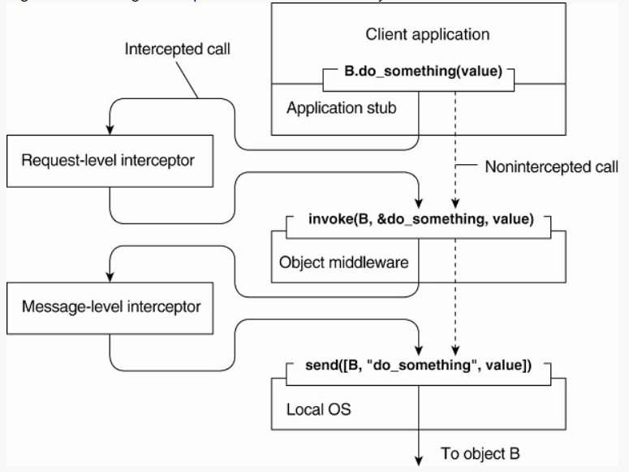
Interceptors:-
Figure 2-15. Using interceptors to handle remote-object invocations.
Notes:
An interceptor is nothing but a software construct that will break the usual flow of control and allow other (application specific) code to be executed.
Request-level interceptors and message-level interceptors are common mechanisms in web services and distributed systems that provide ways to handle and manipulate requests or messages before they reach their final destination. They are used for tasks like logging, security, authentication, and data transformation.

Slide 29
General Approaches to Adaptive Software:-
Based on the usage/request if we change the functionality/working of the middleware that is called adaptive middleware.
Three basic approaches to adaptive software:
Separation of concerns:- separate the extra functionalities into different parts and later work on them into a single implementation.
Computational reflection:-A technique that allows software to observe and modify its own structure and behavior at runtime.
Component-based design:-making it easier to adjust, extend, or replace parts of the software as needed.

Slide 30
Self Management in Distributed Systems
The ability of a system to autonomously handle tasks like configuration, optimization, healing, and security, reducing or eliminating the need for human intervention.
This concept is key in designing systems that can scale effectively, recover from failures, and adapt to changing environments without requiring constant manual management.

Slide 31
Components of Self-Management:-
Self-Configuration:-The system can automatically configure itself when new nodes are added or when changes occur.
Self-Optimization:- The system constantly monitors its performance and adjusts resources to optimize its operation.
Self-Healing:- The system detects failures or faults and takes corrective actions without human intervention.
Self-Protection:-The system autonomously identifies and mitigates security threats.This includes detecting malicious activity (e.g., intrusion detection), preventing unauthorized access, and patching vulnerabilities.

Slide 32
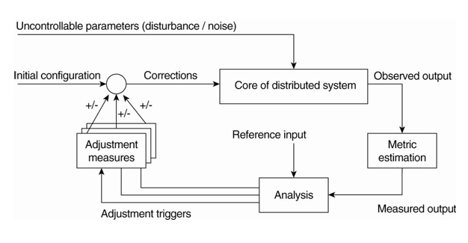
The Feedback Control Model:-
There are many different views on self-managing systems, but what most have in common (either explicitly or implicitly) is the assumption that adaptations take place by means of one or more feedback control loops. Accordingly, systems that are organized by means of such loops are referred to as feedback control systems.
Figure :-The logical organization of a feedback control system.
Notes:
Metric estimation component is for evaluating and predicting the system's performance, stability, and accuracy
Feedback analysis component it conatins alogorithms and decide on possible adaptions

Slide 33
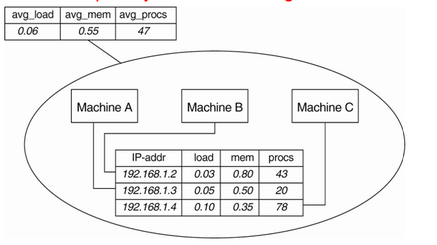
Example: Systems Monitoring with Astrolabe
Astrolabe is a system designed for monitoring and managing large-scale distributed systems. It organizes a large collection of hosts into a hierarchy of zones.
The information gathered by each machine can be viewed as a record in database.
Select AVG(procs) as avg_procs from hostinfo
Figure :-Data collection and information aggregation in Astrolabe.
Notes:
Every host runs an Astrolabe process, called an agent, that collects information on the zones in which that host is contained. The agent also communicates with other agents with the aim to spread zone information across the entire system.

Slide 34
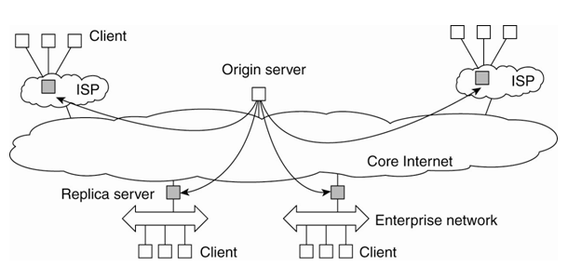
Example: Differentiating Replication Strategies in Globule
Globule assumes that the Internet can be viewed as an edge-server system. In particular, it assumes that requests can always be passed through an appropriate edge server, as shown in below figure.
This simple model allows an origin server to see what would have happened if it had placed a replica on a specific edge server.
On the one hand, placing a replica closer to clients would improve client-perceived latency, but this will induce traffic between the origin server and that edge server in order to keep a replica consistent with the original page.
Figure :- The edge-server model assumed by Globule.
Notes:
Globule, a collaborative content distribution network
Globule relies on end-user servers being placed in the Internet, and that these servers collaborate to optimize performance through replication of Web pages

Slide 35
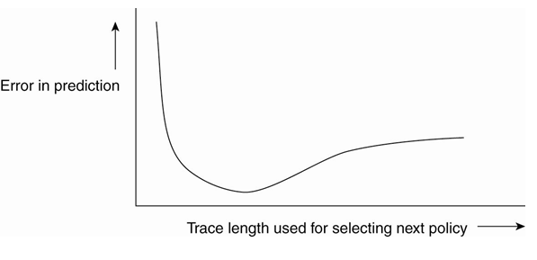
Dependency between prediction accuracy and trace length
Figure:-The dependency between prediction accuracy and trace length.
Notes:
When an origin server receives a request for a page, it records the IP address from where the request originated, and looks up the ISP or enterprise network associated with that request using the WHOIS Internet service (Deutsch et al., 1995). The origin server then looks for the nearest existing replica server that could act as edge server for that client, and subsequently computes the latency to that server along with the maximal bandwidth. In its simplest configuration, Globule assumes that the latency between the replica server and the requesting user machine is negligible, and likewise that bandwidth between the two is plentiful.
[Page 64]

Slide 36
Example: Automatic Component Repair Management in Jade
Jade ,a java implementation framework that allows components to be added and removed at runtime.
Steps required in a repair procedure:
Terminate every binding between a component on a non-faulty node, and a component on the node that just failed.
Request the node manager to start and add a new node to the domain.
Configure the new node with exactly the same components as those on the crashed node.
Re-establish all the bindings that were previously terminated.

Slide 37
Thank you

