Slide 1
PROJECT 1 Message board status report
Vyshnavi Popuri
Shravan Chouti

Slide 2
Forum for Technology news:
This is a message board for technology news where user can post regarding any updates in different technologies.
Allows user to view the posts of others and respond to them.
User can choose from various topics available and then start a discussion.

Slide 3
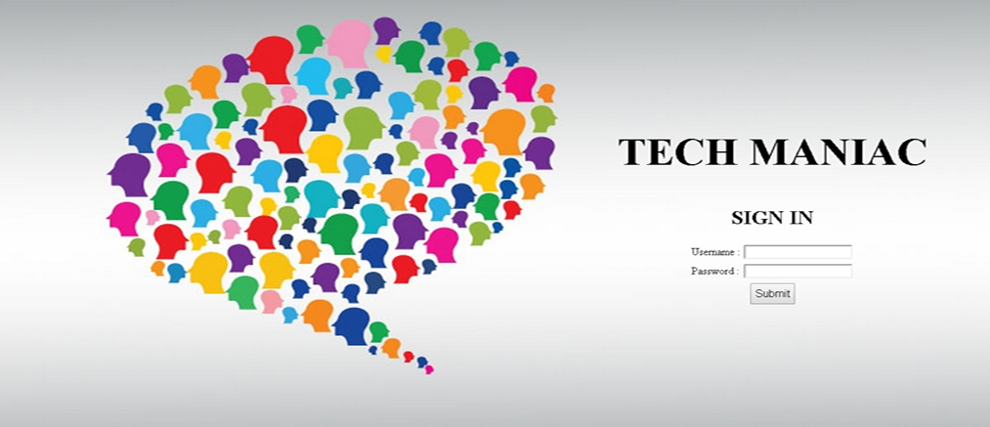
Status: Login Page created, DB connections are done, working on the home page and multiple threads in the page. Problems: Alignment and UI problems. Solution: CSS properties such as div, horizontal, vertical and text align etc. Concepts: PHP, HTML and CSS To-dos: Create multiple threads i:e different topics in the home page

Slide 4
References
http://getbootstrap.com/2.3.2/base-css.html#tables
http://getbootstrap.com/2.3.2/getting-started.html#html-template
http://www.tech-forums.net/forums

