Slide 1
Name: SUN VYSING ID: e20191124 Group: I4-GIC-C
Internet Programming I
TP: 03

Slide 2
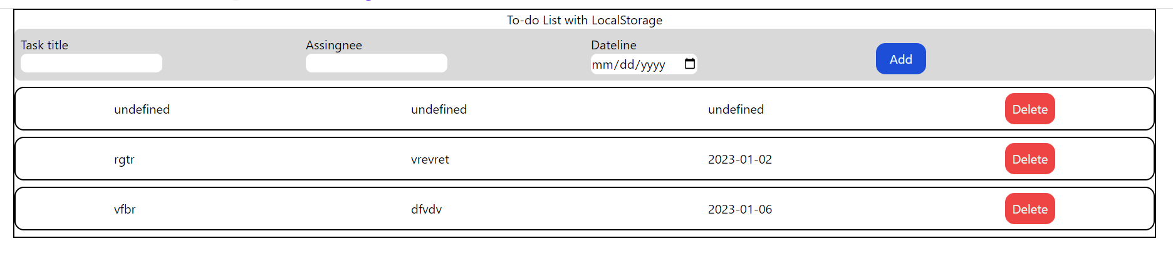
Exercise 1

Slide 3
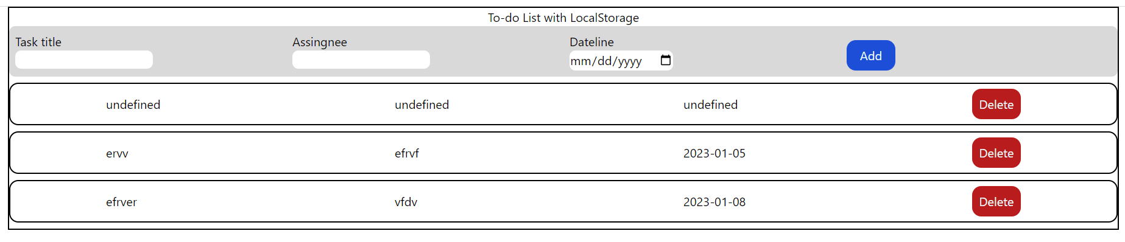
Exercise 2

Slide 4
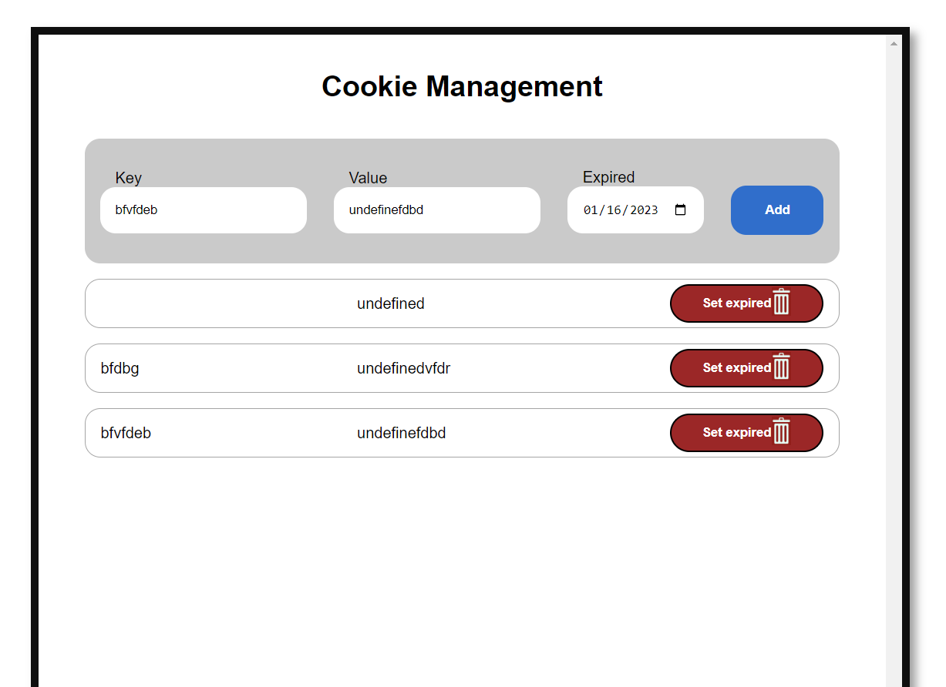
Exercise 3

Slide 5
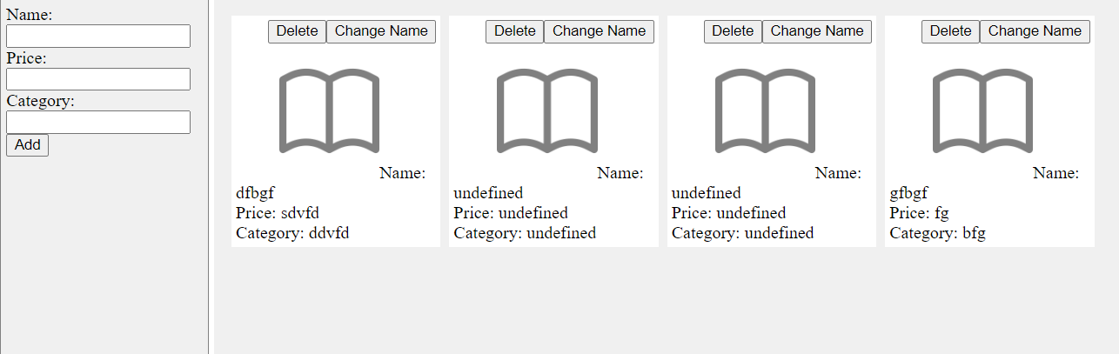
Exercise 4

Slide 6
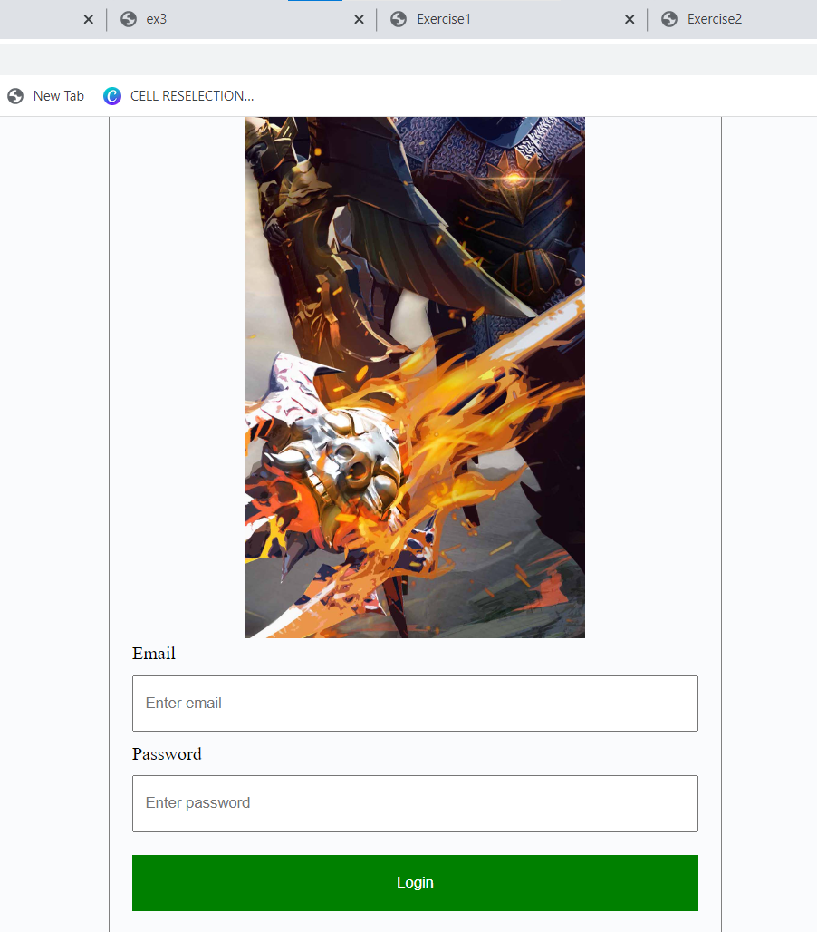
Exercise 5

