Slide 1





The *ongoing* future of
Perl is a very popular programming language used in web development, software integration, data conversion, system administration, and many other areas. This talk will discuss Perl capabilities, applications, use in industry, and job prospects and ways to excel.
Presented by Southampton Perl Mongers
Wednesday
29 October
1-2pm
Room A2.08
Anglesea building
Where is your language in the food chain?

Slide 2
The *on-going* future of Perl5
Southampton Perl Mongers
Slides are available at http://goo.gl/5v8nXl

Slide 3
About us

Slide 4
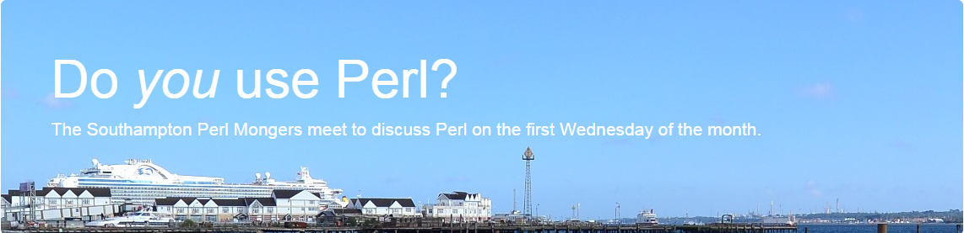
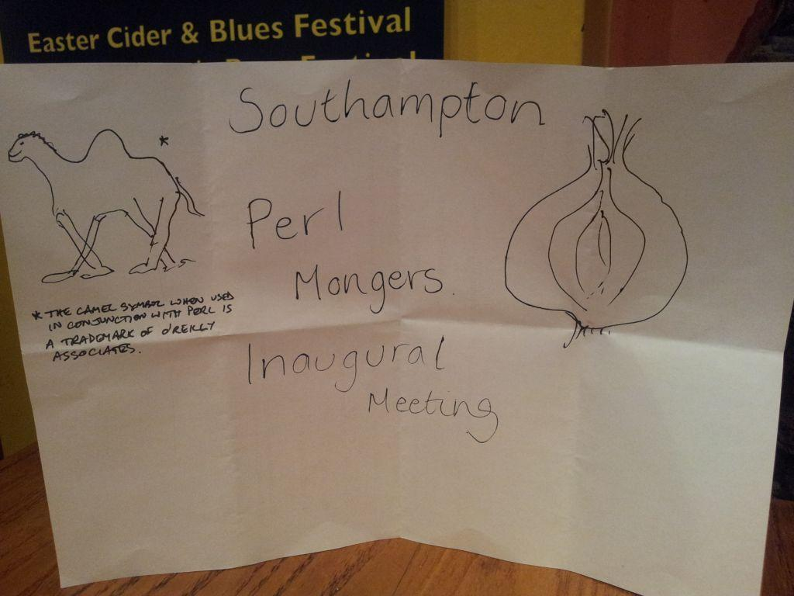


About us
http://southampton.pm.org/

Slide 5
Why we are here..

Slide 6

Why we are here..

Slide 7
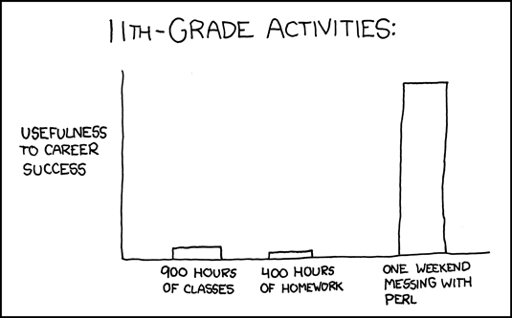
source: http://xkcd.com/519/

Slide 8
Agenda
Part 1: Perl jobs & trends
Part 2: Perl awesomeness

Slide 9






























Who is using Perl?
Notes:
for more: https://github.com/vmbrasseur/Perl_Companies/blob/master/Perl_Companies.yaml
VD: I am not happy about diff sizes :(

Slide 10

What’s Perl?
An awesome programming
language that allows
you to quickly
achieve various
tasks in your way!

Slide 11
Perl influenced...

Slide 12
Perl influenced...
Windows PowerShell

Slide 13
Perl influenced...
Windows PowerShell
Ruby

Slide 14
Perl influenced...
Windows PowerShell
Ruby
JavaScript

Slide 15
Perl influenced...
Windows PowerShell
Ruby
JavaScript
and more...
see http://en.wikipedia.org/wiki/Perl for more

Slide 16
What can you do with Perl?
Amazing web applications that are easy to scale, develop and deploy in different environments with great frameworks like Mojolicious, Catalyst, Dancer, etc.

Slide 17
What can you do with Perl?
Scientific computing (Perl Data Language)
Controlling your UAV (UAV-Pilot)
Generating G-codes for 3D printing (Slic3r)
I can’t think of anything that Perl would not be able to do, but another language could.

Slide 18
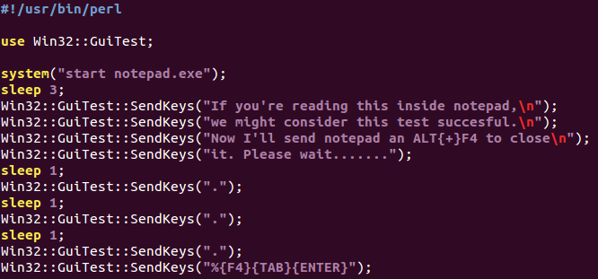
Demo

Slide 19


Google Summer of Code
GSoC 2015 website
Google@Home source code
Google@Home start up guide

Slide 20
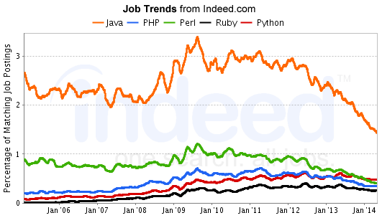
source: goo.gl/aFyHgJ

Slide 21
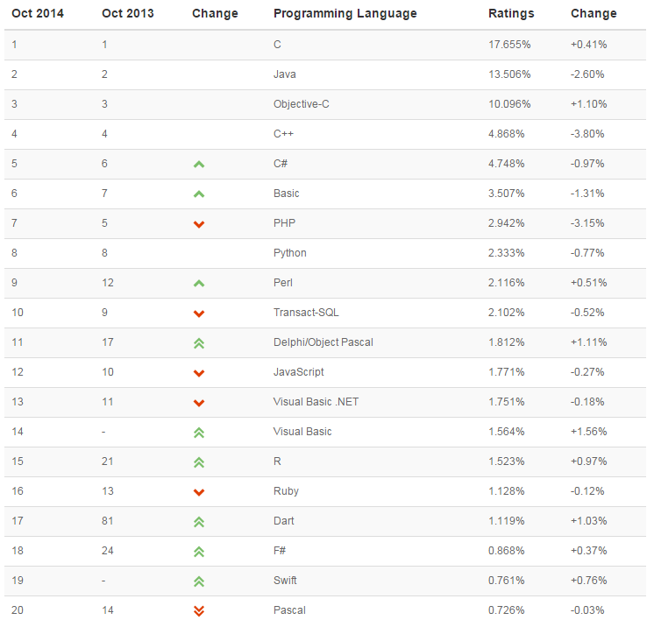
source: TIOBE Index for October 2014 ( tiobe.com )

Slide 22
Invest Regularly in Your Knowledge Portfolio
Different languages solve the same problems in different ways. By learning several different approaches, you can help broaden your thinking and avoid getting stuck.

Slide 23
Invest Regularly in Your Knowledge Portfolio
Developers who know only Python find it more difficult to start working with other languages.

Slide 24
Invest Regularly in Your Knowledge Portfolio
No language can be mainstream forever.

Slide 25
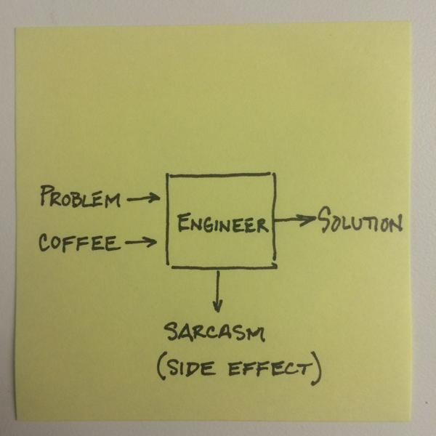
A rule of thumb..

Slide 26
Before we start..
….In Perl there are also two important things to keep in mind when you code:
Easy things should be easy, and hard things should be possible - Larry Wall
There's more than one way to do it (TMTOWTDI)

Slide 27

Perl has some of the best Unicode support today, especially with respect to regular expressions.
Benjamin Peterson
The Guts of Unicode in Python
PyCon 2013 [ http://goo.gl/uIl8VB ]

Slide 28

Lets start learning Perl!
… and finally let’s rock a little bit

Slide 29
Obtaining Perl
Windows: Strawberry Perl
(http://strawberryperl.com/)
Linux: Install from distribution repositories, e.g.
$ sudo apt-get install perl
# yum install perl

Slide 30
Give me a variable!
use strict;
use warnings;
my $name = 'John';
my $greeting = “Hello there, $name”;
print “$greeting\n”;

Slide 31
Give me a hash!
my %person = ( name => 'John', age => 29, );
my $greeting = “Hello there, %person{'name'}”;
print “$greeting\n”;
%person{'age'} = 30;

Slide 32
Give me an array!
my @people = ( 'John', 'Sue', 'Mary' );
for my $person (@people) {
print “Hello there, $person\n”;
}

Slide 33
Give me a function!
for my $person (@people) {
greet($person);
}
sub greet {
my ($person) = @_;
print “Hello there, $person\n”;
return 1;
}

Slide 34
Give me an object!
package Person;
sub new {
my ($class, $name, $age) = @_;
return bless {
name => $name, age => $age,
} $class;
}
1;

Slide 35
Give me an method!
sub greet {
my ($self) = @_;
print “Hello there, $self->{'name'}”;
return 1;
}

Slide 36
Using objects
use strict;
use warnings;
use Person;
my $person = Person->new('John', 29);
$person->greet();

Slide 37
Obtaining help
http://perldoc.perl.org

Slide 38
Mojolicious
Mojolicious is unique and awesome web framework.

Slide 39
I
Mojolicious

Slide 40
I
a lot
Mojolicious

Slide 41
Mojolicious
Mojolicious is unique and awesome web framework.
In 1998, Perl was called “The duct tape that holds the internet together”.

Slide 42
Mojolicious
Mojolicious is unique and awesome web framework.
In 1998, Perl was called “The duct tape that holds the internet together”.
In 2014, Mojolicious is called “The duct tape for the HTML5 world”.

Slide 43
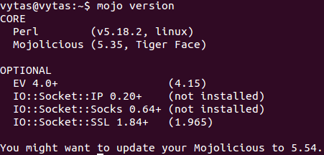
mojo version

Slide 44
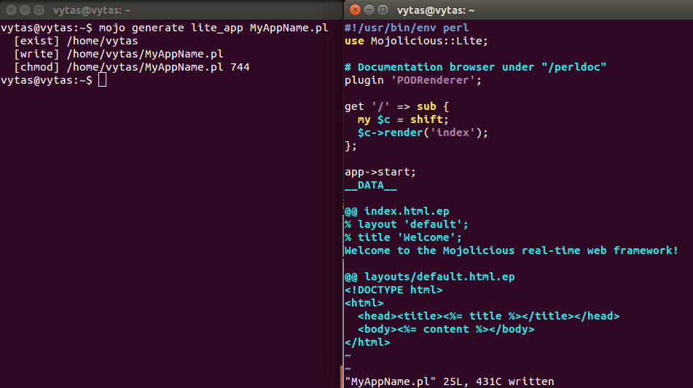
mojo generate lite_app

Slide 45
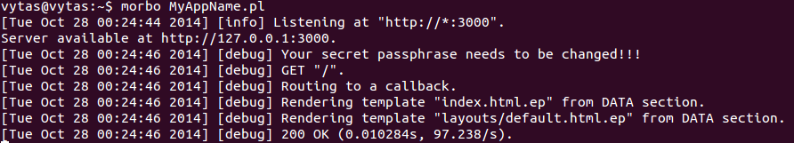
Run your app

Slide 46
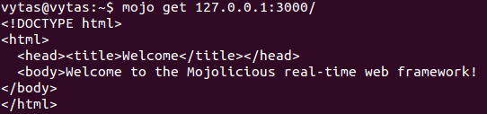
mojo get

Slide 47
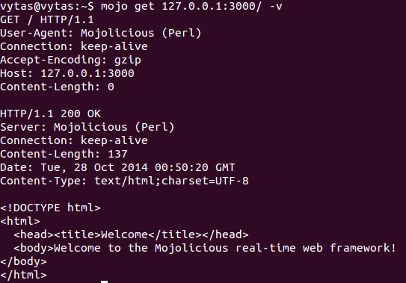
mojo get -v

Slide 48
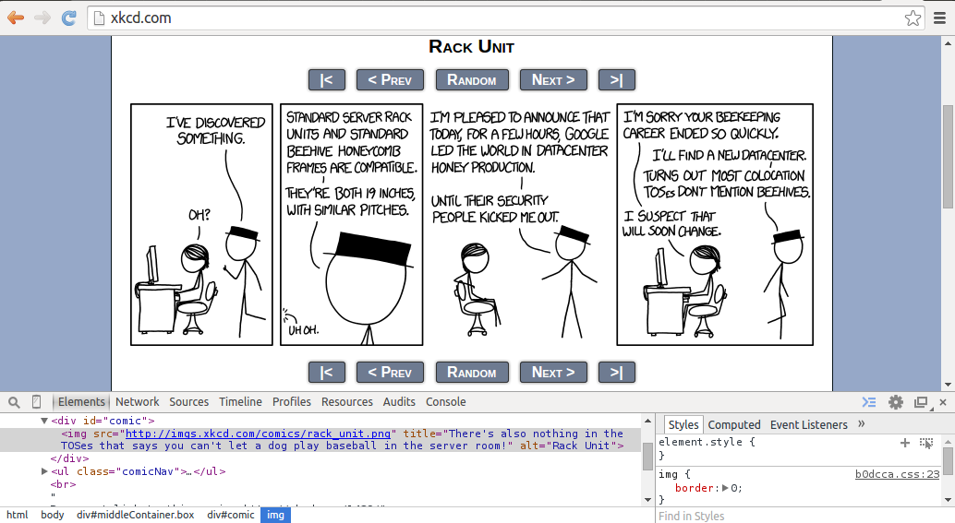
How to get newest comic from xkcd.com ?

Slide 49
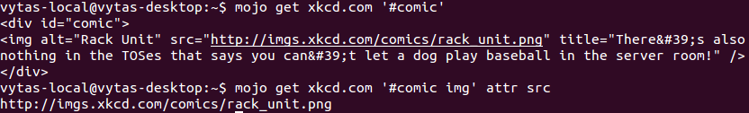
How to get newest comic from xkcd.com ?

Slide 50
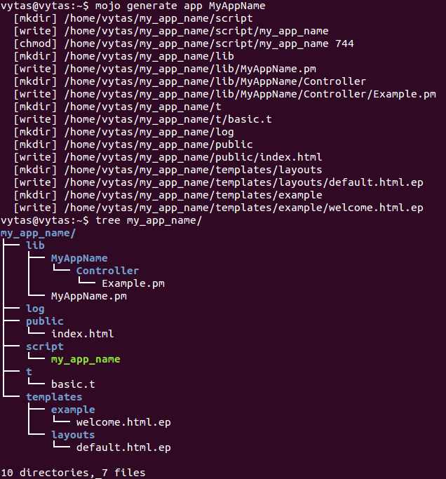
mojo generate app

Slide 51
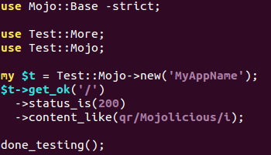
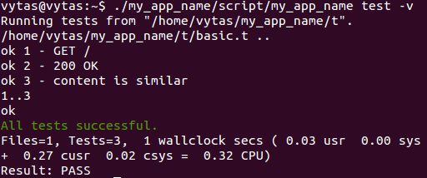
mojo test

Slide 52

https://metacpan.org/

Slide 53
Upcoming events ( 2014 )
London Perl Workshop ( 8 November )
http://act.yapc.eu/lpw2014/

Slide 54
Join Perl Mongers!
Come to Perl social meetings, get a free drink!
Next one Wed 5th Nov, Platform Tavern, Soton
More information on http://southampton.pm.org/

Slide 55
Apply for send-a-newbie
Annually 1 newbie gets sent to YAPC for free
http://www.send-a-newbie.enlightenedperl.org/index.html

Slide 56
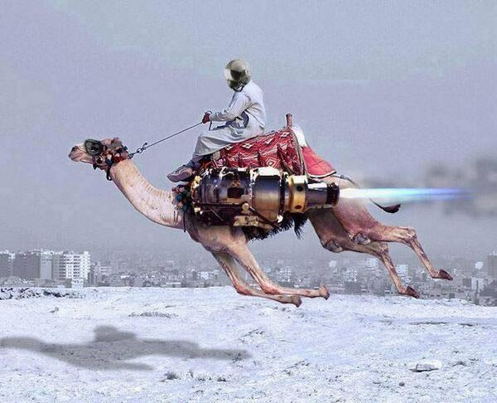
That’s All Folks
Any Questions?

Slide 57

Thank you

Slide 58
Bonus slides
Didn’t have time to cover bonus slides, hence removed...

