Slide 1

Predicting Loan Repayment
An Analysis of LendingClub.com Data

Slide 2

Presentation Overview
Objective
Dataset Overview
Data Preprocessing and Handling
Exploratory Data Analysis
Model Development and Evaluation
Success Measures
Model Comparison
Conclusion and Recommendations

Slide 3

Objective
Analyze LendingClub.com data to predict whether borrowers will repay their loans.
Developing various models and evaluating them to land on a model that can give best accuracy and best combination of recall of bad borrowers and good borrowers.

Slide 4

Dataset Overview
Description:
LendingClub.com dataset with features related to loan and borrower information.
Key Features:
Features include credit policy, loan purpose, interest rate, installment, annual income, debt-to-income ratio, FICO score, credit line days, revolving balance, revolving line utilization, inquiries, delinquencies, and public records.
Target Variable:
not.fully.paid: Indicates whether the borrower paid back the loan in full (0) or not (1).

Slide 5

Data Preprocessing And Handling
Studying the data
Checking for missing/ duplicate values.
Encoding categorical variables.
Scaling numerical features.
Removing outliers using the IQR method.
Applying SMOTE algorithm to reduce data biasness

Slide 6
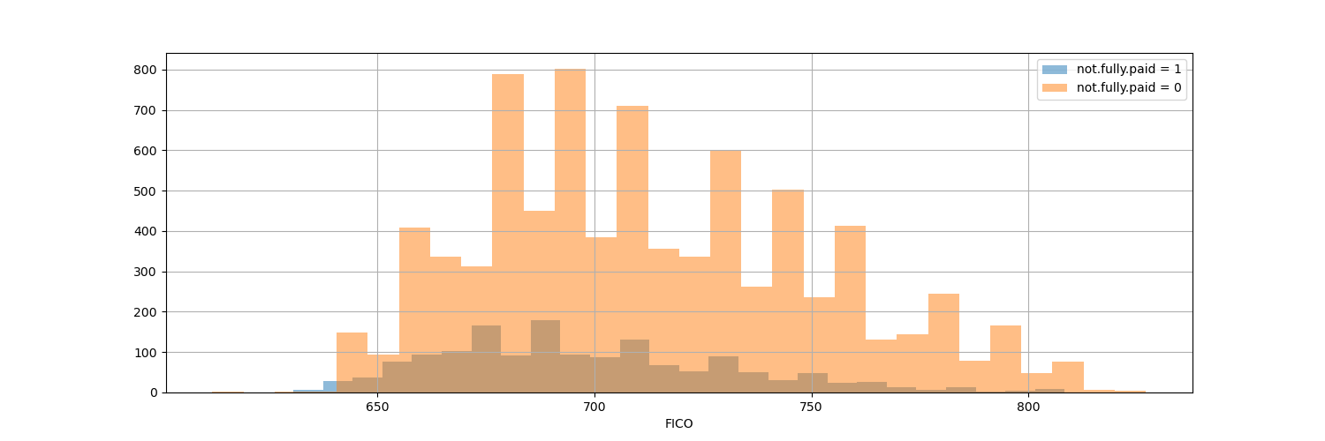
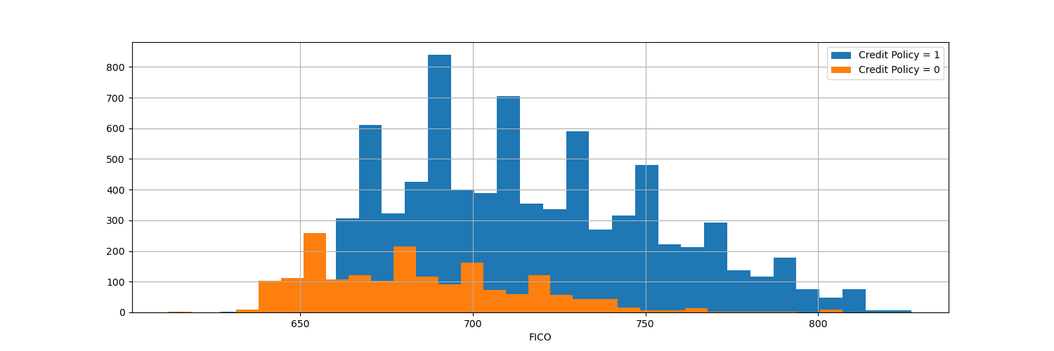
Exploratory Data Analysis (EDA)
Histograms to check on trend of fico score with loan pay back and credit policy
We can see borrowers with high FICO score are among the people who paid back the loan
We can see borrowers with high FICO score are the ones who have Credit Policy 1

Slide 7
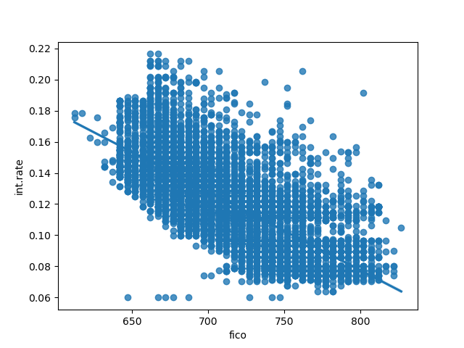
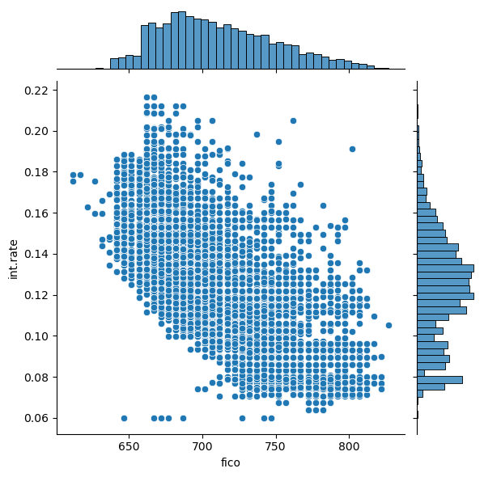
Exploratory Data Analysis (EDA)
Regression Plot and Joint Plots to view fico score and interest rates dependency
We can observe that it is very rare that for any high fico score there is high interest rate
They both are strongly negatively correlated with correlation of -0.714

Slide 8
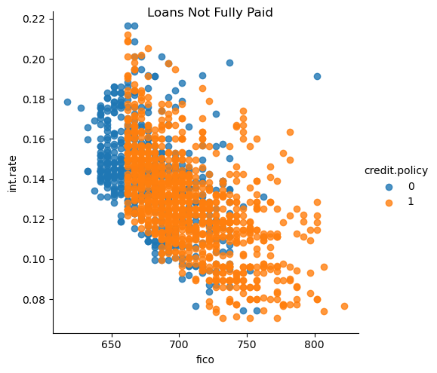
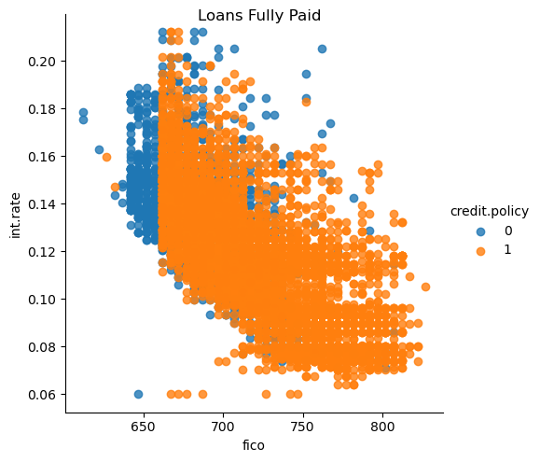
Exploratory Data Analysis (EDA)
Lm Plots to view the trend dependency as per fico score, interest rate, credit policy, not fully paid
In the given data set, density of borrowers who has fully paid is high
From below graphs we can see there is no much difference in pattern of full paid or not, fico score, interest rate considering credit policy being 1 or 0

Slide 9
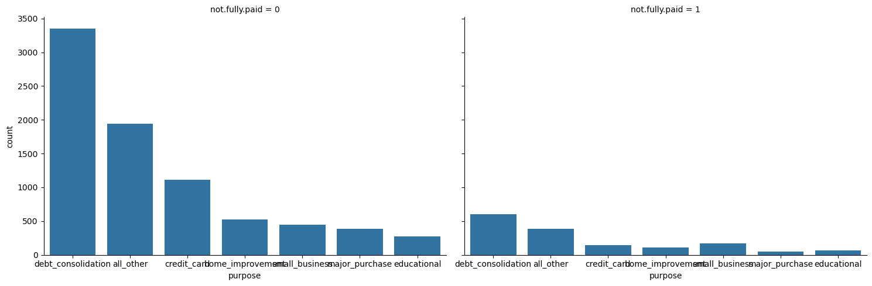
Exploratory Data Analysis (EDA)
Count Plots to have a look on Loan payback as per the purpose of loan taken
As we can see mostly the loan are taken on purpose of debt consolidation as purpose followed by all other purposes, credit card

Slide 10
Models Developed For Prediction (Original Data)
Decision Tree
precision recall f1-score accuracy
0.74 0.73 0.74 0.73
Decision Tree with Scaled X
precision recall f1-score accuracy
0.74 0.73 0.74 0.73
Random Forest
precision recall f1-score accuracy
0.75 0.83 0.76 0.83
Gradient Boosting
precision recall f1-score accuracy
0.76 0.83 0.76 0.83

Slide 11
Models Developed For Prediction (Cleaned Data)
Decision Tree
precision recall f1-score accuracy
0.88 0.87 0.87 0.87
Random Forest
precision recall f1-score accuracy
For 0 - 0.92 0.97 0.95
For 1 - 0.90 0.59 0.71
0.92 0.92 0.91 0.92
Gradient Boosting
precision recall f1-score accuracy
0.78 0.82 0.79 0.82

Slide 12
Models Developed For Prediction (Cleaned Data With SMOTE Algorithm)
Decision Tree
precision recall f1-score accuracy
0.87 0.85 0.86 0.85
Random Forest
precision recall f1-score accuracy
0.89 0.89 0.89 0.89
Gradient Boosting
precision recall f1-score accuracy
0.77 0.76 0.78 0.76

Slide 13
Models Developed For Prediction (Applying Best Hyper Parameters)
Decision Tree
precision recall f1-score accuracy
0.79 0.79 0.79 0.79
Random Forest
precision recall f1-score accuracy
0.89 0.89 0.89 0.89
Gradient Boosting
precision recall f1-score accuracy
For 0 - 0.93 0.95 0.94
For 1 - 0.74 0.65 0.69
0.90 0.90 0.90 0.90

Slide 14

Success Measures
Good Accuracy
Best Combination of Recall for Fully Paid and Not Fully Paid along with good accuracy
Note: The importance given to resistance towards False Negatives and False Positives varies with the project to project, further should be discussed with stakeholders and needs indepth research

Slide 15

Model Comparison(Random Forest Classifier (Cleaned Data))
For class 0:
Precision: 0.92
Recall: 0.97
F1-score: 0.95
For class 1:
Precision: 0.90
Recall: 0.59
F1-score: 0.71
Overall:
Precision: 0.92
Recall: 0.92
F1-score: 0.91
Accuracy: 0.92
Analysis:
For class 0: Precision and recall are both high, leading to a high F1-score of 0.95.
For class 1: Precision is high at 0.90, but recall is significantly lower at 0.59, leading to a lower F1-score of 0.71.
Overall performance metrics (accuracy, precision, recall, F1-score) are high at 0.92, indicating the Random Forest classifier is performing well overall.
However, the disparity in recall between classes indicates that the model is much better at predicting class 0 than class 1.

Slide 16
Model Comparison (Gradient Boosting Classifier (Applying Best Hyper Parameters))
For class 0:
Precision: 0.93
Recall: 0.95
F1-score: 0.94
For class 1:
Precision: 0.74
Recall: 0.65
F1-score: 0.69
Overall:
Precision: 0.90
Recall: 0.90
F1-score: 0.90
Accuracy: 0.90
Analysis:
For class 0:Precision and recall are both high, leading to a high F1-score of 0.94. This indicates that the model performs very well in predicting class 0.
For class 1: Precision is relatively high at 0.74, but recall is lower at 0.65, leading to a lower F1-score of 0.69. This indicates that while the model is good at identifying true positives for class 1 when it does predict class 1, it misses a significant number of true class 1 instances.
Overall performance metrics (accuracy, precision, recall, F1-score) are all high at 0.90, indicating that the Gradient Boosting classifier performs well overall.

Slide 17

Conclusion
Recommendations
Considering the success factors considered, the above discussed model are good in predicting loan repayment with highest accuracy. Whereas, we can choose the model depending on success factors we choose as per our business needs.
Data collected has more information about borrowers who fully paid the loan, it would be helpful to improve data if more data related to delinquent borrowers would be available. There can be more models developed too if the information about resistance towards false outputs can be given.

Slide 18

QUESTIONS

