Slide 1
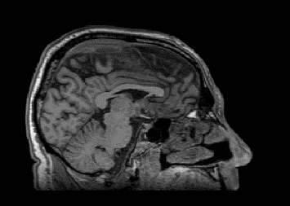
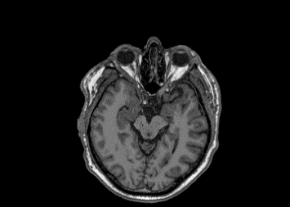
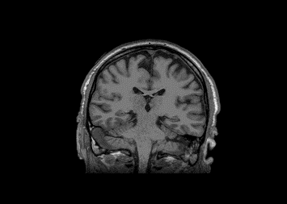
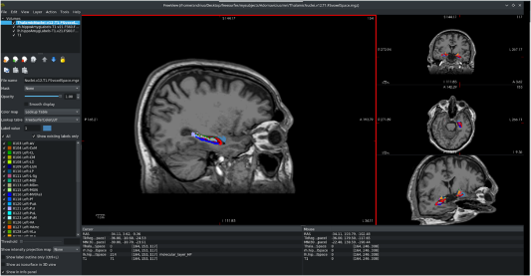
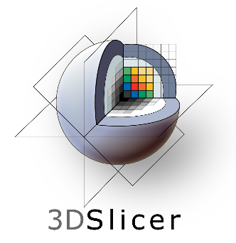
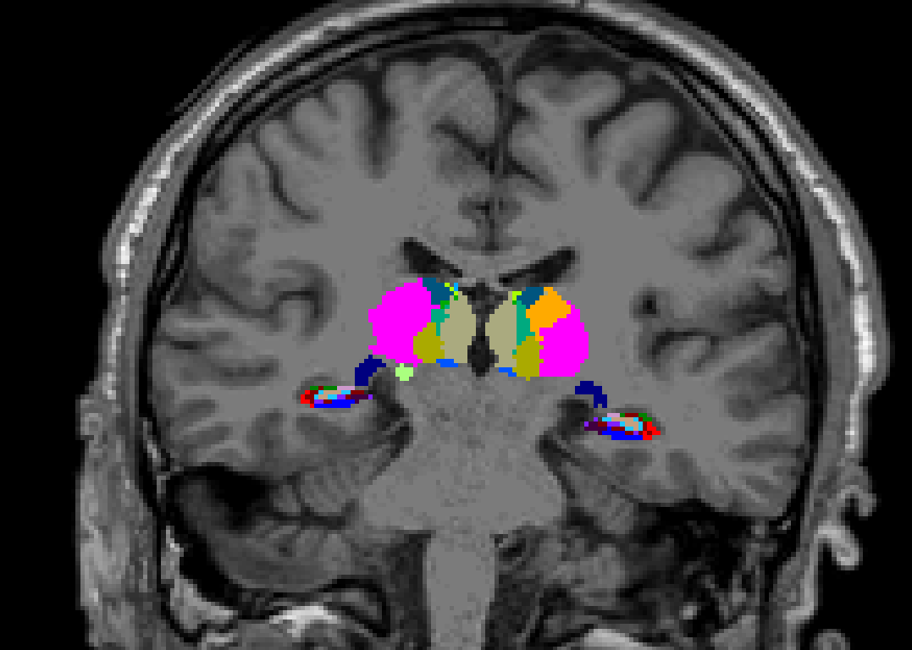
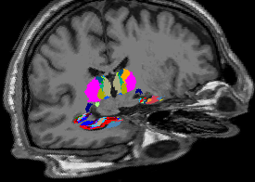
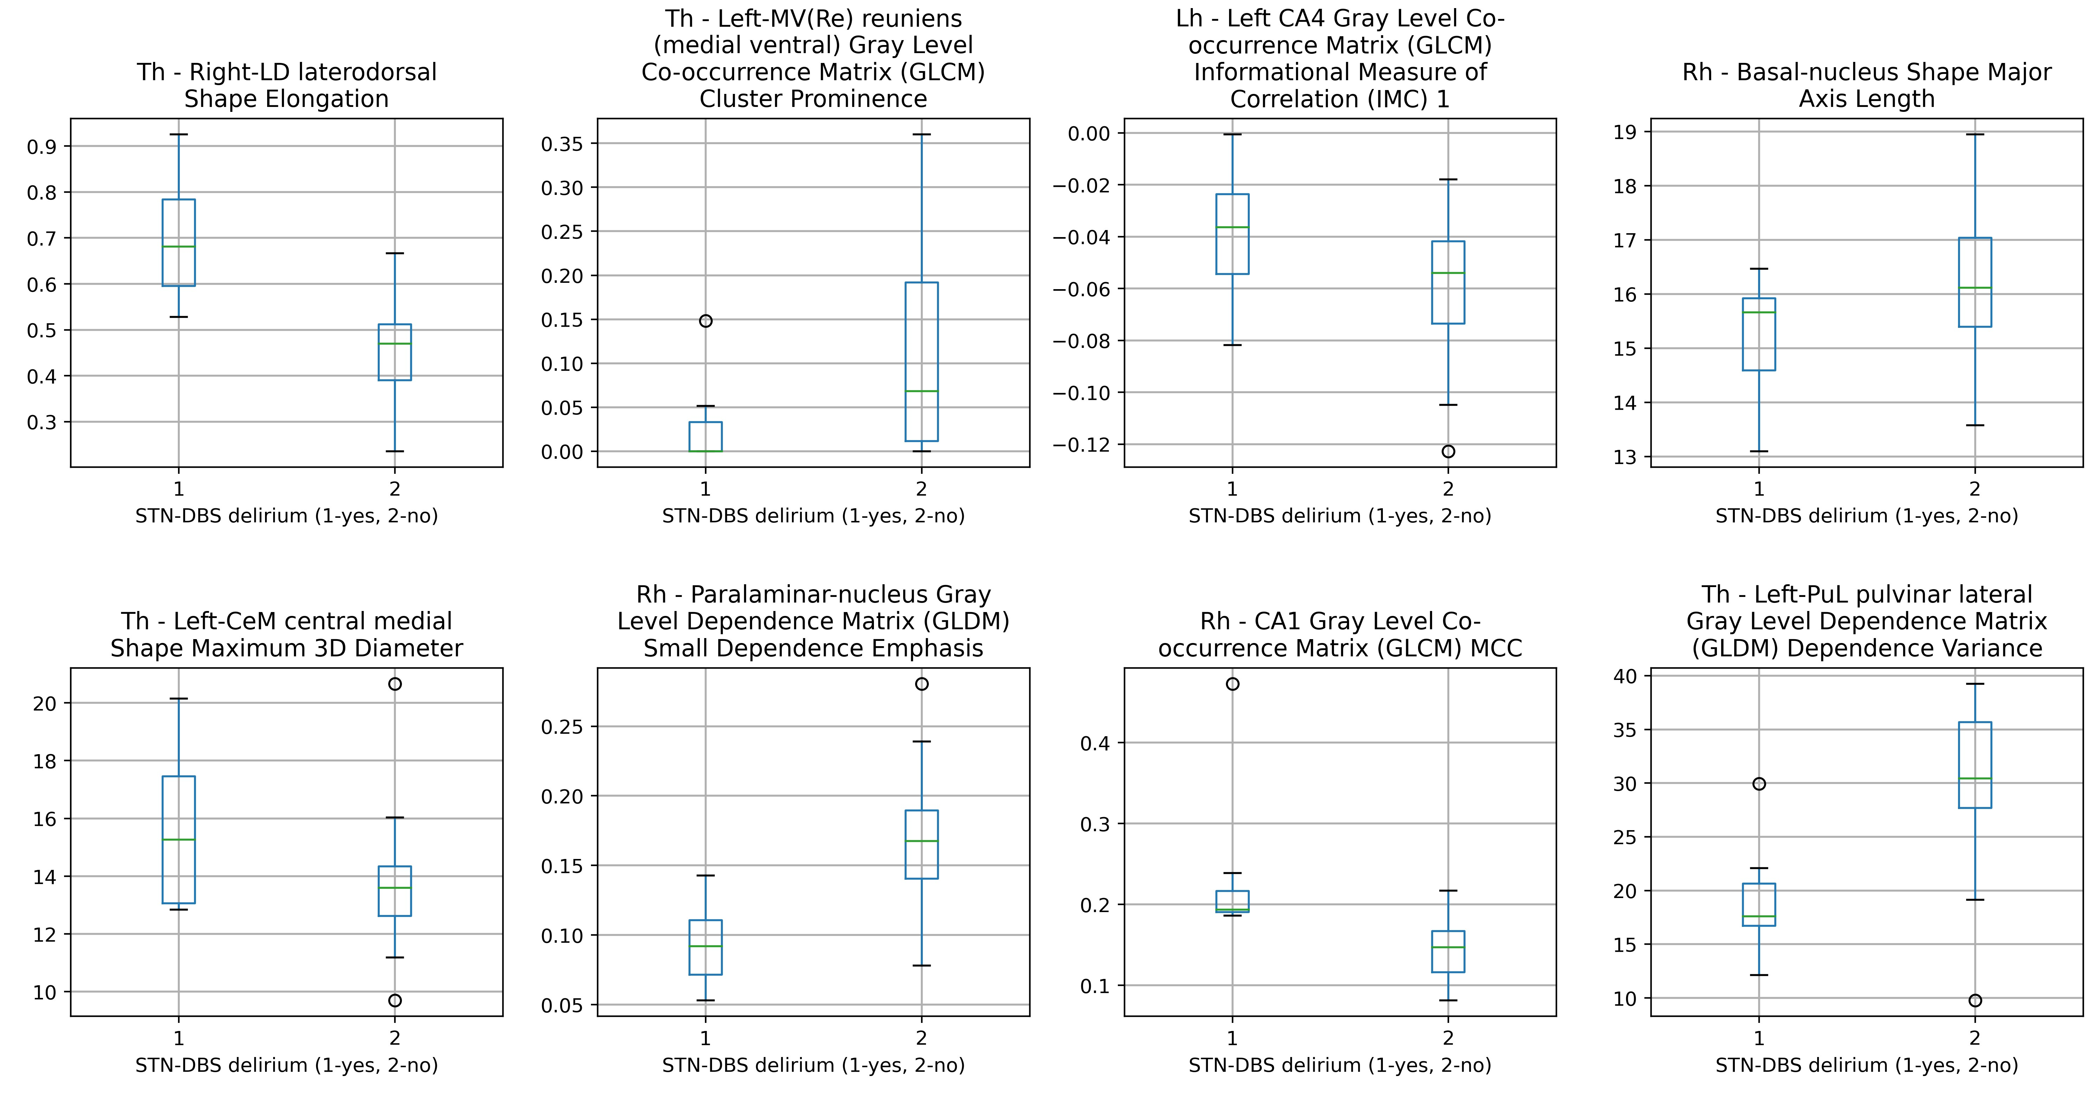
1. Image data
A
Pre-operative MRI
2. Image segmentation
and radiomic feature extraction
FreeSurfer
21 segments of amydala and hippocampus x 2 hemispheres, 47 segments of thalamus
3D Slicer
Radiomic feature extraction
n=10 680 in total
B
C
3. Feature selection mRMR method
5 features subset
10 features subset
20 features subset
D
Relevant non-redundant features
Selected 20 features
4. Predictive models for feature subsets
Machine learning methods
Prediction
Regularized binary logistic regression LR
Decision tree classifier DT
STN-DBS delirium (no/yes)
Linear discriminant analysis LDA
Naive Bayes classifier NB
Support vector machine SVM
Feed-forward neural network FNN
E
One-class support vector machine OC-SVM
F
Feed-forward neural network autoencoder FNN-A

