Slide 1
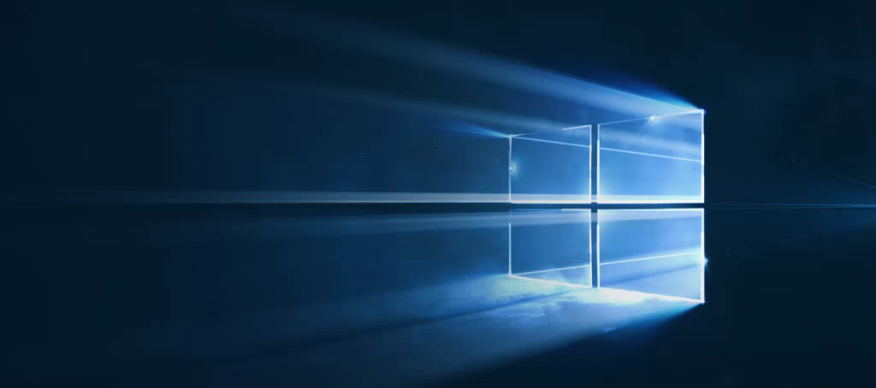
Windows
Camp
2015

Slide 2




Windows Camp
#wincamp

Slide 3
Что нового/полезного принесла VS2015 для разработчиков приложений для Windows 10.
Игорь Сычев
Premier Field Engineer, Microsoft

Slide 4
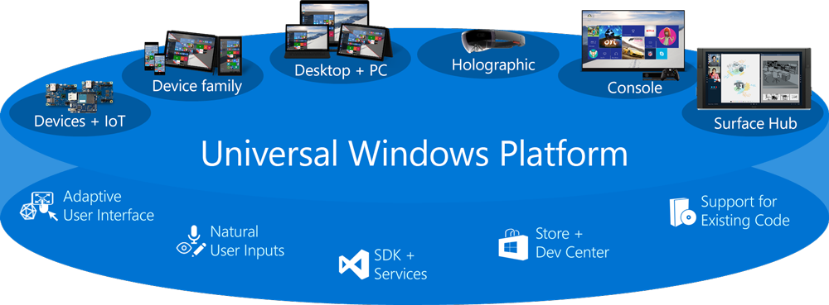
Universal Windows Platform (UWP)

Slide 5
VS2015 versions for Windows 10
Enterprise
Professional
Community (Visual Studio Community is free for individual developers, open source projects, academic research, education, and small professional teams. )
Express for Windows 10 (Install on windows 10 for app development for windows 10)
Notes:
https://www.visualstudio.com/en-us/downloads/visual-studio-2015-system-requirements-vs.aspx
https://www.visualstudio.com/en-us/products/visual-studio-community-vs.aspx

Slide 6
Features group by OS
 | Windows 10 | Windows 8/8.1 | Windows 7
Write Code
Deploy/Debug to Remote Machine
Deploy to Emulator
Deploy to Simulator
Deploy to Local Machine
VS Designer
UI Debugging Tools
https://www.visualstudio.com/visual-studio-2015-compatibility-vs
Notes:
https://www.visualstudio.com/visual-studio-2015-compatibility-vs

Slide 7
Supported OS for Universal Windows development
Windows 8.1
Windows 10
Windows Server 2012 R2
Windows 7
Best developer experience for building Universal Windows apps
Deploy/Debug/Profile
Simulator
Local Machine
Mobile Emulators
Remote Machine
Device
XAML Designer/Intellisense
Manifest Designer
All other features work at parity with Windows 10, except:
Deploy/Debug/Profile
Mobile Emulators
Remote Machine
Device
No XAML Designer
No WACK (Server R2)
All other features work at parity with Windows 8.1, except:
Deploy/Debug/Profile
Remote Machine
Device
No Manifest Designer

Slide 8
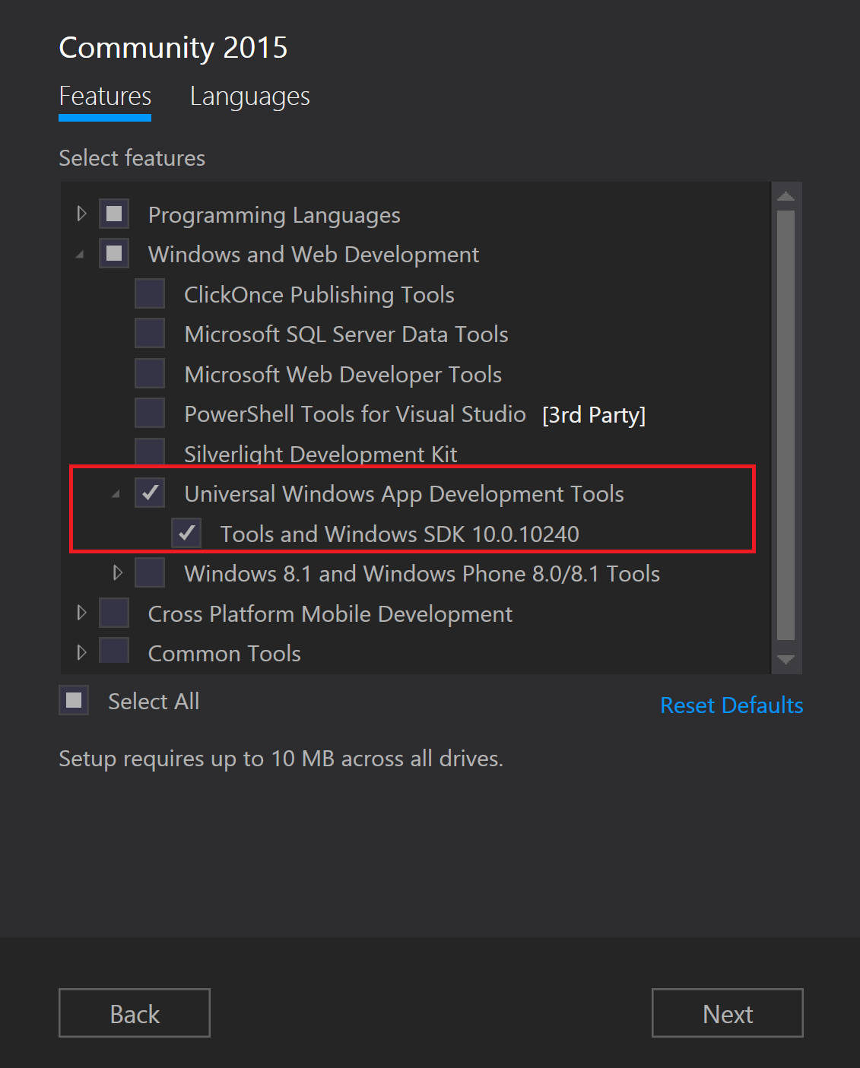
How to Install?
Visual Studio tools for Universal Windows apps

Slide 9
XAML Tree Visualizer (XamlPivot)
Notes:
https://msdn.microsoft.com/en-us/library/dd409789.aspx
http://blogs.msdn.com/b/visualstudio/archive/2015/02/24/introducing-the-ui-debugging-tools-for-xaml.aspx
https://channel9.msdn.com/Series/ConnectOn-Demand/228

Slide 10
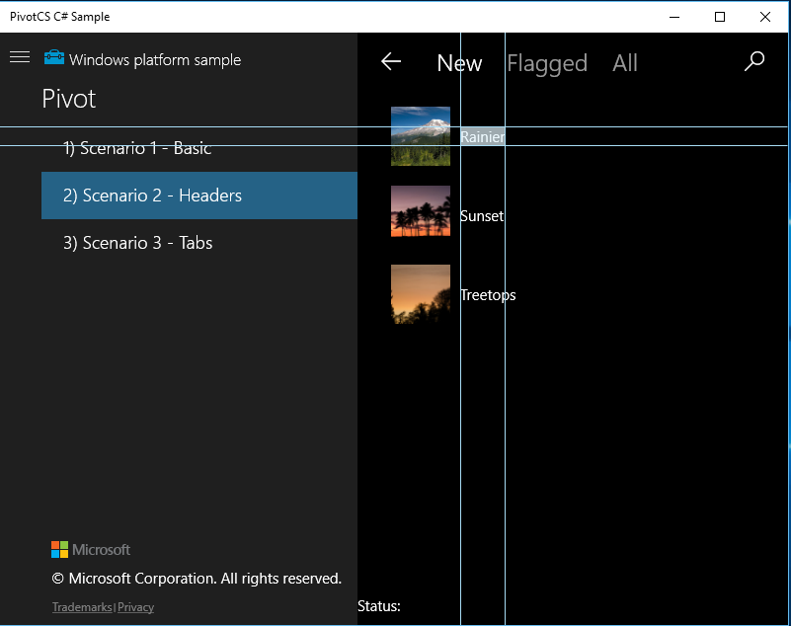

Slide 11
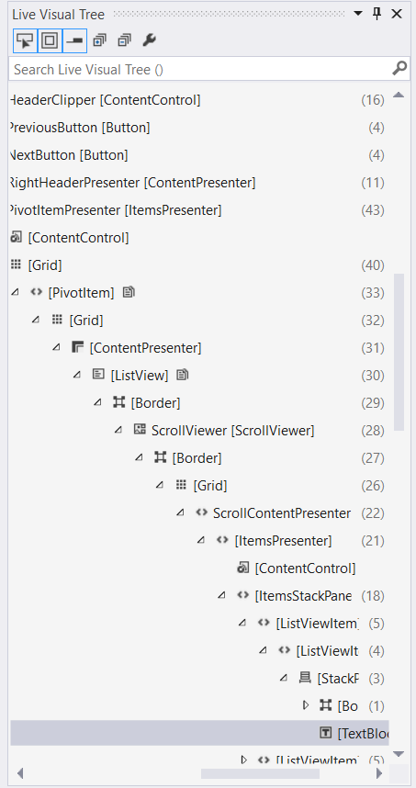
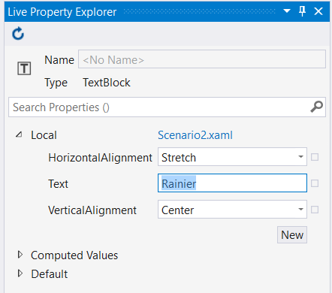

Slide 12
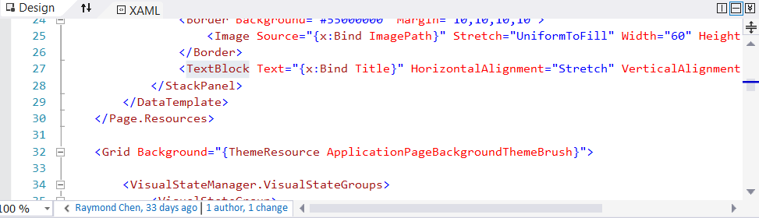

Slide 13
Diagnostic Tools - Memory
Notes:
http://blogs.msdn.com/b/visualstudioalm/archive/2015/01/16/diagnostic-tools-debugger-window-in-visual-studio-2015.aspx
http://blogs.msdn.com/b/visualstudioalm/archive/2015/07/20/performance-and-diagnostic-tools-in-visual-studio-2015.aspx
http://blogs.msdn.com/b/visualstudioalm/archive/2014/11/13/memory-usage-tool-while-debugging-in-visual-studio-2015.aspx

Slide 14
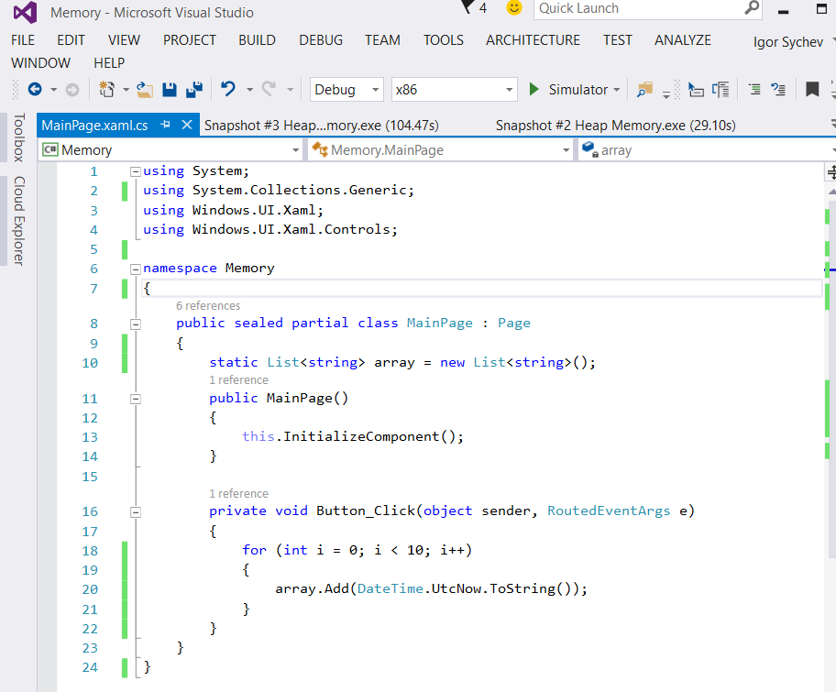

Slide 15
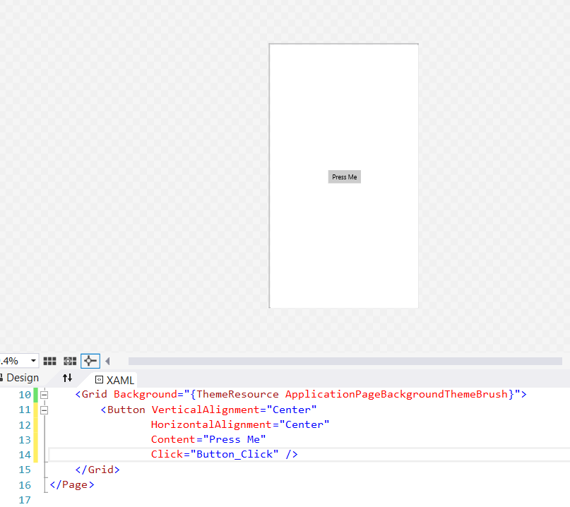

Slide 16
Network
Notes:
http://blogs.msdn.com/b/visualstudio/archive/2015/05/04/introducing-visual-studio-s-network-tool.aspx

Slide 17
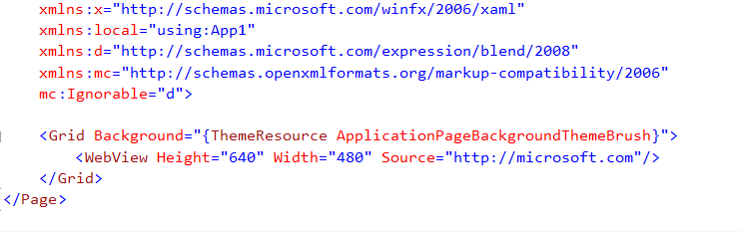

Slide 18
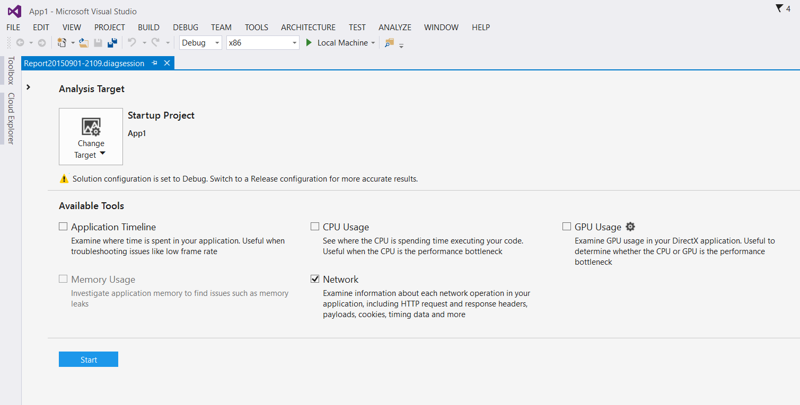

Slide 19
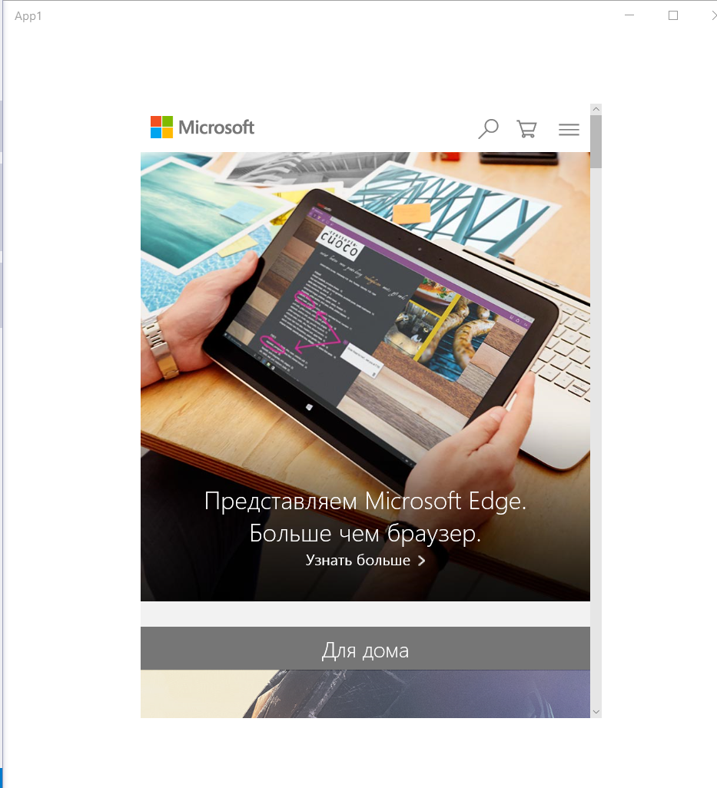

Slide 20
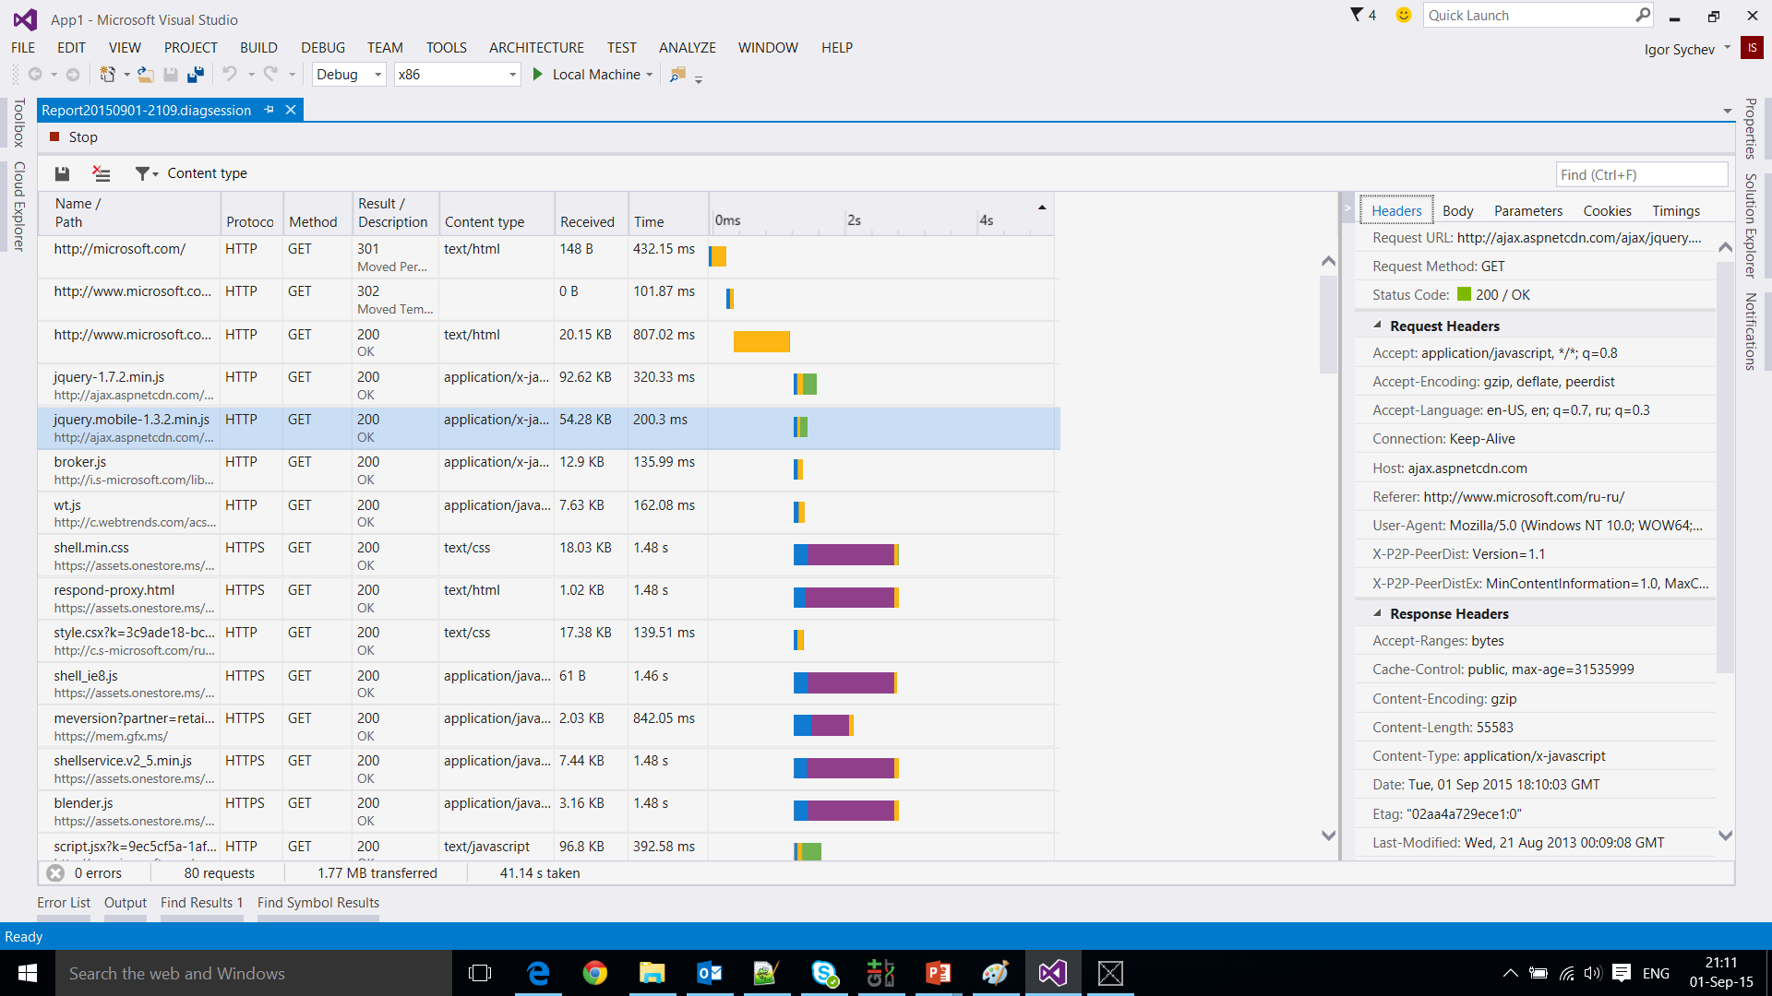

Slide 21
Packaging

Slide 22
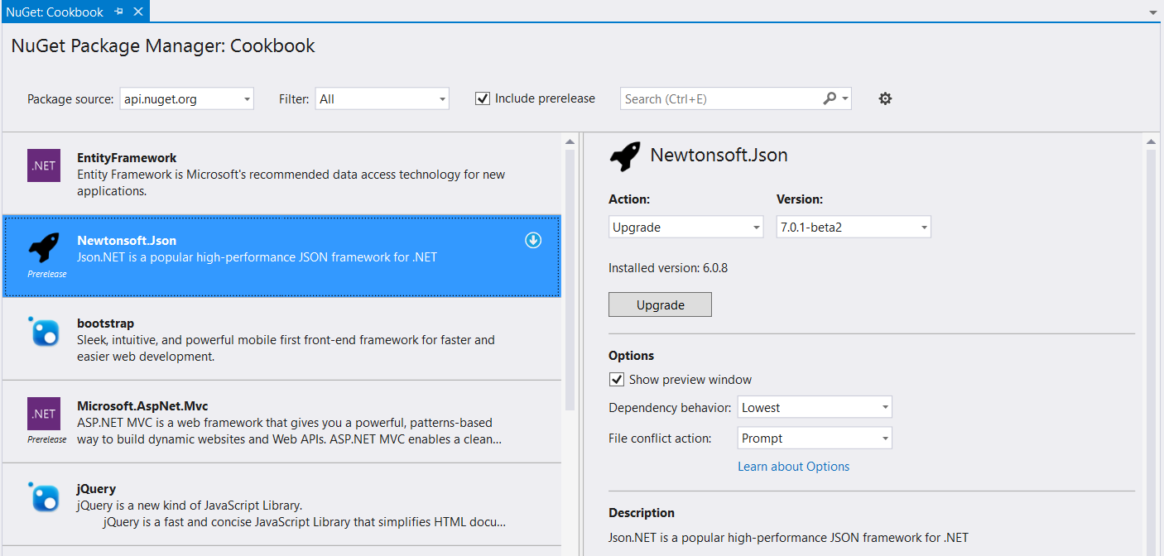
Nuget
UWA support referencing Windows 8.1 NuGet packages

Slide 23
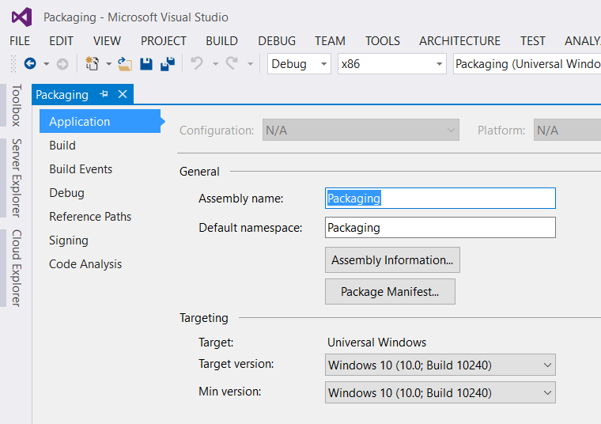
Project Properties
<Dependencies>
<TargetDeviceFamily
Name="Windows.Universal" MinVersion="10.0.10240.0" MaxVersionTested="10.0.10525.0" />
</Dependencies>

Slide 24
Windows 10 Packaging
A package is applicable to a device if the device satisfies all the declared dependencies:
Device family
Universal, Desktop, Mobile, Xbox, Team, Holographic
Can precisely specify required minimum device family version
Processor architecture
ARM, x86, x64, Neutral
Foreground memory [optional]
Amount of memory your app can use while it is running in the foreground
300MB, 750MB, 1000MB, 2000MB
DirectX [optional]
Combination of DirectX API version and DirectX hardware feature level

Slide 25
Package selection
Store automatically chooses the highest-versioned applicable package for a device
Store will try all published packages for your app until we find a match
v1.9.0.0
Windows 10 Universal or better
Works with any processor
v1.6.0.0
Windows 10 Universal or better
Works with any processor
v1.4.2.0
Windows Phone 8.1 or better
Requires 300MB of memory while running
v1.8.4.0
Windows Desktop 10.0.11001.0 or better
Works with any processor
Requires DirectX 12 APIs and DXFL 12_0 or better

Slide 26
Package selection
v1.9.0.0
Windows 10 Universal or better
Works with any processor
v1.6.0.0
Windows 10 Universal or better
Works with any processor
v1.4.2.0
Windows Phone 8.1 or better
Requires 300MB of memory while running
v1.8.4.0
Windows Desktop 10.0.11001.0 or better
Works with any processor
Requires DirectX 12 APIs and DXFL 12_0 or better
v1.9.0.0
Windows 10 Universal or better
Works with any processor
v1.6.0.0
Windows 10 Universal or better
Works with any processor
v1.4.2.0
Windows Phone 8.1 or better
Requires 300MB of memory while running
v1.8.4.0
Windows Desktop 10.0.11001.0 or better
Works with any processor
Requires DirectX 12 APIs and DXFL 12_0 or better
Gaming desktop
Desktop Device Family
Windows 10.0.11041.0
DXFL 12_0

Slide 27
Package selection
v1.9.0.0
Windows 10 Universal or better
Works with any processor
v1.6.0.0
Windows 10 Universal or better
Works with any processor
v1.4.2.0
Windows Phone 8.1 or better
Requires 300MB of memory while running
v1.8.4.0
Windows Desktop 10.0.11001.0 or better
Works with any processor
Requires DirectX 12 APIs and DXFL 12_0 or better
v1.9.0.0
Windows 10 Universal or better
Works with any processor
v1.6.0.0
Windows 10 Universal or better
Works with any processor
v1.4.2.0
Windows Phone 8.1 or better
Requires 300MB of memory while running
v1.8.4.0
Windows Desktop 10.0.11001.0 or better
Works with any processor
Requires DirectX 12 APIs and DXFL 12_0 or better
Older laptop
Desktop
Windows 10.0.12473.0
x86 processor
DXFL 11_0

Slide 28
Package selection
v1.9.0.0
Windows 10 Universal or better
Works with any processor
v1.6.0.0
Windows 10 Universal or better
Works with any processor
v1.4.2.0
Windows Phone 8.1 or better
Requires 300MB of memory while running
v1.8.4.0
Windows Desktop 10.0.11001.0 or better
Works with any processor
Requires DirectX 12 APIs and DXFL 12_0 or better
v1.9.0.0
Windows 10 Universal or better
Works with any processor
v1.6.0.0
Windows 10 Universal or better
Works with any processor
v1.4.2.0
Windows Phone 8.1 or better
Requires 300MB of memory while running
v1.8.4.0
Windows Desktop 10.0.11001.0 or better
Works with any processor
Requires DirectX 12 APIs and DXFL 12_0 or better
Value phone
Windows 10 Mobile
190MB foreground memory

Slide 29
Package selection
v1.9.0.0
Windows 10 Universal or better
Works with any processor
v1.6.0.0
Windows 10 Universal or better
Works with any processor
v1.4.2.0
Windows Phone 8.1 or better
Requires 300MB of memory while running
v1.8.4.0
Windows Desktop 10.0.11001.0 or better
Works with any processor
Requires DirectX 12 APIs and DXFL 12_0 or better
Device | Package given
Gaming desktop | v1.9.0.0
Older laptop | v1.8.4.0
Value phone | v1.4.2.0

Slide 30
VS 2015 store support/Templates
In VS2015 integrated store support for Win8.1,Win10 app
We can still build Windows Phone 8.0 apps, but we have no store support in VS2015 and have no templates

Slide 31
Hardware preferences
Protect your customers and your app’s rating
Declare the hardware you need
Store will inform customers for you
Reviews only come from qualifying devices

Slide 32
Hardware preferences
Touch screen
Mouse
Keyboard
Camera
NFC HCE
NFC
Bluetooth LE
Telephony
All preferences work across consistently all Windows 10 device families
Store detects this hardware with public APIs

Slide 33
Packaging Tools
Notes:
http://blogs.msdn.com/b/visualstudio/archive/2015/05/04/introducing-visual-studio-s-network-tool.aspx

Slide 34
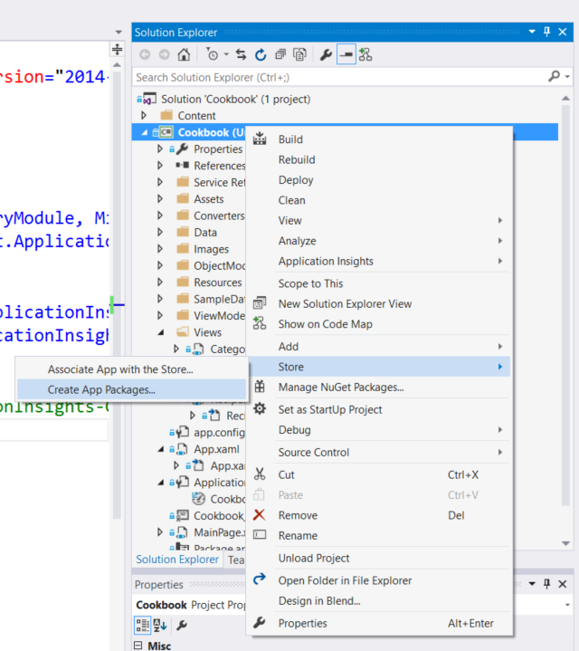
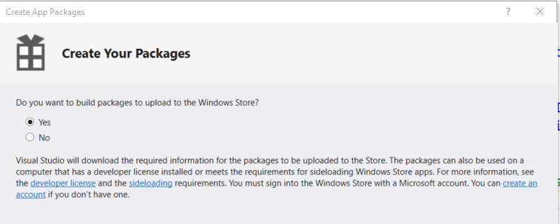

Slide 35
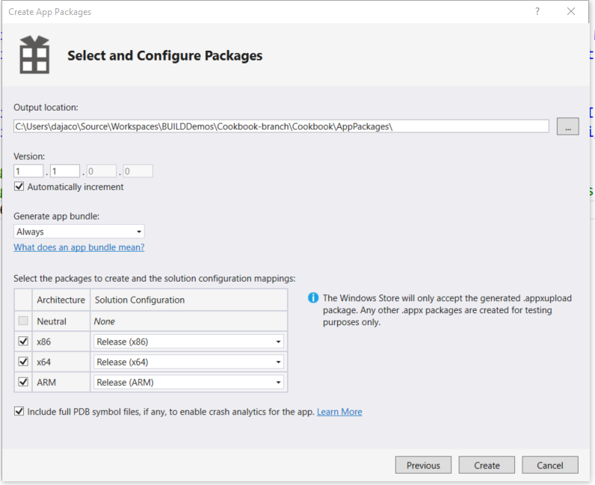

Slide 36
.Net Native
.NET Native compiles C# to native machine code that performs like C++.
With .NET Native optimization, apps start up to 60% faster and use 15-20% less memory when compiled with .NET Native.
Notes:
https://msdn.microsoft.com/en-us/vstudio/dotnetnative.aspx
http://blogs.msdn.com/b/dotnet/archive/2014/05/09/the-net-native-tool-chain.aspx
https://channel9.msdn.com/Blogs/DevRadio/NET-Native-Performance-Optimizing-Your-Windows-Apps-with-NET-Native/
https://msdn.microsoft.com/en-us/library/dn584397.aspx
https://channel9.msdn.com/Shows/Going+Deep/Inside-NET-Native

Slide 37
The .NET Native Tool-Chain
Building the MSIL application from source
Generating interop marshaling and serialization code
Merging the application
Reducing the application
Other MSIL transformations
Compiling from MSIL to Machine Dependent Intermediate Language (MDIL)
Binding from MDIL to native code
Notes:
http://blogs.msdn.com/b/dotnet/archive/2014/05/09/the-net-native-tool-chain.aspx

Slide 38
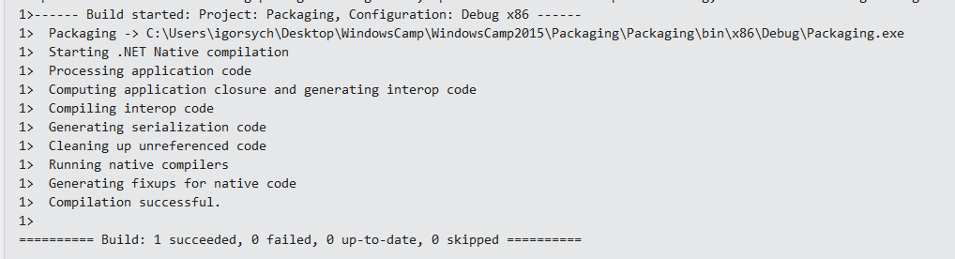

Slide 39
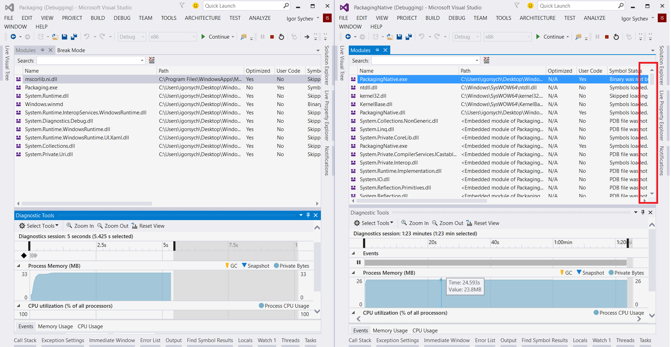

Slide 40
.Net Native
Notes:
http://blogs.msdn.com/b/visualstudio/archive/2015/05/04/introducing-visual-studio-s-network-tool.aspx

Slide 41
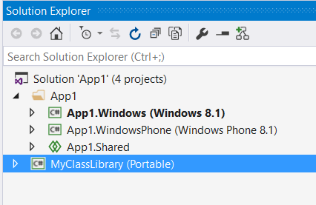
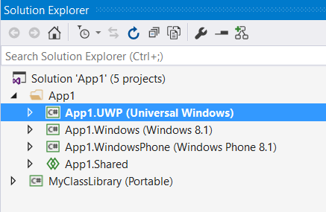
Consolidate (Merge Codebase)
Universal 8.1 App
Single Universal Windows Project

Slide 42
Web Tooling- NPM/NODE/GULP
Notes:
https://www.visualstudio.com/en-us/features/modern-web-tooling-vs.aspx
https://www.visualstudio.com/features/cordova-vs.aspx

Slide 43
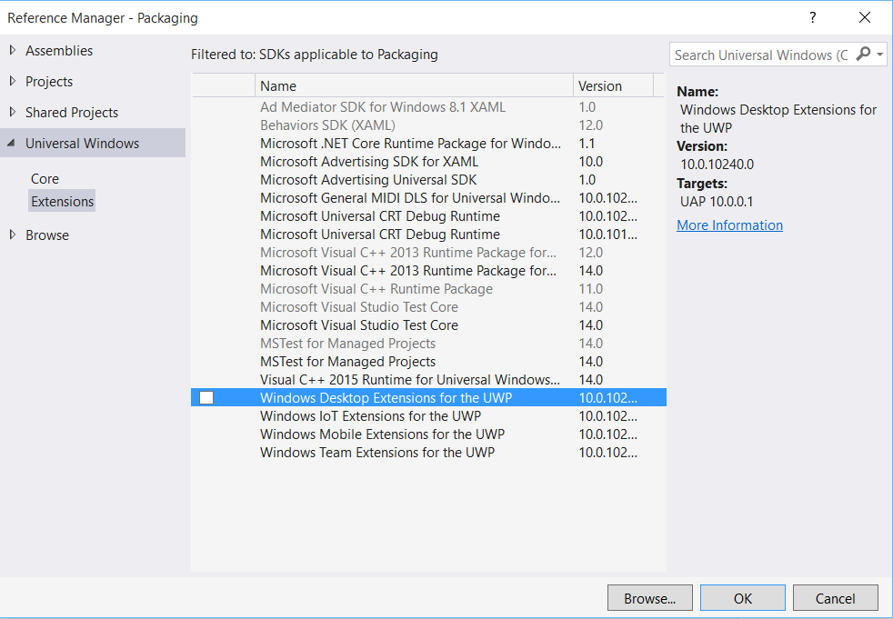
Windows Device Family Extension SDKs
Use device family specific APIs by adding references to Windows Device Family Extension SDKs

Slide 44
3rd Party Extension SDKs
Developers can reference Windows 8.1 Extension SDKs in a Universal Windows app
Referencing a native Windows 8.1 Extension SDK requires referencing “Microsoft Visual C++ 2013 Runtime Package for Windows Universal” SDK
Developers can build Extension SDKs for Universal Windows platform and write adaptive code against platform APIs
Universal Windows Extension SDKs are installed under:
\Program Files\Microsoft SDKs\Windows Kits\10\ExtensionSDKs

Slide 45
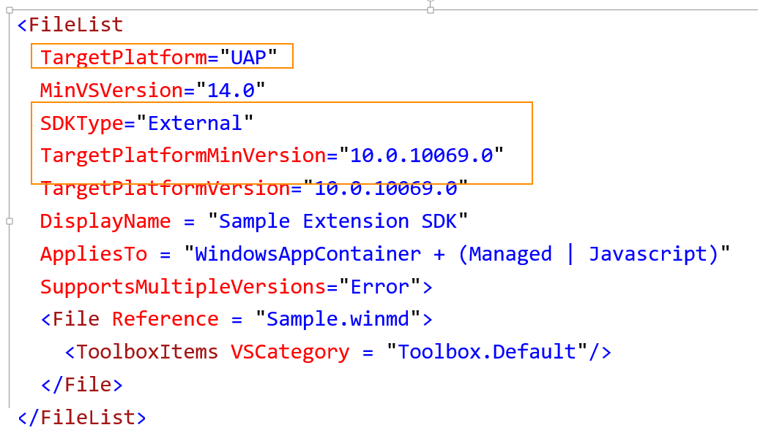
3rd Party Extension SDKManifest.xml

Slide 46
Limitations
Multilingual App Toolkit is not supported windows 10 yet
https://multilingualapptoolkit.uservoice.com/forums/231158-general/suggestions/9668526-windows-10-universall-apps-support

Slide 47
НАЧНИТЕ
РАСКРОЙТЕ
ЗАВЕРШИТЕ
Обозначьте ключевые идеи или темы доклада
Расскажите все, что вы хотели рассказать по этим темам
Подведите итог в соответствии с обозначенными в начале темами

Slide 48

Что нового/полезного принесла VS2015
для разработчиков
приложений для Windows 10.
Игорь Сычев
Premier Field Engineer, Microsoft
igorsych@Microsoft.com

