Slide 1
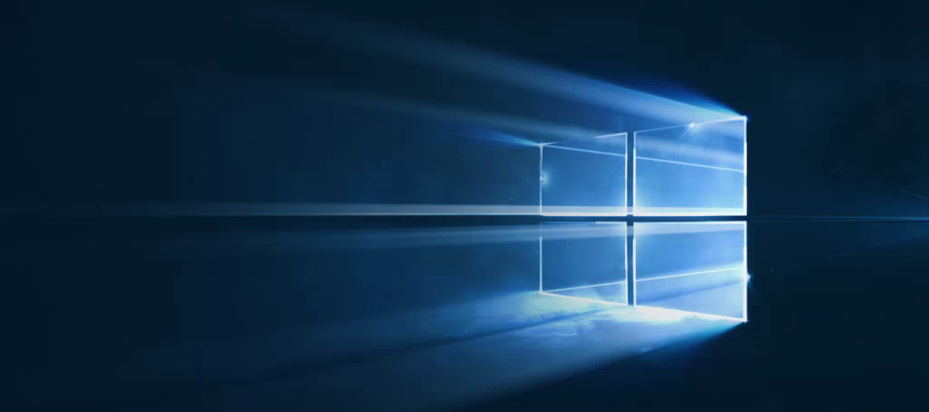
Windows
Camp
2015

Slide 2




Windows Camp
#wincamp

Slide 3
Обзор платформы разработки современных клиентских приложений для Windows 10.
Игорь Сычев
Premier Field Engineer, Microsoft

Slide 4
Ваш опыт с разработкой клиентских приложений?
WPF/Silverlight
Windows Phone (7.0,7.5,7.8,8.0,8.1)/Windows Store (8.0, 8.1)
IOS
Android

Slide 5
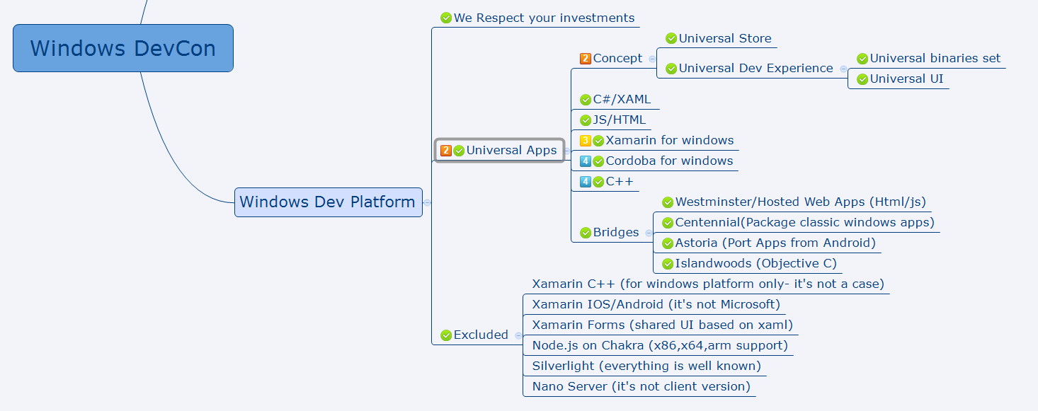
Plan

Slide 6
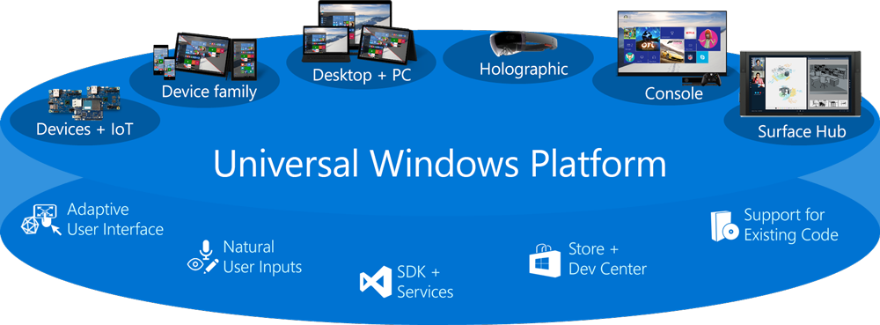
Universal Windows Platform (UWP)

Slide 7
Two different stores
2013
2014
2015
One customer experience (linked apps)
One Store
Two dev experience
Two developer experience with code linking
One codebase
Notes:
2013
Silverlight for Phone
WinRT for Windows
2014
Universal project from 2 heads(start project for phone and for windows) and “pseudo project” with shared code. Pseudo- code copy and pasted to 1 of 2 heads.
2015
One project for all platform

Slide 8
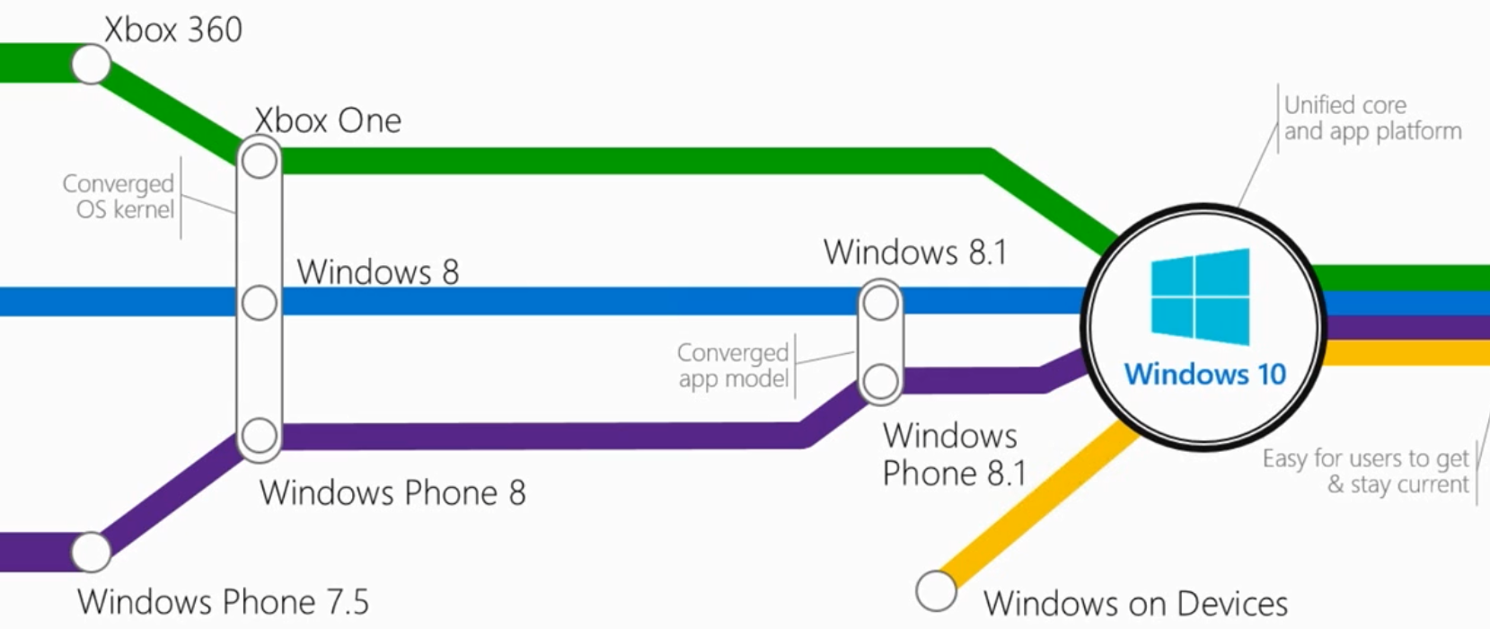
Single Developer Experience #1

Slide 9
We respect your investments (c)Build2013
Windows Phone 8.0,8.1 will continue working(Silverlight)
Windows Phone/Store 8.1 will continue working (WinRT)
Please, rewrite your Silverlight apps to WinRT
https://support.microsoft.com/en-us/lifecycle/search?sort=PN&qid=&alpha=Windows%20Phone%208&Filter=FilterNO

Slide 10
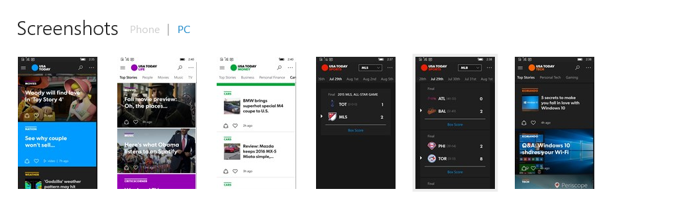

Slide 11
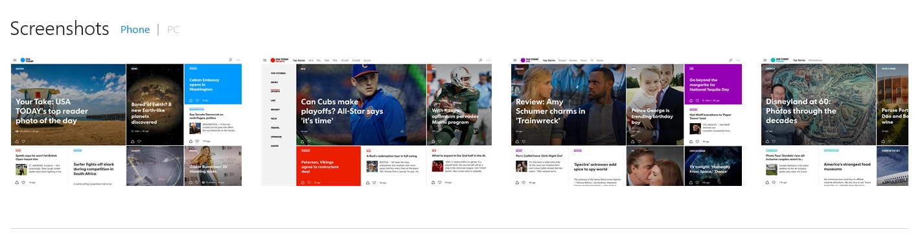

Slide 12
Universal Store
Notes:
USA Today app
One implementation of store functionality
One entry point
One licence

Slide 13
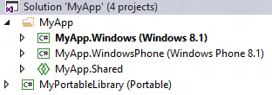
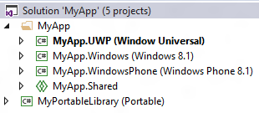
Single Developer Experience #2
Universal 8.1 App
Universal Project

Slide 14
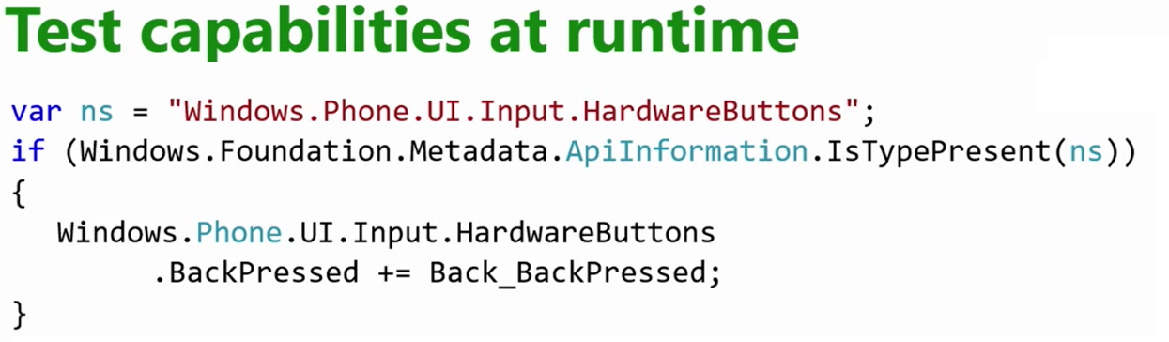
Universal Binaries *
Device families:
Universal device family
Desktop device family
Mobile device family
IoT device family
Surface Hub device family
https://msdn.microsoft.com/en-us/library/dn974113.aspx
Notes:
You can upload different binaries for different device families
https://msdn.microsoft.com/en-us/library/dn974113.aspx
Universal device family
This reference topic enumerates all of the API contracts within this device family, with links to topics with more info on each particular API contract.
Desktop device family
This reference topic enumerates all of the API contracts within this device family, with links to topics with more info on each particular API contract.
Mobile device family
This reference topic enumerates all of the API contracts within this device family, with links to topics with more info on each particular API contract.
IoT device family
This reference topic enumerates all of the API contracts within this device family, with links to topics with more info on each particular API contract.
Surface Hub device family
This reference topic enumerates all of the API contracts within this device family, with links to topics with more info on each particular API contract.

Slide 15
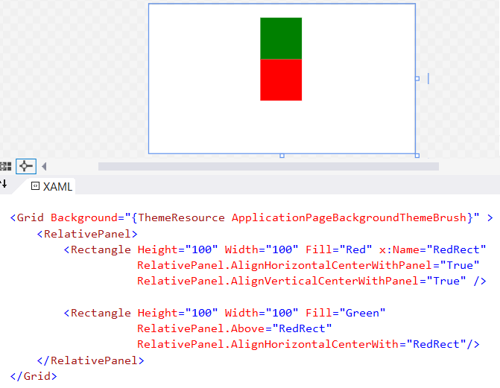
Universal UI(Adaptive)
Relative Panel container
Adaptive Trigger

Slide 16
C#/XAML
Notes:
UWP блаблабла

Slide 17
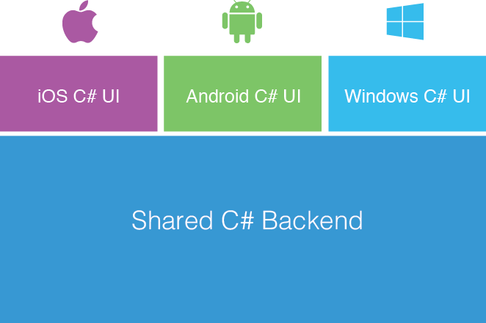
Xamarin + Xamarin.Forms (*1)
Shared UI Code

Slide 18
Small gap between MS and Xamarin Forms
Xamarin Forms for Windows 10 UWP is still in private beta since April 2015…
And no updates since April 2015
https://resources.xamarin.com/xamarin-forms-private-preview.html
Notes:
https://forums.xamarin.com/discussion/46047/any-update-on-xamarin-forms-with-windows-10-universal-windows-platform
https://blog.xamarin.com/xamarin-passes-1-million-developer-milestone/
https://resources.xamarin.com/xamarin-forms-private-preview.html
https://github.com/jamesmontemagno/Hanselman.Forms

Slide 19
Cross platform: Xamarin

Slide 20
JS/HTML

Slide 21
Cross platform: Cordoba (JS/HTML)

Slide 22
C++

Slide 23
Astoria (Bridge from Android)
What is Project Astoria?
Use your existing Android code and tools to build a Windows App
Objective
Lower the barrier to entry to publish apps for Windows Mobile SKU
Principles
Meet developers where they are
Leverage one codebase without forking
Limitations
Only for the Mobile SKU (not Desktop SKU)
1GB memory requirement (all Lumia phones shipping with 1GB+ now)
BETA
Notes:
https://msdn.microsoft.com/en-us/library/windows/apps/xaml/jj945421.aspx?f=255&MSPPError=-2147217396

Slide 24
Astoria Platform Compatibility
Ready
Touch
Keyboard (software input panel)
Accelerometer / Orientation
Sound
Microphone
Open GL 1.1 / 2.0
Camera Intent
Sharing Intent
Webview
WiFi / Network
BETA
In Scope for end of year
Camera v1
Video Playback
Graphics Performance
Background Services
Sensors (Rotation / Proximity)
Bluetooth

Slide 25
Astoria- Call To Action
BETA
https://dev.windows.com/en-us/ProjectAPreviewSignup
http://bridgeforandroid.windows.com/

Slide 26
Islandwood (Bridge for IOS)
What is Project Islandwood?
Compiler and Runtime for Objective-C
Objective
Lower the barrier for IOS dev start developing for Windows
Make minimal changes to your iOS®/Objective-C code to build a Windows app
Build and debug your Objective-C code from Visual Studio
Principles
Make minimal changes to your iOS®/Objective-C code
Limitations
Popular/ most using IOS API
BETA
Notes:
https://msdn.microsoft.com/en-us/library/windows/apps/xaml/mt238320.aspx

Slide 27
Islandwood Platform Compatibility
BETA
Games: OpenGL (ANGLE, CAEAGLLayer, EAGLContext), OpenAL, Sensors
UI: UIKit, CoreAnimation, CoreGraphics, CoreText, Touch
Objective-C: ARC, blocks
Foundation / CoreFoundation
Services: StoreKit, Social, Notifications, …
Supports a subset of iOS APIs
Does not track a particular version of iOS
Most used APIs are implemented first

Slide 28
Islandwood Call To Action
BETA
https://dev.windows.com/en-US/uwp-bridges/project-islandwood

Slide 29
Hosted Web Apps (Westminster - Bridge from Web Apps)
What is Project Westminster?
App in a market place, but all content fully on a server.
Objective
Zero time to marketplace for web apps.
Principles
Web content on a server- App is only entry point in Store.
URI control list in the app manifest
Interact with native Windows APIs from JavaScript running on your website.

Slide 30
Cortana Integration
Add a Voice Command Definition file on your server
Add a meta element tag in your HTML
Handle the Cortana activation in your JavaScript
<meta name="msapplication-cortanavcd" content="http://mysite.com/vcd.xml"/>" content="http://flightarcade.azurewebsites.net/vcd/vcd.xml"/>
// Add an event listener for the activation event
if (Windows.UI.WebUI.WebUIApplication.addEventListener(“activated”, function (args)) {
// Handle the Voice Command activation event
var activation = Windows.ApplicationModel.Activation;
if (args.kind === activation.ActivationKind.voiceCommand) {
// Extract the result from the speech recognition from the event arguments
var speechRecognitionResult = args.result;
// Get the recognized command, defined in the VCD file
var command = speechRecognitionResult.rulePath[0];
// Get the full string of text that was spoken
var textSpoken = speechRecognitionResult.text;
}
});

Slide 31
Hosted Web Apps
XML Manifest URI Allow List (Under-the-hood)
WindowsRuntimeAccess=
"all" Match="https://*.websites.net/"
"allowForWebOnly" Match=https://*.website.net/
Developers can control the Universal APIs they want to expose
"none" Match="http://ads.website.net/"
Default is no access

Slide 32
Westminster - Call To Action
https://dev.windows.com/en-us/uwp-bridges/web-apps
Publish your app to Store

Slide 33
Centennial (Bridge from Classic Windows APPS)
What is Project Centennial?
Way for class apps to Store
Objective
Converting classis (exe/msi) windows apps to Universal APP.
Principles
Redirection for File OI, Registery IO
Create APPX package
Limitations
No Custom Drivers
No Privileges Apps
Only .Net/Win32
BETA

Slide 34


Conversion
BETA
Convert
Test
Update
MSI
AppX

Slide 35
Islandwood Call To Action
BETA
https://projectipreviewsignup.windows.com/

Slide 36
UWP Bridges side-by-side
UWP Bridge | API Access | Incremental Dev Investment | Incremental App Maintenance | Additional Notes
Web apps ‘Project Westminster’ | Server-side website Full UWP API access via plug-in model | Create app manifest Store submission | Server-side website | Ideal where majority of the experience is in website Carefully consider heavy server-side processing
Classic applications ‘Project Centennial’ | Most Win32 API access Full UWP API access | Virtualize Store submission TBD | Updates via Store | Limited support for plug-ins, Windows services, and drivers Elevated privs not supported
Android apps ‘Project Astoria’ | Full AOSP API access Select UWP APIs (notifications; live tile) | AOSP compatibility Add Store assets Store submission | Use your IDE Phone testing Shared app code | More UWP capabilities over time Dev work done in existing IDE Ideal for mobile-centric apps and where devs want to use their IDE
iOS code ‘Project Islandwood’ | Full UWP APIs | Import into VS2015 Store submission | Visual Studio IDE Separate projects Shared ObjC code | Support for most iOS APIs Support for runtime debugging Ideal for multi-device apps and where team can install/use VS

Slide 37

Обзор платформы разработки
современных клиентских приложений
для Windows 10.
Игорь Сычев
Premier Field Engineer, Microsoft
igorsych@Microsoft.com

