Slide 1
Entity Framework 7 + Redis/AzureTableStorage
Сычев Игорь
Sychev-igor.90@mail.ru
https://github.com/SychevIgor

Slide 2
О чем доклад?
Azure Table Storage
REDIS
ENTITY FRAMEWORK

Slide 3

Когда будет EF7 и что будет с EF6?
EF 6.1.3
EF 7.0.0 Beta2
Notes:
7-ая версия в конце весны отбранчевалась от 6-ой версии. Я бы даже сказал, это был fork.
<img src="http://habrastorage.org/files/2f0/65d/4ba/2f065d4ba61e4d06b362448987f42bf3.png" alt="image"/>
Разрабатывают его примерно одни и те же люди.
Разработчики и на <a href="http://channel9.msdn.com/Events/TechEd/NorthAmerica/2014/DEV-B417">TechEd</a>, <a href="http://channel9.msdn.com/Events/TechEd/Europe/2014/DEV-B332">TechedEurope </a>, и в своих <a href="http://blogs.msdn.com/b/adonet/archive/2014/10/27/ef7-v1-or-v7.aspx">записках</a> говорят одно и тоже.
EF6 по прежнему продолжает дорабатываться. Не все фичи, созданные после форка, будут доступны в EF7 с самого начала. EF7- это достаточно революционный проект, и были даже мысли:
<i><b>«А 7-ая ли это версия в принципе или это новый продукт похожий на EF по основному API, но сильно разный внутри?»</b></i> Не все заявленные в EF7 фичи будут доступны на всех платформах сразу же.
Команда выбрала путь более частых обновлений EF7, чтобы не заставлять всех ждать полного комплекта изменений.
http://blogs.msdn.com/b/adonet/archive/2014/10/21/ef7-what-does-code-first-only-really-mean.aspx
http://blogs.msdn.com/b/adonet/archive/2014/10/27/ef7-v1-or-v7.aspx
Not everything will be there in the initial release
Because much of the core of EF7 is new, the first release of EF7 isn’t going to have all the features that are required for all applications. There is always a tension between wanting to ship quickly and wanting to have more features in a given release. As soon as we have the core framework and basic functionality implemented we will provide a release of EF7 for folks to use in applications with simpler requirements. We’ll then provide a series of quick releases that add more and more features.
Of course, this means EF7 isn’t going to be usable for every application when it is first released, and for that reason we are continuing development of EF6.x for some time and expect many of our customers to remain on that release.
An example of this is lazy loading support, we know this is a critical feature for a number of developers, but at the same time there are many applications that can be developed without this feature. Rather than making everyone wait until it is implemented, we will ship when we have a stable code base and are confident that we have the correct factoring in our core components. To be clear, it's not that we are planning to remove lazy loading support from EF7, just that some apps can start taking advantage of the benefits of EF7 before lazy loading is implemented.
What about my existing models?
We’re not trying to hide the fact that EF7 is a big change from EF6.x. We’re keeping the concepts and many of the top level APIs from past versions, but under the covers there are some big changes. For this reason, we don’t expect folks to move existing applications to EF7 in a hurry. We are going to be continuing development on EF6.x for some time.
Is everyone going to like this change?
We’re not kidding ourselves, it’s not possible to please everyone and we know that some folks are going to prefer the EF Designer and EDMX approach over code-based modeling.
At the same time, we have to balance the time and resources we have and deliver what we think is the best set of features and capabilities to help developers write successful applications. This wasn’t a decision we took lightly, but we think it’s the best thing to do for the long-term success of Entity Framework and its customers – the ultimate goals being to provide a faster, easier to use stack and reduce the cost of adding support for highly requested features as we move forward.

Slide 4
Векторы изменений в EF7
Не только Server (New Platform)
Lumia 1520 – RAM=2GB
Surface 4-8 GB.
Не только SQL (NoSQL)
Notes:
<h5><b>Основные цели EF7</b></h5>
Обозначены 2 вектора движения EF7:
<ul>
<li>NewMobilePlatforms;</li>
<li>NoSQL.</li>
</ul>
Все дальнейшие изменения надо рассматривать через эту призму.
Уменьшение потребления ресурсов - это обязательное условие для нормальной работы на мобильных девайсах, где объем RAM – 2 Гб на топовых моделях и 512 Мб на стоковых. Рефакторинг и разбиение проекта на разные сборки – это поддержка обоих векторов одновременно. Можно привести достаточно много других примеров.
http://blogs.msdn.com/b/adonet/archive/2014/10/21/ef7-what-does-code-first-only-really-mean.aspx
Code First is a bad name
Prior to EF4.1 we supported the Database First and Model First workflows. Both of these use the EF Designer to provide a boxes-and-lines representation of a model that is stored in an xml-based .edmx file. Database First reverse engineers a model from an existing database and Model First generates a database from a model created in the EF Designer.
In EF4.1 we introduced Code First. Understandably, based on the name, most folks think of Code First as defining a model in code and having a database generated from that model. In actual fact, Code First can be used to target an existing database or generate a new one. There is tooling to reverse engineer a Code First model based on an existing database. This tooling originally shipped in the EF Power Tools and then, in EF6.1, was integrated into the same wizard used to create EDMX models.
Another way to sum this up is that rather than a third alternative to Database & Model First, Code First is really an alternative to the EDMX file format. Conceptually, Code First supports both the Database First and Model First workflows.
Confusing… we know. We got the name wrong. Calling it something like “code-based modeling” would have been much clearer.
Is code-base modeling better?
Obviously there is overhead in maintaining two different model formats. But aside from removing this overhead, there are a number of other reasons that we chose to just go forward with code-based modeling in EF7.
Source control merging, conflicts, and code reviews are hard when your whole model is stored in an xml file. We’ve had lots of feedback from developers that simple changes to the model can result in complicated diffs in the xml file. On the other hand, developers are used to reviewing and merging source code.
Developers know how to write and debug code. While a designer is arguably easier for simple tasks, many projects end up with requirements beyond what you can do in the designer. When it comes time to drop down and edit things, xml is hard and code is more natural for most developers.
The ability to customize the model based on the environment is a common requirement we hear from customers. This includes scenarios such as multi-tenant database where you need to specify a schema or table prefix that is known when the app starts. You may also need slight tweaks to your model when running against a different database provider. Manipulating an xml-based model is hard. On the other hand, using conditional logic in the code that defines your model is easy.
Code based modeling is less repetitive because your CLR classes also make up your model and there are conventions that take care of common configuration. For example, consider a Blog entity with a BlogId primary key. In EDMX-based modeling you would have a BlogId property in your CLR class, a BlogId property (plus column and mapping) specified in xml and some additional xml content to identify BlogId as the key. In code-based modeling, having a BlogId property on your CLR class is all that is needed.
Providing useful errors is also much easier in code. We’ve all seen the “Error 3002: Problem in mapping fragments starting at line 46:…” errors. The error reporting on EDMX could definitely be improved, but throwing an exception from the line of code-based configuration that caused an issue is always going to be easier. We should note that in EF6.x you would sometimes get these unhelpful errors from the Code First pipeline, this is because it was built over the infrastructure designed for EDMX, in EF7 this is not the case.

Slide 5
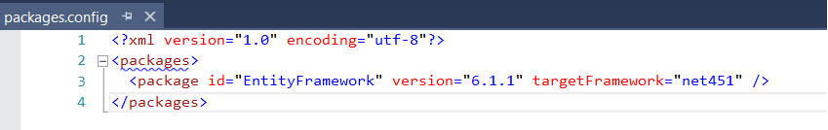
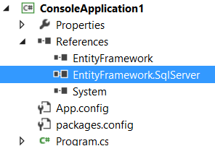
Как Сейчас
Notes:
<h5><b>Рефакторинг и разбиение проекта на модули</b> </h5>
Раньше был один nuget-пакет EntityFramework, который тянул 2 сборки. Больше ничего офицального, хотя были провайдеры для Mysql и тп.
<spoiler title="Выглядело достаточно просто">
<img src="http://habrastorage.org/files/b45/cbf/8b2/b45cbf8b2d9644debf63c9c94e22f561.png" alt="image"/>
<img src="http://habrastorage.org/files/8b5/c25/754/8b5c2575487e4f06998bbe76b01c1563.png" alt="image"/>
<img src="http://habrastorage.org/files/4c4/9e9/2ce/4c49e92cef5d4a7c81ca30c8031d1f0a.png" alt="image"/>
</spoiler>

Slide 6
Стало атомарнее
EntityFramework -> EntityFramework.Core
Providers:
EntityFramework.SqlServer
EntityFramework.SQLite
EntityFramework.Redis
EntityFramework.AzureTableStorage
EntityFramework.InMemory
Для NoSQL providers не будет зависимостей на
EntityFramework.Migrations + EntityFramework.Commands
EntityFramework.Relational
Notes:
https://www.myget.org/gallery/aspnetvnext
https://github.com/aspnet/EntityFramework/wiki/Design-Meeting-Notes:-November-20,-2014
<b>В EF7 за счет поддержки множества платформ и баз данных, проект разделился на 10 сборок. </b>
<img src="http://habrastorage.org/files/275/402/ca1/275402ca1e784d79a0a23ea6634b53c1.png" alt="image"/>
Посмотреть этот список можно в <a href="https://www.myget.org/gallery/aspnetvnext">myget</a> или в <a href="https://github.com/aspnet/EntityFramework/wiki/Design-Meeting-Notes:-November-20,-2014#ef-nuget-packages">Design Meeting Notes</a>.

Slide 7
Nuget Demo
Notes:
Показать установку пакета EntityFramework.SQLServer. Сказать, если не нужны миграции, просто не ставим пакет Migrations.
Открыть 2 папки и сравнить их содержимое на примере SQLServer и ядра EntityFramework.

Slide 8
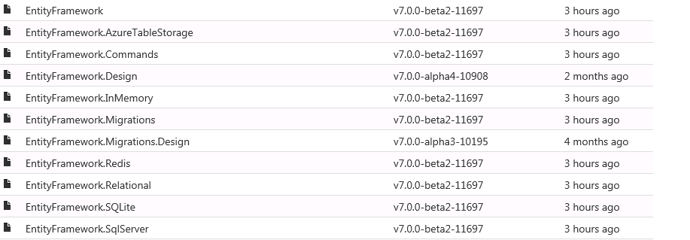
https://www.myget.org/gallery/aspnetvnext

Slide 9
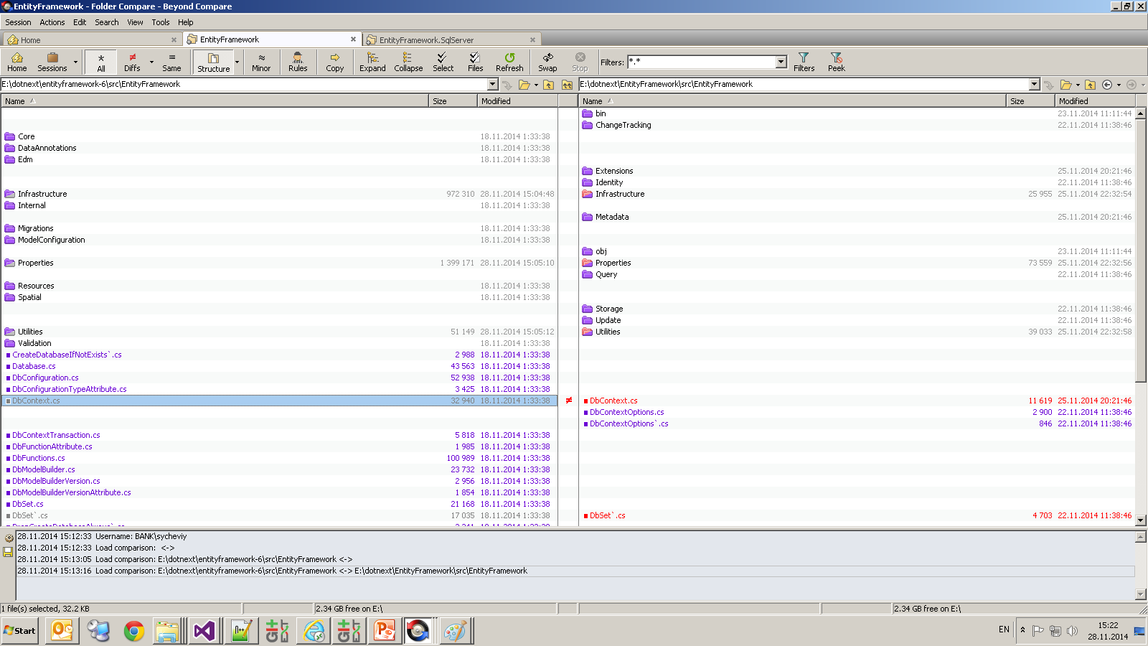

Slide 10
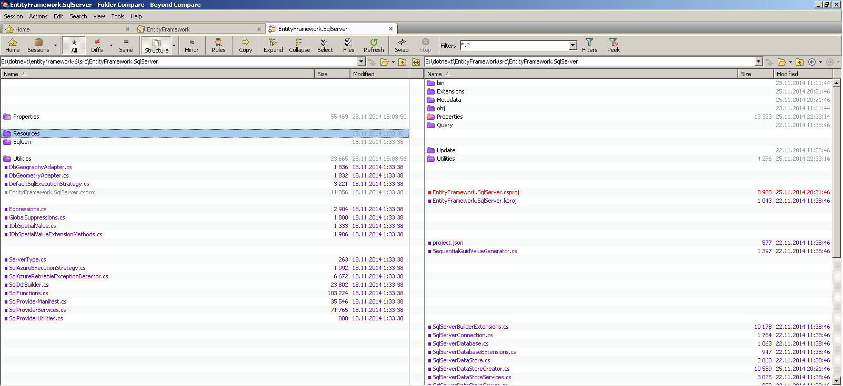

Slide 11
No EDMX Code First-> Code-Based Modeling
Поддержка 2 моделей -> overhead.
Merge edmx моделей кране сложный.
Разработчикам проще писать код, чем рисовать диаграммы.
Code First- не совсем корректное название.
Notes:
Поддержку хранимок очень просят https://github.com/aspnet/EntityFramework/issues/245
<h6><b>No EDMX</b></h6>
Те, кто работал с Model First, Database First, помнят, какие проблемы были с EDMX. Сделать Merge двух веток было крайне нетривиальным занятием, т.к. почти всегда это приводило к куче конфликтов или невалидному edmx-файлу. Любое обновление модели из базы ломало наши кастомизации (в частности, удаление лишних navigation property).
Для тех, кто не смотрел в структуру EDMX- очень рекомендую глянуть.
<spoiler title="Маленький пример для 3 табличек буквально:">
<img src="http://habrastorage.org/files/2eb/618/784/2eb61878443b415c84eb10b1efb378bf.png" alt="image"/>
</spoiler>
Для самой команды EF это выражалось в необходимости поддержки двух разных моделей с одной стороны Code First, с другой - DB/Model First. Подумав, команда решила отказаться от поддержки EDMX в 7-ой версии. Code First only.
Не нужно пугаться, хотя каждый из нас может вспомнить/придумать причину опасности использования Code First. <b>Команда EF разъясняет, что Code First – не совсем корректное имя, и его не совсем правильно понимают. Правильнее было бы назвать Modeling using Code. Когда мы описываем модель непосредственно в C# коде, то разработчик код лучше всего понимает.</b> Графический интерфейс Visual Studio теперь будет работать именно с Code First, а edmx более не поддерживается.
Если вам страшно, что code first может обновит вашу боевую базу, удалив нужные данные или как-то еще напортачить, то вам нужно просто запретить это в настройке и не заниматься обновлением базы, а как познавшим дзен, вести проект базы данных, писать скрипты миграции схемы и данных отдельно и иметь при этом полный контроль над базой данных, а не отдавать все на откуп миграциям из EF.
<b>В VisualStudio 2015 preview можно использовать и ef6 и ef5 и, следовательно, db/model first. Но что будет дальше пока не понятно.</b>
http://blogs.msdn.com/b/adonet/archive/2014/10/21/ef7-what-does-code-first-only-really-mean.aspx
Code First is a bad name
Prior to EF4.1 we supported the Database First and Model First workflows. Both of these use the EF Designer to provide a boxes-and-lines representation of a model that is stored in an xml-based .edmx file. Database First reverse engineers a model from an existing database and Model First generates a database from a model created in the EF Designer.
In EF4.1 we introduced Code First. Understandably, based on the name, most folks think of Code First as defining a model in code and having a database generated from that model. In actual fact, Code First can be used to target an existing database or generate a new one. There is tooling to reverse engineer a Code First model based on an existing database. This tooling originally shipped in the EF Power Tools and then, in EF6.1, was integrated into the same wizard used to create EDMX models.
Another way to sum this up is that rather than a third alternative to Database & Model First, Code First is really an alternative to the EDMX file format. Conceptually, Code First supports both the Database First and Model First workflows.
Confusing… we know. We got the name wrong. Calling it something like “code-based modeling” would have been much clearer.
Is code-base modeling better?
Obviously there is overhead in maintaining two different model formats. But aside from removing this overhead, there are a number of other reasons that we chose to just go forward with code-based modeling in EF7.
Source control merging, conflicts, and code reviews are hard when your whole model is stored in an xml file. We’ve had lots of feedback from developers that simple changes to the model can result in complicated diffs in the xml file. On the other hand, developers are used to reviewing and merging source code.
Developers know how to write and debug code. While a designer is arguably easier for simple tasks, many projects end up with requirements beyond what you can do in the designer. When it comes time to drop down and edit things, xml is hard and code is more natural for most developers.
The ability to customize the model based on the environment is a common requirement we hear from customers. This includes scenarios such as multi-tenant database where you need to specify a schema or table prefix that is known when the app starts. You may also need slight tweaks to your model when running against a different database provider. Manipulating an xml-based model is hard. On the other hand, using conditional logic in the code that defines your model is easy.
Code based modeling is less repetitive because your CLR classes also make up your model and there are conventions that take care of common configuration. For example, consider a Blog entity with a BlogId primary key. In EDMX-based modeling you would have a BlogId property in your CLR class, a BlogId property (plus column and mapping) specified in xml and some additional xml content to identify BlogId as the key. In code-based modeling, having a BlogId property on your CLR class is all that is needed.
Providing useful errors is also much easier in code. We’ve all seen the “Error 3002: Problem in mapping fragments starting at line 46:…” errors. The error reporting on EDMX could definitely be improved, but throwing an exception from the line of code-based configuration that caused an issue is always going to be easier. We should note that in EF6.x you would sometimes get these unhelpful errors from the Code First pipeline, this is because it was built over the infrastructure designed for EDMX, in EF7 this is not the case.
There is also an important feature that could have been implemented for EDMX, but was only ever available for code-based models.
Migrations allows you to create a database from your code-based model and evolve it as your model changes over time. For EDMX models you could generate a SQL script to create a database to match your current model, but there was no way to generate a change script to apply changes to an existing database.
So, what will be in EF7?
In EF7 all models will be represented in code. There will be tooling to reverse engineer a model from an existing database (similar to what’s available in EF6.x). You can also start by defining the model in code and use migrations to create a database for you (and evolve it as your model changes over time).
We should also note that we’ve made some improvements to migrations in EF7 to resolve the issues folks encountered trying to use migrations in a team environment.
What about…
We’ve covered all the reasons we think code-based modeling is the right choice going forwards, but there are some legitimate questions this raises.
What about visualizing the model?
The EF Designer was all about visualizing a model and in EF6.x we also had the ability to generate a read-only visualization of a code-based model (using the EF Power Tools). We’re still considering what is the best approach to take in EF7. There is definitely value in being able to visualize a model, especially when you have a lot of classes involved.
With the advent of Roslyn, we could also look at having a read/write designer over the top of a code-based model. Obviously this would be significantly more work and it’s not something we’ll be doing right away (or possibly ever), but it is an idea we’ve been kicking around.
What about the “Update model from database” scenario?
“Update model from database” is a process that allows you to incrementally pull additional database objects (or changes to existing database objects) into your EDMX model. Unfortunately the implementation of this feature wasn’t great and you would often end up losing customizations you had made to the model, or having to manually fix-up some of the changes the wizard tried to apply (often dropping to hand editing the xml).
For Code First you can re-run the reverse engineer process and have it regenerate your model. This works fine in basic scenarios, but you have to be careful how you customize the model otherwise your changes will get reverted when the code is re-generated. There are some customizations that are difficult to apply without editing the scaffolded code.
Our first step in EF7 is to provide a similar reverse engineer process to what’s available in EF6.x – and that is most likely what will be available for the initial release. We do also have some ideas around pulling in incremental updates to the model without overwriting any customization to previously generated code. These range from only supporting simple additive scenarios, to using Roslyn to modify existing code in place. We’re still thinking through these ideas and don’t have definite plans as yet.
What about my existing models?
We’re not trying to hide the fact that EF7 is a big change from EF6.x. We’re keeping the concepts and many of the top level APIs from past versions, but under the covers there are some big changes. For this reason, we don’t expect folks to move existing applications to EF7 in a hurry. We are going to be continuing development on EF6.x for some time.
We have another blog post coming shortly that explores how EF7 is part v7 and part v1 and the implications this has for existing applications.
Is everyone going to like this change?
We’re not kidding ourselves, it’s not possible to please everyone and we know that some folks are going to prefer the EF Designer and EDMX approach over code-based modeling.
At the same time, we have to balance the time and resources we have and deliver what we think is the best set of features and capabilities to help developers write successful applications. This wasn’t a decision we took lightly, but we think it’s the best thing to do for the long-term success of Entity Framework and its customers – the ultimate goals being to provide a faster, easier to use stack and reduce the cost of adding support for highly requested features as we move forward.

Slide 12
RAM и CPU/быстродействие
Пока доступной информации не много.
По памяти нет вообще ничего.
Отключение DetectChanges для большинства методов.
Удалена настройку AutoDetectChanges
Удаление излишней валидации.
Notes:
https://github.com/aspnet/EntityFramework/issues/1227
<h5><b>Оптимизация использования RAM/CPU</b></h5>
<h6><b>DetectChanges</b></h6>
В EFдостаточно тяжеловесный framework. Его часто сравнивают с более легким BLToolkit или чем-то типа того.
Основной претензией было то, что за счет отслеживания состояний объектов и вызова на каждый чих DetectChanges, он жутко тормозил.
Это все решалось установкой настройки AutoDetectChanges=false при массовых операциях вставки, но об этом надо было знать.
В 7-ой версии настройку AutoDetectChanges удалили за ненадобностью, т.к. DetectChanges перестал вызываться постоянно, только на inEF7 DbContext.SaveChanges, DbSet.Local, DbContext.Entry, DbChangeTracker.Entries. Учитывая, что все это не самые часто используемые команды, то рост скорости вставки очень значительный. В оригинале можно прочесть <a href="https://github.com/aspnet/EntityFramework/wiki/Design-Meeting-Notes:-October-30,-2014#automatic-detectchanges">тут</a>.
<b>По поводу снижения потребления памяти я ничего в записях не нашел.</b>
<h6><b>Валидация</b></h6>
Те, кто раньше использовал EF, помнят проблемы, когда весь код переставал работать, а проблема была всего в одной сущности. В EF7 валидацию сильно упростили. Частично из-за использования различных провайдеров, а это значит, что валидировать модель без привязки к провайдеру, стало достаточно бесполезным занятием. В оригинале можно прочесть в <a href="https://github.com/aspnet/EntityFramework/wiki/Entity-Framework-Design-Meeting-Notes---July-17,-2014#model-validation">статье </a>.
https://github.com/aspnet/EntityFramework/wiki/Design-Meeting-Notes:-October-30,-2014#automatic-detectchanges
In EF6 we automatically called DetectChanges in all the following places:
DbSet.Find
DbSet.Local
DbSet.Remove
DbSet.Add
DbSet.Attach
DbContext.SaveChanges
DbContext.GetValidationErrors
DbContext.Entry
DbChangeTracker.Entries
However, the chances of getting incorrect behavior if DetectChanges is not called when doing Add, Attach, Remove, or queries is relatively low and the perf impact can be high. Therefore in EF7 we will only call DetectChanges automatically for:
DbContext.SaveChanges
DbSet.Local (or equivalent)
DbContext.Entry
DbChangeTracker.Entries These are basically the places where you are about to look at local data and/or entity state and hence detecting changes can be important.
https://github.com/aspnet/EntityFramework/wiki/Entity-Framework-Design-Meeting-Notes---July-17,-2014#model-validation
Model validation
How eagerly and aggressively should EF7 be in validating the model? In previous versions of EF, model validation was part of view generation and was always performed on the full model before it could be used. This has the advantage that potential errors are reported early. It has the disadvantage that it can be very slow, and for a production app with a valid static model there is no point in validating it every time it is built or used.
In EF7 the model has significant characteristics such that:
We want to be able to load the model incrementally, especially when using a compiled model. Loading the entire model to do validation would defeat this. However, we will have the entire model when building it, so validation could be done then.
We are much less restrictive about what makes a valid model, partly because we support more different kinds of providers, and partly because if you don't need something to be in your model for the way you use it, then we don't want to aggressively tell you that you do need. For example, you should be able to query for any shape of "entity" even if it doesn't have a primary key as long as you don't attempt to track the results, do identity resolution, etc.
Given all this we decided to not do up-front validation in EF7, at least initially. We will instead validate lazily based on how you use the model. We will consider some form of up-front validation if feedback, bug reports, etc. indicate that it will significantly help people fall into a pit of success.

Slide 13
Provider specific настройки
ATS
EntityType:
Table
PartitionAndRowKey
Property:
Column
Timestamp
SQL Server
Key
Clustered
Index
Clustered
Model
UseSequence (3 overloads: empty; name; name, block size, start)
UseIdentity
Property
UseSequence (3 overloads)
UseIdentity
Notes:
https://github.com/aspnet/EntityFramework/wiki/Design-Meeting-Notes---October-2,-2014
Каждый провайдер в чем-то уникален, в чем-то схож с другими.
Настройки специфичные для provider настраиваются через расширения.

Slide 14
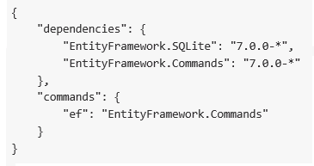
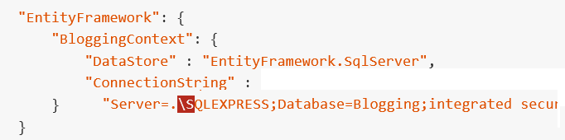

Asp.NET VNEXT
Migrations
Configuration
Notes:
<h5><b>Asp.Net VNext</b></h5>
EntityFramework пишет под тем же руководством, что и asp.net. Мы уже слышали каким революционным будет VNext. Как сказал мой знакомый: “После анонса VNext, нам всем заново придется учить asp.net”. Это сказывается и на самом EF. Если мы заглянем в исходный код, то увидим там:
<img src="http://habrastorage.org/files/e3b/678/43c/e3b67843c78f447da1e079d45f65be75.png" alt="image"/>
В версии для 2015 студии Json-файлы с описанием зависимостей и настроек. В 2013 студии все по старинке, правда…
Еще интереснее, что даже строку подключения можно будет в Json-файле <a href="https://github.com/aspnet/EntityFramework/wiki/Configuring-a-DbContext">написать</a>.
<img src="http://habrastorage.org/files/ee7/cef/7cc/ee7cef7cc8844abfbb43099f27ab56ac.png" alt="image"/>

Slide 15
Где взять исходные кода
https://github.com/aspnet/EntityFramework
Добился компиляции только через неделю после начала работ. https://github.com/aspnet/EntityFramework/issues/821

Slide 16
Где взять бинарники? -Myget
https://www.myget.org/gallery/aspnetmaster
https://www.myget.org/gallery/aspnetvnext
https://www.myget.org/gallery/aspnetrelease
Как добавить https://github.com/myget/PackageSourceDiscovery
Notes:
As an example, we've implemented the above. Open Visual Studio and open any solution. Then issue the following in the Package Manager Console:
Install-Package DiscoverPackageSources Discover-PackageSources -Url "http://www.myget.org/gallery"
Close and re-open Visual Studio and check your package sources. The URL has been verified for a PSD manifest URL and the manifest has been parsed. Matching feeds have been installed into the NuGet.config file, in this case all feeds listed in the MyGet gallery.

Slide 17
Подстава от EF team
04.12.2014
Redis/Azure Table Storage были перенесены из ветки develop для стабилизации.
http://blogs.msdn.com/b/adonet/archive/2014/12/02/ef7-priorities-focus-and-initial-release.aspx

Slide 18
NoSQL
Key/Value store
Схожее API.
Совершенно другой способ доступа (Библиотеки, протоколы)
Разное поведение баз
+ ограничения самих систем баз данных
=> Понимать специфику придется.

Slide 19
Пример: Вставка существующих данных
SQL Server – падает с Primary Key Constraint Exception.
Azure Table Storage падает с http кодом 409- Conflict
Redis – обновляет, если запись была, вставляет если не было.
=> Нельзя завязывать логику на поведение базы данных

Slide 20
REDIS
Key-Value Store.
In Memory (с возможностью записи на диск)
Оригинальная версия под *nix платформу.
Microsoft поддерживает порт под windows.
Поддерживает Cluster, Replication.
Есть собственный механизм очередей Pub/Sub. В EF ни как не представлен.

Slide 21
REDIS +EF
Общий API
Свои ограничения:
Не поддерживаются NavigationProperty/Include не нужен
Запрос фильтрации where не по ключу, могут приводить к существенным тормозам.
UpSert (Update or Insert) при вставке записи в хранилище
Подключение через конфигурация через ConnectionMultiplexer
Notes:
Поддержка Cluster через ConnectionMultiplexer.
Новых функций/методов/api для Redis учить особо не придется, если Вы ранее с EF уже работали.
Код выглядит примерно так же:
<spoiler title="Создаем контекст, выбираем из него типизированный DbSet.
Работая с DbSet, можем делать все CRUD операции."><img src="http://habrastorage.org/files/8d6/a2f/3bc/8d6a2f3bc2c84392b07c307ad7a00305.png" alt="image"/></spoiler>
<spoiler title="Для Redis также поддерживаются не только синхронные, но и асинхронные версии методов."><img src="http://habrastorage.org/files/e69/bca/aa7/e69bcaaa7eda4fd4807205b56fa10d05.png" alt="image"/></spoiler>
<spoiler title="Из DbSet (Реализует IQuariable) все так же можно получить все нужные нам выборки, агрегации и т.д. (правда, реализованы они, понятное дело, отлично, от sql версии.)"><img src="http://habrastorage.org/files/0b7/01e/19c/0b701e19c7f449ed94722ca301f7e1da.png" alt="image"/></spoiler>
Что самое приятное - многие тесты, общие для Redis версии и SQL server.
Например, тест на отключение ChangeTrackingManager
<spoiler title="(способ ускорить работу, если нам не нужно отслеживать изменения в объектах)."><img src="http://habrastorage.org/files/8bd/3ca/718/8bd3ca718ba0454a824bf0b8ab6f2cce.png" alt="image"/></spoiler>
В EF можно было вызвать Include, чтобы загрузить NavigationPropery. На базе при этом делался join таблицы по внешнему ключу.
<spoiler title="В случаи Key-Value store никаких navigation property быть не может, т.к. relations отсутсвуют в key-value store и нет ни какогот join."><img src="http://habrastorage.org/files/fc6/f80/b7d/fc6f80b7d2014d59a18308f44c29e0ee.png" alt="image"/></spoiler>
<h4><b>Что можно сказать про Redis сейчас:</b></h4>
На EF Wiki есть статья "<a href="https://github.com/aspnet/EntityFramework/wiki/Entity-Framework-Design-Meeting-Notes---July-17,-2014#ef7-redis-provider">EF7 Redis provider</a>" в которой есть хоть какая-то информация о работе с Redis, ограничениях по работе с ним.
<h5><b>С запросами с фильтрацией(where) данных надо быть очень аккуратными.</b></h5>
Когда мы будем искать что-то по ключу - все просто, выборка по ключу быстрая операция. Когда делается условие where то в реляционную базу отправлялся запрос и where проводилась на базе данных. В бд могли быть индексы и можно было получить быстрый результат, даже на большом объеме данных. В случаи Redis, будет сканирование всех значений, без каких либо индексов. Думаю на клиент выноситься это не будет, но поиск сканирование всех данных, однозначно медленнее поиска по индексу.
<h4><b>Чего нет и не будет?</b></h4>
<h4><b>Интересные вопросы:</b></h4>
В EF можно через context на прямую вызвать хранимку или произвольный sql код выполнить на mssql server.
В Redis встроен <a href="http://redis.io/commands/EVAL">скриптовый движек</a> Lua , хочется понять можно ли его через EF использовать.
Можно ли на прямую будет вызвать <a href="http://redis.io/commands">команды</a>, если мы поймем, что генерируемый EF запрос не такой, как должен быть.
Наверное есть случаи, когда вызов кода Lua через EF был бы разумен, как и команд на прямую. В текущих документах есть информация по этому поводу, но очень размыто в разделе <a href="https://github.com/aspnet/EntityFramework/wiki/Entity-Framework-Design-Meeting-Notes---July-17,-2014#ef7-redis-provider">Query Sorting</a>
"You can also use the same command to store the result in another data structure that a LUA script could then analyze."
<h4><b>Что бы хотелось узнать:</b></h4>
Лично мне хотелось бы узнать 2 основные вещи:
<ul>
<li>Насколько % EF версия медленнее, чем обычная StackExchange версия. Понятно, что вопрос сложный и зависит от многих факторов, но хоть какие-то цифры увидеть бы.</li>
<li>Насколько стабильно работает с кластерной конфигурацией? Т.к. именно работа кластера таких серверов и интересует.</li>
</ul>

Slide 22
REDIS Standard API
DEMO

Slide 23
Azure Table Storage
Microsoft Azure NoSQL Storage for structured data.
Первичный ключ- состоит из Partition/Row key
3 реплики данных на основе Partition
ATS – это не сервер баз данных, а хранилище сырых данных. Ни какой агрегации, или логики на базе нет.
Всегда, где только возможно включать в LINQ запрос Partition и row key, иначе производительность будет не гарантирована.
Notes:
https://github.com/aspnet/EntityFramework/wiki/Using-EF7-with-Azure-Table-Storage

Slide 24
Azure Table Storage+ EF
ATS connection в OnConfiguring методе.
Partition/Row key для каждой сущности в OnModelCreating методе.

Slide 25
ATS Standard API
DEMO

Slide 26
Спасибо за внимание! Entity Framework 7 + Redis/AzureTableStorage
Сычев Игорь
Sychev-igor.90@mail.ru
https://github.com/SychevIgor

Slide 27
Links
http://channel9.msdn.com/Events/TechEd/Europe/2014/DEV-B332
http://channel9.msdn.com/Events/TechEd/NorthAmerica/2014/DEV-B417
http://blogs.msdn.com/b/adonet/
https://github.com/aspnet/EntityFramework
https://github.com/aspnet/EntityFramework/wiki/Entity-Framework-Design-Meeting-Notes
https://github.com/SychevIgor/dotnext_entityframework7_nosql - сегодняшний доклад
Notes:
http://redisdesktop.com/
https://github.com/StackExchange/StackExchange.Redis
https://github.com/twitter/twemproxy
https://github.com/aspnet/xunit
https://github.com/uglide/RedisDesktopManager
https://github.com/myget/PackageSourceDiscovery
https://github.com/aspnet/Newtonsoft.Json
https://github.com/MSOpenTech/redis
https://github.com/aspnet/Kruntime
https://git01.codeplex.com/entityframework
https://github.com/Azure/redis

