Slide 1
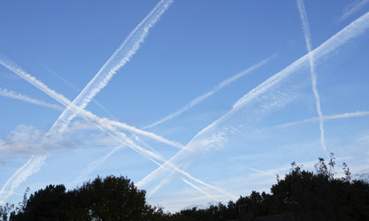
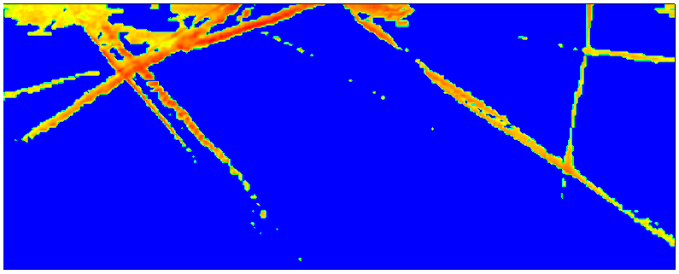
CLOUDS OR CONTRAILS?
NASA SPACE APPS CHALLENGE
24 April 2016

Slide 2
INTRODUCTION
CHALLENGE:
With global air traffic on the rise, climate scientists are concerned about the additional 'clouds' produced by jets. Can an app be developed to help a ground observer determine the probability that an aircraft made the thin lines of white clouds?
THE TEAM:
Vivek Ahuja
Abhishek Bichal
Ritesh Bafna

Slide 3
STRATEGY
Processing algorithm
User takes image of sky
Image + length scale data
Sunlight scattering distribution
Water density pattern recognition
User interface
Determine water mass distribution along pattern line
Check if scatter patterns and mass distribution match known aircraft data
Determine if particular scatter pattern is contrail or cloud
Show contrail-only pattern lines to user over image

Slide 4
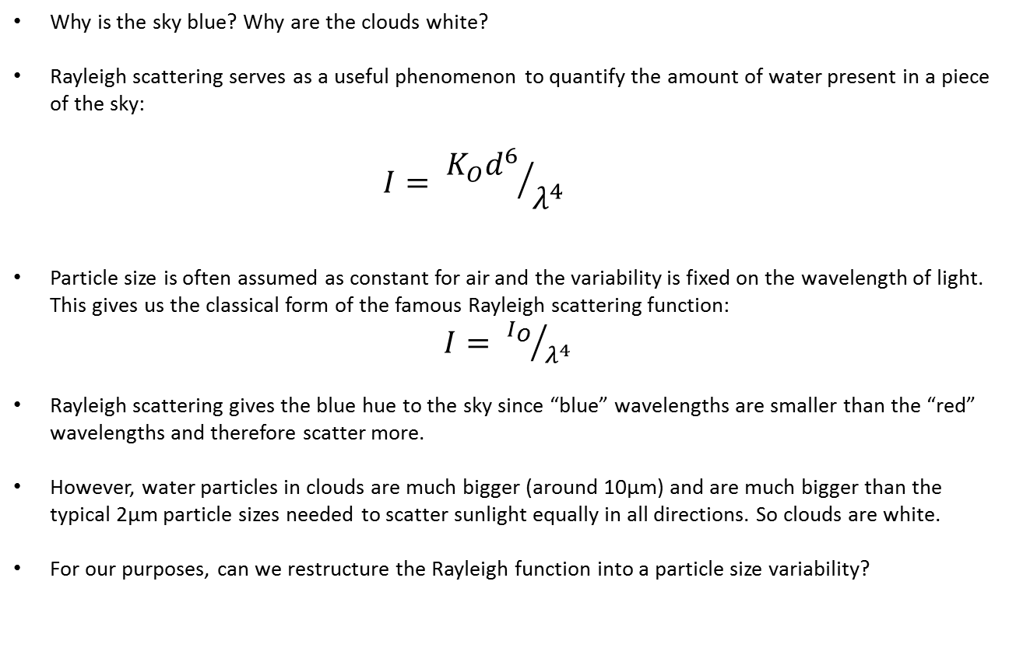
SUNLIGHT SCATTERING DSITRIBUTION
Why is the sky blue? Why are the clouds white?
Rayleigh scattering serves as a useful phenomenon to quantify the amount of water present in a piece of the sky:
$$I= {K_{O}d^{6}}/{λ^{4}}$$
Particle size is often assumed as constant for air and the variability is fixed on the wavelength of light. This gives us the classical form of the famous Rayleigh scattering function:
$I= {I_{O}}/{λ^{4}}$
Rayleigh scattering gives the blue hue to the sky since “blue” wavelengths are smaller than the “red” wavelengths and therefore scatter more.
However, water particles in clouds are much bigger (around 10μm) and are much bigger than the typical 2μm particle sizes needed to scatter sunlight equally in all directions. So clouds are white.
For our purposes, can we restructure the Rayleigh function into a particle size variability?
Particle size
Scattering intensity
Wavelength of light

Slide 5
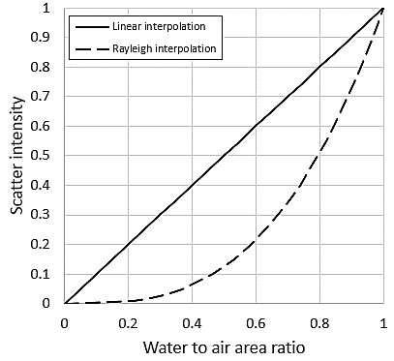
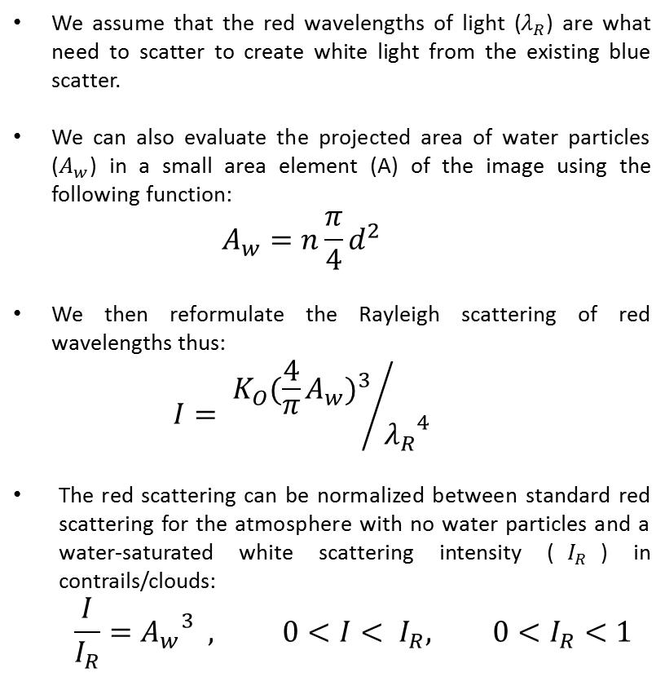


SUNLIGHT SCATTERING DSITRIBUTION
We assume that the red wavelengths of light ($λ_{R}$) are what need to scatter to create white light from the existing blue scatter.
We can also evaluate the projected area of water particles ($A_{w}$) in a small area element (A) of the image using the following function:
$$A_{w}=n\frac{π}{4}d^{2}$$
We then reformulate the Rayleigh scattering of red wavelengths thus:
$$I= {K_{O}{(\frac{4}{π}A_{w})}^{3}}/{{λ_{R}}^{4}}$$
The red scattering can be normalized between standard red scattering for the atmosphere with no water particles and a water-saturated white scattering intensity ($I_{R}$) in contrails/clouds:
$$\frac{I}{I_{R}}={A_{w}}^{3} , 0<I< I_{R}, 0<I_{R}<1$$
$$I_{R}$$
$$\frac{A_{W}}{A}$$

Slide 6
SUNLIGHT SCATTERING DISTRIBUTION
There are two methods to eliminate the blue scatter intensity from the image:
Threshold using absolute gray-scale (ABS).
Threshold using ratio of blue and red color values (RBRC).
The images below show the pros and cons of using either of these methods. For this effort, RBRC was found to be more effective:
Original image taken by user
ABS
Poor patterning recognition
RBRC
Superior pattern lines

Slide 7
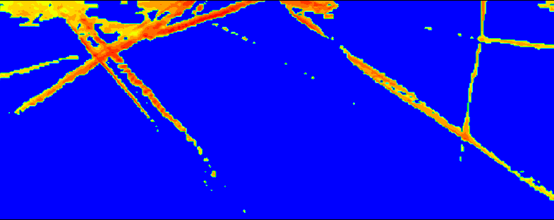
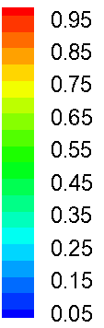

SUNLIGHT SCATTERING DSITRIBUTION
After blue scatter intensity is eliminated from the image color distribution, the remaining intensity distribution is the red color intensity ($I_{R}$), which is normalized:
Original image taken by user
Normalized red scatter intensity ($I_{R}$)

Slide 8
WATER DENSITY PATTERN RECOGNITION
Once the scattering distribution is achieved, we need to determine the density pattern lines in order to isolate contrails from clouds.
Such pattern lines help us in isolating geometric features particular to pure contrails from erroneous cirrus clouds that have a high Normalized Red Scatter Intensities
Challenge: can these lines be determined programmatically?
Can the algorithm determine this region to be a cloud?

Slide 9
PATTERN RECOGNITION STRATEGY (1/2)
Subtract background

Slide 10
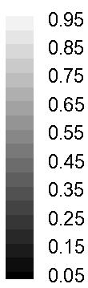
PATTERN RECOGNITION STRATEGY (2/2)
Density pattern recognition lines
1
2
4
3
5
Sample pattern isolation results
1
5
4
3

Slide 11

MASS DISTRIBUTIONS ON PATTERN LINES
Once the pattern lines are recognized along the water density distributions, we evaluate the mass of water inside a thickness layer of the projected water area along the pattern line.
The thickness of the projected water area is assumed to be one aircraft engine exhaust diameter for a variety of typical aircraft engines available for commercial airlines.
Projected area band around density pattern line
Normalized red scatter intensity ($I_{R}$)

Slide 12


IMAGE FIELD OF VIEW
The algorithm works by checking if the mass of water contained in the predicted contrails matches any known aircraft configurations for the length scale of the image
Altitude
Assumed from standard aircraft flight routes
Camera field of view (known from hardware)

Slide 13
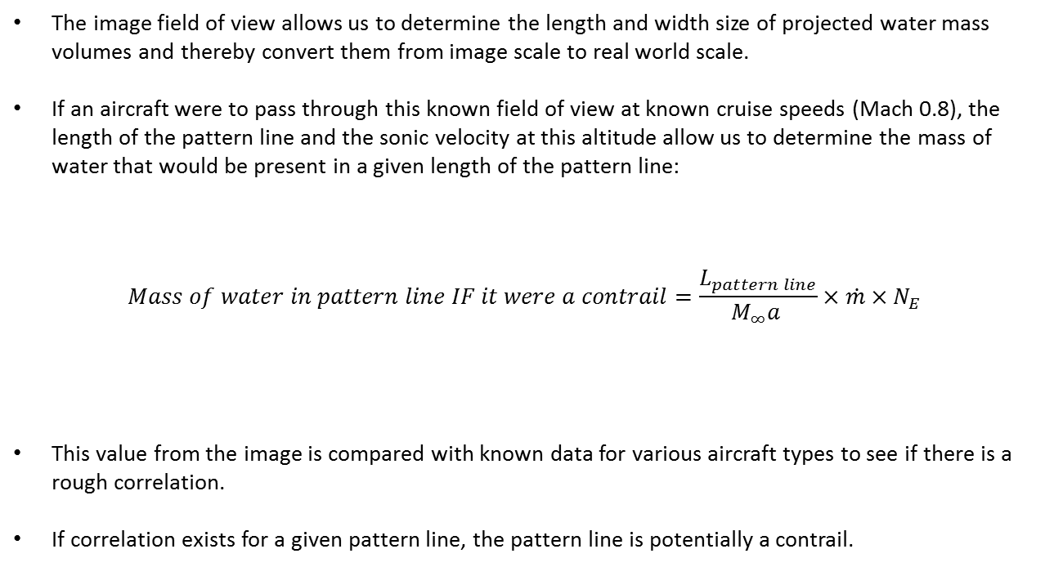
MASS ANALYSIS
The image field of view allows us to determine the length and width size of projected water mass volumes and thereby convert them from image scale to real world scale.
If an aircraft were to pass through this known field of view at known cruise speeds (Mach 0.8), the length of the pattern line and the sonic velocity at this altitude allow us to determine the mass of water that would be present in a given length of the pattern line:
$$Mass of water in pattern line IF it were a contrail=\frac{L_{pattern line}}{M_{∞}a }×\dot{m}{×N}_{E}$$
This value from the image is compared with known data for various aircraft types to see if there is a rough correlation.
If correlation exists for a given pattern line, the pattern line is potentially a contrail.
Mass flow rate of single engine
Length of pattern line in real scale
Number of engines
Cruise Mach number of aircraft
Sonic velocity at altitude

Slide 14
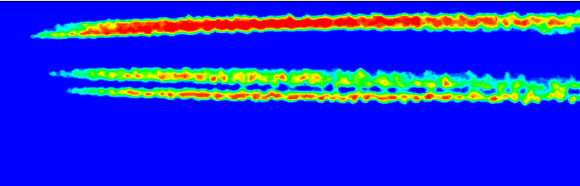
CASE STUDY: AIRBUS A-340 CONTRAILS
Original user image
Normalized red scatter intensity
Density pattern recognition lines
1
2
3

Slide 15
CASE STUDY: AIRBUS A-340 CONTRAILS
Parameters
Altitude
Number of engines
Engine type | CFM-56 series
Mass flow-rate/engine | 817 lbm/sec
Time of flight for image length scale | 1.7 seconds
Diameter of exhaust | 68.3 inches
Image to real world scaling ratio | 1.1176 meters/pixel
Length of pattern lines in image | 419.0 meters
Mass of water in image from image calculations | 2,862.4 kg
Mass of water from exhaust in the image | 2,567.7 kg

Slide 16
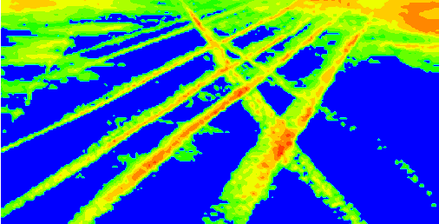
CASE STUDY: CONTRAIL/CLOUD MIXTURE
Original user image
Normalized red scatter intensity
Density pattern recognition lines
2
4
5
1
3

Slide 17
CASE STUDY: CONTRAIL/CLOUD MIXTURE
3
5
2
1
4
Sample pattern isolation results
1
2
5
3
4

Slide 18
CONCLUSIONS & FUTURE WORK
The strategy proposed here to determine clouds from contrails is capable of working with mixed images of contrails interspersed with dissipated and concentrated cirrus cloud patterns.
An app or software built around this approach could also incorporate more checks based on local weather data (wind vectors?) to help the existing pattern recognition algorithm make more advanced decisions and further reduce possibility of erroneous predictions.
More work can be expended on improving the threshold algorithm in the pattern recognizer by using a moving threshold approach.
When isolating patterns from an image where patterns crisscross, information from one pattern was seen bleeding into the other. This can be eliminated/minimized by using the median width of the pattern lines.

Slide 19
THANK YOU

