Slide 1
Introduction to Webpack Vedran Zakanj

Slide 2
Agenda
JavaScript modules
Node.js
module system
npm
as a JavaScript build tool/environment
Webpack
basic config
development server
loaders
plugins
Usage
JS library
React
Angular 2
Angular.js

Slide 3
JS modules
ES5 has no import mechanism in the language spec
module pattern
several module definition APIs:
AMD (Asynchronous Module Definition)
CommonJS
UMD (Universal Module Definition)
ES6 has a module specification (not yet fully supported in all environments)

Slide 4
JS module pattern
// foo.js
var fooModule = (function() {
var a = "Foo module a variable.";
var printFromFoo = function () {
console.log(a);
};
return {
print: printFromFoo
};
})();
// bar.js
var barModule = (function () {
var a = "Bar module a variable.";
var printFromBar = function() {
console.log(a);
};
return {
print: printFromBar
};
})();

Slide 5
JS module pattern
// app.js
var appModule = (function(foo, bar) {
var a = "App a variable.";
foo.print();
bar.print();
console.log(a);
})(fooModule, barModule);
// index.html
<html>
<head>
<title>JS module demo</title>
</head>
<body>
Module demo, look at the console.
<script src="./foo.js"></script>
<script src="./bar.js"></script>
<script src="./app.js"></script>
</body>
</html>

Slide 6
CommonJS module
reserved object exports or module.exports to export properties/functions from a module
require function which accepts a string module identifier and returns the exports

Slide 7
CommonJS modules
// foo.js
var a = "Foo module a variable.";
var printFromFoo = function () {
console.log(a);
};
exports.print = printFromFoo;
// bar.js
var a = "Bar module a variable.";
var printFromBar = function() {
console.log(a);
};
module.exports.print = printFromBar;

Slide 8
CommonJS modules
// app.js
var foo = require('./foo');
var bar = require('./bar');
var a = "App a variable.";
foo.print();
bar.print();
console.log(a);
$ node app.js
Foo module a variable.
Bar module a variable.
App a variable.

Slide 9
Node.js
JavaScript runtime based on Chrome’s V8 JS engine
i.e. makes JS engine capabilities available on the server
i.e. allows writing application backends in JS
uses the CommonJS module specification
modules are file-based

Slide 10
npm
Node Package Manager
manage/publish Node.js packages
huge online repository of packages
also supports writing scripts which make it a viable build tool

Slide 11
npm
uses a package.json file to define package information
name
version
author
dependencies
development dependencies
etc.
makes sense to build our applications as npm packages even if we won’t publish them because we can utilize npm to handle our dependencies and/or build process

Slide 12
npm scripts
automate application development tasks (e.g. run tests or start the app)
JSON object under scripts key in package.json, each key in the object represents the script name and value is the script body
$ npm run <script_name>
some special scripts don’t require the run keyword e.g. –
$ npm start
$ npm test

Slide 13
npm scripts
// package.json
{
“name”: “foo-app”,
“version”: “1.0.0”,
“scripts”: {
“start”: “node app.js”
}
}

Slide 14
npm example usage
# creates package.json via wizard
$ npm init
# installs the express module as a dependency
$ npm install express –save
# edit package.json and add script with name “start” and content “node app.js”

Slide 15
npm example usage
// app.js
var express = require('express');
var app = express();
app.get('/', function(req, res) {
res.send("Hello from our HTTP server");
});
var port = 3333;
var host = "localhost";
app.listen(port, host, function() {
console.log("Server is listening on " + host + ":" + port);
});

Slide 16
npm example usage
# start the application via start script
$ npm start
Server is listening on localhost:3333

Slide 17
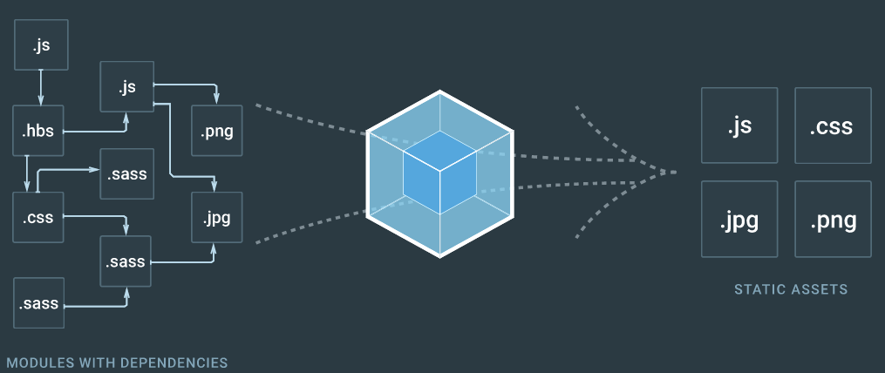
Webpack
https://webpack.js.org/

Slide 18
Webpack
developed as an npm package, installed via npm
bundles Node.js modules into static assets
does not bundle all installed modules, only bundles modules actually used in the code
looks for a module in webpack.config.js file by default, but can be overridden using the --config flag
the webpack.config.js file needs to export a configuration object via Node.js module system

Slide 19
Webpack – basic config
$ npm init
$ npm install webpack --save-dev
setup the npm build script to equal "webpack"
// webpack.config.js
var path = require('path');
module.exports = {
context: path.resolve("./"),
entry: "./src/app.js",
output: {
path: path.resolve("./dist"),
filename: "bundle.js"
}
};

Slide 20
Webpack – base config
// myMath.js
function sum(a, b) {
return a + b;
}
module.exports.sum = sum;
// app.js
var myMath = require('./myMath');
console.log(
"Sum calculated using myMath: “
+ myMath.sum(3, 10)
);

Slide 21
Webpack – base config
// index.html
<html>
<head>
<title>Webpack base example</title>
</head>
<body>
<script src="./bundle.js"></script>
</body>
</html>
# bundle app.js and myMath.js and into bundle.js
$ npm run build

Slide 22
Webpack development server
local server with several options which improve the development experience
supports live reloading and hot module replacement
configured using the devServer object in webpack.config.js
available via the webpack-dev-server package
$ npm install webpack-dev-server --save-dev

Slide 23
Webpack – base config with dev erver
# install dev server package
$ npm install webpack-dev-server --save-dev
# configure start script to run webpack-dev-server
// webpack.config.js
var path = require('path');
module.exports = {
// other options
devServer: {
contentBase: path.join(__dirname, "dist"),
port: 5000
}
};

Slide 24
Webpack – base config with dev server
// webpack.config.js
module.exports = {
// other options
watch: true,
watchOptions: {
aggregateTimeout: 300,
poll: 1000
}
};
enable watching for changes so the server reloads every time a change is detected
poll is required on Windows and Virtualbox VMs for watch to work

Slide 25
Webpack – base config with devServer
$ npm start
Project is running at http://localhost:5000/
webpack output is served from /
changing any JS code now automatically reloads the served page
note that HTML changes are still not reflected, we will get back to it later

Slide 26
Webpack - loaders
a way to tell webpack how to load/preprocess required files and create a build pipeline
babel-loader, ts-loader, css-loader, style-loader etc.
used by configuring the module.rules array in webpack.config.js
additional loader configuration passed via options property of the loader configuration object

Slide 27
Webpack – babel loader example
$ npm install babel-loader --save-dev
$ npm install babel-core --save-dev
$ npm install babel-preset-latest --save-dev
$ npm start
// webpack.config.js
module.exports = {
devtool: 'source-map',
module: {
rules: [
{
test: /\.js$/,
exclude: /node_modules/,
use: {
loader: 'babel-loader',
options: {
presets: ["latest"]
}
}
}
]
}
};

Slide 28
Webpack – babel loader example
// myMath.js
class Math {
sum(a, b) {
return a + b;
}
}
export default Math;
// app.js
import Math from './myMath';
const math = new Math();
console.log(
`Sum calculated using myMath: ${math.sum(3, 10)}`);

Slide 29
Webpack – css loader example
# css loader bundles the css into the JS bundle
$ npm install css-loader --save-dev
# style inlines the css in the html style tags instead of bundling in JS
$ npm install style-loader --save-dev
# We are going to chain them together
//webpack.config.js
module.exports = {
//other config
module: {
rules: [
// other rules
{
test: /\.css/,
// loader chaining
use: [ 'style-loader', 'css-loader' ]
}
]
}
};

Slide 30
Webpack – css loader example
// index.html
<html>
<head>
<title>Webpack base example</title>
</head>
<body>
<a class="btn-primary" href="#">Button text!</a>
<script src="./bundle.js"></script>
</body>
</html>
// app.css
body {
background-color: antiquewhite;
}
.btn-primary {
display: inline-block;
background-color: blue;
padding: 6px 12px;
color: lime;
font-size: 16px;
line-height: 24px;
text-decoration: none;
border-radius: 3px;
text-transform: uppercase;
}

Slide 31
Webpack – css loader example
// app.js
import '../styles/app.css';
import Math from './myMath';
const math = new Math();
console.log(`Sum calculated using myMath: ${math.sum(3, 10)}`);
The CSS rule is configured to first use the css-loader to turn the imported CSS file into a JS module, then the style-loader is chained with it to inline the JS module in the HTML style tags. Notice that the chaining is reverse from the order of loaders specified in the array – the last loader in the array processes the loaded file first.

Slide 32
Webpack – sass loader example
# install sass loader and node bindings to LibSass
$ npm install sass-loader node-sass --save-dev
//webpack.config.js
module.exports = {
//other config
module: {
rules: [
// other rules
{
test: /\.css/,
// loader chaining
use: [ 'style-loader', 'css-loader', 'sass-loader']
}
]
}
};

Slide 33
Webpack – sass loader example
// _buttons.scss
$color-primary: blue;
$color-secondary: lime;
.btn-primary {
display: inline-block;
background-color: $color-primary;
padding: 6px 12px;
color: $color-secondary;
font-size: 16px;
line-height: 24px;
text-decoration: none;
border-radius: 3px;
text-transform: uppercase;
}
// app.scss
@import 'buttons';
body {
background-color: antiquewhite;
}

Slide 34
Webpack – sass loader example
// app.js
import '../styles/app.scss';
import Math from './myMath';
const math = new Math();
console.log(`Sum calculated using myMath: ${math.sum(3, 10)}`);
Same logic applies as in the CSS example, but in this case the sass rule first uses the sass-loader to turn SCSS file into regular CSS which is then passed on to the same css-loader-> style-loader pipeline

Slide 35
Webpack - plugins
plugins allow webpack extension for functionality which does not fall under loaders
uglifyjs-webpack-plugin, commons-chunk-plugin, DefinePlugin, extract-text-webpack-plugin, html-webpack-plugin etc.
some of the plugins come built-in with webpack, while others are available as npm packages

Slide 36
Webpack – extract-text-wepback-plugin example
currently the CSS is inlined in style tags inside the HTML file which is not optimal if we want to utilize browser CSS caching and parallel file loading
using the extract-text-webpack-plugin we can save the CSS to a file instead of inlining it

Slide 37
Webpack – extract-text-wepback-plugin example
# remove the style-loader from package.json since it’s not needed anymore
$ npm install extract-text-webpack-plugin
// webpack.config.js rule
{
test: /\.scss$/,
exclude: /node_modules/,
use: ExtractTextPlugin.extract({
use: [
{
loader: "css-loader",
options: { sourceMap: true }
},
{
loader: "sass-loader",
options: { sourceMap: true}
}
]
})
}

Slide 38
Webpack – libraries
webpack can be used to build libraries consumed by other JS code
most flexible way to do this is to emit the library as an umd module which can then be consumed in all environments
It’s bad practice to bundle library dependencies with the library, much better to import them from the environment

Slide 39
Webpack - libraries
// webpack.config.js output as library
output: {
path: "dist",
filename: "library-file-name.js",
library: "libraryName",
libraryTarget: "umd"
};
// exclude dependencies e.g. jquery
externals: {
jquery: "jQuery"
}

Slide 40
Webpack – ReactJS
needs a way to load jsx files – use babel-loader with the following presets: es2015+ and react to work
to get a comfortable development environment we can enable react hot loading, linting etc
can use the create-react-app cli tool to generate a fully configured ReactJS project powered by webpack

Slide 41
Webpack – Angular 2
optionally use the ts-loader/awesome-typescript-loader if TypeScript is required
requires angular2-template-loader for loading component templates/styles
again, a lot of configuration needed for a comfortable development environment, can start off with a scaffolded project https://github.com/AngularClass/angular2-webpack-starter

Slide 42
Comparison to similar tools
Browserify - webpack is more popular and has more features out of the box, but both are module bundlers so comes down to personal preference
Gulp/Grunt – task runners, can be used instead of npm scripts, but require a learning curve
Bower vs npm with Webpack – prefer npm since Webpack handles CommonJS modules the best – which npm packages are.

Slide 43
Thank you!

