Slide 1
Pictionary Pugle
Guillermo Vazquez, POSHAK PATHAK, Aarya Brahmane, Jeremiah Thomas

Slide 2
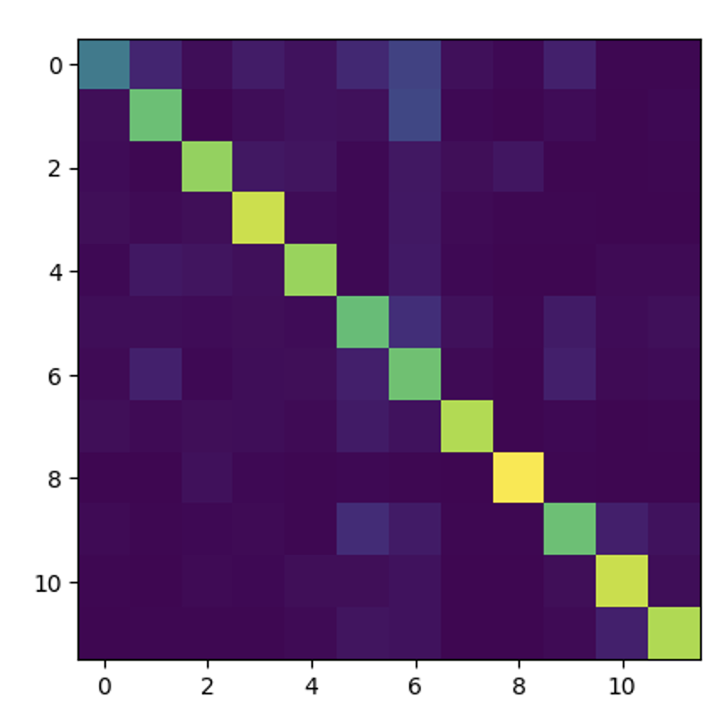
First training without specific data
12 class dataset obtained from the Quick, Draw database. Obtained a relatively good classification accuracy on test datasets.
Data is well behaved and is normalized in arrays of 28x28.

Slide 3
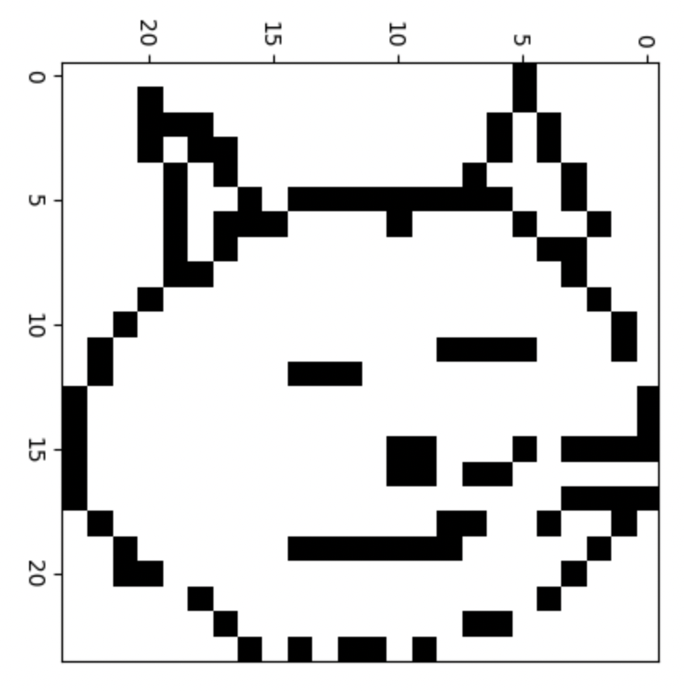
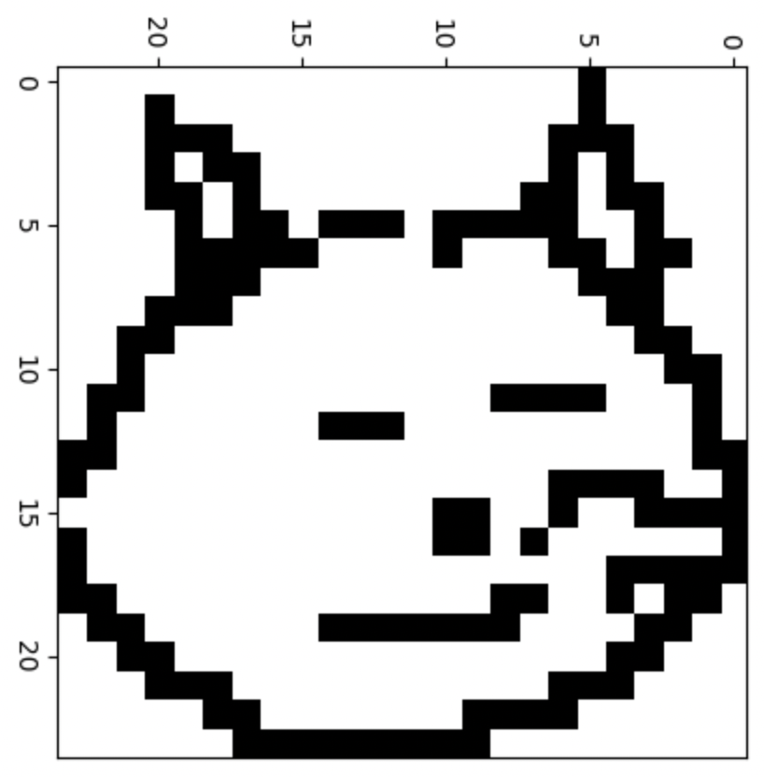
NEW dataset presented a challenge:
15 classes with with relatively less datapoints.
Uglier, more sparsed pictures.

Slide 4
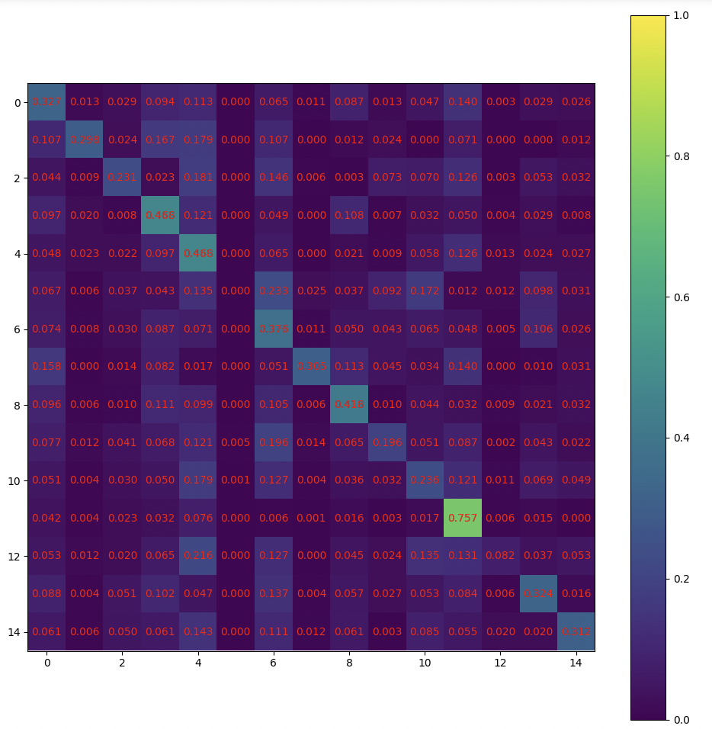
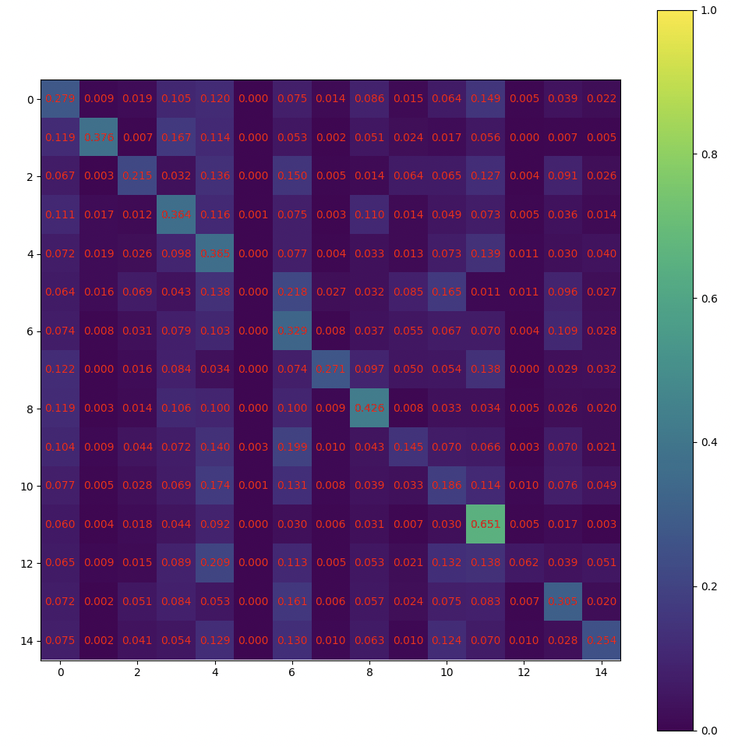
Bayesian OptIMIZATION
Testing (using all strokes)
Testing (using last two strokes)
Hyperparameter tuning of
Learning ratio
Number of hidden layers
Size of hidden layers
Batch size

